Slide 1

Professional Emergency Managers Plenary Panel
National Emergency Training Center
Emergency Management Institute
Emergency Management Higher Education Conference
Mike Slingluff, FBCI June 9, 2004

Slide 2

Who Am I?
World War II Baby Boomer and a Vietnam Vet
Raised on a dairy farm, was a Boy Scout and believe in self reliance and being prepared.
Earned a BS degree from Loyola College and a JD degree from the University of Baltimore. Was admitted to the PA, US District for MD, and Supreme Court bars.
Spent 35 years in the IT world working in government consulting and for the secondary mortgage market. 17 years of which is in Disaster Recovery, BCP and Crisis Management areas.
A fellow of the Business Continuity Institute, a Certified Toastmaster, and have been on a CSP, and various advisory boards.
A founding member and President of MADRA, Inc since its inception in 1997

Slide 3
What is MADRA, Inc?
Mid Atlantic Disaster Recovery Association, Inc. Founded Oct 1989
  All Volunteer, run by an Executive Committee & Officers
  Maryland Corporation Non Profit a IRS 501 (C) (3)
  Maryland, DC, Virginia, Southern Pennsylvania, Delaware
  450 + members on membership list
  MADRA was formed to stimulate communications among individuals, groups and the community (private and public sectors) working in the areas of BCP, DR or Crisis Management.
  No catchall or total solution
  No one has done it completely. Just ask the people who have been through one.
  Real sources of information are other individuals' knowledge or experiences.
  We can all learn from each other! MADRA fosters this.

Slide 4
What Has Happened To Us?
9/11
More dependency on automation
Information is doubling every 2 years
Traditional tape backup and recovery are taking too long
Long business outage becoming unacceptable
Law and regulations are becoming more stringent and apply to more areas
We are becoming more dependent upon other organizations
Notes:
Health Insurance Portability and Accountability Act (HIPAA)
Graham-Leach-Bliley Act (GLBA)
Sarbanes-Oxley (SOX)
SEC Business Continuity Rules for NASD and NYSE April 2004

Slide 5
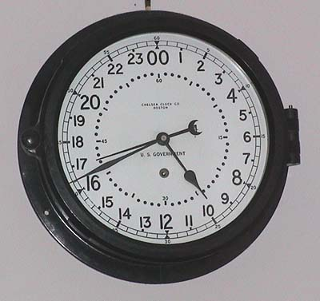

Where Are We Going?
24 hour days
No disruptions
No loss of information and immediate availability
Communications anywhere in the world
Lots more controls
Tighter budgets

Slide 6
What do we do About it?
Part of the answer is education:
Communications is fundamental - You have to sell it!
Technology knowledge - What is out there to use!
Technical Skills - How to plan effectively!
Crisis Management Skills - Do the right things Right!
Relationship Development - What agencies and groups can help or hinder you, and how to develop relations to use to your advantage.
Practices and Exercise - Practice, Push the envelope & Practice more.
Notes:
Communications Fundamentals
Public Speaking
Phone Skills
Writing
Ability to think on your feet
Ability to conduct effective meetings
Technology knowledge
Computers (Mainframe, LANs, UNIX, Servers, Desktops, Laptops, IPAC, Blackberries)
Voice (Telephones, PBX, Cell Phone, Voice IP, voice recording, Voice activated answering systems)
Backup Technology (Tape, SAN (storage area networks), Mirroring, etc)
Multiple data centers, alternate recovery sites
Communications
Data Feeds from information sources
Data Security and Virus Recovery
Technical Skills
BIAs
BCP plan Development
Evacuation and Relocation Plans
Crisis Management Planning
Plan Reviews
Recovery Scenario Development
Crisis Management Skills
Take care of your employee and associates
Respond to the media
External coordination with authorities and first responders
How to get information about your business quickly to make decisions.

Slide 7
What Do We Do About it? (Continued)
Regulatory Knowledge - What laws & Regs effect you & how to comply
Relationship Development - What agencies and groups can help or hinder you, and how to develop relations to use to your advantage.
Practices and Exercise - Practice, Push the envelope & Practice more.
Notes:
Regulatory Knowledge
How to find what regulations apply to your organization
Understand what is required of each
Where to find help in understanding them
How to plan an acceptable response or action plan
Relationship Development
What organizations are out there.(HLS, FEMA, Red Cross, Local Emergency Mgt, Fire and Rescue, Local Police)
These group will impact how you are going to respond and may put limitations on you
Knowing the players and developing relationships prior to an incident is worth its weight in gold.
Practices and Exercises
Practice internally
Practice with your vendor, suppliers and customers
Practice with local and state agencies.
Conduct unplanned and unrehearsed exercises.

Slide 8



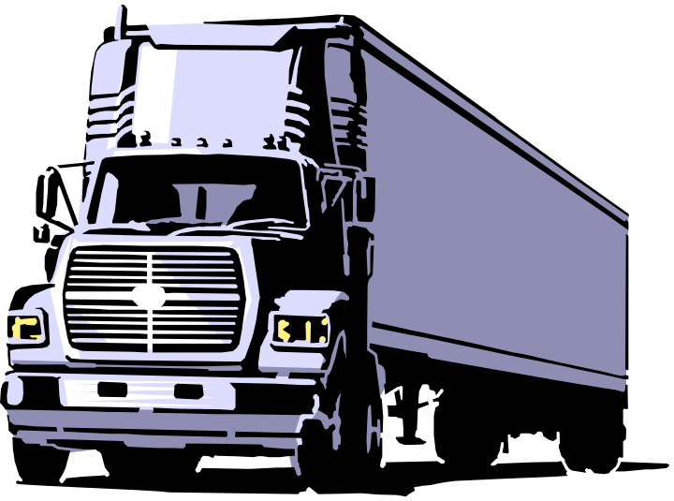
Questions
Can we keep on Truckin?
Mike Slingluff
703-456-5744
mike_slingluff@freddiemac.com
Notes:
This is the time for any questions.
I have tried to layout what educational subjects should be covered from a private sector perspective.
We would like to pull a rabbit out of a hat, but sadly there isn’t one.
You are the guardian of your organization’s future.
Can we keep on Truckin?

