Slide 1
Main Effects of TEL Magnets on p & pbar Beams
TEL Magnets
Coupling Coefficients
Maximum Orbit Changes
Dispersion Changes
Effects of Quad- and Sext- Component
Focal Length of the Main Solenoid
Corrections
Impedance Estimations
Machine Study Observation

Slide 2
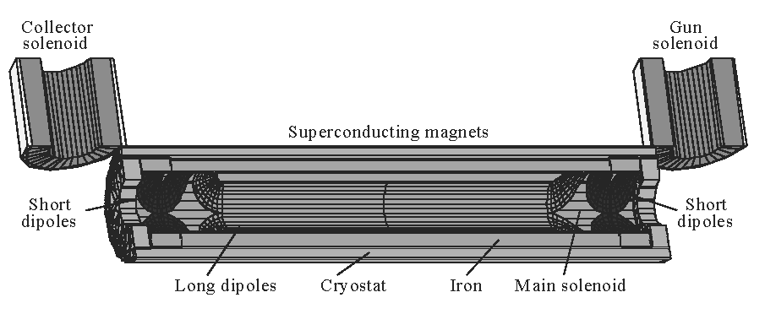
Introduction

Slide 3
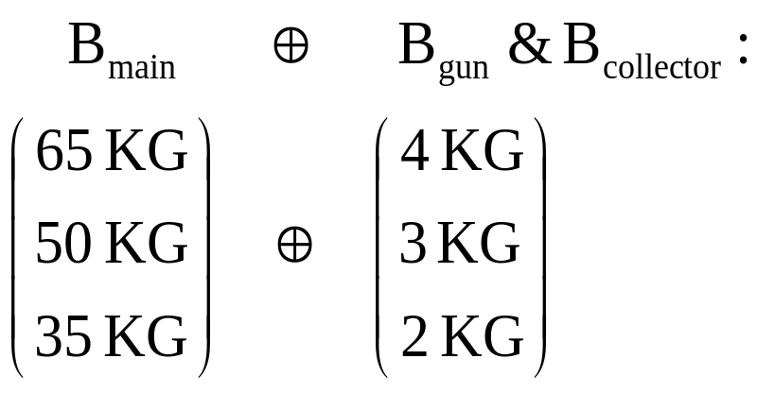
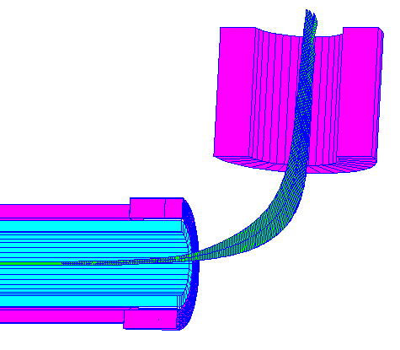
Solenoid Magnets Combination

Slide 4
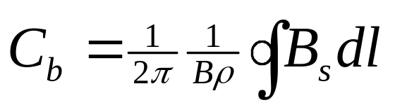
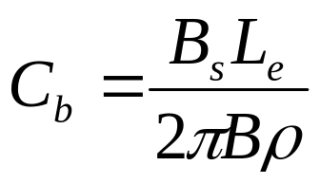
Coupling Coefficient of Main SC Solenoid
Define Coupling Coefficient
For single Solenoid:
where B_{s} is magnetic field strength, L_{e} the effective magnet length and B the beam magnetic rigidity.

Slide 5
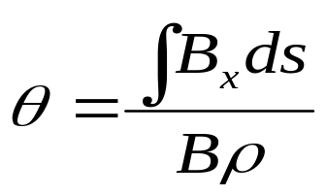

Dipole Kicks of Solenoid Magnets
Bending Angle of Gun-Solenoid Line and Solenoid-Collector Line
Kick Angle
Orbit Displacement
Bending angle canceled each other of the Gun-Solenoid-Collector system, result in a net orbit displacement
L is the length of the main solenoid.

Slide 6
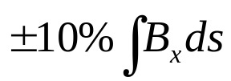
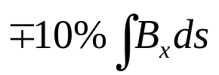
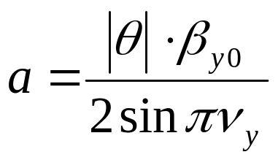
Residual Kick Angle
Pessimistic Estimation
Gun-Solenoid Line:
Solenoid-Collector Line:
Maximum Orbit Change

Slide 7
Effects of Dipole Correctors
Kick Angle of the Dipole Correctors
Maximum Nominal Integral Field
Long Dipole at: 0.36 T•m,
Can Displace e⁻ Beam: 100 mm at B_{s} = 3.5 T
Short Dipole at: 0.1 T•m,
Can Displace e⁻ Beam: 29 mm at B_{s} = 3.5 T
Operated like a 3-bump

Slide 8
Dispersion Changes
Before Solenoid Put in:
D_{x} = 2.5 m, D_{y} = 0.082 m
After Solenoid Put in:
D_{x} = 2.5 m, D_{y} = 0.058 m

Slide 9
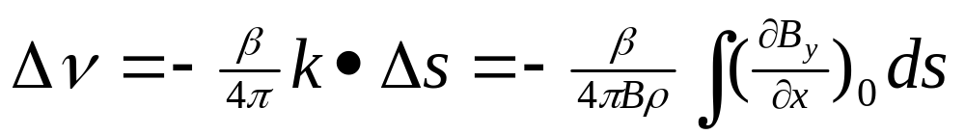
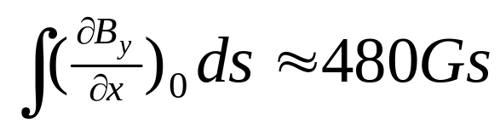
Gradient Effects
Tune Changes at the Maximum B_{s} Field:
 8.510⁻⁴ at 150 GeV
 1.310⁻⁴ at 1 Tev

Slide 10
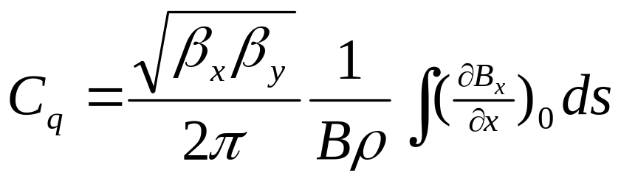
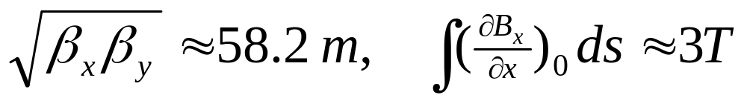
Gradient Effects
Coupling Due to Skew Gradient:
C_{q}  5.6% at 150 GeV
 0.9% at 1 TeV

Slide 11
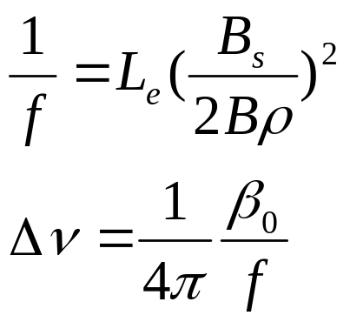
Focal Length of the Main Solenoid
Maximum Tune Change < 0.001
at 150 GeV ( β_{x} = 116 m )

Slide 12
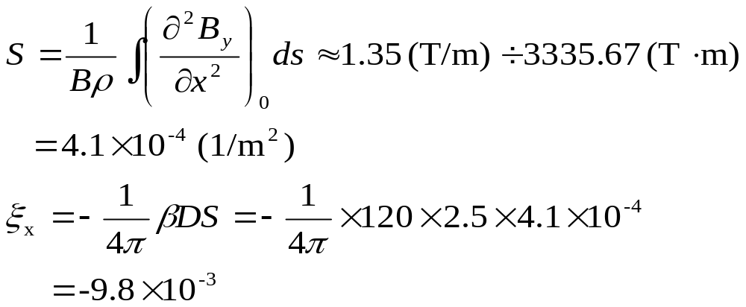
Chromaticity
At B_{s}=6.5 T and 1 TeV

Slide 13
Overall Estimations at B_{s} = 6.5 T
Two end compensate each other
1. Tune:
Gradient effect 20% + Solenoid effect
 8.510⁻⁴ 20% + 1.110⁻³ 1.210⁻³ (150GeV)
1.310⁻⁴ 20% + 2.410⁻⁵ 0.510⁻⁴ (980GeV)
2. Coupling:
Gradient effect 20% + Solenoid effect
 5.6% 20% + 0.53%  1.7% (150GeV)
0.9% 20% + 0.1%  0.3% (980GeV)
3. Orbit: < 0.07 mm

Slide 14
Corrections
TEL Phase: μ_{x} = 16.94, μ_{y} = 16.94
Coupling Correction:
TSQA0 (17.0), TSQA4 (20.3), TSQB0,
TSQD0 (6.7, 7.3), TSQ, TSQE0 (10.5)
Local Kick Angle Corrections:
VDF47 (μ_{y} = 16.85), VDF49 (μ_{y} = 16.97)
HDF46 (μ_{x} = 16.742), HDF48 (μ_{x} = 16.931)
Global Orbit Correction

Slide 15
Observations
At B_{s} = 6 T, 150 GeV (J. Annala)
(.5748, .5854)  (.5744, .5874) with TEL magnets on.
Tune separation increased about 23%
T:SQ -3.05  -3.065, brought tune separation to 0.0038
At B_{s} = 3.5 T, 980 GeV
(.5717, .5789)  (.5713, .5792) with TEL magnets on.
 = 0.0072  = 0.0079 tune separation
RMS Orbit change due to TEL (0.8, 1.2) mm

Slide 16
Impedance Estimation
A. Burov: "careless" limit Z/n = 0.07 Ω
For D = 6 cm hole, Z/n < 0.1 mΩ
For 10 long gap (inexistent actually) in optical diffraction model Z/n < 0.1 Ω
At proton intensity of 7.710¹⁰, the measured signal at all HV electrodes of the TEL are:
#9 29.4 V #10 20.1 V #11 1.2 V #12 18.0 V #13 22.1 V #14 45.4 V #15 14.0 V #16 7.5 V #17 11.0 V #18 4.7 V
Pick-up signals are of the order of 15 V peak-to-peak
Detailed simulation might be needed.

Slide 17
Conclusion
No Disastrous Effects Found
More Machine Study Time Needed for Fine Tune of the System.

