Slide 1
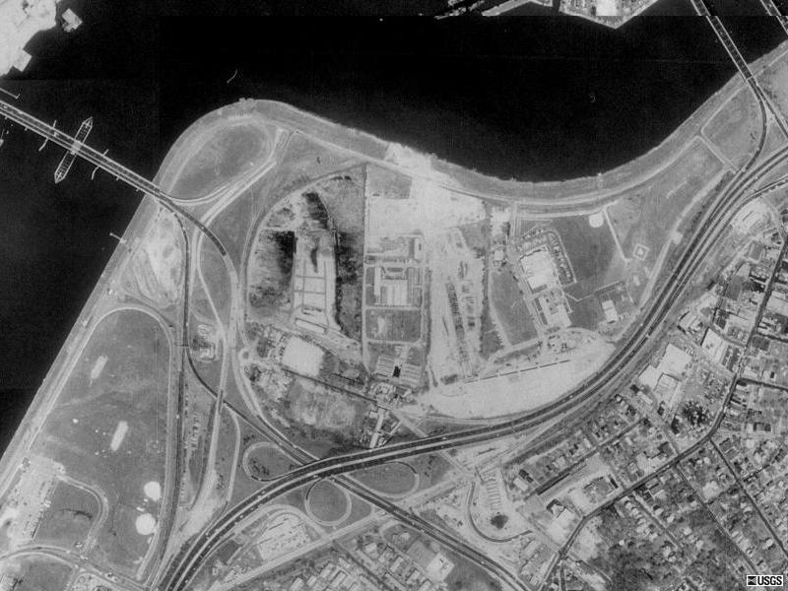

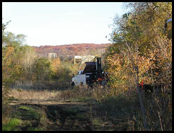
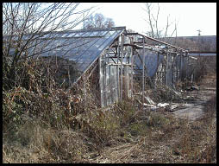
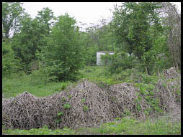
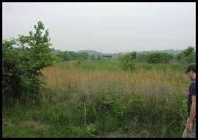
Screening Level Ecological and
Human Health Risk Assessment
Poplar Point, Washington, DC

Slide 2
Site Background
Approximately 44 acres in size
Former location of several nursery operations
Wetland areas have formed on site
  Site development plans may involve connection of wetland areas to Anacostia River
Dense underbrush and young trees present

Slide 3
ERA – Contaminants of Potential Concern
Multiple analytes had concentrations greater than lowest available numerical guideline value in one or more media, including:
  Metals (Sb, As, Ba, Be, Cd, Cr, Hg, Pb, Zn)
  Polycyclic aromatic hydrocarbons (PAHs)
  DDT and its metabolites DDE and DDD
  Polychlorinated biphenyls (PCBs): Aroclor 1260 and Aroclor 1248
  Di-n-butylphthalate
  Methoxychlor, pentachlorophenol
See EVS (2004; Table 2-1) for a complete list
Notes:
COPC selection based on the following documents:
1. Comparison of site-wide soil concentrations to: 1) the USEPA Region III Biological Technical Advisory Group (BTAG) screening levels (USEPA, 1995); 2) interim final or draft USEPA Eco-SSL benchmark values (USEPA, 2003b; 2000b) for the protection of soil invertebrates and plants and; 3) benchmark values from Oak Ridge National Laboratory (ORNL; Efroymson et al., 1997a,b).
2. Comparison of individual sediment concentrations to: 1) USEPA Region III BTAG screening levels (USEPA, 1995) and; 2) USEPA Ecotox thresholds (USEPA, 1996a).
3. Comparison of individual surface water concentrations to 1) USEPA ambient water quality criteria (i.e., criterion continuous concentrations; CCC) cited in USEPA (2002b); USEPA Region III BTAG screening levels (USEPA, 1995) and; 3) USEPA Ecotox thresholds (USEPA, 1996a).

Slide 4
ERA – Receptors of Potential Concern
Soil invertebrates and plants
Aquatic life
Benthos
Amphibians
Birds and mammals
  Willow flycatcher and American robin (avian insectivore and omnivore)
  Short-tailed shrew and raccoon (small mammal insectivore and omnivore)
  Mallard duck (avian omnivore)
  Great blue heron (avian piscivore)
  Red-tailed hawk (avian carnivore)

Slide 5
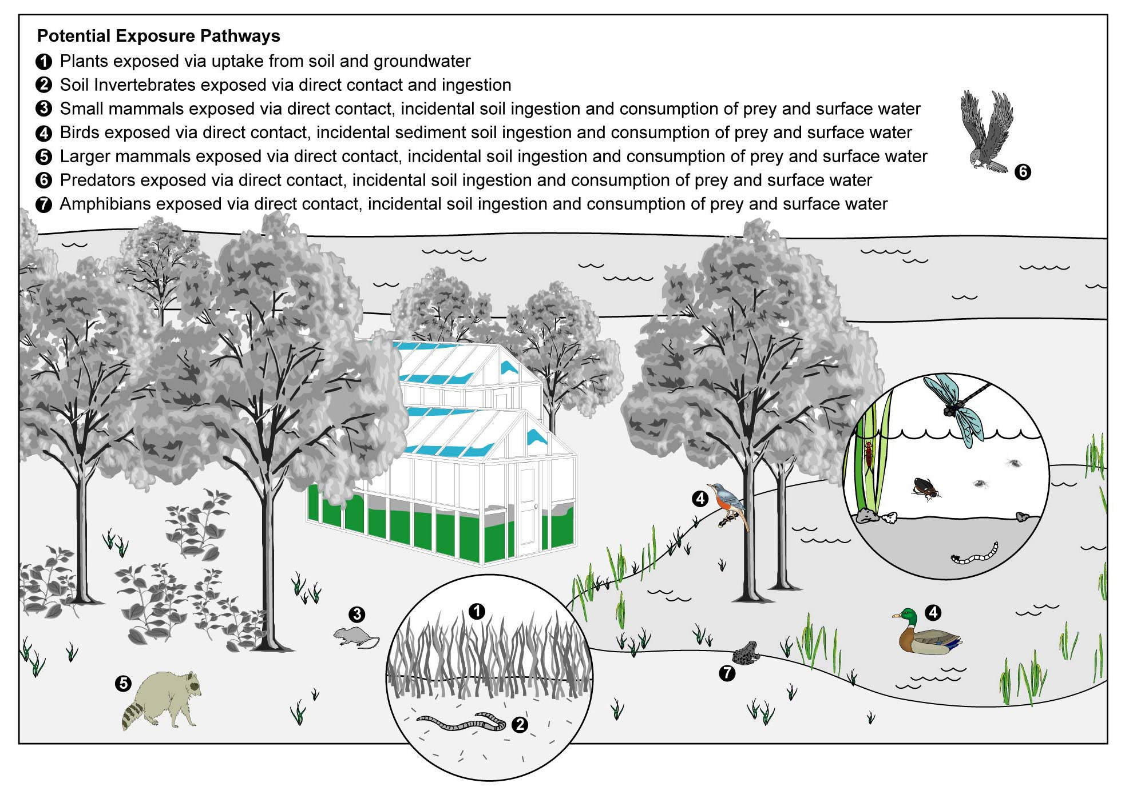

Slide 6
Risks to Soil Invertebrates and Plants
Risks to soil invertebrates and plants were identified
  Hazard quotient approach used
  Background concentrations for metals also considered
  Based on all available soil data from the upper 4 ft
Significant COPCs included:
  Chromium, lead, mercury, zinc
  DDT and its metabolites
  PAHs
Comparison to lowest SQG is highly conservative.
No evidence of direct toxicity to plants observed on site
Notes:
SQG = soil quality guideline
Note that the majority of COPCs had one or more samples with concentrations present above the detection limit (i.e. quantifiable) that also exceeded the lowest available SQG, and therefore, were considered to present a potential risk to soil invertebrates and plants.
Many COPCs had a limited number of samples that exceeded the TRVs, suggesting that adverse ecological effects, if present, would likely be limited in spatial extent or magnitude.
Significant COPCs (i.e., those COPCs with a substantial number of HQs based on quantifiable data) are listed on thes slide

Slide 7
Risks to Aquatic Life, Benthos & Amphibians
Potential risks to aquatic life, benthos and amphibians were identified
Substantial uncertainty
  Number of samples and analyte selection limited
  Ancillary data (e.g., hardness, pH) not available
  Future conditions will likely differ
  Hazard quotient based on lowest available water quality guideline value
  Amphibian toxicity not well understood for many compounds
  Amphibians also exposed through contact with sediment and ingestion of food

Slide 8
Risks to Mammals and Birds
Mechanistic food chain model constructed using the following parameters:
  Body weight and feeding preferences
  Food, water and soil ingestion rates
  BAFs used to estimate COPC concentration in food items
Estimated daily ingested dose for each COPC compared to a NOAEL-based TRV using a hazard quotient approach
Notes:
BAF = bioaccumulation factor.
NOEAL = no-observed adverse effect level
TRV = toxicity reference value

Slide 9
Risks to Mammals and Birds, continued
The following COPCs had HQs > 1 for multiple wildlife receptors:
  DDT and metabolites (maximum HQ = 7015)
  Dieldrin (maximum HQ = 2756)
  Di-n-butylphthalate (maximum HQ = 20307)
  Methoxychlor (maximum HQ = 2620)
  Pentachlorophenol (maximum HQ = 1722)
Metals, PAHs, and PCBs also had HQs > 1
Primary pathway was consumption of soil inverterbrates
Notes:
HQ = hazard quotient

Slide 10
Risks to Mammals and Birds, continued
Conservative assumptions were necessary to address uncertainty associated with a screening-level food chain model
  Dietary selection reflected worst-case diets for the overall receptor group, not specific species
  Dietary selection simplified to major food item groups
  NOAEL-based instead of LOAEL-based TRV
  BAFs do not necessarily reflect actual COPC uptake by soil invertebrates and plants
Notes:
LOAEL = lowest observed adverse effect level
Dietary selection was conservative in that the willow flycatcher was assumed to consume 100% soil invertebrates (as the surrogate for the larger avian insectivore receptor category). Actual diet of willow flycatcher unlikely to consist of large number of soil invertebrates
Dietary selection was highly conservative in that earthworms were used as a surrogate for all terrestrial insects. COPC concentrations in other terrestrial invertebrates likely lower than that of earthworms
Protection at a population level typically uses a LOAEL-based TRV, not a NOAEL-based TRV.
The BAF used relied heavily on mathematical formula and laboratory-based uptake experiments, and may not reflect actual uptake of COPCs by organisms at the site.

Slide 11
Screening-Level ERA Conclusions
Results for all receptors indicate that the likelihood of negligible ecological risks cannot be demonstrated (HQs > 1)
  However, HQs > 1 do not necessarily indicate that adverse effects are likely
  Conservative assumptions (appropriate for a screening-level ERA) made where possible.
Rather, HQs > 1 indicate that further evaluation focused on areas with the greatest uncertainty may be warranted as part of the implementation of a risk management plan for the site.

Slide 12
HHRA – Receptors of Potential Concern
Current Land Use Scenario
  Adult trespassers/transients
  Off-site residents (adults and children)
Future Land Use Scenario
  Park visitors (adults and children)
  Park and construction workers
  Off-site residents (adults and children)
  Park visitors and adjacent residents (adults and children)

Slide 13
HHRA – Operable Exposure Pathways
Surface soil (direct contact: incidental ingestion, dust inhalation and dermal contact)
Surface water (dermal contact and incidental ingestion)
Sediments (dermal contact and incidental ingestion)
Fish consumption
Subsurface soil (direct contact – construction workers only; dust inhalation – off-site residents)
Groundwater (ingestion, inhalation, and dermal contact – adults and children)

Slide 14
Exposure Pathways – Groundwater Ingestion
A quantitative risk assessment was not conducted
There is no current pathway. However, groundwater shall be protected for beneficial uses including potential future use as a raw drinking water source in the District of Columbia (21 DCMR 1104.2)
Potential risk from ingestion assessed by data screening with EPA Region III RBCs and regulatory standards (DC and EPA MCLs) to identify areas of the site with groundwater impacts and address regulatory issues

Slide 15
Screening of COPCs
Contaminants of Potential Concern identified by screening against:
  EPA Region III Risk-Based Concentrations
  District of Columbia RBCA Tier I Risk Based Screening Levels (expanded version)
  EPA Drinking Water Maximum Contaminant Levels (MCLs)
  EPA National Recommended Water Quality Criteria for Protection of Human Health
  DC Ground Water Quality Criteria

Slide 16
HHRA – Contaminants of Potential Concern
Metals (arsenic, beryllium, cadmium, chromium, cobalt, manganese, mercury, thallium, vanadium)
PAHs
Pesticides (4,4’-DDT, 4,4’-DDE, 4,4’-DDD)
PCBs (Aroclor 1248 and Aroclor 1260)
Organic compounds (benzene, beta-BHC, bis(2-ethylhexyl)phthalate, and vinyl chloride)
See EVS (2004; Table 3-7) for a complete list

Slide 17
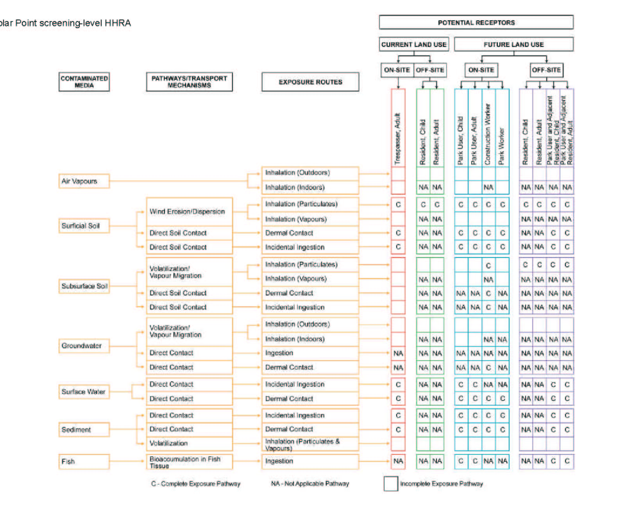

Slide 18
Exposure Assessment
If a substance was identified as a COPC in one media (i.e., soil, groundwater), it was carried forward for assessment in all operable pathways.
Exposure assessment conducted for a reasonable maximum exposure scenario, using 95% UCL values where appropriate, based on sample size
Exposure estimates calculated with and without fish consumption

Slide 19
HHRA Risk Characterization
A hazard quotient greater than 1 and an incremental lifetime cancer risk (ILCR) greater than 1E-6 were used to identify exposure scenarios that could potentially result in adverse health effects
Further evaluation of COPCs with HQ >1 and/or ILCR > 1E-6 may be warranted as part of the implementation of a risk management plan for the site

Slide 20
HHRA Risk Characterization continued
Exposure Scenarios Excluding Fish Consumption
COPCs identified for further evaluation:
  Metals: (Al, As, Be, Cd, Cr, Co, Mn, V)
  PAHs
  Pesticides: (DDT and metabolites, Aroclors 1248 and 1260)
  Organics: (benzene, bis(2-ethylhexyl)phthalate and vinyl chloride)

Slide 21
HHRA Risk Characterization continued
Exposure Scenarios Including Fish Consumption
COPCs identified for further evaluation:
  Metals: (Al, As, Be, Cd, Cr, Co, Fe,Mn, Hg,Th,V and Zn)
  PAHs
  Pesticides: (DDT and metabolites, Aroclors 1248 and 1260)
  Organics: (benzene, bis(2-ethylhexyl)phthalate, bromodichloromethane and vinyl chloride)

Slide 22
HHRA Risk Characterization continued
Exposure Pathways which contribute most to risk estimates - fish consumption excluded
Incidental soil ingestion and dust inhalation (metals and pesticides) and dermal contact with surface water (pesticides, PAHs and organics).
Construction and park workers are most likely to be impacted, off-site residents are the least likely to be impacted

Slide 23
HHRA Risk Characterization continued
Exposure Pathways which contribute most to risk estimates - fish consumption included
Fish consumption (park visitors and park visitors who are off-site residents)
Incidental soil ingestion and dust inhalation (adult trespassers, construction and park workers – don’t consume fish from the site)
Park visitors and park visitors who are off-site residents are most likely to be impacted, off-site residents are the least likely to be impacted

Slide 24
HHRA Uncertainty
Future media concentrations – site currently contains limited surface water and sediments – limited number of samples are assumed to represent future conditions
Hypothetical fish tissue concentrations based on maximum surface water concentrations currently on-site and bioaccumulation factors
Conservative exposure assumptions – receptors assumed to come into contact with all media at the site which may be conservative for a passive recreational setting in a sensitive wetland area

