Slide 1
Overview of Carbofuran Ecological Risk Assessment
Edward Odenkirchen, Ph.D.
Environmental Fate and Effects Division
Office of Pesticide Programs
U.S. Environmental Protection Agency
February 6, 2008

Slide 2
Overview of Ecological Risk Presentations
Overview of carbofuran ecological risk assessment
  Overall conclusions regarding the Agency’s assessment of avian risks associated with carbofuran use
Overview of field data and incident reports (Dr. Melissa Panger)
  Conclusions that can reasonably be drawn from available incident reports
  Conclusions that can reasonably be drawn from the results from field and monitoring studies
Avian probabilistic risk assessment (Dr. Christopher Salice)
  Impact of PRA model version used in the assessment
  Impact of new data and model provided recently by FMC
Notes:
The next three presentations provide an overview of EPA’s ecological risk assessment and the impact of new data or tools provided to EPA throughout the past year on EPA ecological risk conclusions
…..

Slide 3
Timeline of Risk Assessment Development
The assessment of risks to terrestrial and aquatic biota has undergone multiple internal and external peer review steps
  Preliminary eco risk assessment: June – August 2005
    Internal branch review
    Internal division review
    External error correction
  Revised combined risk assessment: March – May 2006
    Public Comment
  Interim RED: August – Nov. 2006
    Public comment

Slide 4
Objective of the Risk Assessment
To estimate the risk to non-target organisms associated with the current registered uses of carbofuran
Non-target taxa assessed include
  Freshwater and estuarine/marine vertebrates, invertebrates
  Terrestrial vertebrates

Slide 5
Consistency with Ecological Risk Assessment Guidelines and Peer Reviewed Methods
Hazard Evaluation Division, Standard Evaluation Procedure. Ecological Risk Assessment EPA-540.9-85-001 June 1986
Guidelines for Ecological Risk Assessment. Risk Assessment Forum. Washington DC EPA/630/R-95/002F
Progress Report for Advancing Ecological Assessment Methods in OPP: Overview Document. Submitted to the FIFRA Scientific Advisory Panel, April 5-7, 2000: Implementing Probabilistic Ecological Assessments
Technical Progress Report of the Implementation Plan for Probabilistic Ecological Assessments- Aquatic Systems. Submitted to the FIFRA Scientific Advisory Panel, April 5-7, 2000: Implementing Probabilistic Ecological Assessments
Technical Progress Report of the Implementation Plan for Probabilistic Ecological Assessments- Terrestrial Systems. Submitted to the FIFRA Scientific Advisory Panel, April 5-7, 2000: Implementing Probabilistic Ecological Assessments

Slide 6
Problem Formulation:
Stressor Source
Carbofuran-
  N-methyl carbamate insecticide/nematicide
  Cholinesterase inhibiting mode of action
  Potential reversibility of this inhibition if dose is not fatal*
*issue discussed further today

Slide 7
Problem Formulation:Use Characterization
The Risk Assessment considered
  26 agricultural uses
  5 non-agricultural uses
  Flowable formulations
  Aerial and ground applications:
    Foliar
    Broadcast
    Banded
    In-furrow
    Drip irrigation

Slide 8
Problem Formulation:Use Characterization
The Risk Assessment considered
  Application rates ranging from lowest to maximum labeled rates
  Uses were usually grouped under common categories of agro-practices, application methods, and rates and surrogate uses selected

Slide 9
Problem Formulation:Exposure Pathways
Aquatic organisms: exposure to residues of carbofuran in the water column
  Surface runoff
  Erosion
  Spray drift
Terrestrial organisms: exposure to residues in food items and drinking water
  direct deposition of spray and spray drift,
  surface runoff and erosion

Slide 10
Problem Formulation:Assessment Endpoints
Non-target organism assessment endpoints are established at the individual organism level:
  Survival
  Growth
  Reproduction

Slide 11
Problem Formulation:Measures of Effect RQ Process
Avian effects measures:
  Bird acute oral LD50
  Bird 21-week reproduction dietary NOAEL
Mammalian effect measures:
  Mouse acute oral LD50
  Rat 3-generation reproduction dietary NOAEL
Freshwater and estuarine/marine vertebrate
  Fish 96-hour LC50
  Fish chronic early life stage or full life cycle NOAEC
Freshwater and estuarine/marine invertebrate
  Invertebrate 48-hour LC50 or EC50
  Invertebrate chronic life cycle NOAEC

Slide 12
Problem Formulation:
Risk Hypotheses
Terrestrial and aquatic vertebrates and invertebrates are subject to adverse effects (i.e. reduced survival or reproduction) when exposed to carbofuran residues following application of pesticide at labeled use rates

Slide 13
Problem Formulation:
Analysis Plan
Three Lines of Evidence
  Deterministic Screening Assessment for both terrestrial and aquatic organisms
    Uses Risk Quotient Model (Exposure/Effects)
  Refined Risk Assessments for acute avian risks and aquatic animal risks
    Use probabilistic techniques
  Field studies, incident reports and field monitoring programs

Slide 14
Risk to Aquatic Organisms
Deterministic Assessment
Focus of assessment—exposure in water compartment
Surface water scenarios modeled—small vulnerable aquatic surface waters
  PRZM/EXAM Model
  Not all labeled uses were modeled directly
    Grouped uses and a single label use selected to represent the group (surrogate approach)

Slide 15
Risk to Aquatic Organisms
Deterministic Results
Freshwater Fish and Invertebrates
  Acute and chronic risks to freshwater fish not an issue for most uses (except corn and sorghum)
  All uses exceed acute and chronic levels of concern for invertebrates (acute RQs 1.6-16; chronic RQs 6.0-36) except
    drip irrigation use on grapes
    lowest foliar rate on alfalfa
    small grains, soybeans, and sunflowers

Slide 16
Risk to Aquatic Organisms
Deterministic Results
Estuarine/Marine Fish and Invertebrates
  All uses had acute and chronic concerns for fish except:
    grapes,
    lowest foliar rate on potatoes and alfalfa
    small grains, soybeans, and sunflowers
  All uses exceed acute restricted and chronic LOCs for invertebrates

Slide 17
Risk to Aquatic Organisms
— Probabilistic Results
Freshwater Fish and Invertebrates
  Supported deterministic screening that acute risk is unlikely concern for fish
  Chronic risk concerns for the highest foliar application rates to corn and sorghum (warm water fish species-NOEC exceeded in over 60% of application years)
  Use on potatoes would infrequently exceed chronic NOEC for fish
  Supported deterministic screening for both acute and chronic adverse effects for invertebrates
    All modeled uses frequently resulted in at least 5% of exposed freshwater invertebrate species > 80% mortality; 25% of freshwater species were estimated to have > 28% mortality
    Reproduction effect levels, were exceeded for nearly all uses in all application years or highly frequently (>43% of years).

Slide 18
Risk to Aquatic Organisms
— Probabilistic Results
Estuarine/Marine Fish and Invertebrates
  Mortality events for fish are of low magnitude and frequency (except for corn and sorghum uses)
  Corn and sorghum on average result > 18% mortality
  Potential for frequent disruptions in the function and quality of vulnerable estuarine/marine sites
    corn and sorghum highest use rates frequently resulted in close to 100% mortality
    coastal potatoes (Section 3 label) and broadcast applications on grapes frequently resulted in >67% mortality
    in-furrow application on cotton at plant and soil incorporated applications for tobacco result in >53% and >23% mortality, respectively (> 50% of modeled daily exposures were a problem)

Slide 19
Deterministic Risk Approach for Terrestrial Vertebrates
Emphasis on dietary route of exposure
Point estimates of peak residue concentrations in avian and mammalian food items (Fletcher et al. nomogram)
  Upper bound estimates of exposure (EEC)
Uses most sensitive tested animal endpoints of effects
  Avian acute LD50 (0.238 mg/kg-bw)
  Avian 21-wk reproduction LOAEC (2 mg/kg-diet, NOAEC not available)
  Mouse LD50 (2 mg/kg-bw)
  Rat 3-generation reproduction NOAEC (20 mg/kg-diet)
Risk Quotient calculation EEC/endpoint
Levels of Concern comparison
  acute lethal risk concern RQ>0.5
  reproduction risk concern RQ>1

Slide 20
Deterministic Risk Approach for Terrestrial Vertebrates
Crops assessed: alfalfa corn, cotton, grapes, potatoes, small grains, sorghum, soybeans, sugarcane, sunflowers and tobacco
  representative uses by application method and rate (model sensitive to these)
Application rates range:0.125 lb ai/acre to 2 lb ai /acre (tobacco 6 lb ai/acre)

Slide 21
Deterministic Risk Results for Mammals
Mammalian RQ results
  Acute
    Herbivores (all body weights 15, 35, 1000g) :
    3.9 to 684
    Granivores (all body weights): 0.11 to 9.5
    Insectivores (all body weights): 4.7 to 365
  Chronic: 0.1 to 72
Levels of Concern comparison
  acute lethal risk concern RQ>0.5
  reproduction risk concern RQ>1
Carbofuran exposures via the dietary pathway are sufficient to cause mortality and reproduction effects

Slide 22
Deterministic Risk Results for Birds
Avian RQ results
  Acute
    Herbivores (all body weights 20, 100, 1000g) : 17 to 6897
    Granivores (all body weights): 0.6 to107
    Insectivores (all body weights): 20 to 3879
  Chronic: >1 to > 690
Levels of Concern comparison
  acute lethal risk concern RQ>0.5
  reproduction risk concern RQ>1
Carbofuran exposures via the dietary pathway are sufficient to cause mortality and reproduction effects

Slide 23
Risks to Birds:
Probabilistic Assessment
Goals
  Define the probability and magnitude of avian effects
  Explore key areas of variability and uncertainty in datasets underlying the deterministic approach
  Consider the potential for exposure routes other than food as risk drivers

Slide 24
Risks to Birds:
Probabilistic Assessment
Problem formulation
  Deterministic assessment identified acute lethal effects as an area of concern for birds
  Risk managers expressed a desire to have more information on these potential effects
  All registered uses were identified as being of concern with screening process
  Focus the refinements on a selected subset of uses:
    Large range of applications rates
    Large potential land area treated (greater opportunity for surrogacy)
    Additional biological information to support refinements regarding resident bird species and their behavior

Slide 25
Risks to Birds:
Probabilistic Assessment
Approach to the Analysis
  Focus on corn and alfalfa crops
  Use Terrestrial Investigation Model version 1.0 as the assessment tool
  Focus on species shown to use these crops as evidenced by incidents and field studies

Slide 26
Problem Formulation:
Focal Species
Considered:
  census data from field studies of pesticide use on corn and alfalfa
  species found dead in such field studies
  open literature surveys of birds in and around corn and alfalfa fields
Selection criteria:
  high frequency occurrence in Midwest corn or alfalfa areas
  high frequency of observation within the actual fields
  either observed mortalities or close to them in terms of size, nesting, and feeding characteristics

Slide 27
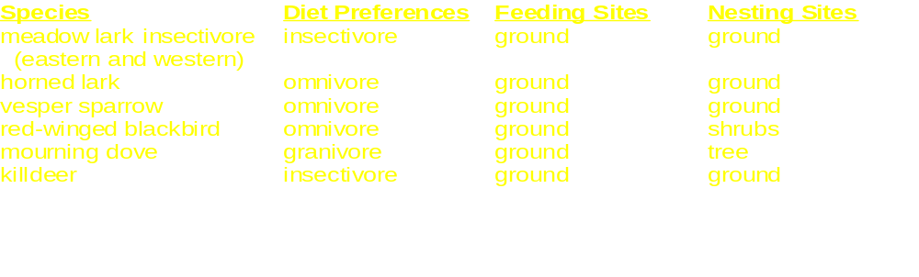
Focal Species Corn
Variety of dietary preferences
Varied expected use of field and field margins

Slide 28
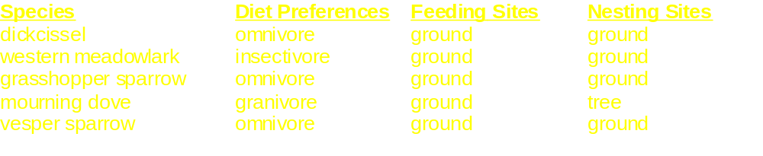
Focal Species Alfalfa
Variety of dietary preferences
Varied expected use of field and field margins

Slide 29
Risks to Birds:
Probabilistic Assessment
Approach to the analysis
  Use full suite of carbofuran acute lethal effects data for birds
  Applications should consider minimum, typical and labeled maximum carbofuran application rates
  Allow for dissipation of carbofuran residues in diet, drinking water, and in the feeding bird*
* An issue more fully explored in today’s presentations

Slide 30
Introduction to TIM 1.0
The model can be characterized as a species specific model which addresses acute mortality over a defined exposure window
  (14 days for carbofuran with two 12-hour time steps per day)
The spatial scale is at the field level, such that the field and surrounding area is assumed to meet habitat requirements for each focal species
Temporal scale is for exposure immediate to and following a single application

Slide 31
Introduction to TIM 1.0
The major parameters addressed in the model are:
  Food habits of select focal species
  Daily ingestion rates of food and water for selected focal species
  Frequency of feeding and drinking on sprayed fields
  Residues on focal species food and water sources
  Degradation rates of of food and water residues
  Inter and intra species toxicity estimates

Slide 32
Introduction to TIM 1.0
For each of the major exposure and effects variables,
Distributions were developed and
combined using Monte Carlo
sampling techniques, and
The probability and magnitude of acute lethal effects were estimated.

Slide 33
RQ Process
Exposure is a point estimate selected to be an expected conservative level from a distribution
Effects endpoint is the LD50
Effects uses lowest LD50 from species tested
Assessment process is division of exposure estimate by effects endpoint
Output is a single number
Probabilistic Process
Exposure varies with variable inputs; entire distribution of exposure values is considered*
Effects considers entire dose-response relationship to account for variability in sensitivity among individuals*
Effects estimates interspecies variability in sensitivity; uses scenarios to express uncertainty about sensitivity of a given species
Assessment is integration of exposure distribution with entire dose response curves
Output is a distribution of the probability and magnitude of adverse effects
* An issue more fully explored in today’s presentations

Slide 34
Conceptual Model Flow Diagram
Focal Species Food Habits,
(insectivore, granivore,
omnivore, or herbivore)
Daily Food and Water
Ingestion Rate
Body Weight
Frequency of Feeding and Drinking
on Contaminated Field
Contaminated
Water Source
Residues on/in
Food and Water
Application Rate
Degradation Rates
on Food Sources
Dose Estimate
Elimination Rate
Species-Specific
or Inter-Species
Toxicity
Distribution Estimate
Dose/Response
Distribution
Individual
Average Risk
An issue more fully explored in today’s
presentations
Individual Mortality
Percent Mortality
(groups or cohorts of individuals within a species)

Slide 35






What Variables are Explicitly Considered in TIM 1.0 ?
Pesticide variables considered in
exposure and effects models
What is the stability of chemical in various environmental media?
What is the toxicity of the pesticide
(LD50, slope of dose-response)? *
Pesticide residue variables considered in
exposure model
What are the residue concentrations in food items? ? *
What are the residues in drinking water sources?
*issue discussed further today

Slide 36
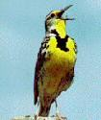

What Variables are Explicitly Considered in TIM 1.0 ?
Bird variables considered in exposure model
What does the bird weigh?
What does the bird eat?
How much does the bird eat? *
Where does the bird eat? *
How much does the bird drink?
Where does it drink?
Application variables considered in
exposure model
What is the application rate (lowest, typical, max. label)?
How is the application made (air, ground, in-furrow)?
*issue discussed further today

Slide 37
Following A Bird in the Model
TIM 1.0 can be run in two modes
  X iterations of Y birds in a cohort
    Track number of dead in each cohort
  X individual birds
    Calculates mean risk of mortality for individuals
  Central tendency results of cohort mortality predictions is very close if not identical to mean mortality risk in individual birds (SAP 2000)
In either case central tendency value is post-processed in a binomial distribution for probability/magnitude of effects for cohorts of Y birds

Slide 38
TIM Avian Exposure Model
Simplified (food ingestion)…
*issue discussed further today
Pick Avian
Species
Is bird feeding in
treated field?*
Yes, =1
No, =0
Calculate total residue ingestion from
Treated Field
Randomly pick an
individual bird from
body weight CDF
BW (grams)
Calculate total daily
intake of pesticide
TCIR = sum CIR_{K} (ug/day)
For each food group, calculate
residue ingestion rate*
CIR_{K} = CON X U_{K} (gram/day)
Based on BW, calculate
Free-living metabolic
Rate FMR (kcal/day)
For each food group,
Calculate daily uptake rate
U_{K} = Frac X TMIR*
(gram/day)
For each food group, randomly
generate residue
CON (ug/gram)*
For each food group, randomly
pick Gross Energies
GE (kcal/gram)
Calculate total daily
metabolized intake rate
TMIR = FMR/ME
(gram/day)
For each food group, calculate
Fraction Metabolized Energy
ME = Frac X GE X AE
(kcal/gram)
For each food group, randomly
pick Assimilation Efficiency
AE (unitless)

Slide 39

Biological Parameters for Exposure Modeling:Frequency in Treated Field
Available data are limited to counts of birds inside and out of a particular crop field
Data do not represent time budgets of individuals
EFED and the SAP believe that use of census data to represent daily time budgets of individual birds has limitations

Slide 40
Biological Parameters for Exposure Modeling:Frequency in Treated Field
The model does not dilute exposure in a time step *
The model uses census data to determine the likelihood that a bird will be in treated area*
*issue discussed further today
Notes:
The exposure model therefore does not dilute exposure in a time step by using census data to determine fraction of food from a treated area
Model uses census data to determine the likelihood that an individual bird will be in treated area during a time step

Slide 41
Retention of Chemical In Birds*
Purpose: to account for pesticide body burden from one exposure time step to another
Relied on metabolism data in chickens
Adjusted single oral dose 24-hour retention factor to appropriate time step
24-hour period retention 17%
12-hour retention set constant at 41 %
*issue discussed further today

Slide 42
Residues in Vegetative Food Items
EFED relied on the summary statistical information provided by Fletcher et al. (1994)
Limited data from field studies
Log normal distributions for residues in each vegetative food item normalized to application rate*
*issue discussed further today

Slide 43
Residues in Insect Food Items
EFED relied on the data of Fischer and Bowers (1997)
Data cover a variety of application methods, pesticides, and crop areas
Log normal distributions for residues normalized to application rate*
*issue discussed further today

Slide 44
Toxicity Endpoint
Problem Formulation: Acute lethal effects
Two sets of data for evaluating acute lethal effects
  Acute single oral dose studies LD₅₀ (selected for use)*
    Dose response relationships largely clear
    Allows for extrapolation across pathways
    Robust data set for species
    Does not account for dietary matrix
    Very short term exposure window
  Acute dietary exposure studies LC₅₀ (not selected for use)
    Dose response relationships obscure
    Limited dietary matrix consideration
    More protracted exposure window, relevance to field not known
* issue discussed further today
Notes:
Both these studies have limitations for estimating the risk to wild avian species exposed to pesticides in the environment. Both studies have a fixed exposure period, not allowing for the differences in response of individuals to different duration of exposure. Further, for the acute oral study, the dose administered in a single dose all at one time does not mimic wild birds’ exposure. Also, for exposure through different environmental matrices, it does not account for the effect of the matrices on the absorption rate of the chemical into the animal. This latter criticism also applies to the dietary test for other food matrices consumed in the wild.
For the dietary test, as it is currently designed, there are several other aspects of this test that limits its utility for refining an assessment. The endpoint of this test is reported as the concentration mixed with food that produces a response rather than as the dose ingested. Although food consumption is some times measured allowing for the estimate of a dose, calculations of the mg/kg/day are confounded by undocumented spillage of feed, how often consumption is measured, mortality within a treatment group, rapid growth rates of test subjects, and the willingness of the birds to consume treated food.
More importantly, there is evidence that the laboratory derived LC₅₀ ChemX values are poor predictors of effects.

Slide 45
Results of Probabilistic Risk Assessment
360 different scenarios were examined for corn and alfalfa uses
For broadcast application to corn and alfalfa, and for each focal species, 27 separate scenarios were examined

Slide 46
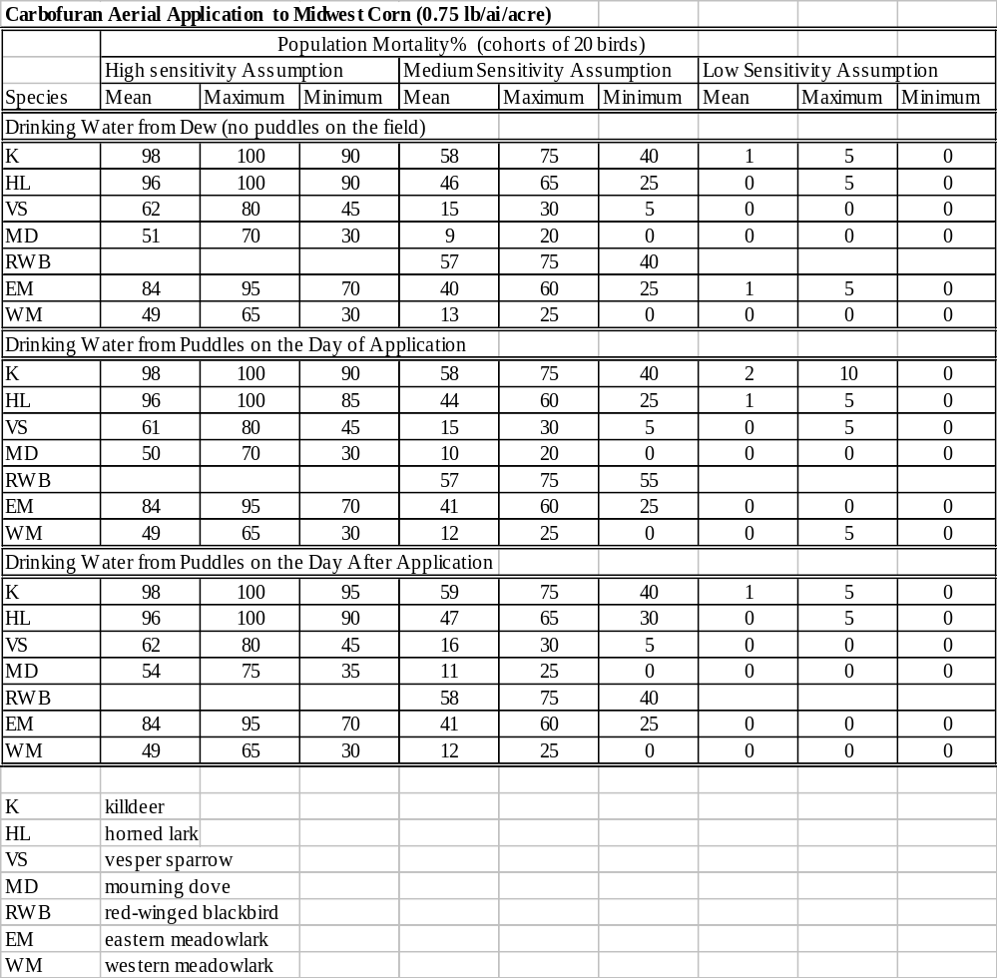
Mean values are for outputs of 1000 20-bird cohorts modeled
Maximum and minimum
values are the extreme outputs
for 1000 20-bird outputs
Three assumptions for sensitivity to the pesticide
are made, reflecting overall uncertainty for a
specific untested species

Slide 47
Carbofuran Foliar Application to Corn
Species | Percent Mortality (cohorts of 20 birds)
 | High Sensitivity Assumption¹ |  |  | ^{Medium Sensitivity Assumption1} |  |  | ^{Low Sensitivity Assumption1}
 | ^{Mean} | ^{5%} | ^{95%} | ^{Mean} | ^{5%} | ^{95%} | ^{Mean} | ^{5%} | ^{95%}
Carbofuran Foliar Application to Midwest Corn (0.25 lbs/a.i./A) Minimum Application
^{K} | ⁸⁷ | ¹⁰⁰ | ⁷⁵ | ¹⁰ | ²⁰ | ⁰ | ⁰ | ⁰ | ⁰
^{HL} | ⁷⁹ | ⁹⁵ | ⁶⁵ | ⁴ | ¹⁵ | ⁰ | ⁰ | ⁰ | ⁰
^{VS} | ³⁵ | ⁵⁰ | ²⁰ | ¹ | ⁵ | ⁰ | ⁰ | ⁰ | ⁰
^{MD} | ²⁵ | ⁴⁰ | ¹⁰ | ¹ | ⁵ | ⁰ | ⁰ | ⁰ | ⁰
^{EM} | ⁶⁶ | ⁸⁵ | ⁵⁰ | ⁷ | ¹⁵ | ⁰ | ⁰ | ⁰ | ⁰
^{WM} | ²⁸ | ⁴⁵ | ¹⁰ | ¹ | ⁵ | ⁰ | ⁰ | ⁰ | ⁰
^{RWB} |  |  |  | ²⁴ | ⁴⁰ | ¹⁰
^{K}

Slide 48
Carbofuran Foliar Application to Corn
Species | Percent Mortality (cohorts of 20 birds)
 | High Sensitivity Assumption¹ |  |  | ^{Medium Sensitivity Assumption1} |  |  | ^{Low Sensitivity Assumption1}
 | ^{Mean} | ^{5%} | ^{95%} | ^{Mean} | ^{5%} | ^{95%} | ^{Mean} | ^{5%} | ^{95%}
Carbofuran Foliar Application to Midwest Corn (0.75 lbs/a.i./A) Typical Application
^{K} | ⁹⁸ | ¹⁰⁰ | ⁹⁰ | ⁵⁸ | ⁷⁵ | ⁴⁰ | ¹ | ⁵ | ⁰
^{HL} | ⁹⁶ | ¹⁰⁰ | ⁹⁰ | ⁴⁶ | ⁶⁵ | ²⁵ | ⁰ | ⁵ | ⁰
^{VS} | ⁶² | ⁸⁰ | ⁴⁵ | ¹⁵ | ³⁰ | ⁵ | ⁰ | ⁰ | ⁰
^{MD} | ⁵¹ | ⁸⁰ | ³⁰ | ⁹ | ²⁰ | ⁰ | ⁰ | ⁰ | ⁰
^{EM} | ⁸⁴ | ⁹⁵ | ⁷⁰ | ⁴⁰ | ⁶⁰ | ²⁵ | ¹ | ⁵ | ⁰
^{WM} | ⁴⁹ | ⁷⁰ | ³⁰ | ¹³ | ²⁵ | ⁰ | ⁰ | ⁰ | ⁰
^{RWB} |  |  |  | ⁵⁷ | ⁷⁵ | ⁴⁰
^{K}

Slide 49
Carbofuran Foliar Application to Corn
Species | Percent Mortality (cohorts of 20 birds)
 | High Sensitivity Assumption¹ |  |  | ^{Medium Sensitivity Assumption1} |  |  | ^{Low Sensitivity Assumption1}
 | ^{Mean} | ^{5%} | ^{95%} | ^{Mean} | ^{5%} | ^{95%} | ^{Mean} | ^{5%} | ^{95%}
Carbofuran Foliar Application to Midwest Corn (1.0 lbs/a.i./A) Maximum Application
^{K} | ⁹⁹ | ¹⁰⁰ | ⁹⁵ | ⁷² | ⁹⁰ | ⁵⁵ | ³ | ¹⁰ | ⁰
^{HL} | ⁹⁷ | ¹⁰⁰ | ⁹⁰ | ⁶¹ | ⁷⁵ | ⁴⁵ | ¹ | ⁵ | ⁰
^{VS} | ⁶⁴ | ⁸⁰ | ⁴⁵ | ²³ | ⁴⁰ | ¹⁰ | ⁰ | ⁰ | ⁰
^{MD} | ⁵⁷ | ⁷⁵ | ⁴⁰ | ¹⁵ | ³⁰ | ⁵ | ⁰ | ⁰ | ⁰
^{EM} | ⁸⁶ | ⁹⁵ | ⁷⁰ | ⁵¹ | ⁷⁰ | ³⁰ | ² | ¹ | ⁰
^{WM} | ⁵² | ⁷⁰ | ³⁵ | ¹⁸ | ³⁵ | ⁵ | ⁰ | ⁵ | ⁰
^{RWB} |  |  |  | ⁶⁴ | ⁸⁰ | ⁴⁵
^{K}

Slide 50
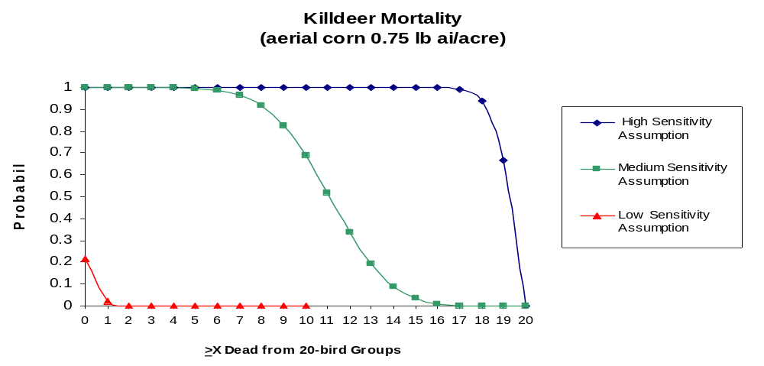
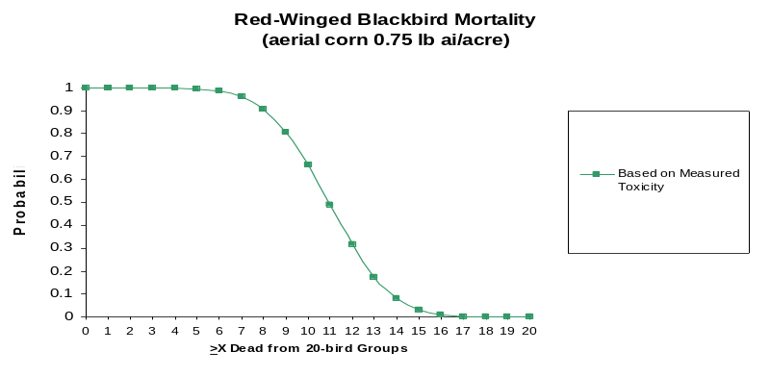
Probability is reverse cumulative and
represents the likelihood
of mortality > to X
For untested species: Three curves are presented, representing
predicted mortality for low, medium, and high sensitivity assumptions
For tested species,
effects certainty is greater and only one curve is presented

Slide 51
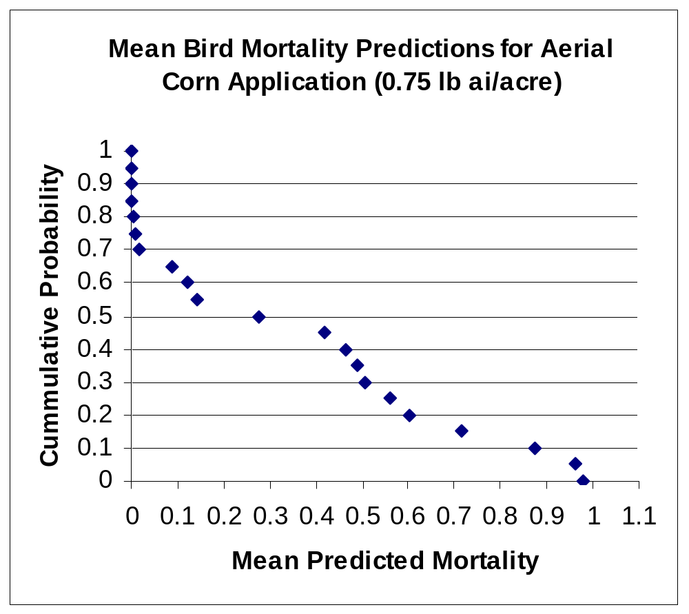
For all species and sensitivity
assumptions modeled, mean
predicted mortalities are
ranked and graphed.
In this case, 65% of the species/sensitivity combinations had at least 10% mortality, with mortality as severe as 98%.
Mean mortality is the fraction of dead birds in 20-bird cohorts.

Slide 52
Results of Probabilistic Risk Assessment
Potentially high mortality in at least some avian species for all scenarios
  55% to 95% of the bird species modeled exhibit mortality
  Results dependent upon:
    application rate (>rate >mortality),
    method (banded and in-furrow less than aerial broadcast),
    target crop (likely a result of differing extent of bird use of fields)
    assumption of sensitivity to pesticide (>sensitivity > level of mortality)

Slide 53
Incident and Field Studies
Third line of evidence
Do observations in the field comport with risk assessment predictions?
  Are one or more exposure routes complete?
  Are laboratory-based predictions of effects manifested in the field?

Slide 54
Ecological Incident Reports: CONCLUSION
When carbofuran is used as currently registered, wildlife mortality can and does occur

Slide 55
Avian Field Studies
Conclusion:
  Carbofuran is measurable in avian diet
  Carbofuran use at current application rates can adversely impact wildlife (mortality incapacitation, reproduction impairment)

Slide 56
Overall Conclusions
Deterministic Model
  One or more exposure pathways are complete
  Exposure levels meet or exceed levels shown to cause adverse effects (mortality and reproduction) in the laboratory
Probabilistic Model
  Exposure is variable but one or more pathways are complete
  Exposure levels are sufficient to cause mortality based on laboratory effects data
  Mortality is frequent and under some situations severe
Incident, Monitoring, Field Data
  One or more exposure pathways are complete
  Exposure levels are sufficient to result in field-observable effects (mortality, incapacitation, and reproduction)

Slide 57
Key Scientific Issues from TIM 1.0 SAP
Focal Species Selection,
Frequency of Birds in Treated Fields Use in the Model,
Frequency of Birds in Treated Fields, Setting Parameters,
Consideration of Drinking Water Source Selection,
Puddle Persistence,
Concentrations in Drinking Water,
Residues in Food Items,
Residue Clearance in Focal Species,
Selection of Exposure Time Steps,
Selection of Acute Toxicity Standard,
Defining the Distribution of Species Sensitivity, and
Other Factors Affecting Sensitivity

Slide 58
Scientific Issues Addressed by New Data
Residues in Food Items,
Residue Clearance in Focal Species,
Selection of Acute Toxicity Standard, and
Other Factors Affecting Sensitivity

Slide 59
Scientific Issues Addressed by New Model (TIM 2.1)
Focal Species Selection,
Frequency of Birds in Treated Fields, Setting Parameters,
Consideration of Drinking Water Source Selection,
Puddle Persistence,
Concentrations in Drinking Water, and
Selection of Exposure Time Steps

Slide 60
Scientific Issues Addressed by Alternative Input Assumptions
Frequency of Birds in Treated Fields, Setting Parameters,
Residues in Food Items,and
Selection of Exposure Time Steps

