Slide 1



Aura Data System Working Group
Meeting Fall 2006
Aura Microwave Limb Sounder
David T. Cuddy
Jet Propulsion Laboratory
California Institute of Technology
Boulder, Colorado
September 13,2006

Slide 2
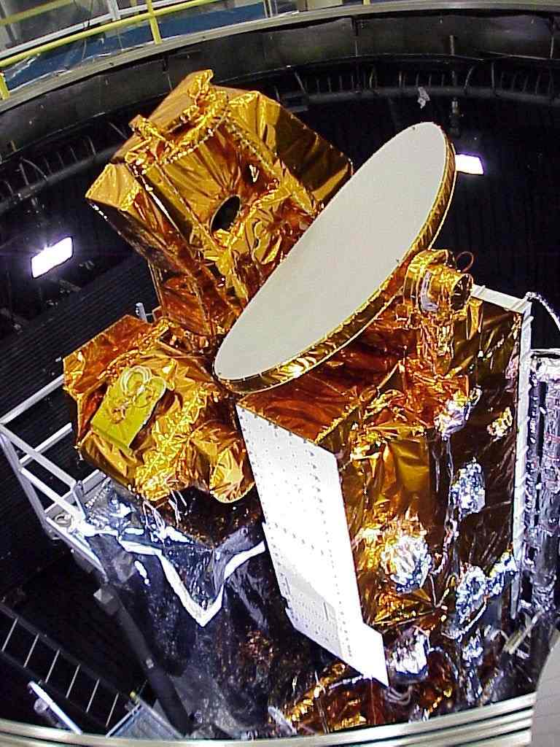
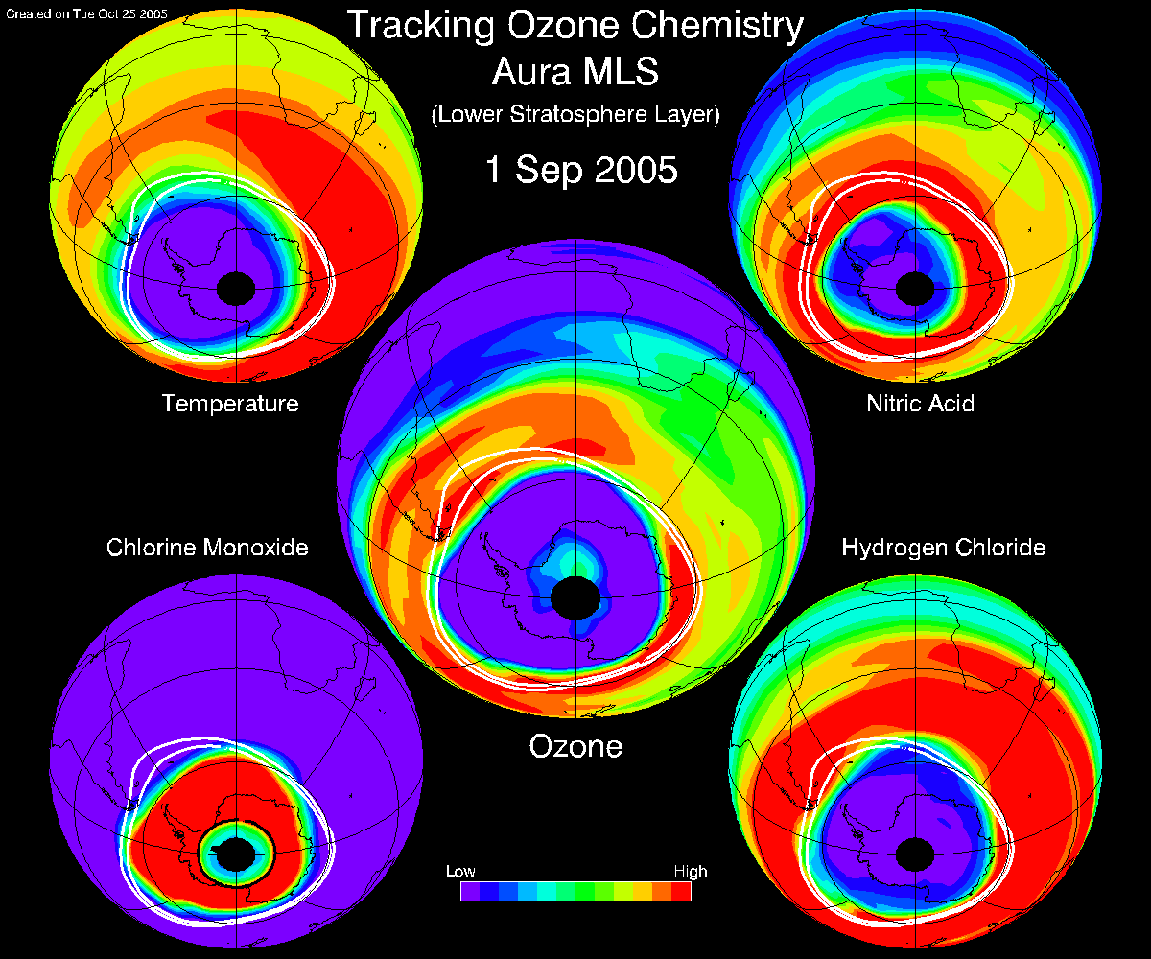
Outline
Major Milestones
Instrument Status
SIPS Status
Science Data Products
Level 2 Processing Status
Testing for Evolution
Version 2 Development Status
MLS Data flow
MLS Data Products for Version 2
Aids to Users
Libraries and Compilers
Performances of PGEs
Summary
Useful Web Pages

Slide 3
Major Milestones
Major MLS milestones since launch (15 July 2005)
  Full-up science observations start . . . . . . . . . . . . . . . . . . . . . . . . . . 13 August 2004
  V1.51 (first public release) data processing starts . . . . . . . . . . . . . 28 January 2005
  V1.51 data accessible on GES DISC, starting . . . . . . . . . . . . . . . 15 February 2005
  Released MLS V1.51 Data Quality Documents . . . . . . . . . . . . . . . 1 August 2005
  All backlog processing completed for V1.51 . . . . . . . . . . . . . . . . . 25 October 2005
  Aura Science Meeting, The Hague, Netherlands . . . . . . . . . . . . 8 November 2005
  V1.52 of Level 2 PGE (no Band 13 data) . . . . . . . . . . . . . . . . . . . . . . . March 2006
  Release 0 of Version 2 PGEs . . . . . . . . . . . . . . . . . . . . . . . . . . . . . . . . . June 2006
  Achieved Mission Success Criteria . . . . . . . . . . . . . . . . . . . . . . . . . 13 August 2006
  Release 1 of Version 2 PGEs . . . . . . . . . . . . . . . . . . . . . . . . . . . . . . . August 2006
  Aura Science Meeting, Boulder, Colorado . . . . . . . . . . . . . . 11-15 September 2006
  Release 2 of Version 2 PGEs . . . . . . . . . . . . . . . . . . . . . . . . . . . . . November 2006
  Begin production with Version 2 (planned) . . . . . . . . . . . . . . . . . . . November 2006
  Release MLS V2 Data Quality Document . . . . . . . . . . . . . . . . . . . . December 2006

Slide 4
Instrument Operations
MLS Instrument continues nominal operations
The MLS Instrument Operations Team (IOT) continues to conduct routine and special instrument operational activities from the Instrument Support Terminal at JPL
Nominal operations includes a monthly Antenna Actuator Assembly lubricant redistribution sweep (AAA reconditioning)
Three major problems have occurred in the last year:
  Band 13 (HCl measurements) shows accelerated degradation and is planned for only monthly measurements (February 2006)
  Entered an unexpected cascading event that shut down some of the instrument (loss of 8 days of measurement – 29 Mar-4 Apr, 2006)
  Bands 10 (ClO) and 29 (HOCl) exhibited anomalous behavior and were shutdown from Apr 18-May 18
    Their behavior shows dependency on temperature variations within the radiometer, that includes orbital variation and Band 13, therefore Band 13 measurements are on hold for the indefinite future
Since start of science operations on 13 August 2004, 94.6% of all possible measurements have resulted in science measurements
  28 days with less than 90% good measurements due to planned non-science activities in support of calibration activities, HIRDLS pitch manuevers, and other activities
  26 days with major outages due to MLS problems

Slide 5
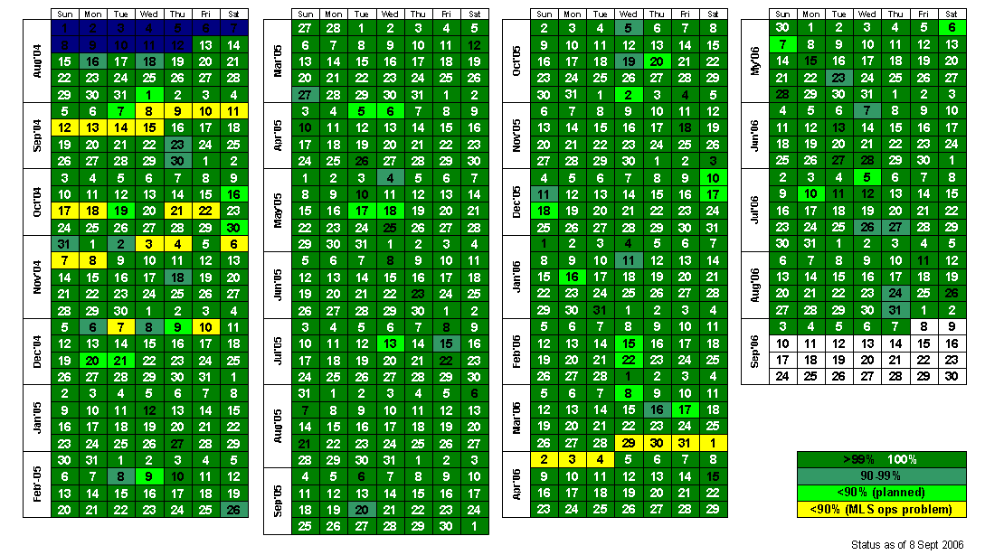
Instrument Calendar

Slide 6
Science Processing/SIPS
SIPS continues routine data production
Running v1.5.2 of SIPS in operations
  Although we are funded for 8/5 staffing, SIPS has been very successful in a 24/7 operations – excellent team at Raytheon, Pasadena shared with TES
  Data flow from GES-DAAC has been mostly consistent and timely
  Issues worked via email, phone calls, and biweekly telecons between SIPS and GES-DAAC in a timely manner - GES-DAAC has been very responsive
Level 1 processing is active with v1.51 and v2.11
  Processing MLS Level 0 data to Level 1 on a daily basis as data arrives
  Limited data from v2.11
Level 2 processing is active with v1.51, v1.52, and v2.1
  If Band 13 is active, also process with v1.51
  Limited data from v2.1
Level 3 processing will become active with V2.2
Data delivery to SCF is active
Data delivery to GES-DISC is active
Producing copies of critical subset of the data on DVD for SCF
  Stopped sending data to University of Edinburgh (co-PI) at their request

Slide 7
Science Data Products
Science team inspects all science products and reviews them at the weekly science team meetings
Routine archiving of Level 1b and Level 2 products at GES-DISC
  Began in February’05 with PGEs v1.51
  Quality Document released August’05 and data became public
  All but 5 days processed to Level 1b since beginning of science operations
  All but 33 days processed to Level 2 since beginning of science operations
  29 days processed by both V1.51 and V1.52 to Level 2
    V1.52 was necessary to process data without Band 13
Because of institutional and location convenience, MLS shares its data holdings with TES scientists at JPL
  Does not use GRID technology (poster by Brian Knosp in session 2)

Slide 8
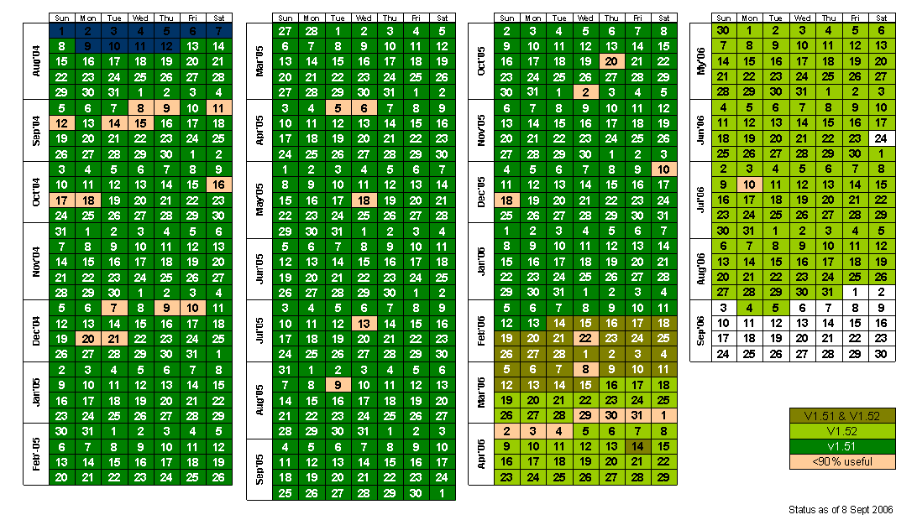
Level 2 Processing Status

Slide 9
Testing for Evolution
MLS SCF and SIPS continue to support testing for Evolution
Mini-MOSS for GEOS-5 data flow from GOLDS tested 8x data flow to SIPS and SCF – no issues
  Concern with data volume especially during the retro-processing period
Providing support of informal tests for
  EDS (Level 0) from GES-DISC to SCF
  PDS (Level 0) from GES-DISC to SIPS
  Level 1 from SIPS to GES-DISC
  Level 2 from SIPS to GES-DISC
Future:
  Level 3 from SIPS to GES-DISC

Slide 10
Version 2
Status of progress on Version 2 of PGEs
Features of Version 2
  Level 1b and Level 2 products will be improved from V1.5
  Add Level 3 products in this release
  Plan to add two new data types at Level 2
    CH₃CN (Methyl Cyanide)
    SO₂ (Sulfur Dioxide) – already have the data types, but no products
  Increment ESDT version (=2) for all data sets
  Use h5repack to optimize output products
    Compression is set to GZIP = 1
Release 0 (V2.0) was dress rehearsal – Jun’06
Release 1 (V2.1) is preliminary release – Aug’06
  Limited set of products available at AVDC
  Uses GEOS-4 as input
Release 2 (V2.2) is the final release – Nov’06
  Products will be the basis for the validation papers due in Mar’07
  GEOS-5 is a required input; GEOS-4 is not a valid input

Slide 11
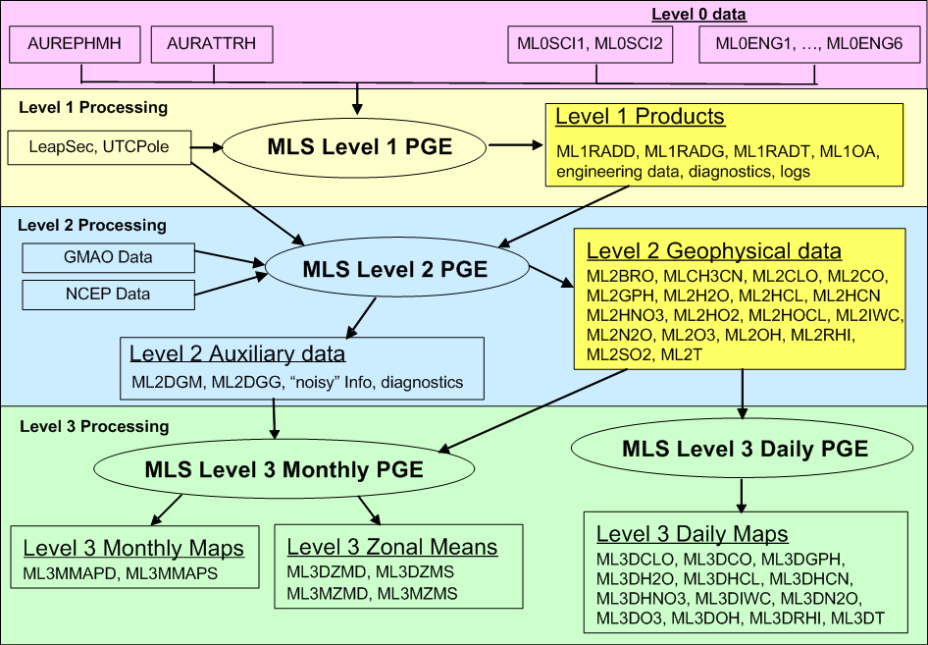
Data Flow Diagram

Slide 12
Level 1B and Level 2 Products for Version 2
Science Data Products
Short Name | Geophysical Parameter |  | Short Name | Geophysical Parameter
ML1RADD | L1 Radiances from DACS |  | ML1RADT | L1 Radiances from THz
ML1RADG | L1 Radiances from GHz |  | ML1BOA | L1 Orbit and Attitude
ML2BRO | L2 Bromine Monoxide |  | ML2HOCL | L2 Hypochlorous Acid
ML2CLO | L2 Chlorine Monoxide |  | ML2IWC | L2 Ice Water Content
ML2CO | L2 Carbon Monoxide |  | ML2N2O | L2 Nitrous Oxide
ML2CH3CN | L2 Methyl Cyanide |  | ML2O3 | L2 Ozone
ML2GPH | L2 Geopotential Height |  | ML2OH | L2 Hydroxyl
ML2H2O | L2 Water Vapor |  | ML2RHI | L2 Relative Humidity w/ ice
ML2HCL | L2 Hydrogen Chloride |  | ML2SO2 | L2 Sulfur Dioxide
ML2HCN | L2 Hydrogen Cyanide |  | ML2T | L2 Temperature
ML2HNO3 | L2 Nitric Acid |  | ML2DGG | L2 Diagnostic, GP Grid
ML2HO2 | L2 Hydroperoxy |  | ML2DGM | L2 Diagnostic, Misc. Grid

Slide 13
Level 3 Products for Version 2
Science Data Products – continued
Short Name | Geophysical Parameter |  | Short Name | Geophysical Parameter
ML3DZMS | L3 Daily Zonal Mean, Standard |  | ML3DZMD | L3 Daily Zonal Mean, Diagnostics
ML3MZMS | L3 Monthly Zonal Mean, Standard |  | ML3MZMD | L3 Monthly Zonal Mean, Diagnostics
ML3MMAPS | L3 Monthly Maps, Standard |  | ML3MMAPD | L3 Monthly Map, Diagnostics
ML3CLO | L3 Daily Map, Chlorine Monoxide |  | ML3IWC | L3 Daily Map, Ice Water Content
ML3CO | L3 Daily Map, Carbon Monoxide |  | ML3N2O | L3 Daily Map, Nitrous Oxide
ML3GPH | L3 Daily Map, Geopotential Height |  | ML3DO3 | L3 Daily Map, Ozone
ML3H2O | L3 Daily Map, Water Vapor |  | ML3DOH | L3 Daily Map, Hydroxyl
ML3HCL | L3 Daily Map, Hydrogen Chloride |  | ML3DRHI | L3 Daily Map, Relative Humidity w/ ice
ML3HCN | L3 Daily Map, Hydrogen Cyanide |  | ML3DT | L3 Daily Map, Temperature
ML3HNO3 | L3 Daily Map, Nitric Acid

Slide 14
Aids to Users
Help is available to user in many ways in addition to those available through GES-DISC
MLS home page provides useful information and links to others
  http://mls.jpl.nasa.gov/
  See poster by Brian Knosp
MLS provides Data Quality Document
  Available through the main MLS web page
MLS provides user registration
  Provides updates to instrument and processing status
Users can ask for help via email: data@mls.jpl.nasa.gov
MLS provides an IDL reader for the Level 2 products through Open Channel Software that distributes software for Caltech/JPL
  http://www.openchannelsoftware.org/projects/Read_MLS_Level_2_Geophysical_P/
  Level 3 readers will be coming soon

Slide 15
Libraries and Compilers
Library versions in used by MLS V1.5
  HDF4: 4.2r0
  HDF5: 1.6.2
  Toolkit: 5.2.12
  HDF-EOS 2.12
  HDF-EOS5 5.1.8
Library versions in used by MLS V2.1
  HDF4 4.2r1(a)
  HDF5 1.6.5-post5
  Toolkit 5.2.14
  HDF-EOS 2.14
  HDF-EOS5 5.1.10
Our compilers:
  gcc 3.4.6
  NAG f95 5.0
  Lahey lf95 6.10e

Slide 16
Performance of PGEs
Performance of PGEs is within limits of resources
Level 1:
  V1.51 requires less than 6 CPU hours for each data day
  V2.x will require less than 6 CPU hours for each data data
Level 2
  V1.51 requires about 7000 CPU hours for each data day
  V1.52 requires about 5900 CPU hours for each data day
  V2.1 requires about 11,200 CPU hours for each data day
    Hope to lower this with V2.2
    Use of queue management will use most of available CPU hours
    Each cluster will provide a maximum of 8736 CPU hours
      3 clusters available, each running 364x3.06 GHz Pentium Xeon processors
    Timeliness attained by dividing a day of data into 350 chunks and running the chunks in parallel on 350 processors
Level 3
  V2.x Daily Map will require less than 6 CPU hours for each 10 day run
  V2.x Monthly run will require less than 6 CPU hours

Slide 17
Summary
Status Summary
  MLS instrument continues to work well, despite several problems
  MLS data processing systems operating smoothly
  Plans are well underway for Version 2 although there are challenges
  All Level 1B and Level 2 products routinely archived & available from GES DISC

Slide 18
Useful Web Pages
Microwave Limb Sounder home page
  http://mls.jpl.nasa.gov/
IDL Reader for Level 2 products
  http://www.openchannelsoftware.org/projects/Read_MLS_Level_2_Geophysical_P/
Aura Guidelines
  http://www.eos.ucar.edu/hirdls/HDFEOS_Aura_File_Format_Guidelines.pdf
EOS Data Gateway (EDG)
  http://delenn.gsfc.nasa.gov/~imswww/pub/imswelcome/
GES DISC Web-based Hierarchical Ordering Mechanism (WHOM)
  http://disc.gsfc.nasa.gov/data/dataset/MLS/
GES DISC Datapool
  http://disc.gsfc.nasa.gov/data/datapool/MLS/
GES-DISC Interactive Online Visualization and Analysis Infrastructure (Giovanni)
  http://reason.gsfc.nasa.gov/Giovanni_mls3d/

