Slide 1
GES DISC Evolution
Transition Readiness Review
OMI S4PA
Bruce Vollmer
Aura Evolution Lead
Bruce.E.Vollmer@nasa.gov

Slide 2
Agenda
Objectives
L0 data
DPREP/Ancillary data
L1-L2 data
Data Interfaces
Data Metrics
Conclusion

Slide 3
Objectives
Convey overall status of progress on transition from ECS to S4PA for OMI data support
Illustrate that OMI data support from S4PA is operational
Conclude that GES DISC evolution is complete for OMI data

Slide 4
OMI L0 data
Datatypes:
  OML0ED, OML0UV, OML0V
  OML0A1X, OML0A2X, OML0EDX, OML0UVX, OML0VX
  ~2054 GB/year
Data Source: EDOS
Level-0 migration is complete and S4PA reconciliation with ECS holdings has been done
Cutover of L0 flow from EDOS completed January 2007.
Archive
  Primary Archive Location : auraraw1
  Replicated Archive Location: rep1
Backups
  Incremental backups performed daily
  Backup tapes (full backup, primary archive) taken to B28 weekly
Distribution
  L0 data unpublished, unadvertised in hidden directory
  FTP; Subscription to OMI SIPS (PDS) is activate on auraraw1; MRI is configured for subscribers on auraraw1

Slide 5
DPREP and Ancillary data
Aura DPREP
  Data processing, archive and distribution takes place on TADS
  AUREPHMN and AURATTN
NISE
  Distribution from ECS to OMI SIPS terminated.
  OMI SIPS obtains data directly from NSIDC.
LeapSecT, UTCPoleT
  Archived and distributed from S4PA on acdisc

Slide 6
OMI L1 data
Data Source: OMI SIPS @ GSFC
Current data stream from OMI SIPS is V003 and only in S4PA (aurapar1)
V002 not migrated from ECS; never released to public
OMI SIPS terminated export of V002 OMI L1B as of 11/06/2007
7 Datatypes
  OMTDOPF (~ 240 GB/year) Restricted
  OML1BCAL (~ 140 GB/year) Restricted
  OML1BIRR (~ 0.1 GB/year) Public
  OML1BRUG (~ 1000 GB/year) Public
  OML1BRVG (~ 1000 GB/year) Public
  OML1BRUZ (~ 80 GB/year) Public
  OML1BRVZ (~ 70 GB/year) Public
Data released to public and available via WHOM, Mirador, WIST/ECHO
Backups
  Incremental backups performed daily
  Backup tapes (full backup) taken to B28 weekly

Slide 7
OMI L2 data
Data Sources: OMI SIPS @ GSFC, ODPS/KNMI¹ (Netherlands), FMI² (Finland)
Current data stream from Data Providers is both V002 and V003 and only in S4PA (aurapar2)
V002 data (8/2004 – 10/2007) migrated from ECS to S4PA
V002 data stream switched to S4PA only 10/2007
13 datatypes, 182 files per day
1200 GB/year
Data released to public and available via WHOM, Mirador, WIST/ECHO
Backups
  Incremental backups performed daily
  Backup tapes (full backup, primary archive) taken to B28 weekly
¹ The Royal Netherlands Meteorological Institute
² Finnish Meteorological Institute

Slide 8
OMI L2 data
Product | Collection(s) | Data Provider
OMTO3 (255 GB/year) | V002, V003 | OMI SIPS
OMAERO (55 GB/year) | V003 | OMI SIPS
OMAERUV (50 GB/year) | V002, V003 | OMI SIPS
OMBRO (115 GB/year) | V002, V003 | OMI SIPS
OMCLD02 (80 GB/year) | V002, V003 | OMI SIPS
OMCLDRR (50 GB/year) | V002, V003 | OMI SIPS
OMDOAO3 (60 GB/year) | V002, V003 | OMI SIPS
OMHCHO (115 GB/year) | V002, V003 | OMI SIPS
OMNO2 (135 GB/year) | V002, V003 | OMI SIPS
OMOCLO (110 GB/year) | V002, V003 | OMI SIPS
OMPROO3 (65 GB/year) | V003 | ODPS KNMI
OMUVB (44 GB/year) | V002, V003 | FMI
OMSO2 (105 GB/year) | V002, V003 | OMI SIPS

Slide 9
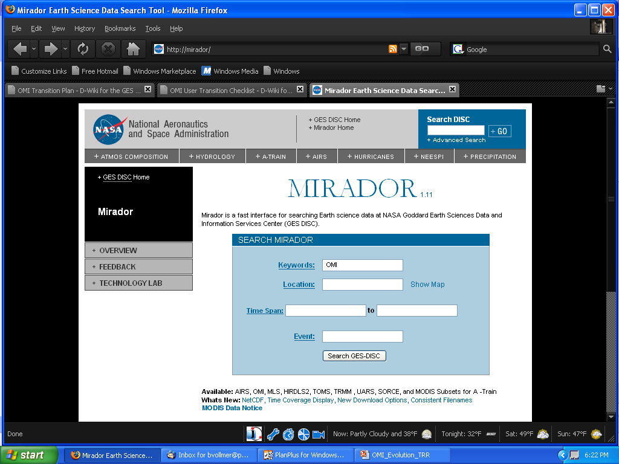
User Interface - Mirador

Slide 10
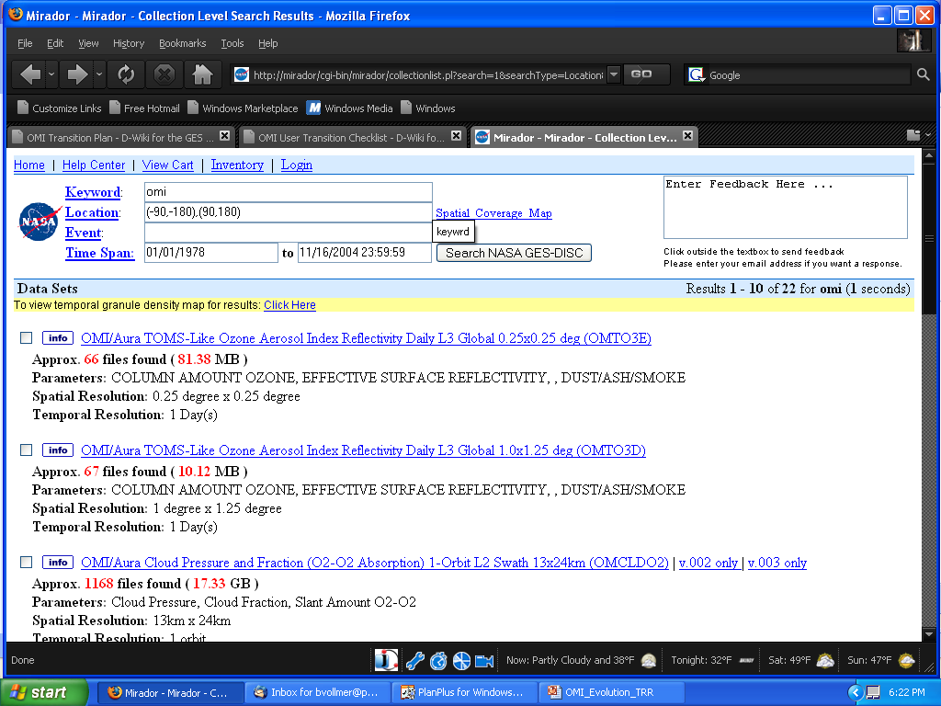
User Interface - Mirador

Slide 11
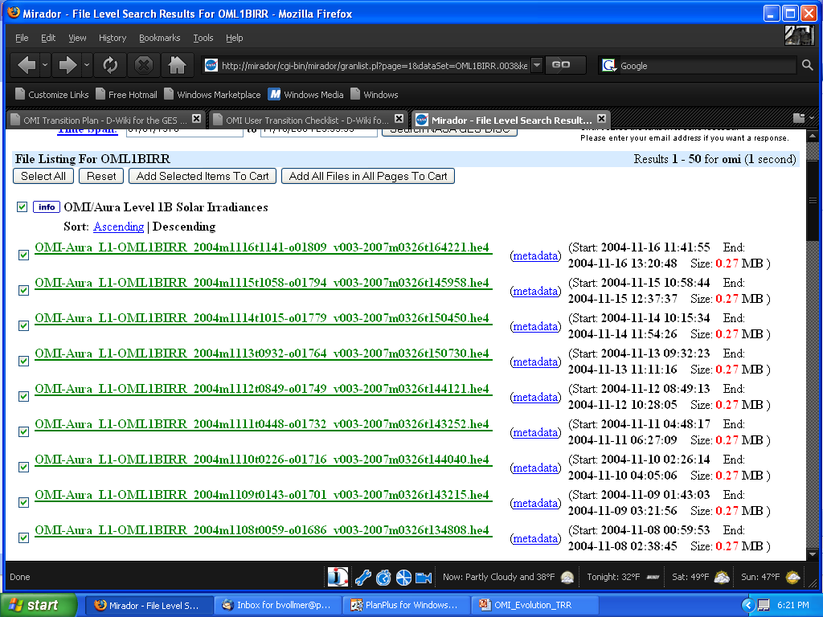
User Interface - Mirador

Slide 12
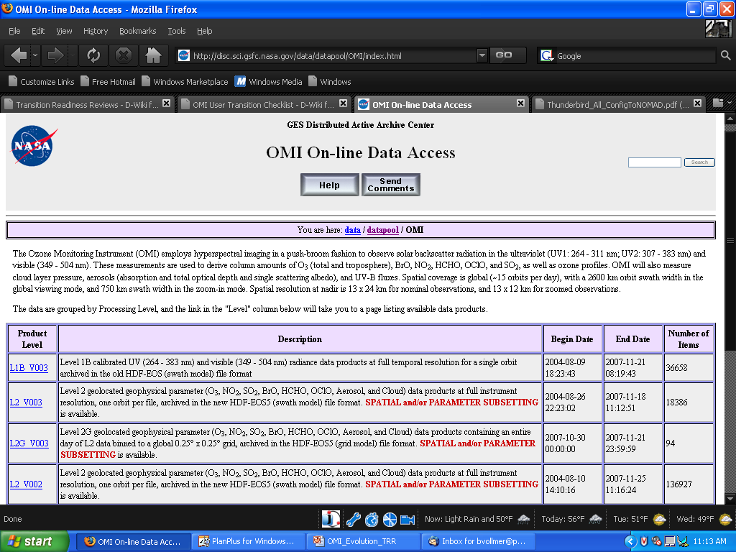
User Interface - WHOM

Slide 13
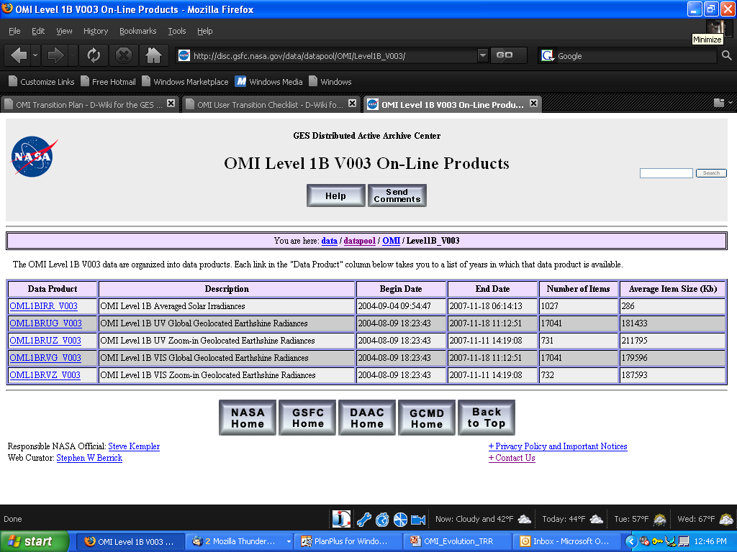
User Interface - WHOM

Slide 14
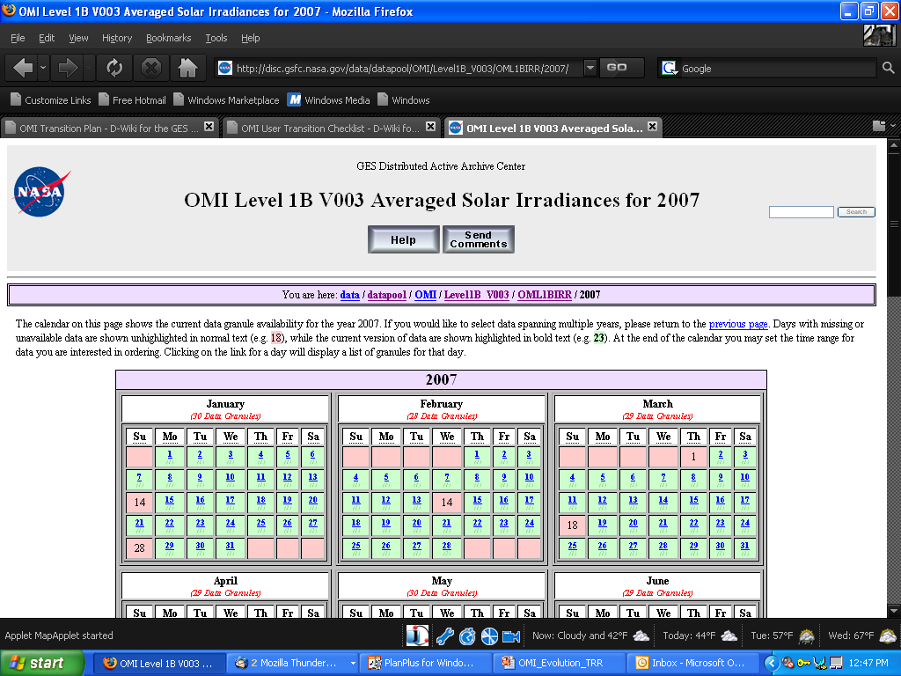
User Interface - WHOM

Slide 15
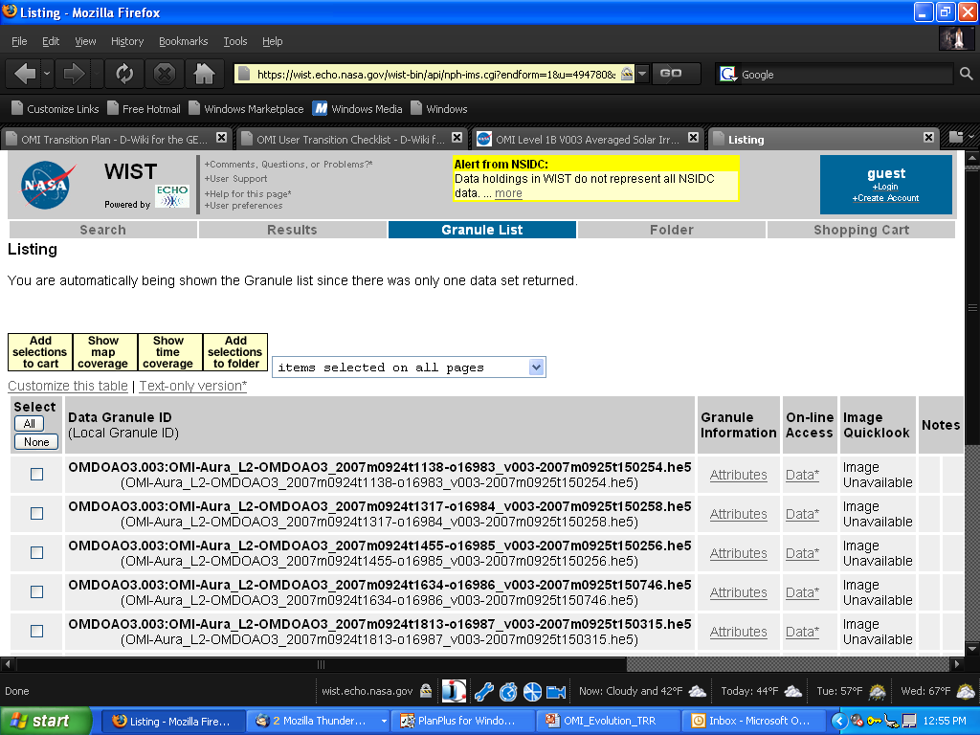
User Interface - WIST

Slide 16
S4PA OMI Data Interfaces
OMI SIPS
ODPS/KNMI
AVDC
FMI
MLS SCF

Slide 17
OMI SIPS
Primary Contacts: Phil Durbin, Elaine Innskeep, (Marghi Hopkins)
Inbound Data
  OMTDOPF, OML1BCAL, OML1BIRR, OML1BRUG, OML1BRVG, OML1BRUZ, OML1BRVZ (aurapar1)
  OMTO3, OMAERO, OMAERUV, OMBRO, OMCLDO2, OMCLDRR, OMDOAO3, OMHCHO, OMNO2, OMOCLO, OMSO2, OMPROO3, OMUVB (aurapar2)
  Data Transfer Mechanism: SFTP Pull
Outbound Data
  UTCPoleT, LeapSecT (acdisc), OML0ED, OML0UV, OML0V (auraraw1)
  Data Transfer Mechanism: SFTP Push
All data flows are operational from S4PA

Slide 18
OMI KNMI
Primary Contacts: Nico Rozemeijer, Jacques Claas
Inbound Data
  OMPROO3 (aurapar2)
Outbound Data
  Datatypes: OMCLDO2 (aurapar2), LeapSecT, UTCPoleT (acdisc)
  Data Transfer Mechanism: SFTP Push
All data flows are operational from S4PA

Slide 19
AVDC
Primary Contact: Bojan Bojkov, Michael Yan
Inbound Data
  None
Outbound Data
  OMAERO, OMAERUV, OMBRO, OMDOAO3, OMHCHO, OMNO2, OMOCLO, OMSO2 (aurapar2)
  Data Transfer Mechanism: FTP Pull
All data flows from are operational from S4PA

Slide 20
FMI
Primary Contact: Timo Pirttijarvi
Inbound Data
  OMUVB (aurapar2)
Outbound Data
  OMTDOPF (aurapar1)
  Data Transfer Mechanism: FTP Pull
All data flows are operational from S4PA

Slide 21
MLS SCF
Primary Contact: Brian Knosp
Inbound Data
  None
Outbound Data
  OMCLDO2, OMTO3, OMCLDRR, OMDOAO3, OMNO2 (aurapar2)
  Data Transfer Mechanism: SFTP Push
All data flows are operational from S4PA

Slide 22
ESDIS Metrics System
OMI archive, distribution and web metrics are
available through EMS

Slide 23
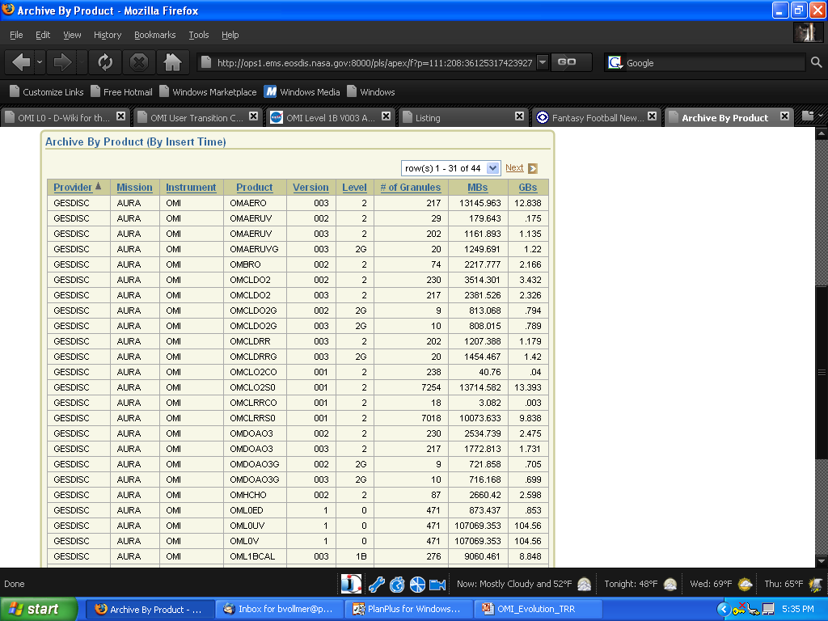
EMS - Archive

Slide 24
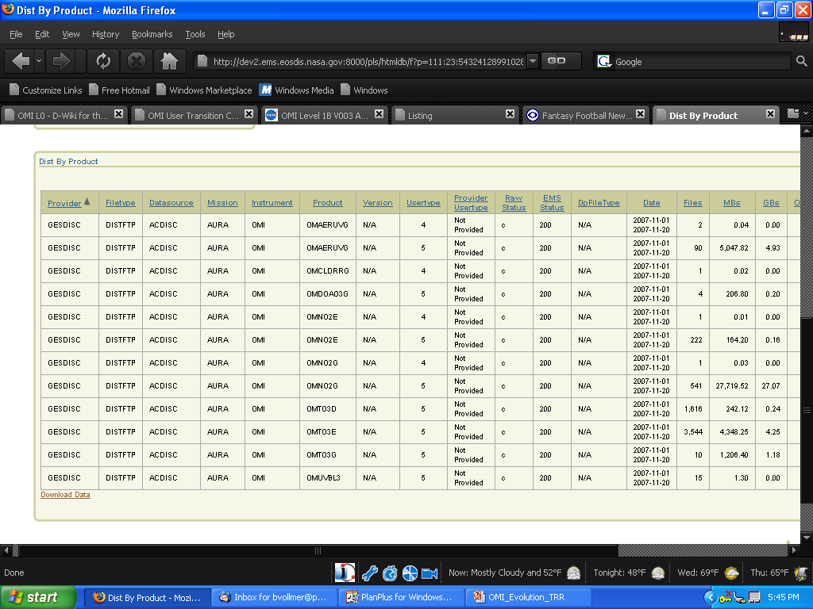
EMS - Distribution

Slide 25
Conclusion
All data interfaces successfully transitioned from ECS to S4PA
All V002 L2 data migrated from ECS to S4PA
All V003 data flow into S4PA
ECS support no longer needed or used for OMI data

Slide 26
Questions?

