Slide 1


Skeletal Response to Weightlessness in the Female Murine Tibia
Amy Brazin, NASA Apprentice
Maria Squire, Ph.D. Candidate
Stefan Judex, Ph.D.
August 20, 2004

Slide 2
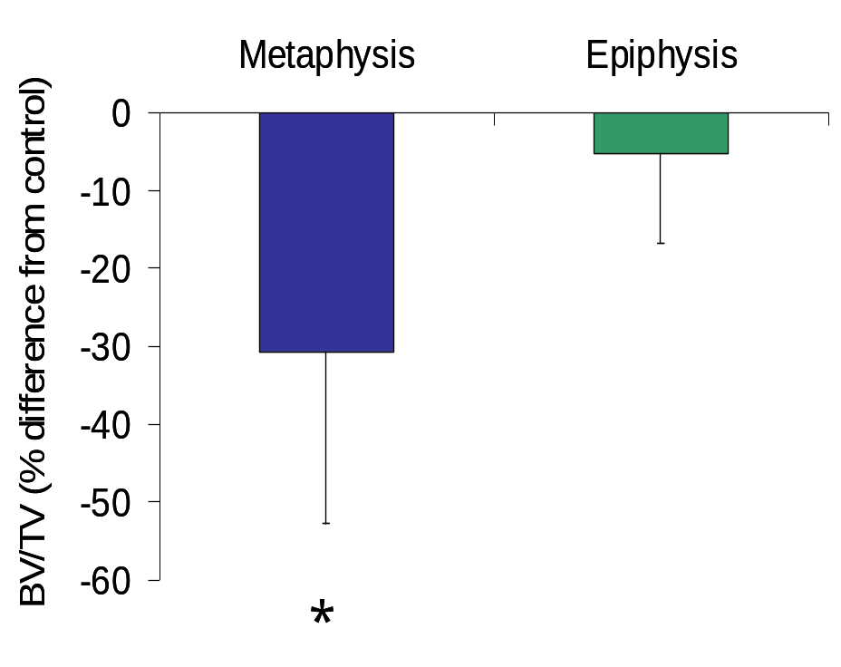
Effects of Disuse are Site-Specific
Metaphyseal BV/TV is 30% lower in disuse mice
Metaphyseal Ct.Ar is lower by 15%→as a result of a decrease in Ps.Ar and increase in Ec.Ar
Yet, diaphyseal Ct.Ar was only minimally affected (3%)→due to an insignificant increase in both Ps.Ar and Ec.Ar
Example:

Slide 3
If I had more time, I would….
Analysis male F1 mice for similar effects in the tibia
Examine the osteoclast, osteoblast, and osteoid growth and population density in specific sites
Research other causes of bone loss such as hormonal secretions

