Slide 1

TERIPARATIDE
Lilly Research Laboratories
Endocrinologic and Metabolic Drugs Advisory Committee Meeting
Holiday Inn, Bethesda, Maryland
July 27, 2001
Center for Drug Evaluation and Research

Slide 2
TERIPARATIDE
Lilly Research Laboratories
Preclinical Safety Evaluation
Gemma Kuijpers, Ph.D., Pharmacology Reviewer
Division of Metabolic and Endocrine Drug Products

Slide 3
Main Preclinical Issue
Teriparatide causes bone neoplasms in the rat

Slide 4
Carcinogenicity Studies
In vivo bioassay
  Species: rat, mouse
  Two year duration
  Multiple dose groups
  Histological tissue examination
  Statistical analysis
  Risk assessment

Slide 5
Carcinogenicity Study with Teriparatide
  Species: F344 rat
  Duration: 2 Years
  Doses: 0, 5, 30, 75 μg/kg/day (LD, MD, HD)
  60 animals/group
  Bone sites examined
    femur, tibia, sternum
    vertebra
    gross lesions

Slide 6
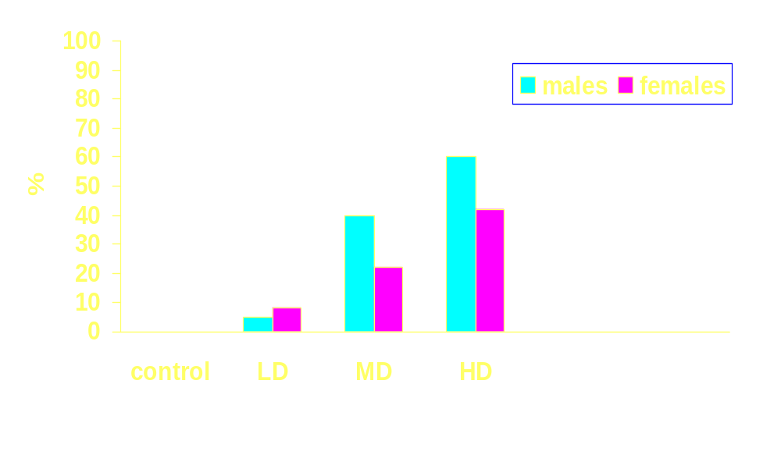
Teriparatide Causes Bone Neoplasms in the Rat
Percent of animals with tumors

Slide 7
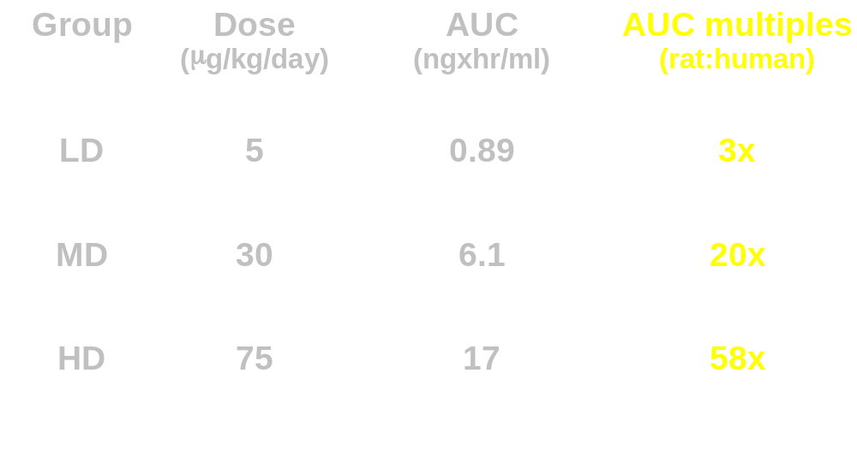
Systemic Exposure to Teriparatide

Slide 8
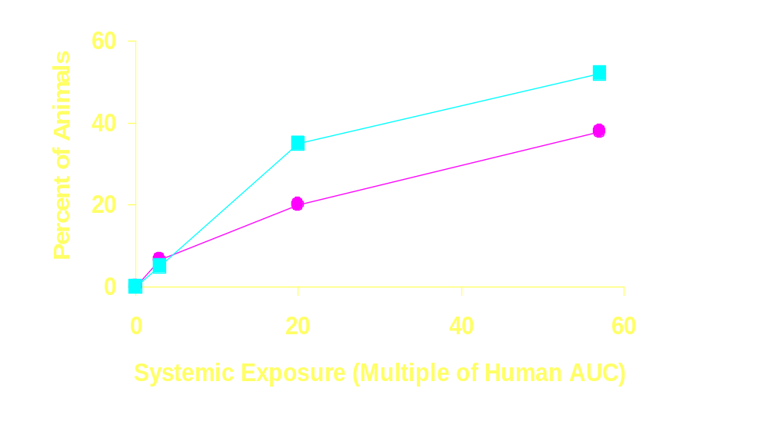
Incidence of Osteosarcoma by Multiple of Human AUC
males
females
x
x
x

Slide 9
Sites of Osteosarcoma
Order of frequency
Males
  Tibia
  Femur
  Vertebra
  Sternum
  Rib
  Skull
  Humerus
  Pelvis
Females
  Vertebra
  Femur
  Rib
  Tibia
  Sternum
  Pelvis
  Skull

Slide 10
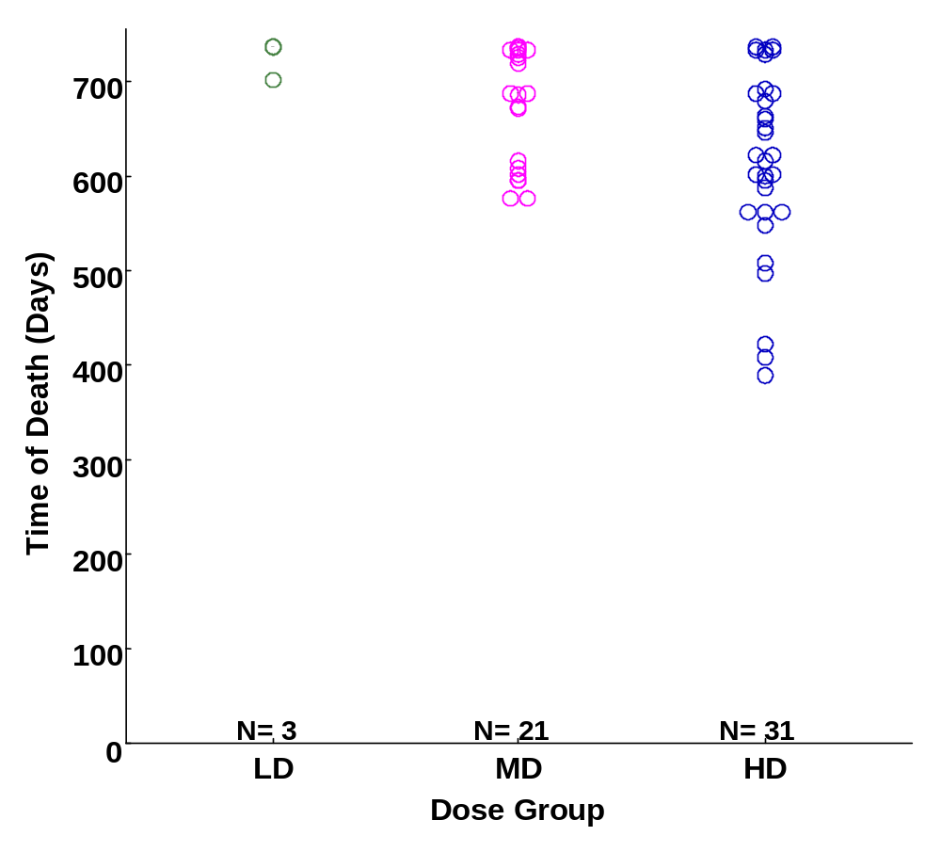
Male Rats with Osteosarcoma Time of Death

Slide 11
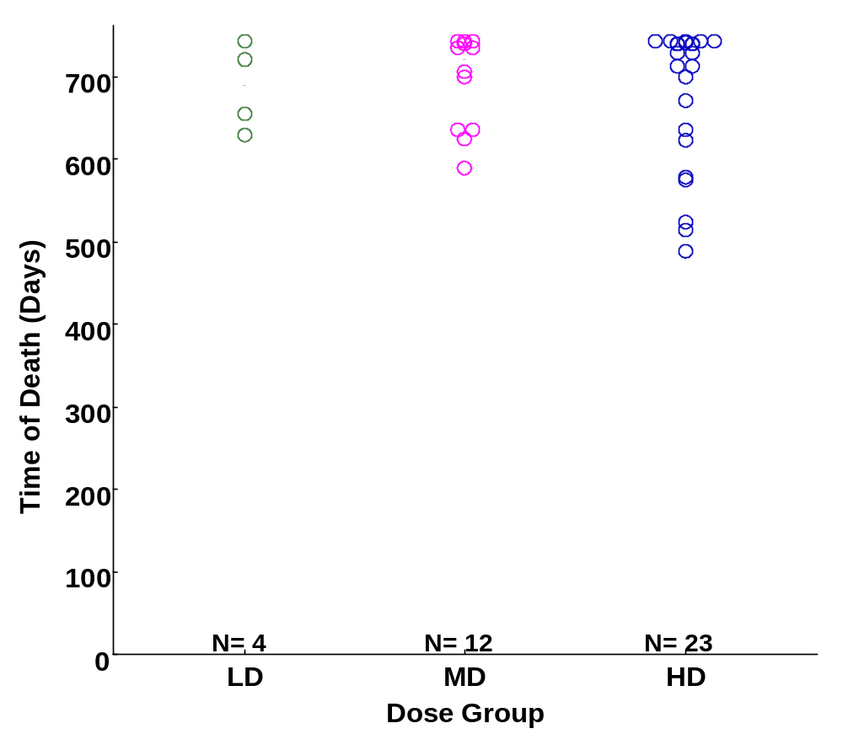
Female Rats with Osteosarcoma Time of Death

Slide 12
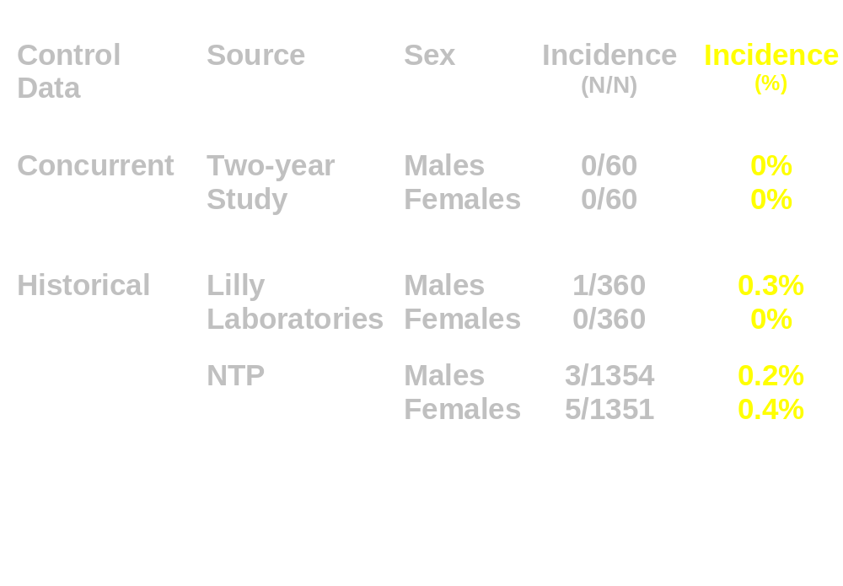
Control Incidence of Osteosarcoma in F344 Rats

Slide 13
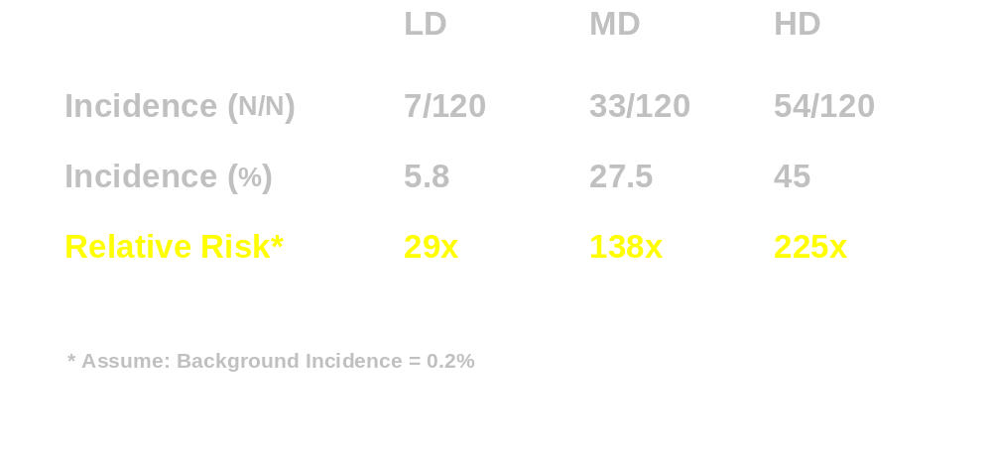
Relative Risk of Osteosarcoma in Teriparatide-Treated Rats

Slide 14
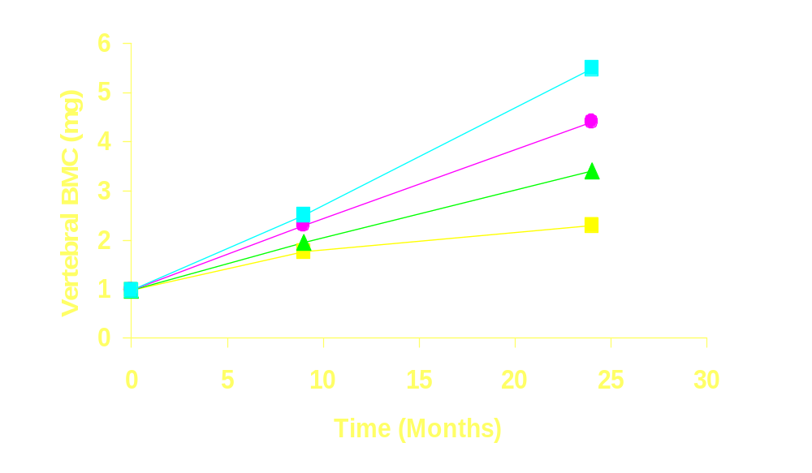
Effect of Teriparatide on Bone Mass (Female Rat)
HD
MD
LD
control

Slide 15
Conclusions
Results of 2-year rat study
Teriparatide causes osteoblast neoplasms
Tumor induction is dependent on dose and treatment duration
No-effect-dose was not established
Teriparatide increases bone mass

Slide 16
Risk Assessment
Hormonal Carcinogenesis
Hormones are non-genotoxic tumor promotors
Mechanism of action is stimulation of cell proliferation

Slide 17
Teriparatide-Induced Rat Bone Tumors
Plausible mechanism:
  Stimulation of osteoblast proliferation
  Increased chance of neoplastic transformation

Slide 18
Clinical Relevance of Rat Bone Tumor Finding
Mechanism of action operative in humans?
Clinical relevance of rodent bone tumors unclear

Slide 19
Further Considerations on Clinical Relevance of Tumor Finding
Validity of rat model
Monkey pharmacology study
Hyperparathyroidism

Slide 20
Validity of Rat Model
Different from humans
  Age of animals at start of treatment
  Prolonged treatment duration
  Extent of skeletal response

Slide 21
Validity of Rat Model
Similar to humans
  Increased bone formation and bone mass
  Osteoblast response to intermittent PTH receptor occupation

Slide 22
Follow-up Animal Studies
Rat Study
  Variables
    animal age at start of treatment (2-6 mo)
    duration of treatment (6-24 mo)
Monkey Study
    18-month treatment
    3 year follow-up

Slide 23
Conclusions
The clinical relevance of the rat bone neoplasms induced by teriparatide is unclear
There is a potential increase in the risk for bone neoplasms in humans treated with teriparatide

