Slide 1


Vol 115, No. 3, pp 463-471, March 2007
Michael.Kosnett@uchsc.edu

Slide 2
OSHA Lead Standards: Medical removal not mandatory until blood lead concentrations ≥ 50 µg/dL
Health effects of lead at low dose warrant a reappraisal of the levels of lead exposure that may be safely tolerated in the workplace.
  Chronic effects of cumulative dose
  Acute effects of recent dose
        hypertension
        decrements in renal function
        cognitive dysfunction
        adverse reproductive outcome

Slide 3
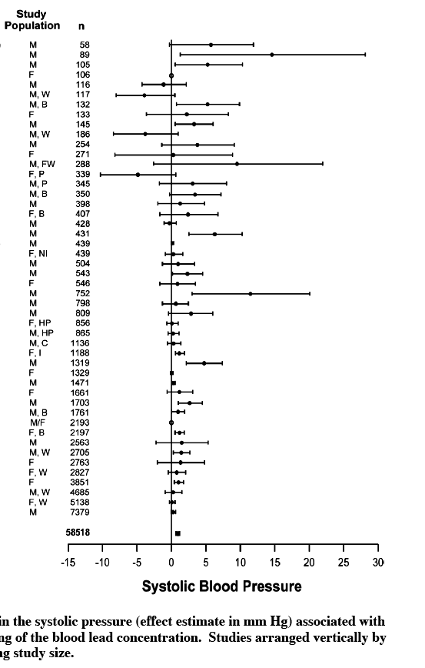
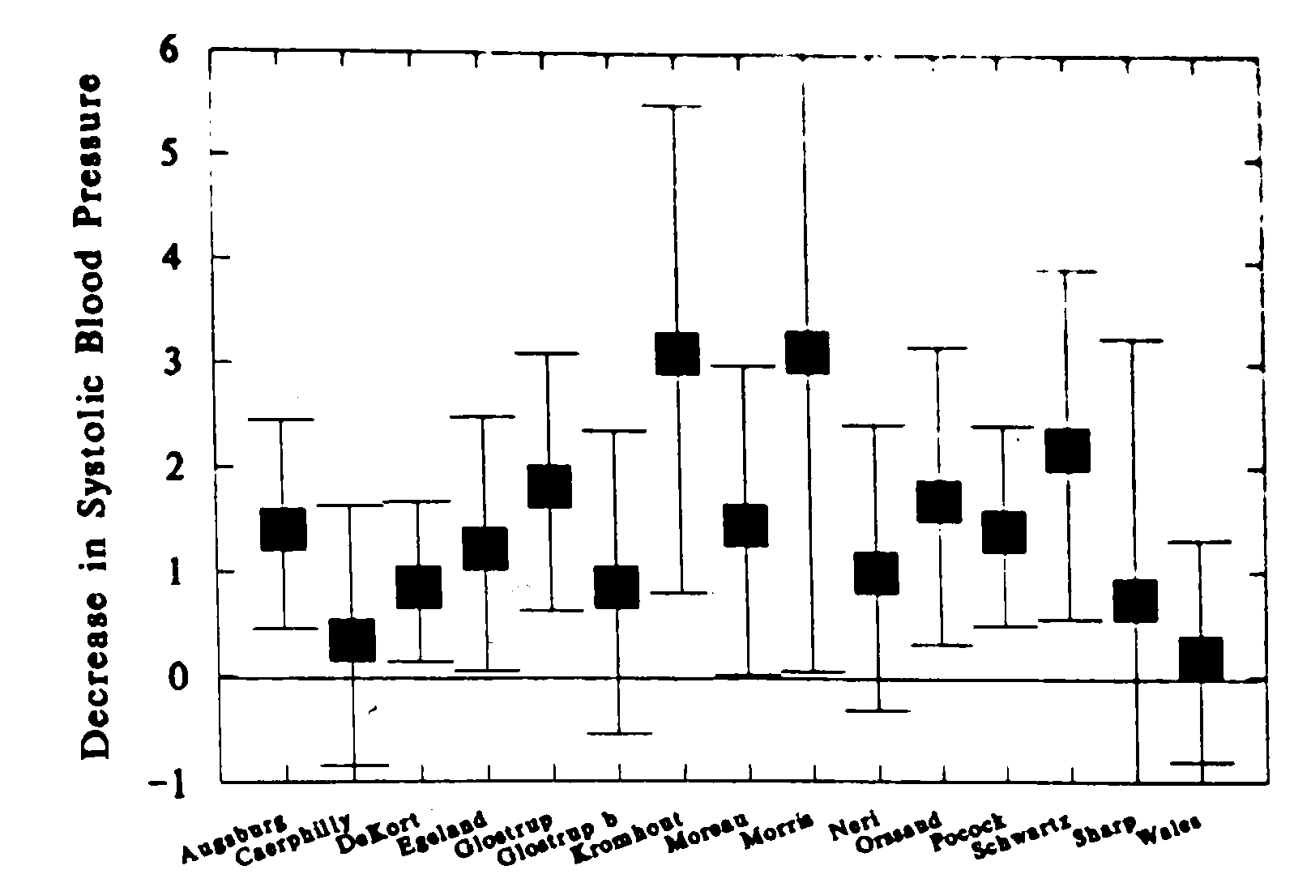
Schwartz, 1995
Meta-analyses:
ΔPbB 5 → 10 µg/dL
= Δ 1.0 or 1.25 mmHg in systolic blood pressure
Nawrot et al, 2002

Slide 4
The Relationship of Bone and Blood Lead to Hypertension. The Normative Aging Study
Hu H et al, JAMA 1996; 275:1171-1176
Case control study: 146 hypertensive men; 444 controls selected from large, ongoing prospective study of aging. Mean age = 66.6 ±7.2 y
Exposure reflects that of general population. Mean PbB = 6.3 ug/dL
Final logistic model (backward elimination) yielded 3 significant risk factors for hypertension:
Body mass index
Family history of hypertension
Tibia bone lead concentration
From the lowest quintile of bone lead to the highest quintile,
the odds of being hypertensive increased by 50 %
O.R. = 1.5 (95% C.I. 1.1 - 1.8)

Slide 5
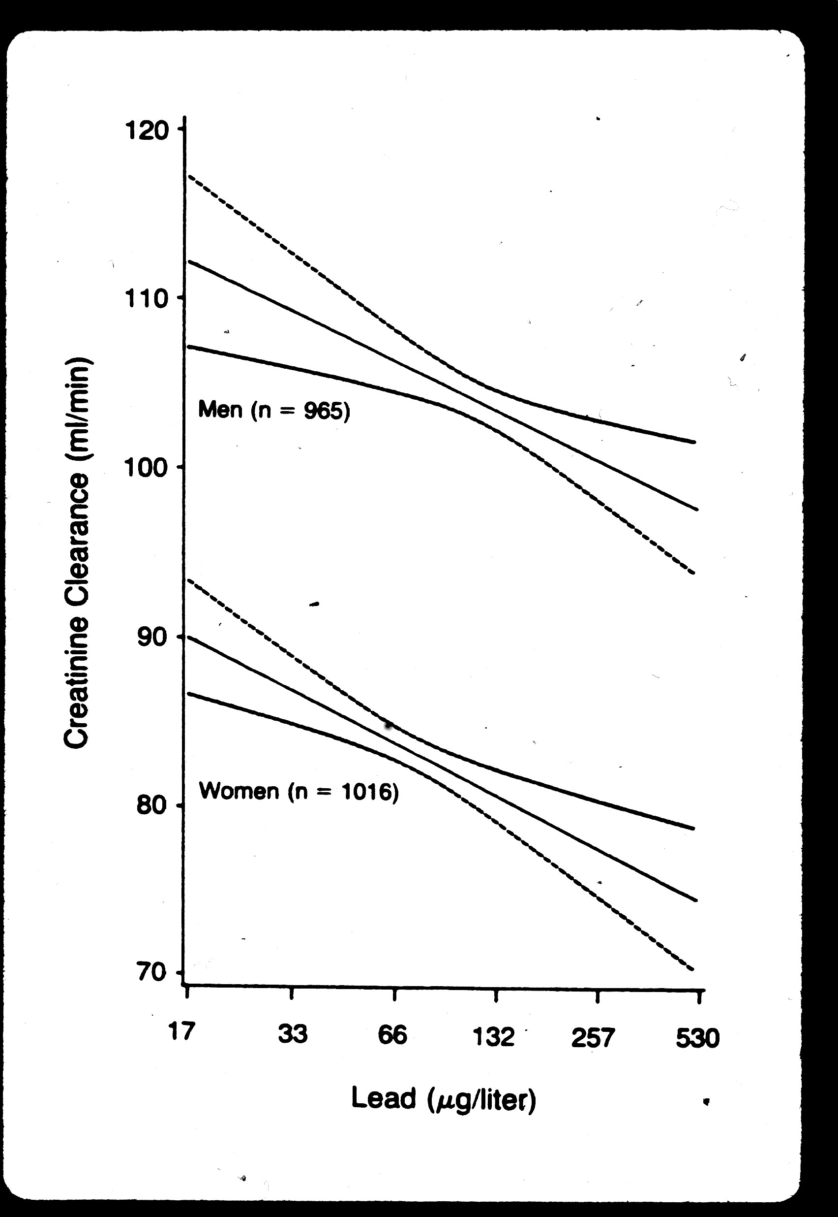
Impairment of renal function with increasing blood lead concentration in the general population
Staessen JA et al. NEJM 327:151-6; 1992
• Random population sample of 965 men and 1016 women (age 20 to 88)
• Blood lead range 1.7 - 72.5 ug/dL; geometric mean (GM) ≈ 10 ug/dL
• Significant correlation between age-adjusted creatinine clearance and blood lead
• Relationship persisted after excluding subjects with occupational Pb exposure, or those with highest tercile of PbB ( GM = 18.4 ug/dL)

Slide 6
Bone lead concentration predicts decrements in cognitive function in older adults
1. Baltimore Memory Study (Shih et al, 2006)
N = 991 randomly selected, sociodemographically diverse community dwelling adults, aged 50 to 70 yrs
Mean PbB = 3.5 ± 2.2 µg/dL Tibia lead: ↓visuoconstruction on neuropsych testing Δ 13 ppm equivalent impact of 4.8 years of age
2. Normative Aging Study (Weisskopf et al, 2007)
N = 1089 older, mainly white men, mean age 68.7 ± 7.4 yrs. Repeat neuropsych testing over ≈ 3.5 yr interval
Median PbB = 5 µg/dL (IQR 3 - 6) Tibia lead: longitudinal ↓visuospatial performance (N = 761)

Slide 7
Blood Lead Levels Measured Prospectively and Risk of
Spontaneous Abortion [Borja-Aburto et al, 1999]
• 562 of 668 women followed through week 20; (16% loss to follow-up)
• Average blood lead at enrollment: 11 ug/dL
• Cases (n=35) PbB = 12 ug/dL Controls (n=60) PbB = 10ug/dL
PbB level (ug/dL) Odds Ratio
< 5 1.0 [referent]
5-9 2.3
10-14 5.4
≥ 15 12.2
test for trend p = 0.021; for Δ PbB of 5 µg/dL, O.R. = 1.8 (C.I. 1.1, 3.1)

Slide 8
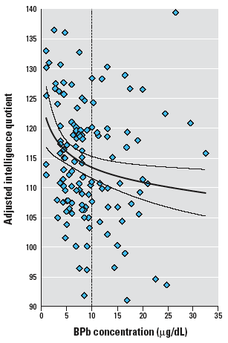
Mexico City Prospective Lead Study (Schnaas et al 2006)
3rd Trimester PbB = 7.8 µg/dL
Every doubling of PbB associated with IQ ↓2.7 pts at 6 - 10 yrs of age
N = 150

Slide 9
BLL (µg/dL) | Management
< 5 | None indicated
5 - 9 | Discuss health risks Reduce Pb exposure for women who are or may become pregnant
10 - 19 | Decrease lead exposure. Increase biological monitoring. Consider removal from exposure to avoid long term risks if exposure control over an extended period does not decrease BLL < 10, or if medical condition present that increases risk with continued exposure
20 -29 | Remove from exposure if repeat BLL measured in 4 weeks remains ≥ 20

Slide 10
BLL (µg/dL) | Management
30 - 39 | Remove from lead exposure
40 - 79 | Remove from lead exposure Refer for prompt medical evaluation Consider chelation for BLL >50 with significant symptoms or signs
≥ 80 | Remove from lead exposure Refer for immediate/urgent medical evaluation Probable chelation therapy

Slide 11
Category | Recommended medical surveillance
All lead-exposed workers | Baseline/preplacement H&P, baseline BLL, serum creatinine
BLL < 10 | BLL q month for first 3 mo. or if ∆ to higher exp., then BLL q 6 mo. If BLL ↑ ≥ 5, evaluate exposure and protective measures. Increase monitoring if indicated
BLL 10 - 19 | As above for BLL < 10, plus: BLL q 3 months Evaluate exposure, controls, work practices Consider removal Revert to BLL q 6 mo after 3 BLLs < 10
BLL ≥ 20 | Remove from exposure if repeat BLL measured in 4 weeks remains ≥ 20, or if first BLL ≥ 30 Monthly BLL Consider return to lead work after 2 BLLs <15 a month apart, then monitor as above

Slide 12
Surveillance recommendations apply to all potential lead exposed workers, even in absence of documented elevations in air lead levels.
Routine measurement of zinc protoporphyrin not indicated
With potential exception of annual BP measurement and risk factor questionnaire, medical evaluations unnecessary for workers maintaining BLL < 20 µg/dL.
Annual worker education about lead hazards is recommended.

Slide 13
Chelation for lead intoxication in adults
BLLs ≥ 100 µg/dL almost always warrant chelation.
BLL 80 - 99 µg/dL, with or without symptoms, can be considered for chelation, as may some symptomatic individuals with blood lead concentrations of 50 - 79
Chelation not recommended for asymptomatic individuals with low blood lead concentrations

Slide 14
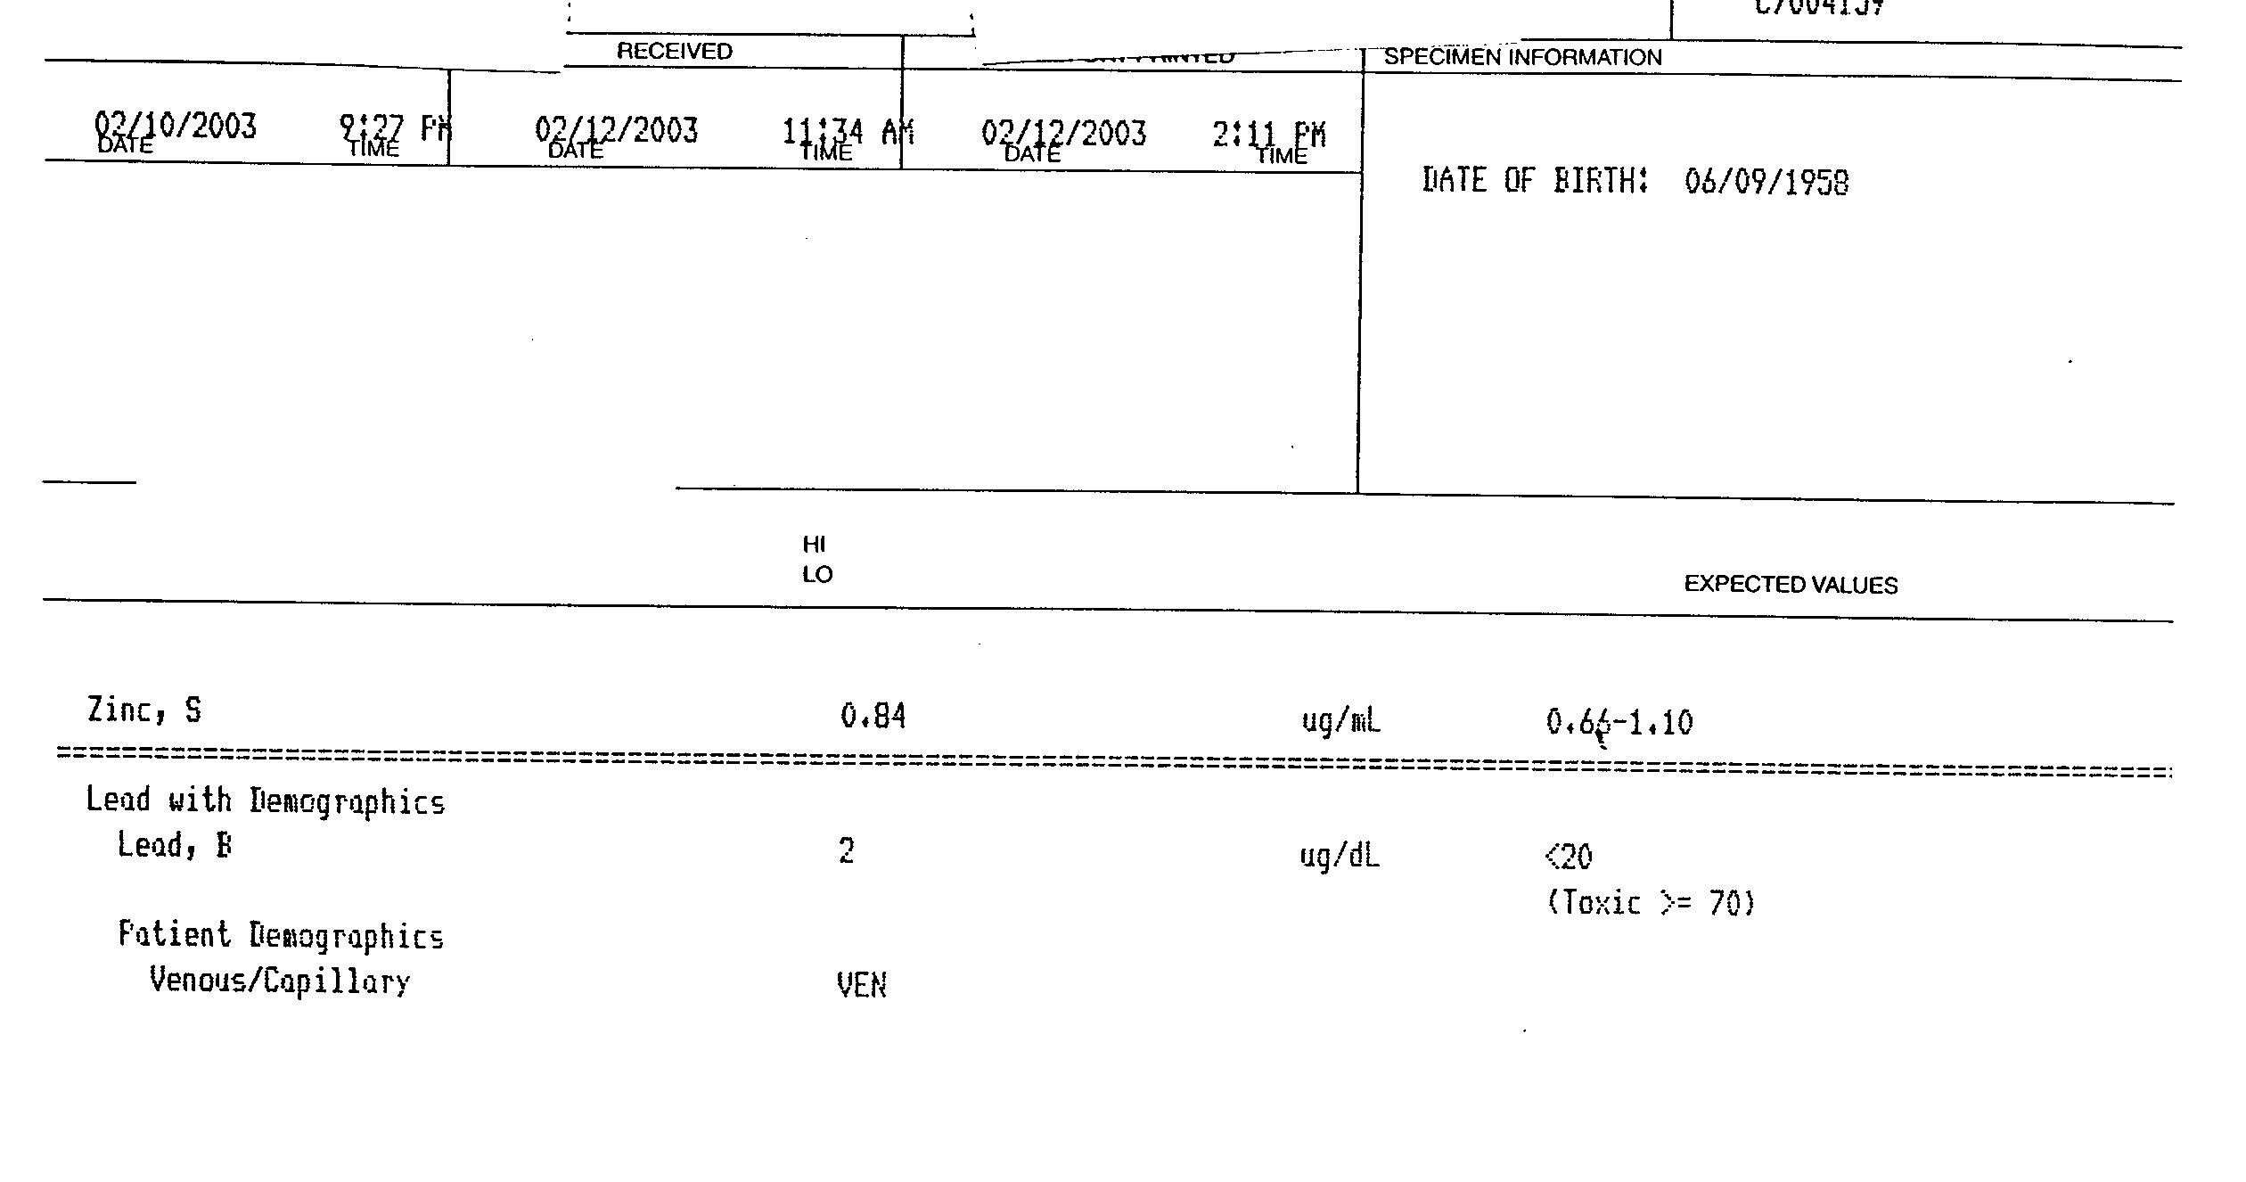

Slide 15
