Slide 1
Unmet Need
Ian Lewis, MB ChB, FRCP, FRCPCH
Pediatric Oncologist, Leeds, UK
Chief Investigator: European Osteosarcoma Intergroup Randomized Trial 80931
NCI External Program Reviewer
2012.02

Slide 2
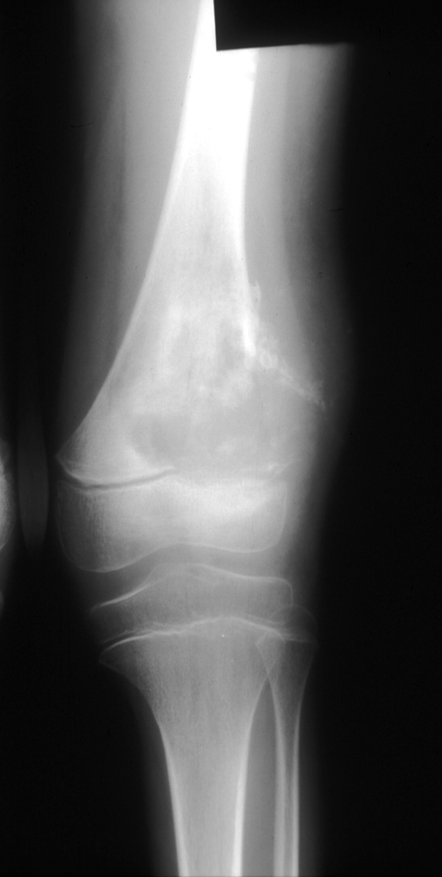
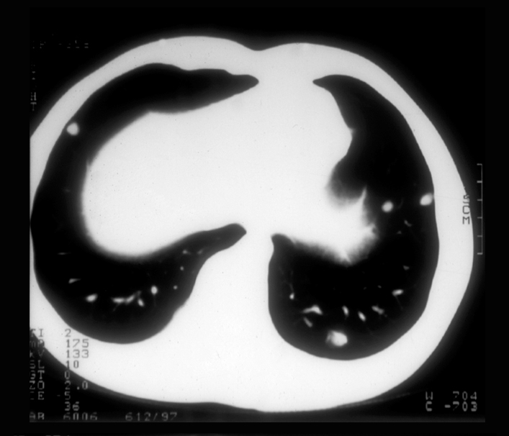
Osteosarcoma
Sites of disease
  Metaphyses of long bones particularly
  distal femur, proximal tibia and proximal
  humerus
Clinically evident metastases at
diagnosis
  Lung alone 20%
  Bones/combined 5%
2405.03

Slide 3
Single Agent Activity in Osteosarcoma
Drug | Responses/ Patients | Response % | Author Year
Doxorubicin | 28/109 | 26 | Cortes 1972
Cisplatin | 8/24 | 33 | Nitschke 1978 Ochs 1978
HD MTX (wkly) | 9/11 | 82 | Jaffe 1977
HD MTX (3wkly) | 11/26 | 42 | Jaffe 1973 Pratt 1980
Ifosfamide | 6/18 | 33 | Marti 1985
2407.03

Slide 4

UK Osteosarcoma Survival 1960-2000
Historical:
Surgery alone
Introduction of chemotherapy
Attempted refinement of chemotherapy
2406.02

Slide 5
EOI 80931 Randomized Trial Doxorubicin/ Cisplatin: Standard vs Intensified
1.0
Events
Total
5 year
Standard
98
250
55%
Intensified
91
254
58%
0.8
0.6
Survival
0.4
0.2
Log rank p-value = 0.52
Hazard Ratio = 1.10 (95% CI 0.83–1.46)
0.0
0
1
2
3
4
5
6
7
Years
2019.02
Lewis et al, J Natl Cancer Inst. 2007. 99:112-28

Slide 6
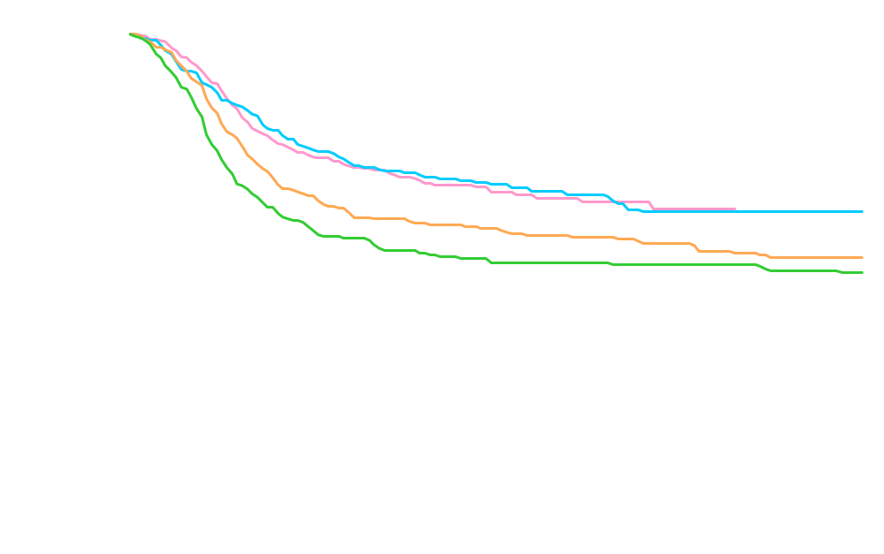
Osteosarcoma Survival by Time Epoch
(SEER Ages 0 – 29)
1993-2002
1987-1992
1981-1986
1975-1980
2094.04

