Slide 1
Screening for
Prostate Cancer:
Sharing the Decision
Notes:
Hello and welcome,
This presentation deals with a common situation for clinicians: helping patients make the best clinical choices. The choice in this instance is whether to be screened for prostate cancer. By screening we mean testing for signs of the disease in men who have no symptoms. This presentation does not address the use of diagnostic tests in symptomatic men. The talk focuses on the prostate specific antigen (PSA) test—the most advanced screening test for prostate cancer. The general principles also apply to the use of the digital rectal exam (DRE) as a screening test.

Slide 2
These Organizations Recommend a Form of Shared Decision Making for Prostate Cancer Screening
American Academy of Family Physicians
American Cancer Society
American College of Physicians/American Society of Internal Medicine
American College of Preventive Medicine
American Medical Association
American Urological Association
U.S. Preventive Services Task Force
Notes:
These organizations have somewhat different statements about screening with PSA, but all agree that, before screening a patient, the clinician should give that patient information about the risk of prostate cancer and the potential benefits and harms of prostate cancer screening and treatment. These organizations also recommend that the clinician involve the patient in making the decision.
Note: Links to these associations and their screening recommendations can be found in the Toolkit on the CDC Web site, www.cdc.gov/cancer/prostate.
SOURCES: American Academy of Family Physicians, 2001; CA Cancer J Clin, 2001; Ann Intern Med, 1997; Am J Prev Med, 1998; American Medical Association Council on Scientific Affairs, 2000; Oncology (Huntingt), 2000; Ann Intern Med, 2002; USPTF, 2002; Harris and Lohr, 2002.

Slide 3
Today’s Goals
To discuss what is known about the risk of prostate cancer and its natural history.
To discuss what is known about the potential benefits and potential harms of screening for and treating prostate cancer.
To discuss how primary care clinicians can use shared decision making with their patients in deciding whether to screen for prostate cancer.
Notes:
The goals of today’s presentation are to:
Discuss what is known about the risk of prostate cancer, its natural history, and risk factors for the disease.
Discuss what is known about the potential benefits and harms of screening for prostate cancer.
Suggest how primary care clinicians can use shared decision making with their patients in deciding whether to screen for prostate cancer. This approach helps men become informed about this issue and invites them to participate in the screening decision.
Sources: Briss P et al 2004; Sheridan SL et al 2004.

Slide 4

Goal 1:
To discuss what is known about the risk of prostate cancer and its natural history.
Notes:
Before turning to the evidence about the potential benefits and possible harms of screening, let’s begin with an overview of the risk and natural history of the disease.

Slide 5
Risk of Prostate Cancer in 40 year old U.S. men, to End of Life
(per 1,000 men)
Risk of Diagnosis | Risk of Death
164 | 34
Notes:
First, some facts about prostate cancer:
This slide shows the risks for 40 year old U.S. men in the general population through the end of life. Of 1,000 40-year-old men, about 164 will be diagnosed with prostate cancer during their remaining lifetimes. Similarly, of those 1,000 men, 34 will die of the disease.
Keep in mind that risk estimates are for the general U.S. population and represent an average person’s risk of developing the disease and of dying from it. Any individual man’s risk, however, depends on many factors, including his age, race or ethnicity, and family history of prostate cancer.
These statistics make two important points:
1) First, the risk of death from prostate cancer is much lower than the risk of being diagnosed with it. This is because most men diagnosed with prostate cancer die from other causes.
2) Equally important is the fact that, on average, about 34 of 1,000 men in the general population do die from prostate cancer. So prostate cancer is an important and potentially life-threatening disease.
SOURCES: NCHS U.S. mortality data 1995-1999; NCI SEER 11 1995-1999; DevCan software (Feuer and Wun, 1999).

Slide 6
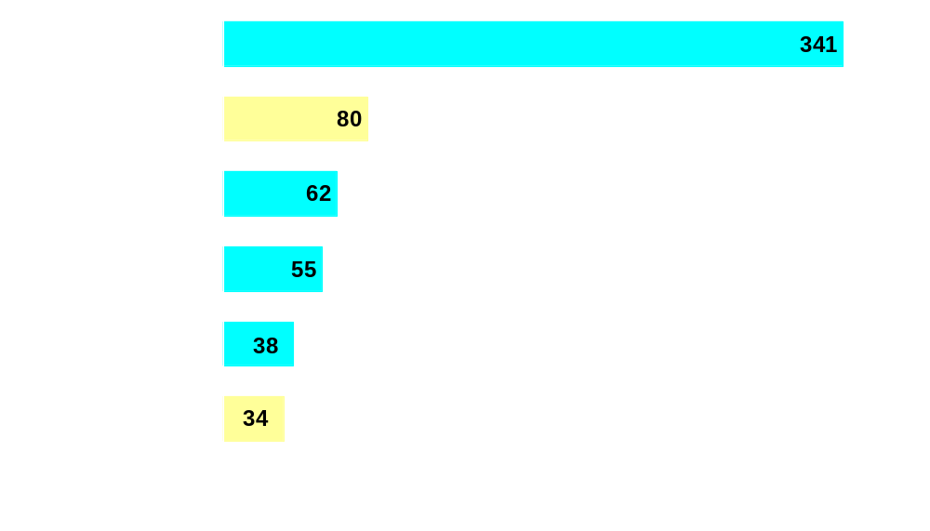
Risk of Death for 40 year old U.S. Men, to End of Life, by Leading Causes
Number of Men per 1,000
Notes:
This slide is similar to the previous one, except that it presents in graphical form the risks of death for 40-year-old men in the general population through the end of life. It also compares prostate cancer with other leading causes of death. As you can see, of 1,000 40-year-old men, about 341 will die from heart disease and 34 will die from prostate cancer during their remaining lifetimes.
Prostate cancer is one of the leading causes of death. As ranked by risk of death for men aged 40 through the end of life, prostate cancer is sixth among all causes and second among cancer causes of death. So prostate cancer is an important men’s health issue.
Prostate cancer should be considered in the context of other men’s health issues, including those for which risk is greater and for which solid evidence-based, clinical preventive services are available.
Note: Heart disease includes coronary heart disease, hypertensive heart disease, heart failure, and other diseases of the heart, but not other vascular diseases.
SOURCES: NCHS U.S. mortality data 1995-1999; NCI SEER 11 1995-1999; DevCan software (Feuer and Wun, 1999). For evidence reviews and recommendations on effective preventive clinical services for leading causes of death, see: http://www.ahrq.gov/clinic/cps3dix.htm

Slide 7
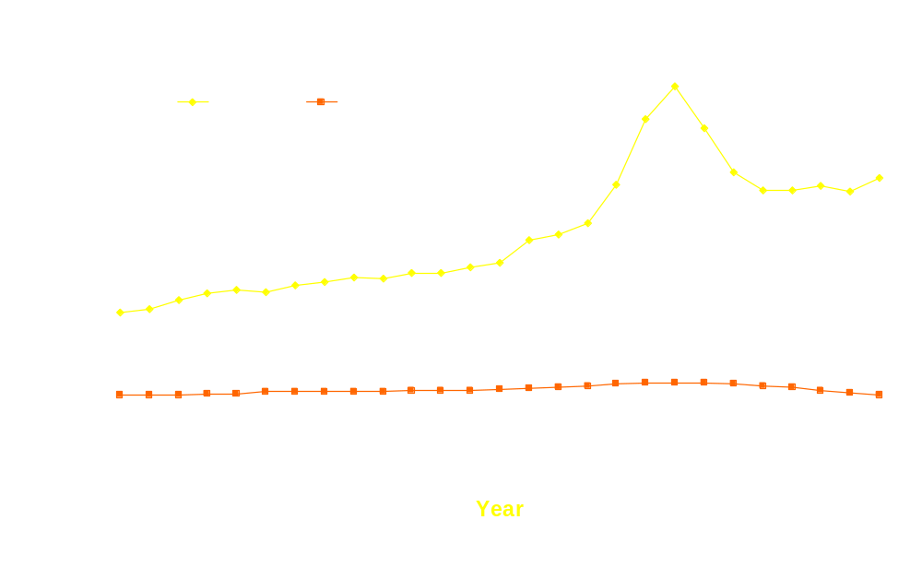
Prostate Cancer Trends in Incidence and Mortality, 1973–1999
Rate per 100,000
Notes:
The risk of dying from or being diagnosed with prostate cancer has changed over time.
Let’s look first at incidence—the rate of new cases—as shown by the top line. Note the general upward trend for detecting new prostate cancers—a substantial increase in the late 1980s, a peak around 1992, and a decline to a lower level.
The principal explanation for the dramatic increase in incidence in the late 1980s is that screening with PSA began to be adopted into usual practice. The steep rise was related to rapid and widespread dissemination of PSA test use for screening among men who had never been previously tested. A large pool of undetected prostate cancers was prevalent among those men. The peak was followed by a steep decline as the prevalent cancers in those men were detected.
Despite the decline from their peak, incidence rates in the mid and late 1990s remained higher than before the introduction of PSA testing. Continuing high rates could be due, in part, to the fact that some men had never had a PSA test and first-time PSA use among them was still finding prevalent cancers. Alternatively, the high rates may reflect, in part, the identification by PSA of cancers that otherwise would never have been detected. The latter issue, overdiagnosis of prostate cancer, is addressed later in the presentation.
As shown in the bottom line, mortality has changed but not as dramatically as incidence. We examine mortality rates in more detail later.
SOURCES: Ries et al., 2002; Etzioni et al., 2002; Potosky et al., 1995.

Slide 8
Risk of Death From Prostate Cancer by Age and by Race/Ethnicity
 | Risk during the next 15 years (per 1,000 men)
Race/Ethnicity |  | At age 50 | At age 65
All |  | 2 | 16
African American |  | 5 | 34
American Indian & Alaska Native |  | 2 | 9
Asian & Pacific Islanders |  | 1 | 7
Hispanic |  | 1 | 12
White |  | 2 | 14
Notes:
This table illustrates the risk of dying of prostate cancer during the following 15 years, for men at age 50 and for men at age 65 for several racial and ethnic groups. The numbers indicate the number of men out of 1,000 who will die of prostate cancer during that time period. For example, in the first (orange) row, among 1,000 men of all racial and ethnic groups at age 50, two die of prostate cancer before reaching age 65.
Note that the risk of dying from prostate cancer increases with age. For all 65 year old U.S. men, 16 out of 1,000 die of prostate cancer during the next 15 years.
The table also shows that mortality risk varies with race/ethnicity. For example, for men at age 50, five African American men per 1,000 die of prostate cancer in the next 15 years, in contrast to one man of Asian/Pacific Islander descent.
Among racial groups, African American men have the highest risk of dying from prostate cancer and their increased risk begins at earlier ages.
SOURCES: NCHS U.S. mortality data 1995-1999; NCI SEER 11 1995-1999; DevCan software (Feuer and Wun, 1999); Ries et al., 2002.

Slide 9
Risk of Prostate Cancer Diagnosis by Age and by Race/Ethnicity
 | Risk during the next 15 years (per 1000 men )
Race/Ethnicity |  | At age 50 | At age 65
All |  | 50 | 117
African American |  | 76 | 163
American Indian & Alaska Native |  | 14 | 35
Asian & Pacific Islanders |  | 18 | 84
Hispanic |  | 29 | 94
White |  | 44 | 113
Notes:
This table is similar to the slide we just examined but it illustrates the risk of being diagnosed with prostate cancer during the following 15 years for men at age 50 and at age 65.
Again, risk increases with age. For all 50 year old U.S. men, 50 out of 1,000 will be diagnosed with prostate cancer during the following 15 years. The number increases with age, so that among 65 year old men, 117 of 1,000 are diagnosed with prostate cancer during the following 15 years.
Risk of diagnosis also varies with race/ethnicity. For example, among 50 year old men, 76 of 1,000 African American men are diagnosed with prostate cancer during the next 15 years, in contrast to 14 of 1,000 American Indian/Alaska Native men.
SOURCES: NCHS U.S. mortality data 1995-1999; SEER 11 1995-1999; DevCan software (Feuer and Wun, 1999); Ries et al., 2002.

Slide 10
Natural History of Prostate Cancer
Prostate cancer is biologically heterogeneous.
Some prostate cancers grow slowly and never cause symptoms.
Other prostate cancers are fast growing and metastasize quickly.
Other types grow at a modest pace.
Notes:
Let’s look at the natural history of prostate cancer to explore why it is a common problem that is sometimes life threatening.
Prostate cancer is biologically heterogeneous. Its severity ranges from nonfatal, asymptomatic, slowly growing tumors that probably require no treatment, to aggressive, fast-growing tumors that metastasize quickly, often before symptoms are noticed. Other types grow at a modest rate.
One way to look at it is to think of prostate cancer as several different diseases—one type grows fast and soon threatens life, another grows slowly and never becomes a real problem. Other types lie somewhere between these extremes.
SOURCES: OTA, 1995; Harris and Lohr, 2002; USPSTF, 2002; Stanford et al., 1999; Humphrey et al., 1996.

Slide 11
Prostate Cancers Vary in Their Natural Histories
Death from Other Causes Death from Other Causes
Death From Prostate Cancer
Patient 1
Symptomatic Phase
Patient 3
Patient 2
Detectable Presymptomatic Phase
Progression of Disease
Death From Other Causes
Patient 4
Disease Not Detectable
Remaining Expected Lifetime
Notes:
This slide illustrates the concept of heterogeneity in the natural history of prostate cancer.
Consider the progression of disease in four men with prostate cancer.
On the left, vertical axis is the progression of prostate cancer, from an undetectable phase through a detectable presymptomatic phase and into a symptomatic phase. On the bottom, horizontal axis is the remaining life expectancy for a man who has no prostate cancer. At the right margin is death from causes other than prostate cancer, and at the top is death from prostate cancer.
First, patient 1 develops prostate cancer at a time when he has a relatively long life expectancy. The prostate cancer grows quickly and soon becomes symptomatic. He may die from this prostate cancer.
Next, patient 2 develops prostate cancer at about the same time as patient 1. However, patient 2’s tumor grows slowly. This man may never experience symptoms and dies of another disease.
Patient 3 develops prostate cancer at the same time as patients 1 and 2 and has a cancer that grows at a modest pace. He develops symptoms and may die of prostate cancer or another condition.
So, A man’s risk of dying from prostate cancer depends in part on the aggressiveness of his cancer.
Now look at patient 4. His cancer occurs at a late stage in his expected lifetime. Even though he has a more aggressive tumor like patient 1, he may die of other causes.
In summary, whether a man who is diagnosed with prostate cancer dies from it or from another cause depends on two things:
How long he is expected to live (which may depend on age or health)
What type of prostate cancer he has.
Men who die from prostate cancer usually have no other life-threatening conditions and have aggressive types of prostate cancer. This is one reason that many men diagnosed with prostate cancer die from another cause—they have another serious condition or a slow-growing type of prostate cancer.
SOURCES: Albertsen et al., 1998; Johansson et al., 1997; Chodak et al., 1994; Lu-Yao and Yao, 1997; Etzioni et al., 2002; Lu-Yao, 2002; Humphrey et al., 1996; Epstein, 2000.
Note: Slide 29 has more information on tumor aggressiveness and tumor grade.

Slide 12
Preventing Prostate Cancer
Known risk factors for developing prostate cancer:
  Age.
  Race/ethnicity.
  Family history of prostate cancer.
No agreement on modifiable risk factors.
Notes:
Other than age and race/ethnicity, the only known risk factor for developing prostate cancer is family history. Risk of developing prostate cancer in men who have a father, brother, or son with prostate cancer (a first-degree relative) is two to three times the risk in other men.
There is no agreement among researchers on modifiable risk factors for prostate cancer, so we do not know how men can prevent development of the disease.
Research is being conducted on a variety of factors that may positively or negatively affect risk, including dietary habits, use of nutritional supplements, physical activity, some infectious agents, and use of the finasteride. At this time there is no agreement that any of these affect the risk of developing prostate cancer.
SOURCES: Vaino and Bianchini, eds., 2002; Hsing et al., 2001.

Slide 13
Summary
Prostate cancer is a leading cause of death.
Risk increases with age and is higher in some racial/ethnic groups and in men with positive family histories.
Prostate cancer is heterogeneous; some cancers are fatal, others are not.
There are no known strategies for preventing the development of prostate cancer.
Notes:
To summarize key points about the risk and natural history of prostate cancer:
Prostate cancer is a leading cause of death.
Risk increases with age and is higher in some racial/ethnic groups and in men with positive family histories.
Prostate cancer is heterogeneous; some cancers are fatal, others are not.
There are no agreed-on strategies to prevent prostate cancer because there is no agreement about whether there are modifiable risk factors.

Slide 14

Goal 2:
To discuss the benefits and
harms of prostate cancer screening and treatment.
Notes:
Returning to the major goals of this presentation: What can we say about the potential benefits and harms of screening for prostate cancer and treating prostate cancers detected by screening?

Slide 15
Key Issues of Screening and Early Treatment
Does screening extend men’s lives (are there benefits)?
Does screening lead to health problems (are there harms)?
Do the benefits outweigh the harms?
Notes:
For the next several slides, we’ll look at evidence regarding three key questions that address whether there is value in screening:
Does screening extend men’s lives (are there benefits)?
Does screening lead to health problems (are there harms)?
Do the benefits outweigh the harms?
The best evidence for examining the benefits and harms of screening comes from controlled clinical trials that randomize men to screening or no screening, then follow them over several years to look for differences in mortality and quality of life.
Two randomized controlled trials are now under way, but it will be several years before they are complete. In the meantime, we’ll look at other evidence that can help us decide about the benefits and harms of screening.

Slide 16
What Are the Potential Benefits of Screening?
Three issues to consider:
Does PSA testing lead to earlier detection?
Does earlier treatment help men live longer?
What happens to mortality rates as screening rates increase?
Notes:
In considering the evidence about whether screening extends lives, there are three main issues to consider:
Does PSA testing lead to earlier detection?
Does earlier treatment help men live longer?
What happens to mortality rates as screening rates increase?
We’ll look at each issue in turn.

Slide 17
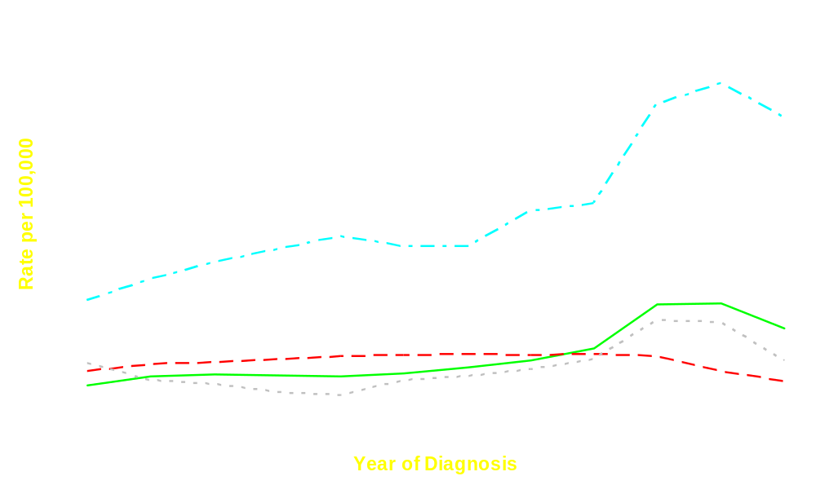
Prostate Cancer Incidence Rates by Stage, 1973–1995
Localized
Regional
Distant
Unstaged
Notes:
Let’s look at the first question: Can we find the cancers earlier?
Current research suggests that PSA detects prostate cancers 3 to 12 years before they would have been detected clinically.
This graph illustrates the ability of PSA to find prostate cancer and, in particular, localized prostate cancer. Presented here are incidence rates of prostate cancers categorized by stage at diagnosis. The most notable trend has been a substantial increase in incidence rate of cancers localized to the prostate, as shown by the top (yellow) line, particularly since 1987, the PSA era.
In contrast, the incidence of distant-stage prostate cancer (red line) decreased during the 1990s.
PSA screening finds early-stage prostate cancers.
SOURCES: Stanford et al., 1999 (Figure 3-11); Draisma et al., 2003; Newcomer et al., 1997; Etzioni et al., 2002; Murphy et al., 1982; Catalona et al., 1994; Richie et al., 1993; Horninger et al., 1998; Hoedemaeker et al., 1997; Labrie et al., 1992; Labrie et al., 1996; Martin et al., 1999; Labrie et al., 1993; Gann et al., 1995; Harris and Lohr, 2002.

Slide 18
Finding Prostate Cancer Earlier Is Not Enough
Symptoms Appear
Death from prostate cancer
Situation 1: Not Screened
Found Early
by Screening
Survival Time
Situation 2
Survival Time
Death
Situation 3
Survival Time
= Lead Time
= Life Extended
Notes:
Is early detection enough? This slide shows why it isn't.
Consider a man who develops asymptomatic and potentially fatal prostate cancer in three different screening and treatment situations.
In the first situation, the man is not screened, experiences symptoms, is treated, and dies from prostate cancer. His survival time is from diagnosis with symptoms until death.
In the second situation, the man is screened and his cancer is diagnosed and treated earlier, but the treatment does not extend his life and he dies from prostate cancer at the same point in time as in situation 1. Although his time from diagnosis to death is increased by screening, his life is not extended.
In the third situation, the man is also screened but receives a treatment that does extend his life (the green line) and he dies from prostate cancer or another cause.
So, even if PSA detects prostate cancer earlier, it will only extend men's lives if there is an effective treatment.
How do we decide if treatment is effective? The best way is a randomized controlled trial.
With treatment for early prostate cancer, most studies have been case-series studies of survival after one treatment, without a randomized comparison group. This would be the same as having a group of men like those in situation 2 or 3. You would know how long the men lived when treated one way, but you wouldn't know whether the treatment was better than another treatment or no treatment.
We discuss this further on the next slides.

Slide 19
Can We Treat Early-Stage
Prostate Cancer Effectively?
After treatment for early-stage prostate cancer, men have excellent survival.
Men with early-stage prostate cancer who choose watchful waiting also have excellent survival.
  A study of 800 men who chose watchful waiting found the 10-year disease-specific survival to be 87%.
Notes:
The next question is whether we can effectively treat early-stage prostate cancers.
On one hand, there is ample evidence from clinical research that men treated with surgery or radiation for early-stage prostate cancer have excellent long-term survival.
On the other hand, studies have shown that men diagnosed with early-stage prostate cancer who choose watchful waiting also do well. Watchful waiting means the cancer is not treated but is actively monitored by PSA and other methods. Decisions are made to treat or continue watchful waiting based on evidence of progression. One study of 800 men who chose watchful waiting found the 10-year disease-specific survival to be 87%.
Excellent survival has been reported from several case-series studies of men with early-stage prostate cancer who chose watchful waiting or different treatments. Unfortunately, in comparing outcomes from these series, it is not clear whether differences in outcomes reported from study to study were due to differences in treatments, in characteristics of the cancers, or in the men.
Only one large, well-conducted randomized controlled trial has been completed that compares treatment of clinically localized prostate cancer with any other treatment. Let's look at the results of that study.
SOURCES: Roach et al., 2000; Zincke et al., 1994a; Zincke et al., 1994b; Walsh et al.,
1994; Paulson, 1994; Krongrad et al., 1997; Hanks, 2000; Roach et al., 1999; Chodak et al.,
1994; Albertsen et al., 1998; Johansson et al., 1997; Harris and Lohr, 2002; Gerber et al.,
1996; Shipley et al., 1999.

Slide 20
Risk of Mortality From Prostate Cancer Among Men in a Randomized Trial
Risk of Mortality From Prostate Cancer Among Men in a Randomized Trial
Average age 65 years at entry; 8 years followup
PROSTATE REMOVED WATCHFUL WAITING
7.1% died of prostate cancer 14.9% died of other causes
13.6% died of prostate cancer
14.7% died of other causes
Notes:
This slide presents a graph of results from a study of mortality among 695 men with prostate cancer randomized to radical prostatectomy or watchful waiting. Their average age was 65 years. The cancers were diagnosed as early stage (T2 or less) and mostly moderate or low grade (Gleason score 10 or less). Five percent of the prostate cancers were detected by PSA screening and about 75% were palpable on digital rectal exam. These cancers were thus larger and more advanced than the usual cancers detected by PSA screening.
Yellow boxes represent men who were still alive after 8 years of followup, the majority in both groups. Gray boxes represent those who died of other causes, the next largest group, and red boxes represent men who died from prostate cancer.
Among men in the surgical group, 7.1% died of prostate cancer. In the watchful-waiting group, 13.6% died of prostate cancer—a statistically significant reduction in prostate mortality of about 6.6%. For all-cause mortality, the difference was not statistically significant; 22.0% in the surgical group vs. 28.3% in the watchful-waiting group.
This study provides good evidence that, among men with low or moderate grade, clinically detected localized prostate cancer, radical prostatectomy reduces risk of death from prostate cancer. We are still uncertain about whether such treatment would be as effective for the smaller cancers detected by PSA screening, some of which would never progress. In addition, if surgery were effective in extending lives in men with PSA-detected cancers, it would likely take longer for this benefit to appear because PSA detects cancers earlier, perhaps 3 to 12 years earlier.
Let’s examine what happens to mortality rates as screening rates increase.
SOURCE: Holmberg et al., 2002.
NOTE: Slide 17 has further detail and references for early detection by PSA.

Slide 21

What Happened to U.S. Prostate Cancer Mortality Rates as Screening Rates Increased?
Notes:
What can we learn from trends in prostate cancer mortality? What happened to U.S. prostate cancer mortality rates as screening rates increased?
This is the same graph of mortality from prostate cancer that we showed earlier, but on a different scale so we can better see changes over time. Prostate cancer mortality in the United States increased modestly during the late 1970s and early 1980s, prior to the introduction of PSA testing.
Next, mortality rates increased between 1987 and 1990—when PSA screening was being adopted into usual practice. This increase is commonly said to be mainly attributable to changes in how cause of death was assigned on death certificates.
During the early 1990s, however, mortality rates began to stabilize and decline. Similar patterns of decline in prostate cancer mortality have occurred in other places where PSA screening has been introduced, for example in Olmsted County, Minnesota, and the Austrian state of Tyrol. The fact that prostate cancer mortality rates have declined in these populations as PSA testing increased suggests a positive benefit on mortality from screening.
Determining the causes of changes in U.S. prostate cancer mortality rates over time is difficult, however, because it is unclear exactly what changes in mortality might be expected and because there have been changes in treatments that may affect mortality. Because many prostate cancers grow slowly, a mortality decline from finding and treating early-stage cancers would have been expected to occur a few years later.
It is important to remember that new treatments were also introduced around the same time. For example, the use of hormonal treatments increased substantially, radical prostatectomy became more widely used, and other treatments were improved.
SOURCES: Albertsen 2003; Ries et al., 2002; Hankey et al., 1999; Tarone et al., 2000; Feuer et al., 1999; Etzioni et al., 1999; Gann et al., 1995; Schmid et al., 1993; Brawley, 1997; Tovar-Guzman et al., 1999; Levi et al., 2000; Albertsen et al., 2000; Meyer et al., 1999; Oliver et al., 2000; Roberts et al., 1999; Bartsch et al., 2000; Bartsch et al., 2001; Potosky et al., 2001; Lu-Yao et al., 2002.

Slide 22

What Happens to Prostate Cancer
Mortality Rates in the U.K., where PSA Screening Is Rare?
Notes:
It would be easier to conclude that PSA screening caused the decrease in U.S. mortality if studies consistently found that mortality reductions occurred primarily in places where there was widespread PSA screening and not in places where there was little or no screening.
Research comparing trends in prostate cancer mortality rates among countries shows inconsistencies in the relationship between national mortality trends and the uptake of PSA screening.
This slide shows changes in prostate cancer mortality in the United Kingdom, where PSA screening is uncommon. Although U.K. mortality rates were substantially higher than U.S. mortality rates from the 1970s through the 1990s, mortality trends were similar to those in the U.S. in showing an increase during the 1980s and a decline in the 1990s.
Also, a recent study comparing screening practices and mortality in two U.S. regions found that PSA screening began earlier and was more common in the Seattle area than in Connecticut, and that aggressive treatment was more common in Seattle than in Connecticut. However, these differences in the practice of PSA screening were not related to differences in prostate cancer mortality over an 11-year follow-up period. Mortality was basically the same in both regions.
These studies are not definitive but they illustrate the complexity in determining relationships between PSA screening use and trends in prostate cancer mortality.
For all these reasons, it is difficult to say whether PSA screening has led to the reduction in U.S. prostate cancer mortality.
SOURCES: Oliver et al., 2001; Lu-Yao et al., 2002.

Slide 23
Do We Extend Men’s Lives by Screening for Prostate Cancer?
We don’t know yet.
It may or may not.
Notes:
Do we extend men’s lives by screening for prostate cancer?
Given the available clinical evidence, the only conclusion is that we honestly do not know, at this time, whether detecting early tumors through PSA testing reduces prostate cancer mortality and extends men’s lives.
Now let’s consider the side effects of PSA testing and early treatment.

Slide 24
Are There Harms From Screening and Early Treatment?
Three issues to consider:
False-positive screening tests.
Overdiagnosis (men who do not benefit from diagnosis).
Side effects of treatment.
Notes:
Having examined the potential benefits of screening in extending men’s lives, the next several slides will examine the potential harms or side effects of screening and early treatment.
Three of the most important potential harms or side effects are:
False-positive screening tests.
Overdiagnosis (men who do not benefit from diagnosis).
Side effects of treatment.
We will address each issue in turn.

Slide 25
Harms: False Positives
Of 100 unscreened men in each group
Age (in years) | # With PSA >4.0 | # With Cancer | # False Positives
50s | 5 | 1–2 | 3–4
60s | 15 | 3–5 | 10–12
70s | 27 | 9 | 18
Notes:
The first type of harm is a false-positive screening test. A false-positive test means the test was positive but no cancer was found at biopsy. This table presents screening results for 100 men in the respective age categories who have never undergone screening. For our purposes, a PSA value above 4.0 is considered positive for prostate cancer.
From the slide we see that if you screen 100 men in their 50s who have never been screened, about 5 of 100 will have PSAs >4.0. Of these five, one to two will be diagnosed with prostate cancer on biopsy. Thus, a majority of men in their 50s with PSAs >4.0 will have false-positive tests.
The number of men per 100 who test positive, who have cancer, and who have false-positive screening tests increases with age. So, 10 to 12 men per 100 in their 60s and about 18 men per 100 in their 70s will have false-positive tests.
While previously screened men will likely experience fewer false-positive tests, the problem is still substantial.
Several refinements to the PSA test, such as free PSA, are being investigated. We don’t know yet if these tests reduce the number of false positives.
It should also be noted that PSA will not detect the cancers of 10% to 30% of men who have prostate cancer at the time of initial screening. These are false-negative PSA tests.
False positives are also a potential harm of screening tests for other types of cancers and other diseases.
The point to make to patients is that if we screen with PSA we will find some positive tests, most of which will not be cancer.
SOURCES: Labrie et al., 1999; Schroder et al., 2000; Catalona et al., 1994; Richie et al., 1993; Labrie et al., 1992; Maattahen et al., 1999; Labrie et al., 1996; Horninger et al., 2000; Martin et al., 1999; Labrie et al., 1993.

Slide 26
Overdiagnosis
Detection by screening of cancers that would never have become clinically apparent.
Detection of cancers in patients whose lives are not extended by screening and treatment.
Overdiagnosis leads to unnecessary treatments and their side effects.
Notes:
Commonly, the word overdiagnosis is used in two situations.
First, it may mean the detection by screening of cancers that would never have become clinically apparent. In other words, men with these tumors would never have known that they had prostate cancer if they had not had a PSA test. They may suffer from anxiety after being told unnecessarily that they have cancer, from unneeded treatment, and, potentially, from the side effects of treatment.
Overdiagnosis can also mean the detection of cancers in patients whose lives are not extended by screening and treatment. Men with these cancers may have had clinically detected cancer but they would not have died of it. For these men, the personal costs of being treated and the associated side effects are not balanced against a benefit of greater life expectancy.
SOURCES: Etzioni et al., 2002; Yao and Lu-Yao, 2002; Draisma et al., 2003; Humphrey et al., 1996; Gilliland et al., 2001.

Slide 27
Overdiagnosis, Tumor Heterogeneity, and Life Expectancy
Death from Other Causes Death from Other Causes
Death From Prostate Cancer
Patient 1
= Detection
Symptomatic Phase
= PSA Screening
Patient 3
Patient 2
Detectable Presymptomatic Phase
Progression of Disease
Death From Other Causes
Patient 4
Disease Not Detectable
Remaining Expected Lifetime
Notes:
This slide is similar to one we showed earlier. Recall that patients 1, 2, and 3 have longer life expectancies than does patient 4.
Patients 1 and 4 have rapidly progressing tumors. Patient 2 has a slow-growing tumor, and patient 3’s tumor is growing at a modest rate.
Patient 1 may or may not benefit from screening. He has an aggressive cancer that may spread prior to detection, and treatment may be less effective even if the cancer is detected early.
Patient 2 is unlikely to benefit from screening because he has a slow-growing tumor and is likely to die of another cause. Also note that he has a type of tumor most likely to be detected by routine screening.
Patient 3 is most likely to benefit from screening if there are effective treatments; otherwise he may die of prostate cancer rather than of other causes.
Patient 4 is also unlikely to benefit from screening because he has a limited life expectancy. This is why many clinicians and researchers think it is inappropriate to screen men with limited life expectancies.
While it may be possible, prior to screening, to estimate a patient's probable life expectancy, it is impossible to tell in advance of screening and diagnosis if a patient is more likely to have a prostate cancer like those of patients 1 and 4, patient 2, or patient 3. And it is not clear what proportions of men with PSA-detected cancers have which types of cancer.
After PSA testing and biopsy, there are currently no agreed-on methods to determine for most patients—those with PSA-detected moderate-grade tumors and intermediate PSA levels—which are most likely to benefit from treatment.
SOURCES: Albertsen et al., 1998; Draisma et al., 2003; Johansson et al., 1997; Chodak et al., 1994; Lu-Yao and Yao, 1997; Etzioni et al., 2002; Yao and Lu-Yao, 2002; Humphrey et al., 1996; Epstein, 2000.
Note: Slide 29 has additional information on tumor grade.

Slide 28
Overdiagnosis
Overdiagnosis is difficult to quantify.
One recent report estimated that during 1988–1998 about 3 of every 10 men aged 60–84 diagnosed with prostate cancer by PSA testing would never have had clinical disease.
Other studies show even higher percentages of overdiagnosis.
Notes:
When evaluating an issue like overdiagnosis, it is important to ask how common the problem is. Let’s look at the evidence.
A recent statistical model using national U.S. data from 1988 through 1998 estimated that about 3 of every 10 men aged 60 to 84 with prostate cancer detected by PSA were overdiagnosed because of PSA testing; that is, they would never have developed clinically detected prostate cancer and would not have been diagnosed during their lifetimes if they had not had PSA tests.
Other studies, including a recent report from a clinical trial of PSA screening show higher proportions of overdiagnoses.
Studies that define overdiagnosis based on the biology of the prostate cancers report smaller estimates of overdiagnosis. That perspective is illustrated on the next slide.
SOURCES: Albertsen et al., 1998; Draisma et al., 2003; Etzioni et al., 2002; Yao and Lu-Yao, 2002; Johansson et al., 1997; Chodak et al., 1994; Lu-Yao and Yao, 1997; Humphrey et al., 1996.

Slide 29
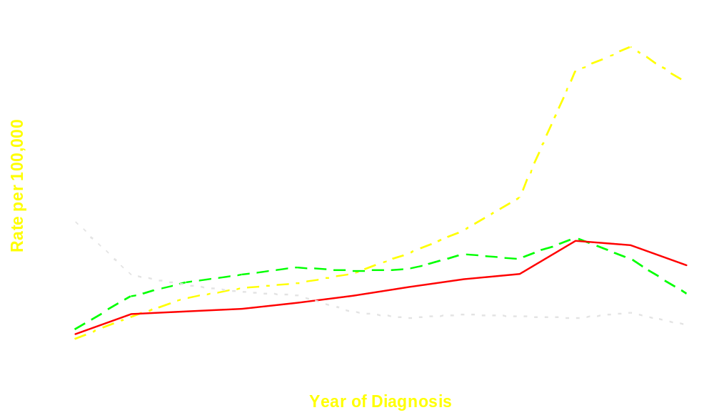
Tumor Rates by Grade
Moderate
Well
Poor
Unknown
Notes:
This graph is similar to the trends in prostate cancer incidence graph shown earlier, but it separates the trends according to whether the prostate cancer type is well differentiated (Gleason 2 to 4, green line), moderate (yellow), or poorly differentiated (Gleason 8 to 10, red). The incidence rate of moderate-grade cancer more than doubled between 1987 and 1992, then declined. Rates of well-differentiated cancers increased much more modestly, and gradually declined during the 1990s.
Many researchers say these trends indicate that PSA testing does not lead to much overdiagnosis because the PSA era has not seen a big increase in diagnosis of well-differentiated, less aggressive prostate cancers (i.e., those less likely to cause death). Instead, rates of moderate-grade cancers have increased. These researchers say moderate-grade cancers are clinically significant and that patients with these cancers are likely to benefit from treatment.
Other researchers point out that it is unclear what proportions of untreated men with PSA-detected moderate-grade cancers would have developed symptoms or died from prostate cancer. During the same time period, sources of specimens pathologists use to grade prostate cancer have changed and Gleason scoring methods have evolved, making comparisons across the time period difficult. Therefore, it is unclear what these trends in prostate cancer by grade really indicate about prostate cancer overdiagnosis.
Next, let’s turn to the side effects of treatment.
SOURCES: Stanford et al.,1999 (figure 3.6); Draisma et al., 2003; Epstein, 2000; Albertsen et al., 1998; Johansson et al., 1997; Chodak et al., 1994; Lu-Yao and Yao, 1997; Etzioni et al., 2002; Yao and Lu-Yao, 2002; Humphrey et al., 1996; Gilliland et al., 2001; Amin et al., 2003.

Slide 30
Side Effects of Treatment
Treatment | Side Effect | Frequency
Radical prostatectomy | Erectile dysfunction Urinary incontinence | 20–70% 15–50%
External beam radiation therapy | Erectile dysfunction Urinary incontinence | 20–45% 2–16%
Androgen depriv-ation therapy | Sexual dysfunction Hot flashes | 20–70% 50–60%
Watchful waiting | Erectile dysfunction | 30%
Notes:
This slide presents some of the the most common side effects associated with different treatments. Other side effects include changes in emotional well being/quality of life and other changes in physical function, including rectal complications. The numbers summarize complications reported at least 12 months after treatment by patients who were fully functional prior to treatment.
Reported rates vary considerably across studies; for example, the percentage of men reporting erectile dysfunction following surgery ranges from 20% to 70%. These studies report such different rates for several reasons, including differences in patient populations, differences in techniques or training of specialists, and differences in how side effects were measured.
There is ongoing research to try to reduce the frequency of side effects.
Currently, however, even conservative estimates suggest that side effects are fairly common following these treatments.
NOTE: Sexual dysfunction includes erectile dysfunction and others such as reduced libido.
SOURCES: Robinson et al., 1997; Wasson et al., 1993; Litwin, 2000; Madalinski et al., 2001; Litwin et al., 2001; Siegel et al., 2001; Krupski et al., 2000; Stanford et al., 2000; Litwin et al., 1999; Talcott et al., 1998; Talcott et al., 1997; Helgason et al., 1997; Shrader-Bogen et al., 1997; Fossa et al., 1997; Helgason et al., 1996; Litwin et al., 1995; Potosky et al., 2000; Walsh et al., 2000; Adolfsson et al., 1998; Fransson and Widmark, 1996; Roach et al., 1996; Hamilton et al., 2001; Beard et al., 1997; Widmark et al., 1994; Nguyen et al., 1998; Dearnaley et al., 1999; Lee et al., 2000; Stock et al., 2001; Fulmer et al., 2001; Brandeis et al., 2000; Chaikin et al., 1996; Lee et al., 1999; Seaward et al., 1998; Seidenfeld et al., 1999; Potosky et al., 2001; Strum et al., 1997; Daniell et al., 2000; Potosky et al., 2002; Fowler et al., 1996; Stieneck et al., 2002; Harris and Lohr, 2002.

Slide 31
Summary
Potential Benefits
Potential Harms
PSA screening detects cancers earlier.
Treating PSA-detected cancers may be effective but we are uncertain.
PSA may contribute to the declining death rate but we are uncertain.
False positives are common.
Overdiagnosis is a problem but we are uncertain about the magnitude.
Treatment-related side effects are fairly common.
Bottom line: Uncertainty about benefits and magnitude of harms
Notes:
What we have attempted to show here is a balance between the potential benefits and harms or side effects of screening and early treatment.
On the benefits side, evidence appears strong that PSA screening leads to early detection of prostate cancer. There is evidence that treating PSA-detected prostate cancer may be effective in reducing the likelihood that patients will die from the disease, but other evidence makes this uncertain. PSA use may contribute to the decline in U.S. prostate cancer mortality, but the evidence is not consistent.
For harms or side effects, false positives are common. Overdiagnosis is a problem, but we are uncertain about the magnitude. Treatment-related side effects are fairly common.
The balance of potential benefits and possible side effects is uncertain. This uncertainty leads the clinician to ask the next question.

Slide 32
How Can I Decide Whether to Screen My Patients?
Most medical organizations recommend that clinicians handle the screening issue by:
  Providing information about the pros and cons of screening.
  Using shared decision making.
Notes:
Most medical organizations have a common recommendation for clinicians about how to handle this decision.
Even though these organizations—like individual patients—vary in how they weigh the importance of pros and cons of prostate cancer screening, there is general agreement on two aspects:
1) Men need to know about these issues and the uncertainties in evidence to make informed choices.
2) Clinicians should handle the decision by:
Educating patients about the pros and cons of PSA screening and then adding another step.
Using shared decision making to help patients decide what is best for them.
SOURCES: Access medical organizations’ screening and shared decision-making recommendations in the Toolkit at www.cdc.gov/cancer/prostate; Barry, 2002.

Slide 33
Should I Screen Higher-Risk Patients?
The balance of harms and benefits for these men is also unknown.
These patients need to be involved in shared decision making.
Notes:
Even if I do not routinely screen patients, shouldn’t I screen higher-risk patients, including African American men and those with family histories of prostate cancer?
The balance of harms and benefits for these men is unknown.
These patients also need to be involved in decisions about screening. The level of risk for men in these groups is part of the information they need to make a decision.
Let’s look at shared decision making in more detail.

Slide 34

Goal 3:
To discuss how clinicians can use shared decision making to help patients decide whether to be screened for prostate cancer
Notes:
In this section, we look at why shared decision making can be an effective strategy and examine steps clinicians can take to help each patient understand his options.
Sources: Briss P et al 2004; Sheridan SL et al 2004.

Slide 35
Informing Patients
Do I know the likelihood of various outcomes?
Do I know the potential benefits?
Do I know the potential consequences of my decisions?
Do I know the potential harms?
Notes:
Informed decision making is always part of the clinician’s goal when advising a patient.
To meet this goal, clinicians need to provide the best available information about potential benefits and possible harms of any clinical service, whether it is preventive, diagnostic, or therapeutic.
Clinicians also need to explain what is known about the likelihood of various outcomes and probable consequences of different decisions.
SOURCES: Sources: Briss P et al 2004; Sheridan SL et al 2004; USPSTF, 2002; Harris and Lohr, 2002; Barry, 2002; Chan, 2001; O’Dell et al., 1999; Taylor et al., 2001; Barry, 1999; Edwards and Elwyn, 1999; Feldman-Stewart et al., 2000; Frosch and Kaplan, 1999; O’Connor et al., 2001; O’Connor et al., 1999; Schwartz and Woloshin, 1999; Woolf, 1997.

Slide 36
Adding Shared Decision Making
Shared decision making means:
Encouraging a patient to participate in the decision.
Helping a patient consider how the evidence fits his values and preferences.
Notes:
Shared decision making goes beyond simply informing patients.
It involves encouraging a patient to participate in the decision.
It means helping a patient consider how the evidence fits his values and preferences.
Shared decision making is a good strategy, especially when the balance of harms and benefits is uncertain, as it is in prostate cancer screening.
In such situations, personal preferences play an important role in helping a patient weigh the evidence. The clinician needs to help a patient understand why his preferences matter and which option best matches his needs and preferences.
SOURCES: Sources: Briss P et al 2004; Sheridan SL et al 2004; Barry, 2002; Chan, 2001; O’Dell et al., 1999; Taylor et al., 2001; Barry, 1999; Edwards and Elwyn, 1999; Feldman-Stewart et al., 2000; Frosch and Kaplan, 1999; O’Connor et al., 2001; O’Connor et al., 1999; Schwartz and Woloshin, 1999; Woolf, 1997.

Slide 37
Shared Decision Making for
Other Clinical Decisions
Sigmoidoscopy, colonoscopy, or fecal occult blood test for colorectal cancer screening.
Metformin and/or lifestyle changes for glucose intolerance.
Treatments for ischemic heart disease.
Hormone replacement therapies.
Notes:
Shared decision making for prostate cancer is similar to many other clinical decisions, including choosing among:
Sigmoidoscopy, colonoscopy, and/or fecal occult blood test for colorectal cancer screening.
Metformin and/or lifestyle changes for glucose intolerance.
Treatments for ischemic heart disease.
Hormone replacement therapies or no therapy.
SOURCES: http://www.ahrq.gov/clinic/3rduspstf/colorectal/colorr.htm; http://care.diabetesjournals.org/cgi/reprint/26/suppl_1/s62.pdf; Knowler et al., 2002; Liao et al., 1996; Morgan et al., 2000; http://www.ahrq.gov/clinic/3rduspstf/hrt/hrtrr.htm.
Sources: Briss P et al 2004; Sheridan SL et al 2004.

Slide 38
Benefits of Shared Decision Making
How the patient benefits:
  Takes an active role in his health care.
  Becomes better informed.
  Chooses the option most consistent with his personal preferences.
How the clinician benefits:
  Solves a clinical dilemma.
  Informs and involves a patient in his care.
Notes:
For a patient, shared decision making encourages him to:
Take an active role in his health care.
Become well informed about the decision.
Take a course of action that best fits his values.
Be more satisfied with the decision.
For the clinician, shared decision making:
Solves a clinical dilemma in a manner consistent with most professional organizations’ recommendations.
Teaches a patient to become more involved in his own care.
Addresses legal issues related to screening by involving the patient in the decision and noting the discussion and decisions in the medical record.
SOURCES: Chan et al., 1998; Frosch and Kaplan, 1999; Holmes-Rovner et al., 2000; Kaplan, 1999; Woolf, 1997.

Slide 39
What Is the Best Way To Use
Shared Decision Making?
These are the key elements:
  Provide information: Use decision aids.
  Discuss his questions and concerns.
  Discuss why men choose different options.
  Listen and make a joint decision.
Notes:
Although you have limited time, shared decision making for prostate cancer is only a variant of what you usually do. It involves covering four key elements with your patient:
First, give him information so he has the basic facts. It can help to use printed or video decision aids, which we cover in the next few slides.
Second, discuss why there may be several right answers. Discuss his questions and concerns.
Third, help him understand why men choose different options.
Fourth, try to determine if he's ready to decide or needs more time.
Let's briefly review what is involved in each key element.
Note: Decision aids are available at www.cdc.gov/cancer/prostate.
SOURCES: Davison et al., 1999; Flood et al., 1996; Frosch et al., 2001; Schapira et al., 2000; Volk et al., 1999; Wilt et al., 2001; Wilkins et al., 1999; Wolf et al., 1996; Wolf et al., 1998; Chan et al., 2001; O’Dell et al., 1999; Woolf, 1997.

Slide 40
1. Inform Your Patient
Let him know that the decision is his, with the clinician’s help.
Give him information about:
  Prostate cancer.
  Screening tests.
  Benefits and side effects of treatment .
Notes:
It is helpful to begin by letting the patient know why it is important that he understands the information—because the decision is his, with the clinician’s help. Give him information about prostate cancer, screening, and treatment.
There are several good ways to inform the patient. You can use handouts or videotapes, discuss facts and options, involve your staff, and be available to answer questions. But making sure your patient is well informed is a critical first step.
We’ve just reviewed some basic facts about prostate cancer, screening, and current evidence about the benefits and side effects of treatment. Help your patient learn about the following issues: the types of prostate cancer; risk of dying from the disease among men of the same age, family history, and race/ethnicity; risk in the context of other men’s health issues such as heart disease; the ability of PSA to detect prostate cancer early; the uncertainty about whether treatment will extend his life; the issue of overdiagnosis; and the side effects of treatment. You can include these basics in your discussion.
SOURCES: Davison et al., 1999; Flood et al., 1996; Frosch et al., 2001; Schapira et al., 2000; Volk et al., 1999; Wilt et al., 2001; Wilkins et al., 1999; Wolf et al., 1996; Wolf et al., 1998; Chan et al., 2001; O’Dell et al., 1999; Woolf, 1997.

Slide 41

Decision Aids To Help in
Shared Decision Making
Decision aids:
Are available in different types: Pamphlets, videos, Web-based formats.
Can help achieve different goals:
  All inform and promote patient involvement.
  Some help patients see that their preferences fit one option better than another.
Can be used at different times: Before, during, or after the visit.
Are available at www.cdc.gov/cancer/prostate.
Notes:
Now let’s look at tools, or decision aids, that can help inform men about these issues and promote shared decision making for prostate cancer screening.
Several types of decision aids seek to inform and promote shared decision making; a few try to help a patient understand his preferences by asking him to make choices.
These aids differ in the following ways:
Type of media used (e.g., pamphlet, video).
When to use the aid—before, during, or after the visit.
Note: Decision aids are available at www.cdc.gov/cancer/prostate.
SOURCES: Davison et al., 1999; Flood et al., 1996; Frosch et al., 2001; Schapira et al., 2000; Volk et al., 1999; Wilt et al., 2001; Wilkins et al., 1999; Wolf et al., 1996; Wolf et al., 1998; Chan et al., 2001; O’Dell et al., 1999; Woolf, 1997.

Slide 42
Decision Aids To Help in
Shared Decision Making
Evidence suggests such aids help men:
Become better informed.
Understand their options.
Understand which option best fits their preferences.
Notes:
There is evidence that:
Aids help patients become better informed.
Patients like the aids and like knowing that their clinicians want them to know more.
Aids help patients choose options that fit their preferences.
All types of aids seem to help, so you can choose those that best fit your practice.
SOURCES: Davison et al., 1999; Flood et al., 1996; Frosch et al., 2001; Schapira et al., 2000; Volk et al., 1999; Wilt et al., 2001; Wilkins et al., 1999; Wolf et al., 1996; Wolf et al., 1998; Chan et al., 2001; O’Dell et al., 1999; Woolf, 1997.

Slide 43
2. Discuss His Questions and Concerns
Address misconceptions.
Give him time to think.
Use more than one visit, if needed.
Notes:
After giving a patient information about prostate cancer, the next step is to answer questions and address concerns.
It is important to recognize that many men have misconceptions about prostate cancer. Often, cancer sounds more important than any other health concern. Help him understand that it is an important issue for men’s health, but so are many others. Help him understand that issues regarding prostate cancer and its detection and treatment may be different than he thinks. Many men with prostate cancer do not die from it, even without treatment. But prostate cancer can kill, so it is important to be well informed because he should help decide what is best for him.
Tell him there is no rush to make a decision. Give him time to think or learn more. Tell him that you can discuss it again and decide at a later visit. Offer him a decision aid to take home. Suggest that he may want to discuss it with family members.
He may be surprised that you are not telling him what is best. Tell him that his opinion is important. Let’s now turn to that issue.
SOURCES: Access information about informing your patients in the Toolkit at www.cdc.gov/cancer/prostate; Davison et al., 1999; Flood et al., 1996; Frosch et al., 2001; Schapira et al., 2000; Volk et al., 1999; Wilt et al., 2001; Wilkins et al., 1999; Wolf et al., 1996; Wolf et al., 1998; Chan et al., 2001; O’Dell et al., 1999; Woolf, 1997; Farrell et al., 2002; National Cancer Institute, 2000.

Slide 44
3. Discuss Why Men Choose Different Options
Patient who decided to be screened:
“The way I see it, it’s the best thing we’ve got to protect ourselves from prostate cancer. Even if it saves one life, it is worth all of the possible side effects of treatment. I’m one of those people who just likes to know.”
Patient who chose not to be screened:
“The problem is we really don’t know if it will help anyone, and it could hurt people. I think I’ll wait until we know more.”
Notes:
Use reasoning from other patients to help your patient see different ways of looking at the issue.
This slide presents two actual patient quotes you might use.
The first man seems more worried about dying of prostate cancer than about treatment side effects. He thinks early detection and treatment may save his life. He wants any prostate cancer to be detected despite the uncertainty.
The second man seems worried about the harms associated with screening, such as overdiagnosis and treatment side effects. He thinks those harms outweigh the uncertainty about benefits. He would not want treatment so he wouldn't want to know whether he had cancer.
Ask which man sounds most like the way your patient feels.
Tell him you will support any choice he makes.
SOURCE: Quotes from actual patients.

Slide 45
4. Listen and Make a Joint Decision
If he is ready to choose, accept and support his decision.
If he is not ready, put the decision off until the next visit.
If he asks what you would choose, tell him you know men who have chosen both options.
If he is unable or does not want to make a decision, give him your recommendation.
Notes:
A man may be ready to decide but still want your reassurance that either option is reasonable. Listen to whether the patient is leaning one way or the other, then tell him the choice is okay.
You can also tell him, if he is not ready to decide, that you will be available to discuss it when he is ready.
If he asks what you would choose, tell him you know men who have chosen both options.
In a few rare cases, a patient won’t be able to make his own decision. If you must choose for him, try to think about which patient scenario best fits your patient.

Slide 46
Summary
Shared decision making is the best current answer because:
  There is evidence that screening may extend men’s lives, but the evidence is not conclusive.
  Some men suffer harms from screening.
  How men weigh potential harms and benefits depends on the individual.
Our challenge:
  To find ways to help men make their own decisions.
Notes:
To summarize, we have seen that there is some evidence that screening extends men’s lives, but there is also evidence that it doesn’t. That’s why we need the ongoing studies.
Some men will experience harms from screening and treatment. One problem is that we don’t precisely know how many men in every 100 whose lives will be extended and how many will suffer side effects (although we have a better handle on the latter).
Men need to weigh these issues, given our uncertainty. We deal with uncertainty every day, of course, but some men have trouble understanding it.

Slide 47
CDC Activities and Resources Related to Prostate Cancer and Shared Decision Making
For more information, go to this Web site:
www.cdc.gov/cancer/prostate
Notes:
More information about prostate cancer screening and shared decision making can be found at the CDC Web site. This includes information about decision aids and other resources, and links to other sources of information.

