Slide 1
Zometa for Prostate Cancer Bone Metastases
Protocol 039
Amna Ibrahim, M.D.
Oncology Drug Products
FDA

Slide 2
Critical Questions: Study 039
Considering both the 4 mg and 8/4 mg arms, how convincing is the Prostate Cancer Trial (039)?
Can data from other studies provide support?

Slide 3
Overview of Prostate Cancer Trial
Study Results
Exploratory analysis
No baseline imbalances
No impact of early discontinuations on primary endpoint
Summary of issues of trial

Slide 4
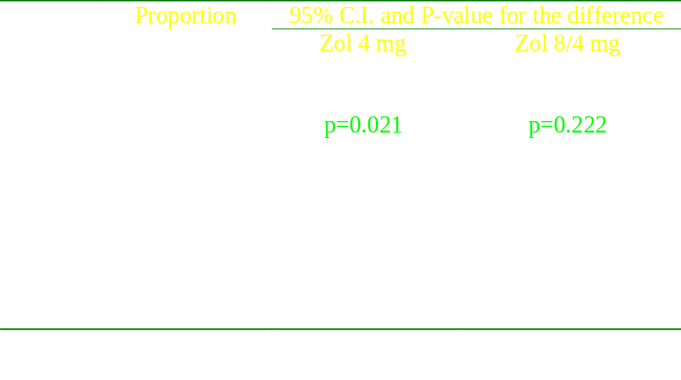
Proportions of Patients with SREs:
Protocol defined Primary Endpoint

Slide 5
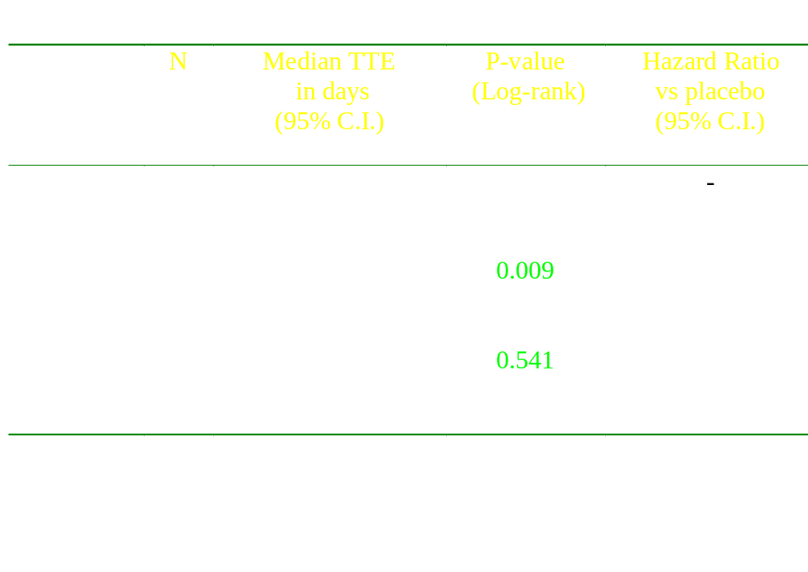
Time To First Event:
FDA preferred Primary Endpoint

Slide 6
Time to to First SRE
Hazard Ratios with 95% C.I.
4 mg
Study 011
8 mg
4 mg
Study 039
8 mg
HR = 1

Slide 7
Secondary Endpoints - 039

Slide 8
Exploratory analysis

Slide 9
Pooled analysis: Zometa vs. Placebo - 039 exploratory analysis
Time to first SRE: Zometa 4 mg + 8/4 mg vs Placebo:
p-value * = 0.06
H.R. point estimate = 0.78
95% C.I. = 0.60, 1.01
Proportion of Patients with SRE: Zometa 4 mg + 8/4 mg vs Placebo
p-value * = 0.04
Diff. In proportions = -0.08
95% C.I. = -0.161, -0.001
* Should be interpreted with caution due to exploratory nature of the analysis. α is not adjusted for multiple testing

Slide 10
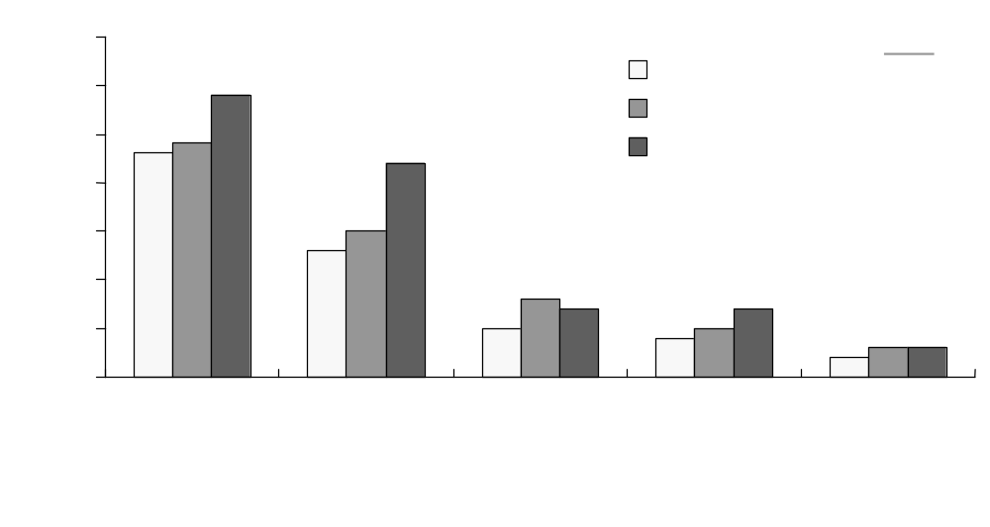
Proportion of Patients with Individual SREs - 039
exploratory analysis

Slide 11
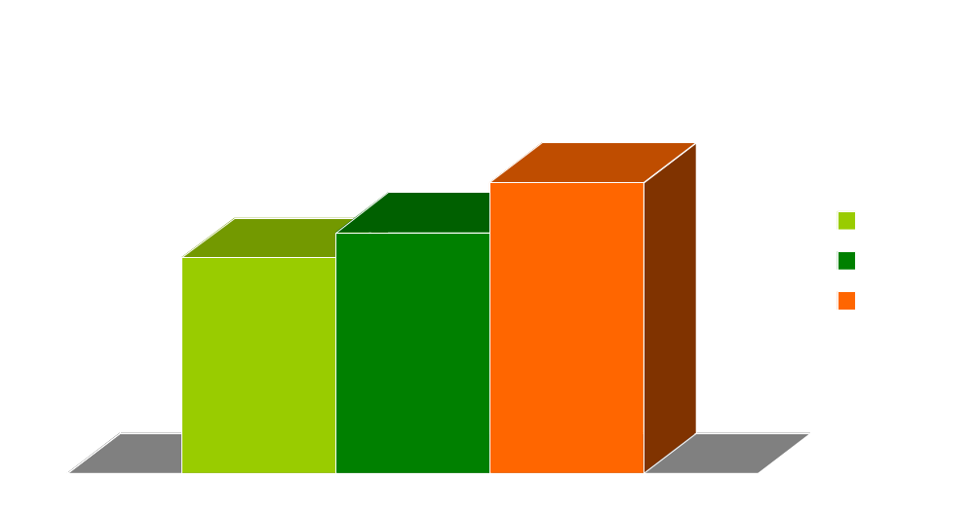
Proportions (%) of Patients with any SRE in Blastic Metastasis in Solid Tumor Trial-011 exploratory analysis - support for prostate cancer study
N=133
N=14
N=15
35%
N=11
29%
26%
Percent of patients
9
42 patients
51 patients
40 patients
Patients with blastic metastasis at baseline of Study 011

Slide 12
No Baseline Imbalances
Multivariate Cox Regression model
- 4 mg arm vs. placebo
p-value = 0.02
HR = 0.68
95% CI = 0.49, 0.94
- 8 /4 mg vs. placebo
p-value = 0.37
HR = 0.87
95% CI = 0.67, 1.18

Slide 13
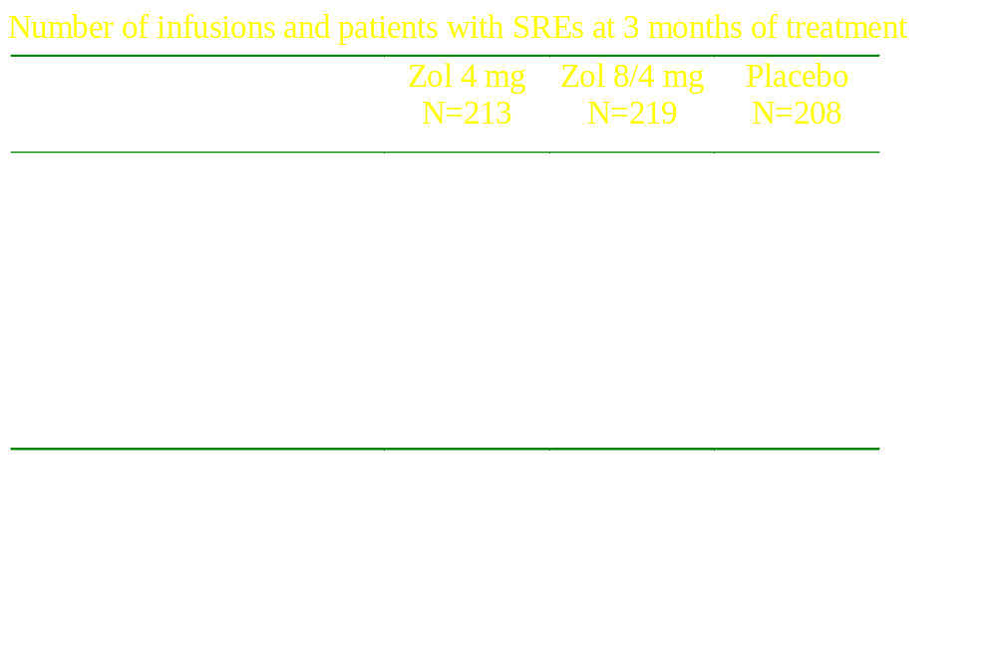
Early discontinuations were not the cause of inconsistency

Slide 14
Summary of Results
Prostate Cancer Trial - 039
Proportion of patients with SRE and
Time to first SRE for 4 mg arm were significantly better than placebo
Proportion of patients with SRE and
Time to first SRE for 8/4 mg arm
show no difference compared to placebo

Slide 15
FDA Guidance for Industry
Providing Clinical Evidence of Effectiveness for Human Drug and Biological Products
“When considering whether to rely on a single multicenter trial, it is critical that the possibility of an incorrect outcome be considered and that all the available data be examined for their potential to either support or undercut reliance on a single multicenter trial”

Slide 16
FDA Guidance for Industry
FDA approval of New Cancer Treatment Uses for Marketed Drug and Biological Products
“If a product has already been shown to be safe and effective in the treatment of patients with a given type of cancer, a single, adequate and well-controlled, multicenter study demonstrating acceptable safety and effectiveness in another biologically similar pattern of responsiveness to chemotherapy may support labeling for that additional form of cancer”

Slide 17
Summary of Issues
Considering both the 4 mg and 8/4 mg arms, how convincing is Study 039?
This is a first indication of a bisphosphonate for a predominantly osteoblastic disease. Can support be drawn from other trials?
Is there substantial evidence to support efficacy of the 4 mg arm?

Slide 19
Zometa for Bone Metastases of Solid Tumors other than Breast Cancer and Prostate Cancer
Protocol 011

Slide 20
Overview of the Solid Tumor Trial
Study Results
Heterogeneous population
Response of bone metastases to chemotherapy
Summary of issues

Slide 21
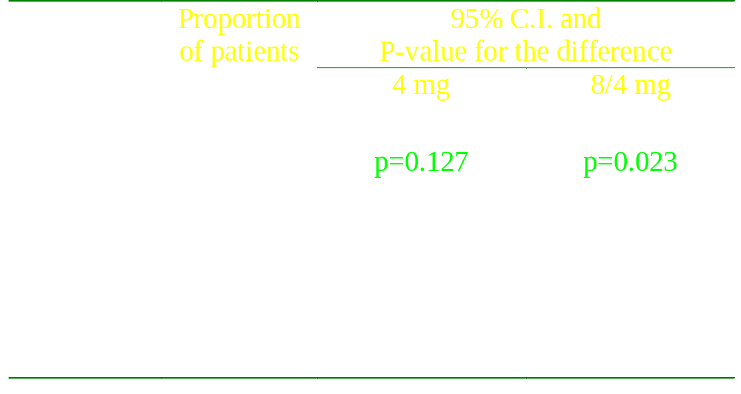
Proportions of Patients with SREs:
Protocol defined Primary Endpoint

Slide 22
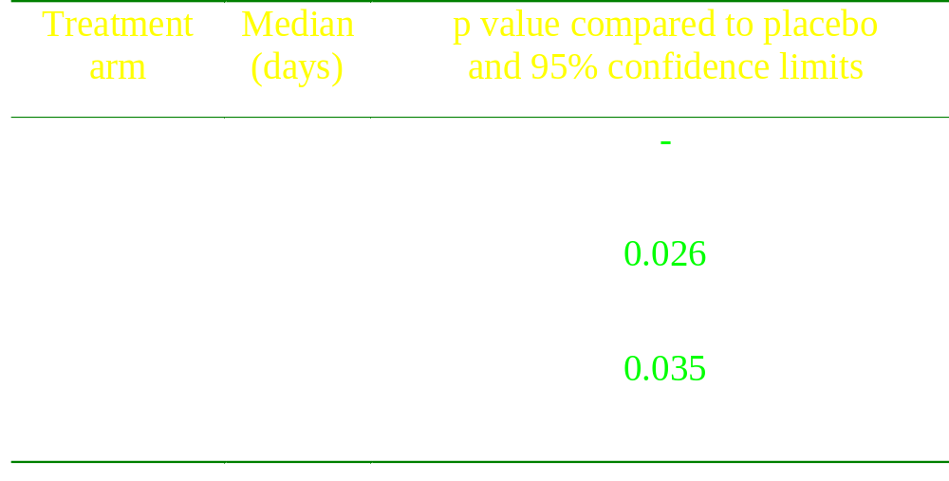
Time To First Event:
FDA preferred Primary Endpoint

Slide 23
Pooled analysis: Zometa vs. Placebo - 011
exploratory analysis
Time to first SRE Zometa: 4 mg + 8/4 mg vs Placebo:
p-value * = 0.01
H.R. point estimate = 0.74
95% C.I. = 0.58, 0.935
Proportion of Patients with SRE: Zometa 4 mg + 8/4 mg vs Placebo
p-value * = 0.03
Diff. In proportions = -0.08
95% C.I. = -0.15, -0.01
*Should be interpreted with caution due to exploratory nature of the analysis. α is not adjusted for multiple testing

Slide 24
Heterogeneous Population
Varying predilection of different tumors to metastasize to bone.
Variable tumor behavior in bone
Potentially variable tumor response to Zometa in diverse tumor types

Slide 25


Slide 26
Response of bone metastases to chemotherapy
Prior chemotherapy treatment not recorded
The study was blinded and randomized, and likely will not impact on study results.

Slide 27
Results Summary
‘Other Solid Tumor Trial’ - 011
No statistical difference for 4 mg for protocol-specified endpoint
Substantial evidence for 4 mg for Time to First SRE
Substantial efficacy for 8 mg in both endpoints, i.e. Proportions of Patients with any SRE and for Time to First Event

Slide 28
Issues of ‘Other Solid Tumors’ Trial
Heterogeneous population
Is there substantial evidence to support efficacy of the 4 mg arm?
If yes, should Zometa be approved for all solid tumors?

