Slide 1
Conversational IT for Better, Safer, Pediatric Care
William G. Adams, MD
Associate Professor of Pediatrics
Director of Child Health Informatics
Boston Medical Center/Boston University School of Medicine badams@bu.edu

Slide 2
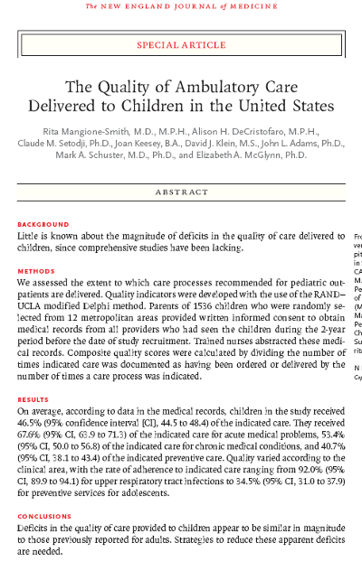


Slide 3
A Critical Role for Patient-Centered HIT
Limits of clinician-centered HIT
Pressing need to:
  Respond to individuals
  Engage patients outside clinical settings
  Provide access to personal medical information
  Empower patients to be active participants in decisions and daily management
  Consider unique constraints for child-centered systems

Slide 4
Conversational IT
Speech-based
Bidirectional
Informative
Adaptive
Intelligent

Slide 5
Why Telephony?
Conversational
Ubiquitous
Directed
Scalable
Outbound

Slide 6
Three Child-centered Conversational Systems
TLC-Asthma
Healthy Eating and Activity Today (HEAT)
Personal Health Partner (PHP)

Slide 7
TLC-Asthma: An Integrated Information System for Child-centered Monitoring and Case Management

Slide 8
TLC-Asthma Scripts
Four age-specific child scripts (Grades K-1, 2-3, 4-6, 7+)
6 rotating modules
Separate scripts for parents
Modules
  monitor and teach
  alert nurse case manager

Slide 9
TLC-Asthma Alert Summary*
 | Child # (%) | Parent # (%)
Child seriously ill | 23(4) | 3(1)
Persistent asthma symptoms | 167(31) | 100(22)
Missed school due to asthma | 21(4) | -
Medication change | 54(10) | 61(13)
Needs refill | 25(5) | 25(5)
Medication knowledge deficiency | 66(12) | 50(11)
Rx does not match symptoms | 34(6) | 54(12)
Excessive reliever med. use | 95(18) | 91(20)
Persistent trigger exposure | - | 9(2)
Peak flow monitoring problem | 33(6) | 55(12)
No action plan | 3(1) | 3(1)
Other | 13(2) | 6(1)
* 6 month intervention, 79 intervention families

Slide 10
TLC-Asthma – Results
No difference in ER visits, hospitalizations, or spirometry
36% decrease in daytime symptom-days
25% increase in symptom-free days
67% fewer missed school days
Increased effect in heavier users
Preliminary, unpublished findings

Slide 11
The Healthy Eating and Activity
Today (HEAT) Program:
Telephony-based Self Care for
Overweight Children

Slide 12
HEAT
Two evidence-based programs
  Traffic Light Diet (TLC, Epstein et al)
  Student Media Awareness to Reduce Television (SMART, Robinson et al)
9-12 yr old children in early stages of overweight ( BMI < 5 above 95 %’ile)
Child’s parent participates with child
PCP supports family’s efforts

Slide 13
Theoretical Foundation for
HEAT Content
Component | Theory/goal
Greeting and positive praise or encouragement for sticking with the program | Reinforcement to build adherence to the program
Follow-up on challenge / goal set in the previous call | Contingency management, rewards
Educational topic related to weight management strategies | Building behavioral capability
Assessment related to the topic of the call | Self-monitoring / self-awareness
Challenge / goal setting related either to the previous challenge or to the topic of the day | Building self-efficacy / goal setting Implementation intention
Summary statement / closing to wrap up what was discussed

Slide 14
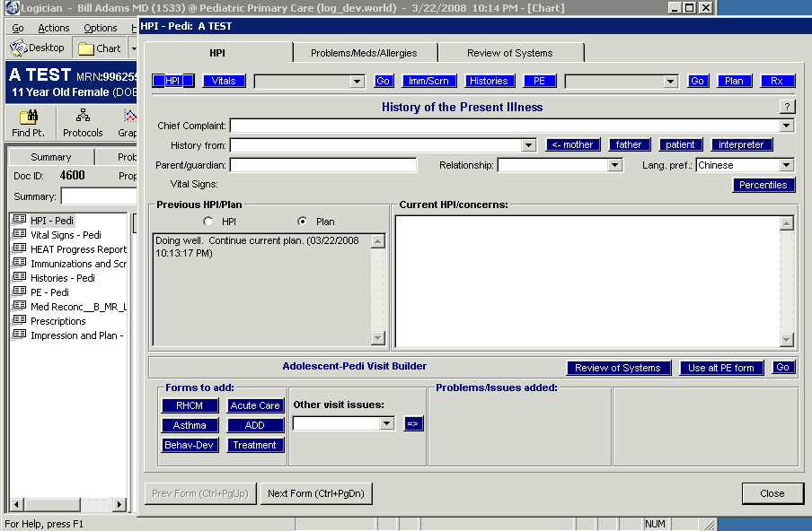
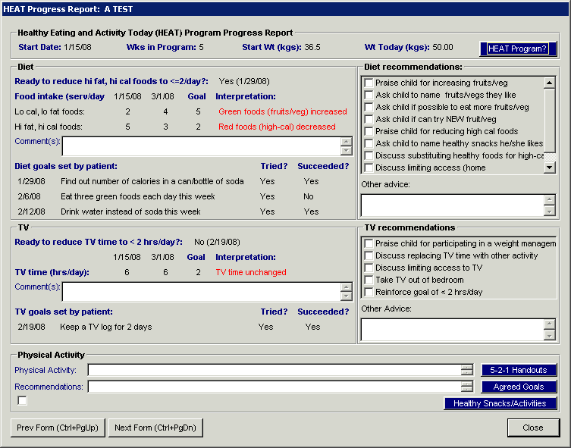

Slide 15
The Personal Health Partner (PHP)
Pre-visit conversation with parent
Pediatric primary care and medication safety
RCT (assigned at time of call):
  Usual Care
  Assessment (w/ EHR Integration)
  Assessment, Counseling, and Activation

Slide 16
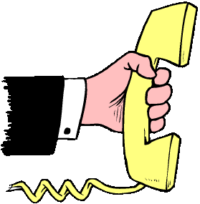

PHP
System
Architecture
Anywhere
Primary Care Center
Parent
Clinician
Network
Communication Gateway Server (Envox)
EHR (Logician)
Database
(SQL Server)
Speech Recognition (ASR) and Text-to-Speech (TTS) (Loquendo)
vXML Application Server (Tomcat)
vXML Script Development Software (Envox)

Slide 17
Hypotheses
PHP use will be associated with more comprehensive visits
PHP counseling will improve parental:
    Knowledge
    Behavior
    Activation
PHP will improve efficiency by pre-populating RHCM form in EHR

Slide 18
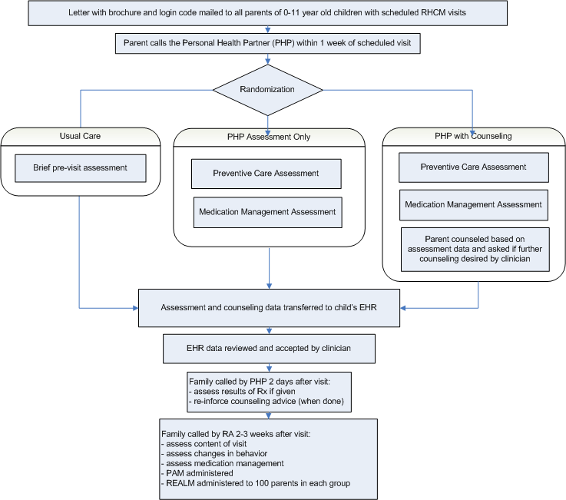
PHP
Study Design

Slide 19
PHP Assessment Samples
Topic | Trigger | Activation
Parental Smoking | Caller is smoker | Call local/national quit line
Child Development | Failed Screening | Discuss concerns with PCP, offer EI phone number
Maternal Depression | Positive screen (PHQ2), no current treatment | Call/find parent PCP, discuss feelings with pediatrician
TB Risk | At risk, due for screening | Remind clinician to do PPD
Medication Reconciliation | Inactive or undocumented med in EHR Med List | NA (physician notified via EHR)
Medication Use | On prescription meds | Bring medication to visit
 | Dosing errors | Discuss dosing with clinician
 | Asthma reliever used as controller | Bring medication to visit and discuss use with clinician

Slide 20
Demonstration

Slide 21
PHP: Year 1 Activities
Script development (questions, triggers, counseling, activation)
New script data model and tools
EHR data and user interfaces
Focus group planning

Slide 22
