Slide 1
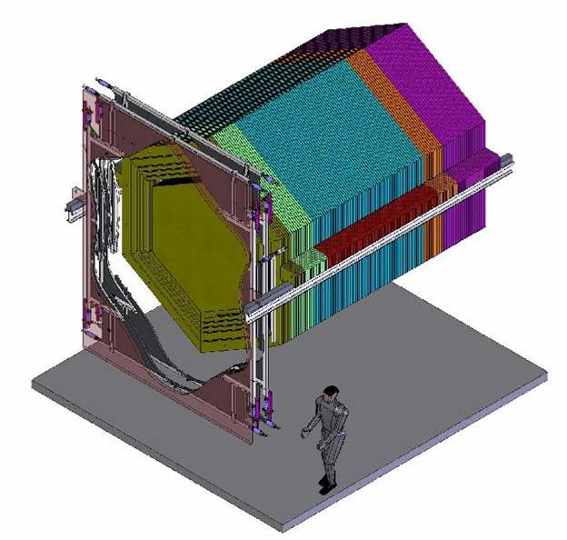
MINERνA (E-938)
Goals
Progress
Project Status
Jorge G. Morfín
Fermilab
DOE Review - May 2006

Slide 2
MINERνA
MINERνA is a dedicated low-energy neutrino nucleus scattering experiment to be installed in the NuMI near hall.
Main goals are measurements of low-energy exclusive and inclusive neutrino cross sections and studies of the nuclear effects on these cross sections and on neutrino-induced hadron showers.
With this information we are in a unique position to provide critical input for the world neutrino oscillation program
  “neutrino engineering” for NuMI and T2K program
MINERνA also provides an opportunity to use the axial current for studies of nucleon structure and nuclear effects.
  Topics of joint interest to the HEP and Nuclear Physics (NP) communities

Slide 3
The MINERνA Collaboration -
Experts from two communities - HEP and NP
Black = Theorist
D. Drakoulakos, P. Stamoulis, G. Tzanakos, M. Zois
University of Athens, Athens, Greece
D. Casper, J. Dunmore, C. Regis, B. Ziemer
University of California, Irvine, California
E. Paschos
University of Dortmund, Dortmund, Germany
M. Andrews, D. Boehnlein, N. Grossman, D. A. Harris, J. Kilmer,
J.G. Morfin, A. Pla-Dalmau, P. Rubinov, P. Shanahan, P. Spentzouris
Fermi National Accelerator Laboratory, Batavia, Illinois
I.Albayrak, M..E. Christy, C.E .Keppel, V. Tvaskis
Hampton University, Hampton, Virginia
R. Burnstein, O. Kamaev, N. Solomey
Illinois Institute of Technology, Chicago, Illinois
S.Kulagin
Institute for Nuclear Research, Moscow, Russia
I. Niculescu. G. .Niculescu
James Madison University, Harrisonburg, Virginia
W.K. Brooks, A. Bruell, R. Ent, D. Gaskell,,
W. Melnitchouk, S. Wood
Jefferson Lab, Newport News, Virginia
R. Gran
University of Minnesota-Duluth, Duluth Minnesota
G. Blazey, M.A.C. Cummings, V. Rykalin
Northern Illinois University, DeKalb, Illinois
D. Buchholtz, H. Schellman
Northwestern University, Evanston, IL
S. Boyd, S. Dytman, M.-S. K, D. Naples, V. Paolone
University of Pittsburgh, Pittsburgh, Pennsylvania
L. Aliaga, J.L. Bazo, A. Gago,
Pontificia Universidad Catolica del Peru, Lima, Peru
A. Bodek, R. Bradford, H. Budd, J. Chvojka,
P. de Babaro, S. Manly, K. McFarland, J. Park, W. Sakumoto,
J. Seger, J. Steinman
University of Rochester, Rochester, New York
R. Gilman, C. Glasshausser, X. Jiang, G. Kumbartzki,
R. Ransome, E. Schulte
Rutgers University, New Brunswick, New Jersey
D. Cherdack, H. Gallagher, T. Kafka, W.A. Mann, W. Oliver
Tufts University, Medford, Massachusetts
R. Ochoa, O. Pereyra, J. Solano
Universidad Nacional de Ingenieria. Lima, Peru
J. Nelson, F.X.Yumiceva
William and Mary College, Williamsburg, Virginia

Slide 4
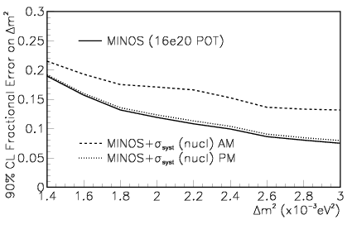
Neutrino Interaction Uncertainties and
Oscillation Measurements I
D. Harris et al. hep-ex/0410005
Current Generation’s Primary Goal: MINOS
  Precise Δm² measurement from ν_{μ} disappearance vs. E_{ν}
  Biggest systematic concern: correctly measuring the E_{ν}?
    aπ absorption, rescattering and charge exchange
    Cross sections for 1,2..n π production
μ
π
ν
π

Slide 5
Neutrino Interaction Uncertainties and
Oscillation Measurements II
Next Generation’s Primary Goal: NOνA and T2K
  Search for ν_{μ} ν_{e} transitions at one neutrino energy
  Biggest systematic concern:
    Predicting background (discovery based on an excess above background!)
  Later, precision measurements with neutrinos and anti-neutrinos
Next Generation’s “guaranteed” measurement
  More precise Δm² measurement, if you understand the backgrounds
Process | QE | RES | COH - C | DIS - low E
δσ/σ NOW (CC,NC) | 20% | 40% | 50% | 20%
δσ/σ after MINERνA (CC/NC) | 5% / na | 7% / 12% | 5% / 20% | 5% / (10%)
Without MINERνA, NOνA risks being limited by cross section uncertainties

Slide 6
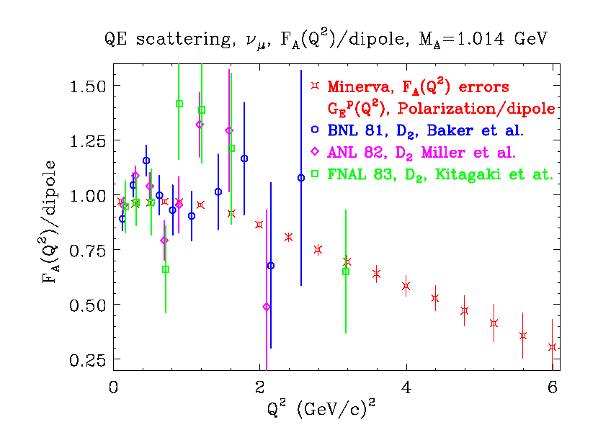
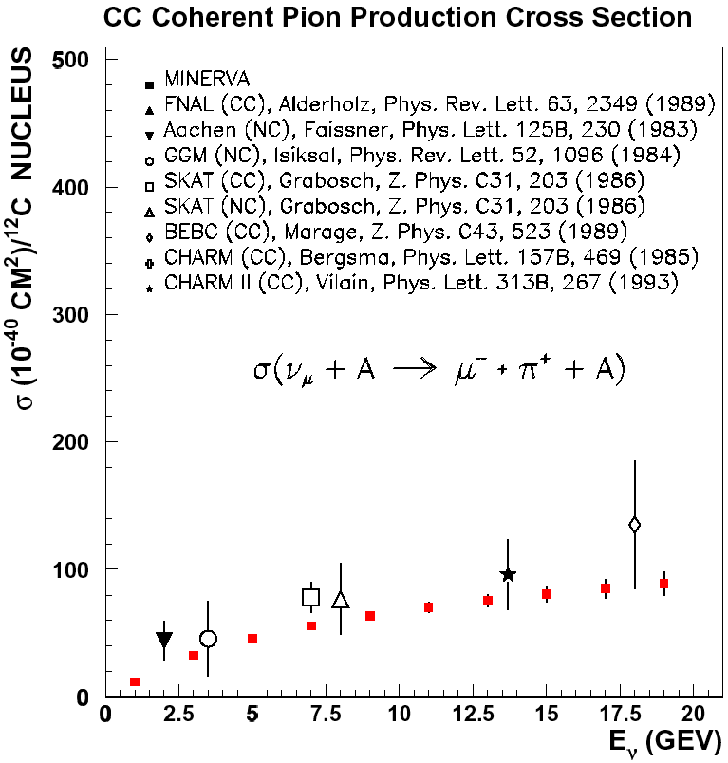
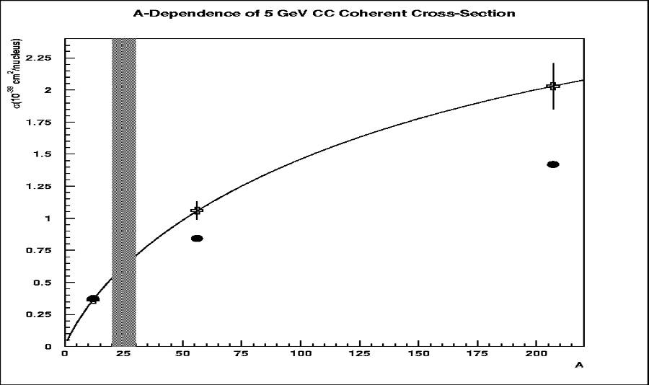
MINERνA Physics Results
High Q² axial form factor of nucleon
(complements high Q² vector FF from JLab)
Coherent cross-sections vs. energy
(exploit resolution, containing detector)
σ vs E_{ν}
vs A

Slide 7
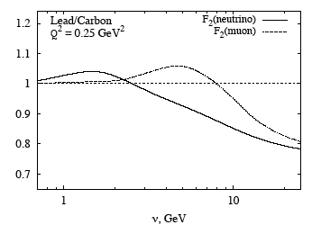
MINERνA Physics Results
A-dependence of:
  low Q² - low ν (1-π) − K2K & MiniBooNE “low Q² problem”
  exclusive final states (nuclear re-interactions)
  deep inelastic scattering (F₂^{ν}, xF₃^{ν})
F₂(Pb)
F₂(C)
Sergey Kulagin model

Slide 8
To Accomplish its Goals…The Detector
MINERνA proposes to build a low-risk detector with simple, well-understood technology
Active core is segmented solid scintillator
  tracking (including low momentum recoil protons)
  particle identification
  few ns timing (track direction, identify stopped K±)
Surrounded by electromagnetic and then hadronic calorimeters
  photon (π⁰) and hadron (π±) energy measurement
C, Fe and Pb nuclear targets upstream of solid scintillator core
MINOS Near detector as high-energy μ spectrometer

Slide 9
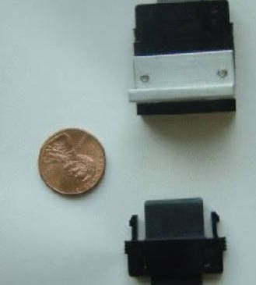
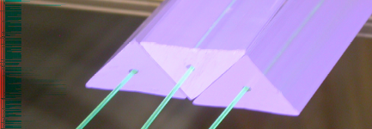
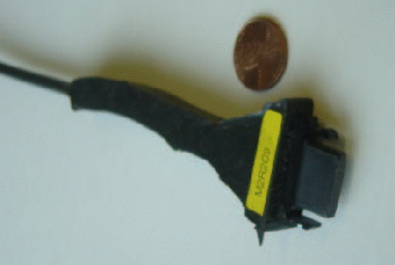
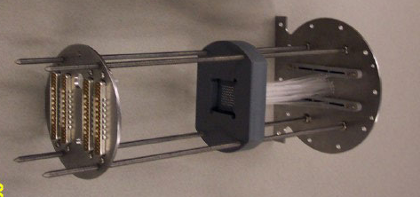
MINERνA Optics - Extruded Scintillator
(Inner detector scintillator and optics shown,
Outer Detector has rectangular scintillator)
Basic element: 1.7x3.3cm triangular strips.
1.2mm WLS fiber readout in center hole
Assemble
into planes
Particle
PMT Box
Clear fiber
Scintillator and embedded WLS
DDK Connectors
Cookie
M-64 PMT

Slide 10
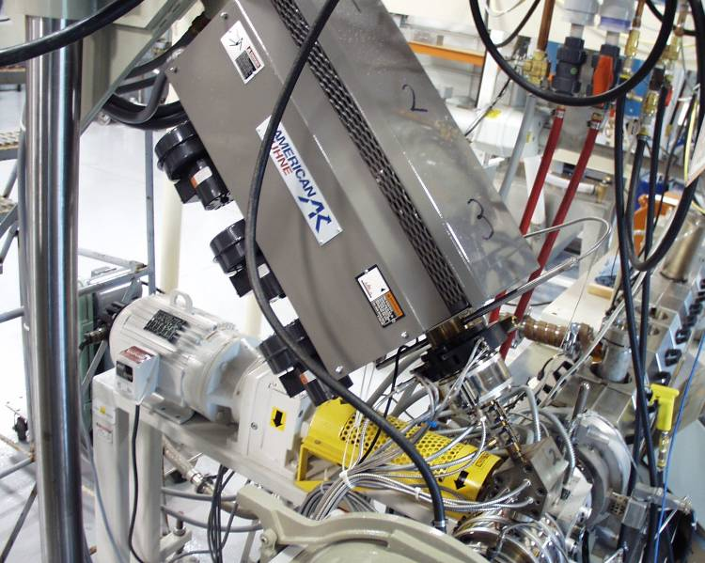
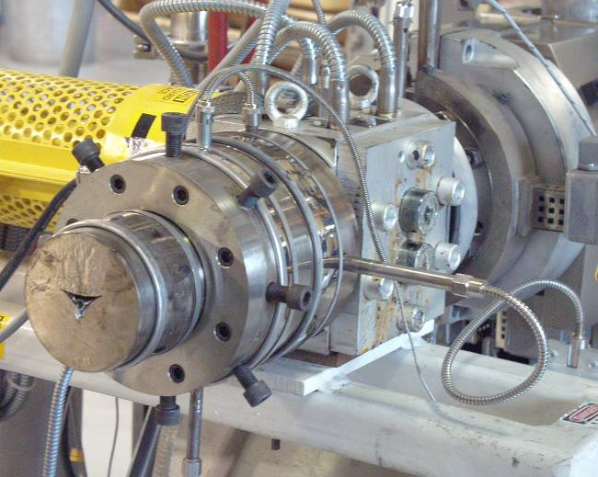
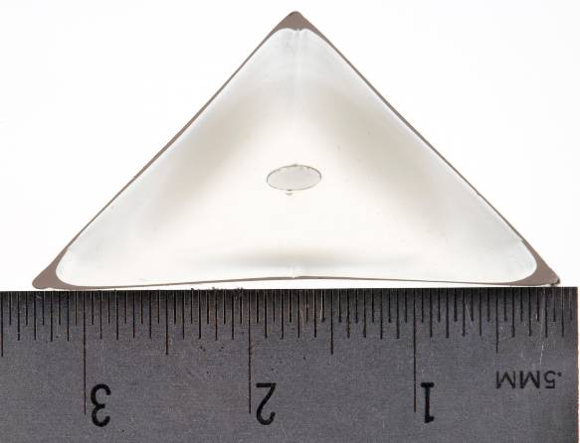
Progress: R&D / Prototyping
Focus on ID scintillator triangles - Fermilab, NIU
  Demonstrated feasibility of meeting mechanical specs
  Provide scintillator for light yield measurements
  Detailed estimates of labor costs
ID Triangle Die
(July ’04-present)
Co-Extruder
(Oct ’05-present)

Slide 11
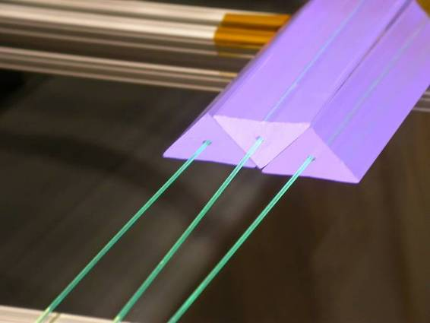
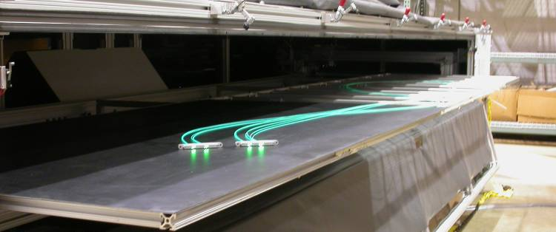
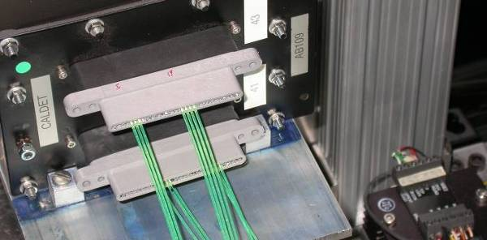
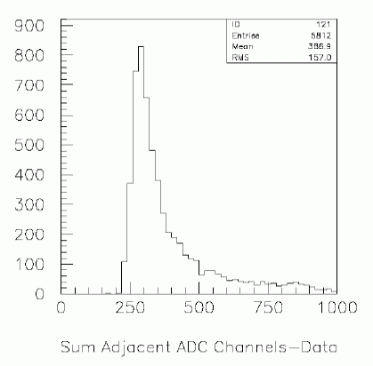
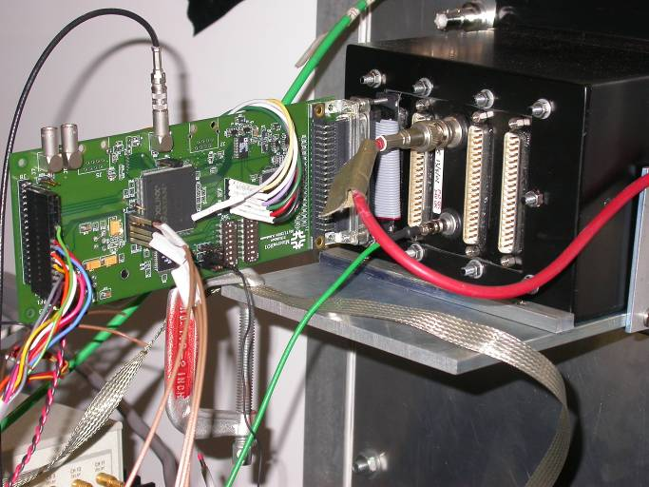
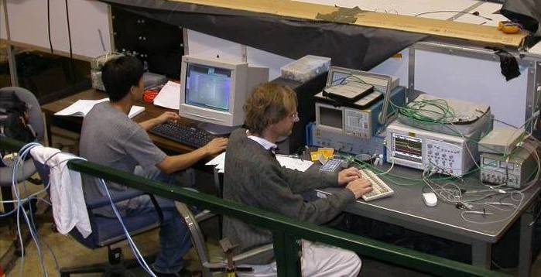
Vertical Slice Test
VST1 array,
electronics
and DAQ
11 PE/MIP per doublet
Extrapolates to 18 PE/MIP
(5.4 PE/MeV)
in final detector

Slide 12
Progress: R&D/Prototyping - continued
Electronics Prototypes - Pittsburgh and Fermilab
  Front-end Boards
  HV prototype card
Mechanical Prototype/Mock-ups - Rochester and Fermilab
  time-motion studies of assembly
  determine tooling, fixtures required
  feasibility evaluation of installation and repair procedures
WLS Fiber testing and qualification - Rochester, William and Mary
  Attenuation and light yield
  Fiber flexibility and light loss
Prototyping Fiber Cables - Rochester and William and Mary
  transmission measurements
  Engineering and production tasks
PMT testing and PMT Box Assembly - Tufts, Athens, James Madison and Rutgers
  learning steps required to align, test and safely house the photomultipliers
  Interface-heavy tasks are making use of many other early prototypes

Slide 13
Accomplishments since last DOE Review
Project
  Project Office fully established including Project Manager, Deputy Project Manager, Scheduler, Budget Officer, Document Coordinator and Project Engineers
  Successfully passed CD-1/trial CD-2 Director’s Review 12/2005
  Prepared CD-1 documentation, ready to be submitted to DOE
Technical Advances: demonstrating basic element performance
  Scintillator co-extrusion and WLS light yield
  Clear fiber cable transmission
  Electronics: noise, charge sensitivity
Technical Advances: demonstrating construction feasibility
  extrusion of scintillator, fiber gluing tests
  prototype PMT box, PMT alignment scheme
  scale modules of module assembly

Slide 14
Accomplishments…continued
Physics Analysis Advances
  Optimized detector design with updated Monte Carlo studies of several physics channels
  Organized and ran joint Fermilab/Jlab workshop on common physics objectives. Led to several refined physics objectives.
Software Advances
  Begun transition to Object-Oriented Simulation and Data structures
  Established core software working group
  Beginning full pattern recognition / reconstruction program

Slide 15
Fermilab Responsibilities
Co-spokesperson: Jorge G. Morfín
Project Manager - Deborah Harris
Deputy Project Manager: Nancy Grossman
Document Coordinator: Dave Boehnlein
Project Scheduler: T.J. Sarlina
Project Budget Officer: Sherie Landrud
Project Engineers: Jim Kilmer and Stan Orr
ES&H Coordinator: Mike Andrews
Scintillator Extrusions: L2 Manager Anna Pla,
Frame, Absorbers & Stand: L2 Manager Jim Kilmer
Module Assembly & Installation: co-L2 Manager Jim Kilmer,
Fiber & Connector Polishing: Eileen Hahn
Electronics Design: Paul Rubinov
3.2 FTE Fermilab Physicists

Slide 16
MINERνA Costs
Costs (in k$) - including contingency, escalation and burdened
We are revisiting all costs in detail for baselining
R&D only in FY06-07, Mostly Construction Funds in FY08-10
 |  |  | FY'06 | FY'07 | FY'08 | FY’09 FY’10 | TOTAL
MIE |  |  | 0 | 0 | 5860 | 3420 390 | 9670
R&D |  |  | 2855 | 4420 | 340 | 0 0 | 7615
Total |  |  | 2855 | 4420 | 6200 | 3420 390 | 17285

Slide 17
Proposed Schedule
2006 Continue R&D with Vertical Slice Test
2007 Multi-plane Tracking Prototype:
  Roughly 20% of the full detector
  Full EM Pb Calorimeter, no hadron Calorimeter
  Tests to be performed
    Scintillator spacing uniformity
    Plane uniformity across many planes
    Planes stacked as close as physics dictates?
    How to replace PMT Boxes /front end boards
2008 Construction Begins
2009 Cosmic Ray Data and hopefully
  some neutrino data

Slide 18
MINERνA
MINERνA results will dramatically improve our knowledge of how low-energy neutrinos interact with matter and help minimize the systematic errors of current and future neutrino oscillation experiments.
This unique and critical FNAL role in the world neutrino efforts can be accomplished with a modest-scale project because of the investment in NuMI.
MINERνA is on track technically to build and use the detector.
  R&D and prototyping progressing well
FNAL personnel play important roles in many parts of the experiment!

Slide 19
Backup Slides

Slide 20
Event Rates
13 Million total CC events in a 4 - year run
Assume 16.0x10²⁰ in LE, ME, and sHE NuMI beam configurations in 4 years
Fiducial Volume = 3 tons CH, ≈ 0.6 t C, ≈ 1 t Fe and ≈ 1 t Pb
Expected CC event samples:
8.6 M ν events in CH
1.5 M ν events in C
1.5 M ν events in Fe
1.5 M ν events in Pb
Main CC Physics Topics (Statistics in CH)
Quasi-elastic 0.8 M events
Resonance Production 1.6 M total
Transition: Resonance to DIS 2 M events
DIS, Structure Fncs. and high-x PDFs 4.1 M DIS events
Coherent Pion Production 85 K CC / 37 K NC
Strange and Charm Particle Production > 230 K fully reconstructed events
Generalized Parton Distributions order 10 K events
Nuclear Effects C:1.4 M, Fe: 2.9 M and Pb: 2.9 M

Slide 21
MINERνA Detector
Side HCAL: 116 tons
Side ECAL Pb: 0.6 tons
Fully
Active
Target:
8.3 tons
Side HCAL (OD)
DS ECAL:
15 tons
Side ECAL
Fully Active Target
Nuclear
Targets
Downstream
HCAL
ν
Downstream ECAL
Nuclear
Targets:
6.2 tons
(40% scint.)
DS HCAL:
30 tons
ID
Side ECAL
Veto Wall

Slide 22
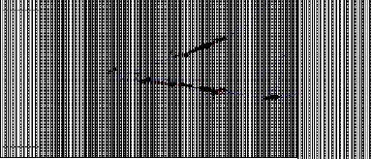
Example Events
π⁰ Production
  two photons clearly resolved (tracked). can find vertex.
  some photons shower in ID,
  some in side ECAL (Pb absorber) region
  photon energy resolution is ~6%/sqrt(E) (average)
γ
nuclear targets
active detector
ECAL
ν
HCAL
γ

Slide 23
Vital Statistics of MINERνA
Number of Channels | 30992
Channels in ID+CALS | 25088
Channels in OD | 5904
Volume of Scintillator (m³) | 22.5
WLS Fiber (km) | 90.7
Clear Fiber (km) | 41.6
Number of M-64 PMTs | 503
Mass of ID (metric tons) | 10.8
Mass of OD in ID region (metric tons) | 98.0
Mass of CALS, Nuclear Targets (metric tons) | 27.2
Mass of OD in CAL region (metric tons) | 62.9
Total MINERvA Mass (metric tons) | 199
Plastic Region Mass (metric tons) | 5.87
Data Rate (bits/spill) | 7.9E+6

Slide 24
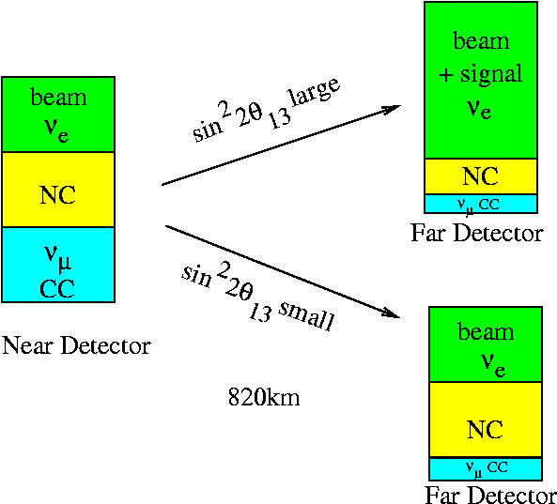
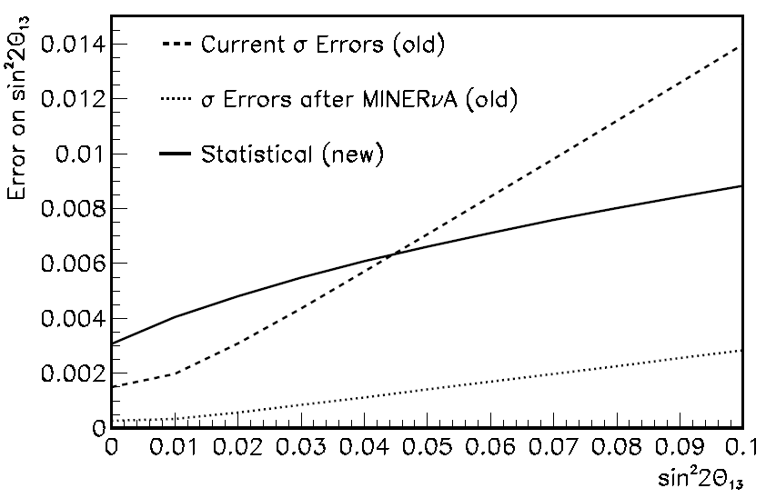
Old NOνA vs New NOνA
Based on “old” NOνA Design
What about the change from old NOvA design to new design?
New: Signal has more resonance contributions, more poorly known process

