Slide 1
The CMMI®
What, Why, and When
by Cynthia Wise
CMMI® is registered in the U.S. Patent and Trademark Office.
by Carnegie Mellon University

Slide 2
What is the CMMI®
Capability Maturity Model Integration (CMMI®)
is a collection of best practices
for the development and maintenance
of products and services
used to guide and measure process improvement
which will lead to business benefits
Not just software

Slide 3
CMM Situation
Proliferation of CMMs and CMM-like models for software, people, software acquisition, Systems Engineering and Integrated Product Development
The models share similar process improvement concepts, but differ in
  model representations,
  terminology,
  appraisal methods
SA-CMM
P-CMM
SW-CMM
IPD-CMM
SE-CMM
Security-CMM

Slide 4
CMM Integration (CMMI) Project
The CMMI Project was established to provide a product suite from which users can tailor integrated Capability Maturity Models
Collaborative effort
  Industry
  Government
  Software Engineering Institute
Initial areas of focus (disciplines)
  Software engineering (SW)
  Systems engineering (SE)
  Integrated product and process development (IPPD)
  Newest addition - Supplier Sourcing (SS)

Slide 5
CMMI Source Models
Capability Maturity Model for Software v2, draft C (SW-CMM V2C)
Electronic Industries Alliance/Interim Standard 731, System Engineering Capability Model (SECM)
Integrated Product Development Capability Maturity Model, draft V0.98 IPD-CMM v0.98
Includes improvements
made to SW-CMM v1.1

Slide 6
Discipline?
?
The bodies of knowledge available when selecting a CMMI model
The vision is that other bodies of knowledge will be integrated into the CMMI framework
Discipline specific amplifications describe how specific practices can be interpreted for a particular discipline

Slide 7
CMMI
SE/SW/IPPD/SS
Representations
SW-CMM
v1.1
v2.0c
Staged
SA-CMM
v1.02
EIA 731
(SE-CMM
+SECM)
IPD-CMM
v0.9
Continuous
Software
Eng.
Systems
Eng.
Concur-
rent Eng.
Acquisition
Disciplines

Slide 8
CMMI-SE/SW
The core
Representations
SW-CMM
v1.1
v2.0c
Staged
SA-CMM
v1.02
EIA 731
(SE-CMM
+SECM)
IPD-CMM
v0.9
Continuous
Software
Eng.
Systems
Eng.
Concur-
rent Eng.
Acquisition
Disciplines

Slide 9
CMMI Model Representations
The CMMI allows you to select from 2 model representations to best guide your organization’s process improvement efforts
Both representations consist of the same process areas
  Each process area is described by goals, practices, typical work products, and other informative material
Continuous
Staged

Slide 10
CMMI Staged Representation
Process Areas are organized into maturity levels
Maturity levels provide the recommended improvement path and order for approaching process areas
Practices for each process area are grouped into
  Generic practices - address the institutionalization common features
  Specific practices - address the unique aspects that must be implemented to satisfy the process area
Emphasis is organizational maturity

Slide 11

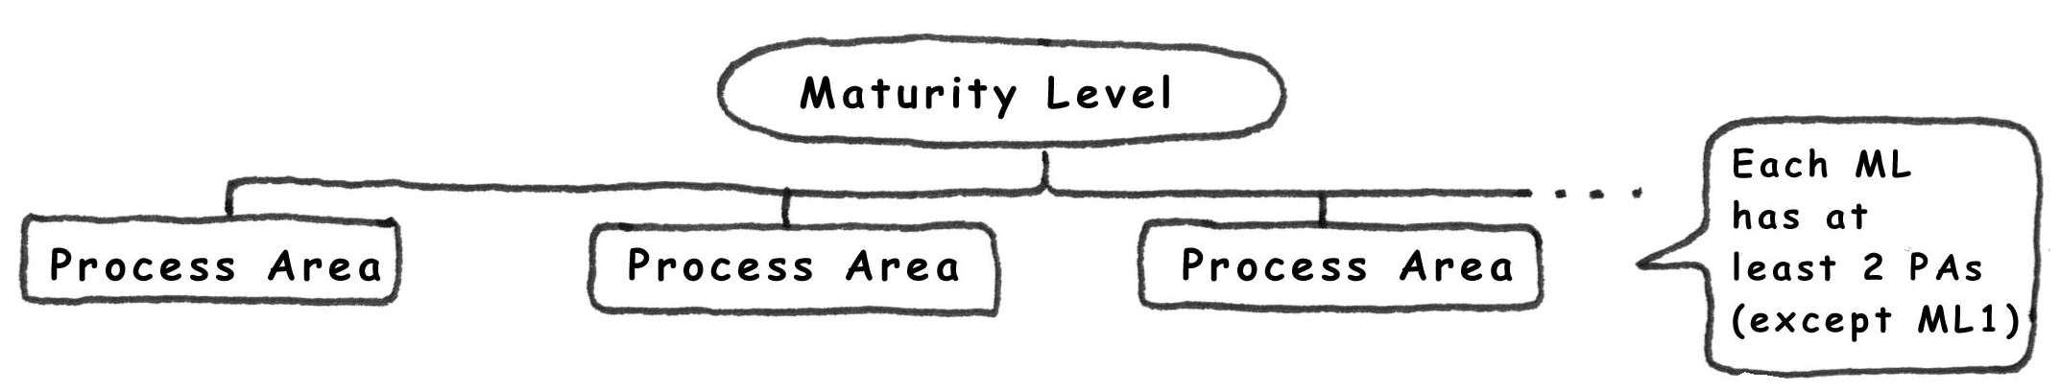
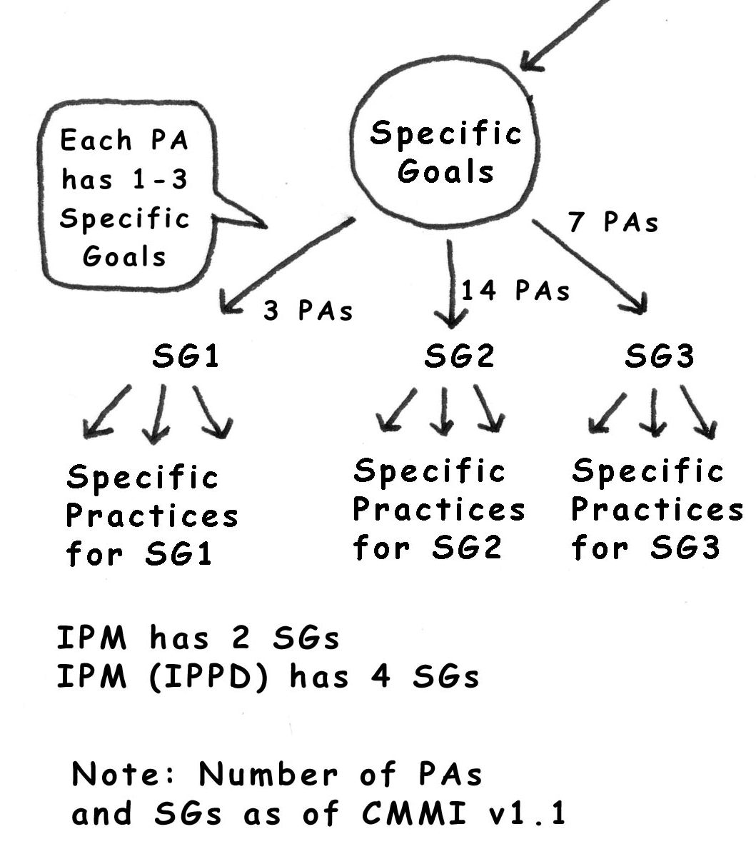
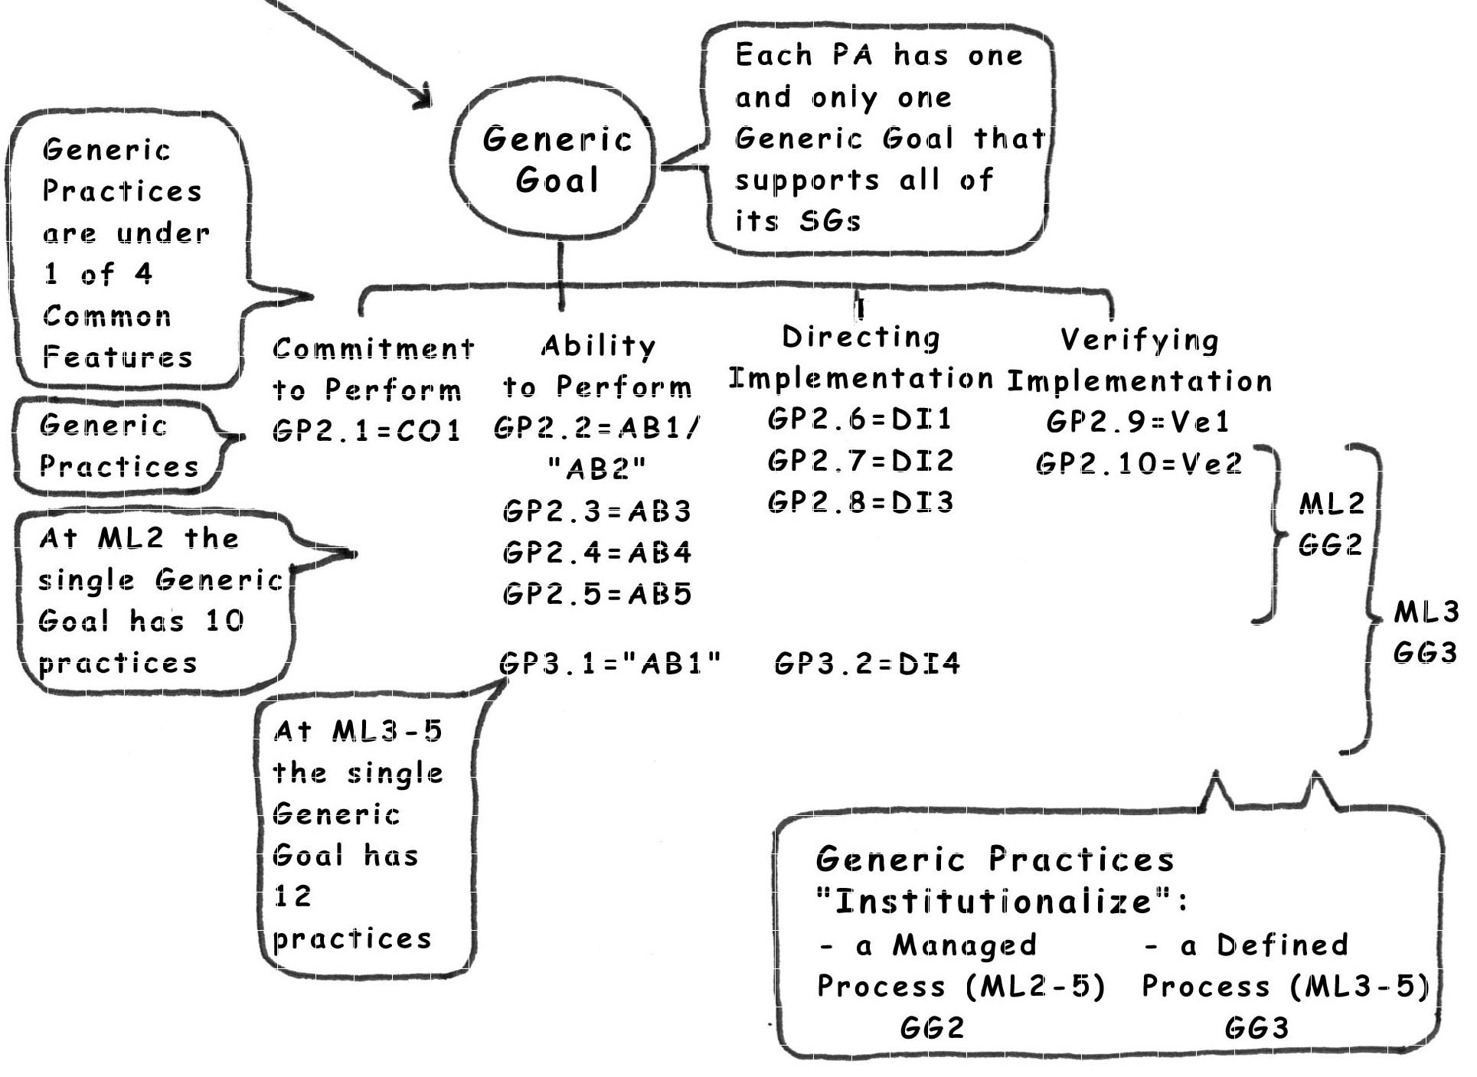


Slide 12
CMMI Maturity
Levels
Optimizing
(5)
Focus on
continuous process
improvement
Quantitatively Managed
(4)
Process is measured
and controlled
Processes well
characterized and
understood
Defined
(3)
Processes are planned
and controlled at
project level
Managed
(2)
Initial
(1)
Unpredictable,
ad hoc

Slide 13
CMMI Continuous Representation
Process Areas are the summary component in the continuous representation
Capability levels (0 through 5) provide the recommended order for approaching process improvement within each process area
  Each capability level contains specific and generic practices related to the process area
The organization decides the order in which the process areas are addressed
Emphasis is process capability

Slide 14
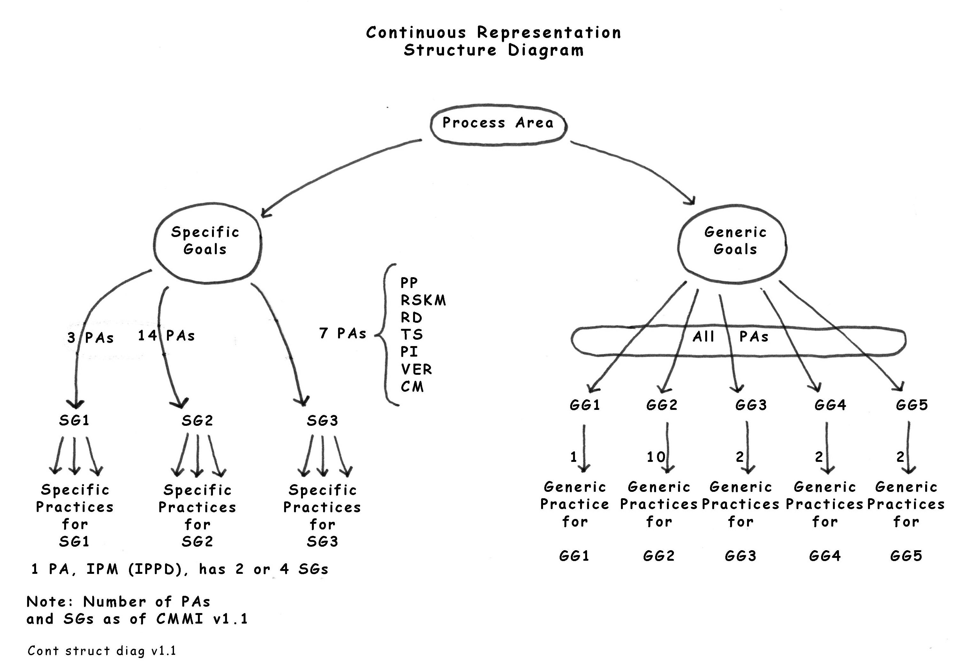

Slide 15
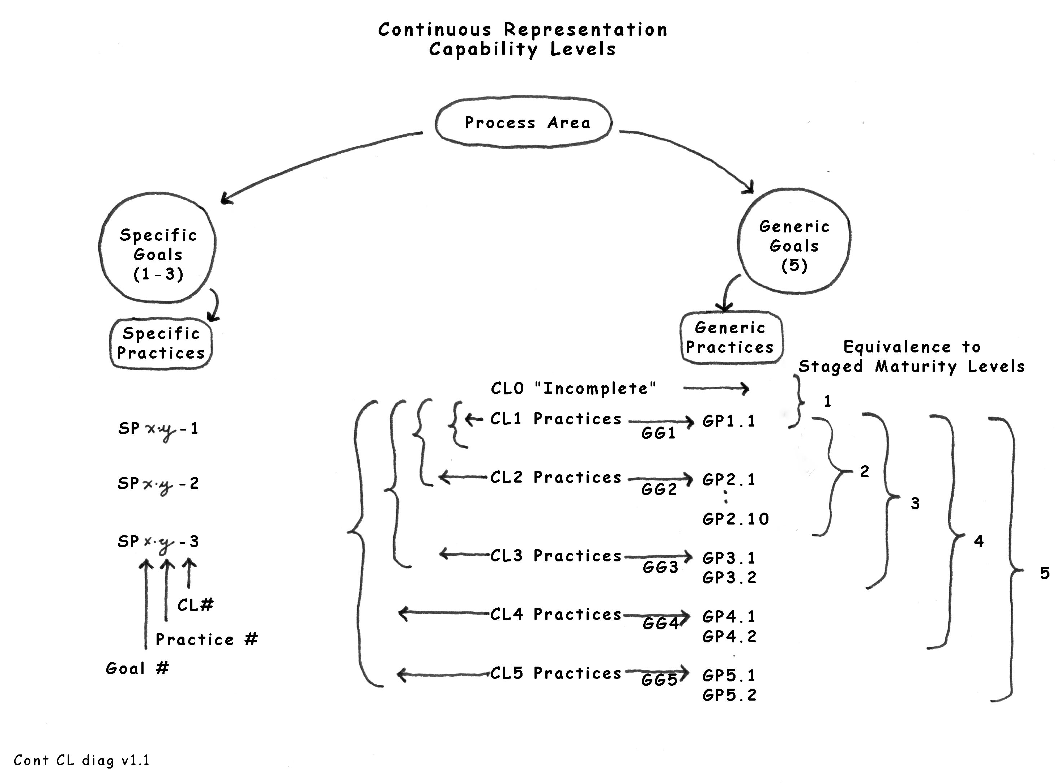

Slide 16
Capability Level Achievement Profile

Slide 17
Comparing SW-CMM 1.1 to
CMMI SE/SW/IPPD/SS
Maturity Level 2
SW-CMM Key Process Areas CMMI Process Areas
Requirements Management Requirements Management
Software Project Planning Project Planning
Software Project Tracking & Oversight Project Monitoring and Control
Software Subcontract Management Supplier Agreement Management
Software Quality Assurance Process and Product Quality Assurance
Software Configuration Management Configuration Management
Measurement and Analysis

Slide 18
Comparing SW-CMM 1.1 to
CMMI SE/SW/IPPD/SS
Maturity Level 3
SW-CMM Key Process Areas CMMI Process Areas
Organization Process Focus Organizational Process Focus
Organization Process Definition Organizational Process Definition
Training Program Organizational Training
Integrated Software Management
Integrated Project Management
(IPPD)
Risk Management
Intergroup Coordination
Software Product Engineering
Requirements Development
Technical Solution
Product Integration
Verification
Validation
Peer Reviews
Decision Analysis and Resolution
Organizational Environment for Integration
Integrated Teaming
Integrated Supplier Management

Slide 19
Comparing SW-CMM 1.1 to
CMMI SE/SW/IPPD/SS
Maturity Level 4
SW-CMM Key Process Areas CMMI Process Areas
Quantitative Process Management
Quantitative Project Management
Software Quality Management
Organizational Process Performance

Slide 20
Comparing SW-CMM 1.1 to
CMMI SE/SW/IPPD/SS
Maturity Level 5
SW-CMM Key Process Areas CMMI Process Areas
Defect Prevention
Causal Analysis and Resolution
Technology Change Management
Organizational Innovation and
Deployment
Process Change Management

Slide 21
CMMI
Common Features
Commitment to Perform
  Organizational Policy
Ability to Perform
  Establish a Defined Process (3+)
  Plan the process
  Provide resources
  Assign Responsibility
  Train People
Directing Implementation
  Manage Configurations
  Identify and Involve Relevant Stakeholders
  Monitor and Control the Process
  Collect Improvement Information (3+)
Verifying Implementation
  Objectively Evaluate Adherence
  Review Status with Management
Practices related to these common features are defined as Generic practices in both model representations

Slide 22
Why Switch to CMMI?
The main benefit of CMMI is the cross-discipline approach to improving processes for developing, acquiring, and maintaining products & services
CMMI encompasses the entire product flow - not just software development
  Think about the “systems” aspect
    Understanding customer needs and expectations
    Requirements engineering
    Packaging and delivery
    Help/upgrade processes
Focus isn’t on just one discipline

Slide 23
Why Switch to CMMI?
One of the most frequently identified barriers to producing quality software is managing the interfaces with other groups
(e.g., customer, systems engineering, systems integration, operations, infrastructure, subject matter experts, etc.)
CMMI will help to break down those walls to develop an integrated, seamless product flow
Provides a common framework for all organizational groups to work together to improve the ability to deliver and maintain quality products

Slide 24
Why Switch to CMMI?
CMMI provides more guidance on the development of product solutions
Appears to encourage more modern, iterative development approaches
  Some view SW-CMM as “waterfall development”
Provides more flexibility in implementing integrated product teams
Software Product Engineering Requirements Development
Technical Solution
Product Integration
Verification
Validation

Slide 25
When to consider switching to CMMI
The software improvement program has been successful and the organization wants to expand to address the entire product flow
New projects starting up could take advantage of the guidance of the CMMI
  Expanded usage of suppliers
  Integrated product teams will be used
  Need for more structured product development
    Particularly in understanding customer needs and potential solutions
SEI will make improvements to the CMMI and the SCAMPI assessment methodology
  There are no more updates being made to SW-CMM and CBA IPI assessment methodology

Slide 26
Summary
We explored the answers to these questions
  What is the CMMI?
  What does it address that the SW-CMM doesn’t?
  Why should we consider following the CMMI?
  When should an organization consider making the switch.
We hope you are able to use these insights in your organization.
Good luck and thanks for attending.
Cynthia Wise
Process Transition International, Inc.
tel. 724-935-3507
web: www.processtransition.com
e-mail: cwise@processtransition.com

