Slide 1
Grants.gov Application Process

Slide 2
Grants.gov 5-Step Process
Accessing and submitting an application for an announcement
(opportunity) through Grants.gov is basically a 5-step process:
  Registration
  Select opportunity
  Download PureEdge Viewer (to enable viewing of Grants.gov forms)
  Download application forms
  Complete and submit application forms

Slide 3

Access Grants.gov
Access Grants .gov by typing the following URL into your browser:
http://www.grants.gov

Slide 4
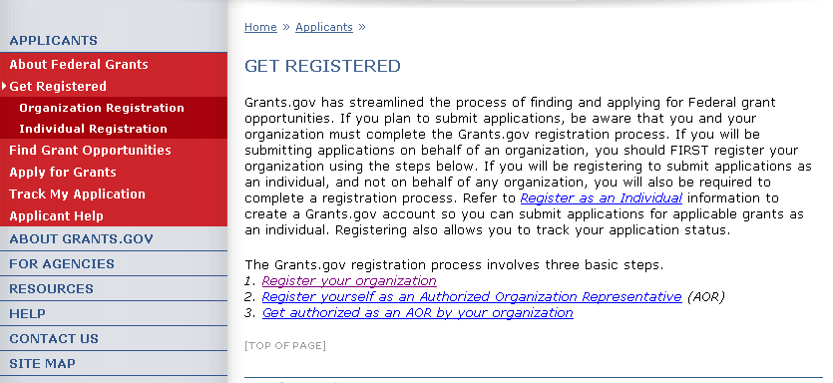
1. Registration
To register your office with Grants.gov, click Get Registered in the left column on the Grants.gov home page. The Get Registered page is displayed. Click Register your Organization.

Slide 5
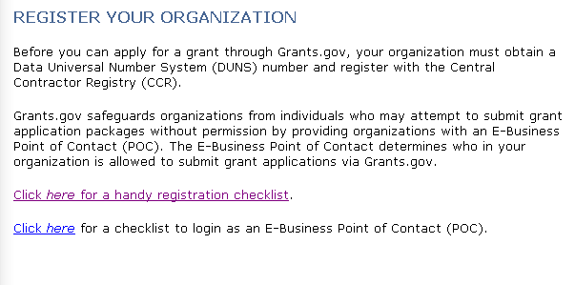
1. Registration (cont’d)
The Register your Organization page is displayed. For registration details, click the link for handy registration checklist. The Organization Registration Checklist (in PDF format) is displayed for viewing and printing.

Slide 6
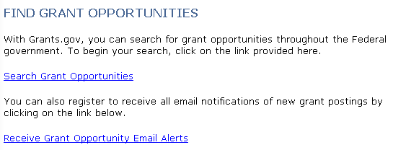
2. Select Grant Opportunity
Click Find Grant Opportunities in the left column. The Find Grant Opportunities page is displayed. Click Search Grant Opportunities.

Slide 7
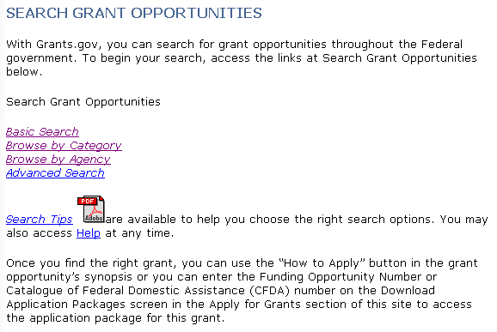
2. Select Grant Opportunity (cont’d)
The Search Grant Opportunities page is displayed. Select the type of search you want. The Basic Search was selected for this example.

Slide 8
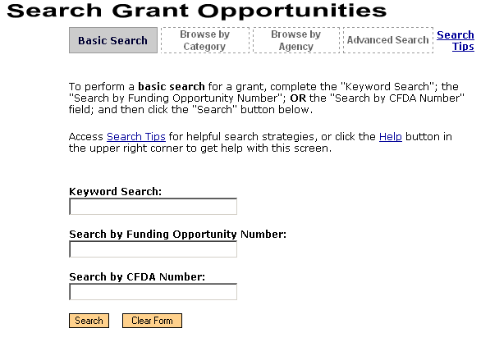
2. Select Grant Opportunity (cont’d)
The Basic Search page is displayed. Enter your search data and click Search.

Slide 9
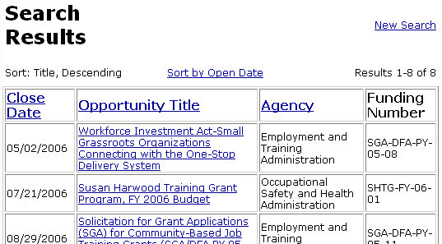
2. Select Grant Opportunity (cont’d)
The Search Results page is displayed. Click the desired Opportunity Title to view the announcement.

Slide 10
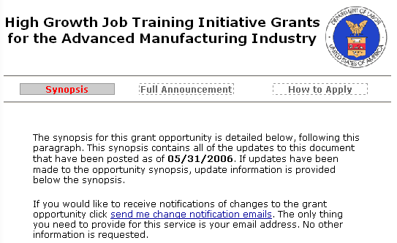
2. Select Grant Opportunity (cont’d)
The selected opportunity is displayed for your review. To submit an application for the announcement, click How to Apply.

Slide 11
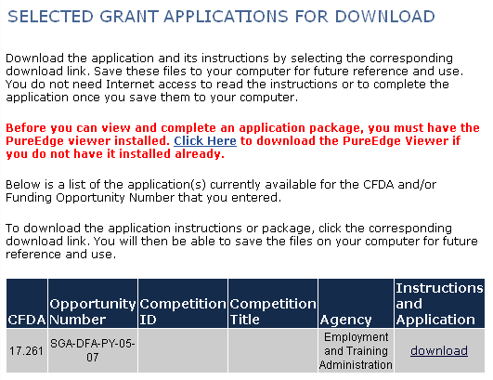
3. Download the PureEdge Viewer
The Selected Grant Applications for Download page is displayed. Before you can view and complete an application package, you must install the PureEdge Viewer. Click the download link to install the Viewer. The File Download box appears. Click Run to start the process.

Slide 12
4. Download the Application
When the PureEdge Viewer download is complete, the Selected Grant Application for Download page is redisplayed. To download the application, click Download in the Instructions and Application column .

Slide 13
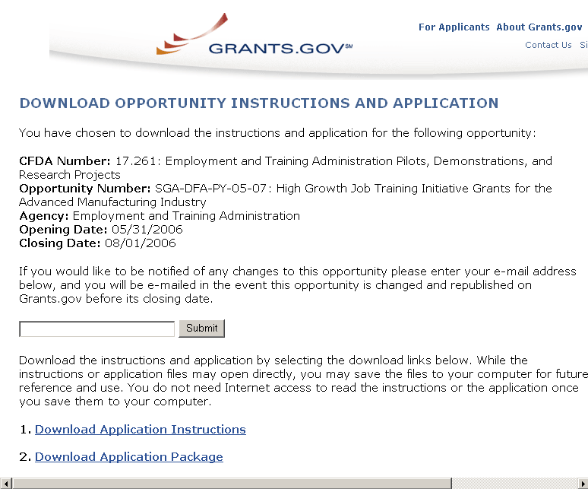
4. Download the Application (Cont’d)
The Download Opportunity Instructions and Application page is displayed. Click the links for Download Application Instructions and Download Application Package at the bottom of the page.

Slide 14
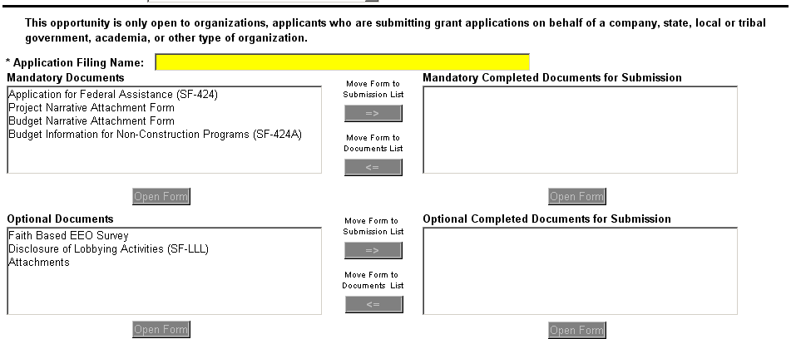
5. Complete/Submit Application
After you download the Grant Application Package, select the document you want to fill out in either the Mandatory or Optional Documents box. Click Open Form. When a form is completed, click the arrow under Move Form to Submission List. You will see the document title moved to the Completed Documents for Submission box.

Slide 15
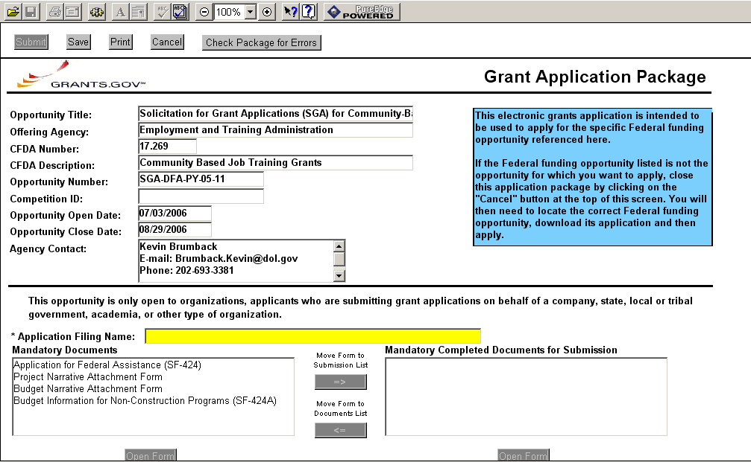
5. Complete/Submit Application
(Cont’d)
When the mandatory and optional forms have been completed and moved to the Completed Documents for Submission boxes, click the appropriate buttons in the tool bar above the page (save, check for errors, and print). The final button should be Submit.

Slide 16
QUESTIONS?

