Slide 1


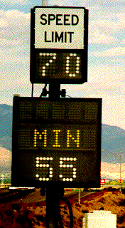
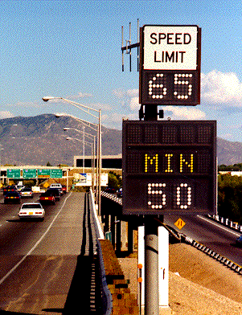
Examples of Variable Speed Limit Applications
Speed Management
Workshop
January 9, 2000
TRB
79th Annual Meeting

Slide 2
Background
This document was prepared for use at the Speed Management Issues Workshop (1/9/2000) as part of the Transportation Research Board 79th Annual Meeting.
This document was prepared by Mark Robinson, P.Eng., of SAIC for US DOT as part of a task order contract on Rural Intelligent Transportation Systems (DTFH61-98-C-00073).
The following pages provide an introduction to Variable Speed Limit (VSL) systems and provide specific examples of domestic and foreign applications of VSL.
This list of example applications is not meant to be comprehensive and may not be totally updated.
Information on additional VSL systems and further information on systems discussed would be welcomed and can be sent by email to mark.d.robinson@saic.com

Slide 3
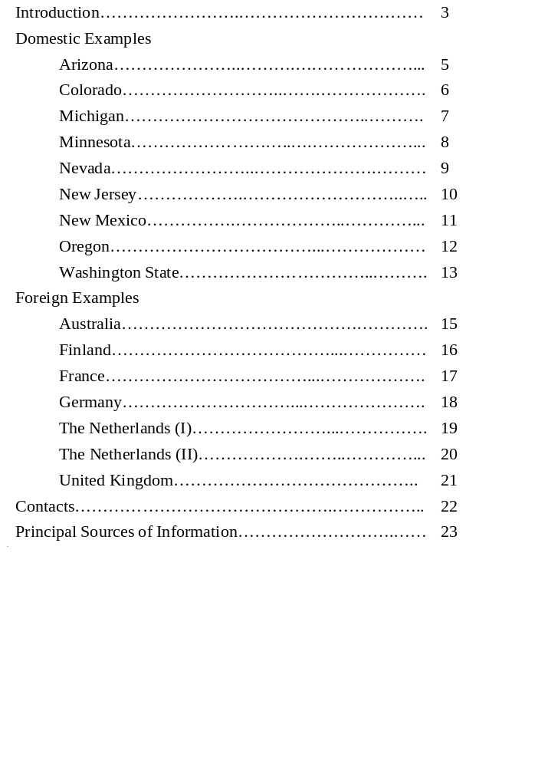
Table of Contents

Slide 4
Introduction to VSL
VSL systems are a type of Intelligent Transportation System (ITS) that utilizes traffic speed and volume detection, weather information, and road surface condition technology to determine appropriate speeds at which drivers should be traveling, given current roadway and traffic conditions.
These advisory or regulatory speeds are usually displayed on overhead or roadside variable message signs (VMS).
VSL systems have been around for the last 30 years and currently are successfully being used and/or tested in parts of Europe and Australia.
VSL systems are already being used in several states and could be implemented in appropriate areas across the United States to help potentially reduce driver error and speeds, and to enhance the safety of our roadways through the use of innovative technology.
Oftentimes, the VSL system is part of a larger incident management, congestion management, weather advisory, or motorist warning system.
The following pages provide examples of past, current and planned VSL system applications.

Slide 5
Domestic Examples

Slide 6
Arizona
Status: Experimental
Objective:
  to develop a variable speed limit system that utilizes “fuzzy” control technology to identify speed limits appropriate for differing environmental conditions.
Setting: Simulated - possible Field Operational Test on I-40
Size: NA
Displayed Speed Logic:
  The algorithm uses a “fuzzy logic” system of speed management.
  Fuzzy logic is multi-valued reasoning -- decision-making is neither black nor white. The concept replicates human reasoning processes.
  Fuzzy Logic uses imprecise categories, or a range of values with overlap, to determine the maximum prudent speed based on: road surface condition; average wind speed; wind gust speed; visibility; degree of cross wind; and, precipitation intensity.
  The maximum prudent speeds are based on weighted averages of these components, established by highway agency and state police partners as the calculation basis.
  Emergency speeds can be set manually.
Advisory/Enforceable/Enforced: NA - Future Study
Results:
  The 1998 program developed and evaluated prototype algorithm and hardware/comm links. The 1999, phase II research is being initiated to refine the algorithm, to field test the system and communications, and to analyze reliability and appropriateness of the system’s decisions. The work by Northern Arizona University on phase II is supported by the ATLAS Center at the University of Arizona, as well as by Arizona DOT.

Slide 7
Colorado
Status:
  Active (Dynamic Downhill Truck Speed Warning System Operational Test - began mid-1995)
Objective:
  to identify vehicle-specific safe operating speeds for long downgrades
  to reduce runaway truck accidents through real-time driver information
  to modify driver behavior
Setting: Rural - Eisenhower Tunnel on I-70 west of Denver
Size:
  currently located inside the Eisenhower Tunnel just before the tunnel exit
  consists of:
    weigh in motion sensor
    variable message sign
    inductive loop detectors
    computer hardware and software
Displayed Speed Logic:
  The algorithm within the computer system computes a safe speed based on the truck weight, speed, and axle configuration.
  The recommended speed is displayed on a variable message sign.
  Each truck receives a vehicle- specific recommended safe speed message.
Advisory/Enforceable/Enforced: Advisory
Results:
  Since system deployment, truck-related accidents have declined on the steep downhill grade sections while the volume of truck traffic has increased by an average of 5 percent per year.

Slide 8
Michigan
Status:
  Inactive (activated 1962, dismantled sometime after 1967)
Objective:
  to warn motorists to decelerate when approaching congestion and accelerate when leaving congestion
Setting:
  Urban – M-10 (John C. Lodge Freeway) in Detroit between the Edsel Ford Freeway (I-94) and the Davison Freeway
Size:
  5.2 km (3.2 miles)
  21 variable speed sign locations
Displayed Speed Logic:
  The speed limit signs were manually switched at the control center.
  The signs could display speeds in increments of 5 mph from 20 to 60 mph.
  The speed was chosen by the operator based on CCTV and pen plots of freeway speed.
Advisory/Enforceable/Enforced: Advisory
Results:
  Michigan officials felt variable speed displays did not significantly increase or decrease vehicle speeds.

Slide 9
Minnesota
Status:
  Demonstration
Objective:
  to make work zone speed limits on high volume urban freeways easier to sign and enforce
Setting: Urban (variable - portable)
Size: Variable - depends on size of work zone
Displayed Speed Logic:
  When construction workers are not present, the speed continues to be 65 mph.
  When construction workers arrive, a designated worker changes the speed limit to 45 mph.
Advisory/Enforceable/Enforced: Enforceable
Results:
  This application is at the demonstration stage. More information should be available in a year.

Slide 10
Nevada
Status: Active
Objective:
  to set speed limits based on the 85th percentile speed, visibility and pavement conditions.
Setting: Rural - on Interstate 80 next to a coal-fired power generation facility in a canyon with a river.
Size:
  four VSL signs - two eastbound and two westbound
  visibility detectors
  speed loops
  Road Weather Information System (RWIS) weather station
  there are advance "reduce speed ahead when flashing" flashing signs prior to the installation of the VSL signs. These signs can be used in conjunction with, or independently of, the VSL signs.
Displayed Speed Logic:
  Speed limits are computed using a logic tree based on the 85th percentile speed, visibility (based on stopping sight distance), and pavement conditions (based on frost, ice, rain, or dry conditions).
  The sign is limited to increments of 10 mph. Only the tenths digit can be changed.
  The system is remotely controlled - no human intervention.
  On clear days, the signs remain blank.
Advisory/Enforceable/Enforced: Regulatory and Enforceable
Results:
  The reliability of the visibility sensor has limited the operation of this installation to date.

Slide 11
New Jersey
Status: Active (installed in the late 1960s)
Objective:
  to provide early warning to motorists of slow traffic or hazardous road conditions
Setting: Urban/Rural - New Jersey Turnpike
Size:
  120 signs over 148 miles
  inductive loop detectors collect speed and volume data
  addition of weather sensing equipment is planned in the near future
Displayed Speed Logic:
  The posted speed limits are based on average travel speed and are displayed automatically (manual override used for lane closures and construction zones).
  The posted speed limit can be reduced from the normal speed limit (depending on the milepost location 65 mph, 55 mph, and 50 mph) in five-mph increments, to 30 mph.
  The posted speed limit can be reduced for six reasons: crashes; congestion; construction; ice; snow; and fog.
  The speed warning signs display, “Reduce Speed Ahead” and the reason for the speed reduction.
  When appropriate, the distance between the warning sign and the beginning of the congestion is displayed on the warning sign.
Advisory/Enforceable/Enforced: Enforced
Results:
  The New Jersey Turnpike Authority feels that the signs are effective.
  The signs provide motorists with information on unusual roadway conditions, which dictate the need for speed reduction.
  State Police enforce the reduced speed limits by issuing summonses to those motorists found to be in violation.

Slide 12
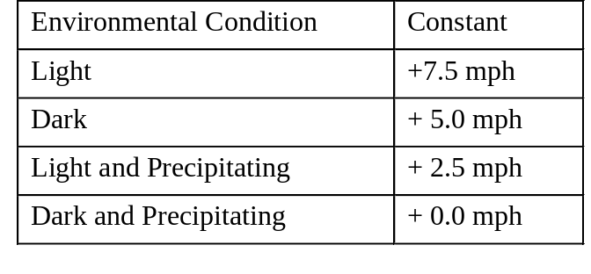
New Mexico
Status: Inactive (activated 1989, dismantled 1997 due to road widening)
Objective:
  to provide a US test bed for VSL equipment and algorithms
  to post speed limits that reflect traffic conditions (to minimize accident risk and advise motorists of hazards)
Setting: Urban – I-40 Eastbound in Albuquerque
Size:
  4.8 km (3miles)
  3 variable speed sign locations
Displayed Speed Logic:
  Fully automated - updated every minute
  Smoothed Average Speed + Environmental Constant
  Posted speeds ranged from 30-55 mph
  Also displayed minimum speed limit
Advisory/Enforceable/Enforced: Enforced
Results:
  - Overall, the equipment and algorithm were a success.
  - There was a slight reduction in accidents.
  The effectiveness evaluation was hindered by high average speeds, sign visibility, and sun glare.
  The maximum speed limit that could be posted was the National Maximum Speed Limit (55 MPH). Because smoothed average speeds regularly exceeded this maximum, the ability of the system to post speed limits that reflected traffic conditions was hindered.

Slide 13
Oregon
Status:
  Expected to be operational in Spring 2000 (part of the “Green Light” Field Operational Test).
Objective:
  to advise truck drivers what speed they should travel to make it safely down Emigrant Hill, on I-84 between Pendleton and La Grande.
Setting: Rural - 6 mile long 6% downgrade
Size:
  weigh in motion (WIM) scale
  roadside variable message sign
  automatic vehicle identification (AVI) reader
Displayed Speed Logic:
  Vehicle weight is measured using WIM and the vehicle is identified using AVI.
  A downhill advisory speed is computed for each vehicle and displayed on the VMS.
  Properly weighed transponder equipped trucks receive a truck specific message. For example:
TRUCK ADVISORY
ABC TRUCKING
20MPH DOWNHILL
  Improperly weighed transponder equipped trucks receive a truck specific generic message (without a suggested speed). For example:
TRUCK ADVISORY
ABC TRUCKING
STEEP DOWNGRADE
  Trucks without a transponder do not receive a message.
  The state can override the system to display emergency information.
Advisory/Enforceable/Enforced: Advisory
Results: NA - not yet operational

Slide 14
Washington State
Status: Active (TravelAid)
Objective: to improve safety and to increase the availability of road condition and weather information to motorists crossing Snoqualmie Pass
Setting: Rural - I-90 Snoqualmie Pass
Size:
  13 Light Emitting Diode (LED) Variable Message Signs over 40 miles
  only 17 miles (mp 45 to mp 62) are operated as VSL during the winter months
  6 weather stations provide environmental conditions
  sensors in pavement to determine pavement conditions
Displayed Speed Logic:
  The speed limit throughout the Pass is posted at 65 mph due to roadway geometry.
  When roadway conditions are poor, speed limits are reduced in 10-mph increments primarily depending on whether traction tires are advised (55 mph), traction tires are required (45 mph), or whether chains are required (35 mph).
  WSDOT has also developed a matrix of speeds based on other elements including visibility and severe weather.
  The decision to reduce the speed limit is based on feedback from multiple weather stations, snow plow operators, and State Patrol.
  The speed limit is recommended by computer and confirmed by an operator.
Advisory/Enforceable/Enforced: Enforced
Results:
  WSDOT has observed motorists slowing down when the VSL system is in use.
  A comprehensive evaluation of the project will be performed by the Washington State Transportation Center.

Slide 15
Foreign Examples

Slide 16
Australia
Status: Active (System is fully operational. Prototype was installed in 1993)
Objective:
  to avoid rear-end collisions in fog
Setting:
  F6 Tollway South of Sydney
Size:
  12 signs over 11 km (7 miles)
Displayed Speed Logic:
  Each sign is connected to road loops and a visibility detector.
  The advisory speed is based on the visibility distance and the speed of the preceding vehicle.
  The driver is advised of the speed to travel to avoid a rear-end collision with the preceding vehicle.
Advisory/Enforceable/Enforced: Advisory
Results:
  Data is being collected to perform a safety evaluation of the system.

Slide 17
Finland
Status: Active (Experimental - tests began in 1994)
Objective:
  to influence driving behavior and improve road safety without decreasing driver motivation to obey posted speed limits
Setting: Rural – E18 in Southern Finland between Kotka and Hamina
Size:
  67 VSL signs and 13 VMS signs over 25 km (15 miles) (motorway and dual carriage road)
  2 unmanned stations to monitor local weather (wind velocity and direction, air temp., relative humidity, rain intensity and cumulative precipitation) and road surface conditions (dry, wet, salted, snowy - through 4 sensors)
Displayed Speed Logic:
  Weather information is analyzed by a central unit that gives the speed limit recommendation:
    120 km/h (74 mph) for good road conditions;
    100 km/h (62 mph) for moderate road conditions;
    80 km/h (49 mph) for poor road conditions.
  A slippery road warning may also be given (as determined by the central unit).
Advisory/Enforceable/Enforced: Enforced
Results:
  95% of drivers interviewed endorsed the use of speed limits set according to the prevailing road conditions.
  The concept of weather controlled speed limits and displays is promising.

Slide 18
France
Status:
  Active
Setting: Urban -Marseille
Size:
  8 km (5 miles)
Displayed Speed Logic:
  Speed limits posted are based on prevailing speed and weather conditions.
  Manual override is possible.
  Speed and volume data are collected by overhead radar and television surveillance.
Advisory/Enforceable/Enforced: Unknown
Results:
  unknown

Slide 19
Germany
Status: Active (installed in 1970s)
Objective:
  to stabilize traffic flow even under heavy flow conditions, thus reducing crash probability, improving driver comfort and reducing environmental impacts
Setting:
  Rural Autobahn
  A8 between Salzburg and Munich, A3 between Sieburg and Cologne, A5 near Karlsruhe
Size:
  Varies - up to 30 km (18.7 miles) in length
  signs are located every 1.5 to 2 km (0.9 to 1.2 miles)
Displayed Speed Logic:
  The displayed speed is 100, 80 or 60 km/h (62, 49 or 37 mph) based on computer control algorithm (in accordance with the Road Traffic Code).
  The algorithms use traffic data (count and speed) measured with inductive loops, and environmental data measured with fog, ice, wind, and other detectors in determining the displayed speed.
Advisory/Enforceable/Enforced: Enforceable
Results:
  The German Ministry of Transport has seen some safety benefits from the use of VSL.
  Recent crash data has shown that the use of the speed limit and speed warning signs has reduced the crash rate by 20 to 30 percent.
  Motorists respond better to the electronic signage than the fixed signage, because the electronic signs provide advisory information.

Slide 20
The Netherlands (I)
Status: Active (installed 1991)
Objective:
  to elicit safer driving behavior during fog
Setting: Urban - A16 near Breda
Size:
  signs every 700-800 m (0.4 - 0.5 miles) over 12 km (7.4 miles)
  20 visibility sensors
  automatic incident detection
Displayed Speed Logic:
  Posted speed is 100 km/h (62 mph).
  If visibility drops below 140 m (456 ft), then the speed limit also drops to 80 km/h (49 mph).
  If visibility drops below 70 m (228 ft), the speed limit is dropped to 60 km/h (37 mph).
  If an incident is detected, 50 km/h (31 mph) on the first sign upstream and 70 km/h (43 mph) on second sign upstream.
Advisory/Enforceable/Enforced: Unknown
Results:
  After the system was installed, drivers reduced their mean speeds by approximately 8 to 10 km/h (5-6 mph) during fog conditions.

Slide 21
The Netherlands (II)
Status: Active (installed 1992)
Objective:
  to create uniformity of speeds and volumes within and between lanes and thereby reduce the risk of shock waves, crashes and congestion
Setting:
  Rural - A2 between Amsterdam and Utrecht
Size:
  20 km (12.4 miles) with signs spaced approximately 1km (0.6 miles) apart
  loop detectors every 500 m (0.3 miles)
  automatic incident detection
Displayed Speed Logic:
  The standard speed limit is 120 km/h (74 mph).
  The variable posted speeds are 50, 70 and 90 km/h (31, 43 and 55 mph).
  The posted speed is determined by a system control algorithm based on 1-minute averages of speed and volume across all lanes.
  If an incident is detected, a speed of 50 km/h (31 mph) is displayed.
Advisory/Enforceable/Enforced:
  Enforced (photo radar) if posted in red circle, advisory if posted without a circle
Results:
  The majority of drivers interviewed said they adjusted their speed due to the VSL, and in general, the drivers complied with the speed signs.
  The severity of shockwaves and speed in all lanes were reduced by speed control measures.

Slide 22
United Kingdom
Status: Active (extended 1995)
Objective:
  to smooth traffic flows by reducing stop-start driving
  to demonstrate control of traffic speeds which might be used on wide motorways (dual 5/6 lane).
Setting:
  Urban - M 25 London Orbital
Size:
  22.6 + km (14+ miles) with variable speed display stations spaced at 1 km (0.6 mile) intervals
  loop detectors at 500 m (0.3 mile) intervals
  CCTV
Displayed Speed Logic:
  Speed limits are changed according to detected vehicle volumes.
    The displayed speed changes from 70 mph to 60 mph when volume exceeds 1,650 vehicles per hour per lane.
    The displayed speed is lowered to 50 mph when volumes exceed 2,050 vehicles per hour per lane.
  The system also monitors traffic speeds and stationary traffic to slow vehicles down that are approaching a queue, and has additional logic to stop speed limit settings fluctuating too often.
Advisory/Enforceable/Enforced:
  Enforced - photo radar (uses 35mm photos)
Results:
  There is very high driver compliance with the VSL signs.
  Police are impressed with the system.
  Drivers are also impressed - 68% would like to see the system extended.
  There has been a 10-15% reduction in accidents.

Slide 23
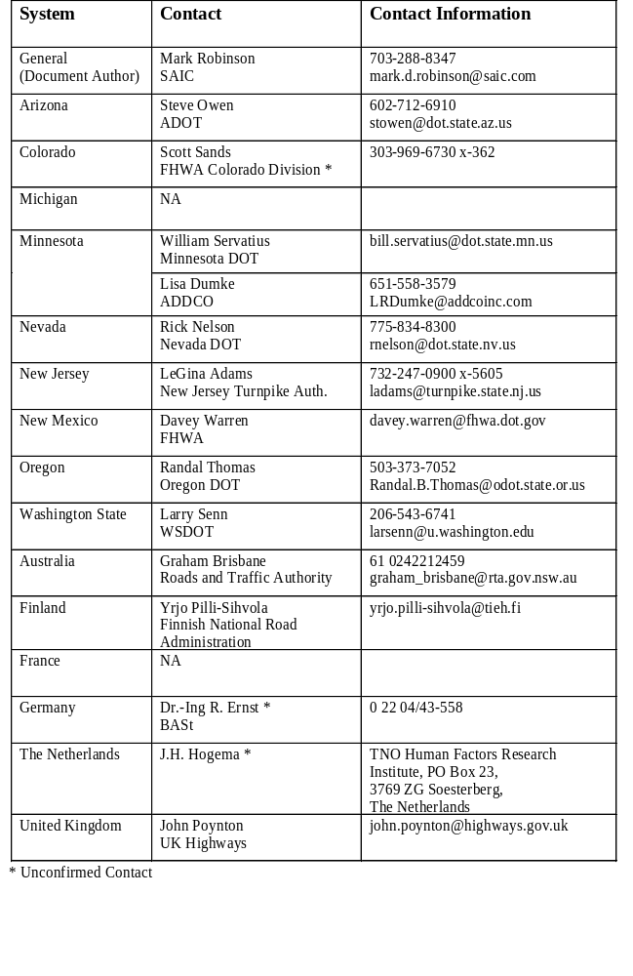
Contacts

Slide 24
Principal Sources of Information
Arizona - 1, 2, 3, 4
Colorado - 2, 5, 6
Michigan - 2, 7
Minnesota - 8
Nevada - 1
New Jersey - 1, 2, 7
New Mexico - 1, 2, 7
Oregon - 2, 9
Washington State - 1, 2
Australia - 1
Finland - 2, 10
France - 7
Germany - 1, 2, 7
Netherlands I - 1
Netherlands II - 2, 7
United Kingdom - 1, 2, 7
1. Zarean, M., Pisano, P., Dirnberger, K., and Robinson, M. (1999) Variable Speed Limit Systems: The-State-Of-The-Practice. Proceedings of the 1999 Rural Advanced Technology & Transportation Systems Conference, Flagstaff, AZ.
2. Nelson, D.C. Applications of Variable Speed Limits & Speed Management in the United States and Internationally. Unpublished paper, University of Maryland.
3. http://enterprise.prog.org/varspeed.htm#anchor126696
4. Arizona Transportation Research Center (1998) The Fuzzy Variable Speed Limit Device Project. ATRC Research Notes: August 1998, ADOT, Phoenix, AZ.
5. http://www.its.dot.gov/staterpt/CO.HTM#dynamic
6. http://www.tfhrc.gov/pubrds/pr97-12/p18.htm
7. Wilkie, J.K. (1997) Using Variable Speed Limit Signs to Mitigate Speed Differentials Upstream of Reduced Flow Locations. Southwest Region University Transportation Center - Compendium: Graduate Student Papers on Advanced Surface Transportation Systems, TTI, College Station, TX.
8. Dumke, L.R. (1999) The signs they are a changin’ - A modular approach to real-time information. Traffic Technology International, June/July ‘99.
9. http://www.odot.state.or.us/motcarr/hweb/its/green/light.htm
10. Pilli-Sihvola, Y., and Rama, P. (1997) Speed Limits. ITS International (November/December 1997).

