Slide 1
E-Grants Grantee Reporting System

Slide 2
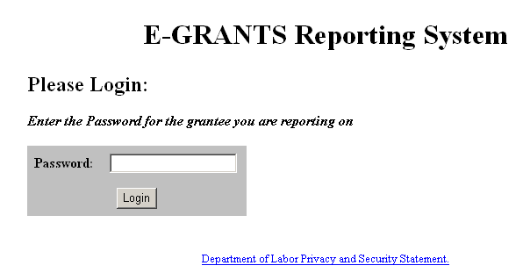
Access E-Grants Grantee Reporting
Access the E-Grants Grantee Reporting System by typing the specified URL into your browser. Type your password and click Login. (Note: the URL and password will be provided by the DOL (VETS) staff via e-mail).

Slide 3
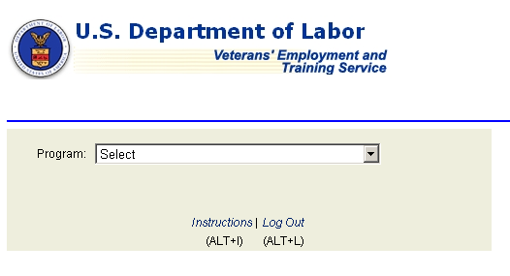
Select Report
The Select Program window is displayed. Click Instructions to display the Instructions for Online Reporting.
Click the down arrow in the Program field and select the desired program.

Slide 4
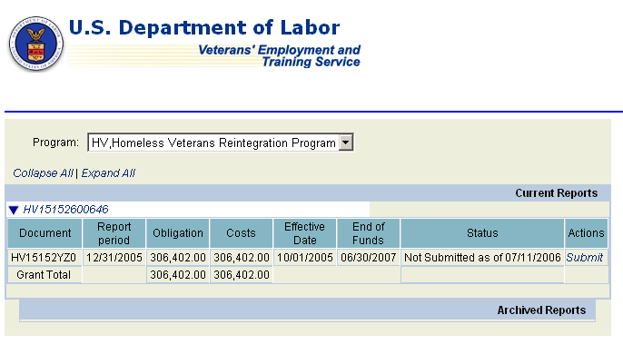
Review/Create Report
The selected program is displayed. To create a new Financial Status Report (SF-269) for the program, click Submit in the Actions column. Note: A new report may only be created for grants that have a status of Not Submitted. The FSR must be filed quarterly (no quarters may be skipped).

Slide 5
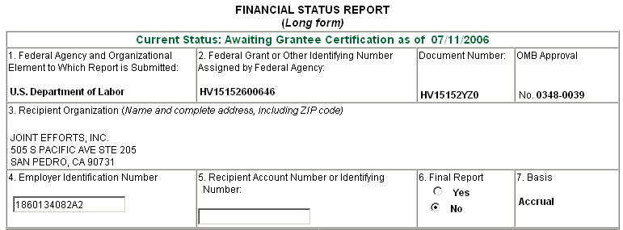
Fill in SF-269
The Financial Status Report (SF-269) is displayed. Fill in the Form. Field definitions and instructions are provided below the Form or when you click the title of a field in Items 10 a-i and 11 a-e. If there are no figures to report, enter zeros. To create a Final Report, click Yes in Item 6- Final Report.

Slide 6
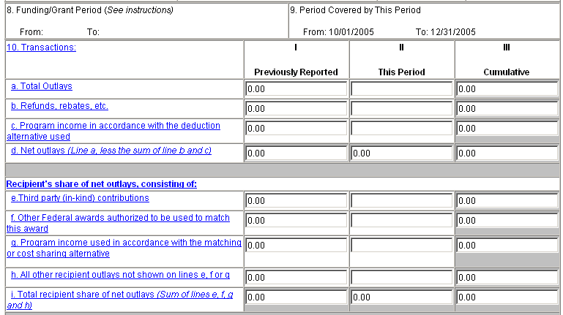
Fill in SF-269 (Cont’d)
Fields that have gray borders may not receive data. Data for these fields is automatically calculated and entered.

Slide 7
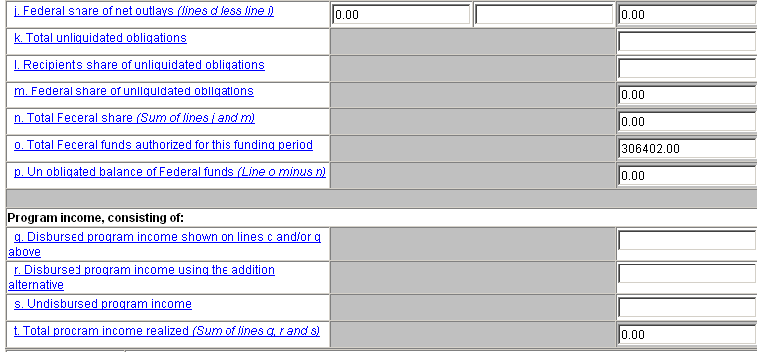
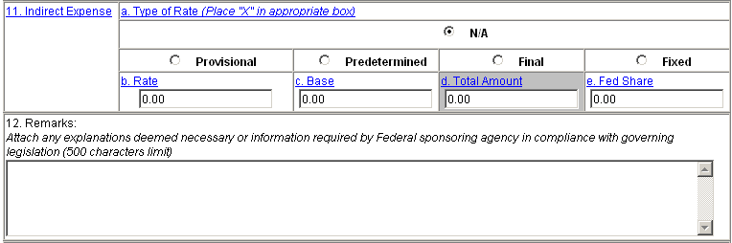
Fill in SF-269 (Cont’d)
The figure in Item 10j-Federal share of net outlays cannot exceed the figure in Item 10o-Total federal funds authorized for this funding period.
.

Slide 8
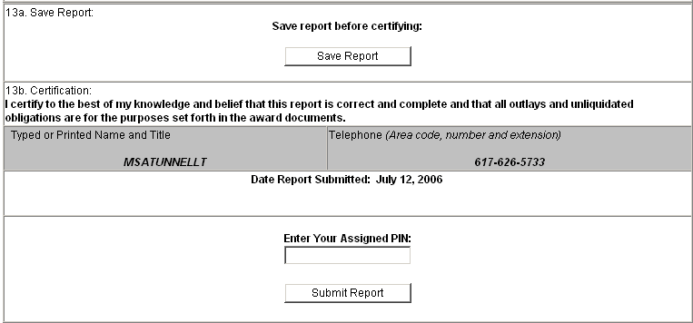
Fill in SF-269 (Cont’d)
The SF-269 must be saved before it can be certified. To save the report, click Save Report. To certify the SF-269, type the assigned PIN and click Submit Report. Note: A confirmation message is displayed and can be printed for each of these functions (shown on following pages).

Slide 9
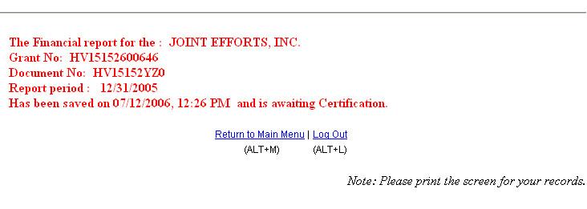
Save Confirmation Message
After you save the FSR, a confirmation message is displayed and should be printed for your records.

Slide 10
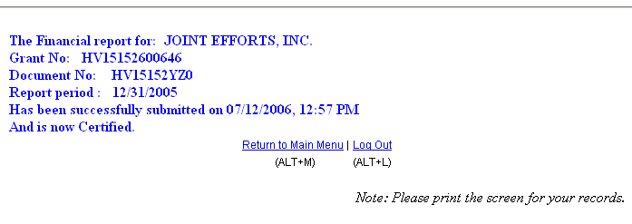
Certify Confirmation Message
After you enter your PIN to certify the FSR and click Submit Report, a confirmation message is displayed and should be printed for your records.

Slide 11
QUESTIONS?

