Slide 1
FAFSA on the Web for 2009-2010
Effective January 1, 2009

Slide 2
There are significant changes to the FAFSA on the Web (FOTW) site (www.fafsa.ed.gov) for the 2009-2010 application processing cycle. The following presentation is a preview of some of the screens. Some screens may reflect new or enhanced functionality.

Slide 3
The FOTW site is still being tested screens. There may be slight changes to screens and text prior to system implementation on January 1, 2009.

Slide 4
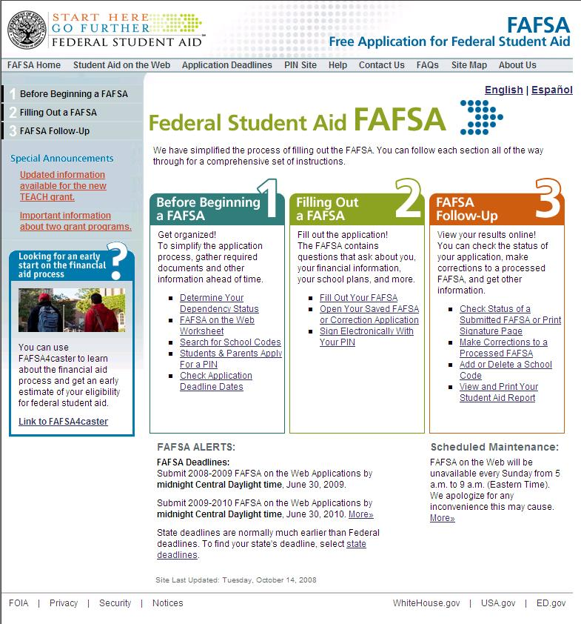
FAFSA on the Web’s Homepage

Slide 5
The “Before Beginning a FAFSA” Section

Slide 6
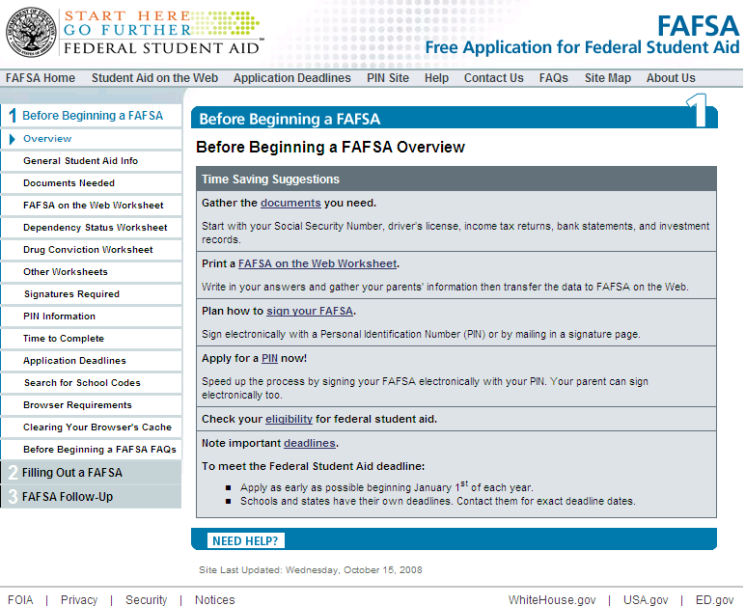
Before Beginning a FAFSA Overview

Slide 7
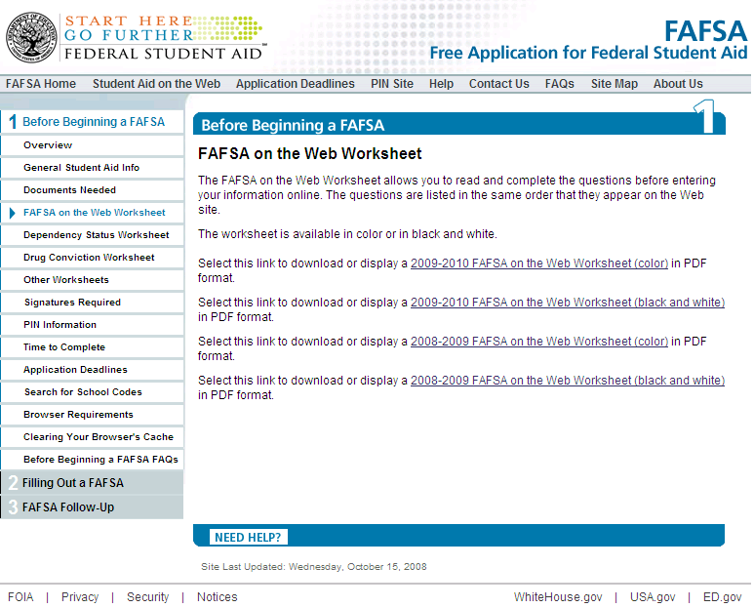
Before Beginning a FAFSA – FAFSA on the Web Worksheet

Slide 8
FAFSA on the Web Worksheet
The questions within FAFSA on the Web are presented in a different order than the questions on the paper FAFSA.
The FAFSA on the Web Worksheet presents the questions in relatively the same order as they are presented within FAFSA on the Web.
Students wanting to pre-fill a paper form in preparation for submitting their application online should complete the FAFSA on the Web Worksheet rather than the paper FAFSA.

Slide 9
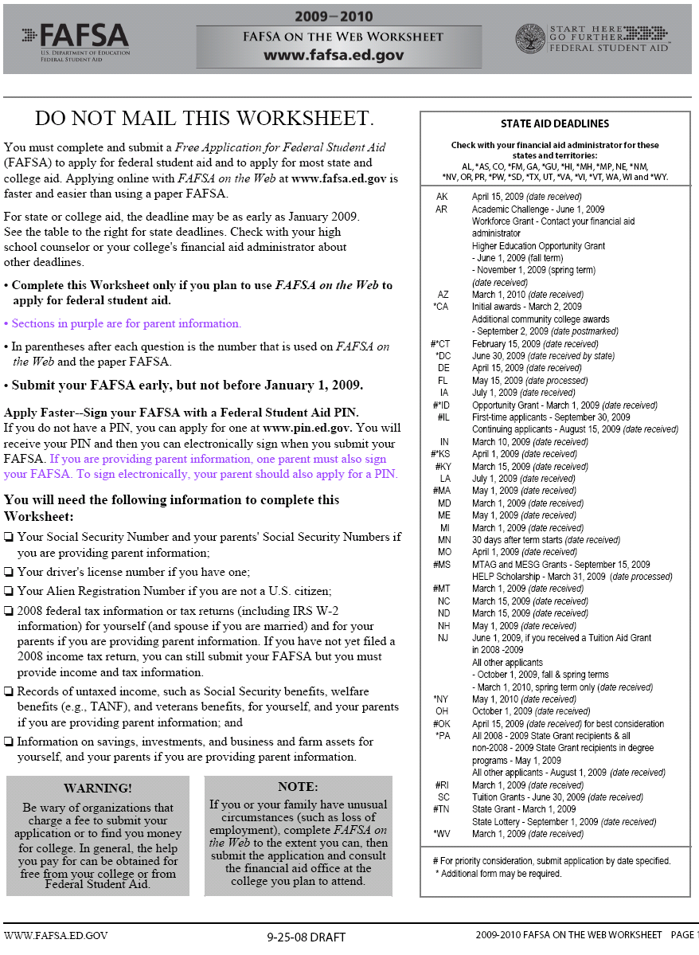
FAFSA on the Web Worksheet

Slide 10
The Updated Dependency Worksheet
The Dependency Worksheet is designed to help students determine if they need to provide parental information on the FAFSA.
Students can use the Worksheet prior to beginning the online application. The Dependency Worksheet has been updated to include new dependency questions and redesigned flow.

Slide 11
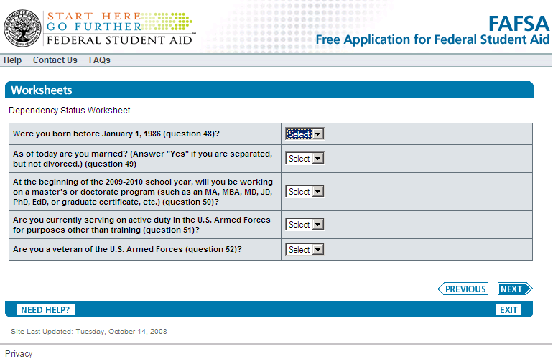
The New Dependency Worksheet

Slide 12
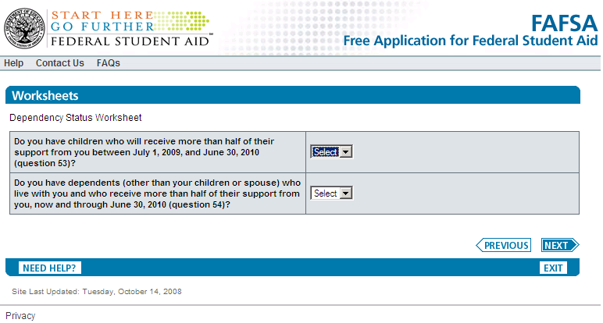
Dependency Worksheet
Displayed only if ‘No’ was answered for all questions on the first worksheet page.

Slide 13
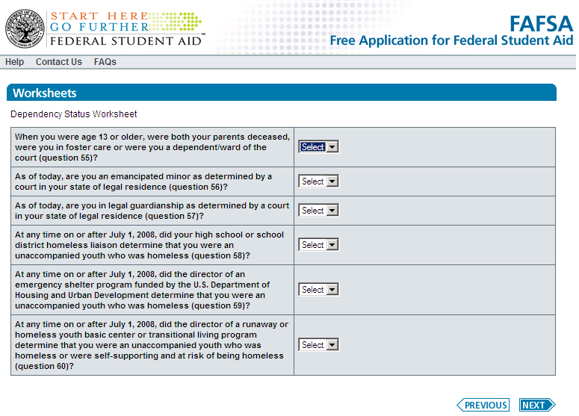
Dependency Worksheet
Displayed only if ‘No’ was answered for all questions on the first two worksheet pages

Slide 14
The 2009-2010
FAFSA on the Web Application

Slide 15
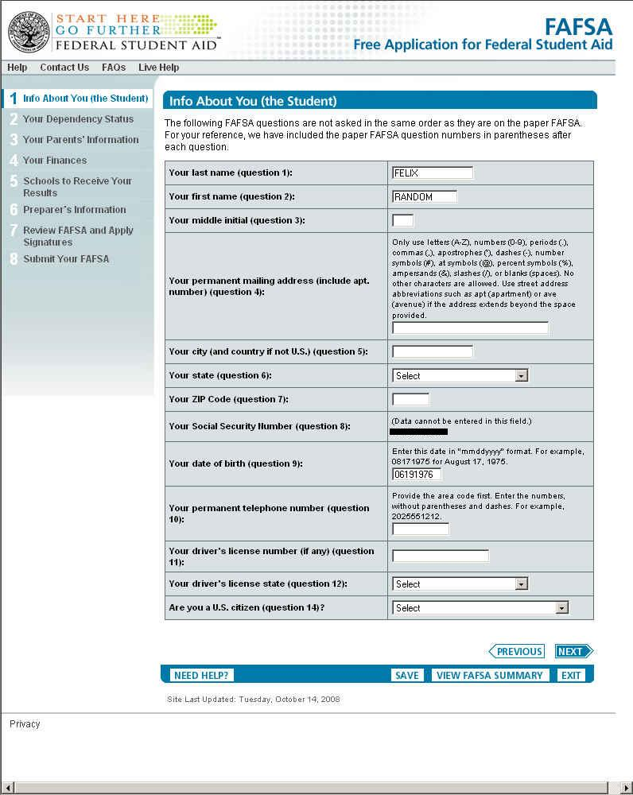
The First Page of FAFSA on the Web

Slide 16
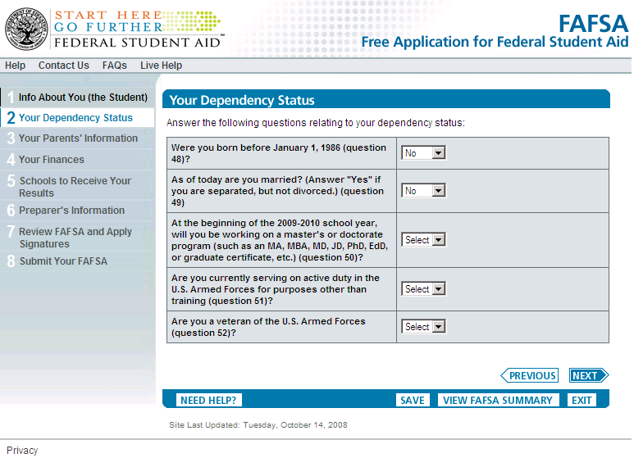
The Dependency Questions: Page 1 of 3

Slide 17
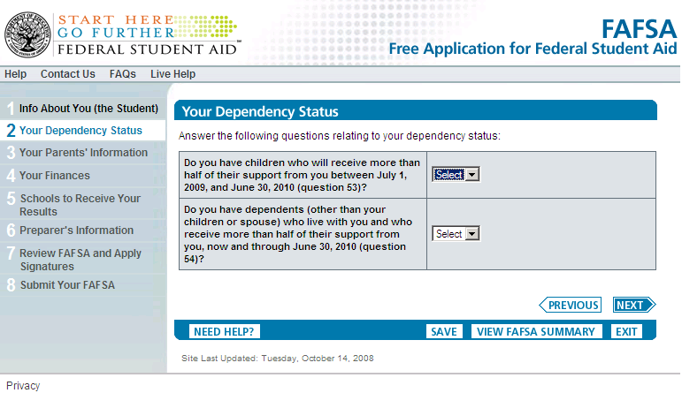
The Dependency Questions: Page 2 of 3
Displayed only if ‘No’ was answered for all questions on the first dependency questions page.

Slide 18
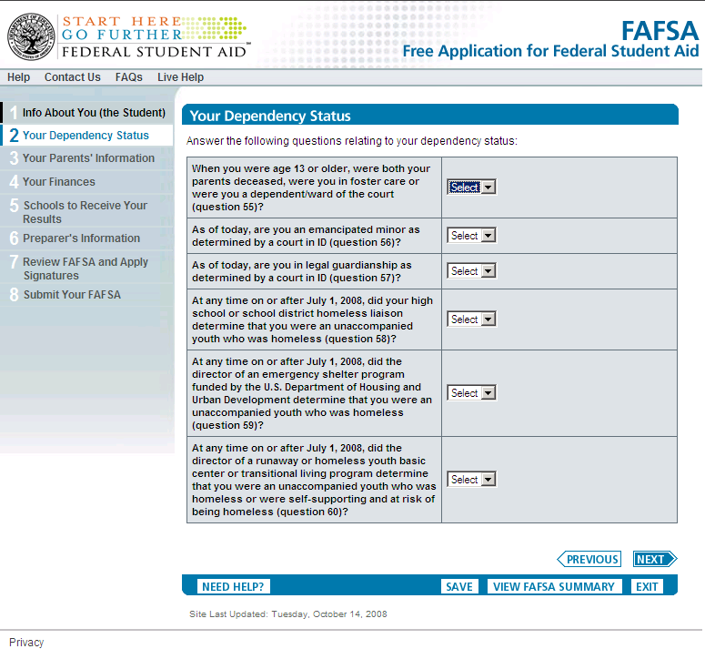
The Dependency Questions: Page 3 of 3
Displayed only if ‘No’ was answered for all questions on the first two dependency question pages.

Slide 19
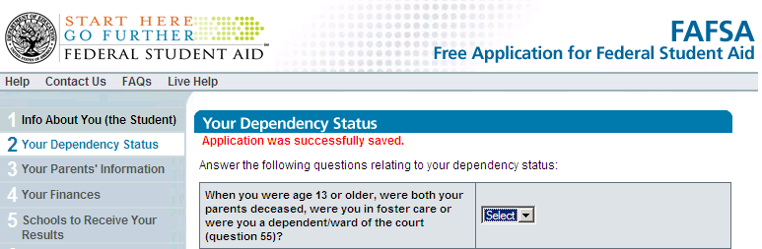
Application Saved Text

Slide 21
Special Circumstances
FAFSA on the Web has been updated to allow dependent students that are unable to provide parental data to submit their application online
No EFC will be calculated and students will be advised of the consequences of submitting an application without parental data
Students will be advised to follow-up with the financial aid office at the college they plan to attend.

Slide 22
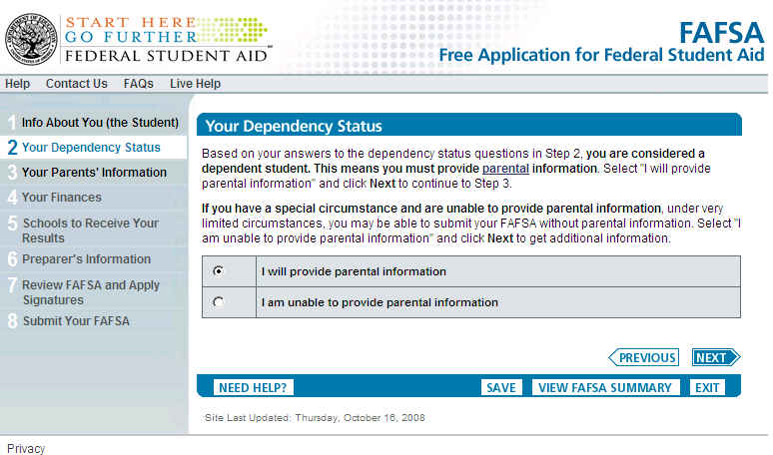
Special Circumstances: Page 1 of 3
Displayed only if student is dependent. Student can indicate that they will provide parental information or they can indicate they have a special circumstance.

Slide 23
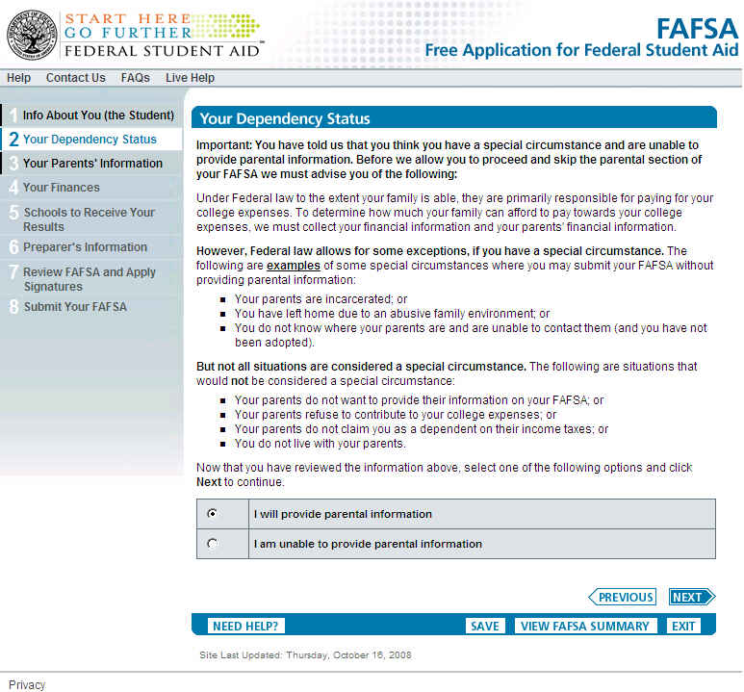
Special Circumstances: Page 2 of 3
Displayed only if a dependent student indicated that they have a special circumstance on page 1.

Slide 24
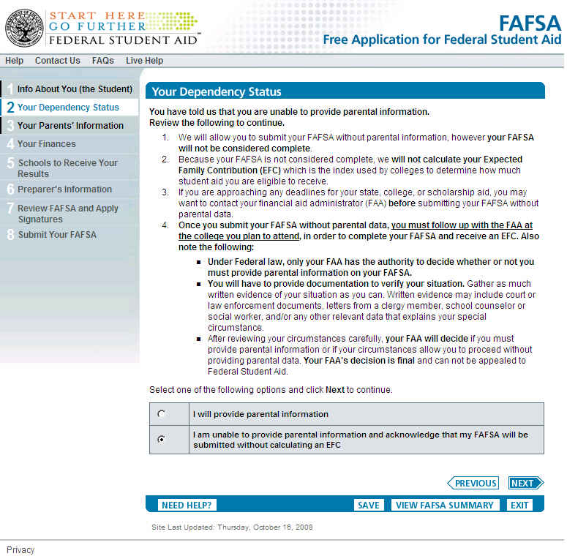
Special Circumstances: Page 3 of 3
Displayed only if a dependent student indicates that they have a special circumstance on page 2. Students must now confirm that they understand their FAFSA will be submitted without calculating an EFC.

Slide 25
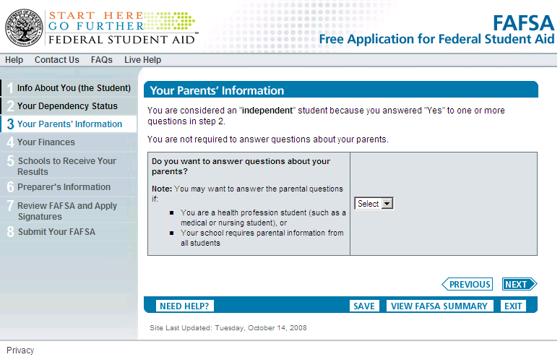
Independent Students and
Parental Questions

Slide 26
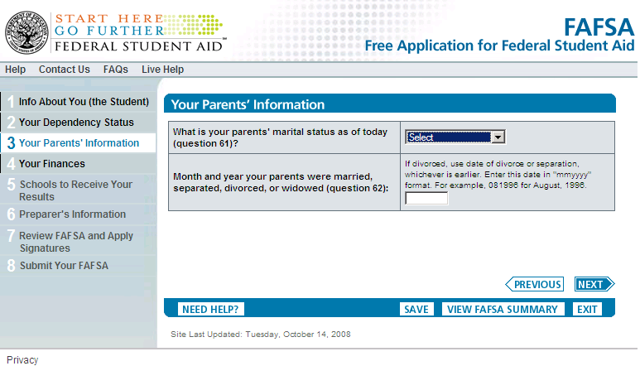
Entering Parental Data

Slide 27
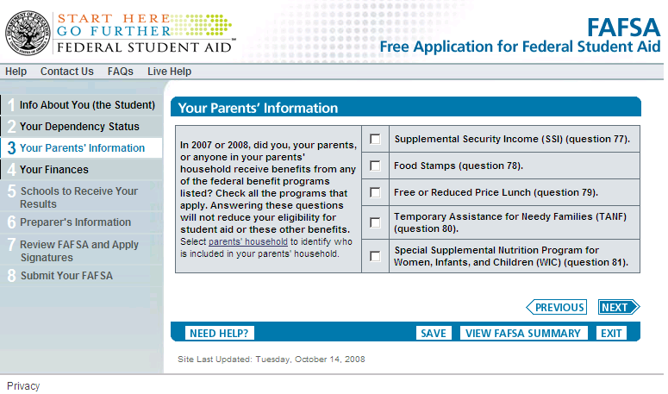
Means Tested Federal Benefits Questions

Slide 28
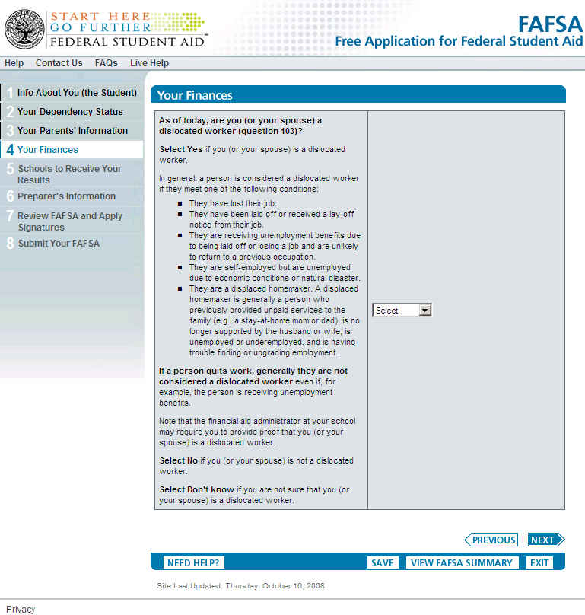
As of today, are you a dislocated worker?

Slide 29
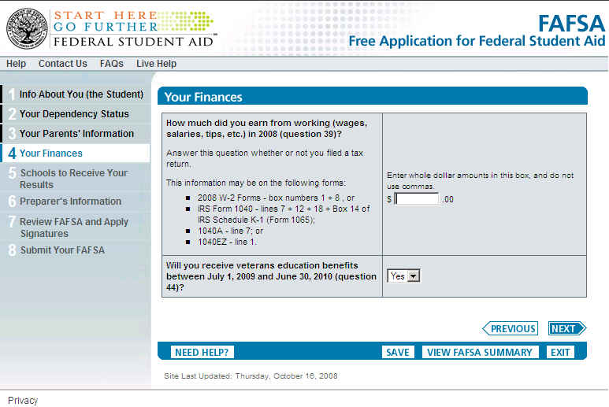
Will you receive veterans education benefits between July 1, 2009 and June 30, 2010?

Slide 30
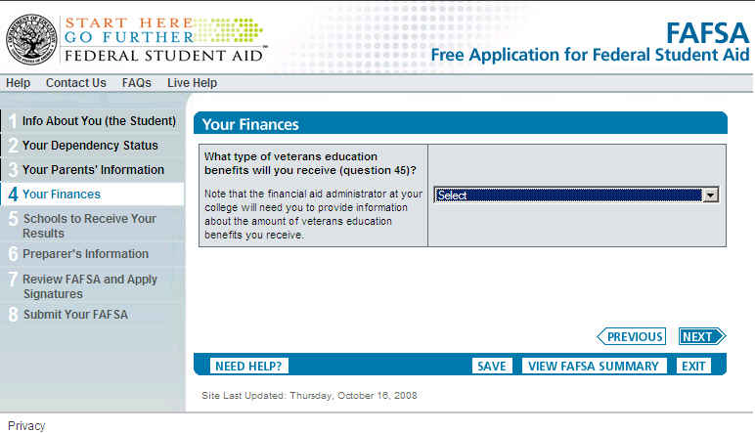
What type of veterans education benefits will you receive?

Slide 31
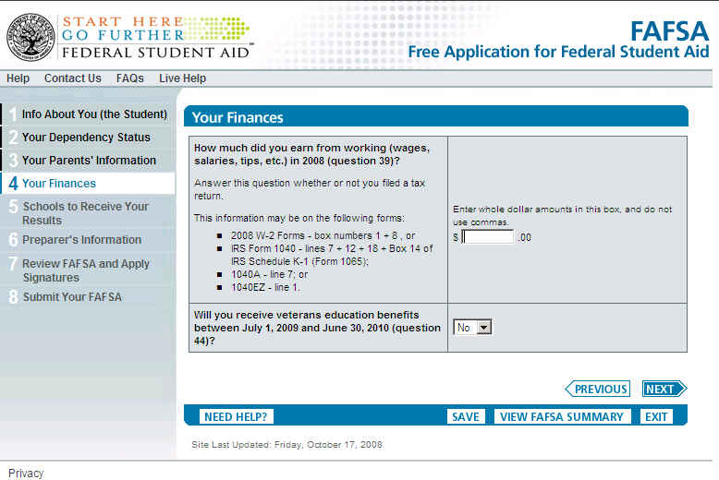
Entering Student Income Information

Slide 32
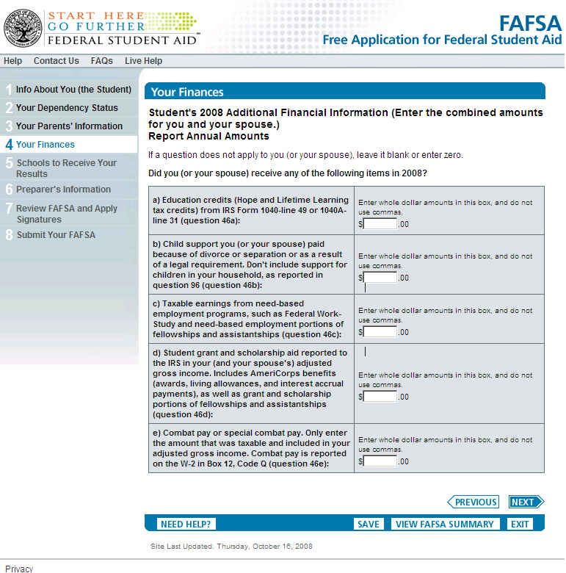
2008 Additional Financial Information

Slide 33
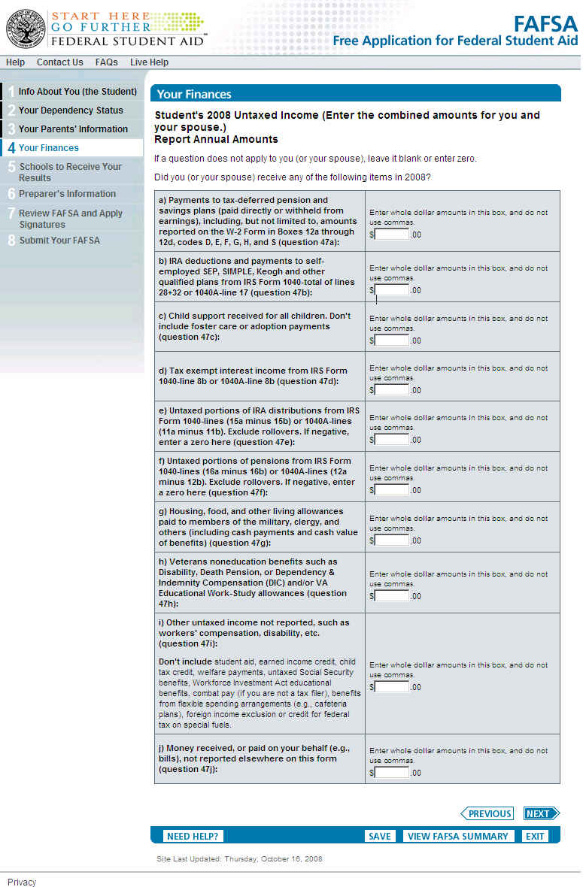
2008 Untaxed Income

Slide 34
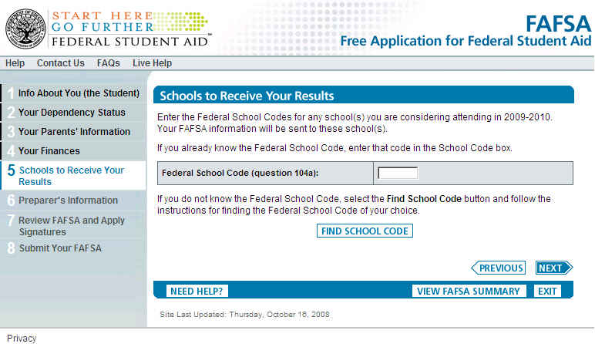
Searching for College Codes

Slide 35
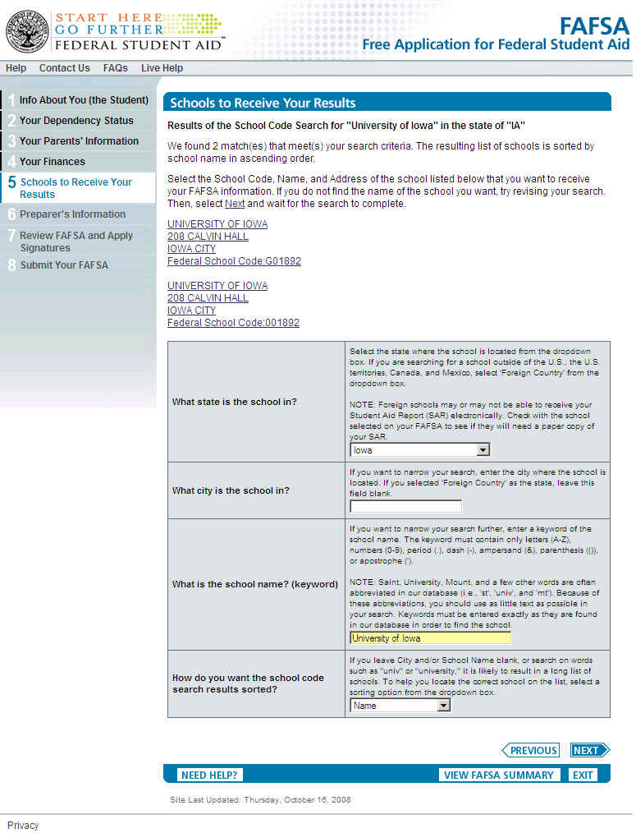
Searching for College Codes

Slide 36
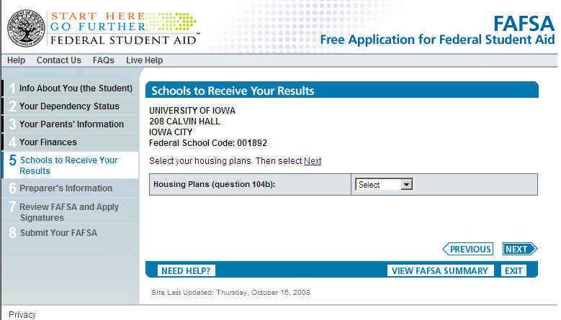
Searching for College Codes

Slide 37
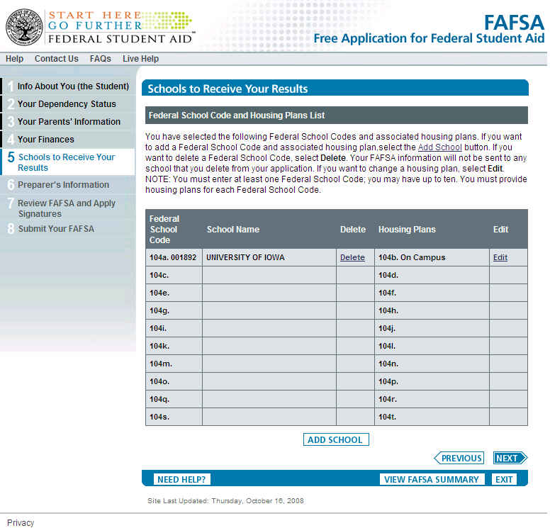
Searching for College Codes

Slide 38
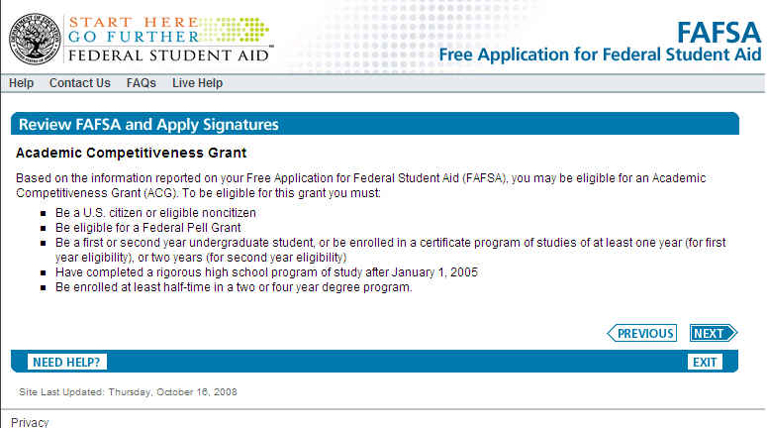
ACG Data Screens

Slide 39
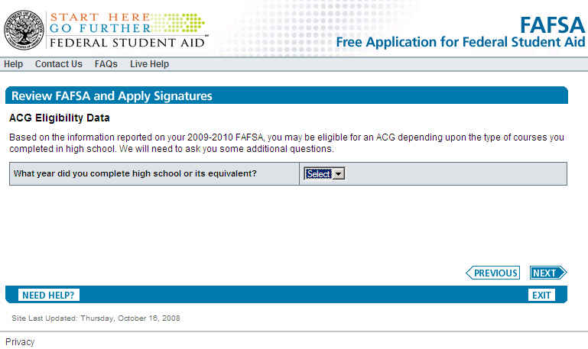
ACG Data Screens

Slide 40
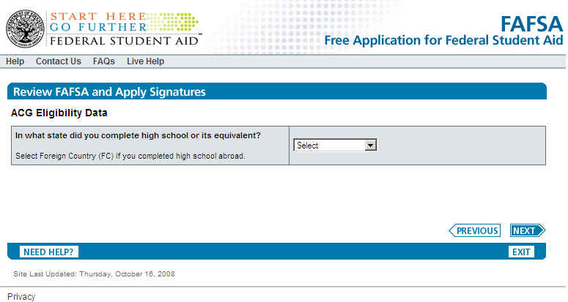
ACG Data Screens

Slide 41
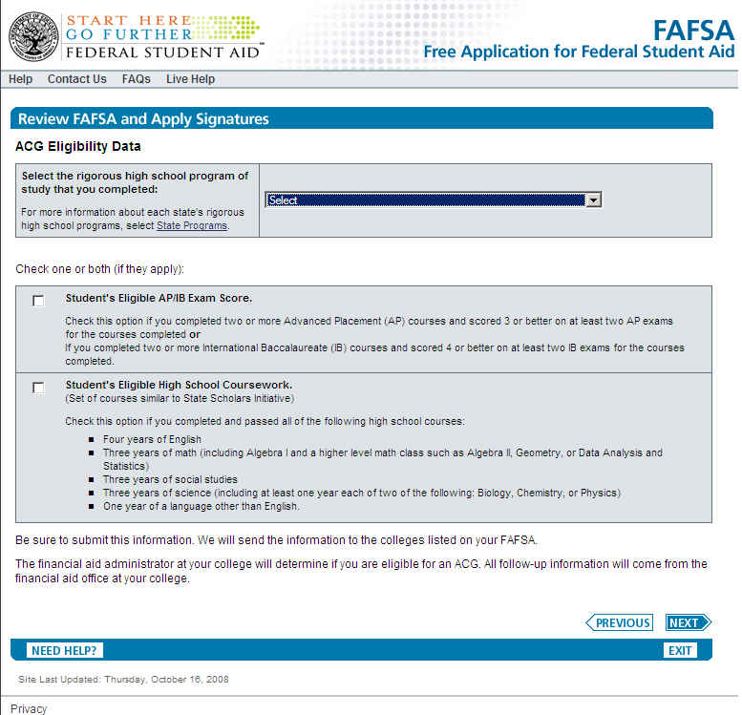
ACG Data Screens

Slide 42
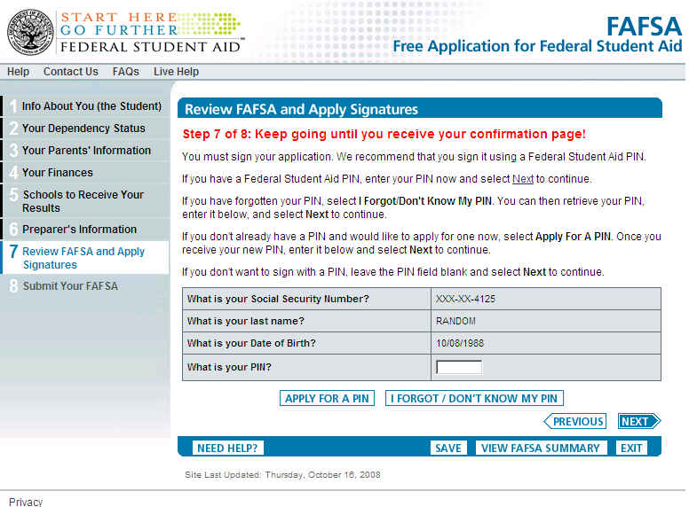
Signature Process

Slide 43
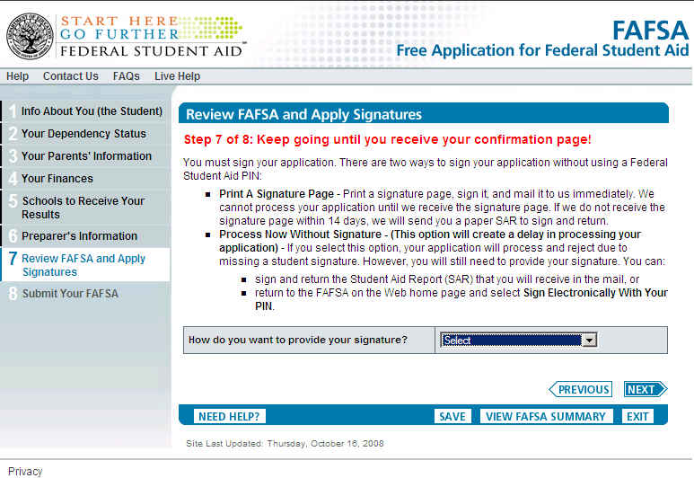
Signature Process – No PIN Provided

Slide 44
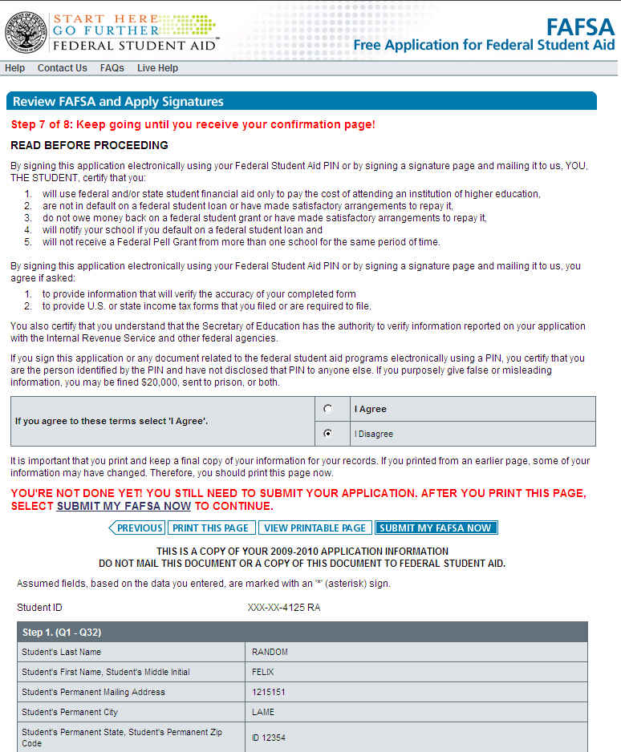
Agreement and Display of Application Information

Slide 45
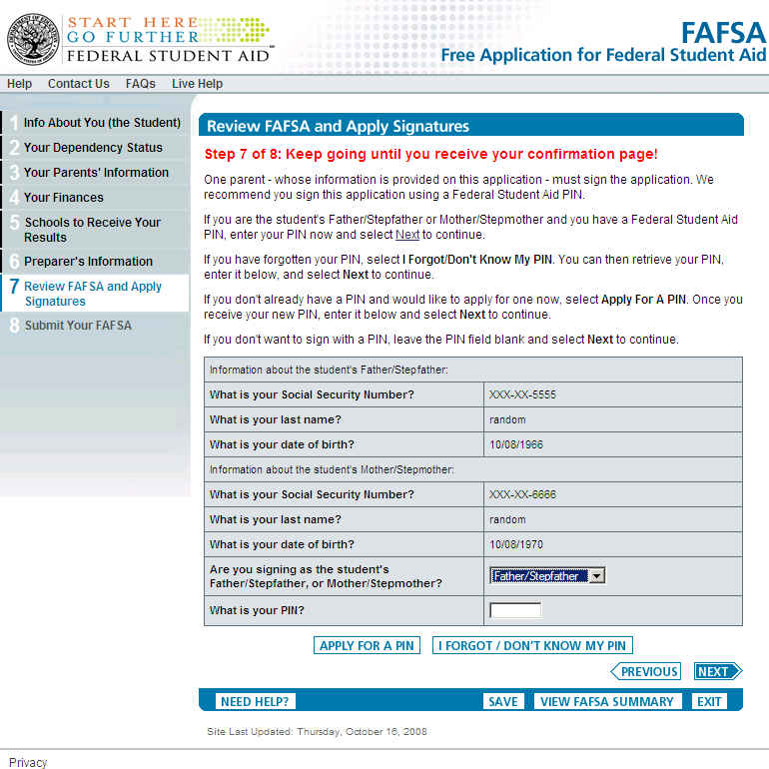
Signature Process - Parents

Slide 46
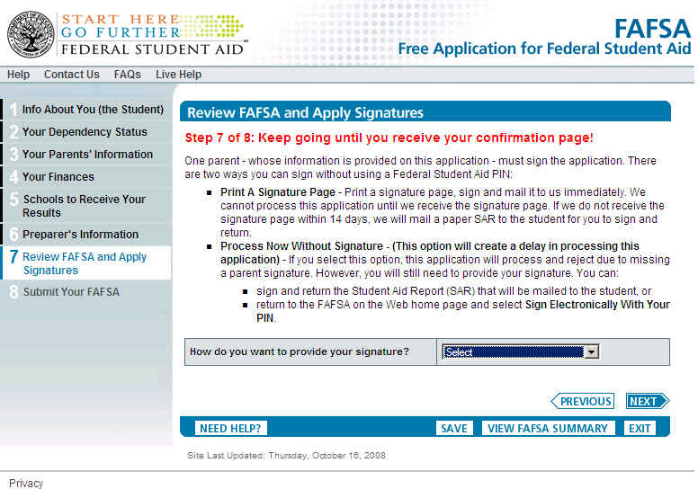
Signature Process – No PIN Provided

Slide 47
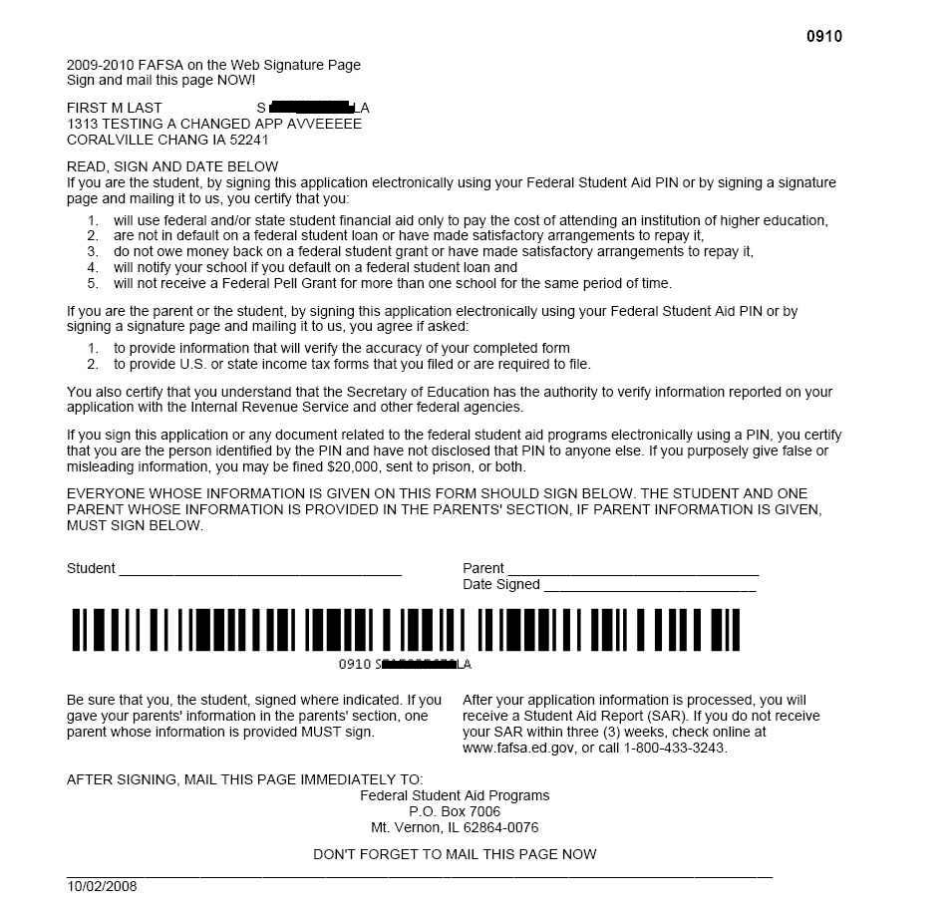
Signature Page – Student and Parent

Slide 48
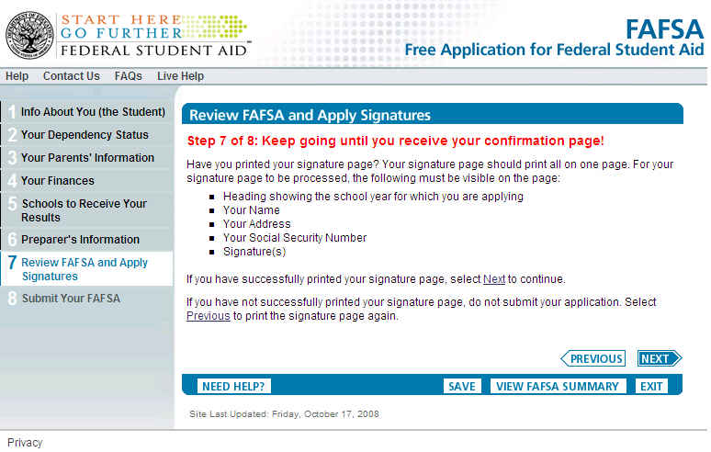
Signature Page Print Verification

Slide 49
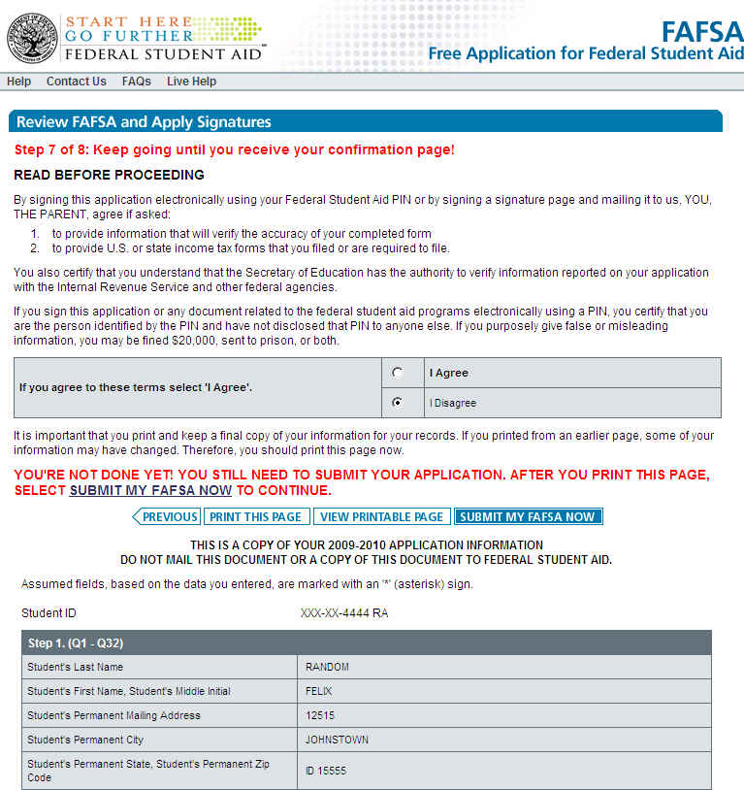
Agreement, Display of Application Information, and Submit My FAFSA Now

Slide 50
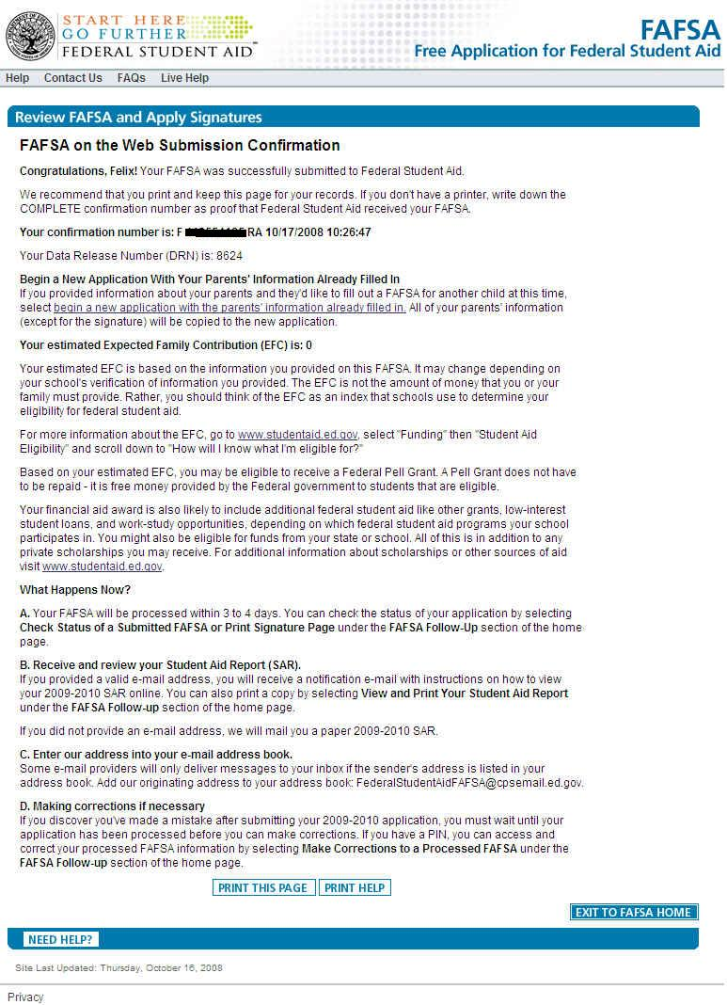
Confirmation Page

Slide 51
The 2009-2010
Spanish FAFSA on the Web

Slide 52
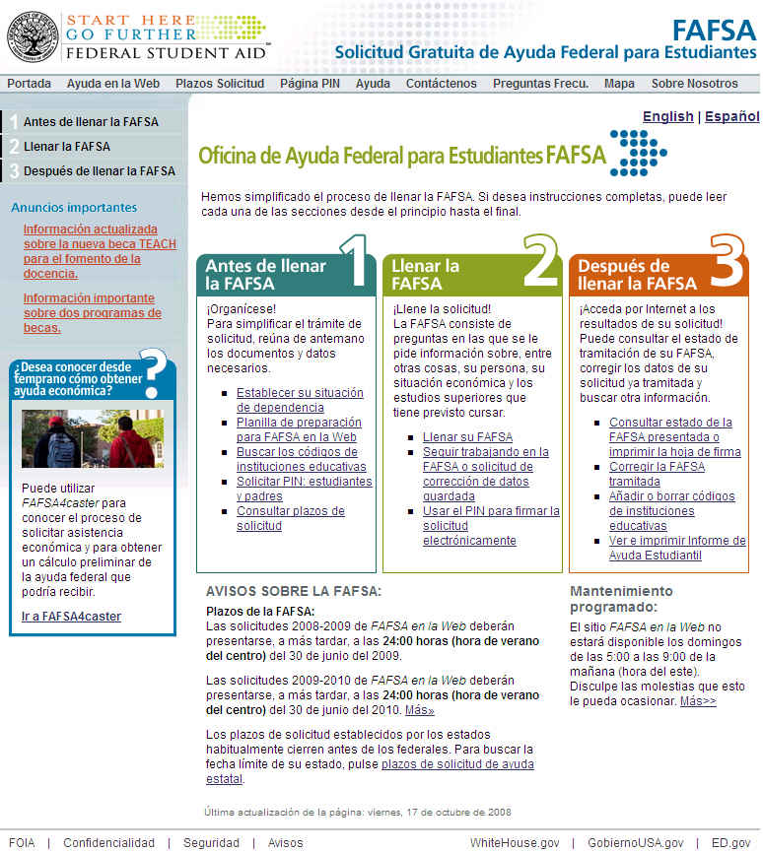
Complete Spanish FOTW Site

Slide 53
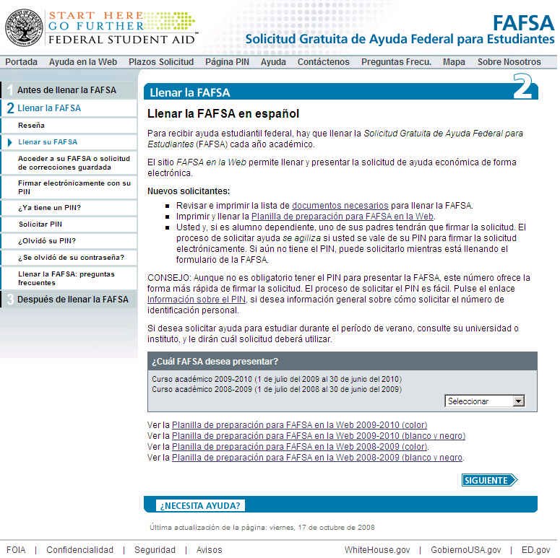
Accessing the Spanish FAFSA on the Web

Slide 54
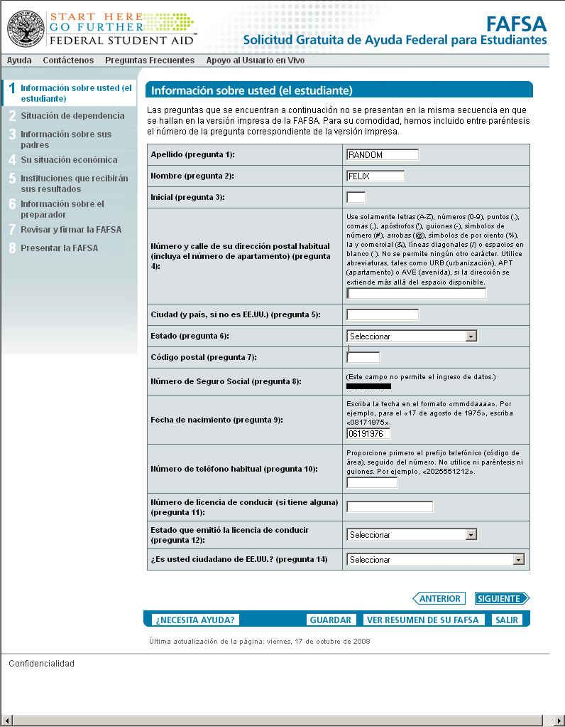
The First Page of Spanish FOTW

Slide 55
The 2009-2010
Corrections on the Web

Slide 56
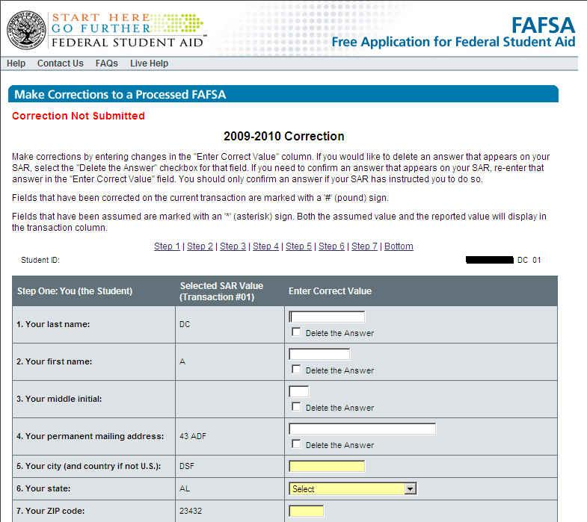
Corrections on the Web

Slide 57
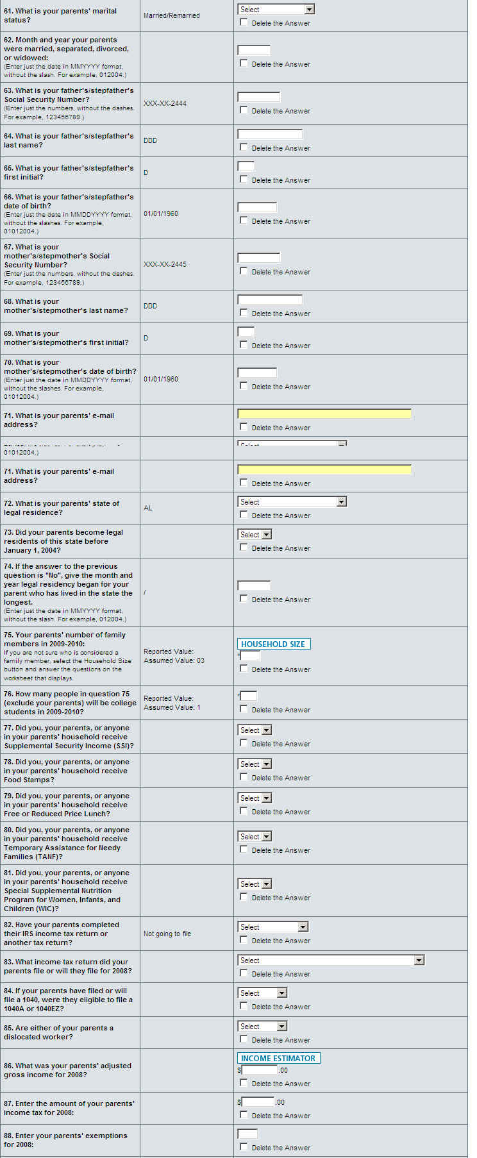
Corrections on the Web (continued)

Slide 58
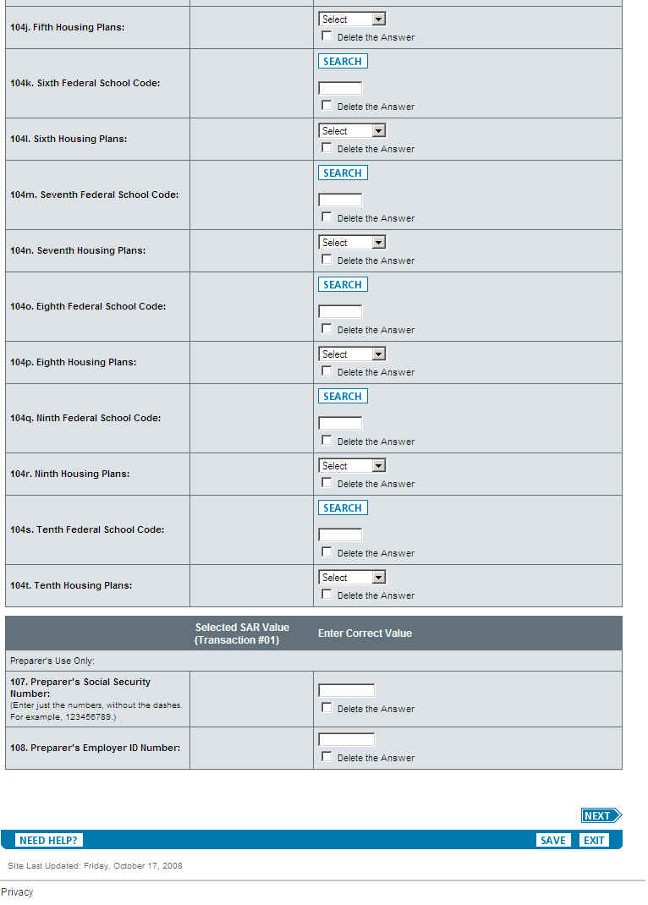
Corrections on the Web (continued)

Slide 59
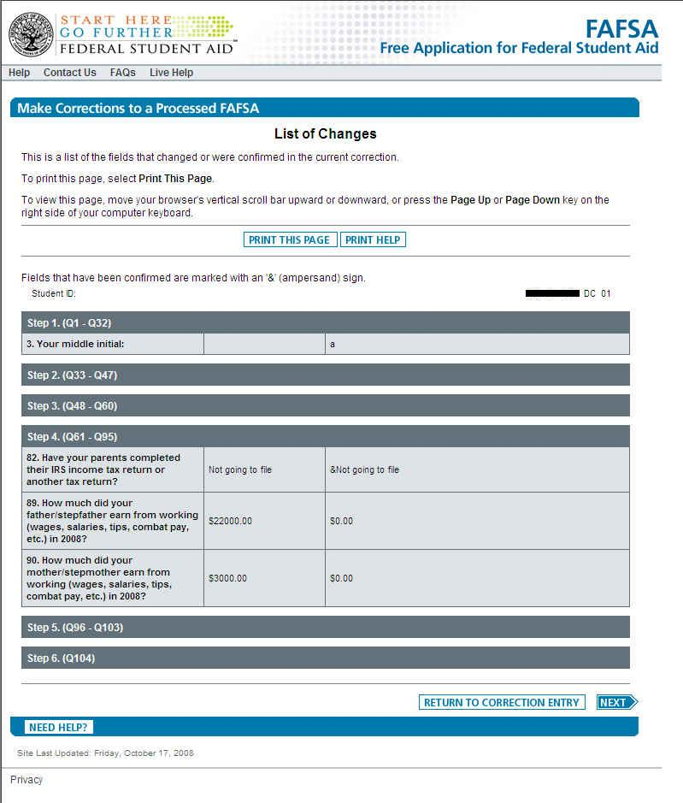
Student List Changes In Corrections

Slide 60
Additional Features and Screens

Slide 61
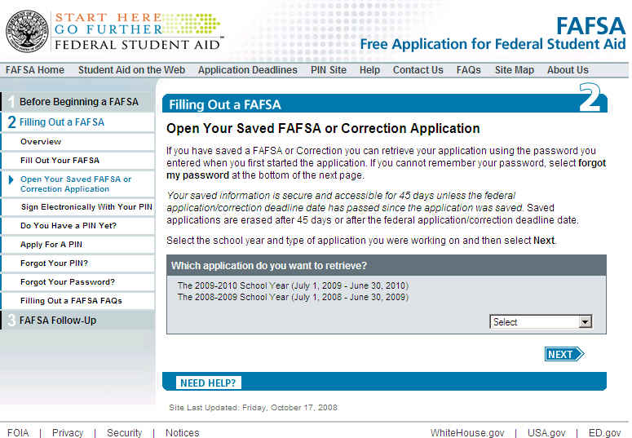
Opening a Saved Application

Slide 62
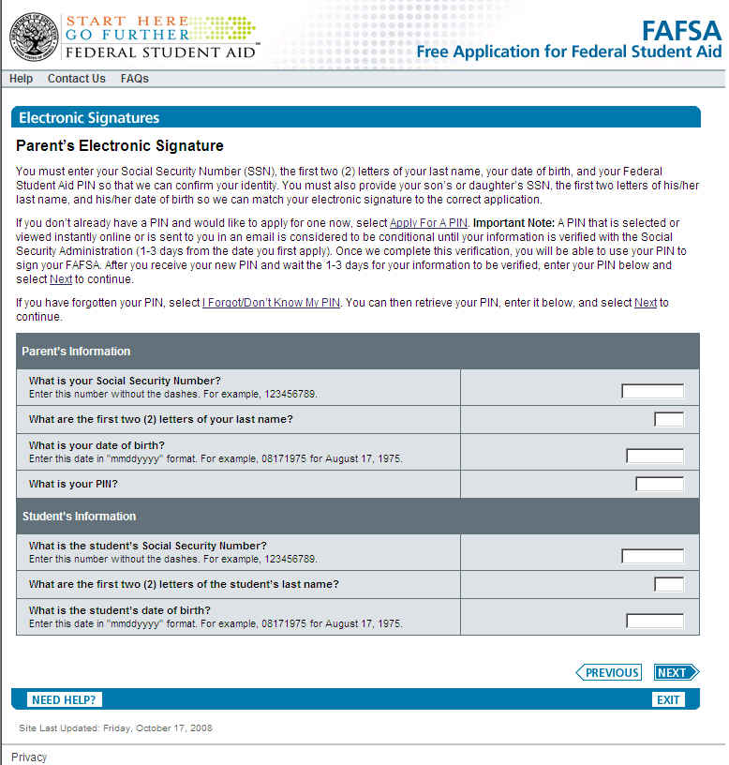
Providing an Electronic Signature

Slide 63

Application Status Check

Slide 64

Application Status Check –
Application Found

Slide 65

The First Page of Student Access

Slide 66

The Processing Information Page of Student Access

Slide 67
The previous screens represent a sample of the pages which will be found within the 2009-2010 FAFSA on the Web website.
The application and correction portions of the live FAFSA on the Web site will be available for applicants to use on Jan. 1, 2009.
You may use the FAFSA on the Web Demo site to preview the 2009-2010 application and correction processes beginning
December 14, 2008.
(FAFSA on the Web Demo site information is on the next page)

Slide 68
The FAFSA on the Web Demo Site
URL
  http://fafsademo.test.ed.gov
User Name
  eddemo
Password
  fafsatest
Availability
  2008-2009 FAFSA on the Web is available now
  2009-2010 FAFSA on the Web will be available beginning December 14, 2008

Slide 69
Thank you for previewing the 2009-2010
FAFSA on the Web website.
Click the button below to view this presentation again.
Click the button below to end this presentation.

