Slide 1

Welcome Vendors!
What is e-Buy and how does it Work?
e-Buy is designed to facilitate the request for and submission of quotes for commercial products and services offered through the GSA Federal Supply Schedules program. Using the e-Buy system, Federal Purchasers (buyers) may prepare and post a Request for Quote (RFQ) for specific products and services for a specified period of time. Once posted, schedule contractors (sellers) will receive an email notifying them that an RFQ has been posted and a quote is requested. This email also provides instructions to the seller on how to access e-Buy and submit their quote.
Each RFQ is assigned to a Federal Supply Schedule, Special Item Number (SIN) category by the buyer. The category assignment determines which sellers may receive the email notice to quote. Sellers are automatically listed under their awarded SIN categories. Buyers may notify all sellers listed under a specific SIN category or may choose to notify a lesser number of sellers. Sellers not notified may still submit a quote for an RFQ placed under their awarded SIN. It is advisable to check the e-Buy site daily for RFQ opportunities.
Navigation: If the tutorial opens up in your web browser, simply click your mouse to advance to the next slide. Use the “Backspace” key to go back. If the tutorial opens in the PowerPoint application, click on “F5” to view the tutorial. Use the spacebar or click your mouse to advance to the next slide. To go back, click on the “Backspace” key. To save the tutorial to your hard drive, right click your mouse over the “Here” link and double click on “Save Target As…”. Then select the location on your hard drive to save the file.

Slide 2
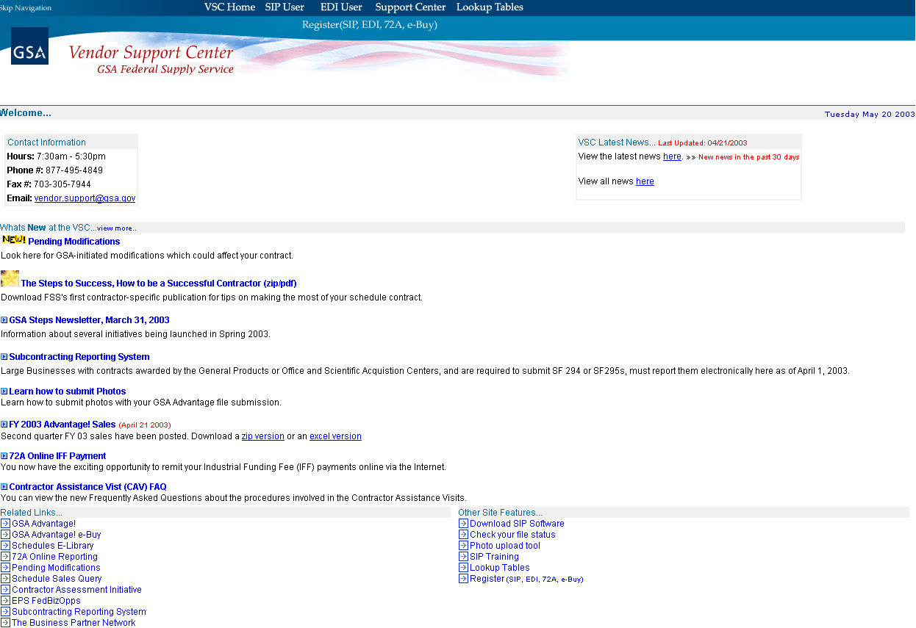
The e-Buy system is located at the Vendor Support Center website vsc.fss.gsa.gov.
Click on this link to access e-Buy.

Slide 3
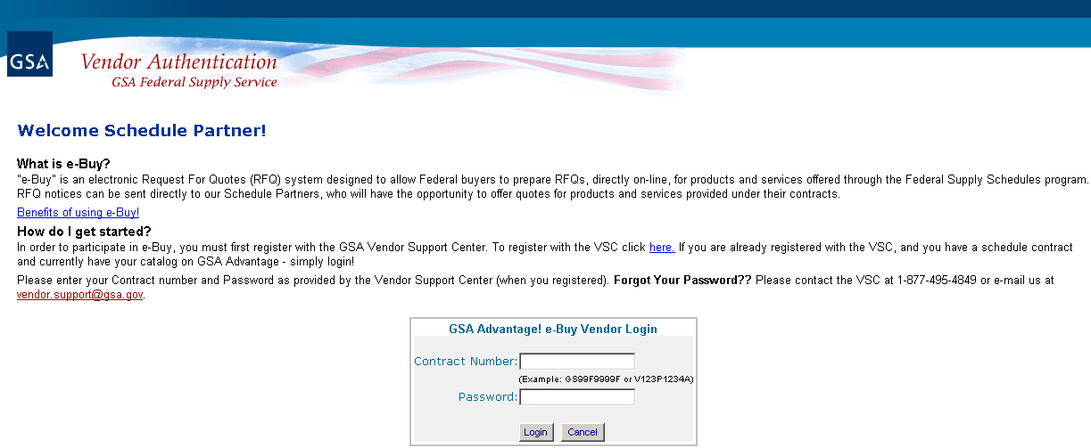
In order to access e-Buy, you must login to the system with your “Contract Number” and your VSC assigned “Password”.

Slide 4
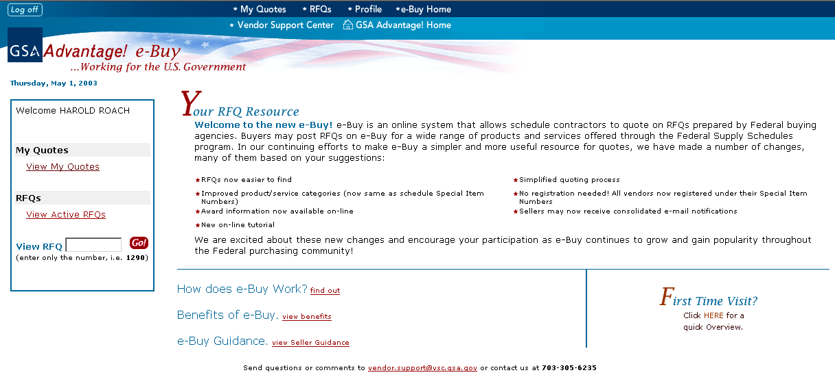
Upon successful login, you will proceed to the e-Buy homepage.
You may view RFQs, by clicking on “RFQs”.
If you have received an email notifying you of an RFQ or already have an RFQ number, you may enter the number here.

Slide 5
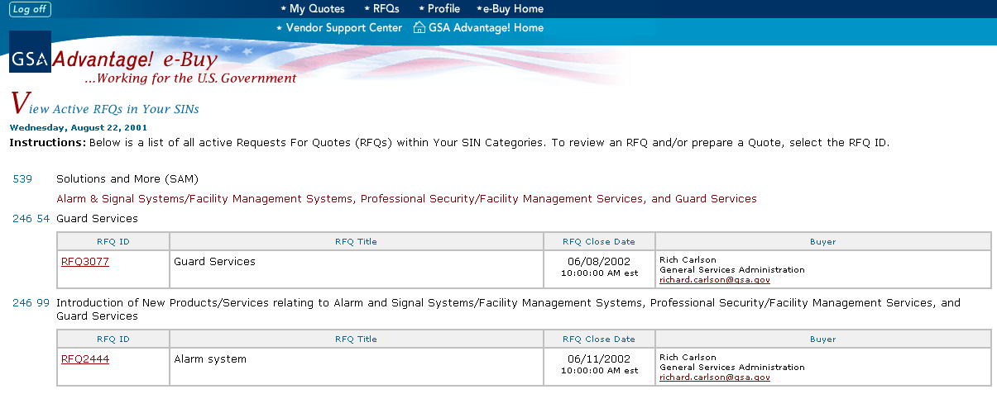
A list of RFQs, from your awarded SIN Categories, will be displayed. Note: You will not be able to quote on RFQs from SINs you do not have contracts under.
If you have questions about the RFQ, you can contact the buyer by clicking on the email link.
To view or quote on an RFQ, click on the “RFQ ID” link.
The “RFQ Title” is displayed here
Make sure to note the “RFQ Close Date”. Any quotes received after the RFQ closes will not be accepted.

Slide 6
Guidelines for Submitting Quotes
Seller may view and offer a quote against any RFQ posted on e-Buy that falls under one of the Special Item Numbers (SINS) awarded under their Federal Supply Schedule contract. Sellers must offer only those products and services included in their schedule contract and may not include open market or “incidental” items in their offer.
Seller will receive an email notifying them that a quote is requested whenever and RFQ is placed in one of their SIN categories, unless the buyer elects to notify a lesser number of sellers. Sellers not notified via email may still submit a quote. Check e-Buy daily for RFQ opportunities since email notification is not guaranteed.
Sellers may not see the number of bidders, nor may they see the number of emails sent out requesting quotes.
Seller quotes are not visible to other sellers. Sellers will not be provided names of other sellers. Only the buyer can view the seller names and quotes. However, award information will be made available on e-Buy after the RFQ has closed.
Seller may provide comments or attach other documents as necessary to complete their quote.
Seller may quote on a portion or all of the requirements (unless buyer indicates “all or none” in the RFQ).
Sellers submitting quotes on a GSA Advantage catalog item may offer brand name or equal (unless buyer specifies brand name only in the RFQ).
Quotes must include all charges. Any extra charges (i.e. transportation, installation, inside delivery, etc.) which are part of the quote, must be specified and included in the quote. There is a separate area to provide transportation cost if the product(s) offered are FOB origin.
Seller must indicate a time period for how long the quote is valid. However, all quotes must be good for a minimum of seven (7) days from the RFQ closing date.
Seller may modify their quote anytime prior to closing. The buyer will only see your final quote.
Seller will receive an email informing them if their quote was awarded or not awarded. For award information, please login to e-Buy and go to “My Quotes”.
Submission of a quote does not obligate the buyer to submit an order. However, if a quote is awarded, buyer must submit an order.
Seller may contact the buyer if clarification is needed or if there are questions or if a response to a quote has not been received within 15 days after the RFQ has closed.
A buyer may make a partial award under some conditions
A buyer may generate order through e-Buy or they may generate purchase orders separate from e-Buy using their own internal systems.
Before preparing your quote, please review the “Guidelines for Submitting Quotes”.

Slide 7
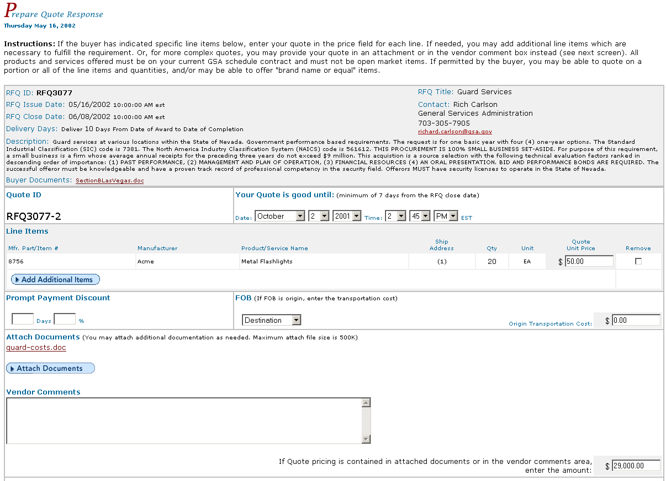

On the “Prepare Quote Response” page, you can view the buyer’s requirements and enter your quote information.
The information submitted by the buyer is listed in this box.
The requirements of the buyer will be displayed in the “Description” or via the “Buyer Documents” attachments.
Make sure to specify how long your quote is good for. The quote must be valid for a minimum of seven (7) days after the RFQ closes.
The buyer may also request quotes on individual line items, which will be displayed here. Enter your pricing information in the “Quote Unit Price” box.
The “Quote ID” will be displayed here.
In order to quote, you may need to include additional documentation. Files can be added by clicking on “Attach Documents”.
If the products are being offered FOB origin, make sure to include the transportation costs in this box.
Any additional comments may be added in this box.
If your pricing is included in attached documents or the in comments box, enter the total quote price in this box.
After entering all quote information click on “Continue”.

Slide 8
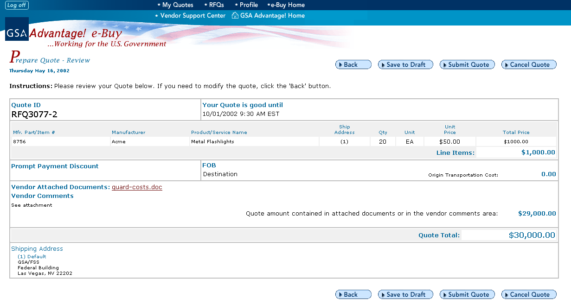
Your quote is now ready for a final review. If you need to make changes, click on “Back”. If you are ready to send the quote, select “Submit Quote”.
If you save a quote to draft, the quote will not be sent to the buyer until you click on “Submit Quote”.

Slide 9
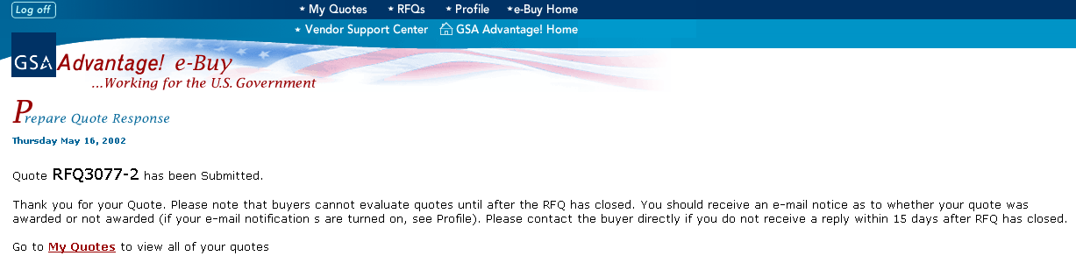
After your quote has been submitted, a confirmation will be displayed. To view your quote, click on “My Quotes”.

Slide 10
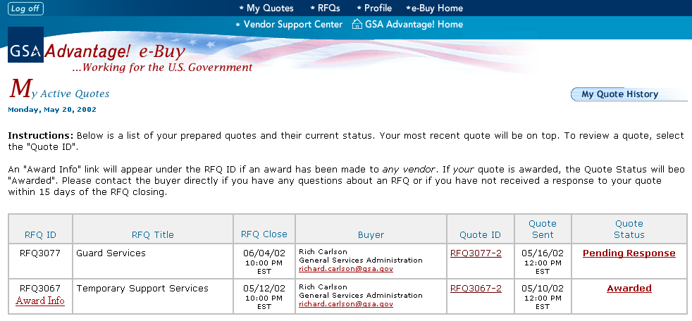
A list of your quotes will be displayed on this page.
Your quote may be modified by clicking on the “Quote ID” link.
If an award has been made by the buyer, an “Award Info” link will be displayed under the “RFQ ID”. Click on the link to view information on who received the award(s) under this RFQ.
Your quote status will be displayed here. Click on the link for status definitions.

Slide 11
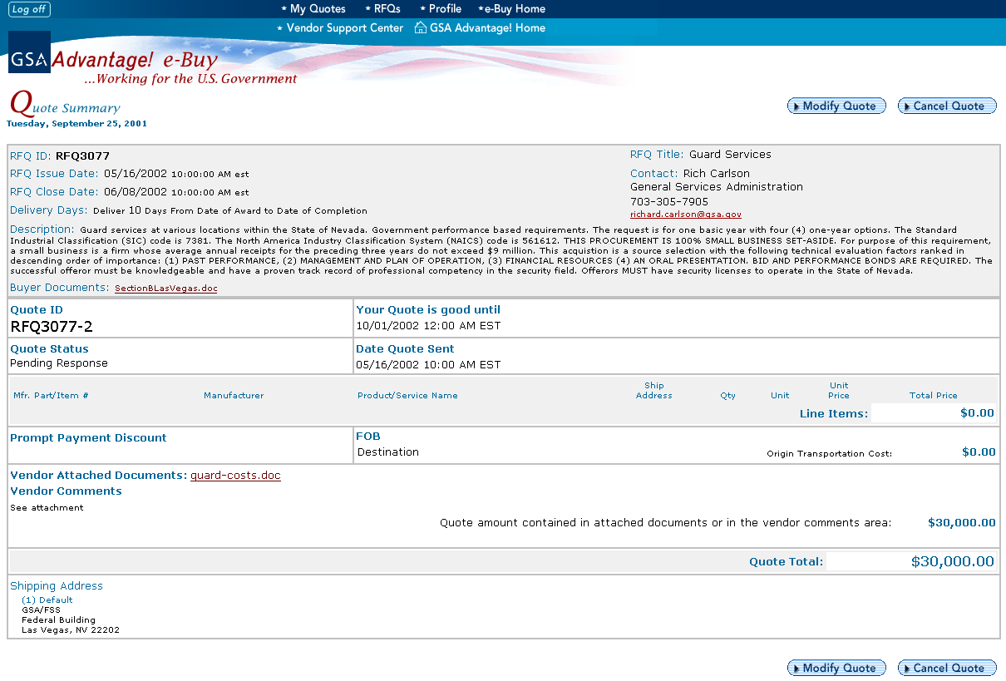
Upon clicking on the “Quote ID” link, a summary of your quote will be displayed. Your quote can be updated by clicking on the “Modify Quote” button. The quote may be modified as many times as necessary prior to the RFQ closing.
You may also cancel your quote, anytime prior to closing, by clicking on “Cancel Quote”.

Slide 12
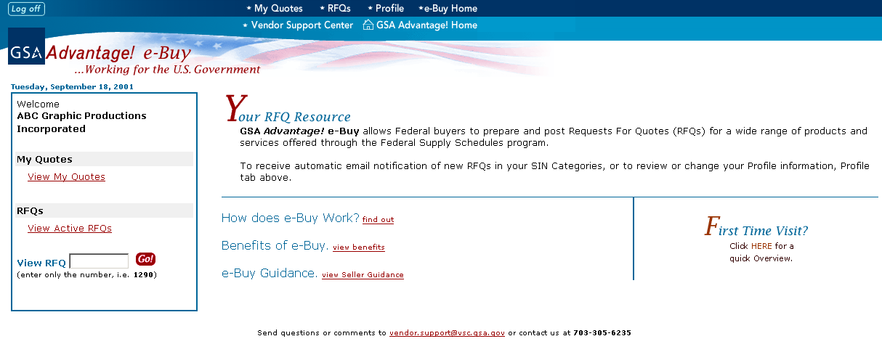
For each vendor, e-Buy maintains a “Profile” area. This area can be accessed by clicking on the “Profile” link at the top of any page.

Slide 13
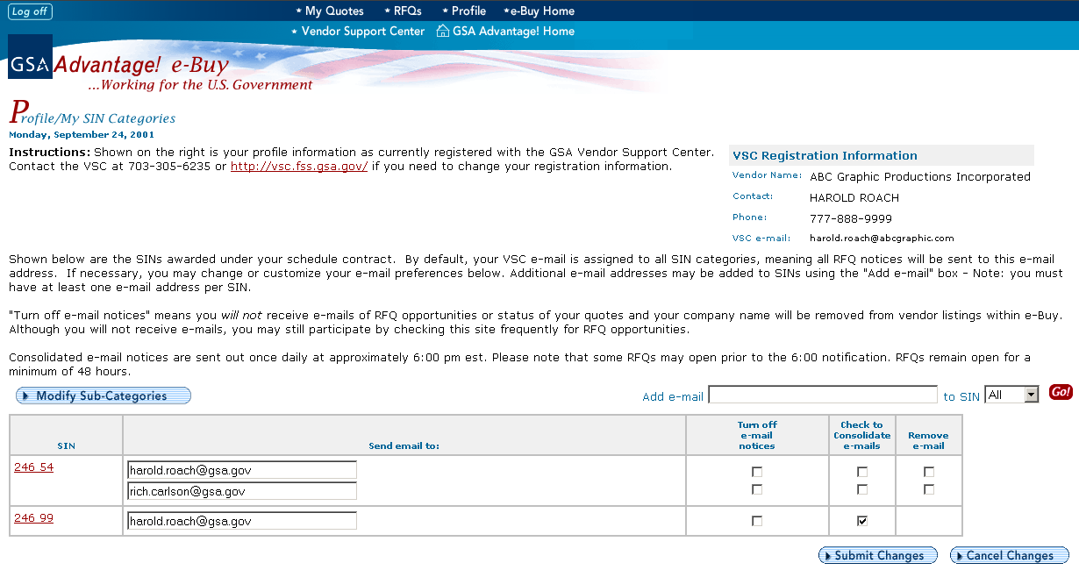
The “Profile” stores personal information that is registered with the Vendor Support Center.
You can add email addresses by entering the address in this box and selecting the appropriate SIN.
The “Profile” also contains email information. In order to receive RFQ email notification, you must assign an email address to each SIN. You may add multiple addresses for each SIN.
The system also allows you specify your email preferences.

Slide 14
Check Out the Great Benefits e-Buy has to Offer our Schedule Partners!
e-Buy maximizes the opportunity to participate by notifying you of new government requirements for your products and/or services!
e-Buy saves you money by reducing the cost of finding government business opportunities and reducing lead-times and cost of submit quotes!
e-Buy is interactive, allowing federal buyers and schedule contractors to communicate requirements and quotes via the web and e-mail!
e-Buy helps vendors establish new business relationships as new opportunities are discovered!
e-Buy is efficient, because it is an electronic RFQ/Quote system which streamlines the acquisition process!
e-Buy increases sales potential as it makes you more aware of new business opportunities!
e-Buy provides valuable information on the Federal marketplace allowing you to expand your customer base!
e-Buy saves you time since business opportunities are sent directly to you via email and quotes can be sent electronically!
e-Buy is fast and easy to use!
We are excited about the new e-Buy and encourage your participation as e-Buy continues to grow and serve as a vital acquisition tool throughout the Federal purchasing community!

