Slide 1
DOTS Plus Online System Overview
Presented by: Federal Aviation Administration
Oceanic & Offshore Operations
Date: 05 – 09 November 2007

Slide 2
Using DOTS+
Interaction with DOTS+ is currently done with plain ASCII messages:
Access is through specific terminals via X.25 protocol.
Data entry can be tedious and error-prone.
There is no notification of changes – updates must be explicitly requested each time.

Slide 3
The old way.
TKF.AAL934.1010.KIAD.ZSPD.300.ORVIT.2020.10.

Slide 4
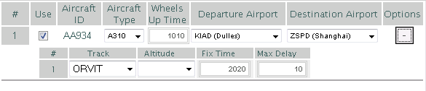

The new way.

Slide 5
Using DOTS+ Online
DOTS+ Online will provide a robust, user-friendly interface…
Will allow users to do everything with DOTS+ that they do now.
Access is through any common web browser via the Internet (will support Internet Explorer 6.0 and Firefox 2.0 at minimum).
Immediate validation of data avoids erroneous submissions.
Updated data is pushed to users automatically in real-time and near real-time.
Frequently submitted data can be stored in template-like lists that can be submitted en masse.
Customizable appearance and settings for each user.

Slide 6
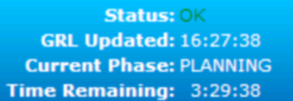
System Status Monitoring
Overall system status is monitored and displayed (indicates connectivity with DOTS+).
The last update time for the GRL is displayed.
The current DOTS+ phase (e.g., “PLANNING”) is displayed.
The time remaining in the current phase is displayed

Slide 7
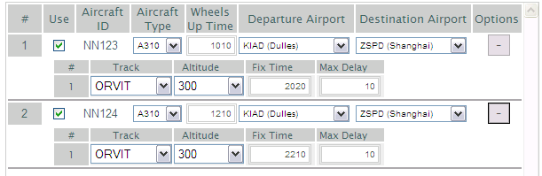
Stored Reservation Requests
Frequently used requests can be stored for regular submission.
Stored requests can be modified as needed before being submitted.

Slide 8

Dynamic GRL
Gateway Reservation List has two views.
Table View shows all data in a sortable spreadsheet-style list.
  Cells containing updated data are highlighted.
Changed data
Changed row indicator (click to clear highlights)

Slide 9
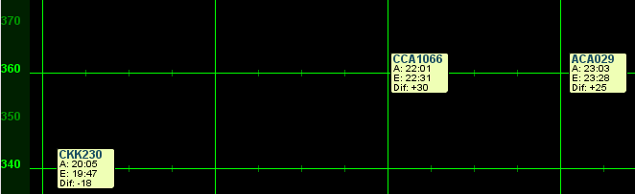
Dynamic GRL
Graphical View shows gateway reservations by altitude over time.
  Reservations can be dragged to new times and/or altitudes, automatically generating a request to DOTS+.

Slide 10
Current Project Status
Implemented in Java (Java Server Pages and applets), Javascript, and Asynchronous Javascript with XML (AJAX).
Currently 11,444 lines of code.
Overall development is approximately 85% complete.
First deployment expected as scheduled, 1st Qtr FY08.

Slide 11
Testing and Training
A “Testing and Training” server is on the Internet at http://dotsplus.cssiinc.com.
No actual DOTS+ machines are currently connected – a “DOTS Simulator” is performing very limited DOTS functions.
For those interested, accounts can be set up to use the Testing and Training server.

Slide 12


