Slide 1
Polar/VIS Resident Archive
Design goals
  Polar/VIS resident archive to be located at U. of Iowa and mirrored at GSFC. [1]*
  User from the internet can access the entire VIS data set, process raw (*.dat) images, display those images, download those images, download the pixel data (pc2 files) [2]
  The images can be displayed raw [4,6] or
  The images can be put through a default “best processing” and displayed [3,4,6] or
  The images can be “advanced” processed by the experienced user and displayed. [6]
  Advanced User accounts to perform multiple image processing [5,6]
  Automatic account setup with email notification to system administrators and PI.[3]
  Email to user upon completion of data processing [3]
  FTP directory setup for downloading of data [3]
  Automatic expiration after 2 weeks [3]
  Survey Files served as per current web site [2,6]
  ASCII files deliver full data set (column, row, intensity, pixel location) [7]
  Spacecraft positional and attitude information for each image will be provided [8]
  Links to the other Polar resident archives will be provided [9]
  Documented procedures for obtaining scientifically useful data [10]
2 PCs for redundancy
Step-by-Step Schedule for completion in the next year.
* Numbers in brackets refer to Polar Mission Resident Archives Guiding Principles

Slide 2
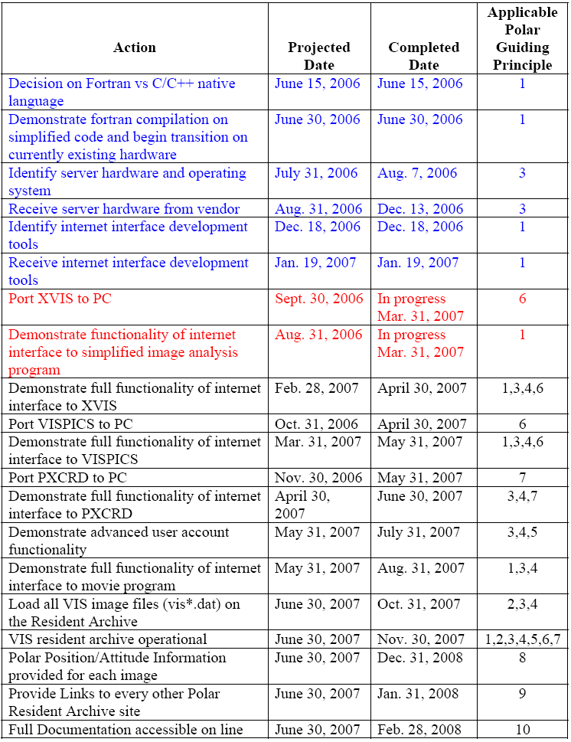
Polar/VIS Resident Archive Schedule

