Slide 1
eTariff Public Viewer
(eTariff Search Page)

Slide 2
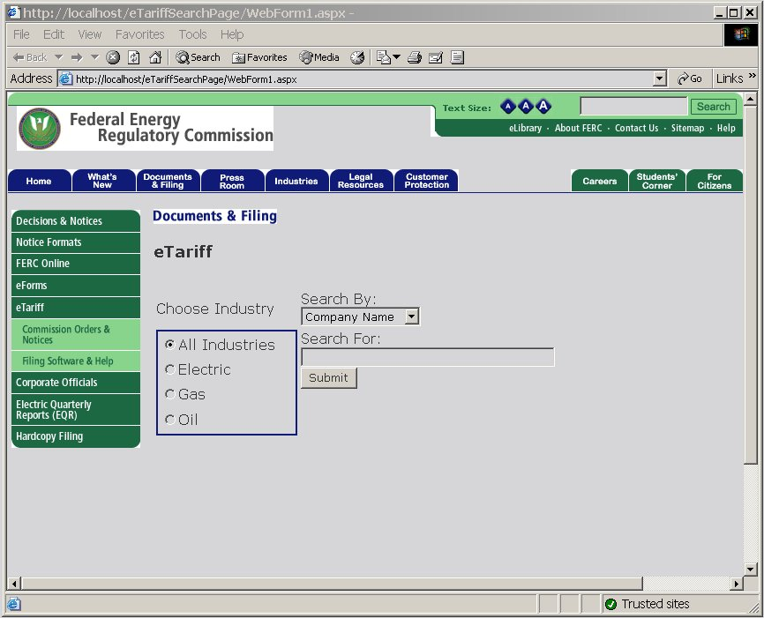
eTariff Public Viewer
First page displayed to user:

Slide 3
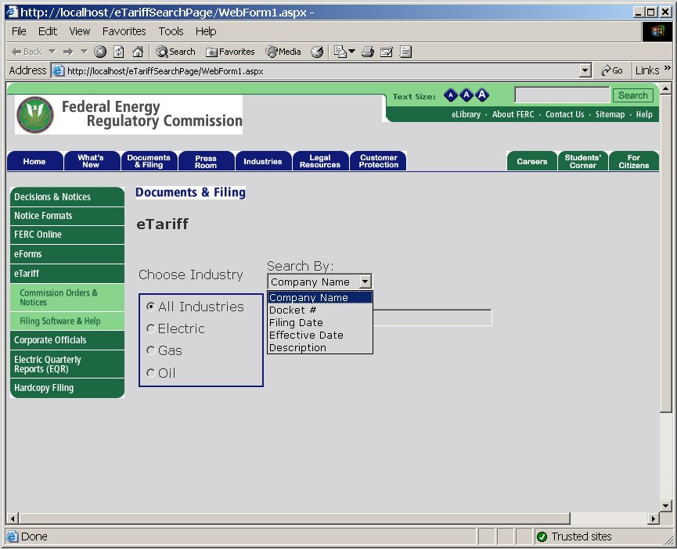
eTariff Public Viewer
User can search using several different criteria (Search By):

Slide 4
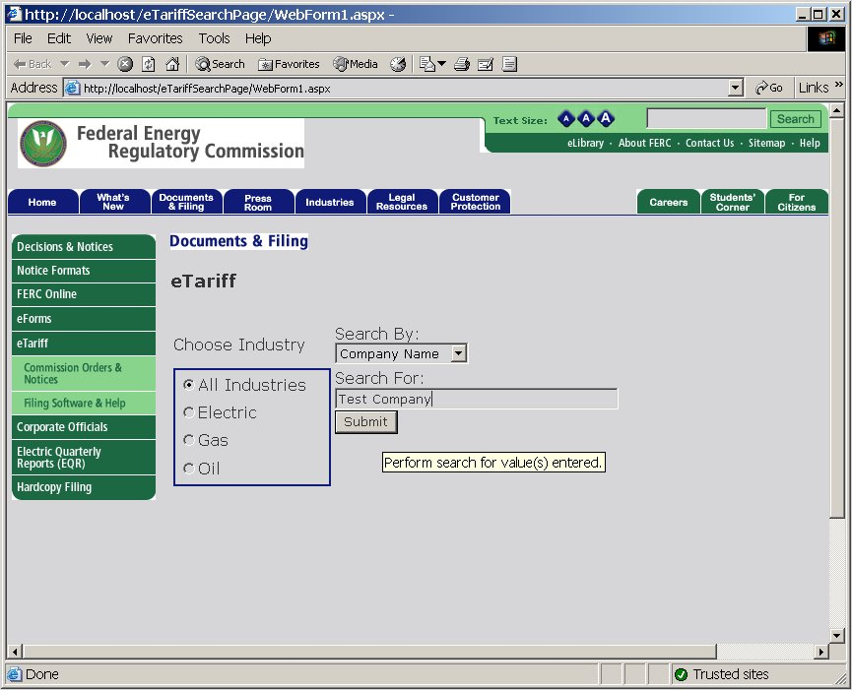
eTariff Public Viewer
User enters what they are searching for (Search For) and clicks Submit button:

Slide 5
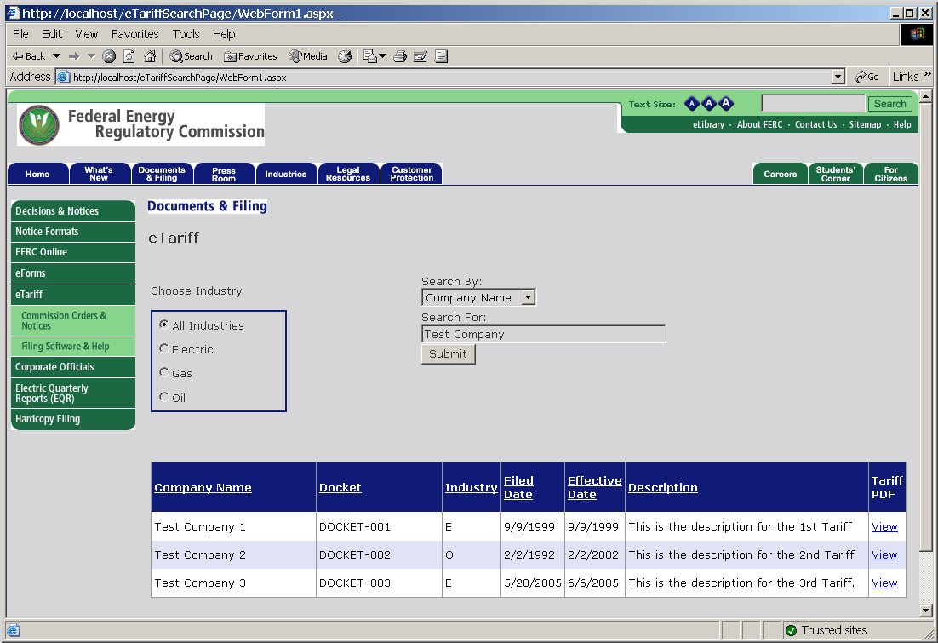
eTariff Public Viewer
Matching records are displayed in a grid. Link to Tariff is shown at right:

Slide 6
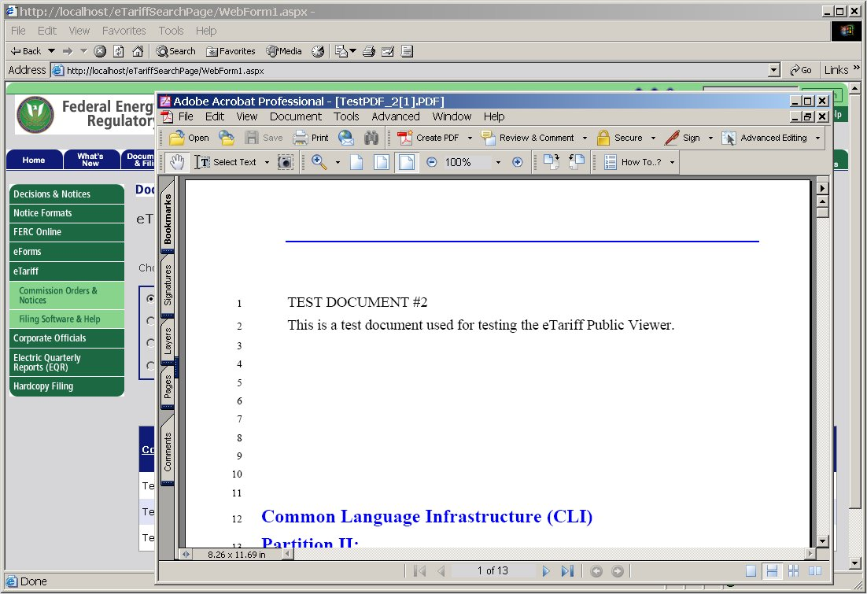
eTariff Public Viewer
User clicked “View” link to display PDF of the selected Tariff:

Slide 7
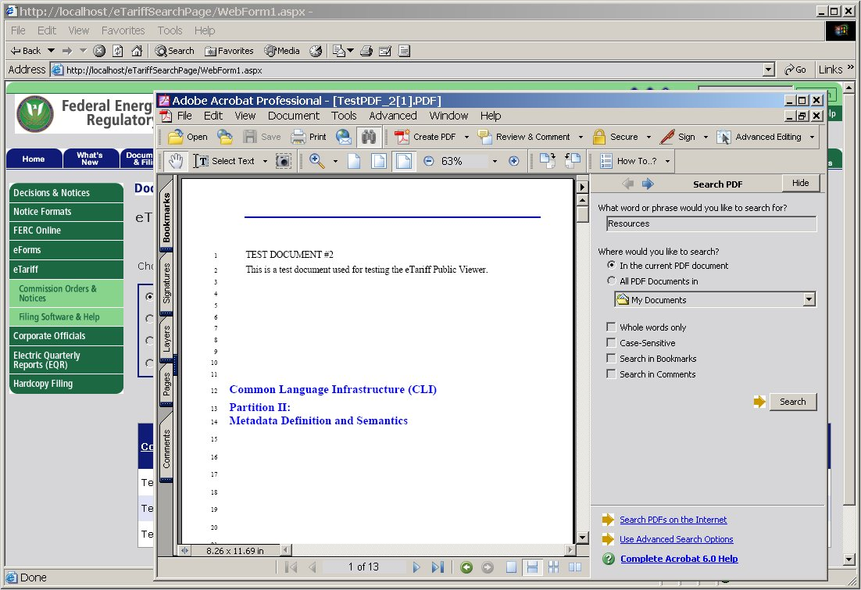
eTariff Public Viewer
User can then search thru Tariff for text or phrases using Acrobat Reader:

Slide 8
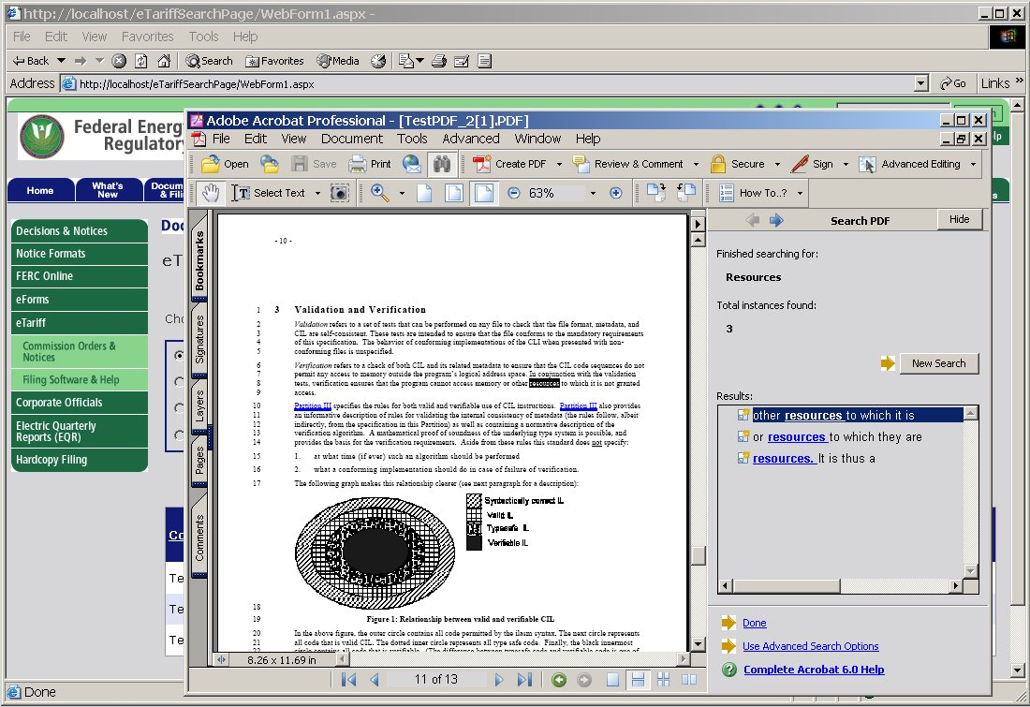
eTariff Public Viewer
Results of PDF text search are displayed for the User:

Slide 9
eTariff Public Viewer
Proposed enhancements:
  Perform text searches within a specific tariff program.
  Perform text searches across several or all tariff programs.
  Perform text searches by tariff or section status.

