Slide 1
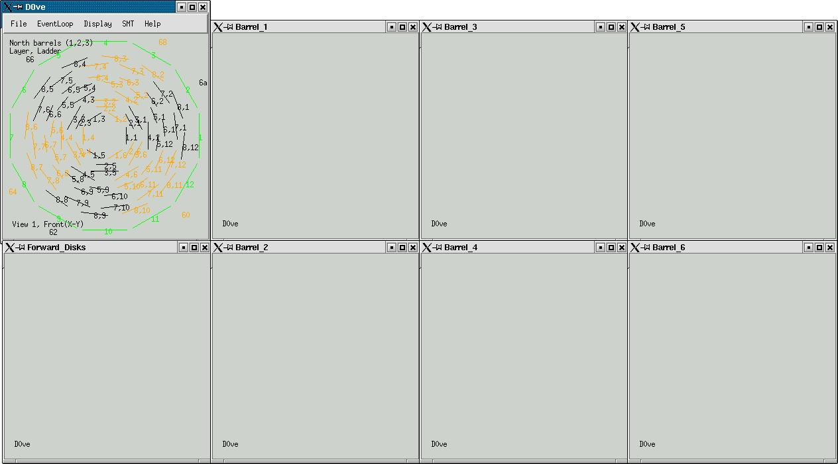
The SMT Event Display
CONTENTS
How To Run The Program
The Display
Modes Of Operation
Printing Options
HOW TO RUN THE PROGRAM
The online SMT Event Display is run with a different command according to the current run type. To run it during normal data-taking, open a new terminal window and type
> setup d0online
> start_daq smt_event_display all
If there is a zero-bias run then use the option 'zb' instead of 'all', ie...
> start_daq smt_event_display zb
When the DAQ shifter is taking a special run then you should give 'special' as the argument but if you are unsure of what to use then you can try 'anything'. This last option receives any data from the first ten runs being taken by the DAQ shifter, regardless of the run type.
After launching the program, the following windows should be displayed:

Slide 2
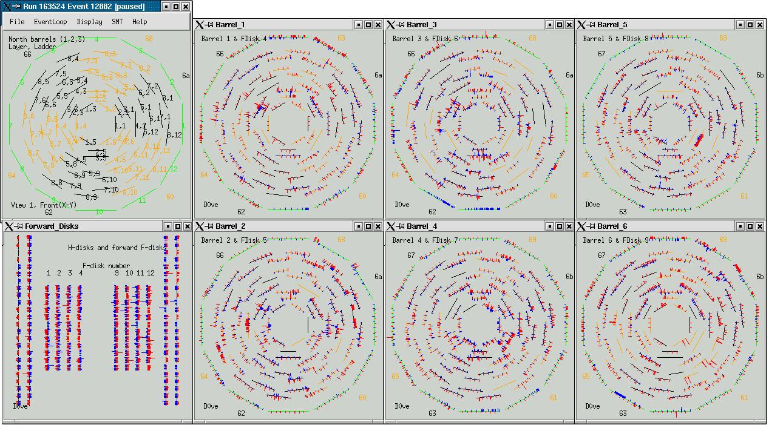
There are two ways to process events in the SMT Event Display. Selecting 'Start/Resume' from the EventLoop menu (or pressing return in any of the event display windows) will start a continuous event loop. Doing this a second time will pause the event loop. The default time between events is 5 seconds but this can be changed by selecting 'set pause interval' from the EventLoop menu and entering the desired interval, in seconds.
Selecting 'pause/step' from the EventLoop menu (or pressing space in any of the event display windows) will request the next available event. This allows the user to look at events one at a time.
THE DISPLAY
During operation, the SMT Event Display uses eight graphical windows to display data within the silicon detector (as shown below). Six of these are used to display the six barrels and the associated f-disks. One displays the forward f-disks and h-disks. The remaining window contains a key to the barrel display, showing ladder numbers, and a menu for controlling the program.
Each barrel is displayed in the r-phi plane with the ladders drawn in groups of black or orange, depending on which VRB crate they are connected to. Crate numbers are written on the outside of the barrel.The corresponding f-disk is also drawn on the outside of the barrel with each wedge coloured green. All ladders are pictured as being axially aligned, even though some stereo ladders are offset from the axial plane by 2 degrees or 90 degrees in the real detector. This representation should still be useful for diagnostic purposes.

Slide 3
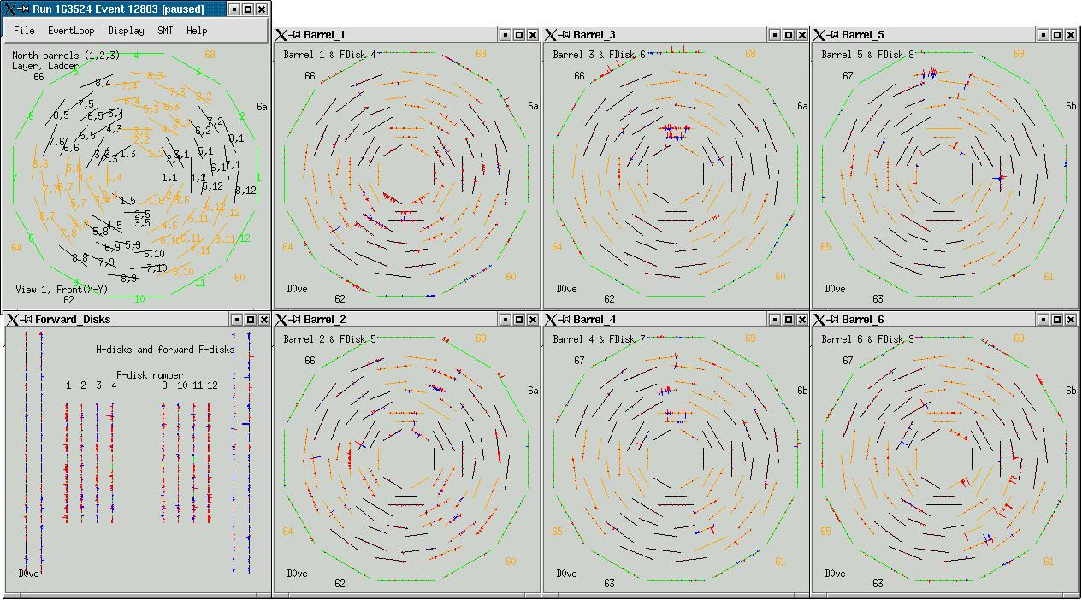
The forward disks display window lays all wedges out in a straight line with 12 wedges per f-disk and 24 wedges per h-disk. Again, this representation is geometrically incorrect but diagnostically convenient.
All detector signals are shown in red for p-side chips and in blue for n-side chips. The length of the line is proportional to the amplitude of the signal recorded, up to a maximum of 256 ADC counts.
The main window containing the barrel key can be reconfigured by making selections in the 'SMT' menu. The South and North barrel keys and the six barrel readouts can be added / overlaid and removed from the window which allows the user to see 'tracks' which cross more than one barrel.
MODES OF OPERATION
The event display runs in one of a number of calibration modes (default is STATIC, explained below) which determine how the data is processed before being displayed. The user can select the desired calibration mode from the 'SMT -> Configurator Mode' menu.These modes are listed below.
STATIC The signal as measured by the detector is displayed. A global pedestal is also subtracted but this is currently set to zero (example shown on previous page.)
GENERIC SDAQ chip pedestals from the database are subtracted before the data are displayed (example below.)

Slide 4
GENERIC_MIXED GENERIC mode is applied to those VRB crates operating in sparse
readout mode while DYNAMIC mode is applied to those crates
operating in all readout mode.
DYNAMIC Pedestals are calculated on a chip-by-chip basis and then subtracted.
ONLINE_DB Pedestals are imported from the database on a strip-by-strip basis and
subtracted.
ONLINE_FILE Pedestals are imported from a file on a strip-by-strip basis and subtracted.
MIXED ONLINE_FILE mode is applied to those VRB crates operating in sparse
readout mode while DYNAMIC mode is applied to those crates
operating in all readout mode.
PRINTING OPTIONS
The event display output can be printed to a postscript file by selecting one of the options in the 'File -> PS print' menu. Individual displays can be saved to file or the option exists to save all displays at once, to either a single file or separate files.

