Slide 1
“Partnering for Success” National Information Technology Center

Slide 2
NITC’s New Billing System
Commercial off-the-shelf software product.
Some of the systems features.
  Web interface for ease of access to information and reports.
  Suite of standard reports available with extensive data at summary and detail levels.
  Excel spreadsheets supported.
  Limited ad-hoc reporting capabilities.
  Security features incorporated.

Slide 3
General step-by-step instructions to access your data are outlined in the following slides
The first step is to obtain a user ID and password. See “Procedures for requesting access to billing system” document located on the NITC website.
After your user ID and password are established start your web browser and go to website https://billing.nitc.usda.gov

Slide 4
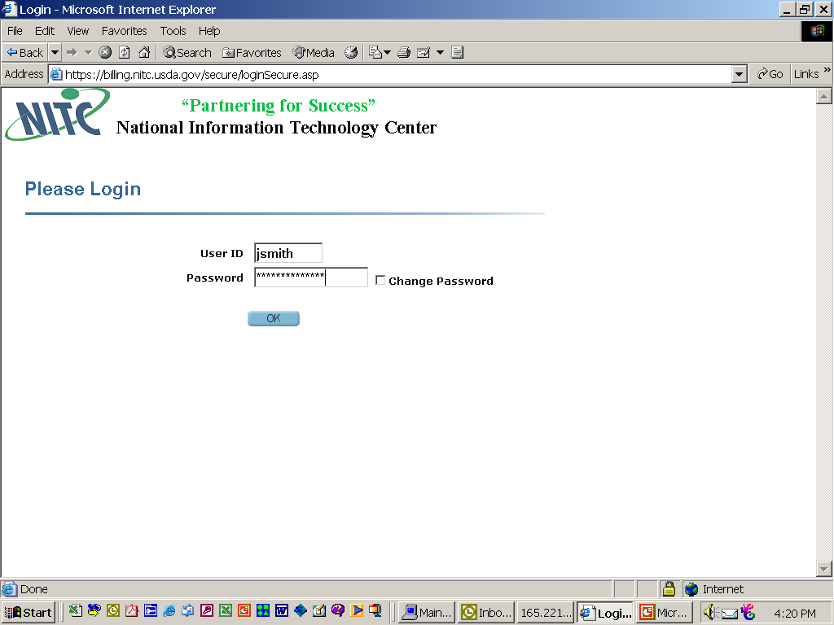
Enter your user ID and password to access your data. The first time you log in you may be asked to load a viewer, if so click ok.

Slide 5
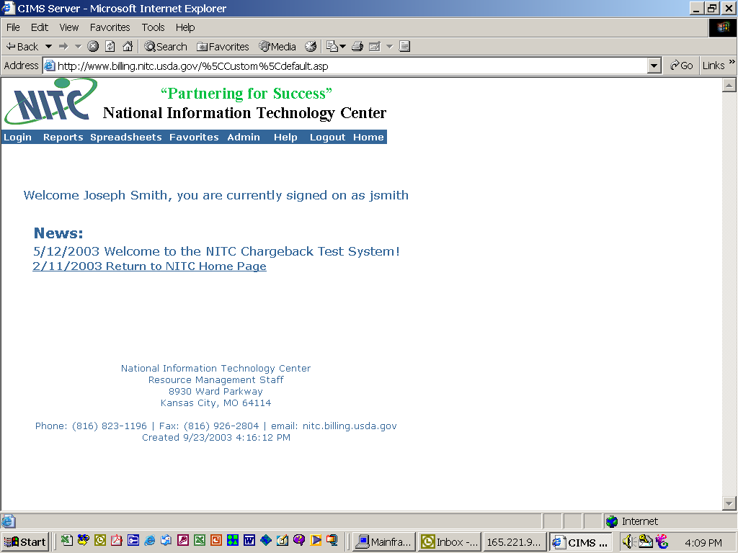
Successful sign on will present you with this screen.

Slide 6
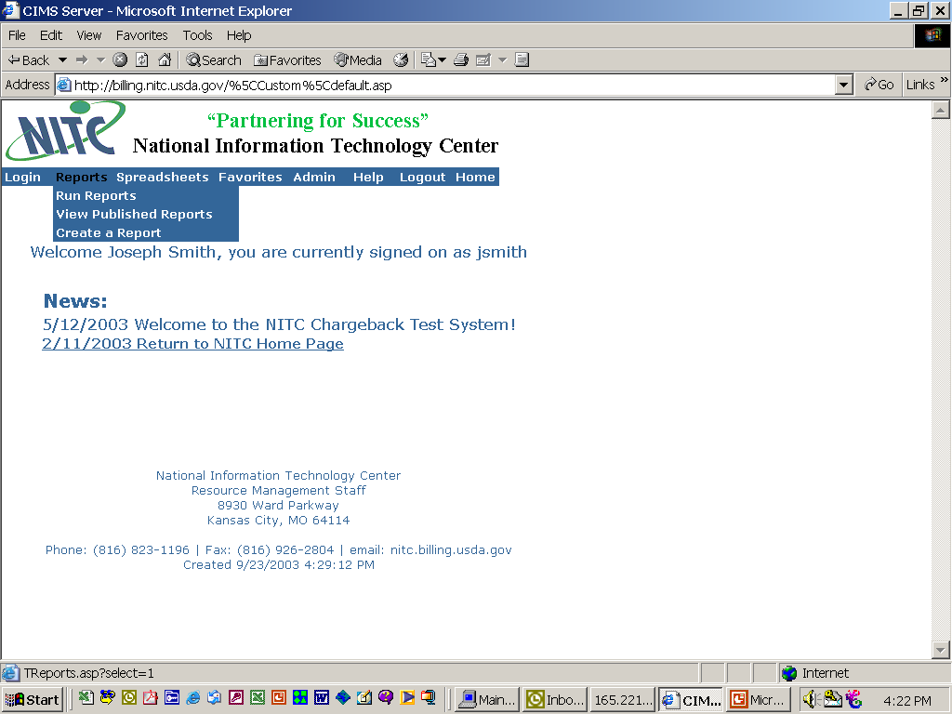
Select reports, run reports to view report groups. Users data is located here. These reports contain detailed usage and charge information. Monthly invoices will be available in the “View published reports” option.

Slide 7
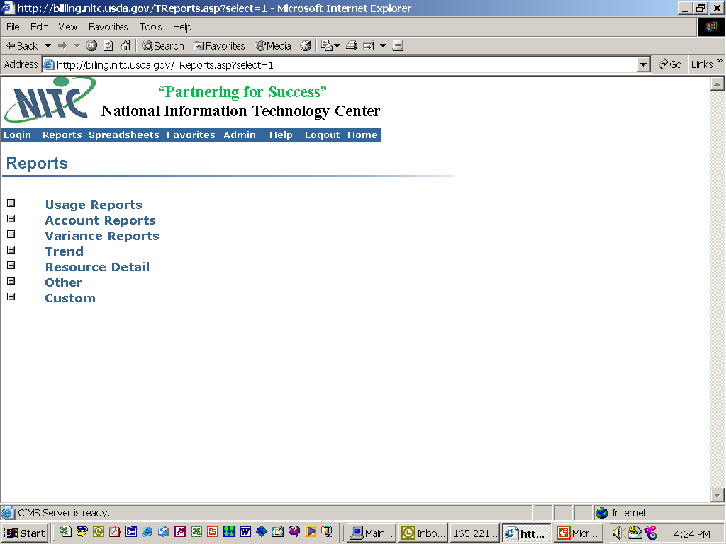
The different report groups are displayed. Each group displays data in different formats and at different levels of detail.

Slide 8
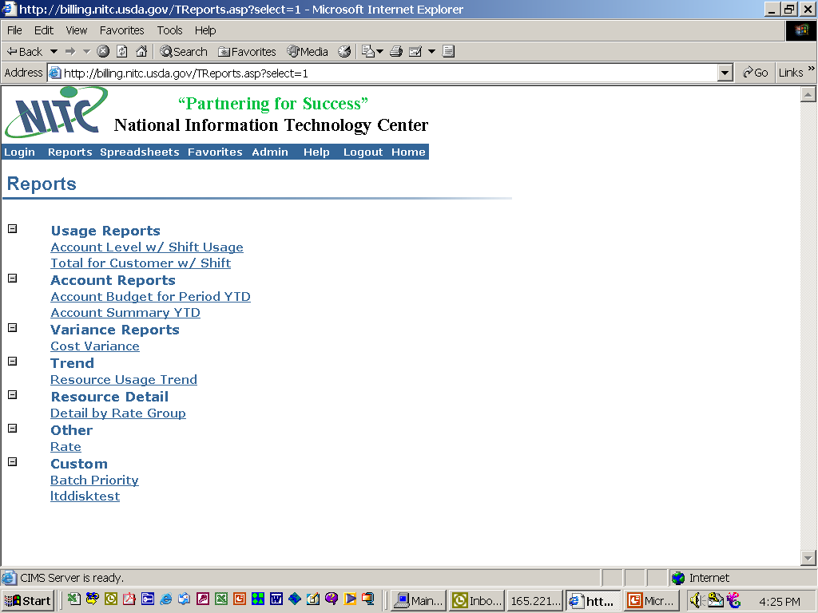
Expanding the groups, clicking on the plus (+), will display the reports that are available. For example, select usage report “Account level w/shift usage”.

Slide 9
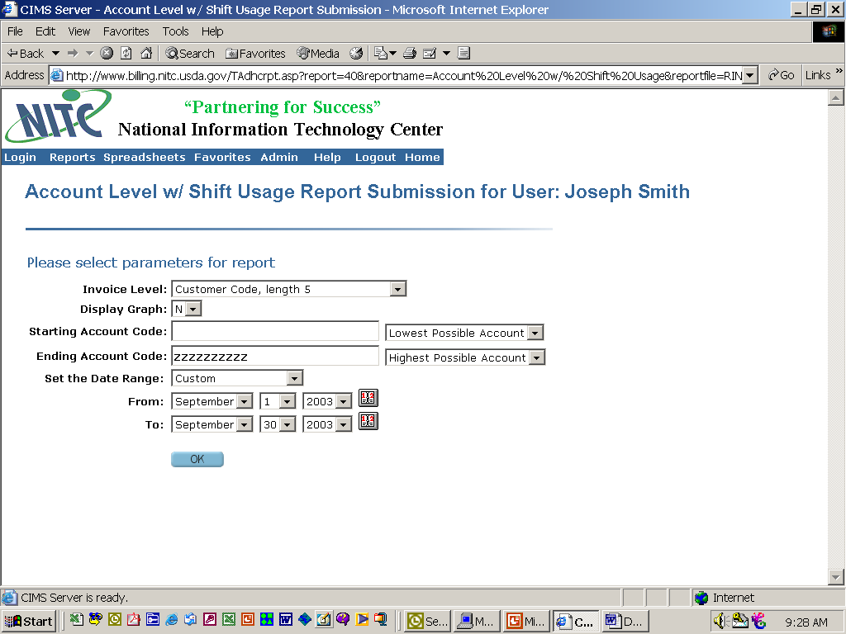
This page will be displayed when a specific report is selected. It allows the user to select criteria for several categories which determine what data will be selected, summarized and displayed. Select ok after making the selections.

Slide 10
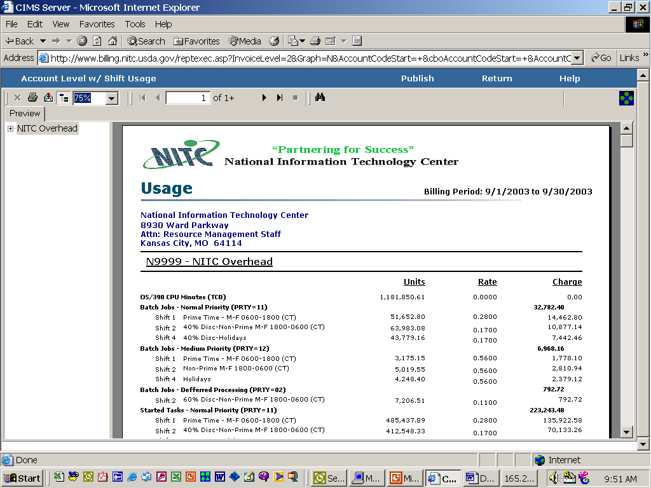
The report is generated.

Slide 11
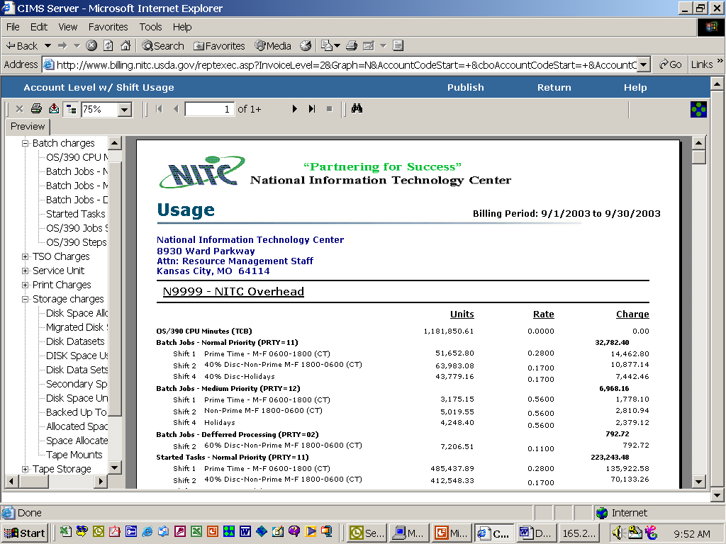
By expanding the plus (+) in the left panel the resource groups and resources used are displayed. This allows for quick access to items by clicking on the selection required.

Slide 12
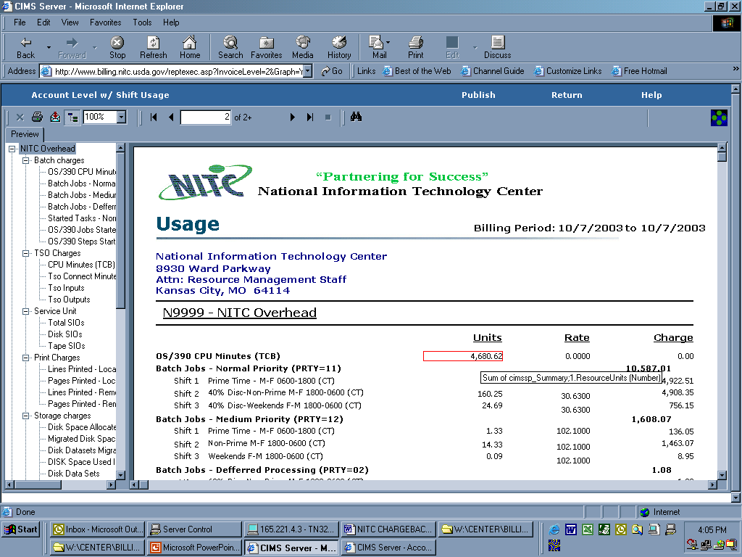
To display detailed information for an item, place the curser on a Units amount and click.

Slide 13
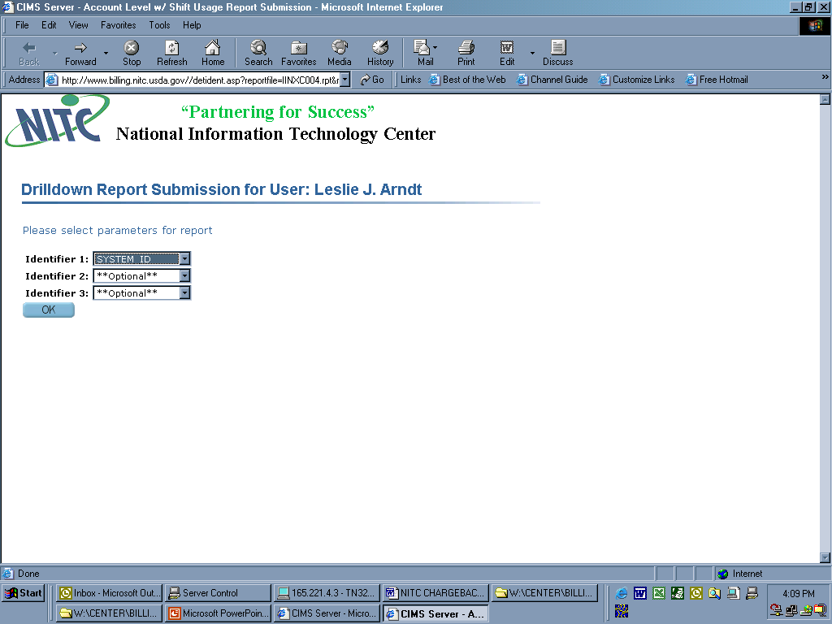
This page allows for the selection/drilldown of specific information on the category selected. There are up to three levels of identifiers with several selection criteria for each identifier group.

Slide 14
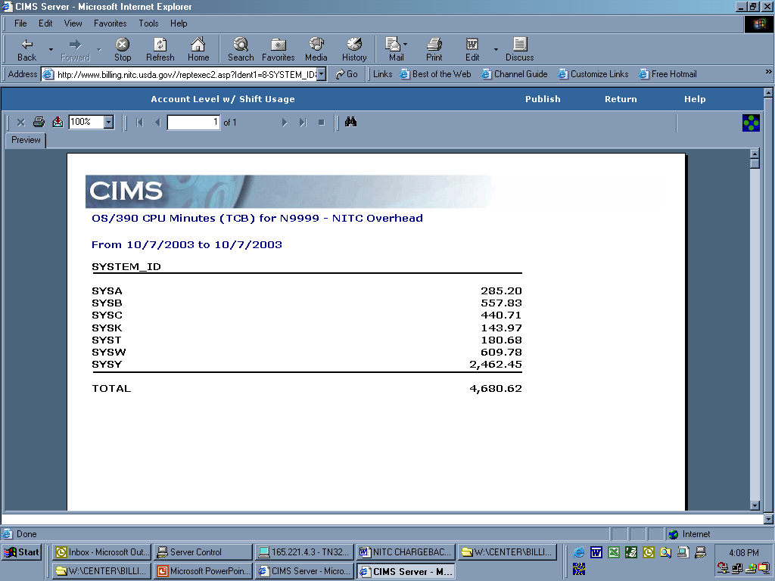
This is an example of the specific information available through the selection criteria available for identifiers.

Slide 15
Questions?
System Access: A.J. Young 816.823.2406
        Alesia.Young@nitckc.usda.gov
Jerry Lee 816.823.1196
Jerry.Lee@nitckc.usda.gov
System Use: Jerry Lee 816.823.1196
Jerry.Lee@nitckc.usda.gov
Brenda Thoele 816.823.2407
Brenda.Thoele@nitckc.usda.gov
Leslie Arndt 816.926.2311
Leslie.Arndt@nitckc.usda.gov
Any question: nitc.billing@usda.gov
Unresolved
items: Janet Guyer 816.926.2722
Janet.Guyer@nitckc.usda.gov

