Slide 1
Aggregate
Reporting
National Student Loan Data System

Slide 2
Objectives
Understand aggregate loan terms
Identify loan types that impact aggregate limit calculations
Calculate aggregate limits using NSLDS methodology
Apply aggregate information to eligibility decisions

Slide 3
Defining and Using Aggregates
NSLDS Terms
  Outstanding Principal Balance (OPB)
  Aggregate Amounts
    Aggregate Loan Information
    Loan Level Aggregate OPB
Why are NSLDS aggregate amounts used?

Slide 4
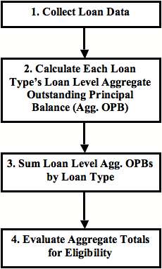
NSLDS Aggregate Totals Calculation Process

Slide 5
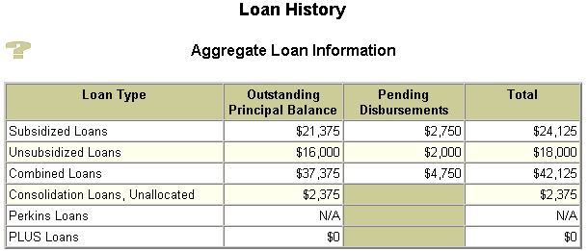


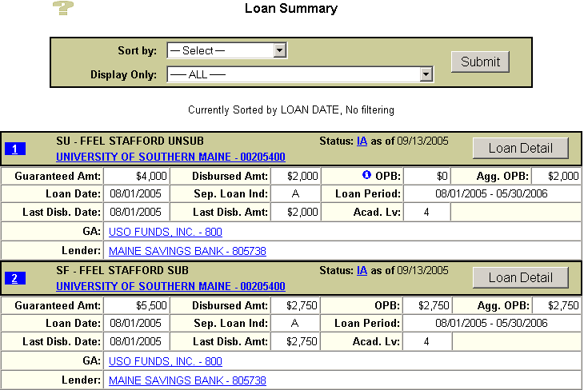
Aggregate Outstanding Principal Balances

Slide 6
Loan Limit Poll Question
Live Meeting Poll
Do Perkins and PLUS loans count against a student’s FFEL/DL loan limit?
Yes
No
Changes directly made to this slide will not be displayed in Live Meeting. Edit this slide by selecting Properties in the Live Meeting Presentation menu.

Slide 7
2. Calculate Each Loan Type’s Loan Level Aggregate OPB
NSLDS reviews loans in student’s financial aid history
Categorizes each loan into respective loan type (e.g., bucket)
Three main loan groupings:
  Recent loans
  Older loans
  Consolidation Loans

Slide 8
Recent Loans
May have adjustments not yet posted
May have additional disbursements or adjustments not yet reported to NSLDS
Included at end of calculation as Pending Disbursements

Slide 9
Recent Loans, continued
 | Recent loans
Period End Date | Loan Period End Date plus 90 days has not yet passed
Loan Status | IA, ID, IG, IM
Aggregate Outstanding Principal Balance (Agg. OPB) | Greater of OPB, or Disbursed Amount Not to exceed Net Loan Amount

Slide 10
Older Loans
Included in Aggregate OPB calculations
 | Older loans
Period End Date | 90 days or older
Loan Status
Aggregate Outstanding Principal Balance (Agg. OPB) | Lesser of Net Loan Amount, or Disbursed Amount, or OPB If all are greater than zero

Slide 11
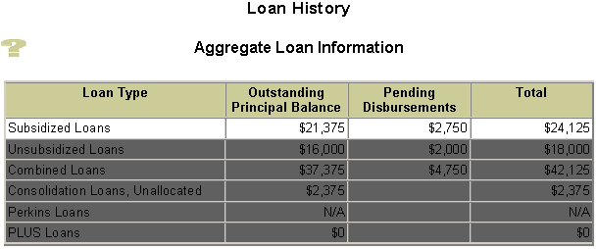
Subsidized Loan Aggregate
Calculation Components
Loan Types / Bucket:
Subsidized (from Loan Summary)
SF – FFEL Sub Loan Category: Recent or Older Loans
D1 – Direct Stafford Subsidized Recent or Older Loans
D6 – Direct Consolidation Subsidized Calc’d Sub
CL – FFEL Consol. Calc’d Sub Aggr. OPB amount(s)

Slide 12

You Make the Call - Part 1
This loan is a(n) ________ loan with a loan level Aggregate OPB of _______.

Slide 13
Part 1 - You make the call
Live Meeting Poll
Fill in the blanks for the following statement: This loan is a(an) ________loan with a loan level Agg. OPB of _________.
Recent, $5,500
Older, $2,750
Recent, $2,750
Older, $5,500
Changes directly made to this slide will not be displayed in Live Meeting. Edit this slide by selecting Properties in the Live Meeting Presentation menu.

Slide 14
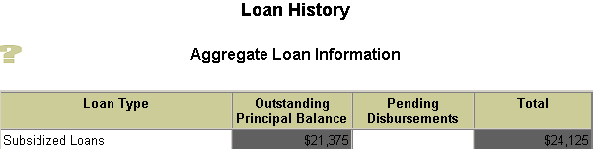
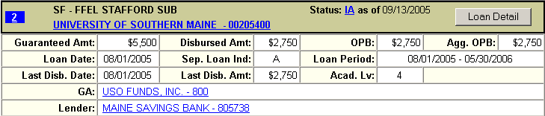
You Make the Call - Part 2
What is the loan level Pending Disbursement?

Slide 15
Part 2 - You make the call
Live Meeting Poll
What is the loan level Pending Disbursement?
$0
$2,750
$5,500
$8,250
Changes directly made to this slide will not be displayed in Live Meeting. Edit this slide by selecting Properties in the Live Meeting Presentation menu.

Slide 16
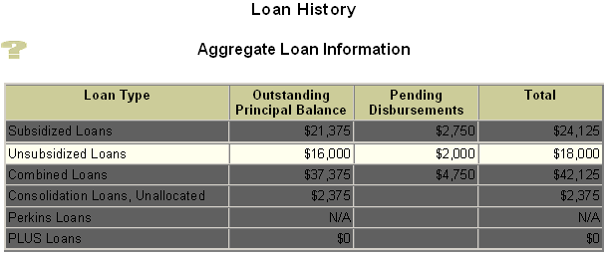
Unsubsidized Loan Aggregate Calculation Components
Loan Types/ Bucket:
Unsubsidized (from Loan Summary)
SU – FFEL Unsub. Loan Category: Recent or Older Loans
SL – Supplemental Loan (SLS) Loan Category: Recent or Older Loans
FI – Federally Insured (FISL) Loan Category: Recent or Older Loans
RF – FFEL Refinanced Loan Loan Category: Recent or Older Loans
D2 – Direct Stafford Unsubsidized Loan Category: Recent or Older Loans
D5 – Direct Consolidation Unsub Calc’d Unsub
CL – FFEL Consol. Calc’d Unsub Aggr. OPB amount(s)

Slide 17

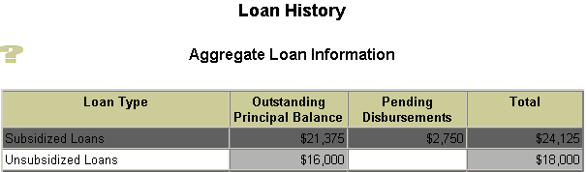
You Make the Call - Part 3
True or False:
This loan is an older loan with a loan level Agg. OPB of $2,000 and a loan level Pending Disbursement of $4,000.

Slide 18
Part 3 - You make the call
Live Meeting Poll
This loan is an older loan with a loan level Agg. OPB of $2,000 and a loan level Pending Disbursement of $4,000.
True
False
Changes directly made to this slide will not be displayed in Live Meeting. Edit this slide by selecting Properties in the Live Meeting Presentation menu.

Slide 19
Consolidation Loan Components
When no underlying loans reported within 60 days of FAH review, loan level Agg. OPB is zero
If CL over 60 days old and has no underlying loans, then whole CL treated as Subsidized
CL falls under older loan category

Slide 20
Consolidation Loans & Aggregate OPB
Process to determine impact of Consolidation Loans (CL) on Aggregate OPB:
  2A. Identify underlying loans
  2B. Determine number of CLs & Totals
  2C. Determine Calculated Agg. OPBs
  2D. Determine CL;s Unallocated Agg. OPB
  2E. Calculate CL’s Combined Loans Agg. OPB

Slide 21
2A. Identify CL’s Underlying Loans
Step 1: Determine Loan Status | Loan Status is one of these: PC ◻ PN ◻ DN ◻ DP ◻ PF
Step 2: Determine Loan Status Date | Loan Status Date: ________ Is Loan Status Date within 210 days (before or after) Consolidation Loan Date? ◻ Yes ◻ No
Step 3: Underlying Loan? | If Loan Status is one listed in Step 1 and the answer to Step 2 is Yes, then loan is underlying loan.

Slide 22











You Make the Call - Part 4
Which are Underlying Loans? Included in Agg OPB totals for loan limit comparison?

Slide 23
Part 4 - You make the call
Live Meeting Poll
Which loans are included in the Subsidized Aggregate OPB?
6, 8, 11, 12
7
9, 10, 13
14
Changes directly made to this slide will not be displayed in Live Meeting. Edit this slide by selecting Properties in the Live Meeting Presentation menu.

Slide 24
2B. Determine Number of CLs and Totals
FFEL Consolidation Loan Types
Perkins Loan Types
PLUS Loan Types
Subsidized Loan Types
Unsubsidized Loan Types

Slide 25
Consolidation Loans & Totals
Determine number of CLs = 2
Sum Disbursed Amt of Loan Types
  Total CL Disbursed Amt: $39,000
  Total Subsidized Disbursed Amt: $18,625
  Total Unsub Disbursed Amt: $13,000
Loans Not Factored into Aggregate OPB Loan Limits
  Total Perkins Disbursed Amt: $ 4,000
  Total PLUS Disbursed Amt: $ 1,000

Slide 26
2C: Determine Calculated Agg. OPBs
Calculate ratio for each Loan
Type - percentage of CL attributable to Loan Type
Ratio =
Sum of Underlying Loans’ Disb Amts
Sum of CL Disb Amts
Determine Calculated Agg. OPB amount for each CL
Aggregate =
Ratio 
CL Guaranteed Amt

Slide 27
Calculate CL Subsidized Agg. OPB
Determine ratio for subsidized loans
  Total of underlying Sub Disbursement Amounts = $18,625
  Total of CL Disbursement Amounts = $39,000
  Ratio = $18625/$39,000 = 0.47756
Determine Calculated Subsidized Aggregates
(Ratio  Guaranteed Amount)
  Calculated Subsidized Aggregate for CL #4= $8,119
  (0.47756  $17,000)
  Calculated Subsidized Aggregate for CL #5= $10,506
  (0.47756  $22,000)

Slide 28
Activity
Individual Activity
Participant Workbook page 14

Slide 29
Debrief: Calculate CL Unsubsidized Agg. OPB
Determine ratio for Unsubsidized loans
  Total of underlying Unsub Disbursement Amounts = $13,000
  Total of CL Disbursement Amounts = $39,000
  Ratio = $13,000/$39,000 = 0.33333
Determine Calculated Unsub Aggregates
(Ratio  Guaranteed Amount)
  Calculated Unsubsidized Aggregate for CL #4= $5,667
  (0.33333  $17,000)
  Calculated Unsubsidized Aggregate for CL #5= $7,333
  (0.33333  $22,000)

Slide 30
Calculate Perkins Share of CL’s Agg. OPB
Determine ratio for Perkins loans
  Total of underlying Perkins Disbursement Amounts = $4,000
  Total of CL Disbursement Amounts = $39,000
  Ratio = $4,000/$39,000 = 0.10256
Determine Perkins Share of CL’s Aggregate OPB
(Ratio  Guaranteed Amount)
  Perkins Share of CL #4 Aggregate OPB = $1,744
  (0.10256  $17,000)
  Perkins Share of CL #5 Aggregate OPB = $2,256
  (0.10256  $22,000)

Slide 31
Calculate PLUS Share of CL’s Agg. OPB
Determine ratio for PLUS loans
  Total of underlying PLUS Disbursement Amounts = $1,000
  Total of CL Disbursement Amounts = $39,000
  Ratio = $1,000/$39,000 = 0.02564
Determine PLUS Share of CL’s Aggregate OPB
(Ratio  Guaranteed Amount)
  PLUS Share of CL #4 Aggregate OPB = $436
  (0.02564  $17,000)
  PLUS Share of CL #5 Aggregate OPB = $564
  (0.02564  $22,000)

Slide 32
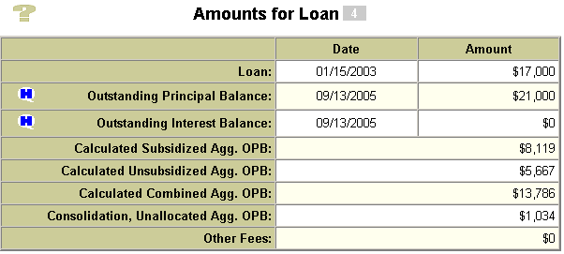
2D: Calculate CL Unallocated Amounts
 | Guaranteed Amount | $17,000
- | Total Perkins Share | $1,744
- | Total PLUS Share | $436
- | Calculated Sub Aggregate OPB | $8,119
- | Calculated Unsub Aggregate OPB | $5,667
= | Calculated Consolidation, Unallocated Aggregate OPB for CL #4 | $1,034

Slide 33
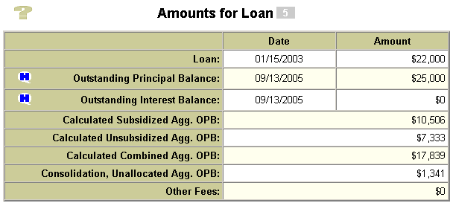
CL Unallocated Amounts, cont.
 | Guaranteed Amount | $22,000
- | Total Perkins Share | $2,256
- | Total PLUS Share | $564
- | Calculated Sub Aggregate OPB | $10,506
- | Calculated Unsub Aggregate OPB | $7,333
= | Calculated Consolidation, Unallocated Aggregate OPB for CL #5 | $1,341

Slide 34
2E. Calculate CL Combined Agg. OPB
Combined Agg. OPB = Calculated Sub Agg. OPB + Calculated Unsub Agg. OPB
Combined Agg. OPB (older loans) ‘adjusted’ when:
  Underlying Perkins loans are factored out of Unallocated Amount
  Underlying PLUS loans are factored out of Unallocated Amount (for PLUS Borrower)

Slide 35
3. Sum Loan Level Agg OPBs by Loan Type
Collect all loan level Agg. OPB numbers
Roll individual calculated numbers into respective loan types
Add in respective loan type’s pending disbursements
Display each loan type’s Aggregate OPB Totals in Aggregate Loan Information section

Slide 36

Subsidized Roll-Up
Roll up Loan Level Summary amounts to Aggregate: Subsidized Loan Type
+
=

Slide 37
Unsubsidized Roll-Up
Roll up Loan Level Summary amounts to Aggregate: Unsubsidized Loan Type
+
=

Slide 38
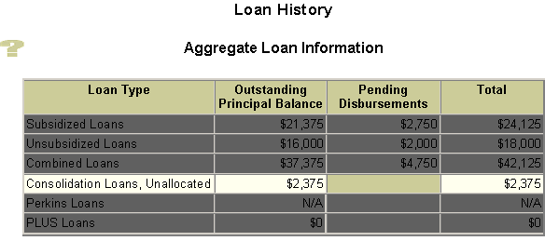
Unallocated Amount Roll-Up
Roll up Loan Level Summary amounts
to Aggregate: Unallocated Amount

Slide 39
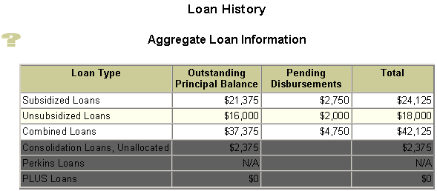
Combined Loan Amounts Roll-Up

Slide 40
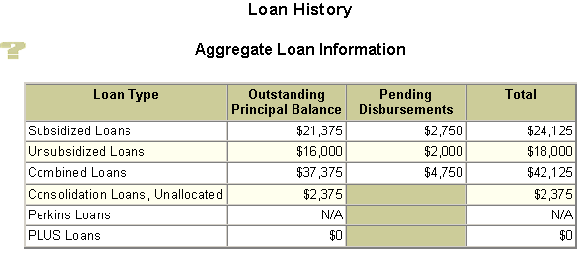
4. Evaluate Totals for Eligibility

Slide 41
Resolving NSLDS Warnings
Live Meeting Q&A
How could you resolve the NSLDS warnings you see on PW page 18?
Changes directly made to this slide will not be displayed in Live Meeting. Edit this slide by selecting Properties in the Live Meeting Presentation menu.

Slide 42
Wrap Up

Slide 43
Questions?
?

