Slide 1
Development and Demonstration of a Prototype
Free Flight Cockpit Display of Traffic Information
Walter W. Johnson Vernol Battiste NASA Ames Research Center
Susanne Delzell Sheila Holland Sean Belcher Kevin Jordan San Jose State University

Slide 2
Outline of Presentation
AMES Display Prototype
Free Flight Simulation
Summary

Slide 3
The AMES Display
A prototype display for Airborne Management of Enroute Separation
Design Goals
Function and Symbology
  Basic Display
  Alerting Display
  Display Tools

Slide 4
Prototype Objectives & Approach
Objectives:
Cockpit based . .
  traffic situational awareness display
  aircraft separation monitoring
  flight path awareness and planning display
  Approach:
  Cockpit based . .
  2-D traffic planview
  “Strategic” multistage conflict alerting
  prediction tools to preview and test simple flight paths
Notes:
One general objective of this project is “the development of standards for a cockpit situational awareness display of traffic information” . The RTCA Task Force 3 has identified this as a critical Free Flight enabling technology.
A second related objective is to develop standards that support cockpit-based aircraft separation monitoring and general flight path planning.
Global spatial awareness
“Strategic” multistage conflict alerting
Prediction tools that allow crew to test paths

Slide 5
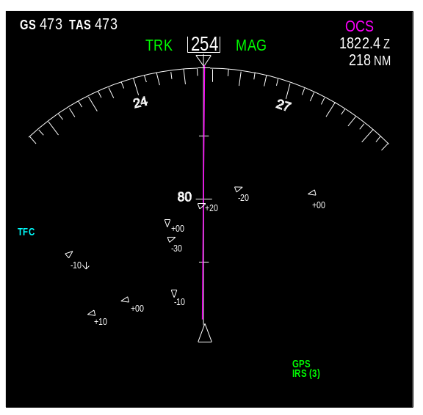
Basic Traffic Display
Relative planview CSD placed in 747-400 map mode
Traffic Features
  Location
  Heading
  Relative Altitude Tag
  Altitude Change Tag
  Aircraft ID Tag

Slide 6
Alerting
Purpose
  Allow earlier conflict separation evaluation/resolution
Approach
  Preserve short-range TCAS alerts
  Provide three longer range alerts using algorithm provided by Kuchar (1997)
Notes:
Allow crews to begin evaluation/resolution of potential separation problems at an earlier point
Preserve near-term ‘tactical’ information provided by two highest TCAS alerts

Slide 7
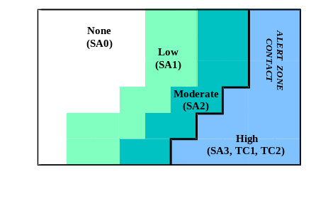
Strategic Alerting Logic
Traffic aircraft mapped into 2-D threat space
Four threat levels (regions) correspond to four display levels
Threat Space
Notes:
Threat is a dual function of conflict probability and total available maneuvers that will resolve conflict
Alerting algorithm output mapped into 3 Situational Awareness (SA) advisory and informational levels, and associated symbology

Slide 8
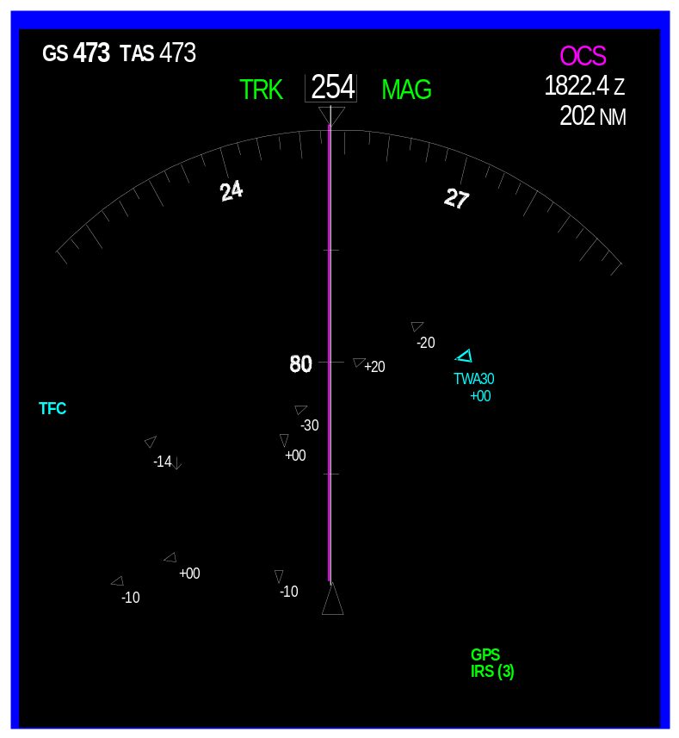
Level 1 Strategic Conflict Alert
Minimal
Aircraft symbol is an open blue triangle
Aircraft ID displayed

Slide 9
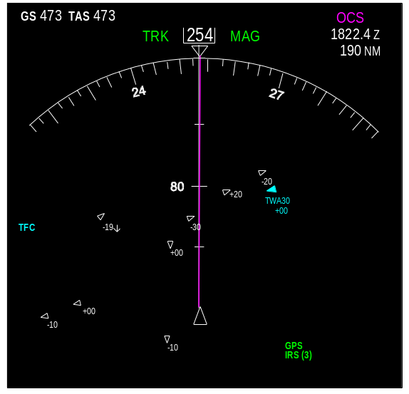
Level 2 Strategic Conflict Alert
Moderate
Aircraft symbol is a solid blue triangle
Aircraft ID displayed

Slide 10
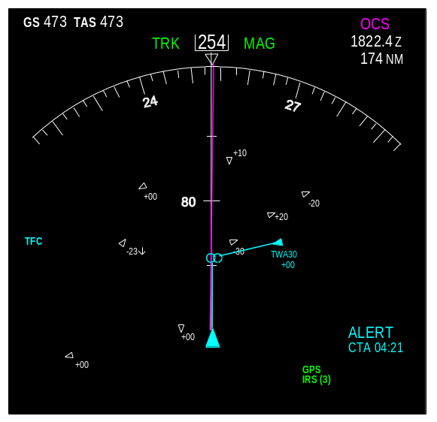
Level 3 Strategic Conflict Alert
‘Alert Zone Contact’
Audible alert
Ownship symbol is solid blue.
Lines extend from Ownship and Traffic to point of closest approach, and terminate in 5 NM diameter circles
‘ALERT’ and time to closest approach displayed
Aircraft ID displayed

Slide 11
Display Tools
Predictor Tool
Route Assessment Tool

Slide 12
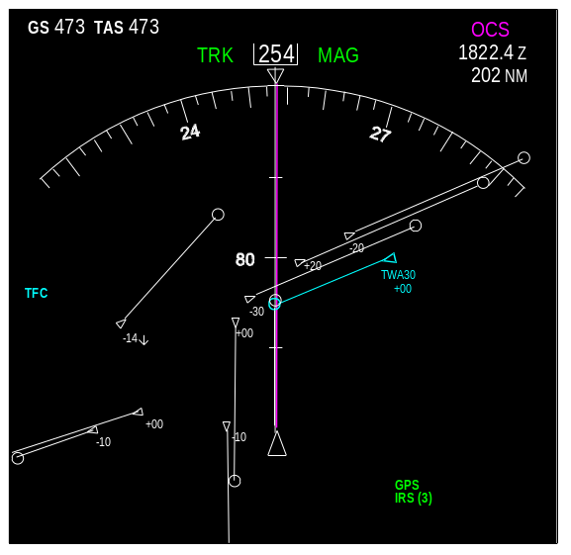
Predictor Tool
Temporal predictor lines extend from traffic and Ownship
Crew may set between 1 and 10 minutes
Lines terminate in a circle with 5 NM diameter
Predictor lines set to six minutes
Notes:
While this display can show a prediction of loss of separation, it does not supplant the alerting logic since it does not reflect probabilities

Slide 13
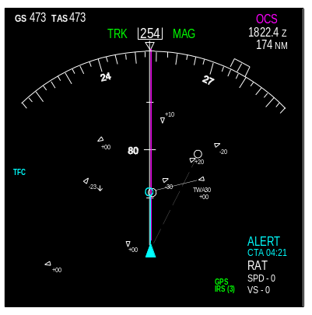
Route Assessment Tool
Route Assessment Tool (RAT) used for conflict resolutions and alternative path planning.
RAT displays alerts associated with a proposed change to a flight path
RAT allows examination of changes in
  Ground Speed
  Heading
  Vertical Speed
The RAT, depicted as a white dotted line, tests for a clear path 10 minutes into the future

Slide 14
AMES Display Free Flight Simulation Demonstration
Simulation Goals
Task
Manipulations
Dependent Measures
Results

Slide 15
Simulation Goals
Objectives:
Preliminary evaluation of display effectiveness
Gather information to guide further development
Approach:
Evaluate performance
  with and without multistage alerting and specialized tools
  across different conflict encounter geometries
Gather debriefing data

Slide 16
Task
Maintain separation during Scenarios
Crews may talk with other aircraft
Idealized
  low workload
  good weather
  moderate density
  clear frequencies
  no mixed equipage

Slide 17
Display Manipulation
Basic Traffic Display
120 NM Range
Only Level 3 Alerting
Enhanced Traffic Display
Basic Traffic Display
Levels 1-3 Alerting
Predictor and Route Analysis Tools

Slide 18
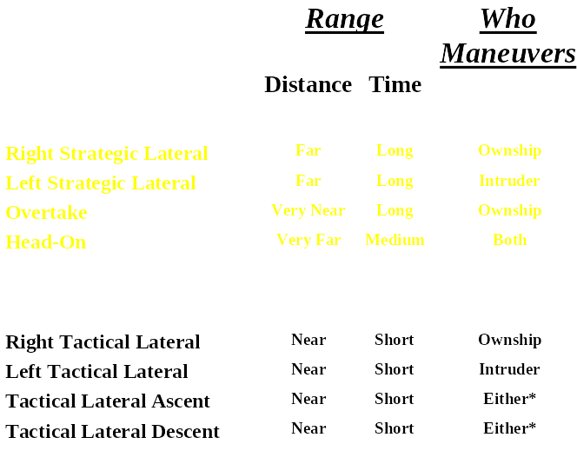
Scenario Manipulation
Range at Initial Alert / Maneuver Requirement
Strategic Conflict
Tactical Conflict

Slide 19
Dependent Measures
Proactivity
Minimum Separation
Ownship Maneuvers

Slide 20
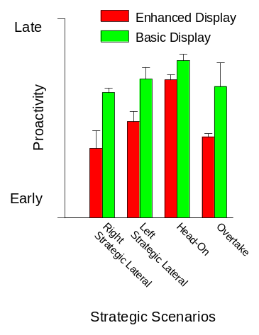
Results
Responding Early to Potential Conflicts
Crews with the Enhanced Display resolved Strategic Conflicts earlier*
* p < 0.05

Slide 21
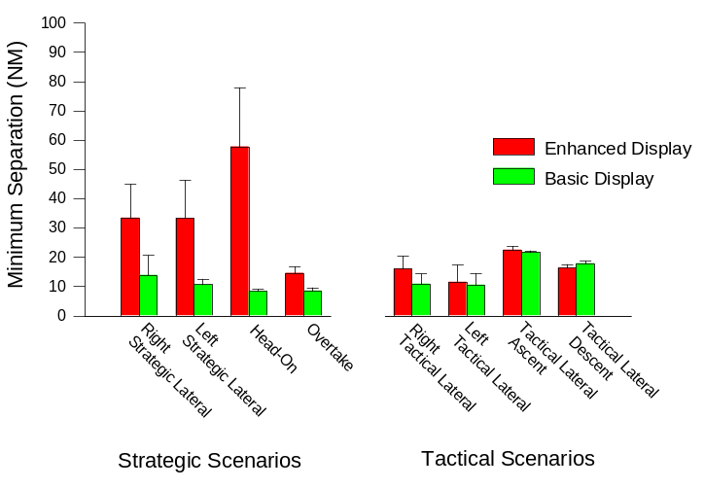
Results
Maintaining Separation Between Aircraft
Crews with Enhanced Display had larger separations in the Strategic Conflicts *
* p < 0.05

Slide 22
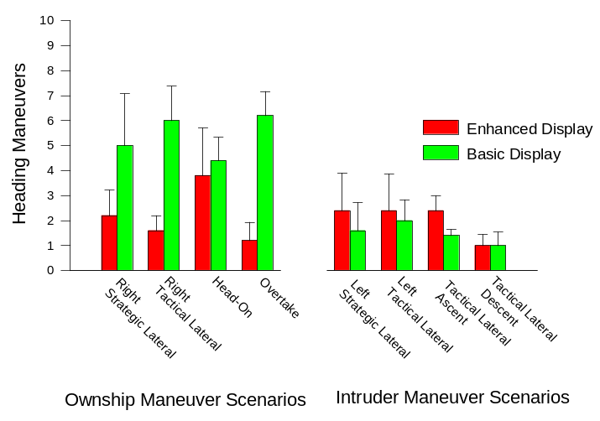
Results
Total Number of Heading Maneuvers
Crews with Basic Display made more heading maneuvers in the Ownship Maneuver Scenarios*
* p < 0.05

Slide 23
Results
Crew Debriefing
Crews enthusiastic about using both displays for Free Flight.
Requests
  Basic Display crews wanted display features in Enhanced Display
  At least 120 NM range
  More intent information
Concerns
  Clutter from Data blocks and predictor lines
    However all crews wanted the predictor tool and IDs and many would leave it on despite clutter
Notes:
Crews were enthusiastic about using both displays for Free Flight. However, crews with the Basic display tended to ask for the features that were included in the Enhanced display (i.e. advanced alerting and predictor tools). There were several other areas in which crews tended to have comments
Crews noted potential problems with clutter and its associated impacts on detection and salience. Data blocks and predictor lines were identified as significant sources of clutter.
However, crews liked the predictor tool, and many would leave it on, even though it contributed to clutter. A few also wanted to leave the Aircraft Ids on.
Crews wanted the early information provided by the 120 NM range. None wanted a smaller range and several wanted a greater range.
Several crews desired enhanced intent information on the display. In the absence of this the radio communications were considered vital.

Slide 24
Summary
Crews were enthusiastic about both displays, but those who had the Basic display tended to ask for the features in the Enhanced display
For Strategic Conflicts the Enhanced Display crews
  resolved conflicts earlier
  maintained larger minimum separations
The tools and alerting did not lead to increased maneuvers, but instead tended to generate fewer heading maneuvers
Features vs. clutter remains significant display issue
Notes:
Show rest of slides

Slide 25
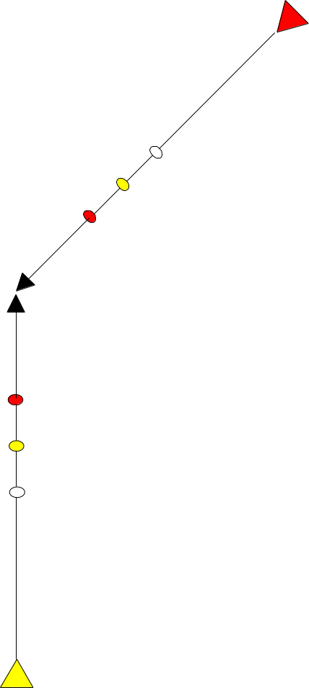
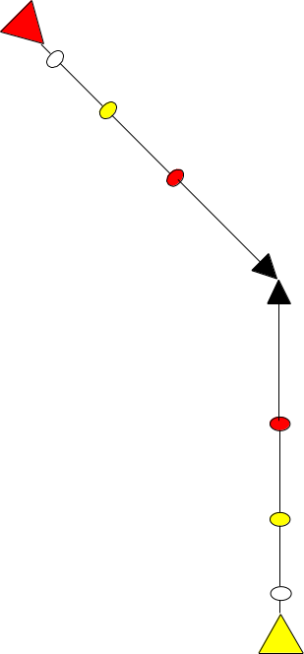
Scenarios
Right and Left Strategic Lateral Encounters
Advanced Warning
  SA₁ occurs 2.5 minutes before SA₂.
  SA₂ occurs 2-3 minutes before SA₃
SA₃
SA₂
SA₁

Slide 26
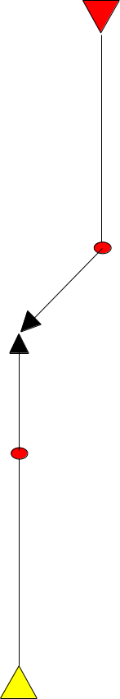
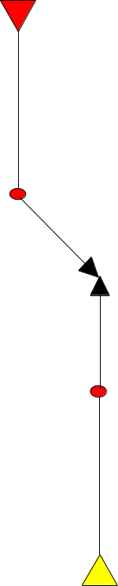
Scenarios
Right and Left Tactical Lateral Encounters
No Advanced Warning
  Immediate SA₃ when Intruder changes course
SA₃
SA₂
SA₁

Slide 27

Scenarios
Head-On and Ownship Overtaking Intruder
Advanced Warning for Head-On Encounter
  SA₂ occurs when Intruder enters surveillance range (120 NM)
  SA₃ occurs 2.3 minutes later
SA₃
Advanced Warning for Overtake Encounter
  SA₁ occurs 6 minutes before SA₂
  SA₃ occurs 2.5 minutes later
SA₂
SA₁

Slide 28
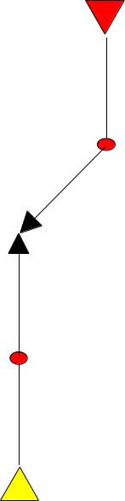
Scenarios
Left Lateral Descent and Right Lateral Climb
No Advanced Warning
  Immediate SA₃ when Intruder changes course
SA₃
SA₂
SA₁

