Slide 1
SIAT C++ CSIP Presentation

Slide 2
What is SIAT?
SIAT = Software Interface Analysis Tool
  SIAT provides language construct, variable set/usage, type usage, function usage, and dependency query capabilities to enhance analysis productivity
  SIAT facilitates understanding of source code by providing call, dependency, type hierarchy, and data flow graph capabilities
  SIAT has a syntax colored, hyperlinked web browser interface to a centralized source code repository for performing code, external interface, impact, and sustaining engineering analysis for multiple libraries

Slide 3
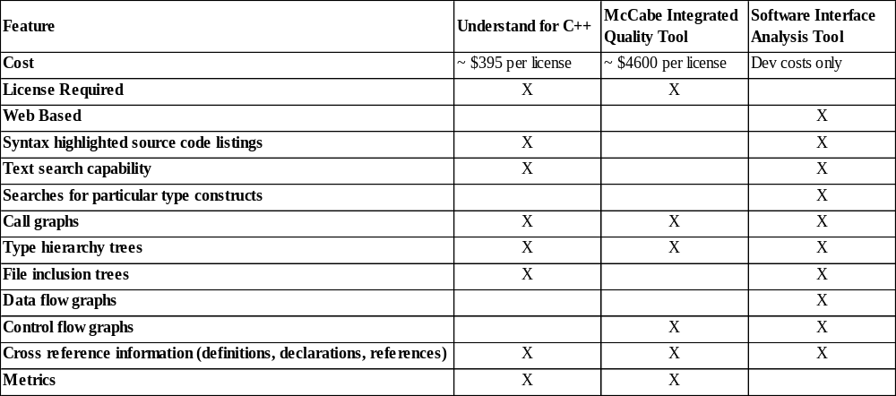
Code Analysis Tool Comparisons

Slide 4
Why SIAT?
Provide analysis/engineering tool with no client side licensing costs
Tool is controlled by IV&V – we can be responsive to specialized IV&V analysis needs
Tool focuses on V&V and system assurance needs
  Not development/test needs (e.g. McCabe test paths)
  Aids in understanding how code is structured
  Pictorially presents calling structure, type hierarchy, file dependencies, data flow, control flow
  Query capabilities – constructs, symbol usage, strings

Slide 5
Version 1.0 Functionality
Source code file browsing
  Syntax coloring, hyperlinked symbol references, context sensitive symbol definition/declaration menus
Symbol usage queries
  Definition, declarations, uses, modifications
Function call graphs
Type hierarchy graphs
Source file dependency graphs (#include’s)
Data flow graphs (not officially in 1.0)

Slide 6
Milestones/Deliverables Review

Slide 7
Milestones/Deliverables Review
Past/Current
  SIAT C++ Software Requirements Specification (10/00)
  SIAT C++ Software Design Document (12/00)
  SIAT C++ Interface Design Review (12/00)
  SIAT Version 1.0 Software Test Descriptions (3/01)
  SIAT Version 1.0 Execution Software/Libraries (6/01)
  SIAT Version 1.0 Users Guide (6/01)
  SIAT Version 1.0 Demonstration (Today – 6/01)
Notes:
Activity Deliverable Due Date Quarter
A1 SIAT C++ Software Requirement Specification 10/27/00 1
A2 SIAT C++ Software Design Document 12/13/00 1
A3 SIAT C++ Interface Design Review 12/13/00 1
A4 SIAT Version 1.0 Software Test Descriptions 3/30/01 2
A5 SIAT Version 1.0 Execution Software/Libraries 6/22/01 3
A6 SIAT Version 1.0 Users Guide 6/22/01 3
A7 SIAT Version 1.0 Demonstration 6/28/01 3
A8 SIAT Version 1.1 Execution Software/Libraries 9/21/01 4
A9 SIAT Version 1.1 Version Description Document 9/21/01 4
A10 SIAT Version 1.1 Installation Guide 9/21/01 4
A11 SIAT Version 1.1 Demonstration 9/26/01 4
A12 GFY2001 End-of-Year Report (inclusive of test results) 9/28/01 4

Slide 8
Milestones/Deliverables Review
Future
  SIAT Version 1.1 Execution Software Libraries (9/01)
  SIAT Version 1.1 Version Description Document (9/01)
  SIAT Version 1.1 Installation Guide (9/01)
  SIAT Version 1.1 Demonstration (9/01)
  GFY2001 CSIP End-of-Year Report (9/01)
GFY2002 Center Initiative for additional SIAT C/C++ functionality has been submitted

Slide 9
System Architecture

Slide 10
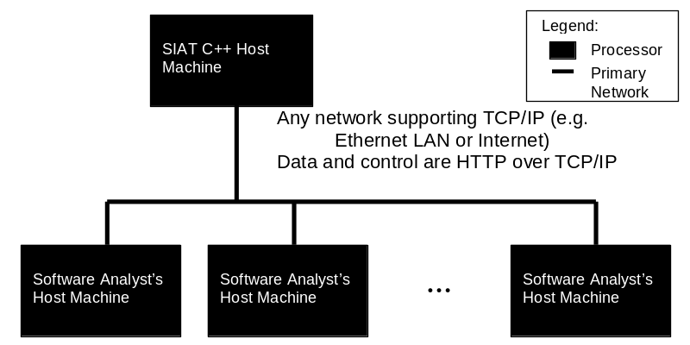
Host Platform Requirements
Server (SIAT C++ Host Machine)
  Sun server running Solaris 2.5.1 or higher
  Netscape Enterprise Server 3.5 or higher
Client (Software Analyst’s Host Machine)
  Desktop Machine with network connection
  Netscape Navigator 4.5+
  Internet Explorer 5+ (informally supported)

Slide 11
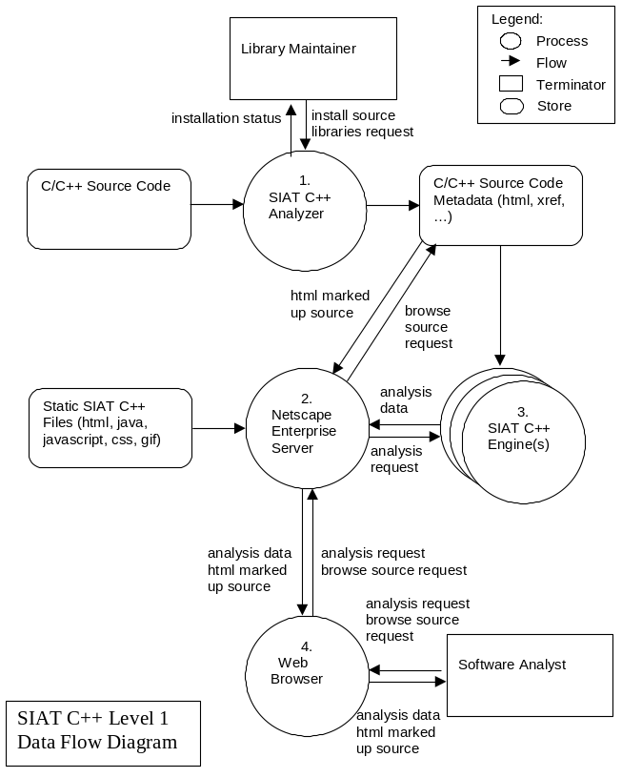
Client / Server System Architecture
Server
  SIAT C++ Analyzer
    EDG C++ Front End Compiler
    Custom Perl/UNIX shell scripts
  SIAT C++ Engine
    One session/process per analyst
    Custom C code application
  Netscape Enterprise Server
    COTS Web Server
    DSM - Custom C code plug-in (for session management)
Client
  Web Brower
    Netscape Navigator 4.5+
    Internet Explorer 5+ (informally supported)

Slide 12
Version 1.1 / 2.X Enhancements

Slide 13
Version 1.1 Enhancements
Part of GFY2001 Center Software Initiative Effort – Delivery date 9/01
Ability to query for all instances of particular constructs
  classes, structs, unions, pointers, derived classes, try statements, throw statements, catch statements
Ability to search for text strings
  Search all source text/ code only/ comments only

Slide 14
Version 2.X Possible Enhancements
GFY2002 CSIP submitted for enhancements
Purchase/Integrate latest EDG C++ Front End
  More complete C++ language support
Complete support for data flow graphs
Control flow graphs for functions
Global data flow using global identifier data
Bookmark source code

Slide 15
Version 2.X Possible Enhancements
Support for saving analysis session context
Ability to attach /view analysis notes on lines in files
Ability to view differences between versions of files
Personal user presentation format preferences
Login security to verify users
Notes:
- Note: Machine and web server access are currently restricted via firewall, web server rules, etc. – so the tool / data are not completely unprotected

Slide 16
Version 2.X Possible Enhancements
Calculate metrics such as cyclomatic complexity and essential complexity
Show type usage information that is more specific than “referenced”, such as “used to define object” or “used as base class in child class definition”
Notes:
- Note: Machine and web server access are currently restricted via firewall, web server rules, etc. – so the tool / data are not completely unprotected

Slide 17
SIAT C++ Version 1.0 Demo

Slide 18
SIAT C++ URL
SIAT C++ has been deployed on the host shenandoah in Fairmont
URL is http://shenandoah.ivv.nasa.gov:2222/siat

Slide 19
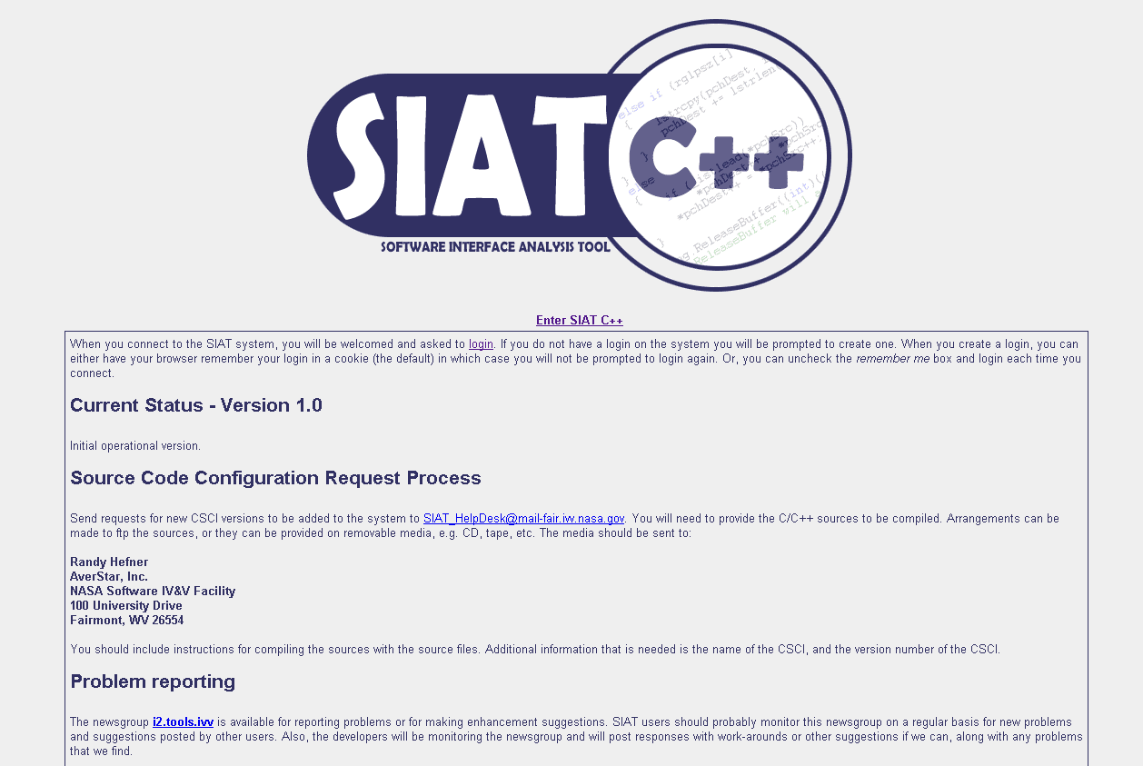
Click here to enter SIAT C++.

Slide 20
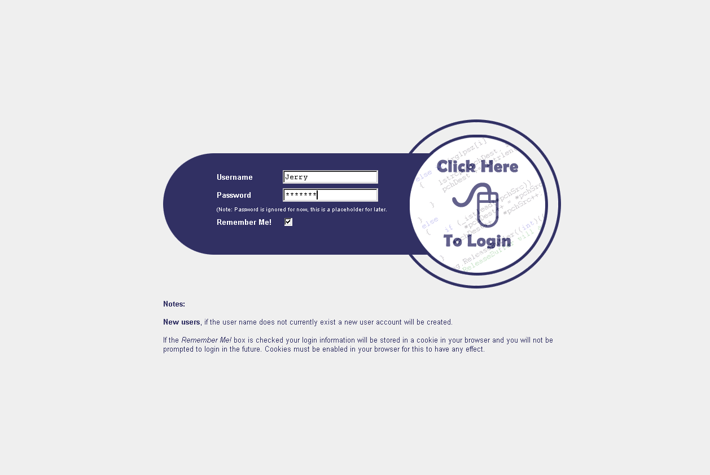
Enter your login information and click here.

Slide 21
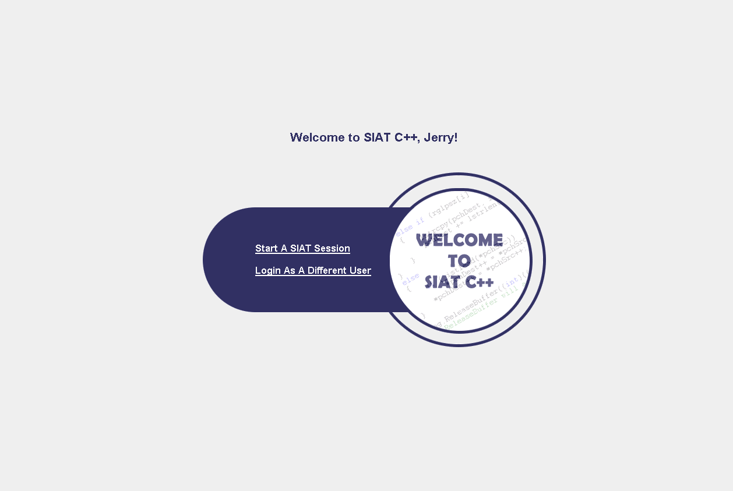
Click here to start a new session.

Slide 22
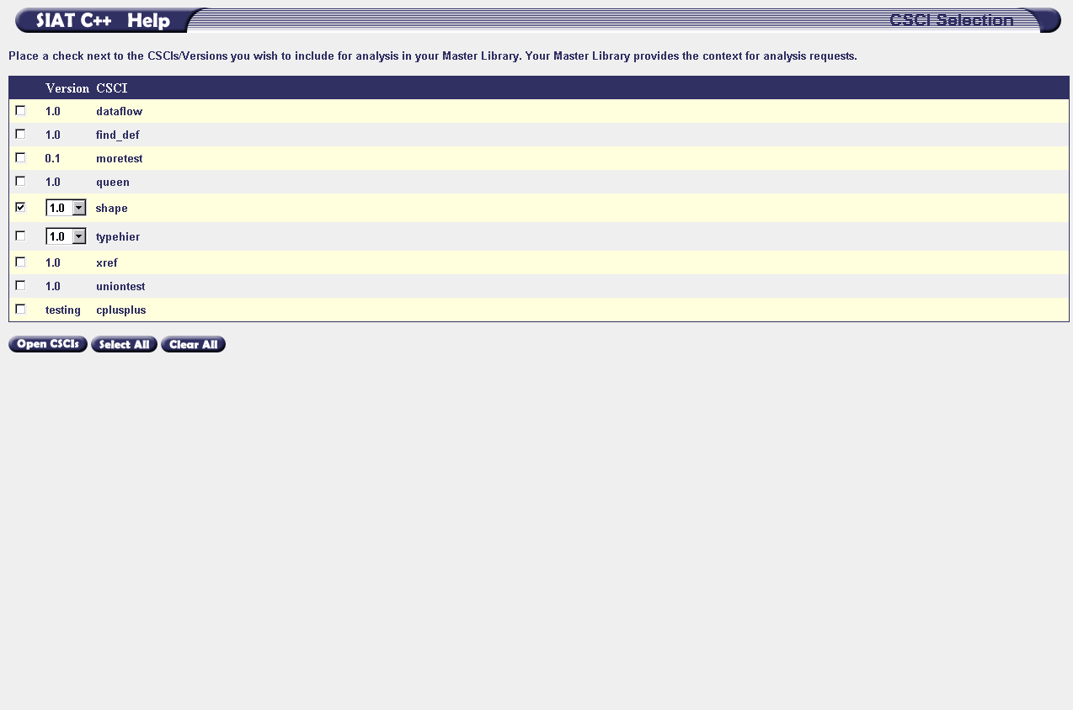
1.) Select the Libraries (CSCIs) that you would like to add to your Master Library.
If a Library has multiple versions, select the version from the dropdown list.
For this example, only the “shape” Library, version 1.0 should be selected.
2.) Click here to view the Master Library.

Slide 23
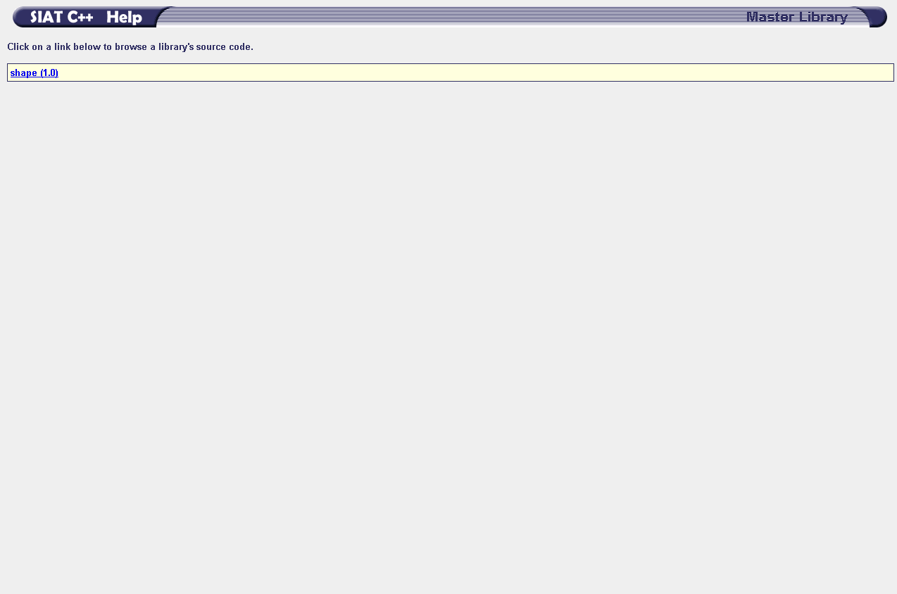
The Master Library View displays the Libraries you have selected.
Click a Library link to begin browsing that Library.
In this example, only the “shape” Library was selected.

Slide 24
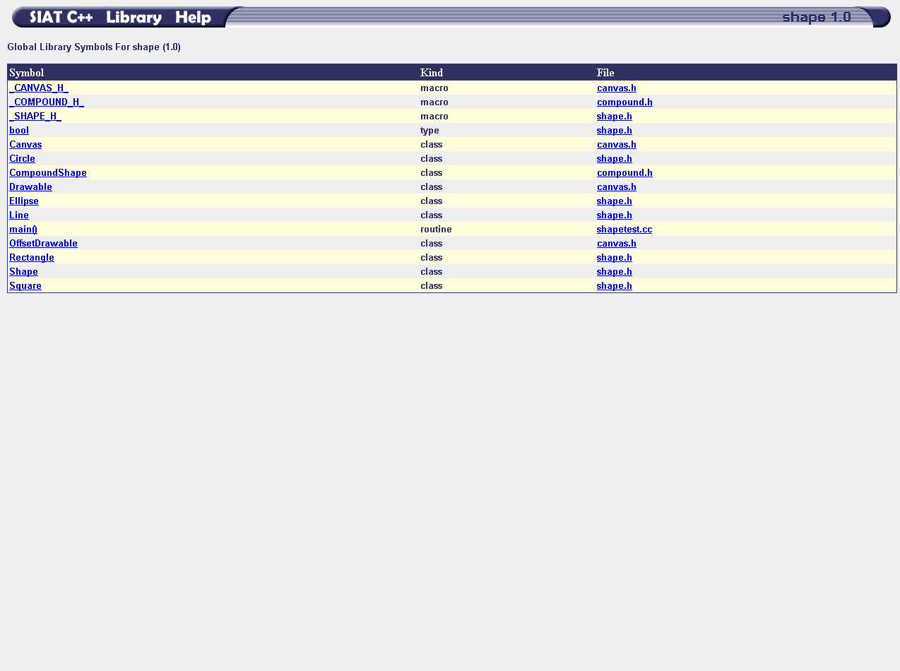
The Library View displays the global identifiers associated with a given Library. The identifier’s name, kind, and containing source file are listed.
Click on an identifier or its containing source file’s name to browse the source code. For this example click the identifier for the symbol “main()”.

Slide 25
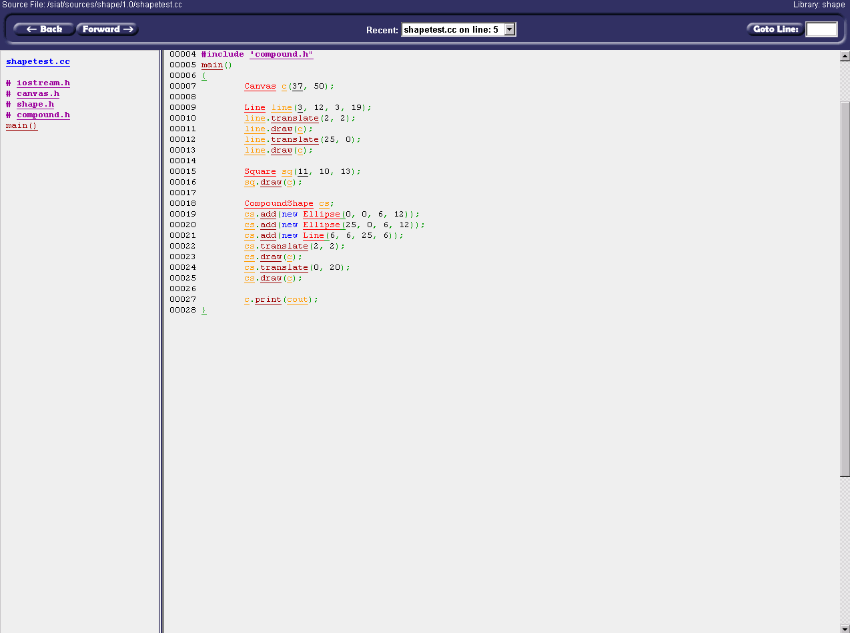
1
2
3
Click the “Ellipse” identifier reference to locate its definition.
The Source View contains:
1.) The Navigation Bar
2.) The Source File Outline
3.) The Hyperlinked Source Listing
Notice that “main()” is located at the top of the Source Listing.

Slide 26
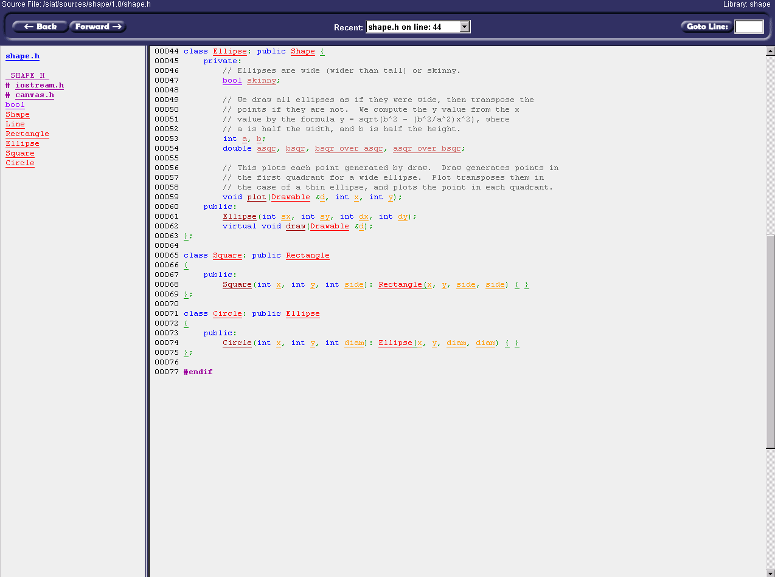
When an identifier reference is clicked, the definition of the identifier is displayed at the top of the Source Listing.

Slide 27
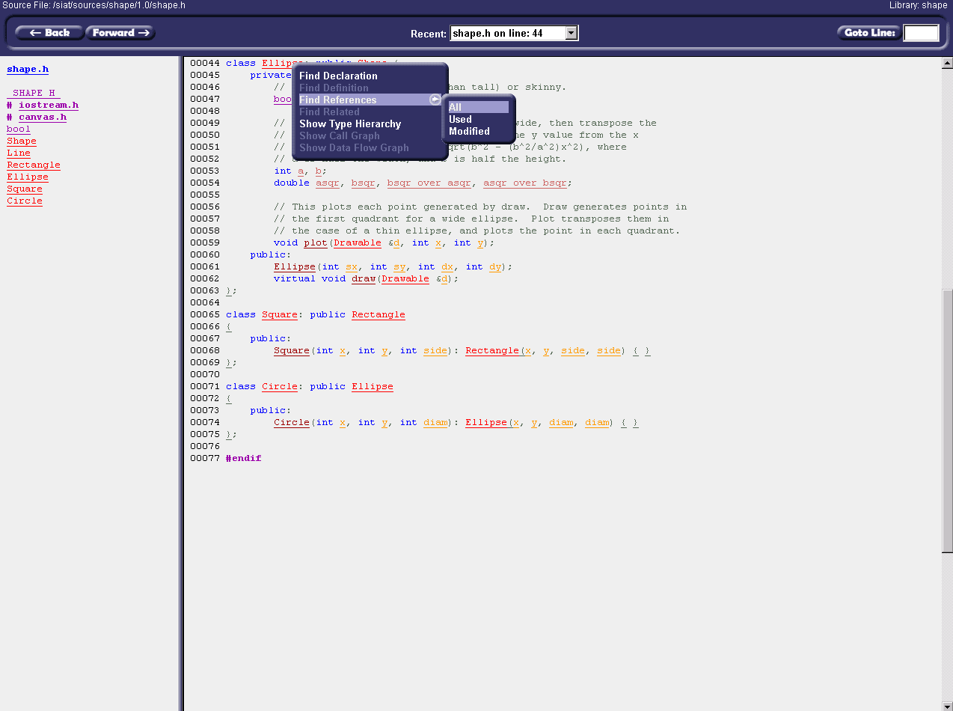
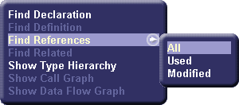
Click on “Ellipse” and select “Find References->All” to view all references to the identifier within the Library.
When an identifier definition or declaration is clicked, the user is presented with a list of analysis actions that can be performed for that identifier.

Slide 28
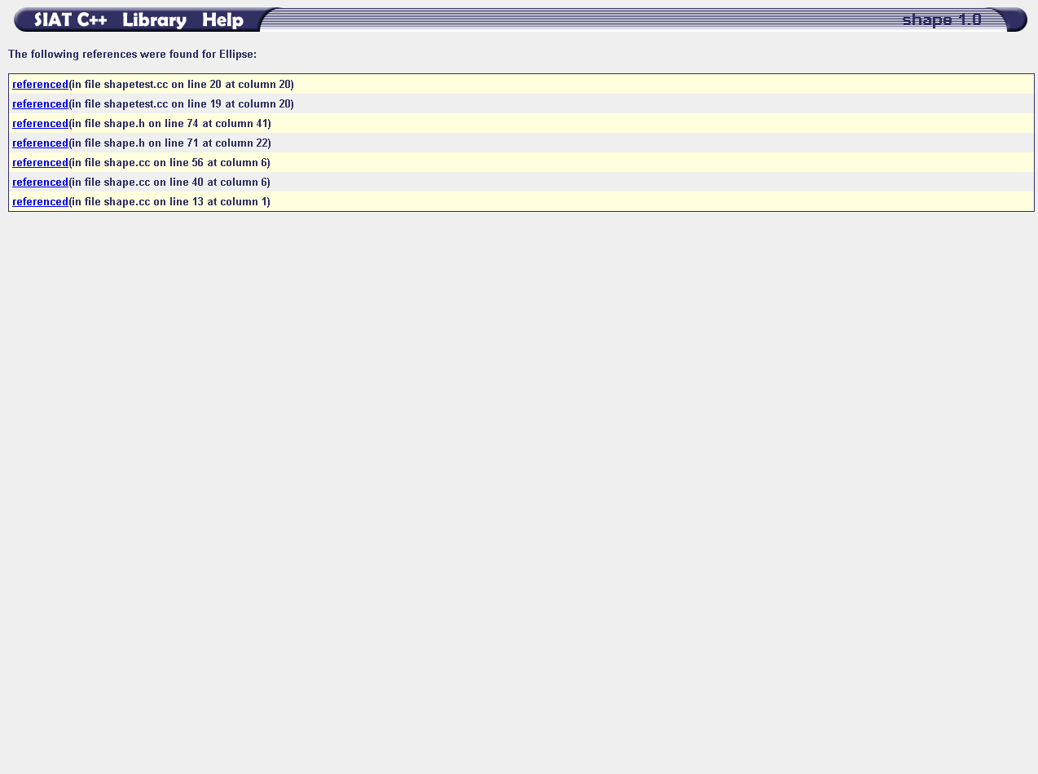
Click on a reference in the list to browse to the location in the Library’s source code where that identifier is referenced.
In this example, select the reference occurring on Line 71 of “shape.h”.
A list of all identifier references for “Ellipse” within the Library are displayed as a result of the “Find References->All” command.
The user could have chosen to view only references in which the identifier was used or modified as well.

Slide 29
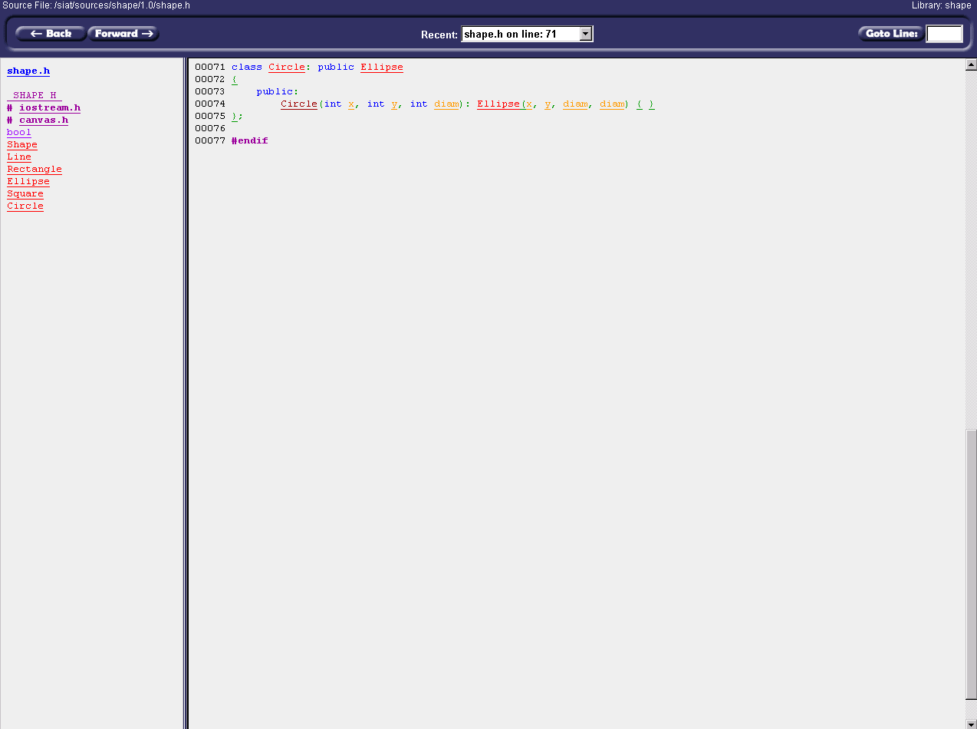
The reference to the “Ellipse” identifier on Line 71 of “shape.h” is displayed at the top of the source file listing. This location is also added to the list of recently viewed items in the Navigation Bar.

Slide 30
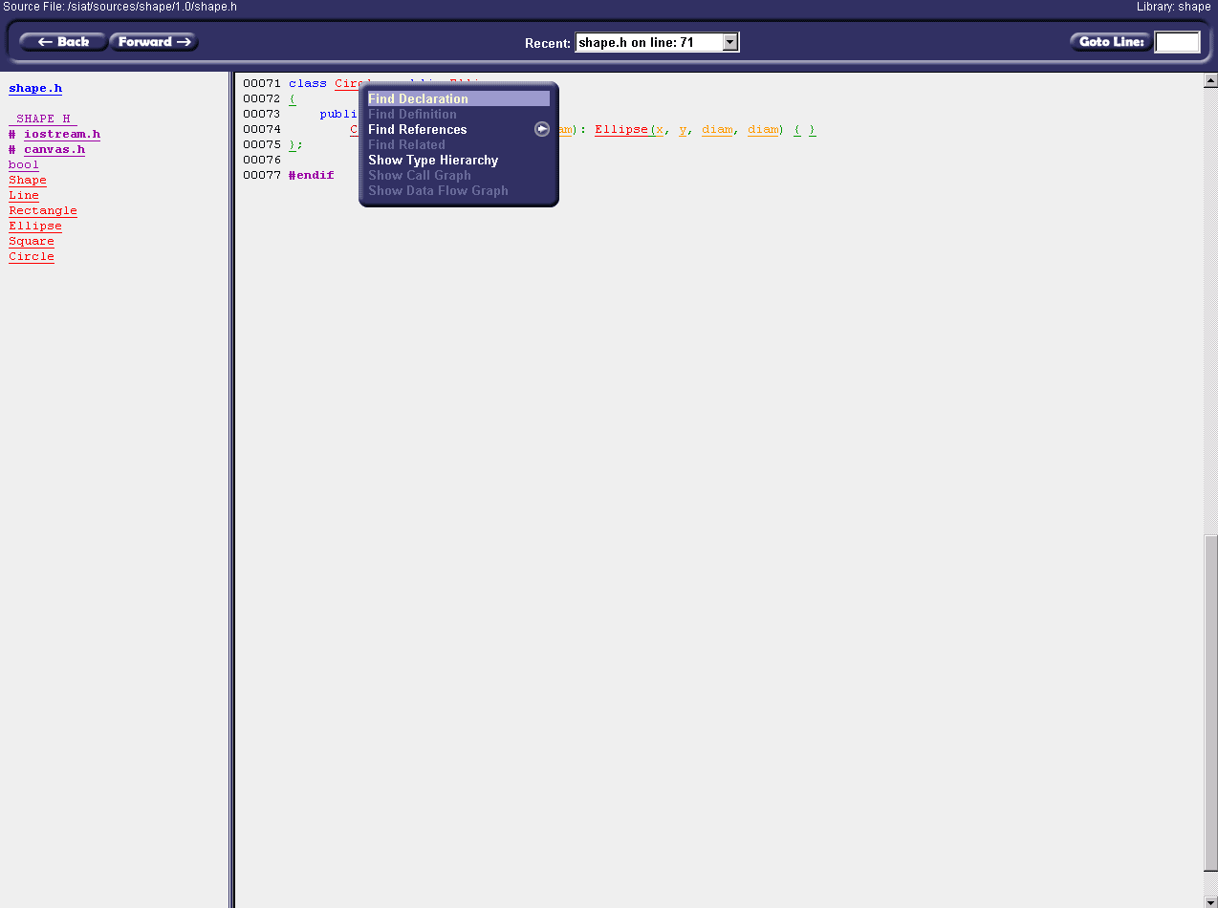
Click on the “Circle” identifier in the definition of the “Circle” class. The popup menu is displayed again. This time, choose “Find Declaration” from the menu.

Slide 31
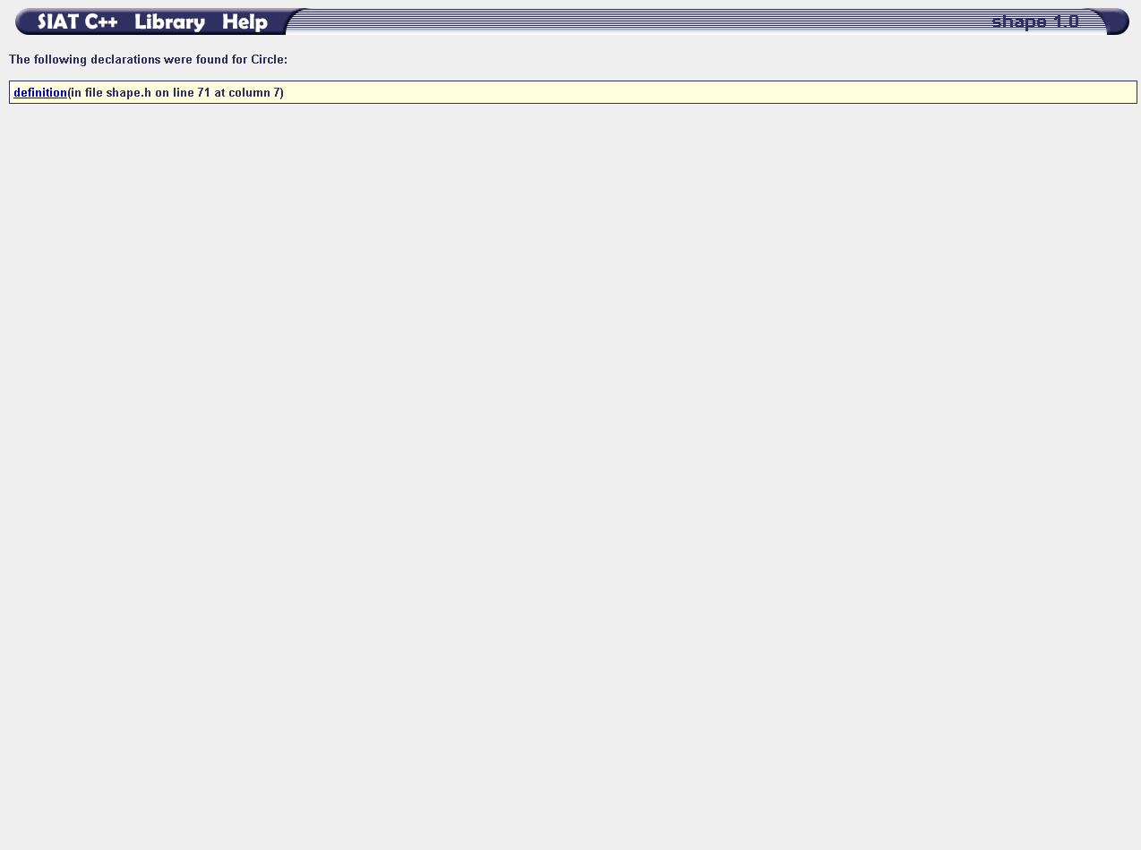
A list of all declarations of the “Circle” class is displayed to the user.
In this case, only the declaration that is also the definition of the class is displayed in the list.
Click the hyperlink to return to the “shape.h” file on Line 71.

Slide 32
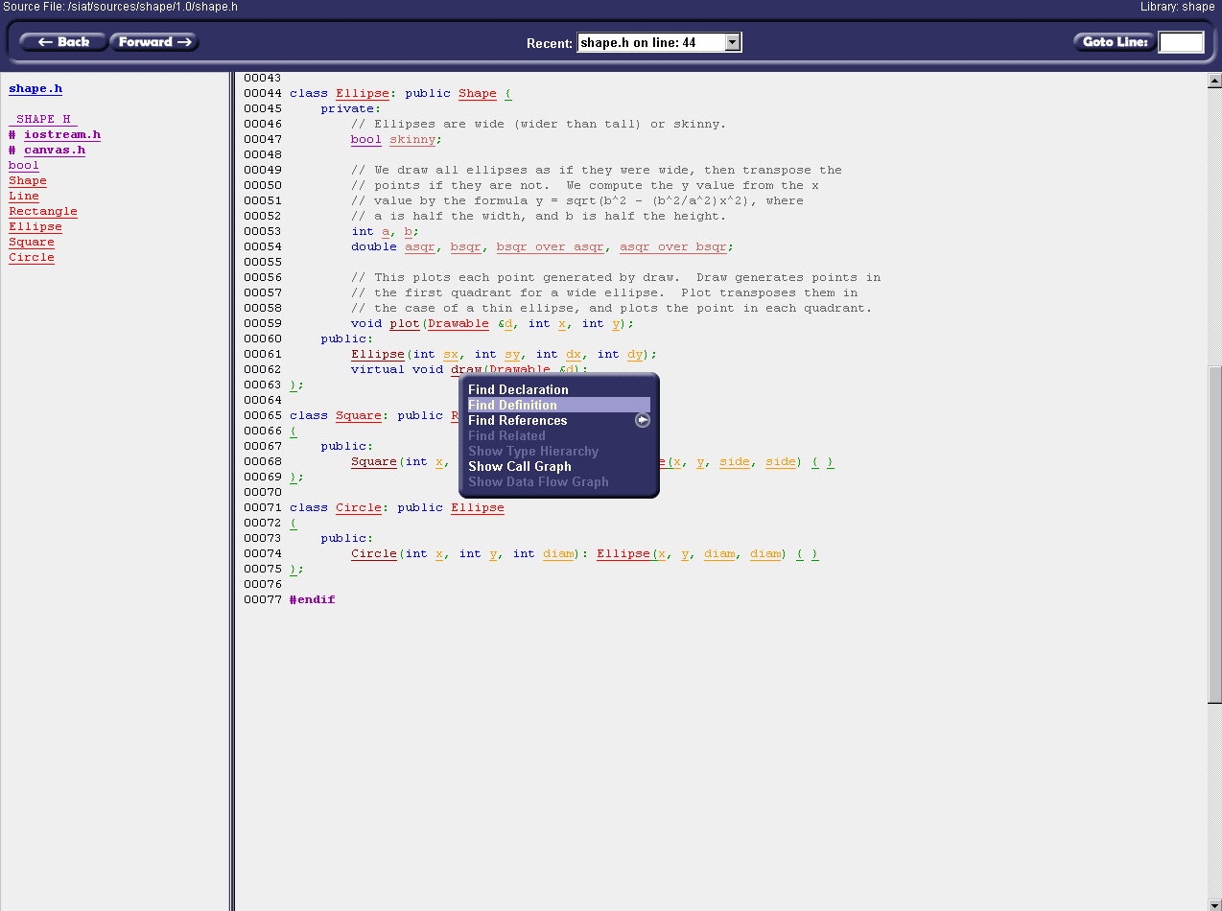
In the “shape.h” source listing, scroll up to Line 62 and click the declaration of the “Ellipse::draw” function. Again, the menu is displayed. This time, select “Find Definition” to locate the definition of this function in the Library.

Slide 33
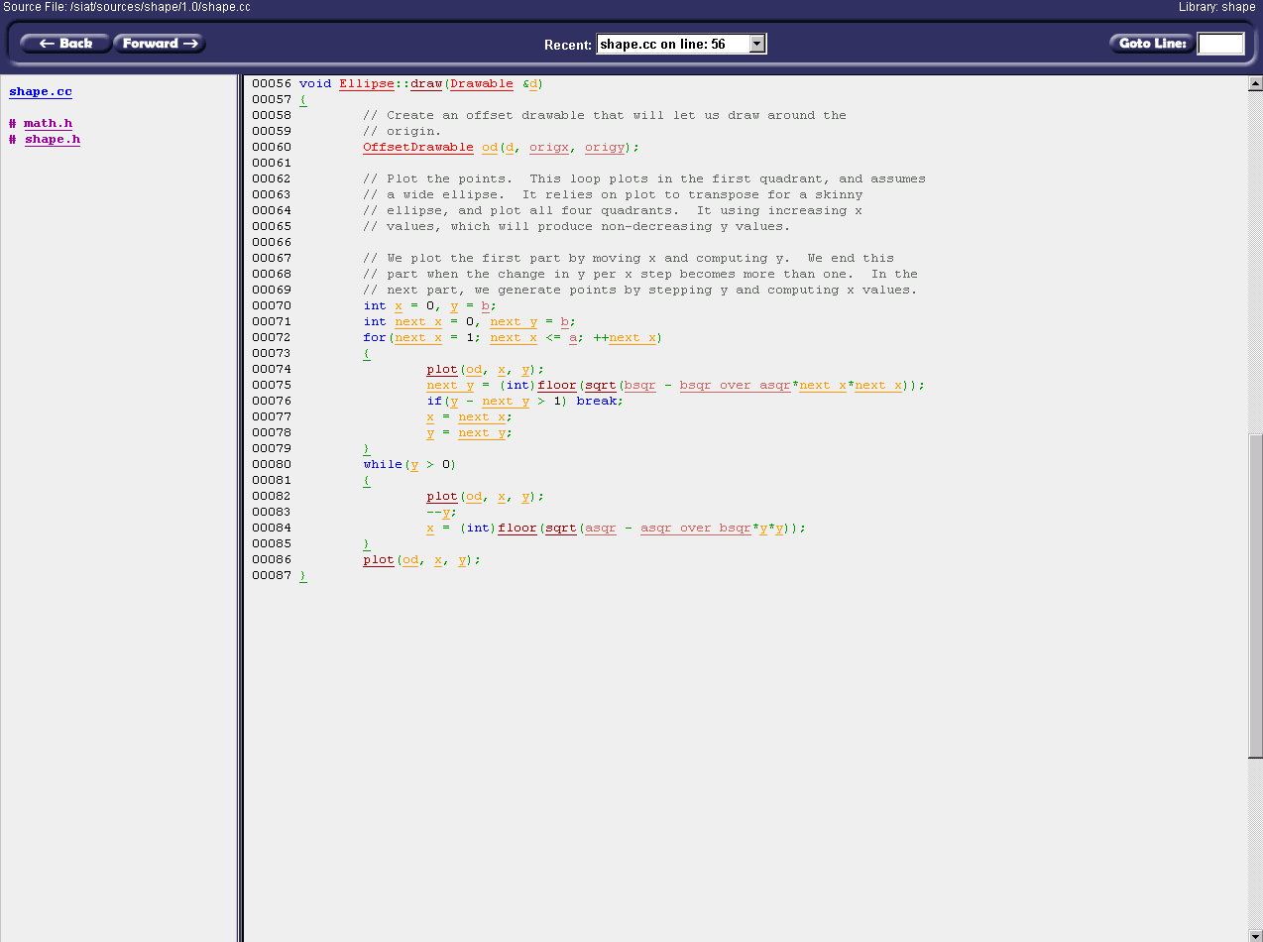
The definition of the “Ellipse::draw” function is displayed at the top of the Source Listing.

Slide 34
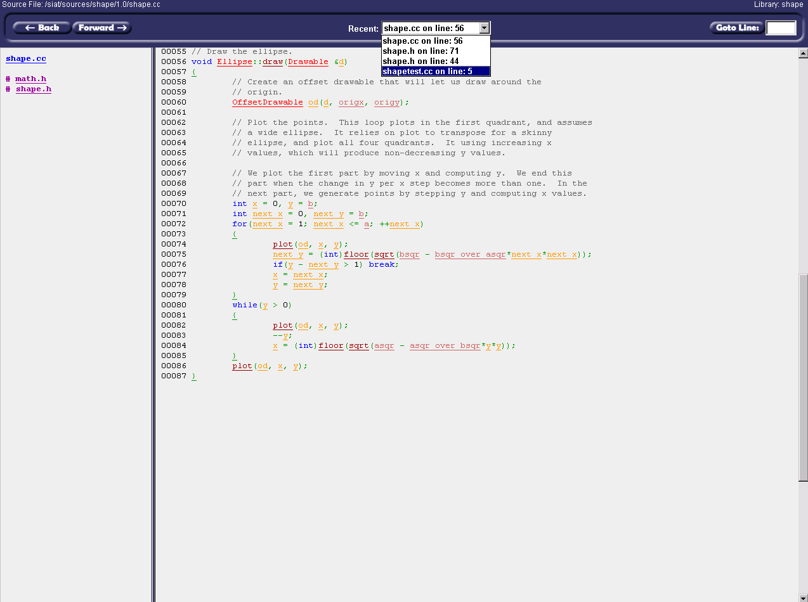
Return to the first location you browsed by selecting the last item from the Recent list.

Slide 35
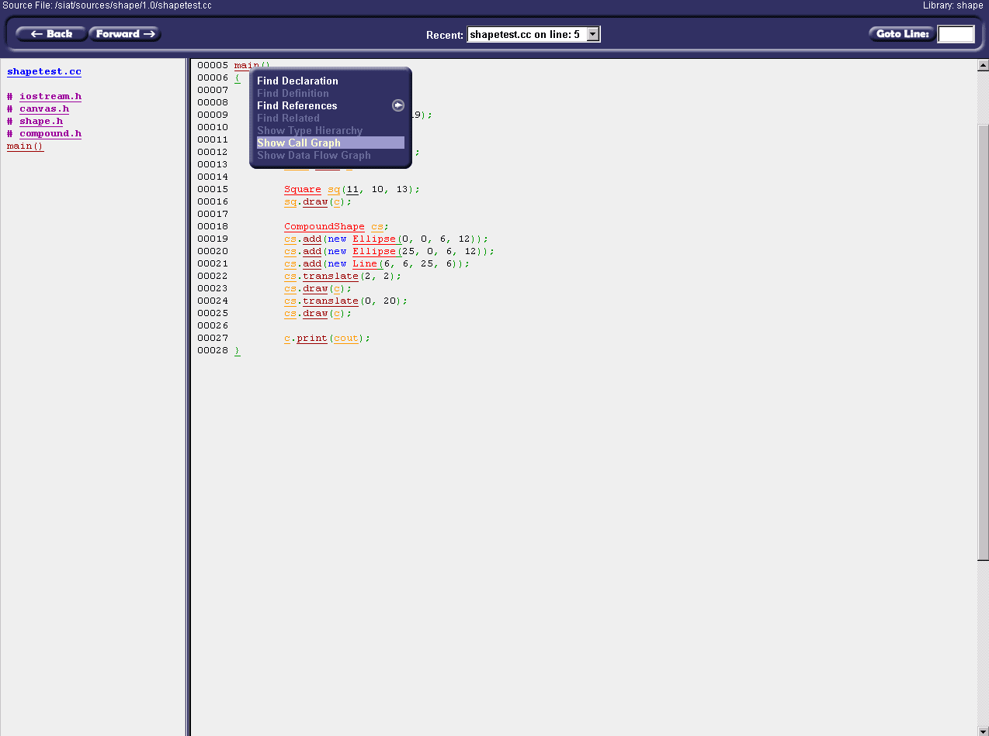
The Source Listing is displayed with “main()” positioned at the top.
Click on the identifier for “main()” and select “Show Call Graph” from the menu that appears to view a function call graph for the “main” function.

Slide 36
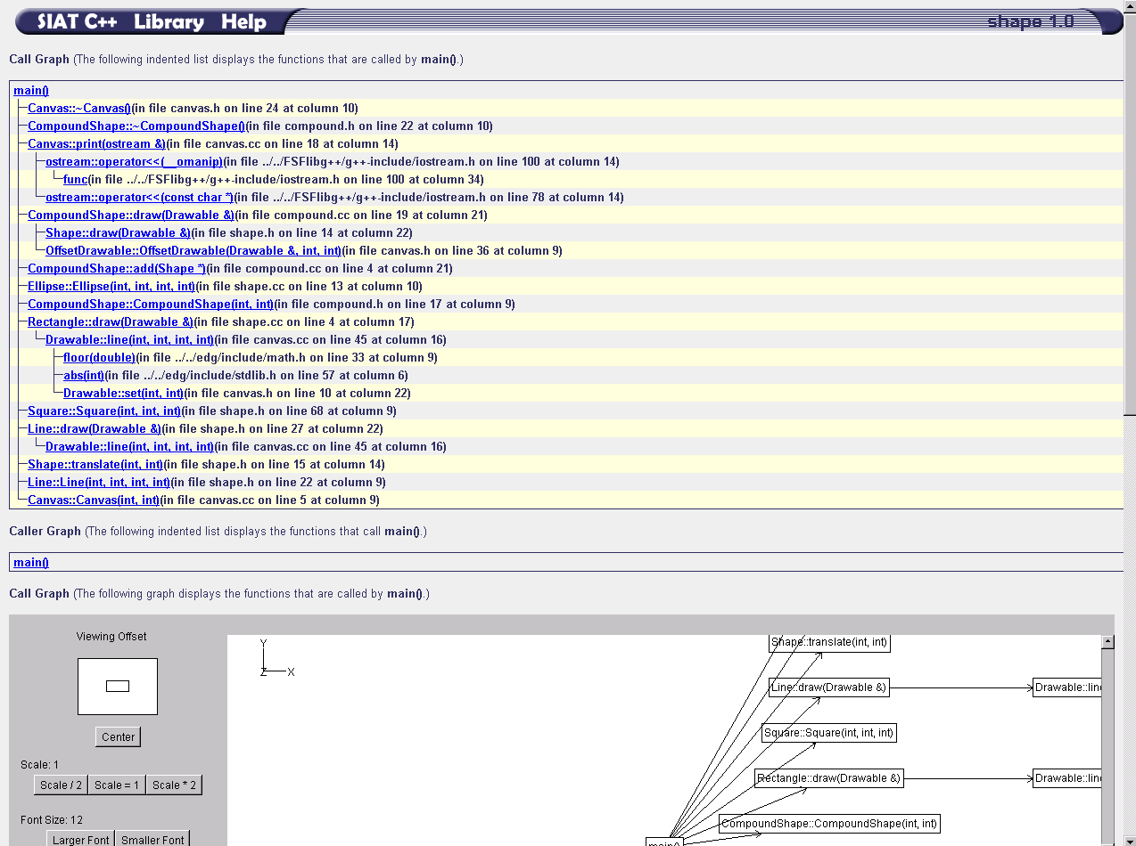
The Graph View displays data as both indented textual list and graphical formats. The textual lists are always displayed first, followed by the graphical version.
Scroll down to view the graphical view of the data.

Slide 37
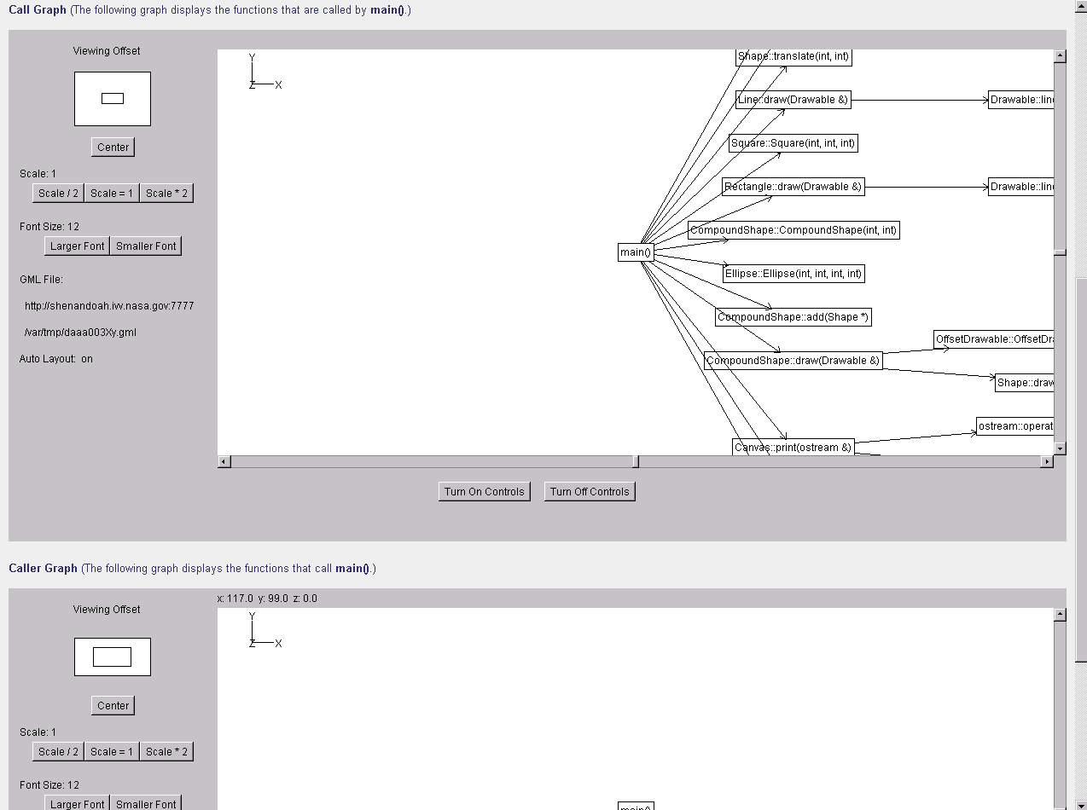
This is an example of the graphical view of graph data. Information in this view is represented as a collection of nodes connected by edges. The scrollbars and the controls to the left and at the bottom of the graph can be used to manipulate the graph for better viewing.

Slide 38
The Call Graph displays functions called by “main()” and the Caller Graph displays functions that call “main()” (none, of course!).
Click on the hyperlink for the function named “Line::draw(Drawable &)” in the Call Graph.

Slide 39
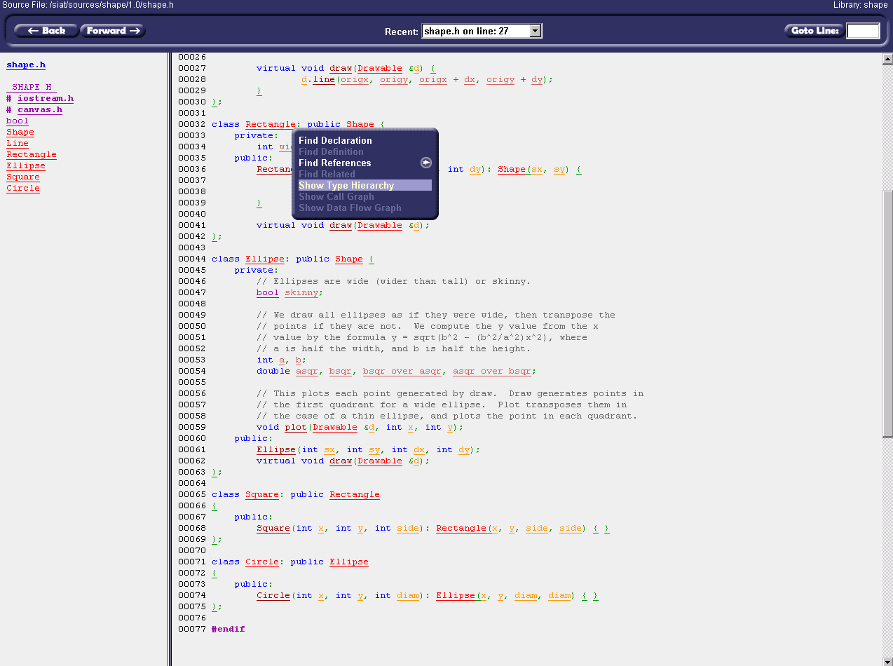
The Source Listing is displayed with the definition of “Line::draw” positioned at the top.
Click “Rectangle” in the definition for the “Rectangle” class on Line 32. Next, select “Show Type Hierarchy” from the menu that appears.

Slide 40
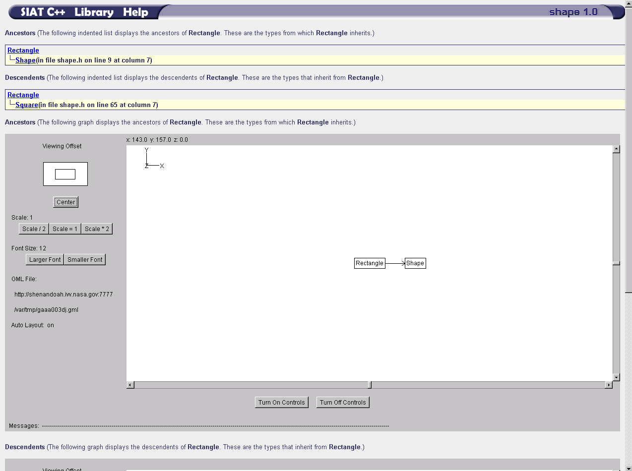
The Ancestors Graph shows those types from which “Rectangle” inherits and the Descendents Graph shows those types that inherit from “Rectangle”.
Click on the node for the class named “Shape” in the Ancestors Graph.

Slide 41
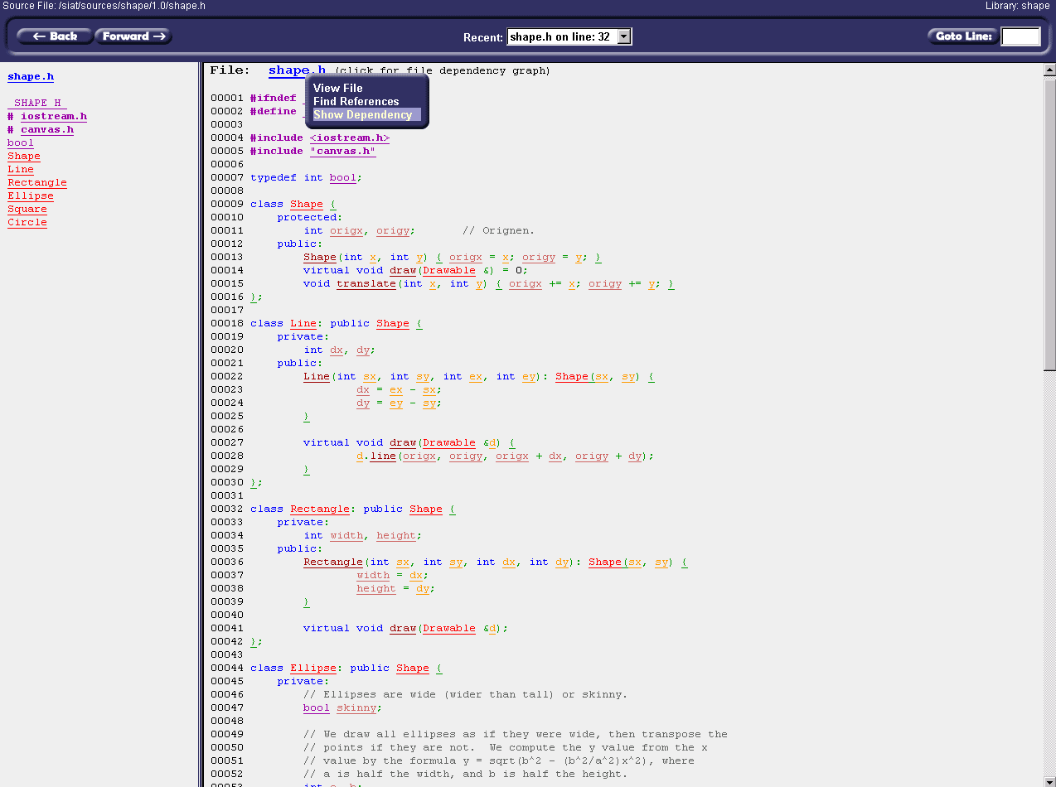
The source file containing the definition of the “Shape” class will be displayed. Scroll to the top of the Source Listing or click on “shape.h” in the Source Outline.
At the top of the Source Listing you will see a hyperlink for the current source file (shape.h). Click this hyperlink and select “Show Dependency” from the menu that appears.

Slide 42
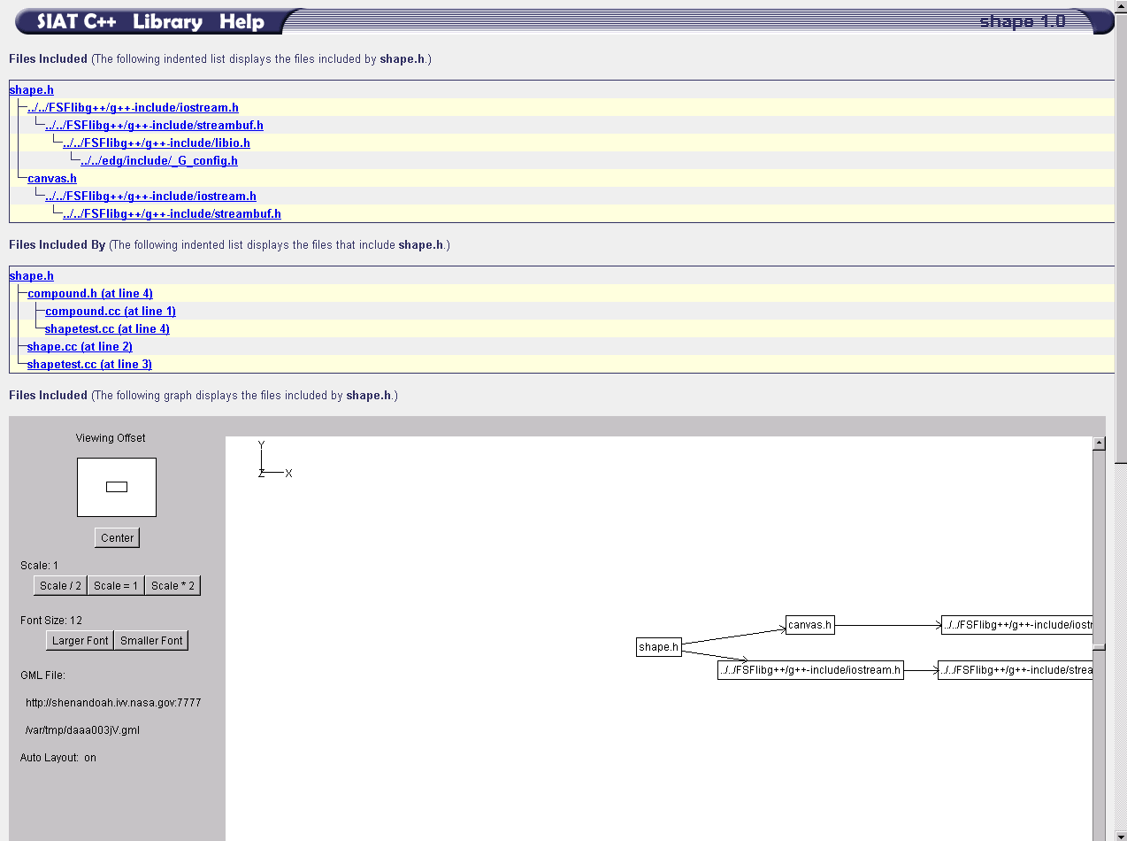
The Files Included Graph shows the files included by “shape.h” and the Files Included By Graph shows the files that include “shape.h”.
Click on the hyperlink for the file named “shapetest.cc” at Line 3 in the Files Included By Graph.

Slide 43
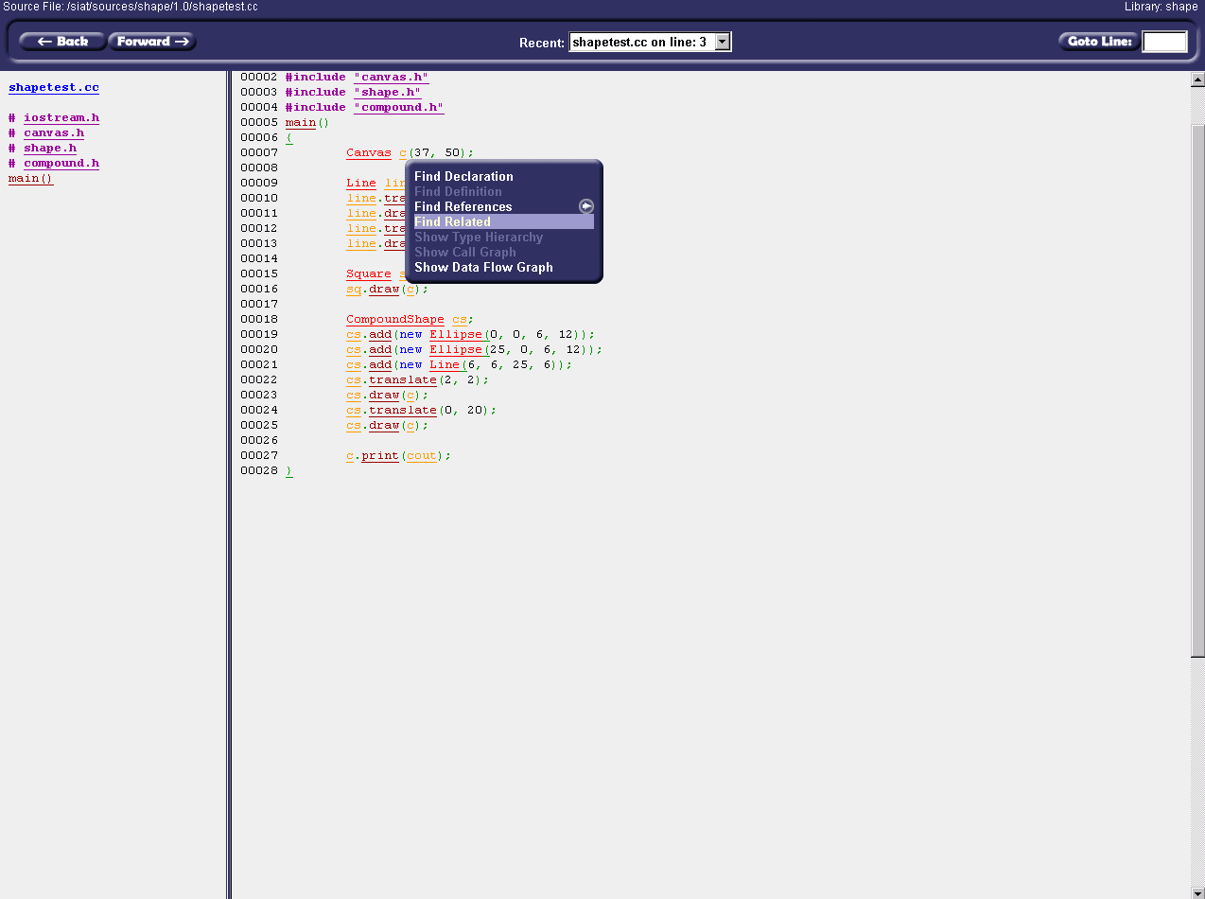
The #include statement for “shape.h” on Line 3 is positioned at the top of the Source Listing.
Click the variable named “c” on Line 7 and select “Find Related” from the menu that appears.

Slide 44
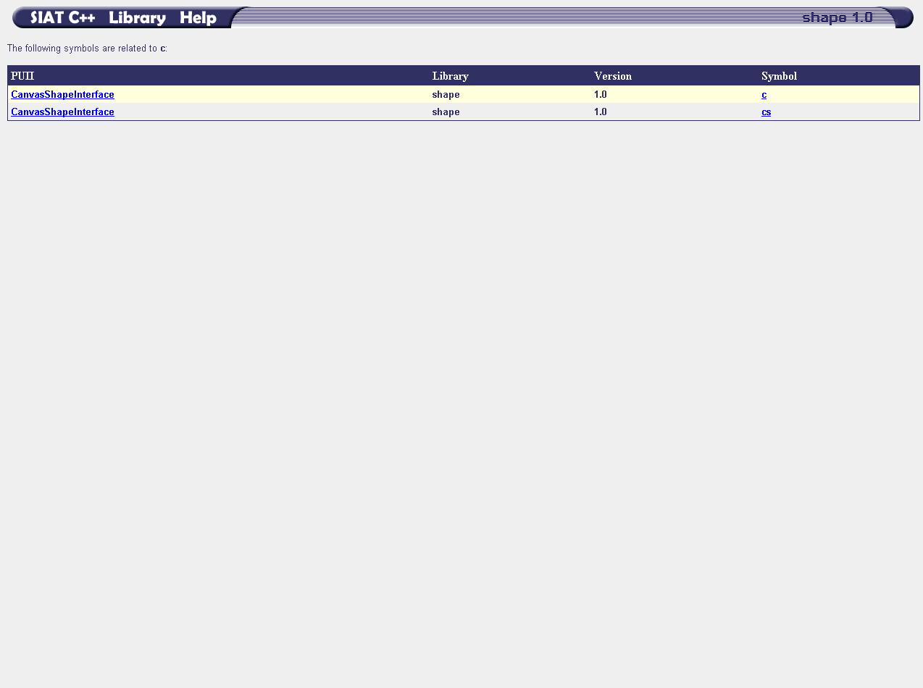
The Related Items View displays source code identifiers that have been related by PUIIs. Each PUII is listed as well as the Library and Version to which the PUII applies. The symbols that are related by the PUII are listed in the last column.
The user can click a PUII name to find out more about a specific PUII. The related symbols can also be clicked to perform the same operations that can be performed from the Source View.

Slide 45
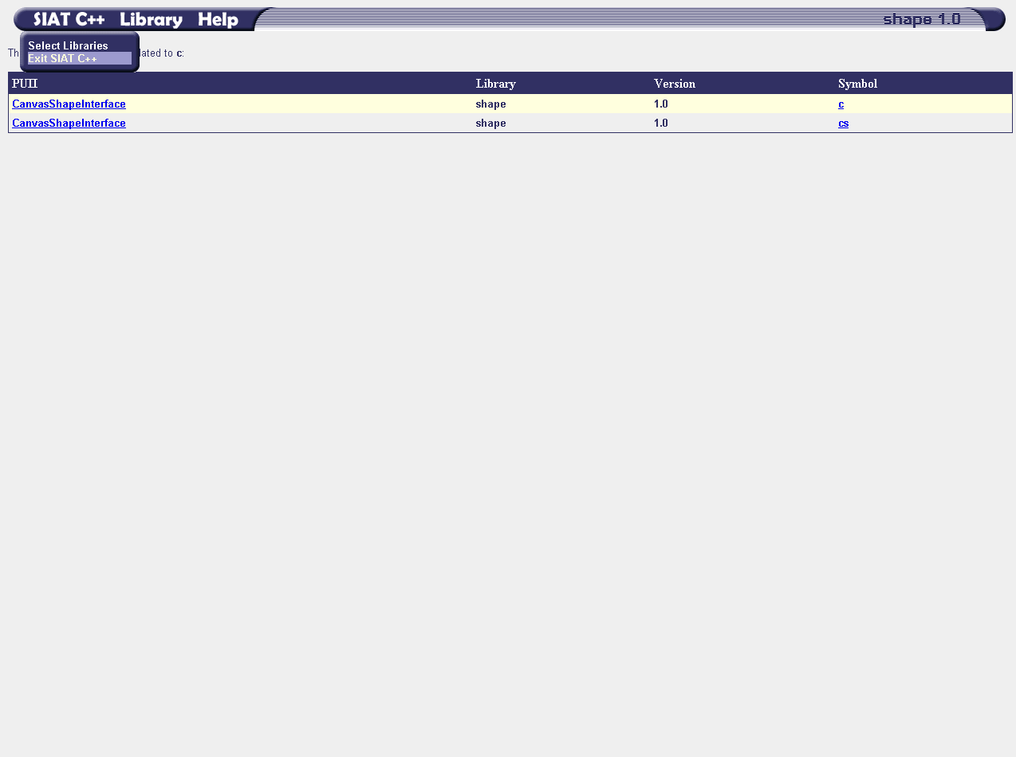
To end a SIAT C++ session, click the “SIAT C++” menu in the menu bar at the top of the page and select the “Exit SIAT C++” menu option.
Notice: This is the only proper way to exit from the SIAT C++ application!

Slide 46
Wrap-up/Discussion

