Slide 1
NSLDS Update
Valerie Sherrer
NSLDS- Department of Education
Jim Yoder
NSLDS- Pearson

Slide 2
Session’s Agenda
Aggregate Reporting
  Classify which loan types impact which aggregate limits
  Differentiate between various aggregate definitions
  Calculate aggregate limits using NSLDS methodology
Password/Security reminders
Storing Outstanding Principal and Outstanding Interest Balances
New Data Provider: Disability Discharges

Slide 3
Aggregate Reporting

Slide 4
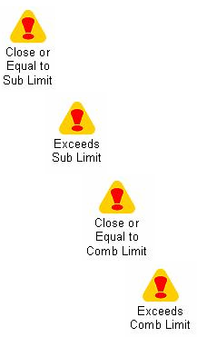
Warning Icons- What’s next when determining student eligibility?

Slide 5

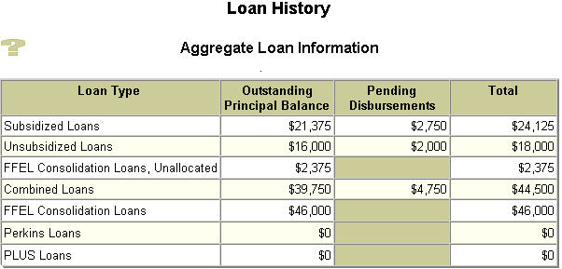

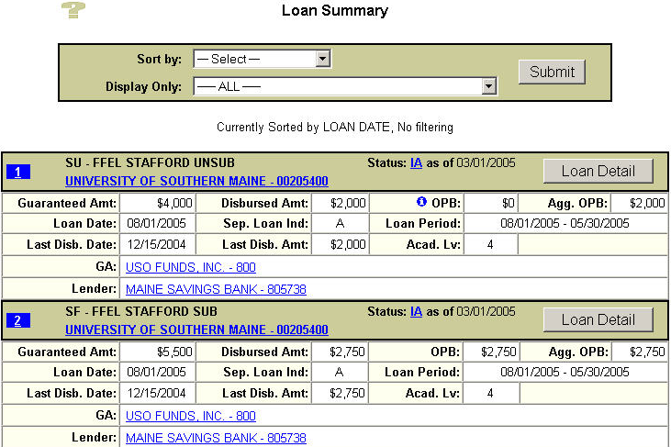
Loan History (Student’s Aggregate Loan Information) vs. Loan Summary (loan level information)

Slide 6
 | Loan Types / Buckets:
 | Subsidized | Unsubsidized | Perkins | PLUS | Consolidation
L o a n De t a i l s / Ag g OPB Co n s i d e r a t i o n s | SF – FFEL Sub Loan Category: Recent or Other Loans | SU – FFEL Unsub. Loan Category: Recent or Other Loans | PU - Federal Perkins Loan | PL – FFEL PLUS | CL – FFEL Consolidation Loan 60 day rule (if no underlying loans then $ 0 Aggr. OPB calculated) If over 60 days old, and no identified underlying loans, then all is treated/Calc’d as Subsidized Loan Category: Other loans NSLDS Methodology / Algorithms Calc’d Subsidized Calc’d Unsubsidized Calc’d Unallocated Perkins Share factored out PLUS Share factored out (for the PLUS Borrower) Calc’d Combined Underlying Loans Loan Status date 210 days +/- of CL’s Loan Date Loan Status Codes: PN, PC, DN, PF, DP ‘Adjusted Agg OPB’ displayed when Underlying Perkins loans factored out of Unallocated Amounts Underling PLUS loans factored out of Unallocated Amounts Inherits underlying CL loan’s underlying loans
 | D1 – Direct Stafford Subsidized Loan Category: Recent or Other Loans | SL - Supplemental Loan (SLS) Loan Category: Recent or Other Loans | NU – National Direct Student Loans | D4 – Direct PLUS | D6 – Direct Consolidation Subsidized 60 day rule (if no underlying Sub/Perkins then $ 0 Agg OPB calculate) Reported by Direct Loans, used by NSLDS Loan Category: Other loans ‘Adjusted Agg OPB’ displayed when Factoring out underlying Perkins
 | D6 – Direct Consolidation Subsidized | FI – Federally Insured (FISL) Loan Category: Recent or Other Loans | DU - National Defense Loan | D7 – Direct PLUS Consolidation | D5 – Direct Consolidation Unsubsidized 60 day rule (if no underlying Unsubs then $ 0 Agg OPB calculated) Reported by Direct Loans, used by NSLDS Loan Category: Other loans
 |  | RF – FFEL Refinanced Loan Loan Category: Recent or Other Loans | EU - Perkins Expanded Lending
 | CL – FFEL Consol. Calc’d Sub Aggr. OPB amount(s) | D2- Direct Stafford Unsubsidized Loan Category: Recent or Other Loans | IC - Income Contingent (ICL)
 |  | D5 – Direct Consolidation Unsubsidized
 |  | CL – FFEL Consol. Calc’d Unsub Aggr. OPB amount (s)

Slide 7
NSLDS Loan Summary Level Agg OPB
Loan Category: Recent vs. Other Loans
Recent Loans
  Period End Date is less than 90 days old
  Loan status = IA, ID, IG, or IM
    Agg. OPB = Greater of the Outstanding Principal Balance or Disbursed Amount, not to exceed Net Loan Amount Loan.
  If both Outstanding Principal Balance and Disbursed Amount equal zero, use zero

Slide 8
NSLDS Loan Summary Level Agg OPB
Loan Category: Recent vs. Other Loans
Other Loans:
  The Agg OPB = lesser of the Net Loan Amount, Disbursed Amount, or Outstanding Principal Balance if all three are greater than zero

Slide 9
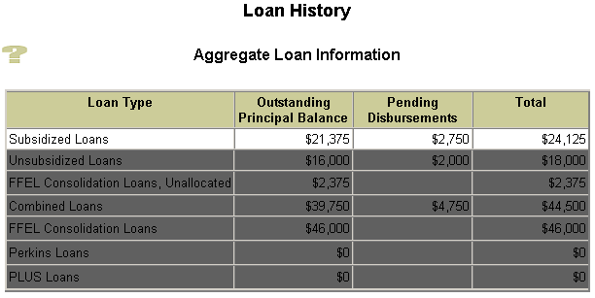
Subsidized Loan type make-up
Loan Types / Bucket:
Subsidized (from Loan Summary)
SF – FFEL Sub Loan Category: Recent or Other Loans
D1 – Direct Stafford Subsidized Loan Category: Recent or Other Loans
D6 – Direct Consolidation Subsidized Loan Category: Other Loans
CL – FFEL Consol. Calc’d Sub Aggr. OPB amount(s)

Slide 10

Fill in the missing pieces
Recent or Other loan? Agg. OPB Amount?
Recent Loan

Slide 11
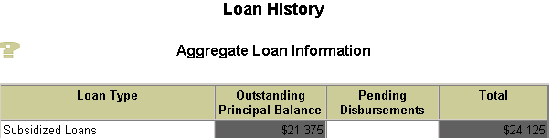

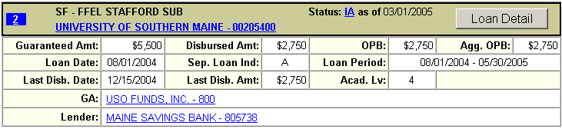
Fill in the missing pieces
Pending Disbursement?
Pending Disbursement Amount $5,500 - $2,750 =
NSLDS Calculates a Pending Disbursement amount when Loan Period End Date + 90 Days has not passed and Loan status is IA, ID, IG, or IM.
Loan Level’s Pending Disbursement = Net Loan amount – Agg OPB.

Slide 12
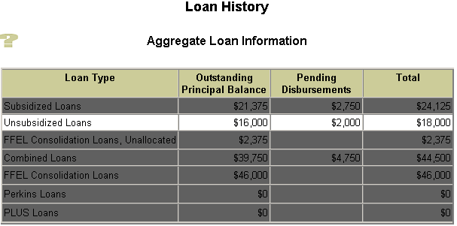
Unsubsidized Loan type make-up
Loan Types/ Bucket:
Unsubsidized (from Loan Summary)
SU – FFEL Unsub. Loan Category: Recent or Other Loans
SL – Supplemental Loan (SLS) Loan Category: Recent or Other Loans
FI – Federally Insured (FISL) Loan Category: Recent or Other Loans
RF – FFEL Refinanced Loan Loan Category: Recent or Other Loans
D2 – Direct Stafford Unsubsidized Loan Category: Recent or Other Loans
D5 – Direct Consolidation Unsub Loan Category: Other Loans
CL – FFEL Consol. Calc’d Unsub Aggr. OPB amount(s)

Slide 13

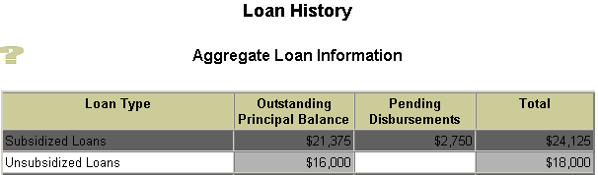

Questions that need answered
Recent or Other loan? Agg. OPB Amount?
Recent Loan
Pending Disbursement?
Pending Disbursement Amount $4,000 - $2,000 =

Slide 14
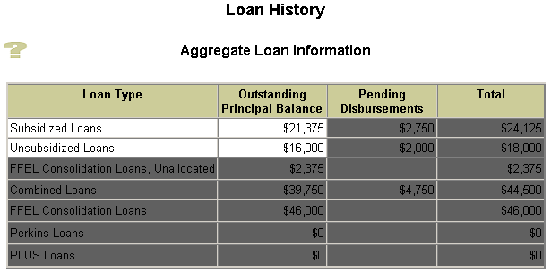


Direct Consolidation loan types make-up
Loan Types / Buckets:
Consolidation- Direct Loans (from loan Summary)
D6 – Direct Consolidation Subsidized 60 day rule (no underlying Sub/Perkins loans= $ 0 Agg. OPB) Reported by Direct Loans, used by NSLDS Loan Category: Other Loan ‘Adjusted Agg OPB’ displayed when: Factors out underlying Perkins
D5 – Direct Consolidation Unsubsidized 60 day rule (no underlying Unsub loans = $ 0 Agg OPB) Reported by Direct Loans, used by NSLDS Loan Category: Other Loan
Other Loans (not recent)

Slide 15
FFEL Consolidation Breakdown

Slide 16
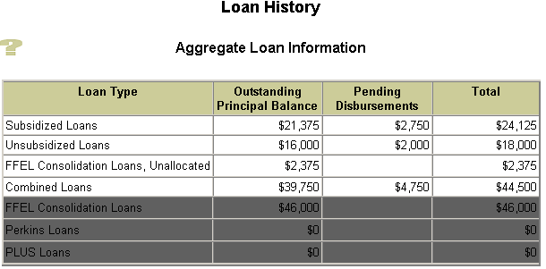
FFEL Consolidation (CL) Loan type make-up
Loan Types / Bucket:
Consolidation- FFEL (from Loan Summary)
CL – FFEL Consolidation Loan 60 day rule (if no underlying loans then $ 0 Aggr. OPB calculated) If over 60 days old, and no identified underlying loans, then all is treated/Calc’d as Subsidized Loan Category: Other loan NSLDS Methodology / Algorithms Calc’d Subsidized Calc’d Unsubsidized Calc’d Unallocated Perkins Share factored out PLUS Share factored out (for the PLUS Borrower) Calc’d Combined Underlying Loans Loan Status date 210 days +/- of CL’s Loan Date Loan Status Codes: PN, PC, DN, PF, DP ‘Adjusted Agg OPB’ displayed when Underlying Perkins loans factored out of Unallocated Amounts Underling PLUS loans factored out of Unallocated Amounts Inherits underlying CL loan’s underlying loans

Slide 17
FFEL Consolidation Loans (CL)
Impacting the Agg OPB
Identification of underlying loans
How many FFEL CL loans
Ratio of underlying loan’s disbursement amounts to CL’s Disbursement Amount(s)
Ratio is applied to the current CL OPB amount(s)

Slide 18
Definition
Underlying Loan
  Loan Status Code = PN, DN, PC, DP or PF
  Loan Status Date within 210 days (before or after) of the Consolidation Loan Date

Slide 19











Identifying the underlying loans

Slide 20




Begin the breakdown/ratio process
Add the Disbursement Amounts of the loan types
FFEL Consolidation Loan Types
PLUS Loan Types
Total CL Disbursement Amount: $39,000
Perkins Loan Types
PLUS Disbursement Total: $1,000
Perkins Disbursement Total: $4,000

Slide 21







Begin the breakdown/ratio process
Add the Disbursement Amounts of the loan types
Subsidized Loan Types
Unsubsidized Loan Types
Total Sub Disbursement Amount: $18,625
Total Unsub Disbursement Amount: $13,000

Slide 22


Calculating the Subsidized Aggregate OPB
1st: Sum the Disbursed Amounts of all Underlying SF, D1, D6 loans
2nd: Divided that by the Amount Disbursed from the CLs (getting the ratio %)
3rd: Multiplied that by the CL’s Aggregate OPB (Other Loan); if multiple CL’s apply ratio % to each
Result is the Calculated Subsidized Aggregate OPB
1st: Total Underlying Sub Disbursement Amount: $18,625
Total CL Disbursement Amount: $39,000
2nd: 18,625 divided by 39,000 = .47756 (over all percentage what we can attribute to be Subsidized)
3rd: .47756 x 17,000 = $8,119 Calc’d Sub Agg OPB
.47756 x 22,000 = $10,506 Calc’d Sub Agg OPB

Slide 23
Calculating the Unsubsidized Aggregate OPB
1st: Sum the Disbursed Amounts of all Underlying SU, SL, FI, RF, D2, D5 loans
2nd: Divided that by the Amount Disbursed from the CLs (getting the ratio %)
3rd: Multiplied that by the CL’s Aggregate OPB (Other Loan); if multiple CL’s apply ratio % to each
Result is the Calculated Unsubsidized Aggregate OPB
1st: Total Underlying Unsub. Disbursement Amount: $13,000
Total CL Disbursement Amount: $39,000
2nd: 13,000 divided by 39,000 = .3333 (over all percentage what we can attribute to be Unsubsidized)
3rd: .3333 x 17,000 = $5,667 Calc’d Unsub Agg OPB
.3333 x 22,000 = $7,333 Calc’d Unsub Agg OPB

Slide 24
Calculating the Perkins Share
1st: Sum the Disbursed Amounts of all Underlying PU, NU, DU, EU, IC loans
2nd: Divided that by the Amount Disbursed from the CLs (getting the ratio %)
3rd: Multiplied that by the CL’s Aggregate OPB (Other Loan); if multiple CL’s apply ratio % to each
Result is the Perkins Share of CL Aggregate OPB
1st: Total Underlying Perkins Disbursement Amount: $4,000
Total CL Disbursement Amount: $39,000
2nd: 4,000 divided by 39,000 = .10256 (over all percentage what we can attribute to be Perkins)
3rd: .10256 x 17,000 = $1,744 Perkins Share of the CL’s Agg OPB
.10256 x 22,000 = $2,256 Perkins Share of the CL’s Agg OPB

Slide 25
Calculating the PLUS Share
1st: Sum the Disbursed Amounts of all Underlying PL, D4, D7 loans
2nd: Divided that by the Amount Disbursed from the CLs (getting the ratio %)
3rd: Multiplied that by the CL’s Aggregate OPB (Other Loan); if multiple CL’s apply ratio % to each
Result is the PLUS Share of CL Aggregate OPB
1st: Total Underlying PLUS Disbursement Amount: $1,000
Total CL Disbursement Amount: $39,000
2nd: 1,000 divided by 39,000 = .0256 (over all percentage what we can attribute to be PLUS)
3rd: .0256 x 17,000 = $436 PLUS Share of the CL’s Agg OPB
.0256 x 22,000 = $564 PLUS Share of the CL’s Agg OPB

Slide 26
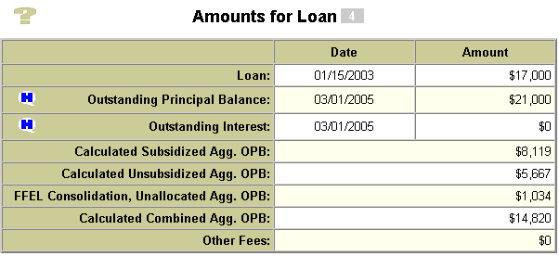
Calculating what’s left over: Unallocated Amount
1st: Start with the CL Agg OPB (Other Loan)
CL Agg OPB : $17,000
2nd: Take out Perkins Share
minus $1,744 Perkins Share of the CL’s Agg OPB
3rd: Take out PLUS Share
minus $436 PLUS Share of the CL’s Agg OPB
4th: Take out Calc’d Sub Agg OPB
minus $8,119 Calc’d Sub Agg OPB
5th: Take out Calc’d Unsub Agg OPB
minus $5,667 Calc’d Unsub Agg OPB
Left over amount = Calculated FFEL Consolidation, Unallocated Aggregate OPB
$1,034 Calculated FFEL Consolidation, Unallocated Agg OPB

Slide 27

Calculating what’s left over: Unallocated Amount
1st: Start with the CL Agg OPB (Other Loan)
CL Agg OPB : $22,000
2nd: Take out Perkins Share
minus $2,256 Perkins Share of the CL’s Agg OPB
3rd: Take out PLUS Share
minus $564 PLUS Share of the CL’s Agg OPB
4th: Take out Calc’d Sub Agg OPB
minus $10,506 Calc’d Sub Agg OPB
5th: Take out Calc’d Unsub Agg OPB
minus $7,333 Calc’d Unsub Agg OPB
Left over amount = Calculated FFEL Consolidation, Unallocated Aggregate OPB
$1,341 Calculated FFEL Consolidation, Unallocated Agg OPB

Slide 28
Calculated Combined Aggregate OPB
Agg OPB displayed is ‘adjusted’ when:
  Underlying Perkins loans factored out of Unallocated Amounts
  Underling PLUS loans factored out of Unallocated Amount (for the PLUS Borrower)
+
+
=

Slide 29
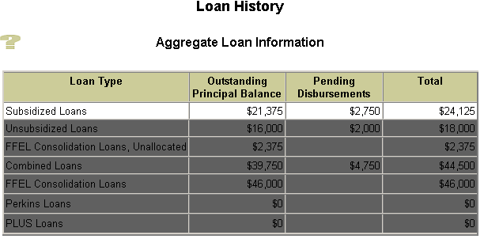

Rolling up Loan Level Summary amounts to Aggregate Level:
Subsidized Loan types

Slide 30
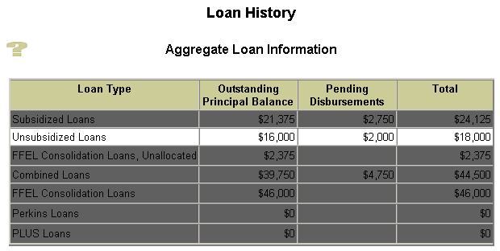
Rolling up Loan Level Summary amounts to Aggregate Level:
Unsubsidized Loan types

Slide 31
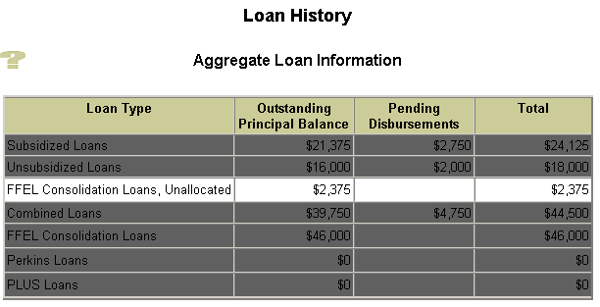
Rolling up Loan Level Summary amounts to Aggregate Level:
Unallocated Amount

Slide 32
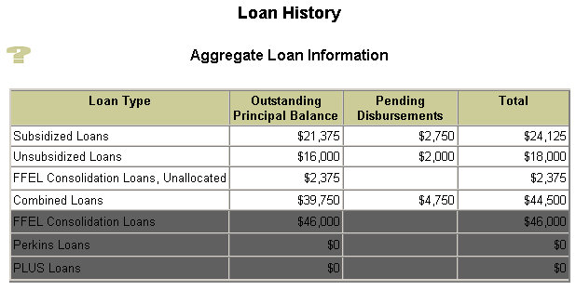
Getting the Aggregate Loan Information
Combined Loan Amounts
+
=

Slide 33
Understanding how we come up with the numbers should help with your decision making and award process

Slide 34
Tips For FFEL Breakdowns
A large Unallocated Amount may indicate:
  Interest/fees
  Misreported underlying loans
  Title VII Loans (HEAL)
  Spousal consolidations
  Timely reporting to NSLDS
NSLDS Web calculations are dynamic where as the ISIR data is static

Slide 35
Tips For FFEL Breakdowns
For FFEL CL loans over 60 days old that have a $0 unallocated amount look to see if the entire balance was calculated as subsidized

Slide 36
Reference Information
Available on IFAP
  NSLDS Newsletters #6, #7, #8 and recently published #9
  Dear Colleague Letter GEN 96-13
  Dear Partner Letter GEN-03-12
  ISIR Guide’s NSLDS FAH section

Slide 37
Where we are today
Pleased to report:
  NSLDS reported the number of tickets on this issue has decreased dramatically
  Guarantors reported the number of calls on this issue has decreased as well
  Schools for the most part are pleased with the aggregate calculation

Slide 38
Password/Security Reminders
Passwords must be 8 characters in length
Password expires every 90 days
At least 1 character must be numeric; 1st character must be letter

Slide 39
Capturing Outstanding Principal Balances (OPB) and Outstanding Interest Balance (OIB) History

Slide 40
Capturing Balance History
Prior to March 2005, historical data on OPB and OIB amounts not stored or displayed in NSLDS
As of late March 2005, NSLDS started to store and display OPB and OIB related data

Slide 41
Capturing Balance History
Historical data related to OPB and OIB reported prior to March 2005 will not be available
Historical balances only seen on NSLDSFAP web site and not student’s web interface
Formulas for calculating aggregates have not been changed

Slide 42
Capturing Balance History
Changes will not affect the Prescreening or Postscreening processes
NSLDS captures OPB/OIB information:
  At end of each quarter
  Before and after a loan status code change

Slide 43
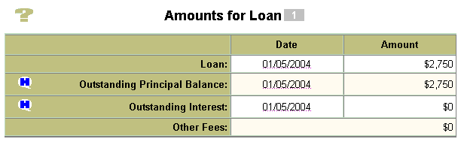
Viewing OPB and OIB History
History icons appear next to the OPB and OIB fields on the Loan Detail screen

Slide 44
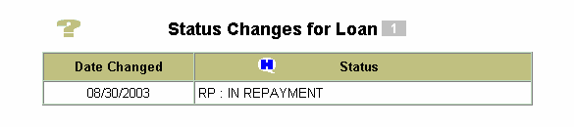
Viewing OPB and OIB History
History Icon displayed in the Loan Status information

Slide 45
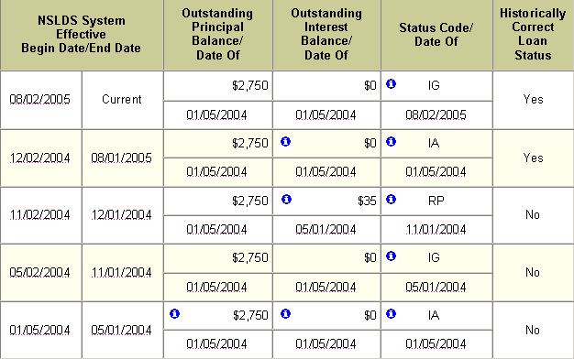
Viewing OPB and OIB History
Clicking the history icon displays the Outstanding Amount Balance History

Slide 46
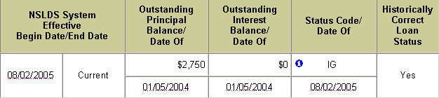
Interpreting the Outstanding Balances History
The information Icon displayed next to the value indicates changed data
In the example above, on 08/02/2005, the Status Code changed to IG, but the OPB and OIB did not change.

Slide 47
Additional Resources
NSLDSFAP On-line help pages
  Loan Detail
  Outstanding Amount Balance History
NSLDS Newsletter #10, May 2005

Slide 48
New Data Provider:
Conditional Disability Discharge Tracking System (CDDTS)

Slide 49

Discharge Codes
D = Death
R = Reaffirm
C = Conditional
P = Permanent
M = Multiple
Discharged Death
Conditional
Discharge
Reaffirm Discharge
Permanent Discharge
Multiple Discharges

Slide 50
Conditional Disability Discharge Process
Since late 2002, CDDTS has been administering Conditionally Discharged Loans but not reporting to NSLDS
As of April 2005, CDDTS began reporting as GA575
  Balances during Conditional period
  Closures for Permanently Discharged Loans
  Loan Status
    DI- Disability
    DS- Defaulted, then Disabled

Slide 51
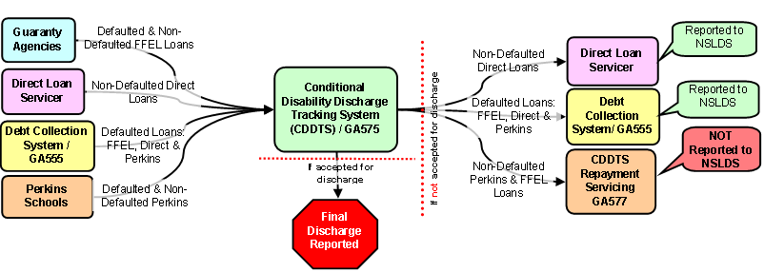
Flow of Loans- To and From CDDTS

Slide 52

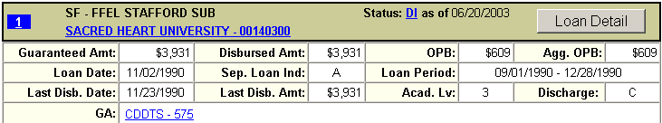

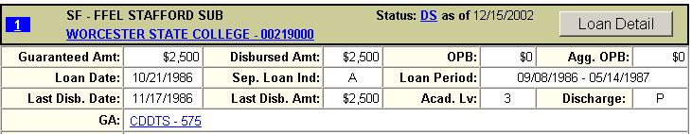
Disability Discharge Flags
Conditional
  DI or DS Loan Status Codes and loan balance is greater than $0
Permanent
  DI or DS Loan Status Codes and loan balance is equal to $0

Slide 53
Reinstated Loans
CDDTS will reassign Reinstated Loans:
  Direct Lending will receive non-defaulted Direct loans
  DCS (GA555) will receive all defaulted loans, including Direct Loans

Slide 54
CDDTS Repayment Servicing
Two types of non-defaulted loans will not be reported to NSLDS after reinstatement:
  FFEL
  Perkins
CDDTS Repayment Servicing (GA577) will receive these loans and should be contacted for status information

Slide 55
ISIR/SAR Data
Loans associated with GA575
  Contact Type “DDP” for Disability Data Provider
  Comment Code: 137
Loans associated with GA577
  Contact Type “RDS” for Reinstated Disability
  Comment Code: 139 (Perkins)
  Comment Code: 147 (FFELs)

Slide 56
References and Contact information
Contact information for GA575 and GA577
  NSLDS Newsletter #10, May 2005
  NSLDSFAP Organization Contact List

Slide 57
NSLDS Customer Service Center
  1-800-999-8219
  Expert Assistance 8:00 am – 9:00 pm Eastern Time
  NSLDS@pearson.com

Slide 58


