Slide 1

Rental Housing Integrity Improvement Project (RHIIP) Training
UPFRONT INCOME VERIFICATION:
The Key to Reducing Income and Rent Errors within HUD Rental Assistance Programs
Introduction of HUD’s New EIV System
October 13, 2005

Slide 2
Agenda
Welcome
Rental Housing Integrity Improvement Project (RHIIP) Overview
What’s New in the Enterprise Income Verification (EIV) System
Security Awareness
Getting Connected & Using EIV
How to Use UIV Data & Income Discrepancy Resolution
Questions & Answers Session

Slide 3
Statistics from 2001 Quality Control for Rental Assistance Subsidies Study
HUD overpaid rental subsidy by $2.6 billion (QC Study – 2001)
Estimated 60% of all subsidy and rent calculations contained some type of error:
  Calculation errors
  Failure to verify income *
  Incorrect deductions

Slide 4
What is Upfront Income Verification (UIV)?
Upfront Income Verification:
the verification of income, before or during a family re-examination, through an independent source that systemically and uniformly maintains income information in computerized form for a large number of individuals.

Slide 5
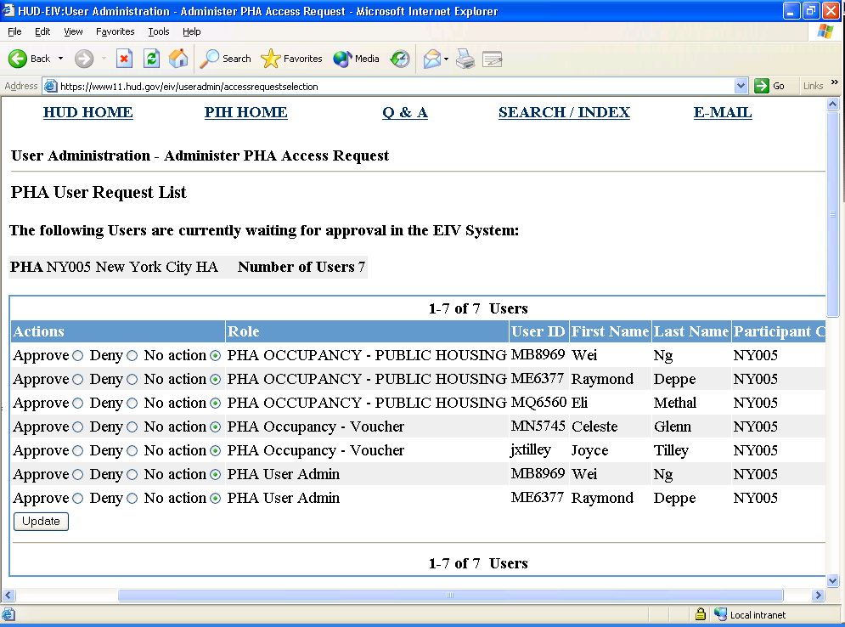
Getting Access to EIV
PHA Executive Director identifies User Administrator(s) and occupancy users
Submit access authorization and use agreement forms to HUD Field Office
HUD Field Office approves PHA User Administrator(s)
User administrators requests access for all staff
HUD Field Office approves PHA requests
** All EIV users must have a WASS ID with PIC & EIV access rights

Slide 6
Getting Access to EIV - Continued
To request & obtain a WASS ID, go to:
https://entp.hud.gov/idapp/html/pha_reg.htm
To obtain copies of EIV Access Authorization and/or Rules of Behavior and User Agreement forms, go to:
http://www.hud.gov/offices/pih/programs/ph/rhiip/uivsystem.cfm

Slide 7
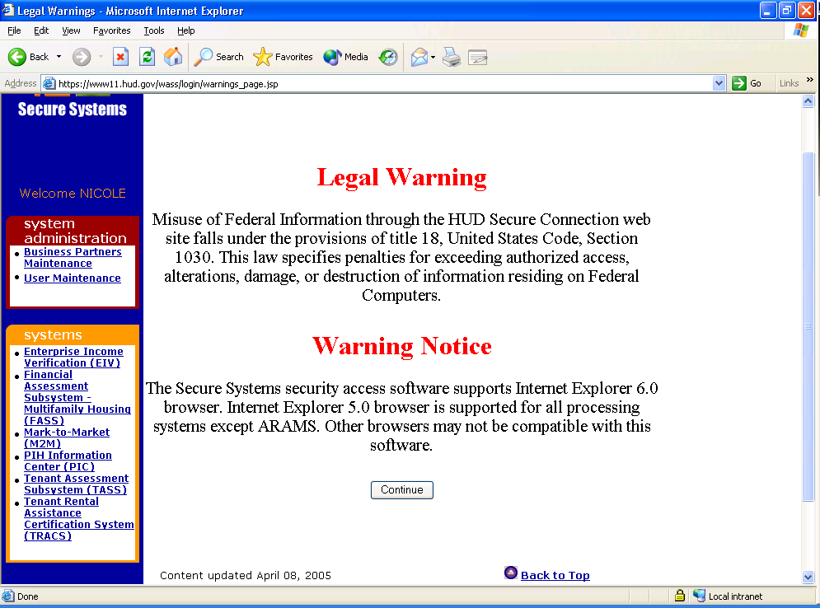
Logging On To EIV
Click continue at the Legal Warning & Warning Notice screen

Slide 8
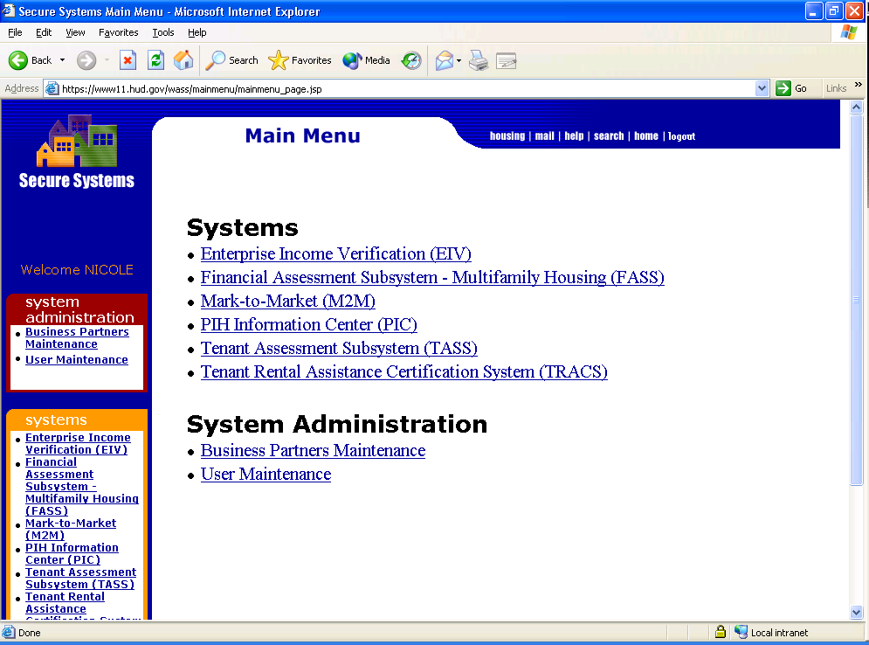
Logging On To EIV - Continued
Click on the Enterprise Income Verification (EIV) link to access the system
Note: If user does not see EIV link make sure WASS ID has PIC and EIV access rights assigned to it

Slide 9
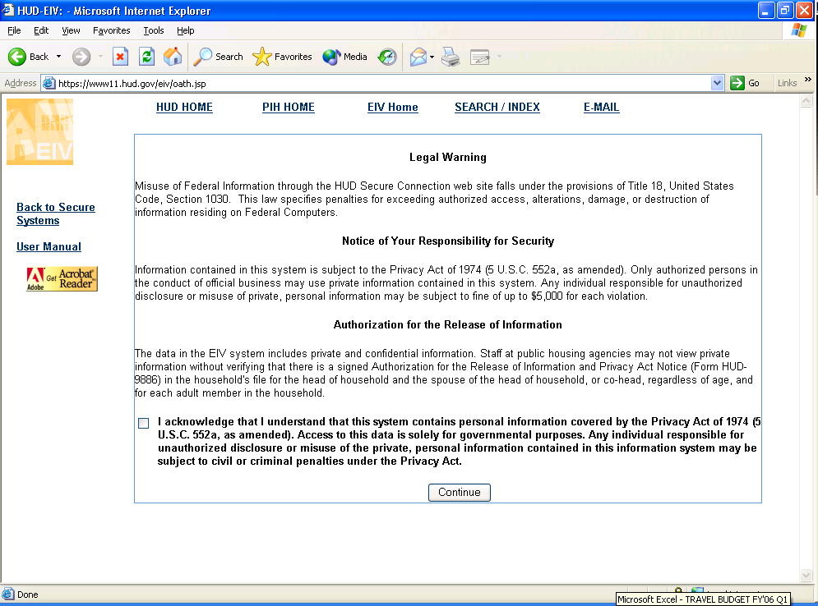
Using The EIV System

Slide 10
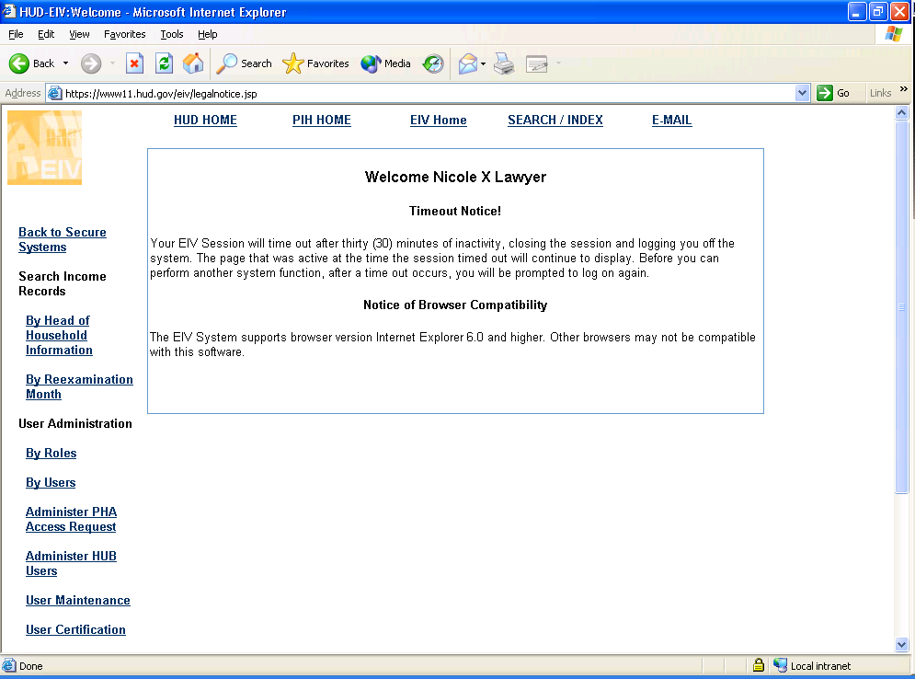
Using The EIV System

Slide 11
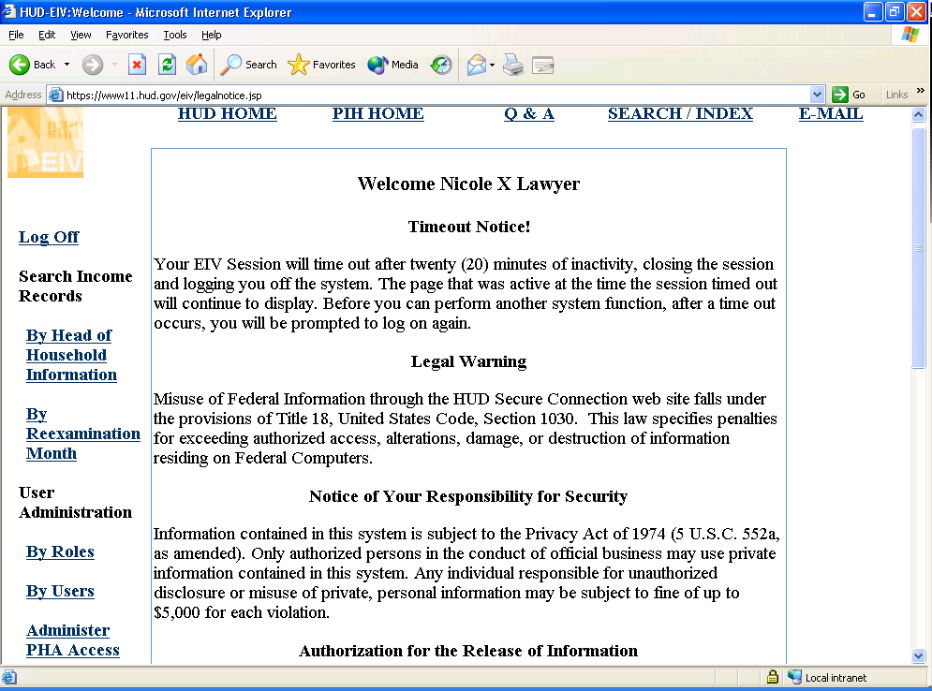
Obtaining Income Information For a Household
Users can search for income records by HOH SSN or Re-examination month
Click on either link to begin search
Click on either link to begin search

Slide 12
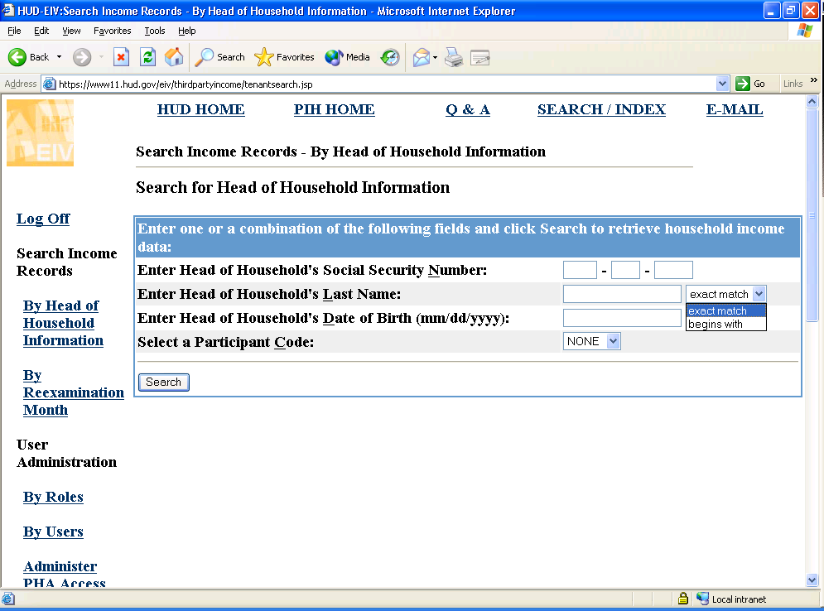
Searching For Income Records By Head of Household SSN

Slide 13
Searching For Income Records By Head of Household SSN - Continued
EIV allows multiple search criteria
  Head of Household SSN; and/or
  Head of Household Last Name; and/or
    Exact match
    Begins with
  Head of Household Date of Birth
Click on Search or press Enter
Note: it easiest to search by simply entering the HOH’s SSN

Slide 14
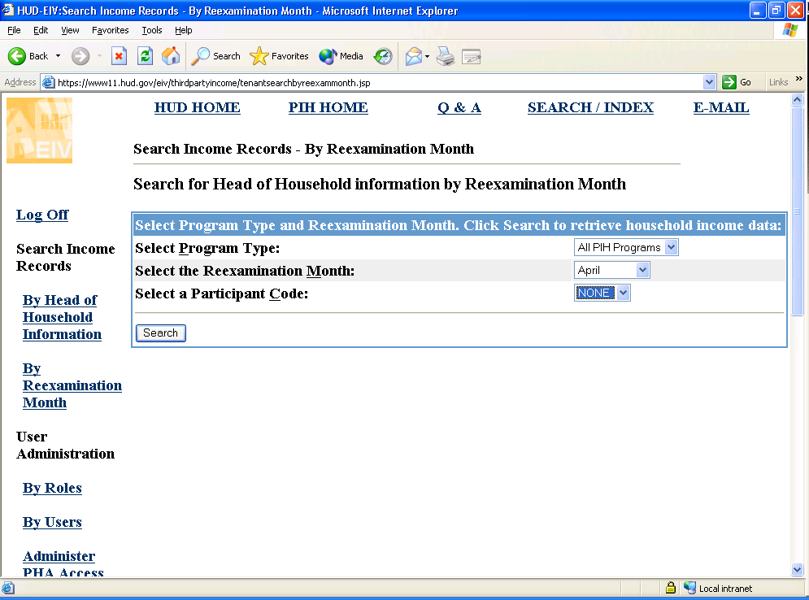
Searching For Income Records By Program Type and Re-examination Month

Slide 15
Searching For Income Records By Program Type and Re-examination Month
User can search for income records by:
  Program Type
    All PIH Programs; or
    Public Housing; or
    Section 8
  Re-examination Month

Slide 16
Identity Verification Status
Identity Verification Status
  Verified: tenant SSN, last name, and date of birth combination has been verified by SSA
  Not Verified: tenant record has not been sent to SSA for verification yet
  Failed: tenant SSN, last name and date of birth combination verification failed by SSA. No income information is displayed
  Deceased: according to SSA records, the tenant with SSN, last name and date of birth combination is deceased
  Note: Income information will only be displayed for individuals whose identity verification status is “verified”

Slide 17
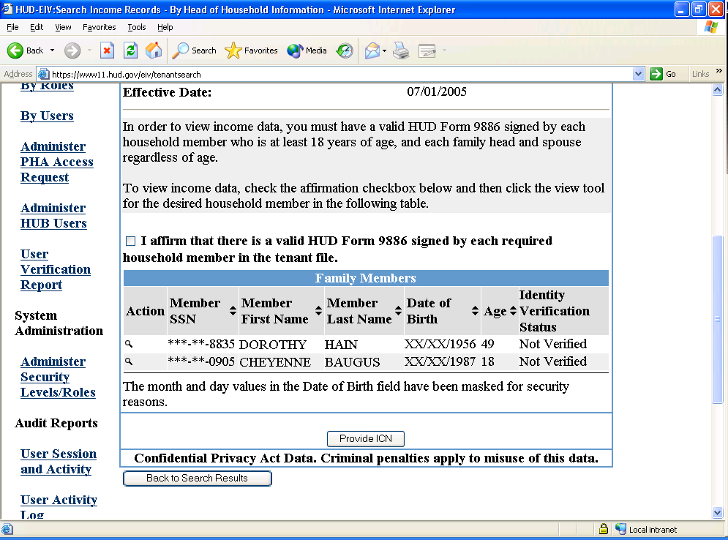
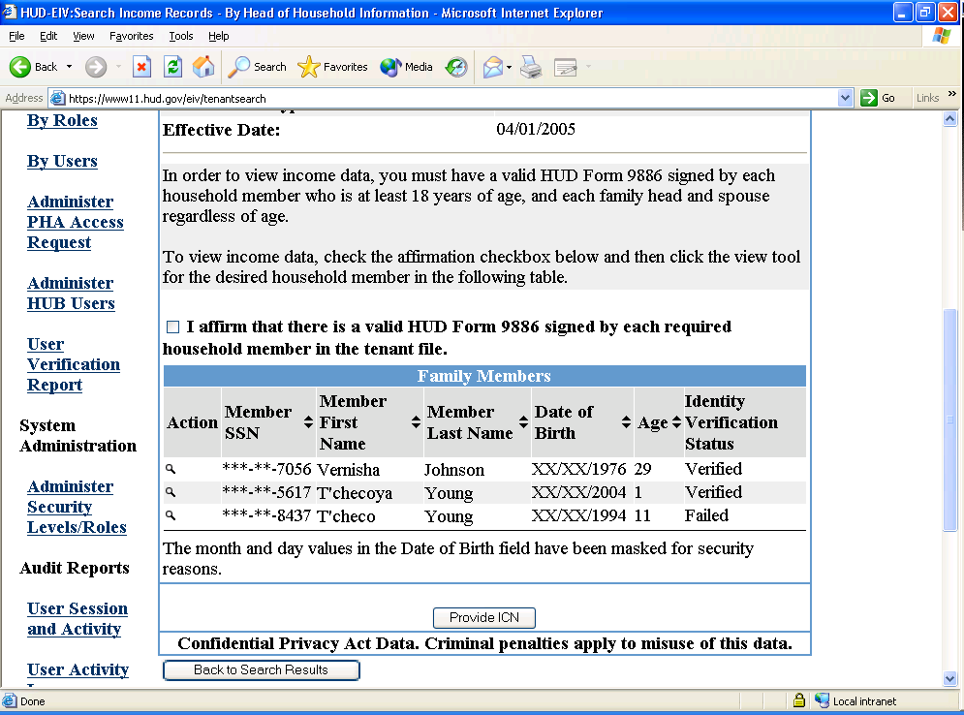
Identity Verification Status
Sample Screen Shots
Not Verified
Failed

Slide 18
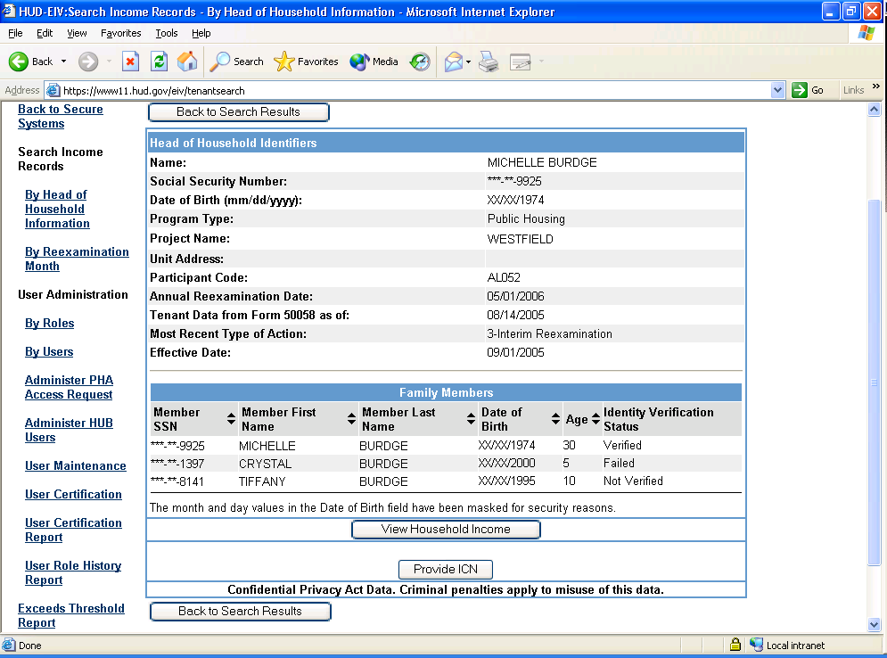
Identity Verification Status
Sample Screen Shots - Continued
When identity verification status is deceased or failed, detailed information regarding the error is available upon clicking the view household income button. An error message is displayed under the household member whose identity verification failed
Not Verified
Deceased/
Verified

Slide 19
Viewing UIV Data
For a Household
Simply click on the view household income button from the household summary page to display household income
  Available employment and income information is displayed for each household member
  Detailed error messages as to why a household member’s identity verification failed
  Date household member died is displayed for any household member whose identity verification status is “deceased”

Slide 20
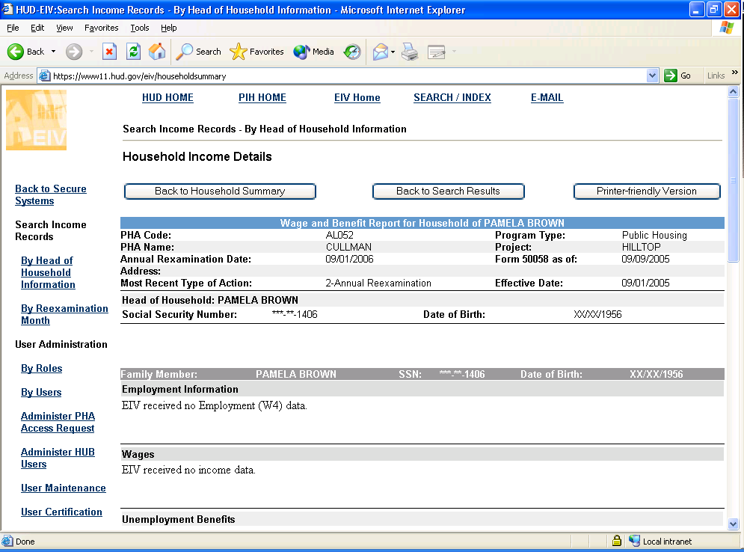
Viewing UIV Data For a Household - Continued

Slide 21
Viewing UIV Data For a Household - Continued
Each income source and other information is contained in a separate section.
  Employment Information
  Wages
  Unemployment Benefits
  Social Security Benefits (SS)
  Dual Entitlement
  Medicare Data
  Supplemental Security Benefits (SSI)
  Black Lung
  Disability

Slide 22
Printing Household Income Details Report
Simply click on the Printer-friendly version button and a new window will open up to enable the user to print a report for the displayed household member
Simply click on the printer icon to print out the income details report
Report will include information for all household members

Slide 23
Disclosure of UIV Data
PHAs may not disclose (or re-disclose) UIV data to any third parties (UIV data is property of HUD and protected by Federal Privacy Act)
PHAs in FL may not maintain HUD-provided UIV data in tenant files
PHAs may provide UIV data to the individual (only) to whom the record pertains
UIV data of minors may be provided to the minor’s parent or guardian

Slide 24
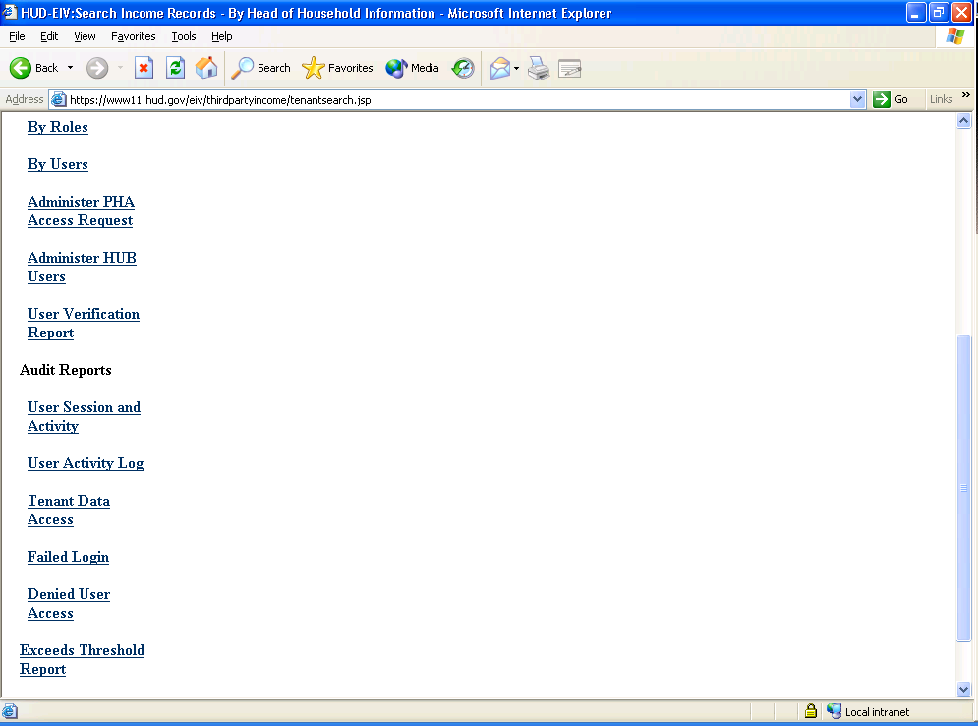
Accessing the Exceeds Threshold Report
Click on the Exceeds Threshold Report Link to access report

Slide 25
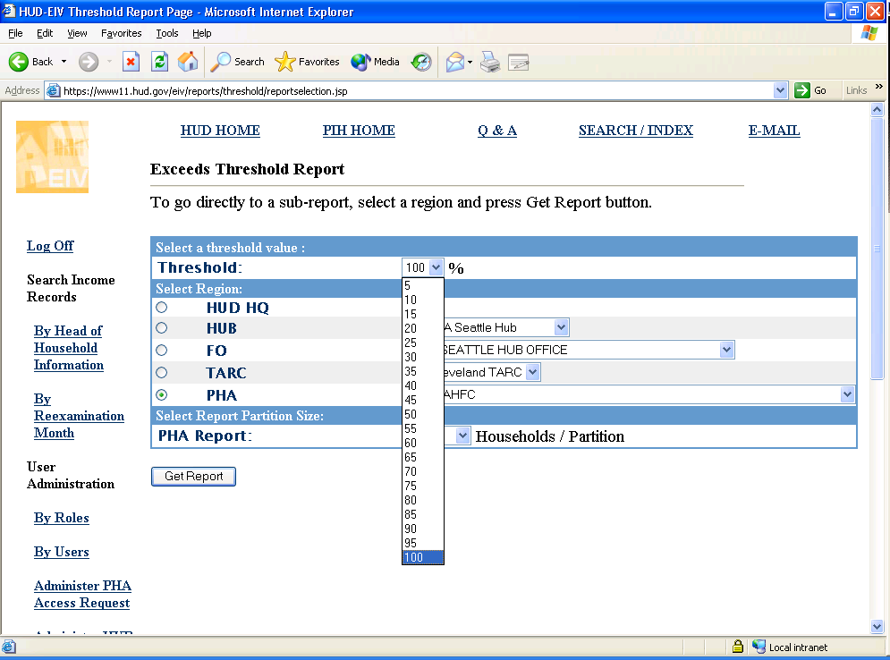
Exceeds Threshold Report - Continued
Select % by which UIV income is greater than PIC reported income

Slide 26
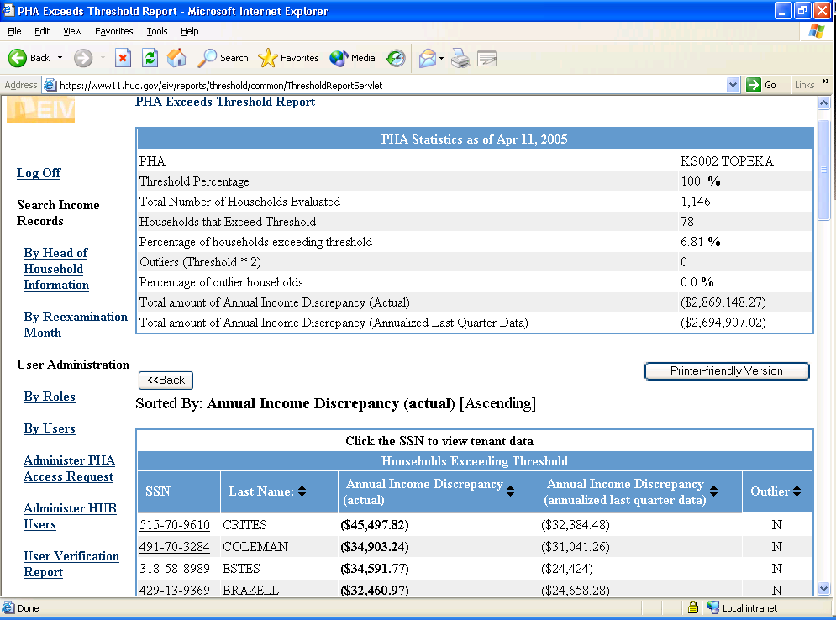
Exceeds Threshold Report - Continued
PHA statistics
  # of households evaluated
  # of households exceeding the specified threshold
  # of households exceeding the specified threshold X 2 (Outliers)
  % of Discrepant Households
Listing of Discrepant households
  Includes HOH last name & SSN exceeding specified threshold
  Includes HOH last name & SSN exceeding the specified threshold X 2

Slide 27
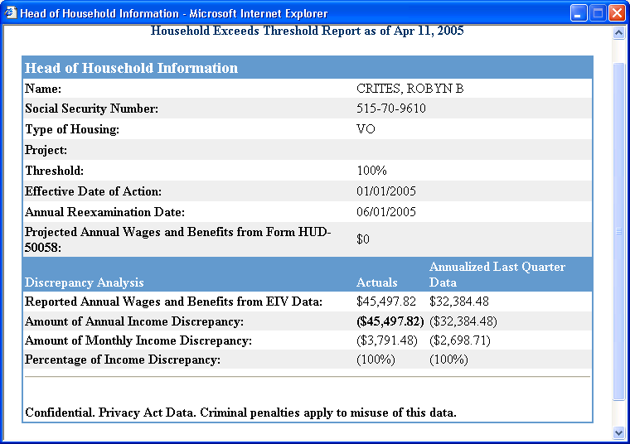
Exceeds Threshold Report – Continued
Detailed Household Report
Includes income reported on 50058 and reported by UIV sources
Compares 50058 income to UIV income
Provides monthly and annual discrepancy amount along with %

Slide 28
Benefits of HUD’s EIV System
Quick access to web based application to obtain income verifications
Eliminates the need for requesting written third party verification when tenant does not dispute UIV data and additional information is not needed
Meets regulatory requirement for written third party verification and justifies use of current tenant-provided documents for income calculations
Identifies tenant income discrepancies

Slide 29
How to Use UIV Data

Slide 30
Projecting Annual Income When UIV Data is Available
HUD guidelines for using UIV data consistently and uniformly
Substantial difference: one that is $200 or more per month. (Equates to $2,400+ a year)

Slide 31
Projecting Annual Income When UIV Data is Available - Continued
When UIV data is not substantially different than tenant-reported income:
  If UIV data is less than tenant-reported income, use tenant-provided documents to calculate anticipated annual income
  If UIV data is greater than tenant-reported income, use UIV data to calculate anticipated annual income, unless tenant can provide the PHA with acceptable documentation to verify a change in circumstances.

Slide 32
Projecting Annual Income When UIV Data is Available - Continued
When UIV data is substantially different than tenant-reported income:
  PHA must request written third party verification from the discrepant income source [24 CFR 5.236(3)(I)]

Slide 33
Use of UIV Data
UIV data is used to validate tenant-reported income
UIV data should not be used to calculate anticipated annual income
When the tenant disputes the UIV data, the PHA must request written third party verification

Slide 34
Federal Privacy Act
5 U.S.C 552a
“In order to protect any individual whose records are used in a matching program, no recipient agency, non-Federal agency, or source agency may suspend, terminate, reduce or make a final denial of any financial assistance or payment under a Federal benefit program to such individual, or take other adverse action against such individual, as a result of information produced by such matching program, until the agency has independently verified the information.”

Slide 35
Income Discrepancy Resolution
When UIV data indicates a substantial income discrepancy and the tenant disputes the UIV information, the PHA must request written third party verification [24 CFR 5.236(3)(I)]
The PHA should verify effective dates of new and terminated income sources
The PHA may not take any adverse action based solely on UIV data

Slide 36
Income Discrepancy
Resolution - Continued
Once the PHA has verified and validated the income discrepancy, the PHA should calculate the tenant retroactive rent due and initiate a repayment agreement and/or other corrective action
PHAs are encouraged to refer egregious cases to the local HUD OIG

Slide 37
Income Discrepancy Resolution - Continued
Income discrepancies are either:
  Valid
  Invalid

Slide 38
Valid Income Discrepancies
Valid Income Discrepancies: are those discrepancies where:
  the tenant failed to disclose an income source and/or under reported the amount of income that was effective as of the interview date of a mandatory re-examination of income; and/or
  the tenant failed to report a change or increase in an income source and/or income amount as required by some PHA’s interim re-examination policies.
  Note: These discrepancies result in tenant rent underpayments and HUD subsidy overpayments.

Slide 39
Examples of Valid Income Discrepancies
Mr. Jones reports he has no income, but fails to report that he is employed at McDonald’s.
Mr. Jones reports he works at McDonald’s, but fails to report that he is also employed at ABC Box Company.
Mr. Jones reports he receives welfare benefits, but fails to report that he also receives social security benefits.
Mr. Jones reports he receives social security benefits, but fails to report that he also receives Supplemental Security Income.
Mr. Jones received a substantial increase in his earnings from McDonald’s, but failed to report this increase to the PHA (as required by the PHA’s interim increase policy).
Mr. Jones requests that his employer falsify the content of a PHA-provided wage form, and the employer misstates the tenant’s income. (i.e. the employer reports less earnings, lower wage rate or omits bonuses and over time amounts.)
  Note: These discrepancies result in tenant rent underpayments and HUD subsidy overpayments.

Slide 40
Invalid Income Discrepancies
Invalid Income Discrepancies: are those discrepancies that are not a result of tenant error. These discrepancies may occur as a result of:
  PHA error; and/or
  incorrect UIV data

Slide 41
Examples of Invalid Income Discrepancies
PHA Errors:
  The PHA recorded the income on Section 7 of the 50058 form incorrectly.
  The PHA recorded the earned income disallowance incorrectly on Section 7 of the 50058 form. The PHA fails to exclude the income by inserting the earned income on line 7d and then listing the same dollar amount on 7e, which reflects the excluded amount.
  The PHA calculated household income based on the best available third party written verification, third party oral verification, and/or tenant provided documentation at the time of the re-examination interview. If the PHA had had access to UIV tools, the PHA would have calculated a higher household income. Note: This type of discrepancy results in tenant rent underpayments and HUD subsidy overpayments. The PHA should correct these errors ASAP

Slide 42
Examples of Invalid
Income Discrepancies - Continued
UIV Data Errors:
The reporting agency (income data source) made an error in its records.
  Ex. The income reported under a social security number is incorrectly listed under the tenant’s SSN.
There has been an incident of identity theft and someone else is using the tenant’s SSN.

Slide 43
Benefits of Resolving Income Discrepancies
Reduce HUD subsidy overpayments
Reduce PHA income and rent errors
Increase PHA rent revenue (Public Housing)
Increase available HAP funds (HCV – S8)
Ensure limited and decreasing Federal funding serve as many eligible families as possible
Improves income integrity in HUD rental assistance programs

Slide 44
UIV Case Study

Slide 45
Case Study: Valid Income Discrepancy (Fraud)
Mr. Jones previously reported his only income was $50 a month in non-wage income from his sister. This income has been reported for the last 3 years.
PHA uses the EIV system, which indicates earnings of:
  Q1 2005 - $2,000 ABC Box Co.
  Q4 2004 - $2,000 ABC Box Co.
  Q3 2004 - $2,00 ABC Box Co.
  Q2 2004 - $2,000 ABC Box Co.
  Q1 2004 - $1,500 ABC Box Co.
  Q4 2003 - $1,500 ABC Box Co.
  Note: tenant does not dispute UIV data

Slide 46
Case Study: Valid Income Discrepancy (Fraud) - Continued
Why may this income discrepancy be invalid?
Why may this income discrepancy be valid?
What Should the PHA do?
May the PHA take adverse action based on the UIV data from the EIV system?

Slide 47
Case Study Answers
Upon initial view of UIV data, this income discrepancy could be invalid because Mr. Jones’ identity could have been compromised or the the employer may have reported the earnings under an incorrect SSN
Upon initial review of the UIV data, this income discrepancy could be valid because it appears that Mr. Jones failed to disclose complete and accurate income information at the time of mandatory reexaminations of income.

Slide 48
Case Study Answers
3. The PHA should contact the tenant to discuss the income discrepancy and provide him/her the opportunity to contest or admit to the income discrepancy. The PHA should also request needed documentation to resolve the income discrepancy.
4. The PHA may not take any adverse action based solely on the UIV data. If the tenant disputes the UIV data, the PHA must request written third party verification of the disputed information and request documentation from the tenant.

Slide 49
Visit HUD’s Web Page For More Information on UIV
www.hud.gov/offices/pih/programs/ph/rhiip/uiv.cfm

Slide 50
For Help with the EIV System
EIV_Help@ HUD.gov
Or Contact the UIV Coordinator at
your local HUD Field Office

Slide 51
Ask HUD Session
Panel Members
Nicole Faison – RHIIP Manager
Myra Newbill – EIV System Security Administrator
David Sandler – EIV System IT Project Manager
Tomas Vagoun – EIV System Analyst

