Slide 1
eRA Address and Degree Changes
July 2003 Release
June 19, 2003

Slide 2
Address Line 5 Retirement
Ultimate goal: identify addresses by components
Why start with line 5?
  Easiest part of the address to extract to structured fields
  Structured fields (city, state, zip) already exist in the database
  Many users are already entering information in the structured fields
  Opportunity to synchronize with the Commons
  Conforms with USPS guidelines

Slide 3
Address Line 5 Changes
Conversion of existing data, where possible
Modification to address screens
Modification to miscellaneous documents
Line 5 will remain in the database

Slide 4
Conversion of Address Line 5
Analysis of line 5 data:
  Domestic addresses with city, state, and zip
  Internat’l addresses with city, country, postal code
  The remainder can be anything
Identify domestic line 5 that can be parsed into city, state, zip (validate against USPS database)
Where line 5 and structured fields both contain data, convert only if data matches
Data not converted will remain as is

Slide 5
Modification to Address Screens
Address line 5 will not be updateable
Users will be instructed to reenter the information from line 5 in lines 1-4, and erase the data in line 5
Before saving any address changes:
  Line 5 must be empty
  Domestic addresses must have city, state, zip data
  Non-US and Canadian addresses must not have state code

Slide 6
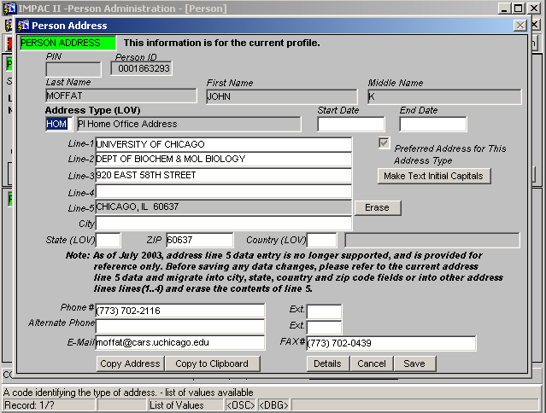
Example of Address Screen

Slide 7
Modification to Other Documents
Reports, mailers, summary statement, etc. where address is displayed
Where Line 5 is currently displayed, it will be displayed only when there is data in the field
Changes made so that city, state, zip is now included where not previously on the document, when Line 5 is null

Slide 8
IRDB Changes
Added columns to PV_GRANT_PI_MV
  instn_bus_country_seq_num
  pi_wrk_country_seq_num
  instn_bus_country_name
  pi_wrk_country_name
Added columns to PV_GRANT_PI PowerView:
  country_seq_num
  country_name

Slide 9
New Table
USPS_cities_t captures detail from USPS “City State Product”
Columns:
  city_name
  state_code
  county_name
  zip_code
Monthly update from USPS will be applied to database

Slide 10
Future Changes
Clear out all data from line 5; drop from database
Incorporate business rule validation against USPS database
Migrate to atomic fields for all address lines

Slide 11
Degree Changes
Degree codes and categories
“Earned degree” information
Duplicate degree records

Slide 12
Degree Codes and Categories
563 distinct degree codes currently in IMPAC II
  Ineffective for management reporting
  Data integrity issues
New list of degree codes developed—start with degrees that represent 98% of the data
  Additional queries done to find the top five degrees by IC
  Degrees not on list can be entered in “other degree text” field, with corresponding generic degree code

Slide 13
New List of Degrees
AB Bachelor Of Arts
BA Bachelor Of Arts
BS Bachelor Of Science
DDS Doctor Of Dental Surgery
DMD Doctor Of Medical Dentistry
DPH Doctor Of Public Health
DSC Doctor Of Science
DVM Doctor Of Veterinary Medicine
EDD Doctor Of Education
MA Master Of Arts
MBBS Foreign - Bachelor Of Medicine And Surgery
MD Doctor Of Medicine
MPH Master Of Public Health
MS Master Of Science
PHD Doctor Of Philosophy
RN Registered Nurse
SCD Doctor Of Science
VMD Doctor Of Veterinary Medicine
DRPH Doctor Of Public Health
BSN Bachelor Of Science In Nursing
DC Doctor Of Chiropractic
DNSC Doctor Of Nursing Science
DO Doctor of Osteopathy
FAAN Fellow Of The American Academy Of Nursing
JD Doctor Of Juris Prudence
MB Foreign - Bachelor of Medicine
MBA Master Of Business Administration
MLS Master Of Library Science
MPA Master Of Public Administration
MSN Master Of Science In Nursing
OD Doctor Of Optometry
OTH Other
BOTH Other Baccalaureate
MOTH Other Masters
DOTH Other Doctorate
MDOT Other Doctor of Medicine
VDOT Other Doctor of Veterinary Medicine
DDOT Other Doctor of Medical Dentistry
Current Commons
Degree Codes
“Other”
Degree Codes
Additional
Degree Codes

Slide 14
Degree Categories and Subcategories
Categories used for grouping by highest degree (e.g., summary statement)
  Not stated or cannot be determined
  No degree held
  Baccalaureate held
  Masters held
  Academic doctorate held
  Professional doctorate held
Subcategories used for reporting granularity
  Other
  Baccalaureate
  Masters
  PhD Equivalent (PhD, SCD, DSC, DPH, DRPH)
  Other Doctorate
  Doctor of Medicine (or equivalent degree)
  Doctor of Veterinary Medicine (or equivalent degree)
  Doctor of Medical Dentistry (or equivalent degree)
One “other degree”
code to correspond to
each subcategory

Slide 15
Conversion of Person Degree Data
For person_degs records with degree codes not on the new list of degrees:
  Move the degree code to other_degree_text
  Set the degree code column to the appropriate “other” degree code value
Example: DE (Doctor of Entomology)
  In person_degs, move ‘DE’ to other_degree_text
  Set deg_code=‘DOTH’ (the “other” degree code for Other Doctorate)

Slide 16
Changes to Application
Subcategory displayed to user on entry of degree
User who enters “other” degree will be required to enter other degree text
Reports and documents pull from degree field or from other degree text field, as appropriate
  Use other degree text if degree is an “other” degree

Slide 17
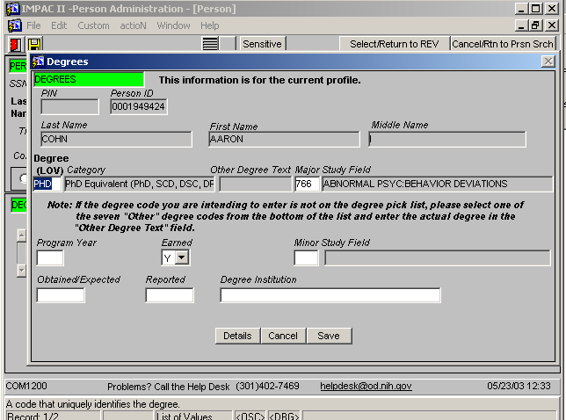
New Screen Shot

Slide 18
Earned Degree Changes
Problem in the interpretation of degree_status_code
  For trainee data, and for F30 and F31, if the deg_status_code is null then the degree is not earned
  For PI and Committee Member data (excluding F30 and F31), if the deg_status_code is null then the degree is earned.

Slide 19
Solution
Convert existing null data to ‘Y’ or ‘N’, depending on the business context
Set a default in the application:
  If the calling module is TA, default the degree status code for a new person degree to ‘N’; otherwise, default to ‘Y’

Slide 20
Duplicate Degree Records
People with more than one of a specific type of degree store that degree once for each occurrence
Will collapse all degree records that are obvious duplicates
Within the application, display a warning message upon entry of a duplicate degree

Slide 21
New Database Tables
deg_subcategories_t
  deg_subcategory_code
  descrip
  deg_category_code
deg_categories_t (replaces current_degs_t)
  deg_category_code
  descrip
history_degs_t
  A replica of the current degs_t table
  Provides historic degree data to users working with degrees that are no longer stored in degs_t

Slide 22
Changes to Database Tables
degs_t
  Added deg_subcategory_code
  Added other_deg_code (indicates if degree is an “other degree” or not)
  Reinstated foreign key constraint from person_degs_t to degs_t
person_degs_t
  Force entry of other_degree_text to upper-case
  New function to strip out punctuation (excluding blank spaces)
  Dropped initial_set_indicator_code
  Modified deg_status_code to “not null”
Applied all changes to the IRDB

Slide 23
Future Changes
Analyze and drop unneeded degree columns from the database
Evaluate further collapses of duplicate degree records for a person, even with additional descriptor data
Provide additional degree sort flexibility
Provide validation on degree entry (e.g., give warning for fellowships if post-doc degree is being entered for pre-doc activity code)
Correct study field text data
Add database element to capture honors, fellowships, licenses, awards, or board certification.

