Slide 1

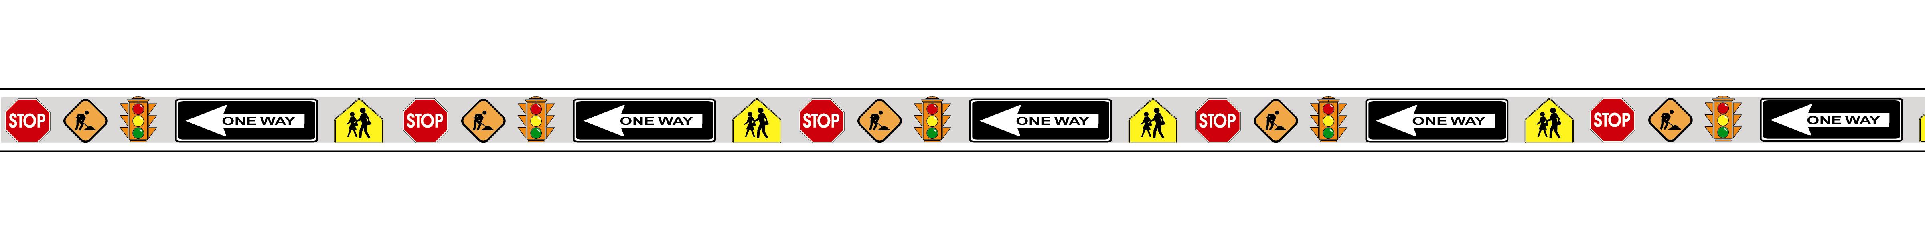
Chapter 2F: Specific Service Signs
Notes:
This presentation will cover the significant changes to Chapter 2F of the MUTCD. Specific service signs are commonly known as LOGO signs. These signs communicate specific destination information such as where to exit for the nearest gas, hotel, or restaurant.

Slide 2

Renumbered Chapter
Chapter 2F specific service signs formerly chapter 2G
Notes:
Due to the consolidation of Parts 2E and 2F of the 1988 MUTCD (for Expressway and Freeway Guide Signs) into Chapter 2E, Specific Service (or Logo) Signs is now becomes Chapter 2F in the 2000 MUTCD.

Slide 3
New “Attraction” Service Category
ATTRACTIONS
Notes:
In addition to the GAS, FOOD, LODGING, and Camping Service categories, a new ATTRACTION category is also included in the 2000 MUTCD.
Attraction services include facilities that have the primary purpose of providing amusement, historical, cultural or leisure activities to the public. This definition of Attraction Services is similar to the definition of Recreational and Cultural Interest and Area signs. The major difference is that attraction signs are not used within Recreational and Cultural interest areas such as parks & Trails. Attraction signs are not used on facility structures.

Slide 4
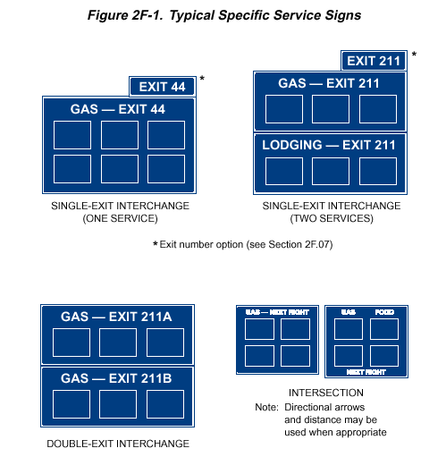

Specific Service Sign Eligibility
Distance to eligible service also addresses services which choose not to participate
Notes:
Based on docket comments received from 6 logo organizations, FHWA has modified this sentence to allow States flexibility to extend the distance criteria for selecting specific service businesses to address those facilities which choose not to participate in the program. In the 2000 MUTCD, it is an OPTION that if within a 5 km (3 mile) limit, facilities for the services being considered are not available, or choose not to participate in the program, the limit of eligibility may be extended in 5 km (3 mile) increments until one or more facilities for the services being considered chooses to participate or until 25 km (15 mi) is reached, whichever comes first.

Slide 5

Number of Service
Categories Displayed on the Same Sign
Maximum of three service categories shall be displayed on the same sign
FOOD
GAS
ATTRACTIONS
Notes:
The 2000 MUTCD states that no more than 3 types of services shall be represented on any sign or sign assembly. If 3 types of services are shown on the same sign, then the logo panels shall be limited to 2 for each service (for a total of 6 logo panels).

Slide 6
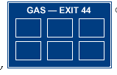
Maximum Number of Logo Panels
Six for any category
Four and two for combination category sign
GAS
FOOD
Notes:
With the growth in demand for Specific Service signs and the variance in business availability in different locations, the 2000 MUTCD now provides for a maximum of 6 logo panels regardless of service category. If 2 service categories are combined on the same sign, then the maximum shall be 4 logo panels for one service and 2 for the other.

Slide 7
Maximum Logo Panel Size
Table II-4 deleted
Freeway and expressway size is 60”x36”
Conventional roads and ramps is 24”x18”
Notes:
Table II-4 is deleted in the 2000 MUTCD. Section 2F.4 lists one size (60” x 36”) for specific service signs used on Freeways and Expressways and a smaller size (24” x 18”) for specific service signs used on conventional roads and ramps. This simplifies the design dimensions.

Slide 8
Minimum Letter Sizes
Freeway and expressway – min. 250mm (10”)
Conventional roads and ramps – min.150mm (6”)
Notes:
Table II-5 is also deleted in the 2000 MUTCD. Instead of determining letter sizes based on so many factors such as whether it is an action message or whether it is used on a Category 1 expressway intersection, FHWA has simplified the design dimensions to require a minimum of 10 inch letter size for signs on freeways and expressways and a minimum of 6 inches for signs on conventional roads and ramps. A 10 year phase in compliance period after the effective date of this final rule is provided to minimize any impact on State and local highway agencies. The compliance date is January 17, 2011. The 2 year adoption date of this final rule applies to all new sign installations.

Slide 9
Questions?

