Slide 1

XMclimate – A Local Tool for Climate Services
CR Climate Services Workshop
July 8-9, 2003
Matthew J. Bunkers, SOO UNR

Slide 2
Objectives
What is XMclimate and what are some of its applications?
Where do you get XMclimate, how do you install it (for both HP & Linux), and how do you run it?
How are data ingested into XMclimate, and what maintenance is necessary for the program?

Slide 3
Part I
XMclimate Functionality

Slide 4
XMclimate Developers
Carl Dierking, WFO Juneau, AK
Paul Shannon, WFO Juneau, AK

Slide 5
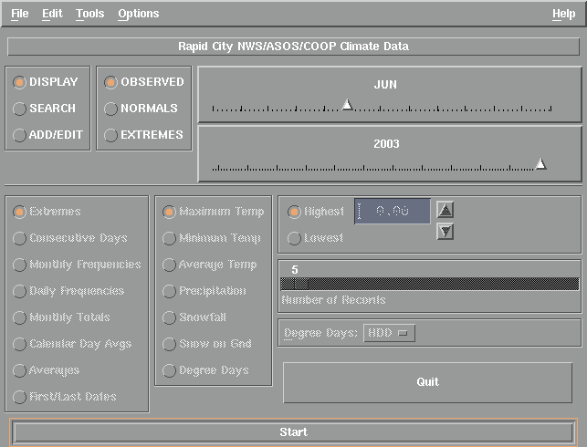
XMclimate “Main” Interface

Slide 6
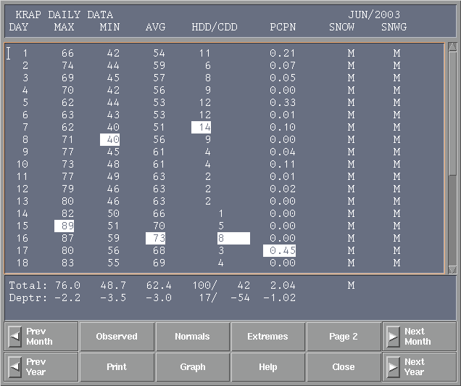
The “Display Observed” Interface
← This appears as a second window.

Slide 7
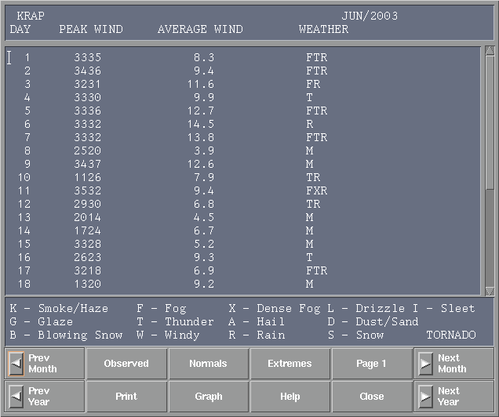
Page 2

Slide 8
The “Display Observed” Interface

Slide 9
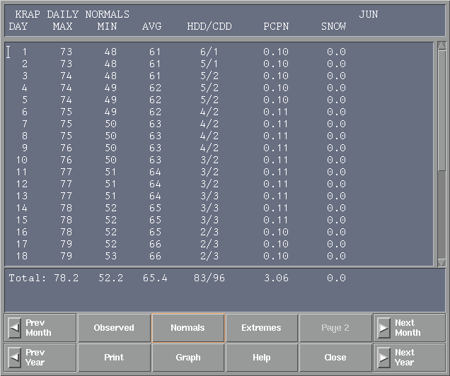
The “Display Normals” Interface
These “Normals” can be entered manually, calculated using a utility in XMclimate, or imported via normals2000 (more on this later).

Slide 10
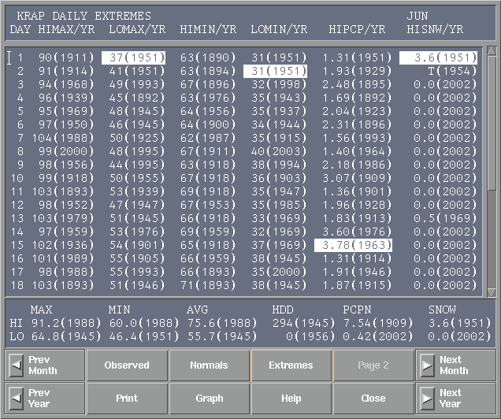
The “Display Extremes” Interface
The “Help”, “Print”, “Prev Month”, and “Prev Year” buttons are intuitive.

Slide 11
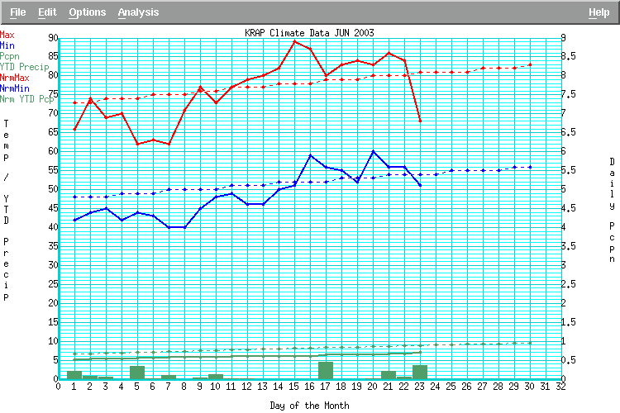
The “Graph Observed” Sub-Interface
(you need the XMgraph utility for this)

Slide 12
Changing Stations
Click

Slide 13
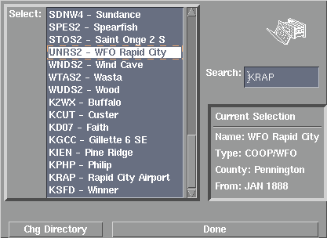
Station Selection GUI
This appears as yet another (i.e., third) window, which you can leave open.
If you start XMclimate with -idonly, names will not appear.

Slide 14
What are some applications?
Somebody calls up and asks:
  “Have we ever been hotter than 105 °F in Rapid City during June or July?”

Slide 15
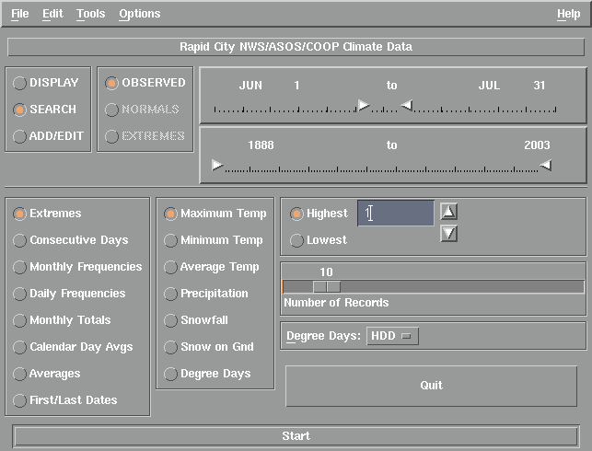
Setup the “Search” Criteria

Slide 16
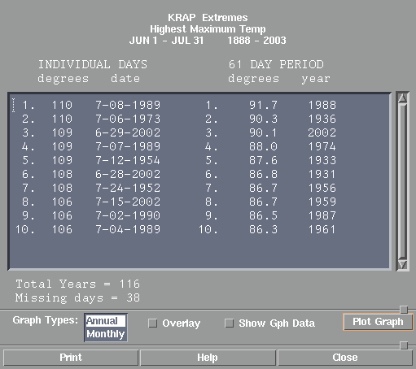
10 Records are Displayed

Slide 17
What if we made this 2?

Slide 18
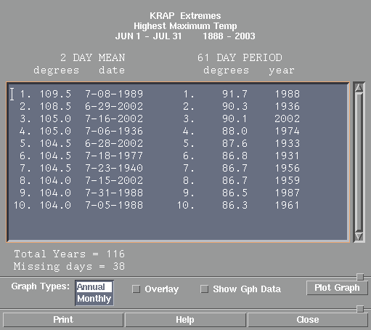
You get a “2 DAY MEAN”

Slide 19
What are some applications?
Somebody calls up and asks:
  “Our minimum temperature has been less than -10 °F for four days in a row – isn’t that unusual for Rapid City?”

Slide 20
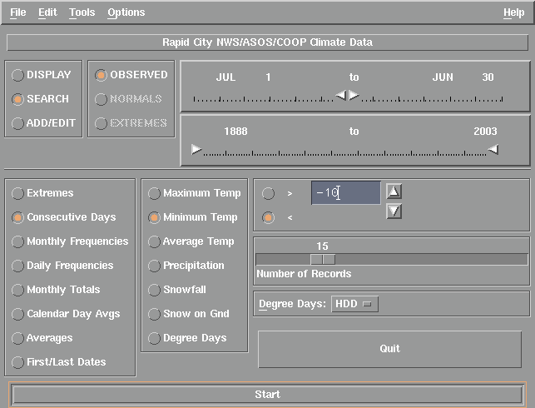
Setup the “Search” Criteria

Slide 21
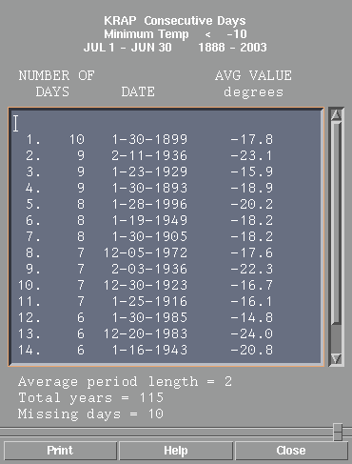
15 Records are Displayed

Slide 22
What are some applications?
Somebody calls up and asks:
  “What are the first, latest, and average dates of sub-freezing temperatures for Rapid City?”

Slide 23
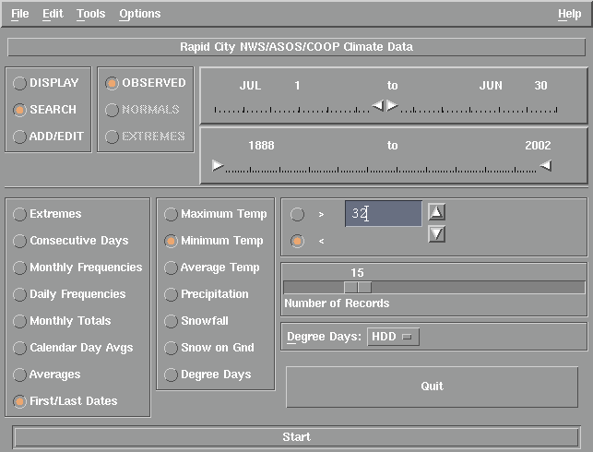
Setup the “Search” Criteria

Slide 24
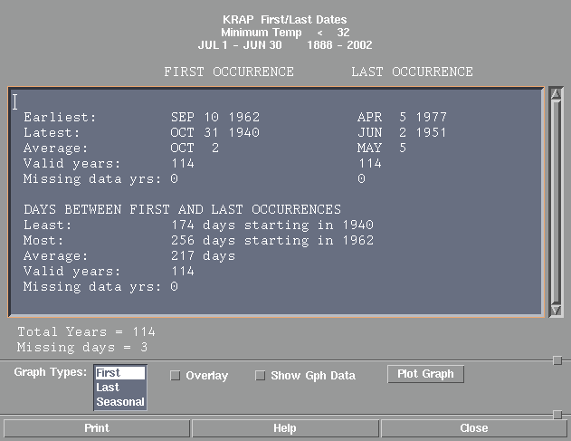
Several Statistics are Displayed

Slide 25
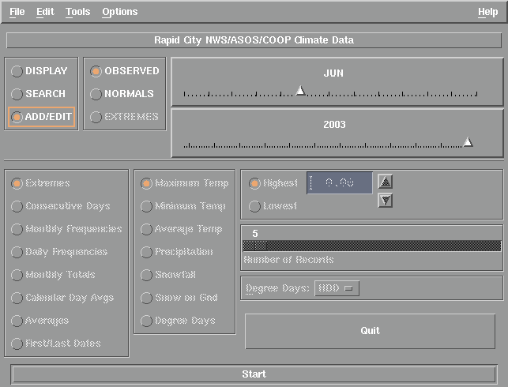
Editing Existing Data

Slide 26
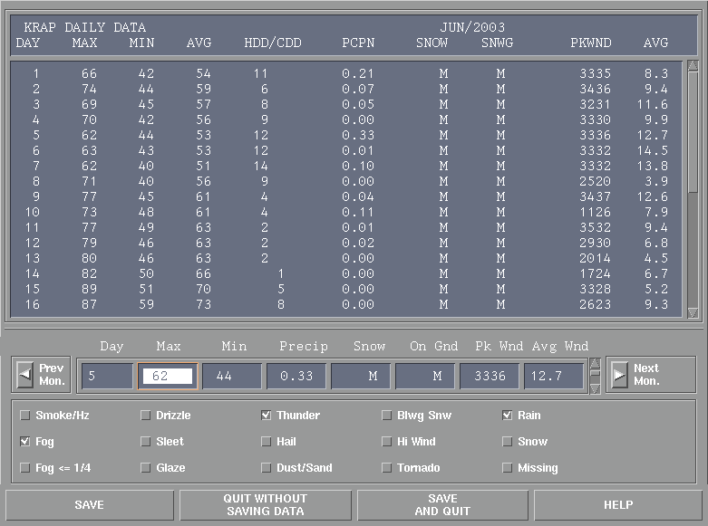
Be careful – there is no undo!
(But you can password protect the file)

Slide 27
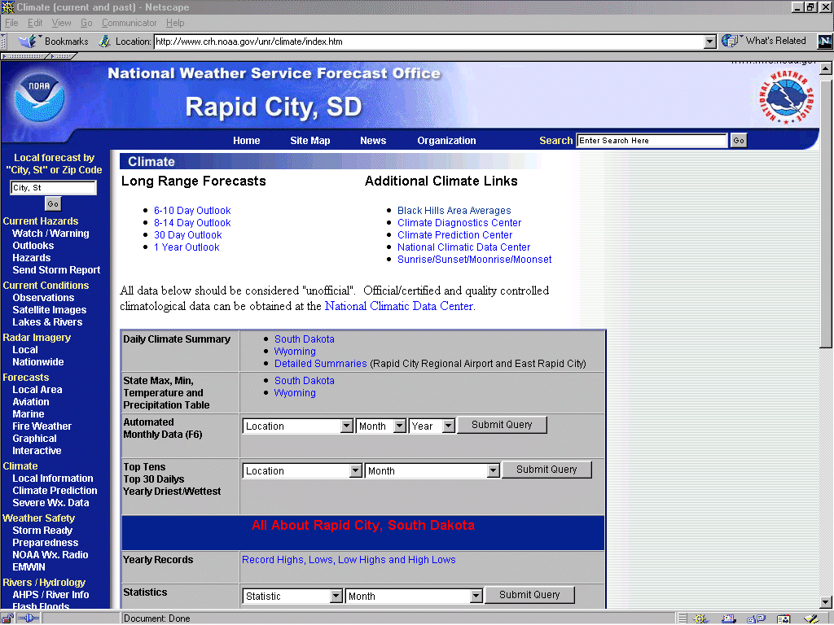
Rapid City WFO Web Apps

Slide 28
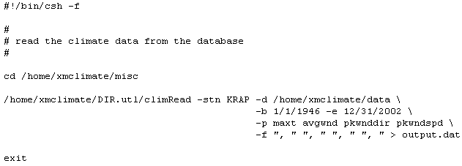
Research Applications
E.g., extracting maximum temperature and wind data for SDSM&T students

Slide 29
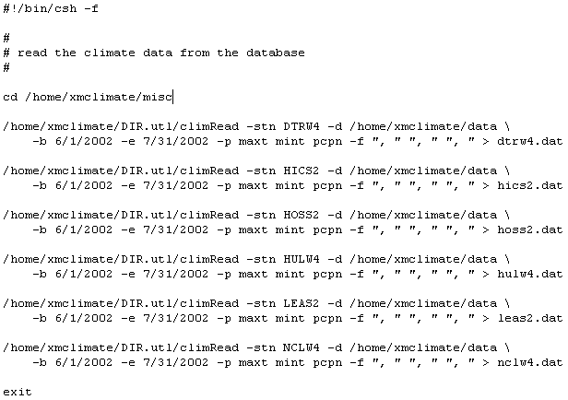
Research Applications Cont.
E.g., extracting temperature & precip data for a fire weather study

Slide 30
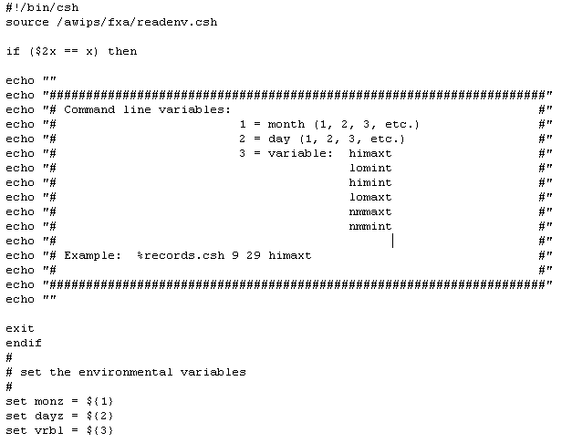
Printing Records
Script continued
on next page.

Slide 31
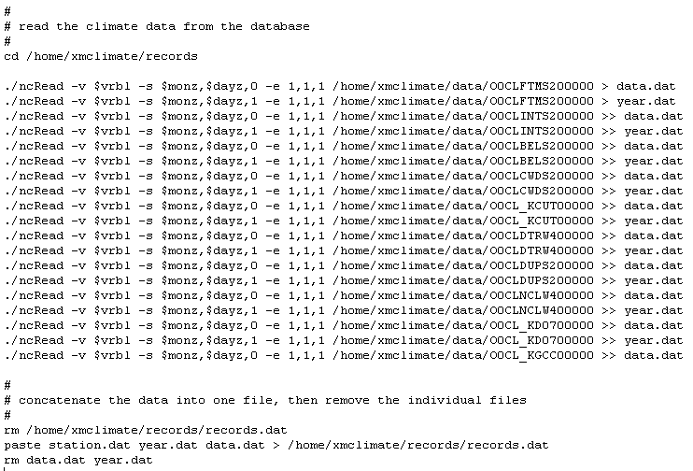
Printing Records Cont.

Slide 32
In Summary
XMclimate is very useful for many different types of climate requests—such as extreme events—from our users (e.g., Media, public, etc.)
XMclimate is helpful for local forecasting (limits)
You can maintain a database of 150+ sites of 1st Order and COOP stations (e.g., as does DSM)
Scripts can be written to extract data for Web applications, and also for research

Slide 33
Part II
XMclimate Installation

Slide 34
Getting Help for XMclimate
First, there are several html files included with XMclimate. These are very useful in the setup process—refer to them (the *.Help files are for XMclimate usage only)
Others who have used XMclimate extensitvely include Craig Cogil (DSM), Mike Gillispie (FSD), and myself (UNR)

Slide 35
Acquiring & Installing XMclimate
The HP version is on the AWIPS Local Applications Database (LAD)
A Linux version is available from:
ftp://inetsrv.arh.noaa.gov/pub/apps/xmclimate/
  This is not on the LAD; there are also many other applications here, including the HP version of XMclimate

Slide 36
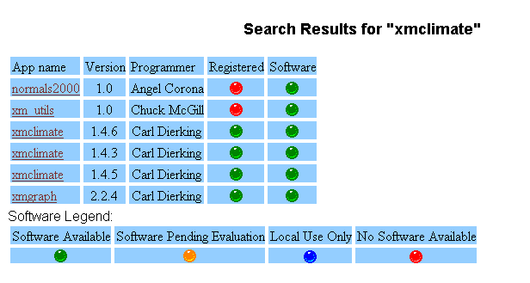
Options from the LAD

Slide 37
XMclimate v1.4.6 (for HP)
xmclimateSetup.man – basic setup file
xmclimateDocs.html.tar.Z – main program documentation
xmclimate020509.hpux10.exe.tar.Z – all program files (also contains above files, plus README.changes & README.climate)

Slide 38
Unpacking/Installing
Let’s assume you are installing in the /home/xmclimate directory; this is NFS mounted, which means you can access the data files from all workstations using one location
% cd /home/xmclimate
(get the appropriate file)
% gunzip xmclimate020509.hpux10.exe.tar.Z
% tar –xvf xmclimate020509.hpux10.exe.tar

Slide 39
Unpacking/Installing Cont.
% mkdir /home/xmclimate/html
% mv *.html html (just for housekeeping)
% mv *.jpg html
% mkdir /home/xmclimate/data
% mv O0CL* data
  file naming convention – O0CLxxxxx00000 where “xxxxx” is the station ID (e.g., O0CL_PAJN00000 for Juneau, AK); if the ID is less than 5 characters it is preceded with underscores; these are netCDF files

Slide 40
Unpacking/Installing Cont.
% mkdir /home/xmclimate/xmgraph
% cd /home/xmclimate/xmgraph
(get the appropriate file)
% gunzip xmgraph010308.hpux.exe.tar.Z
% tar –xvf xmgraph010308.hpux.exe.tar

Slide 41
Running XMclimate
% /home/xmclimate/xmclimate -stn PAJN \
-ddir /home/xmclimate/data \
-udir /home/xmclimate/DIR.utl \
-hdir /home/xmclimate \
-gdir /home/xmclimate/xmgraph \
-bdir /awips/dev/xmclimatedata \
-idonly
This is all one command line argument, but it can be run from a script (other options are also available).
Put on the ~/.dt/localapps.dtwmrc menu; start with the most commonly used station (e.g., I use KRAP)

Slide 42
In Summary
XMclimate (& XMgraph) is easy to download and run
Initially, no configuration necessary
There are several supporting files (i.e., XMgraph, normals2000, xm_utils)
You need to create your own data files – we’ll talk about that next

Slide 43
Part III
XMclimate Maintenance

Slide 44
Creating a New File
First, an “empty” data file needs to be created
You need to gather basic station information:
  station name & ID, 6-digit COOP ID, and beginning date (and optionally – latitude, longitude, elevation, etc.)
Once you create a file, you can’t change the beginning date (you need to create new file)!

Slide 45
Two Ways to Create New File
1st: Use the climateConvert script in the /home /xmclimate/DIR.utl directory (command line)
  The “toolsDir” variable (near the end of the file) needs to be modified so you can set the correct path to the utility directory
    only one modification needed to this script
2nd: Use the XMclimate GUI (under the File → “Create New Station…” menu option)
  This option is preferred/recommended

Slide 46
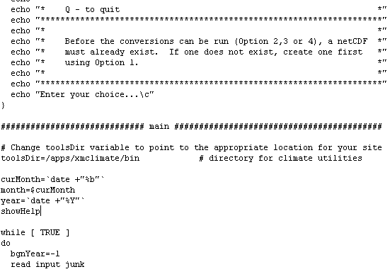
“climateConvert” Script Mod.

Slide 47
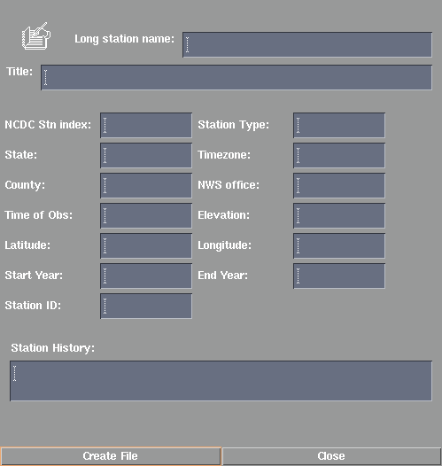
“Create New Station…” GUI
Sioux Falls
WFO Sioux Falls, SD
397667
NWS
SD
Central
Minnehaha
Sioux Falls
2359
1428
43.35
96.45
1932
2003
KFSD
Add whatever you want here.

Slide 48
Data Sources
Data can be acquired in several ways:
  NCDC COOP Summary of the Day CD-ROMs
    I don’t use this option anymore
  http://cdo.ncdc.noaa.gov/plclimprod/plsql/poemain.poe
    We’ll use this instead
  ftp.ncdc.noaa.gov
    Used for monthly updates (data about 5 months old)
  Daily RR3 (COOPs) and DSMs (ASOS)
    Used for near real-time collection
  Manually (necessary for some things, such as QC)

Slide 49
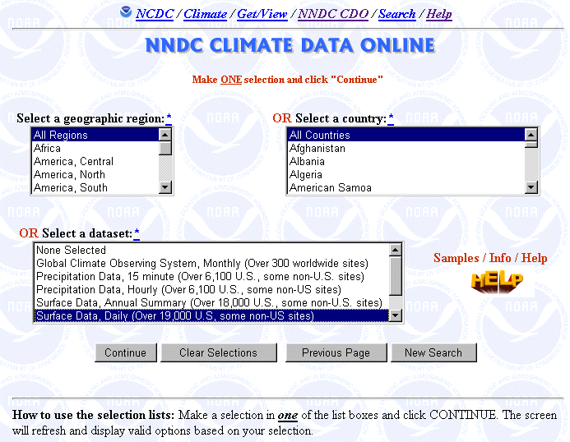
Downloading Web Data

Slide 50
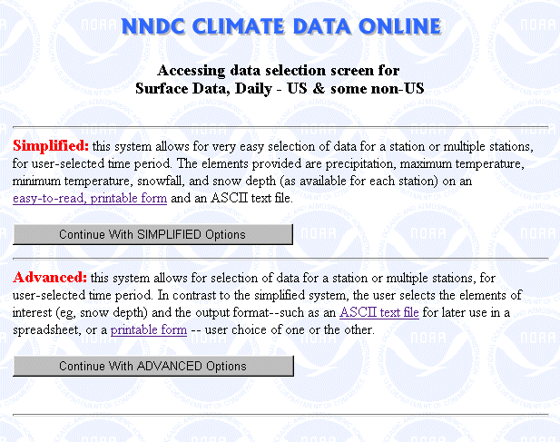
Downloading Web Data Cont.

Slide 51
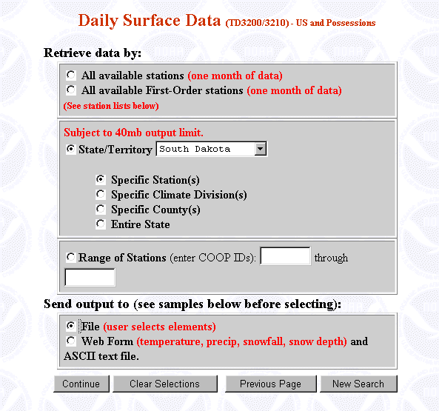
Downloading Web Data Cont.

Slide 52
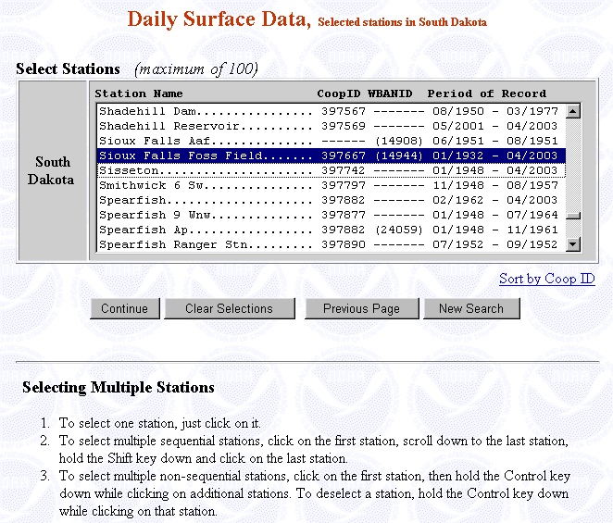
Downloading Web Data Cont.

Slide 53
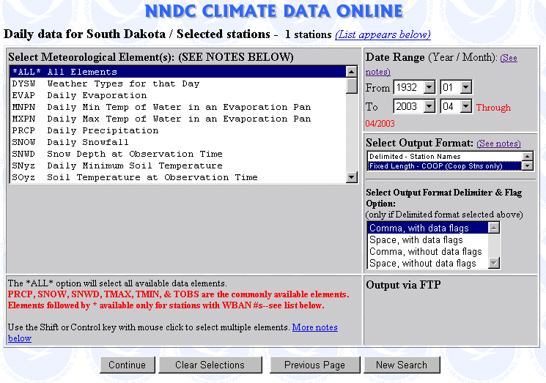
Downloading Web Data Cont.

Slide 54
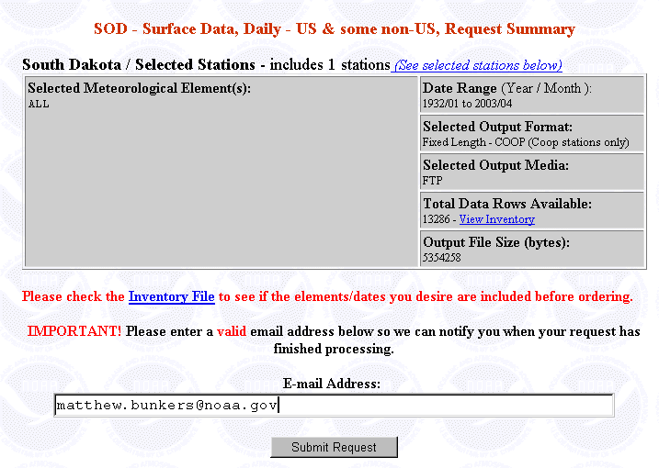
Downloading Web Data Cont.

Slide 55
Ingesting Initial Data
After creating a new file and obtaining data, you will need to populate the file; the initial data will likely come from the Web or CD-ROM (we’ll use the Web)
Make sure you have edited:
/home/xmclimate/DIR.utl/climateConvert
to put in the correct “toolsDir” path, then run the script

Slide 56
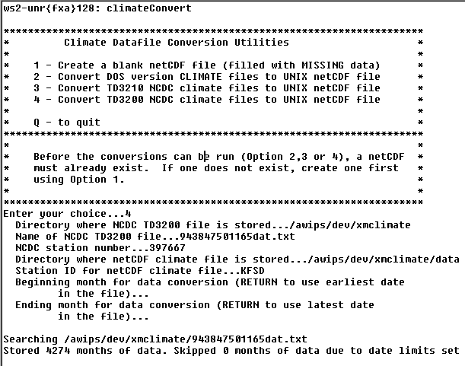
“climateConvert” output

Slide 57
The Next Step
Now you have created a new file and populated it with data from the web
This file may need to be edited for pre-1948 data, as well as for the last 5 months—if desired
The next step is to setup an automated collection of data, followed by updating extremes and creating “normals”

Slide 58
The NCDC ftp Server & Ingesting Monthly Data “Automatically”
A script can be written to automate the collection of monthly data files from NCDC
This allows you to collect data for all stations in one step, with the latest files typically five months old
/home/xmclimate/NCDC/get_NCDC.csh
We run this on the 1st of each month at UNR (see next page)

Slide 59
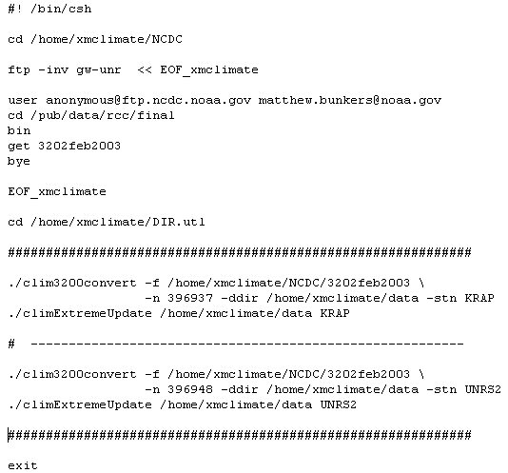
Sample Script for NCDC Data

Slide 60
Ingesting RR3 (COOP) Data
Edit the script:
/home/xmclimate/DIR.utl/shef2climate.pl
  Change “perl5” to “perl” in the first line
  Update the paths and configuration settings at the beginning of the file
  Make a few fixes (see next page)

Slide 61
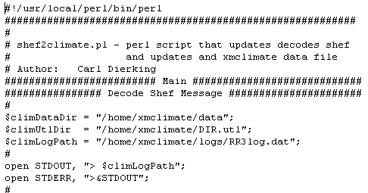
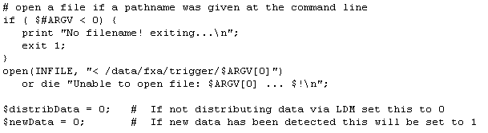
Edit shef2climate.pl

Slide 62
Add RR3 to Triggers
FSDRR3RAP /home/xmclimate/DIR.utl/shef2climate.pl FSDRR3RAP
After you localize your triggers, the COOP data files will update everytime an RR3RAP arrives (works with corrections, but doesn’t always work with multiple stations in the same RR3)
If station doesn’t exist, no big deal

Slide 63
Ingesting DSM (ASOS) Data
Edit the script:
/home/xmclimate/DIR.utl/climDSMload.pl
  Change “perl5” to “perl” in the first line
  Update the paths and configuration settings at the beginning of the file (see next page)

Slide 64
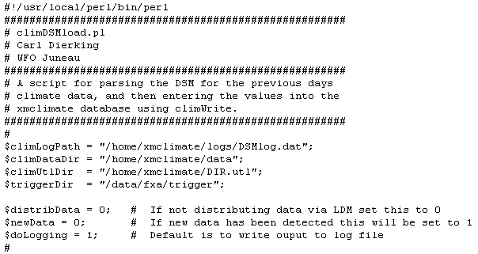
Edit climDSMload.pl

Slide 65
Add DSM to Triggers
CYSDSMGCC /home/xmclimate/DIR.utl/climDSMload.pl CYSDSMGCC
FSDDSMRAP /home/xmclimate/DIR.utl/climDSMload.pl FSDDSMRAP
Etcetera…
After you localize your triggers, the ASOS data files will update everyday (although I have found ~1% missing data)
This will get you wind data too!

Slide 66
Manual Editing
We (UNR) perform manual editing and quality control at the beginning of each month for our “primary” climate sites
Some files are password protected, thus reducing the chance someone will modify the data inadvertently—doesn’t work on current month
  This can be done with the Edit → “Chg Password” menu
  If you forget password, do an ncdump (HP) on the pertinent data file and grep for “pass”

Slide 67
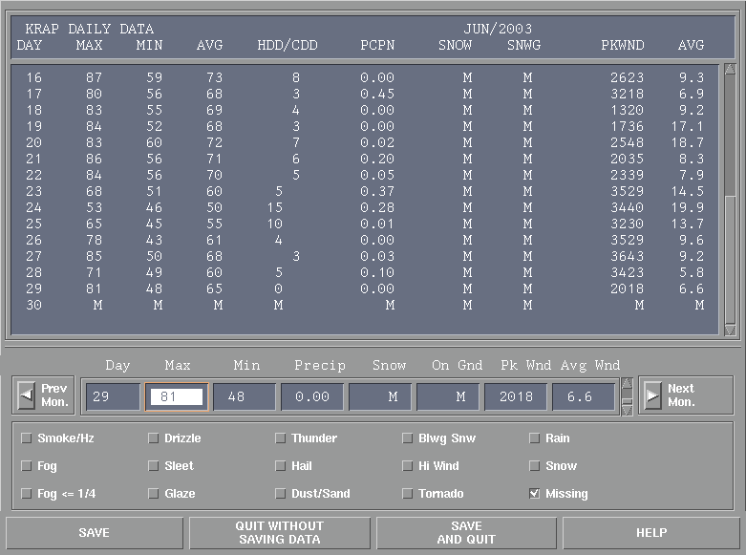
Manual Edit GUI
You must tab through.

Slide 68
Updating Extremes
Extremes should be updated each time you import new data into the xmclimate database for a given station
  This can be accomplished in a script, which we do monthly at UNR (see next page)
  This can also be done with the Tools → “Chk Extremes” option with the main XMclimate interface

Slide 69
Updating Extremes Script

Slide 70
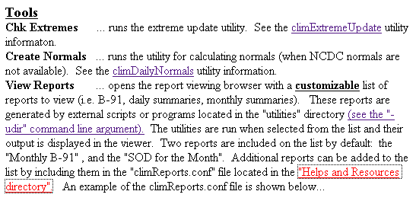
Creating Normals
Normals need to be created for each new station, if the period of record is long enough
  can be done with normals2000.pl script, can be done manually, or can be done with XMclimate utility

Slide 71
In Summary
Blank files need to be created for each new XMclimate station you desire
Data can be obtained from the NCDC Web, NCDC ftp, NCDC CD-ROM, RR3’s, and DSM’s
Some editing of utility scripts is necessary prior to ingest of climate data
Some maintenance and configuration is necessary to keep the database (i.e., observed, extremes, & normals) current and of high quality

Slide 72
Potential Problems
Some older data, especially prior to 1948, require manual input
Erroneous data in NCDC files (on both web and CDROM); XMclimate works good for QC’ing
Make sure you have a backup of your data files (can do this in scripts)!
  climDiff is useful for comparing files, especially after NCDC web data are downloaded—so you don’t overwrite good data with bad data

Slide 73
Potential Problems Cont.
Can have permission problems with data files (e.g., fxa vs. awipsusr, etc.)
Several edits are required to the scripts in the /home/xmclimate/DIR.utl directory, especially with respect to the paths, perl5 → perl, and configuration settings
Normals created with XMclimate do not necessarily agree with NCDC normals

Slide 74
Potential Problems Cont.
May unwantingly overwrite program files when untarring an upgrade to XMclimate
  Suggest untarring in a separate directory, and then comparing the file creation dates, as well as the file contents (using the diff/sdiff commands)
Missing data when searching for top 10’s
  If you are missing one day in a given month, a search for monthly extremes will omit that month
    A fix may be forthcoming for this

Slide 75
Potential Problems Cont.
NCDC website may only be free for noaa.gov sites (not sure about .edu sites)
Not everything with the HP version is functional on Linux yet (e.g., ksh scripts)
There are a few typos in the *.html files

Slide 76
Final Comments
XMclimate is a very powerful climate data interrogation tool
Forecasters and HMTs alike can use this program to help answer a wide array of questions from local citizens, media, and other users
Other features are available with this program, you just need to read the *.xtml files

Slide 77
References
Petrescu, E., 1998: Creation and maintenance of a comprehensive climate database. NOAA Tech. Memo., NWS WR-255, 28 pp.

Slide 78
Acknowledgements
Jeff Chapman, Craig Cogil, Mike Gillispie, and Preston Leftwich provided information used in this presentation

