Slide 1
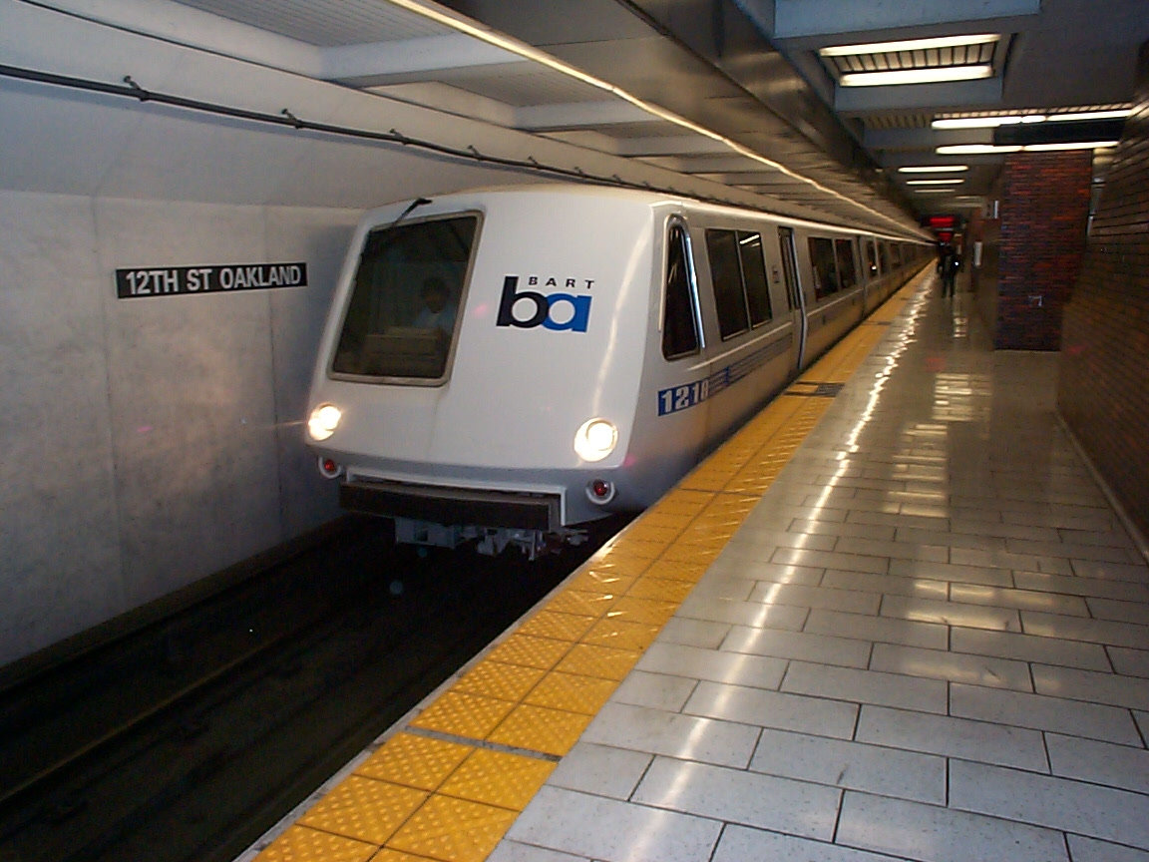
SAN FRANCISCO BAY AREA RAPID TRANSIT DISTRICT
James R. LaGuardia
Panel 5: Acquiring Data During Routine Operations

Slide 2
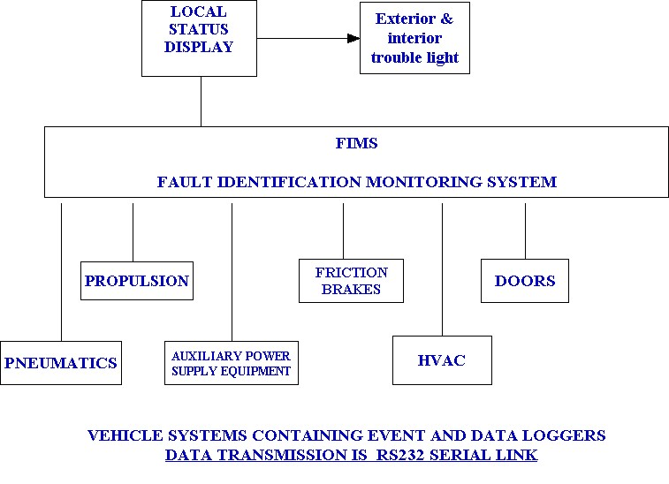
Data Collection/Transmission from Various Systems
Operating with Microprocessors

Slide 3
DATA COLLECTION
The FIMS system will poll each system controller. Depending on the system, the polling will be between 100 milliseconds and 1 second for its current operating status via a serial data link (i.e. friction brakes would be polled more often than the HVAC system) The status polling may be combined with the cross check functions depending on the system being monitored. Faults will be recorded into the FIMS fault log as well as the system being polled. This data is displayed on a real time display screen on each vehicle.

Slide 4
Data Collection
Continued
System CPU Monitoring
Run time diagnostics: During system operation, the microprocessors constantly monitor the performance of the systems to ensure it is operating properly. Should improper operation occur, annunciation shall take place on the real time display and appropriate action shall be taken by the microprocessors. At this time, any failure will be saved in the EVENT log. Actions by the Maintenance Staff using a laptop can collect additional data by downloading Stream/Data logs from the EVENT logs. The data contains information to aid in troubleshooting and snapshots of vehicle conditions at the time of the fault. Depending on the system, the snapshot capture time varies from 5 to 10 seconds and splits that time between conditions leading up to the fault and conditions immediately following the fault. Data is captured at intervals directly related to the system microprocessor speed.

Slide 5
Data Collection with Maintenance
Interaction
A diagnostic interface is provided through the RS-232 port on various system CPU boards that can be connected to the Portable Test Unit (laptop).
Requested diagnostics: Upon request for self-test by maintenance personal, a sequence of tests is executed which test the system more thoroughly than the power-up diagnostics. These tests are not transparent to the operator and proper test set-ups must be done (i.e. vehicle must be at zero speed trainlines must be at specific states, previous tests must have passed, etc.). Should any error that would affect the functionality of the system the operator shall be notified. A test report is available at the end of the testing and can be viewed or saved in Note Pad.
Troubleshooting diagnostics: Troubleshooting diagnostics shall be initialized by maintenance personal through a PTU connected to the microprocessor controller. Maintenance shall have the ability to run all tests automatically or run only selected tests.
The tests invoked from the PTU will be controlled through dual port RAM. Tests will be requested by the system under test CPU with results reported by the serial controller. The test software will be able to test the following hardware function units of the FIMS:
Smart Serial Communications 80386 RAM and ROM
Serial data communication links to other subsystems
Local console communication
PTU information displayed in English and Engineering Units – All raw data converted before displayed.

Slide 6
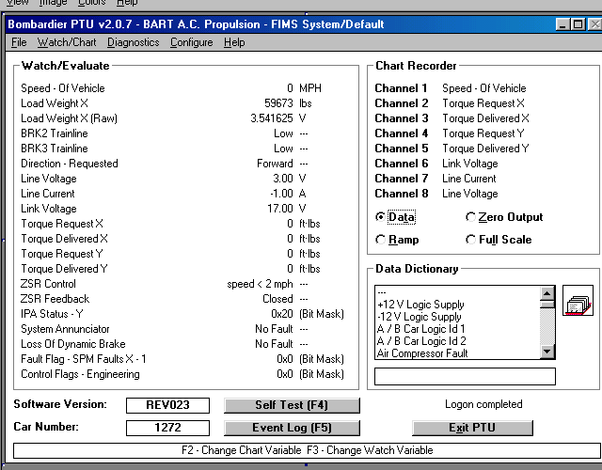
Propulsion Real Time WATCH Screen

Slide 7
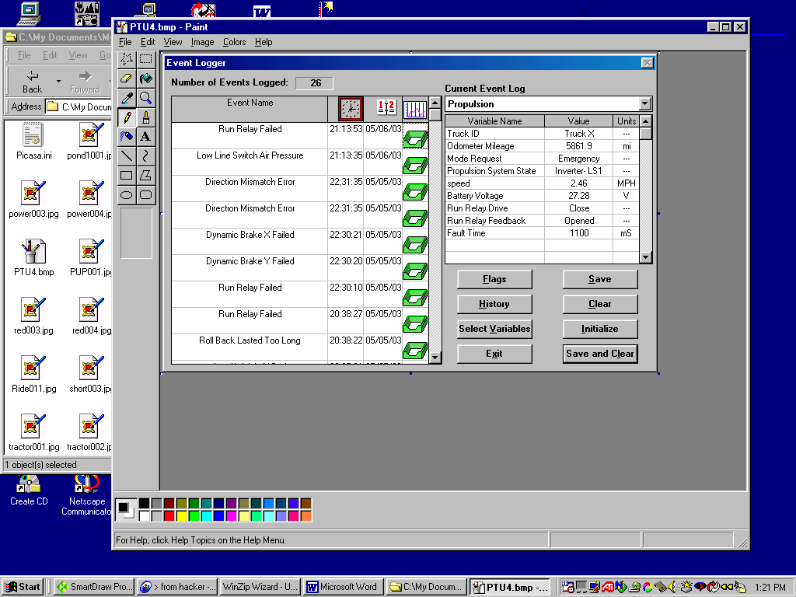
Propulsion Real Time EVENT Screen

Slide 8
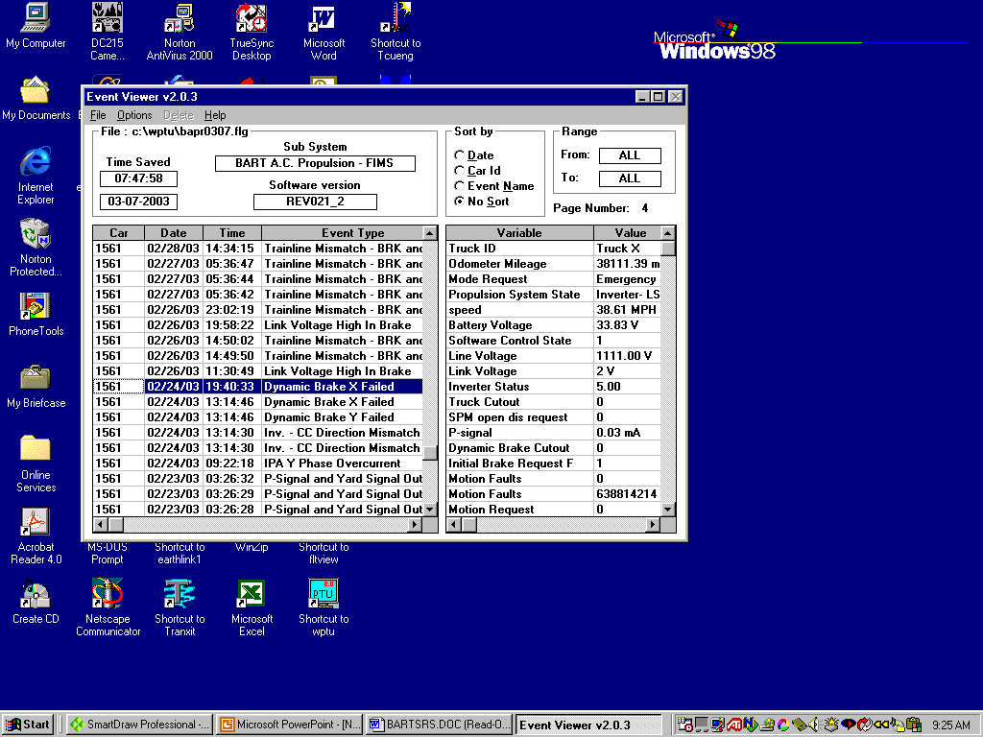
Propulsion Off Line EVENT Log Screen

Slide 9
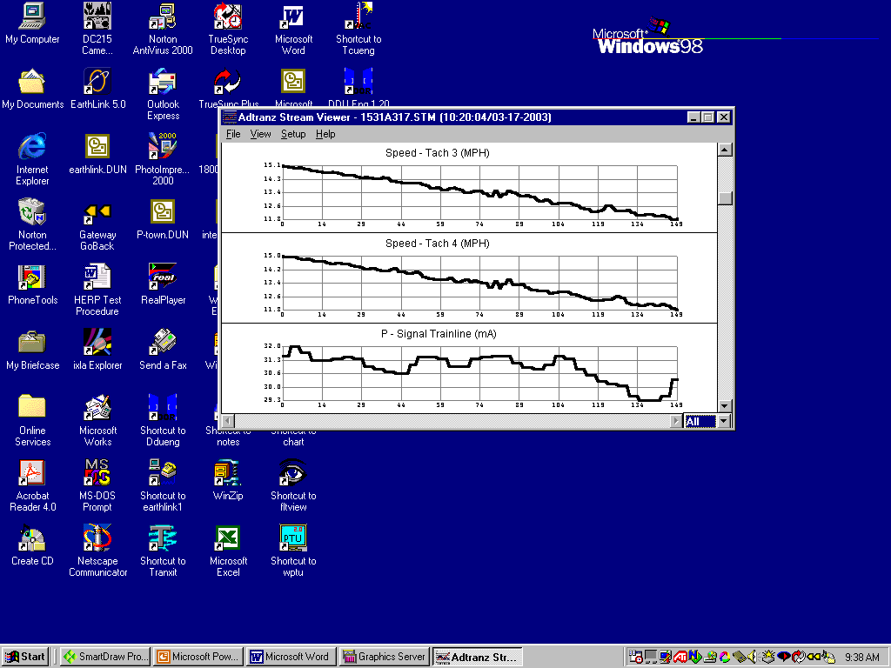
Propulsion Stream/Data log Off Line

Slide 10
Data Archiving
The data retrieved from the vehicle for scheduled and unscheduled
Maintenance is saved to a floppy disk and placed into the vehicle
maintenance record book. Data Archiving, data is stored on the disks for six months to assist with repeating problems or fleet surveys. Data can also be left in the EVENT logs until it is overwritten (FIFO).
Data retrieved from vehicles involved in a incident is transmitted to New Vehicle Engineering and Vehicle Maintenance Engineering for review.
English language with standard Engineering Units.
Hexadecimal values are not acceptable for information at the primary maintenance level.

Slide 11
Data Presentation
The viewing programs for the EVENT logs reside on the PTUs. Each system supplier has their own format and method of data collection, but all must operate and display in the Windows format. EVENTS can be viewed in real-time or off-line. In real-time mode, the PTU will identify the defective Line Replaceable Unit (LRU). Off-line mode is used to transmit data to other computers not directly connected to the vehicle and can be used by Engineering to evaluate vehicle performance or questions related to particular problem.

