Slide 1

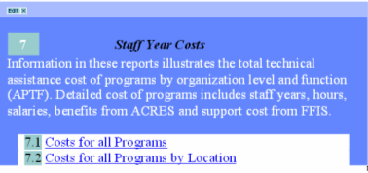
CIS REPORTS SECTION 7
STAFF YEAR COSTS

Slide 2
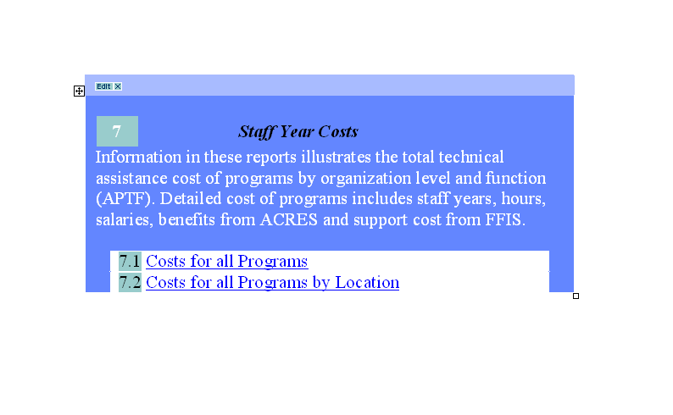
CIS Section 7 Reports:
Notes:
Information in these reports illustrate the total

Slide 3
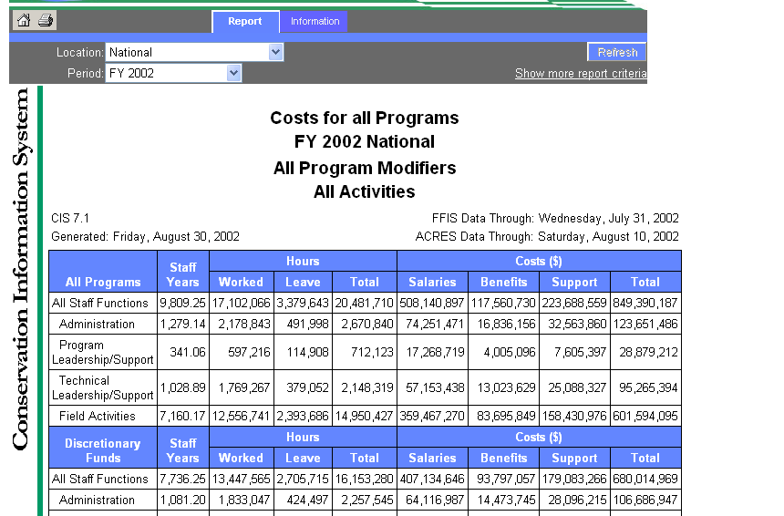
7.1 Costs for all Programs
Purpose:
Hours work including paid leave and total costs by organization level, function, and Conservation Program.
Questions:
What are the costs and staff years worked for NRCS staff by organization level and function?
Notes:
CIS Report 7.1 Costs for all Programs
Key: Hours worked including paid leave and total costs by organization level, function & Conservation Program.
Locations:
National
Regional (summary)
State

Slide 4
What does staff “function” mean?
Administration
Program leadership/support
Technical leadership/support
Field activities
Notes:
Staff Functions are reported in four categories that we report to the Department, Administration and Congress
Administration
Program leadership/support
Technical leadership/support
Field activities

Slide 5
How are hours & cost reported by function?
Total program hours & cost are pro-rated by the A-P-T-F percentage within each state.
These percentages are developed each year in annual financial reports.
Specific A-P-T-F percentages are displayed in CIS Report 9.1
Notes:
Total program hours & cost are pro-rated by the A-P-T-F percentage within each state.
These percentages are developed each year in annual financial reports.
Specific A-P-T-F percentages are displayed in CIS Report 9.1

Slide 6
What is APTF?
Administration – Includes
  all NRCS National Headquarters and Regional staffs.
  State Office State Conservationist or Director's staff;
  Management staff, except IRM;
  Public Affairs Specialist staffs;
  State Resource Conservationist;
  State Conservation Engineer; and State Soil Scientist.
  Greenbook and Central Office charges,
  Business Management Center staffs, and
  National Production Services staffs.
Notes:
Administration – Includes
all NRCS National Headquarters and Regional staffs.
State Office State Conservationist or Director's staff;
Management staff, except IRM;
Public Affairs Specialist staffs;
State Resource Conservationist;
State Conservation Engineer; and State Soil Scientist.
Greenbook and Central Office charges,
Business Management Center staffs, and
National Production Services staffs.

Slide 7
APTF
Program Leadership/Support –
  State office Program planning staffs,
  water quality staffs,
  engineering staffs,
  water resources staffs,
  natural resources planning staffs,
  snow survey data staffs, and
  GIS staffs.
Notes:
Program Leadership/Support –
State office Program planning staffs,
water quality staffs,
engineering staffs,
water resources staffs,
natural resources planning staffs,
snow survey data staffs, and
GIS staffs.

Slide 8
APTF
Technical Leadership/Support – Includes
  National Center staffs, except the Business Management Center and National Production Services staffs,
  State office technical service staffs, except State Conservation Engineer; IRM staffs,
  Resource Conservation Staffs, except State Resource conservationist;
  Soil Survey staffs, except State Soil Scientist;
  Economics and Social Sciences staffs, and
  Ecological Sciences and Planning Staffs; and
  State Cartographic Unit Staffs.
Notes:
Technical Leadership/Support – Includes
National Center staffs, except the Business Management Center and National Production Services staffs,
State office technical service staffs, except State Conservation Engineer; IRM staffs,
Resource Conservation Staffs, except State Resource conservationist;
Soil Survey staffs, except State Soil Scientist;
Economics and Social Sciences staffs, and
Ecological Sciences and Planning Staffs; and
State Cartographic Unit Staffs.

Slide 9
APTF
Field Activities – Includes
  State Plant Materials center (PMC) staffs,
  all State Area Office Staffs,
  Water Quality Office staffs,
  Watershed Project Office Staffs,
  Watershed Protection/River Basin Office staffs,
  RC&D Office staffs,
  Rural Abandoned Mine Program (RAMP)
  Project Office staffs,
  SNOTEL Office staffs,
  Fish Farm Center staffs,
  all Field and Satellite Field Office staffs,
  Major Land Resource Area (MLRA) Office staffs,
  Technical Team staffs, Design Team staffs, Engineer Team staffs, Wetlands Team staffs, and IRT staffs.
Notes:
Staffs reported in the Field Activity category.

Slide 10
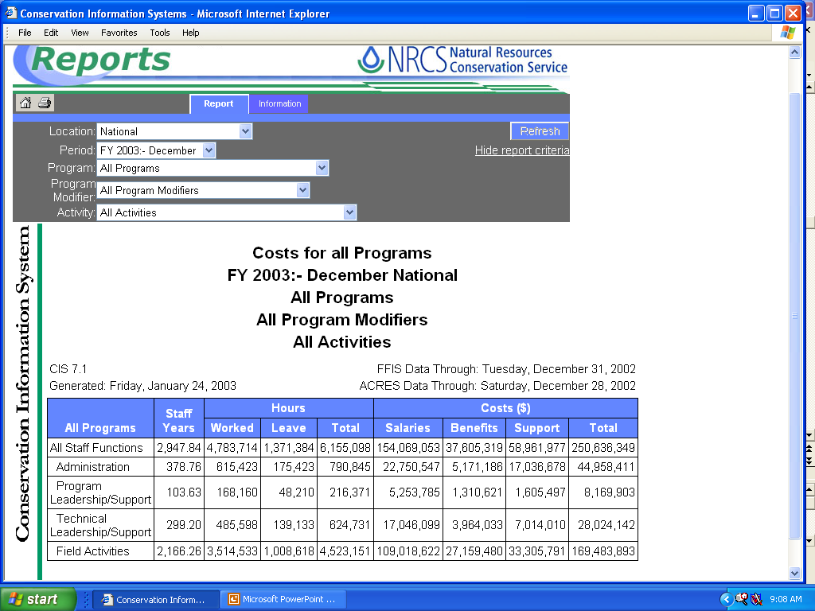
7.1 Costs for all Programs
FFIS
WebTCAS
Notes:
Data Sources:
WebTCAS: (Bi-weekly) – Hours worked, leave hours, and associated salaries & benefits
FFIS: (Monthly) – Support Cost

Slide 11
7.1 Costs for all Programs
Monthly
Bi-weekly
Notes:
CAUTION: Check “as of date”
Be sure FFIS & WebTCAS data is for the same period
Additional report criteria available by:
a) Period
b) Modifier
c) Activities

Slide 12
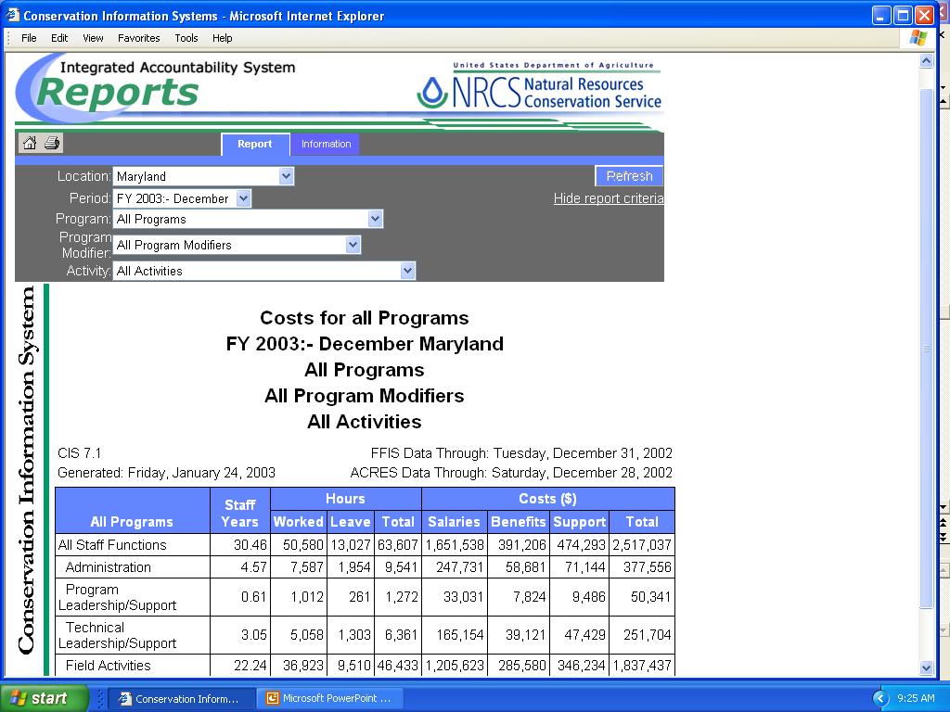
7.1 Costs for all Programs
State summary level
Notes:
State level information can be requested by period, modifier, and activity.

Slide 13
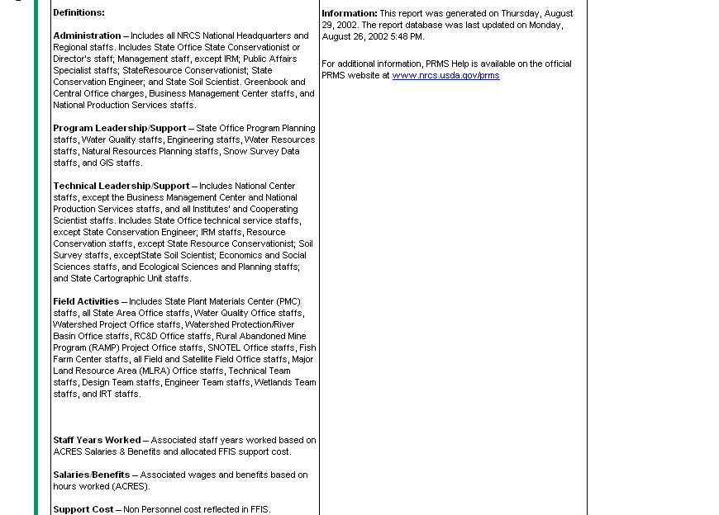
Notes:
Click on Information page to retrieve report metadata

Slide 14
7.1 Metadata Definitions
Report Purpose – Hours worked including paid leave and associated salaries/benefits & support cost by organization level and function.
Report selection criteria include program, activity, and modifier.
Data Source – WebTCAS (Bi-weekly); FFIS (Monthly); Annual Financial Reports (Annually).
Hours worked includes regular time, overtime, compensatory time earned, and credit earned.
Leave hours include all paid leave except comp and credit time earned.
FFIS support cost is prorated based on salary for hours worked by organization level and function.
Notes:
Report Purpose
Hours worked including leave paid and associated salaries & benefits and support cost by organization level and function
Data Source:
WebTCAS (Bi-Weekly) Hours worked, salaries & benefits
FFIS (Monthly) Support Cost
Annual Financial Reports (Annual) Organization level & function
Hours worked – regular, overtime, comp/credit
Leave hours – paid leave except comp/credit
FFIS support cost – based on salary for hours worked by organization level & function

Slide 15
7.1 Metadata Definitions
Staff years – Based on hours worked & paid leave hours divided by annual hours.
  Staff years displayed in this report will be different than staff years extracted from FFIS, other CIS reports, budget formulation, and human resources.
Salaries - Associated wages for both hours worked & leave hours.
Benefits - Associated benefits for both hours worked & leave hours.
Support Cost – Non personnel cost reflected in FFIS.
Staff function – Administrative, program leadership/support, technical leadership/support, and field activities.
Notes:
Staff years – based on actual hours worked & paid leave hours
* Staff years in this report will be different than staff years in FFIS, Budget Formulation, Human Resources, other CIS Reports
Salaries – associated wages for hours worked & leave hours
Benefits – associated benefits for hours worked & leave hours
Support Cost – Non Personnel obligations reflected in FFIS

Slide 16
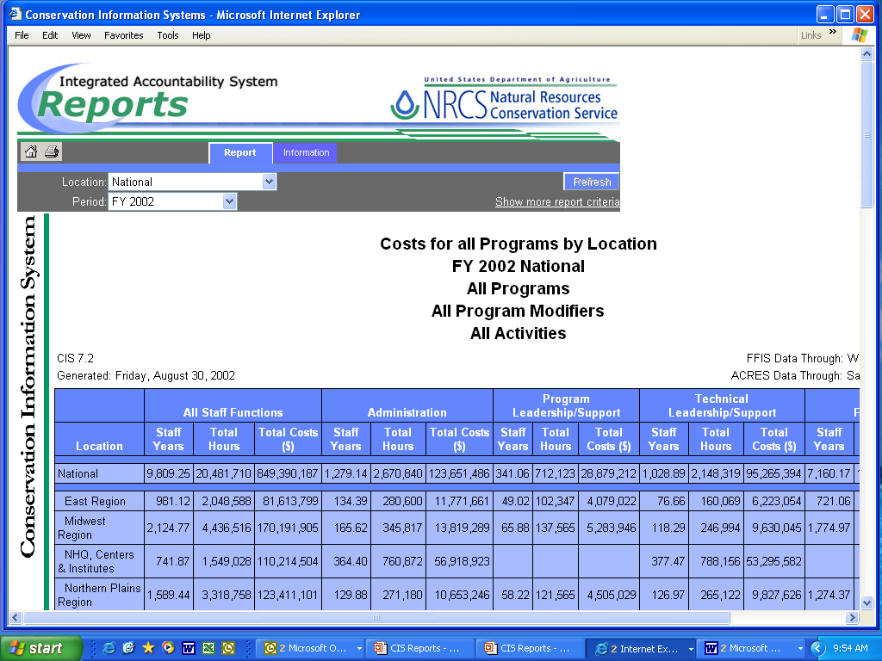
7.2 Costs for all Programs by Location
Purpose:
Total hours worked and associated total cost by organization level, function, and location.
Questions:
What are the costs and staff years worked for NRCS staff by organization level and function?
Notes:
CIS Report 7.2 Costs for all Programs by Location
Key: Total hours worked and associated total cost by organization level & function and location

Slide 17
7.2 Costs for all Programs by Location
Summarized Data
Location
Notes:
Includes following locations:
1) National
2) Region-State
3) State-County-Office
4) State-Congressional District County
Summarized data: Total hours & costs
Total Hours: Hours worked & paid leave hours
Total Costs: Associated salaries/benefits & support

Slide 18
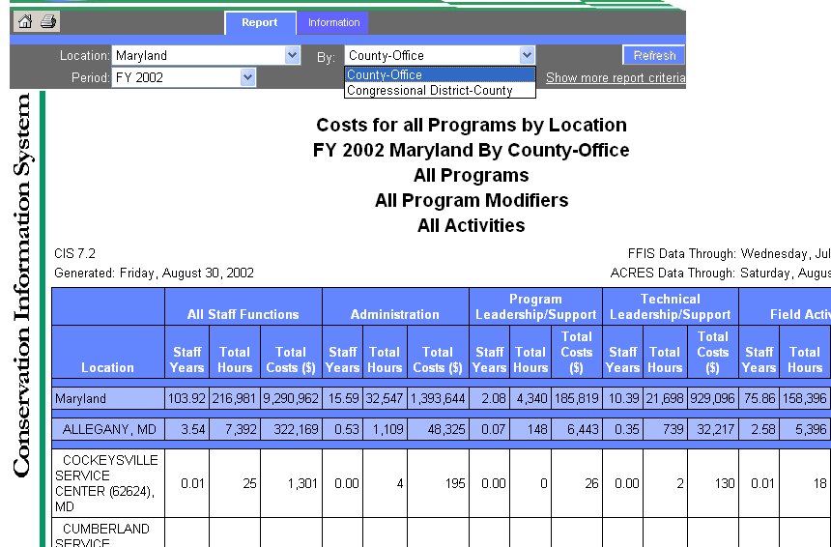
7.2 Costs for all Programs by Location
County-Office/ Congressional District-County
Notes:
State level reports include breakdown by :
a) County-office
b) Congressional District-County
County-office reports include the office location which performed the work in the county.

Slide 19
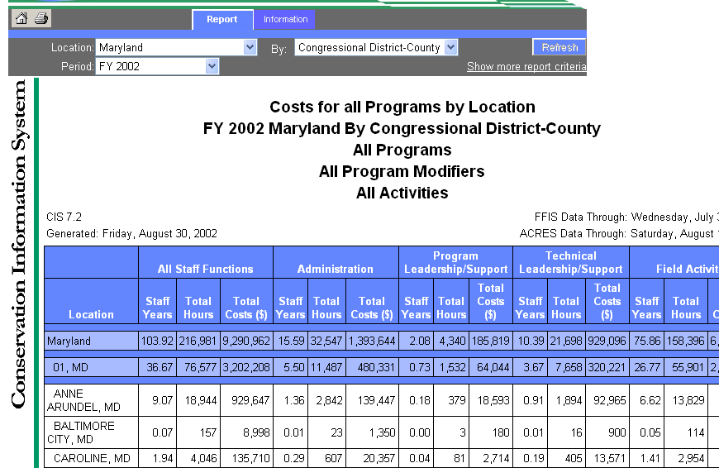
7.2 Costs for all Programs by Location
Congressional District - County
Notes:
Congressional District-County reports
Congressional District-County reports include the county which performed work in the Congressional District.

Slide 20
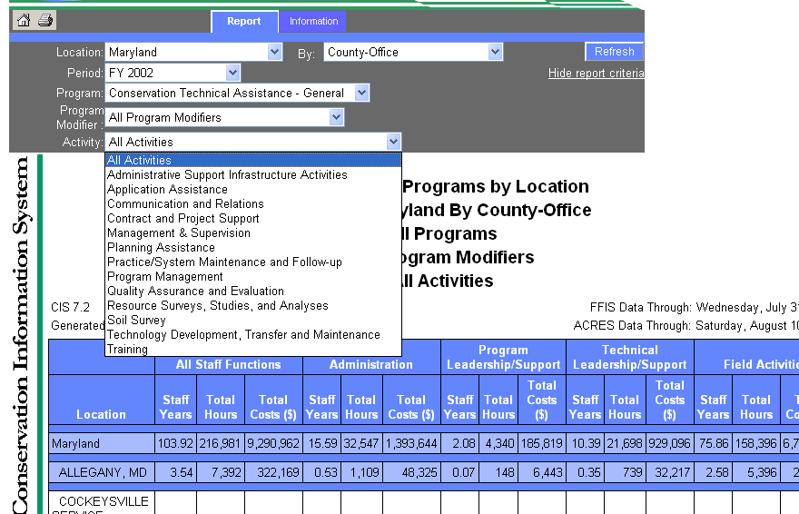
7.2 Costs for all Programs by Location
Additional spinners
Notes:
Additional State report criteria
1) Period
2) Program
2) Program modifier
3) Activity

Slide 21
7.2 Metadata Definitions
Report Purpose – Total hours worked and associated total cost by organization level, function, and location.
Data Source – WebTCAS (Bi-weekly); FFIS (Monthly); Annual Financial Reports (Annually).
Total Hours includes hours worked and paid leave hours.
Total Costs include associated salaries, benefits, and FFIS support cost.
Notes:
Report Purpose
Total hours worked including paid leave and associated total cost by organization level & function
Data Source:
WebTCAS (Bi-Weekly) Hours worked, salaries & benefits
FFIS (Monthly) Support Cost
Annual Financial Reports (Annual) Organization level & function
Total Hours: Hours worked & paid leave hours
Total Costs: Associated salaries/benefits & FFIS support cost

Slide 22
7.2 Metadata Definitions
Staff function – Administrative, program leadership/support, technical leadership/support, and field activities.
Staff years –Based on hours worked & paid leave hours divided by annual hours.
  Staff years displayed in this report will be different than staff years extracted from FFIS, other CIS reports, budget formulation, and human resources.
Notes:
Staff function – administrative, program leadership support, technical leadership support, and field activities.
Staff years – based on actual hours worked & paid leave hours
* Staff years in this report will be different than staff years in FFIS, Budget Formulation, Human Resources, other CIS Reports

Slide 23
Thank you!

