Slide 1
Distribution and Location of Genetic Effects for Dairy Traits

Slide 2
Experimental Design
Predict April 2008 daughter deviations from August 2003 PTAs
  Similar to Interbull trend test 3
  3576 older Holstein bulls
  1759 younger bulls (total = 5335)‏
Results computed for 27 traits: 5 yield, 5 health, 16 conformation, and Net Merit (NM$)‏

Slide 3
Linear and Nonlinear Predictions
Linear model
  Infinitesimal alleles model in which all loci have non-zero effects
Nonlinear models
  Model A: infinitesimal alleles with a heavy-tailed prior
  Model B: finite locus model with normally-distributed marker effects
  Model AB: finite locus model with a heavy-tailed prior

Slide 4
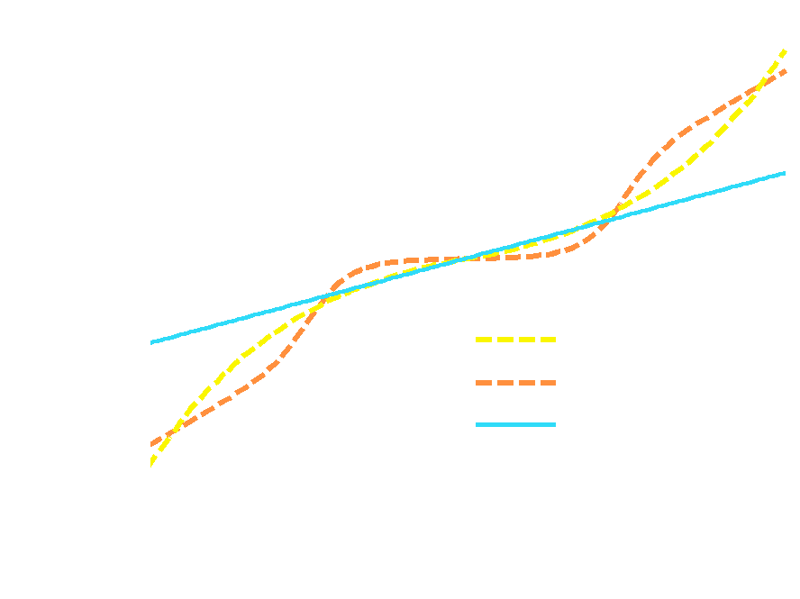
Regressions for marker allele effects

Slide 5
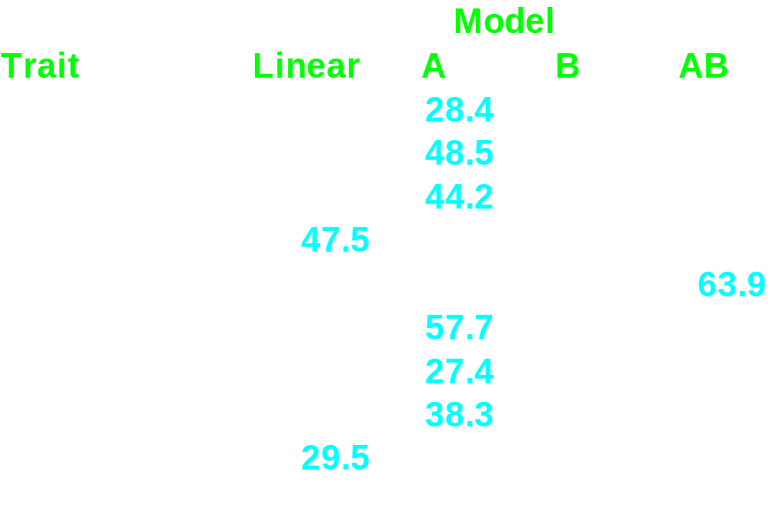
R-square values comparing linear to nonlinear genomic predictions

Slide 6
Largest Effects
Fat %: largest effect on BTA 14 flanking the DGAT1 gene, with lesser effects on milk and fat yield
Protein %: large effects on BTA 6 flanking the ABCG2 gene
Net Merit: a marker on BTA 18 had the largest effect on NM$, in a region previously identified as having a large effect on fertility

Slide 7
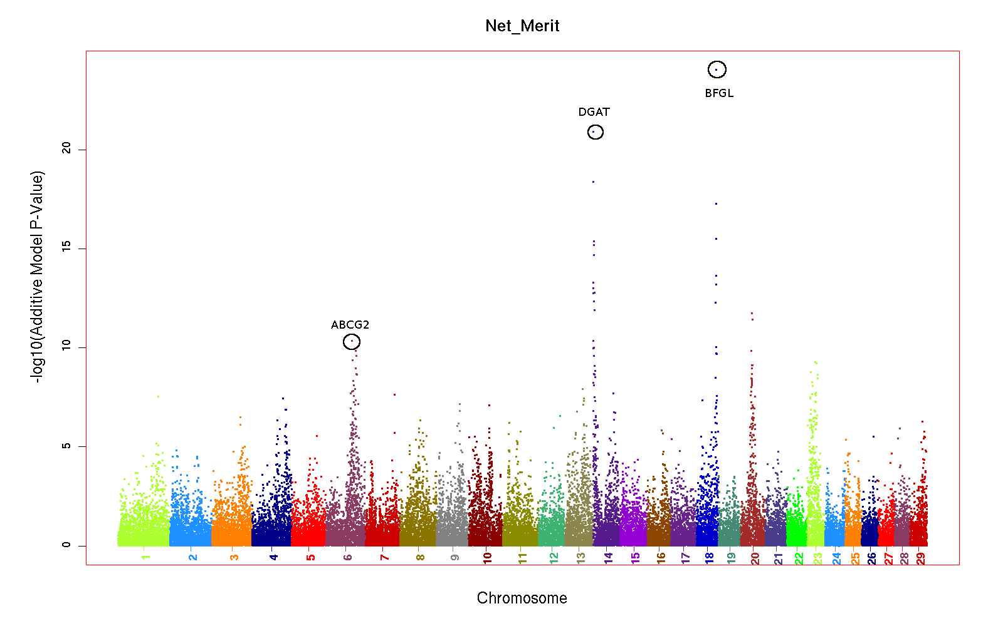

Slide 8
Dystocia Complex
Markers on BTA 18 had the largest effects for several traits:
  Dystocia: Sire and daughter calving ease
  Conformation: rump width, stature, strength, and body depth
  Efficiency: longevity and net merit
Large calves contribute to shorter PL and decreased NM$

Slide 9
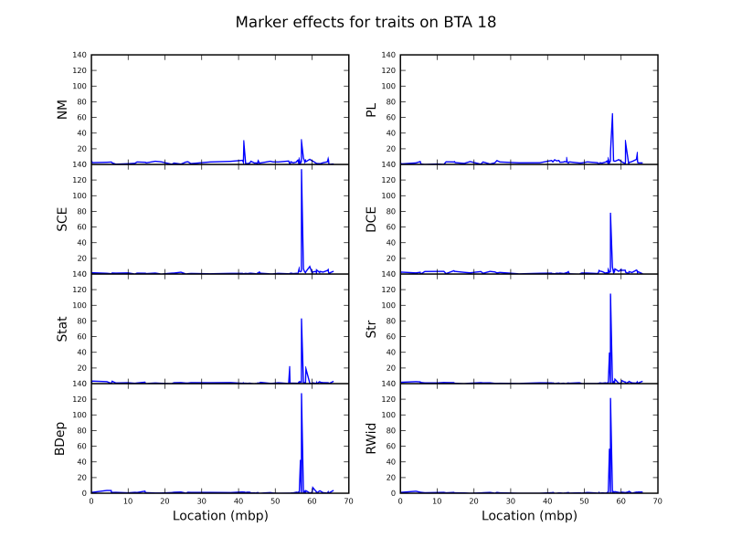

Slide 10
SNP on X Chromosome
Each animal has two evaluations
  Expected genetic merit of daughters
  Expected genetic merit of sons
  Difference is sum of effects on X
  SD = 0.1 σ_{G}, smaller than expected
Correlation with sire’s daughter vs. son PTA difference was significant (P < 0.0001), regression close to 1.0

Slide 11
X, Y, Pseudo-autosomal SNPs
35 SNPs
35 SNPs
487 SNPs
0 SNPs

Slide 12
Conclusions
A heavy-tailed model provides better fits to the data than a linear or finite loci models.
Markers on BTA 18 had large effects on net merit, longevity, calving ease, and conformation.
Results validate quantitative genetic theory, most notably the infinitessimal model.

Slide 13
Acknowledgments
Funding:
  NRI grants 2006-35205-16888, 16701
  CDDR Contributors (NAAB, Semex)‏
Genotyping and DNA extraction:
  BFGL, U. Missouri, U. Alberta, GeneSeek, GIFV, and Illumina
Computing from AIPL staff

Slide 14
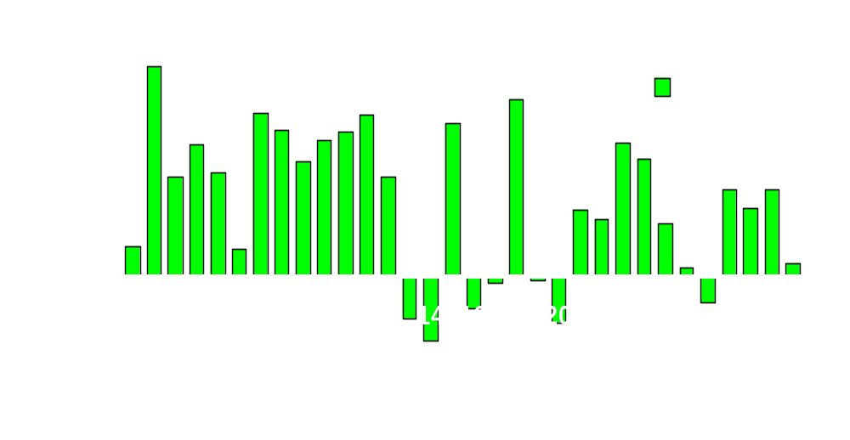
Net Merit by Chromosome for O Man

