Slide 1
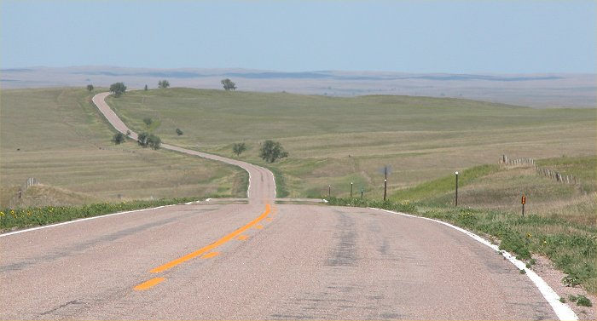
Climate Diagnostics and Prediction Workshop/CLIVAR Drought Workshop
Welcome to Nebraska!
Photo: Melissa Widhalm, NDMC

Slide 2

Nebraska
Home of the Unicameral
Home of the 6th Great Lake
  Sandhills
Kool-Aid, CliffNotes
Berkshire Hathaway (Warren Buffett), Cabela’s, Union Pacific (World’s largest rail yard in North Platte), Valmont Industries

Slide 3
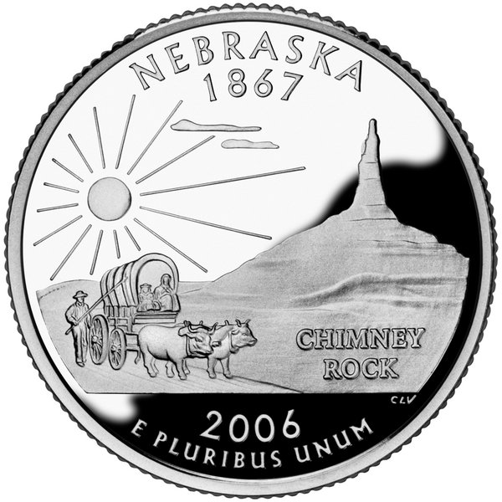
Nebraska
Bird: Western Meadowlark
Animal: White-tailed Deer
Fish: Channel Catfish
Flower: Goldenrod
Tree: Cottonwood
Grass: Little Bluestem
Dance: Square Dance
Fossil: Mammoth
Motto: Equality before the law

Slide 4
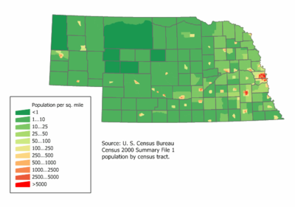

Slide 5
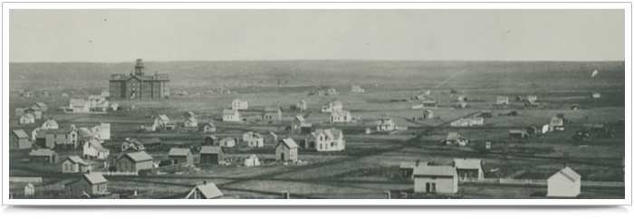

Slide 6
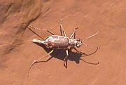
Lincoln, NE
Originally called Lancaster in 1856
  Became the Lancaster County Seat in 1859
Became the capital when Nebraska gained statehood in 1867
Saline wetlands
  Salt Creek Tiger Beetle
  Lincoln Saltdogs
Population: 225,581
Elevation: 1,176 ft
Annual precipitation: 28.4 inches
Annual snowfall: 27.5 inches

Slide 7

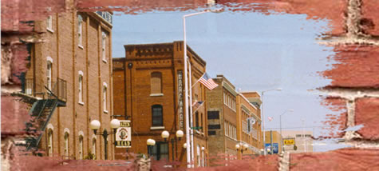


Hours: Monday and Tuesday 9:30 to 5:30
Wednesday thru Friday 9:30 to 8:30
Saturday 10:00 to 4:00

Slide 8
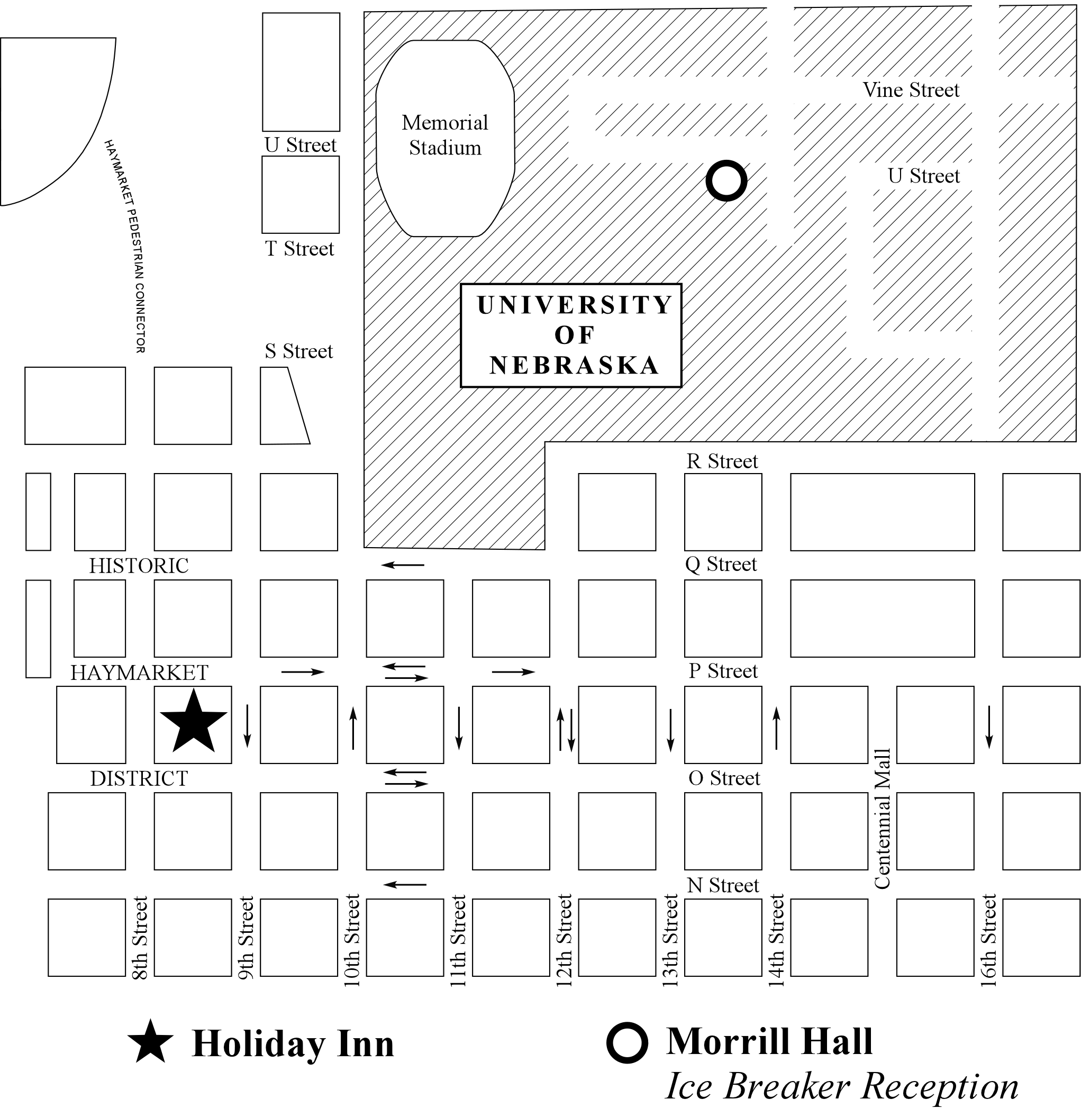

Slide 9
Workshop Details
Thank you!
Funding
Agendas
Social Events
Poster Sessions
Registration Materials
NDMC Staff and Students

