Slide 1
Stability Issues
NSLS-II EFAC Meeting
May 10, 2007
S. Krinsky

Slide 2
Stability Task Force / Workshop April 18-20
http://www.bnl.gov/nsls2/workshops/Stability_Wshop_4-18-07.asp
Visiting Committee
M. Boge PSI
J. Byrd LBL
J.R. Chen Taiwan
Y. Dabin ESRF
R. Hettel (Chair) SLAC
J. Jacob ESRF
J. Maser APS
R. Mueller BESSY-II
D. Shu APS
J. Sidarous APS
O. Singh APS
C. Steier LBL

Slide 3
Electron Beam Sizes and Divergences for Selected NSLS-II Sources
Type of source:
5 m straight section
8 m straight section
Bending magnet
1 T three-pole wiggler
σ_{x} [μm]
38.5
99.5
44.2 (35.4-122)
136
σ_{x'} [μrad]
14.2
5.48
63.1 (28.9-101)
14.0
σ_{y} [μm]
3.05
5.51
15.7
15.7
σ_{y'} [μrad]
3.22
1.78
0.63
0.62

Slide 4
User Requirements
In most cases studied so far, a stability criterion of 10% of the beam size and 10% of the beam opening angle is sufficient, with the exception of the horizontal position for a few techniques
Review Committee→Beam size stability also critical
A common theme which has been expressed is in stability of beam intensity delivered to the experiment, which affects signal-to-noise directly, and this explains why some cases require beam position stability of <10% of the beam size
A “one size fits all” approach may not work for everyone, and tighter stability for a particular experimental program may require local measures

Slide 5
Review Committee: Comments on Stability Solutions
Need cutting-edge technology in many systems on BL and in accelerator
May need mechanical motion/position survey sensors at critical points from source to experiment and in accelerator; ability to include sensors in feedback
Need to mechanically model critical beam line set-ups (supports, modes, etc)
Find a way to monitor I0 just upstream of sample for all critical systems – normalization on sample-by-sample – but there are limits to quality of I0 detector
Recommend phase space acceptance analysis projected to source phase space
Use “telescope technology” to maintain relative stability of components (e.g. D. Shu)
Need instrumentation infrastructure to verify accelerator vs. beam line stability issues and to help achieve stability goals
Committee strongly supports beam designer’s goal to consider source and beam line stability “holistically”

Slide 6
Stability Dependent on Conventional Facilities
Stability goals driven by conventional facility design
  Stability of storage ring tunnel floor
    Vibration < 25 nm PSD from 4-50hz
  Stability of experimental floor
    Vibration level of < 25 nm PSD from 4-50hz for general floor area
    Vibration level for 1 nm resolution beam lines requires further definition but appears achievable with proper correlation
  Thermal stability of storage ring tunnel environment
    +/- 0.1º C for 1 hour time constant
  Thermal stability of experimental floor
    +/- 0.5º C for 1 hour time constant
Review Committee: Accelerator group must confirm that there is no significant thermal
load variation during operation

Slide 7
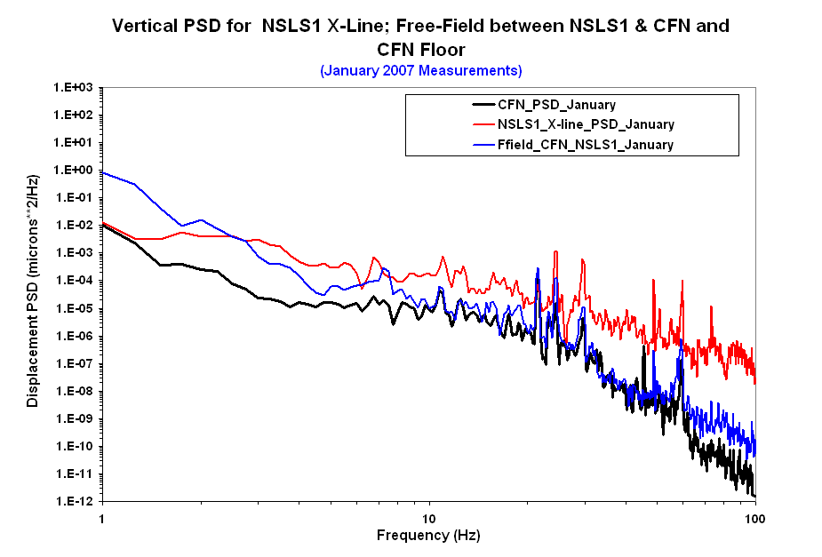
RMS (2 – 50 Hz): ~ 20 nm

Slide 8
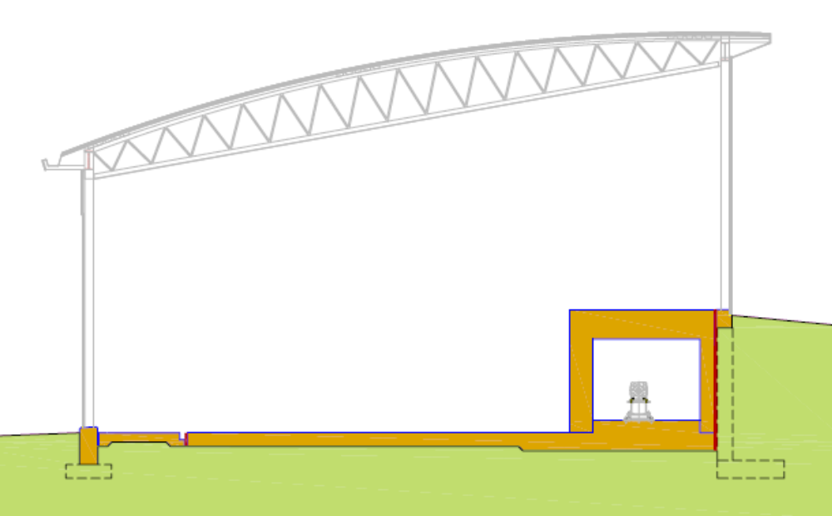
Ring Building Section
Bldg structure Isolated from tunnel and experimental Floor
Electrical Mezzanine
Isolation Joint or Void Space
Isolated Grade Beam
Tunnel Roof
Isolation Joint
Ratchet or
Shield Wall
Access Corridor
Earth Shield Berm
Experimental Floor
“Monolithic Joint”
Isolated Pier for Column
Tunnel Floor

Slide 9
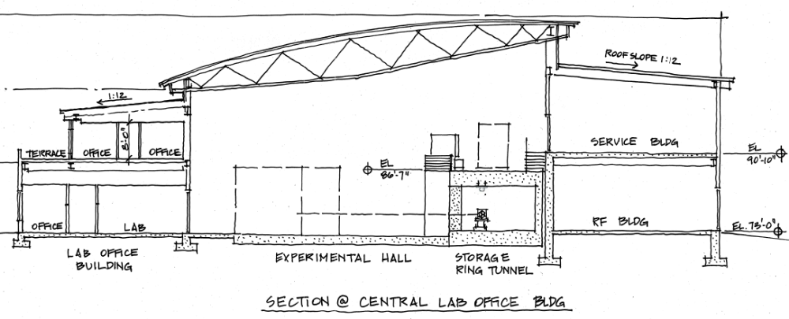
Tunnel Design - Ring Building Section
Need to assure that vibration mitigation measures are carried out at Ring building interfaces with other structures and where systems enter building or tunnel
Non-vibrating Equipment
Rotating Machinery
Non-vibrating Equipment
Rotating Machinery
Distance determined by modeling & empirical analysis
Section at Lab Office Building and Service Building

Slide 10
Review Committee:
Revisit the project design parameters regarding the infield service
buildings. From vibration perspective, it may be better to locate
them in the outfield (maybe incorporated into LOBs) A discussion
took place, and CFG will pursue that approach from cost/benefit
approach. In either case, even with the analysis resulting in
acceptable outcome, an attempt should be made to locate rotating
equipment as far away from SR as practically feasible.

Slide 11
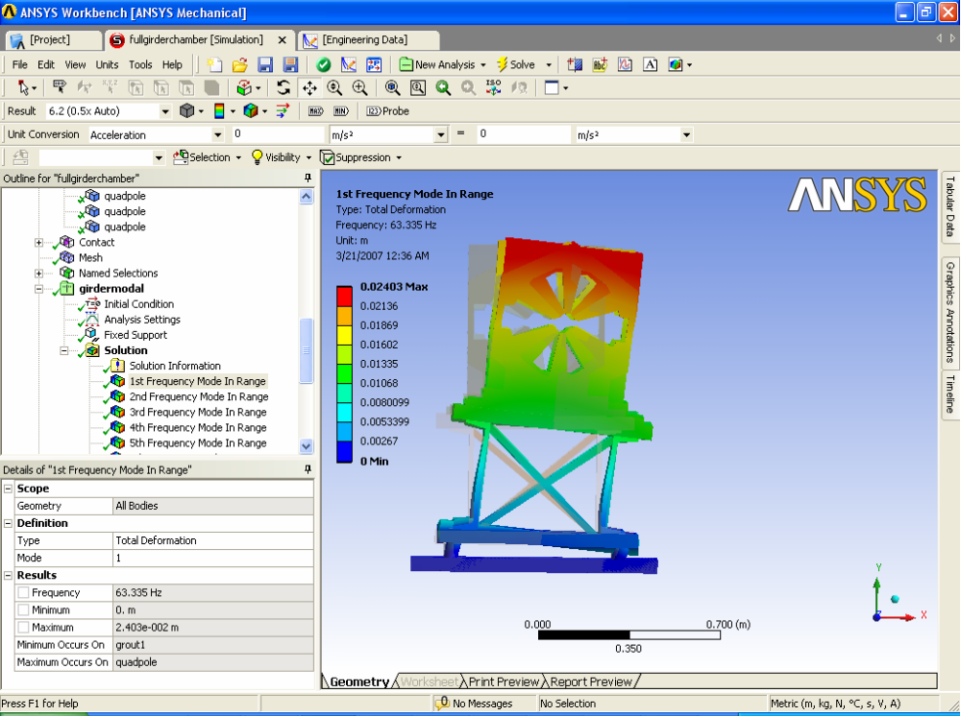
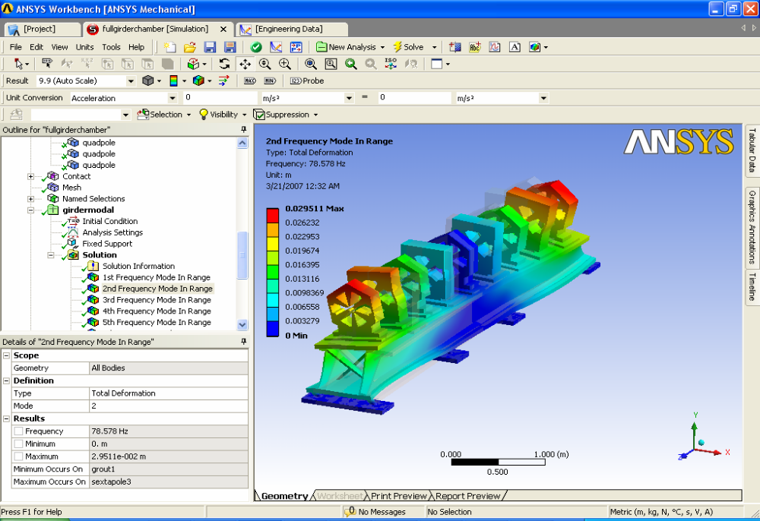
Mode Shapes of the Girder-Magnets Assembly
(a)
(b)
Natural modes of vibration for the girder-magnets assembly: (a) rolling mode = 63 Hz, (b) twisting mode = 79 Hz
RMS (2-50) Hz Displacements: Floor: 20 nm, Magnets: 21 nm
Review Committee: Resonant frequencies often found to be 1.5-2 times
lower than calculation. Must prototype magnet-girder assembly

Slide 12
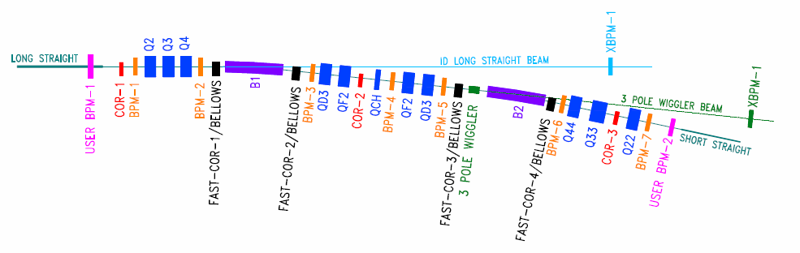
Location of BPMs and Correctors
BPMs mounted on vacuum chambers: ± 0.2 μm (vertical)
User BPMs (upstream and downstream of IDs) : ± 0.1 μm (vertical)
X-BPMs: ± 0.1 μm (vertical)
There are also fast correctors in straights at both ends of ID
Review Committee: Include feed-forward on
skew quads to correct for ID changes

Slide 13
Orbit Feedback
Orbit motion can be reduced by feedback which centers the beam in
RF beam position monitors (BPMs) situated around the ring.
Essential that motion of the BPMs be less than the tolerance to which
we wish to hold electron beam stable.
It is also necessary for the power supplies of the correction dipoles to
have high resolution and low noise (~1ppm).
Bandwidth of the feedback system will be ~100 Hz.
X-ray BPMs on the user beamlines can be used to supplement the RF BPMS
located around the storage ring

Slide 14
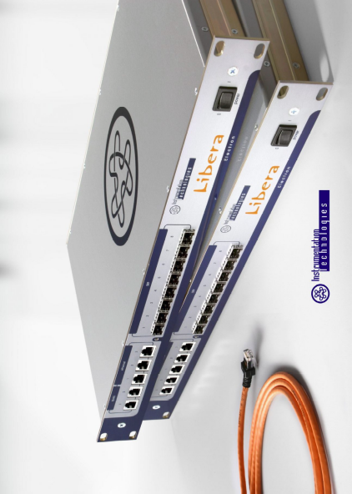
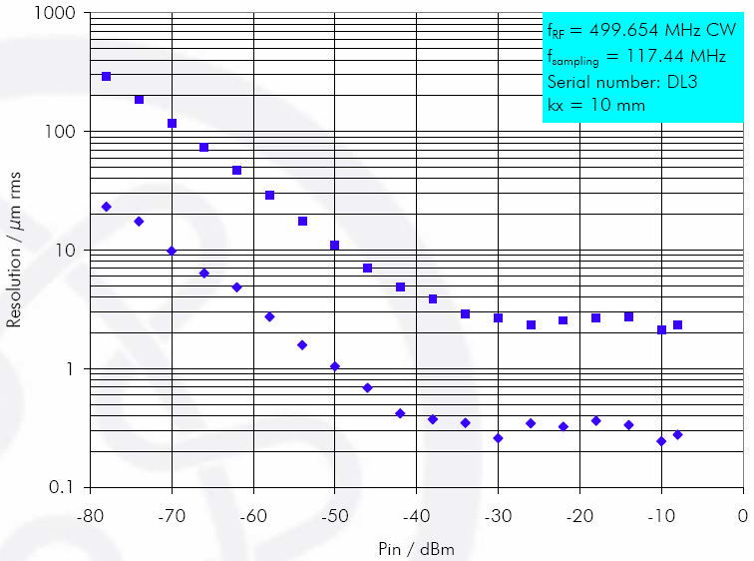
Processing Units
Utilized at Elettra, NSSRC, Diamond, Soleil, PLS
Fast acquisition 10 kHz sampling rate, 2 kHz BW
Slow acquisition: 10 Hz sampling rate, ~4 Hz BW
32 bit data
RMS uncertainty (for 10 mm scale in 1 kHz BW) -90.5dB →0.3µm @ Pin = -20 dBm
8-hour stability (ΔT=±1°C) -80dB→1µm
Temperature drift (T=10–35°C) -94dB/°C → 0.2µm/°C
MTBF ≥ 100,000 hours
For 270 units failure rate will be one unit in 17 days
Review committee: NSLS-II needs about factor of 2
better performance than available today
noise, stability <0.15micron
Technology improving, in a few years will be achievable

Slide 15
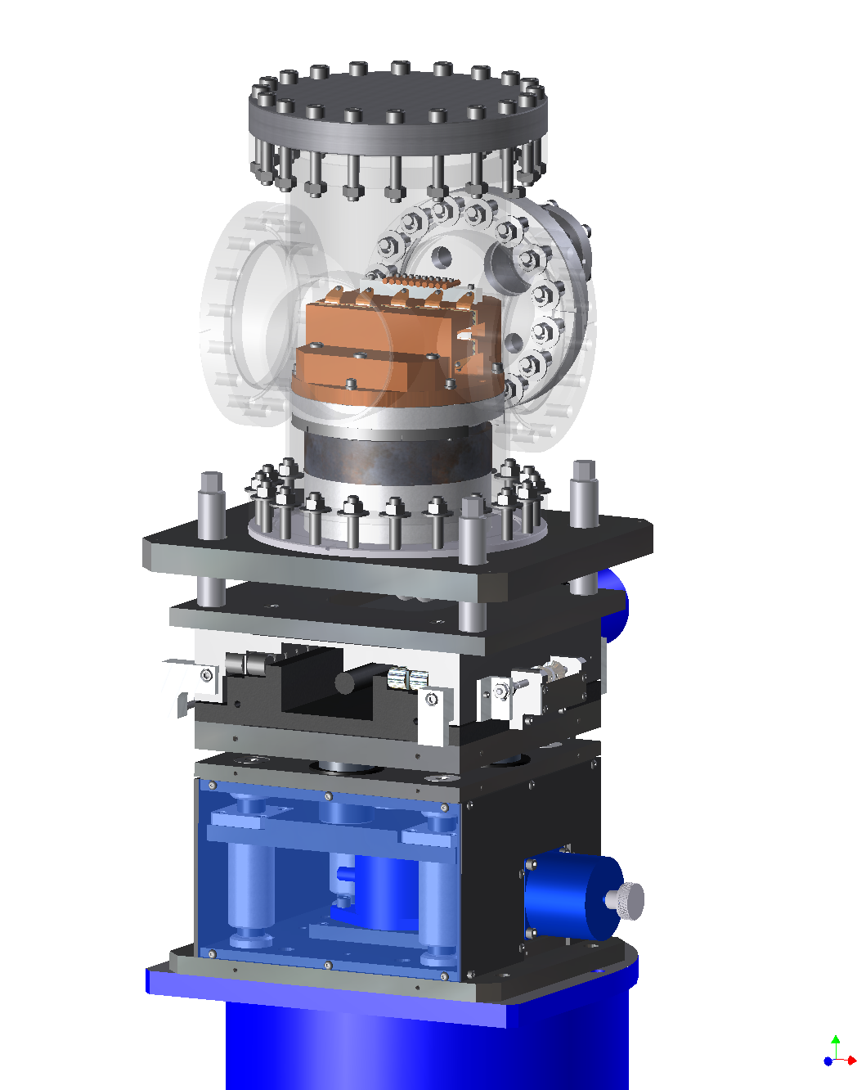
Photon Beam Position Monitors
Will provide information on photon beam position and angle (to account for errors in the wiggler field)
Use of photon BPMs will allow sub-microradian pointing stability
Contamination with dipole radiation can be of less concern due to reduced magnetic field in the bending magnet
Can be used for orbit feedback and/or control of users optics
2D translation stages will precisely locate the photon BPM
Should withstand high power density
Review Committee:
X-ray BPMs will be essential for NSLS-II
Give serious consideration to Decker distortion
Hold Workshop on X-Ray BPM Development

Slide 16
Conclusion
Maintaining orbit motion below 10% of source size
and divergence is believed to be achievable and
satisfies most user requirements

