Slide 1

Neutrino Possibilities at the SNS

Slide 2
Motivation
On this workshop we have nice theory talks about motivation
For me as an experimentalist motivation is two fold
Important Energy Window
Just right for SN studies,
Solar Physics
SN detectors,
Nuclear Physics.
Almost no data in that region
Extremely high neutrino flux
A lot of opportunity
in high precision measurements:
Neutrino spectra from muon decay (test for non V-A components)
Wrong neutrino from muon decay
New exciting, unexplored opportunities !!!

Slide 3
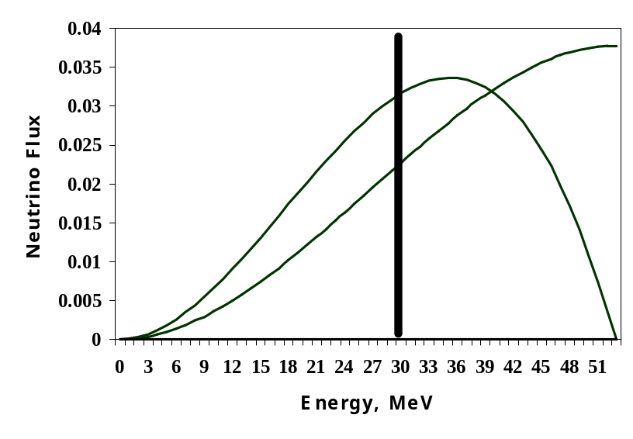
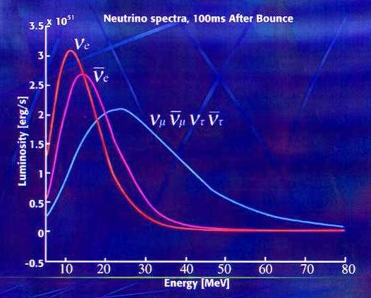
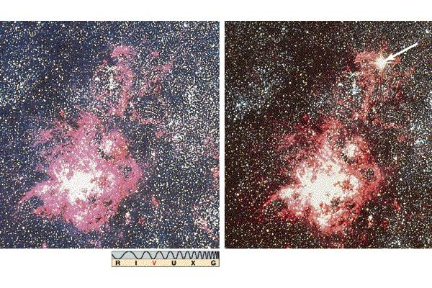
Neutrino Spectra
Normalized spectra
N(ν_{e}) = ( 12 / W⁴) E²_{ν} ( W - E_{ν} )
N(ν_{μ}) = ( 6 / W⁴) E²_{ν} ( W - 2 / 3 E_{ν} )
W=52.83 MeV
ν_{μ} is monoenergetic at ~ 30 MeV
SNS
ν_{μ}
ν_{μ}
ν_{e}
Neutrinos from SNS are in the same energy range as neutrinos from Supernovae !
Supernovae

Slide 4
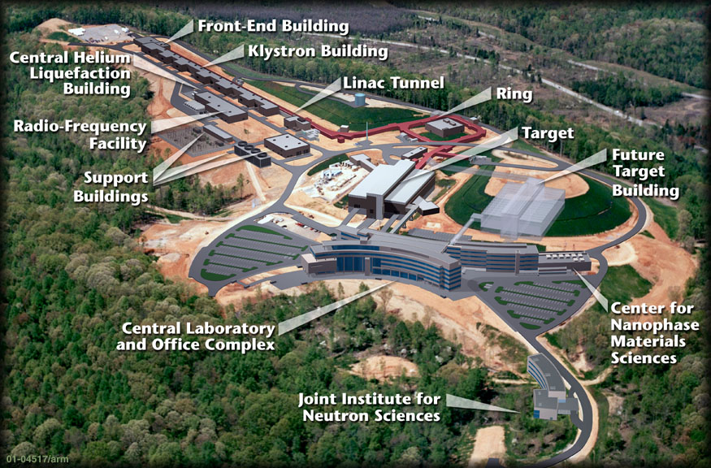
SNS layout
1.3 GeV proton linear accelerator
Accumulator ring
2 MW Mercury target

Slide 5
SNS Parameters
Primary proton beam energy - 1.3 GeV
Intensity - 9.6 ⋅ 10¹⁵ protons/sec
Pulse duration - 380ns(FWHM)
Repetition rate - 60Hz
Total power – 1.4 MW
Liquid Mercury target
Number of neutrinos produced ~ 1.9⋅10²²/year

Slide 6
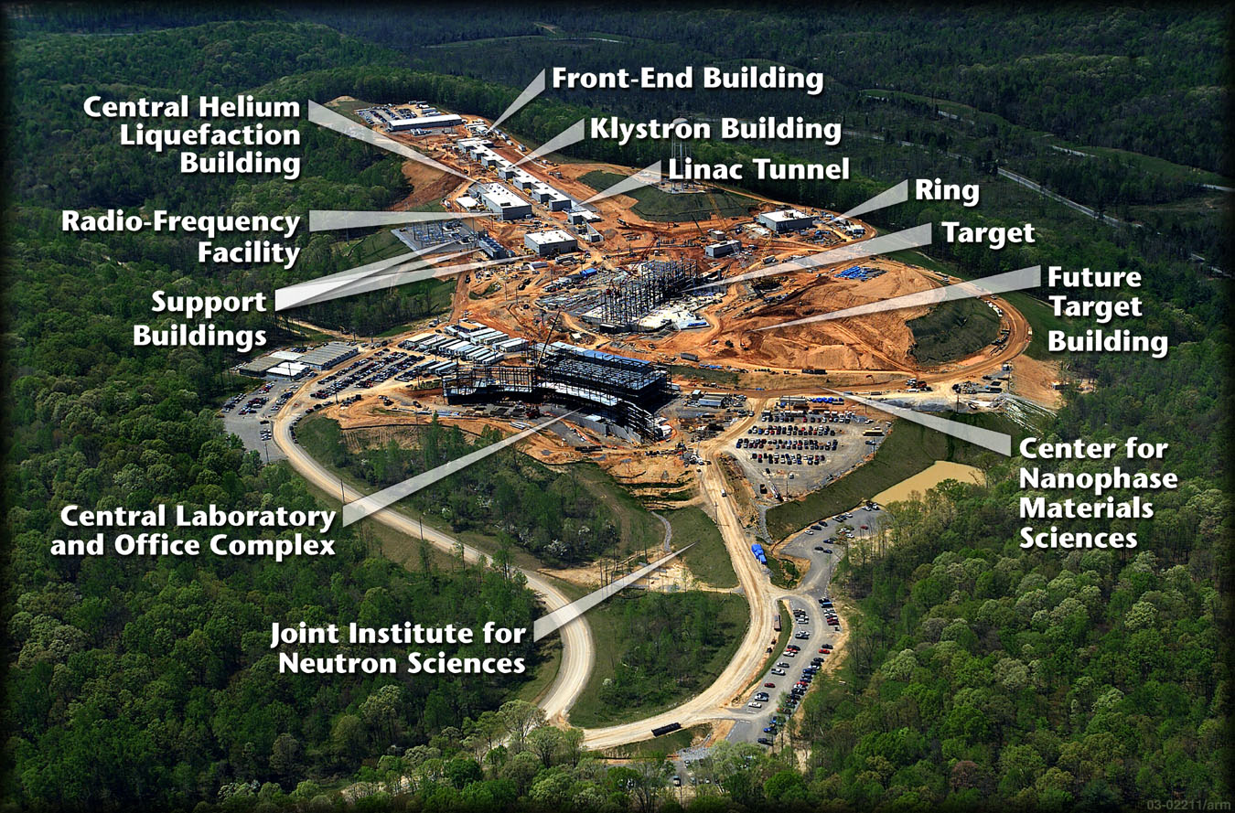
Present status
First beam - 2006, full power - 2008

Slide 7
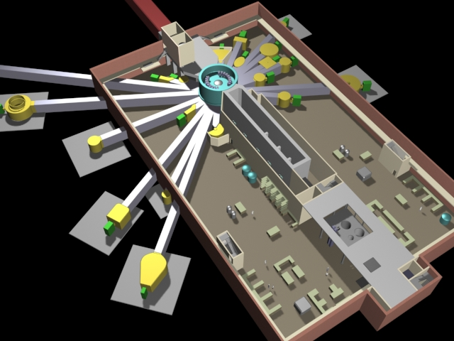
Target building
Proton Beam
~ 60 m

Slide 8
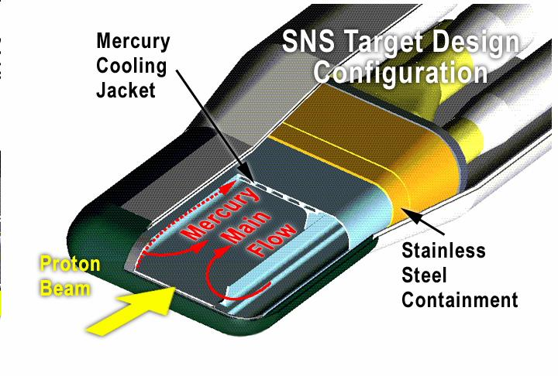
Mercury target
Mercury Inventory – 20 t
Flow rate 340 kg/sec
V_{max} 3.5 m/sec
T_{in} 60⁰C
T_{out} 90⁰C
21 cm
1.3 GeV
Mercury lasts the entire 40 year lifetime of SNS with no change out required
Stainless steel vessel should be replaced a few times per year

Slide 9
Neutrino Production
ν_{μ}
ν_{μ}
π⁺
μ⁺
Hg
0.13
ν_{e}
e⁺
0.09
p
π⁻
Capture
99.6%
SNS
ISIS, LANSCE

Slide 10
Comparison of SNS with others stop pion facilities
Facility | LANSCE | ISIS | SNS | SNS Advantage
Beam energy | 0.8 GeV | 0.8 GeV | 1.3 GeV | 1.7
Beam current | 1.0 mA | 0.2 mA | 1.1 mA
Coulomb delivered per year to the target | 6500 (LSND) | 2370 (KARMEN) | 22000 | 10÷3.5
Beam structure | Continues | Two 200 nsec bunches separated by 300 nsec repetition rate - 50 Hz | 380 nsec FWHM pulses at 60 Hz | Separation ν_{μ} from ν_{e}, better BG suppression
Target | Various | Water cooled Tantalum | Mercury | Source compactness

Slide 11
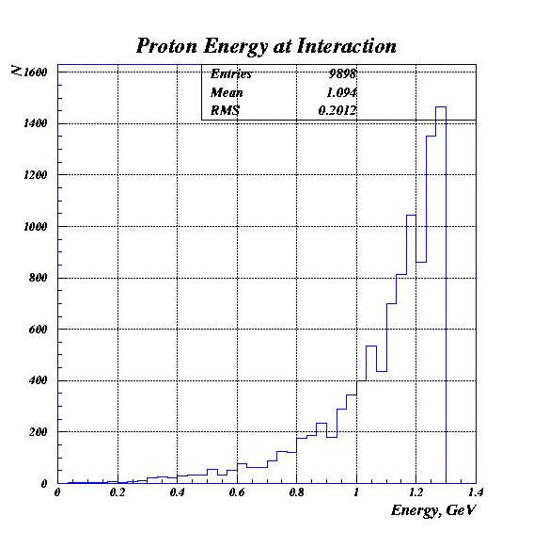
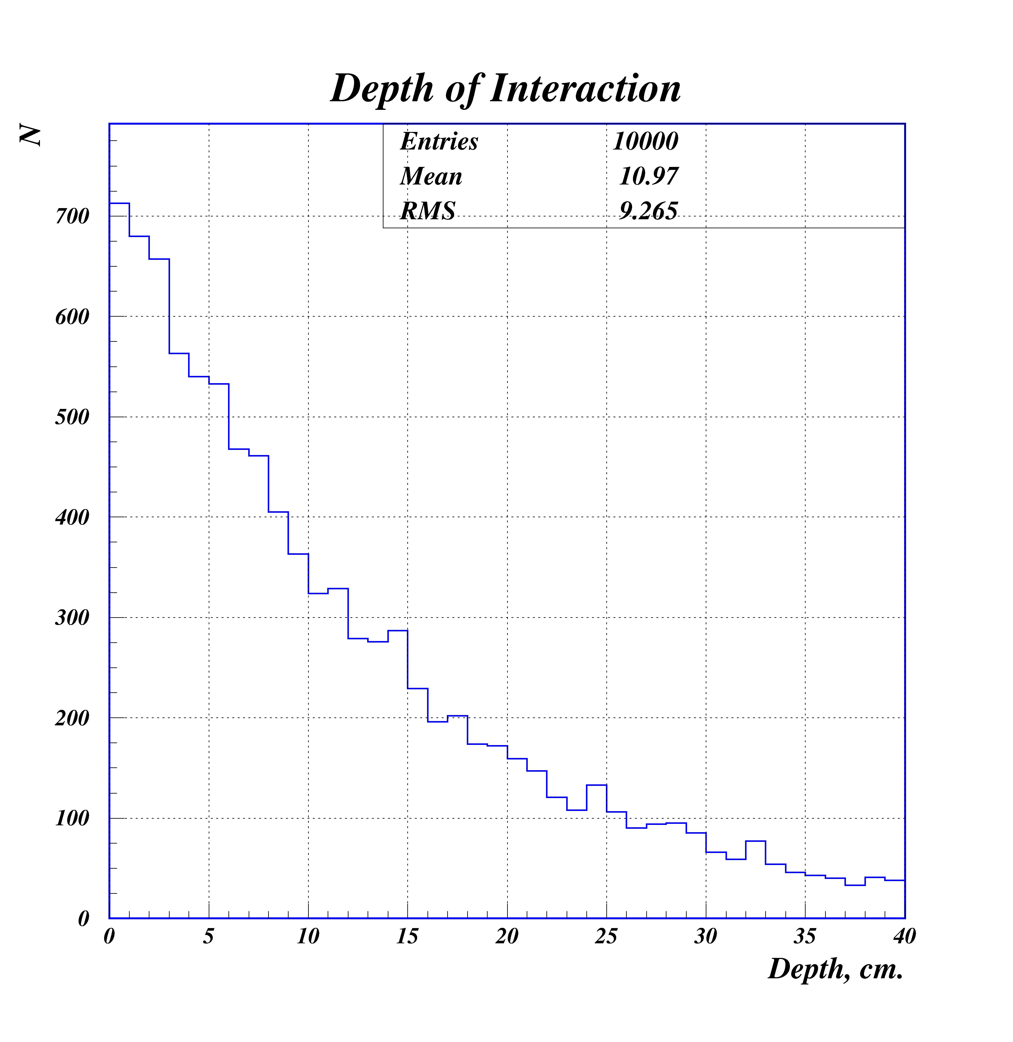
Some Details of Interaction in the Target
Average interaction energy is ~1.1 GeV
Average interaction depth ~11 cm
Proton interacts at the front part of the target

Slide 12
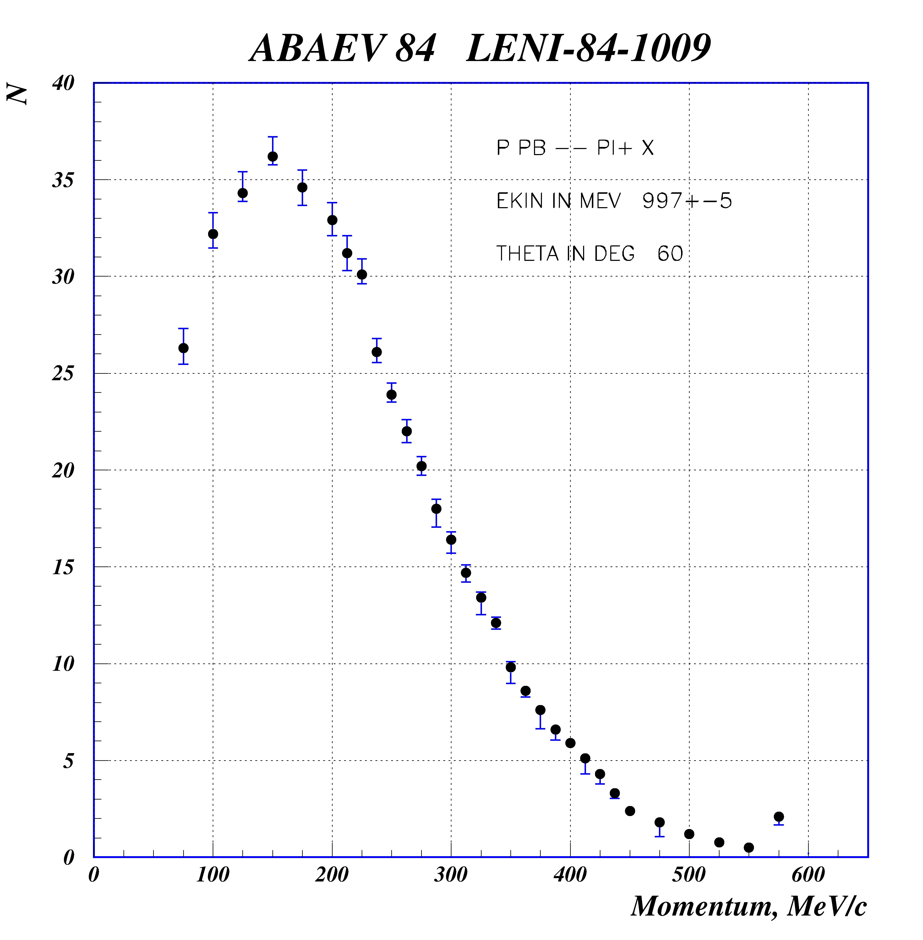
DIF vs. DAR
Pion Spectra
200 MeV/c pions range in mercury is ~ 5 cm
Very few pions have a chance to decay before coming to the rest
Because of the bulk Mercury target, SNS is a Decay At Rest facility !!

Slide 13
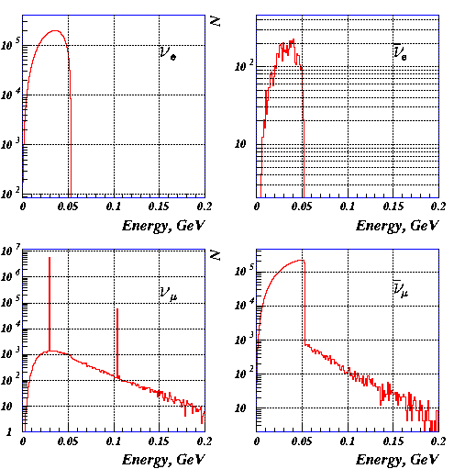
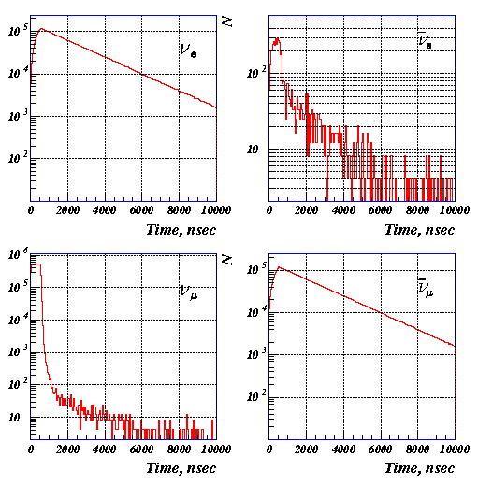
Actual spectra of neutrinos from SNS
Neutrino spectra well defined in SM
ν_{e} and ν_{μ} are in the different time intervals
Energy Time

Slide 14
Neutrino Rates
Number of protons on the target for 1.1 mA is 0.687·10¹⁶ sec⁻¹
Number of each flavor neutrino produced by one proton is 0.13
Lets assume SNS live time is 2/3 of the year
Number of each flavor of neutrinos produced at SNS is 1.9·10²² year⁻¹
Caveat:
There is larger flux of antineutrinos from decay of radioactivity in the target
However: their energy is a few MeV

Slide 15
Cross Sections
Reaction
ν_{e}e⁻ → ν_{e}e⁻
ν_{μ}e⁻ → ν_{μ}e⁻
ν_{e}¹²C → ¹²N_{gs} e⁻
ν_{e}¹²C → ν_{e} ¹²C*
ν_{μ}¹²C → ν_{μ}¹²C*
ν_{e}⁵⁶Fe → ⁵⁶Co e⁻
Integrated Cross Section
0.297⋅10⁻⁴³ cm²
0.050⋅10⁻⁴³ cm²
0.92⋅10⁻⁴¹ cm²
0.45⋅10⁻⁴¹ cm²
0.27⋅10⁻⁴¹ cm²
~2.5⋅10⁻⁴⁰ cm²
SNS will deliver ~ 1.9·10²² neutrinos per year

Slide 16
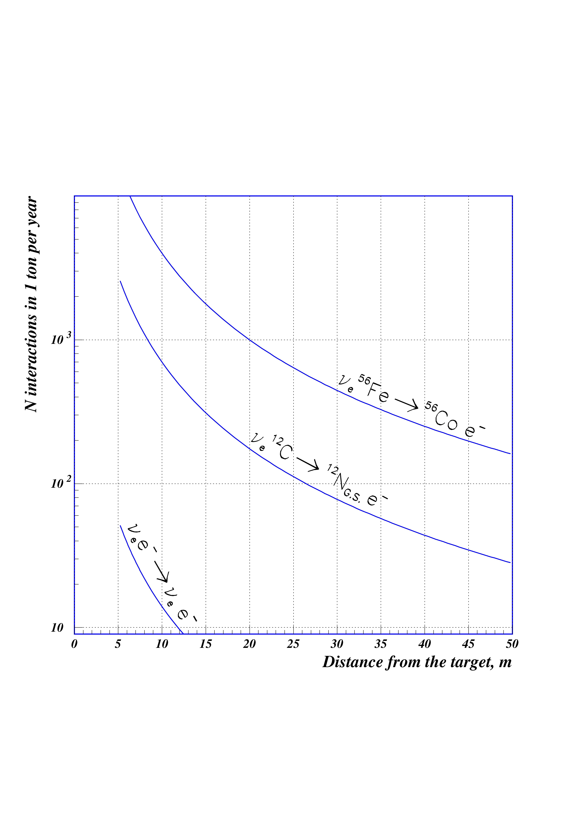
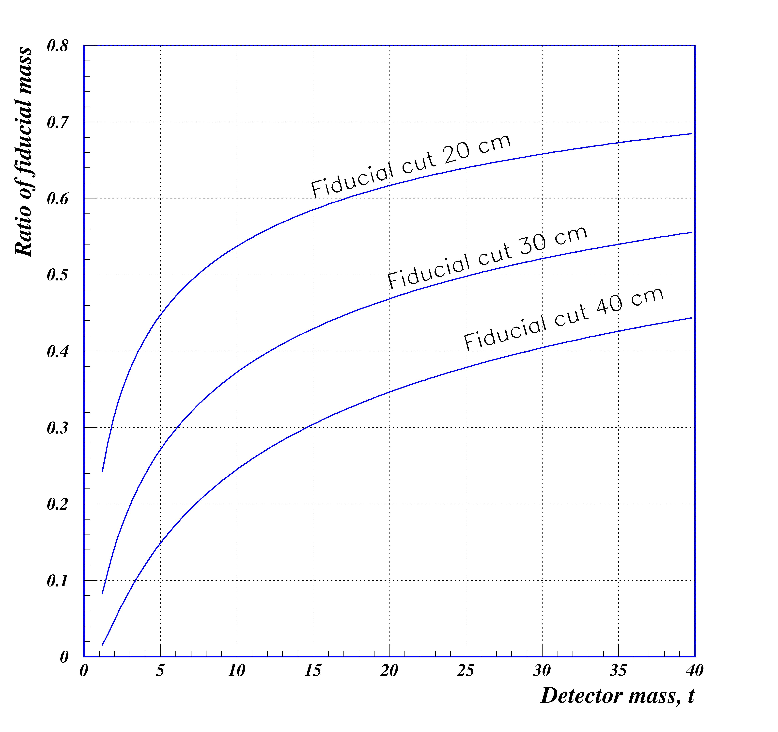
Necessary detector mass
Time measurement ~ 1 Year, statistics 1000 events
Neutrino interactions
One should take into account: efficiency and fiducial mass
Efficiency ~ 30 %
Fiducial mass
KARMEN
LSND
Target mass - 10-20 t

Slide 17
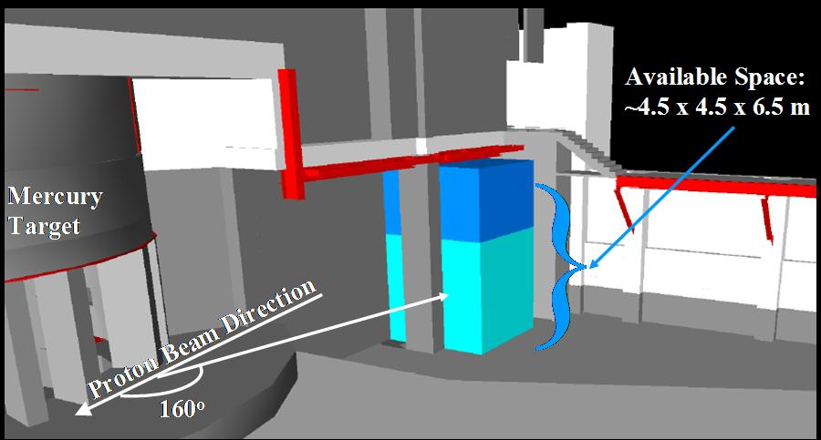
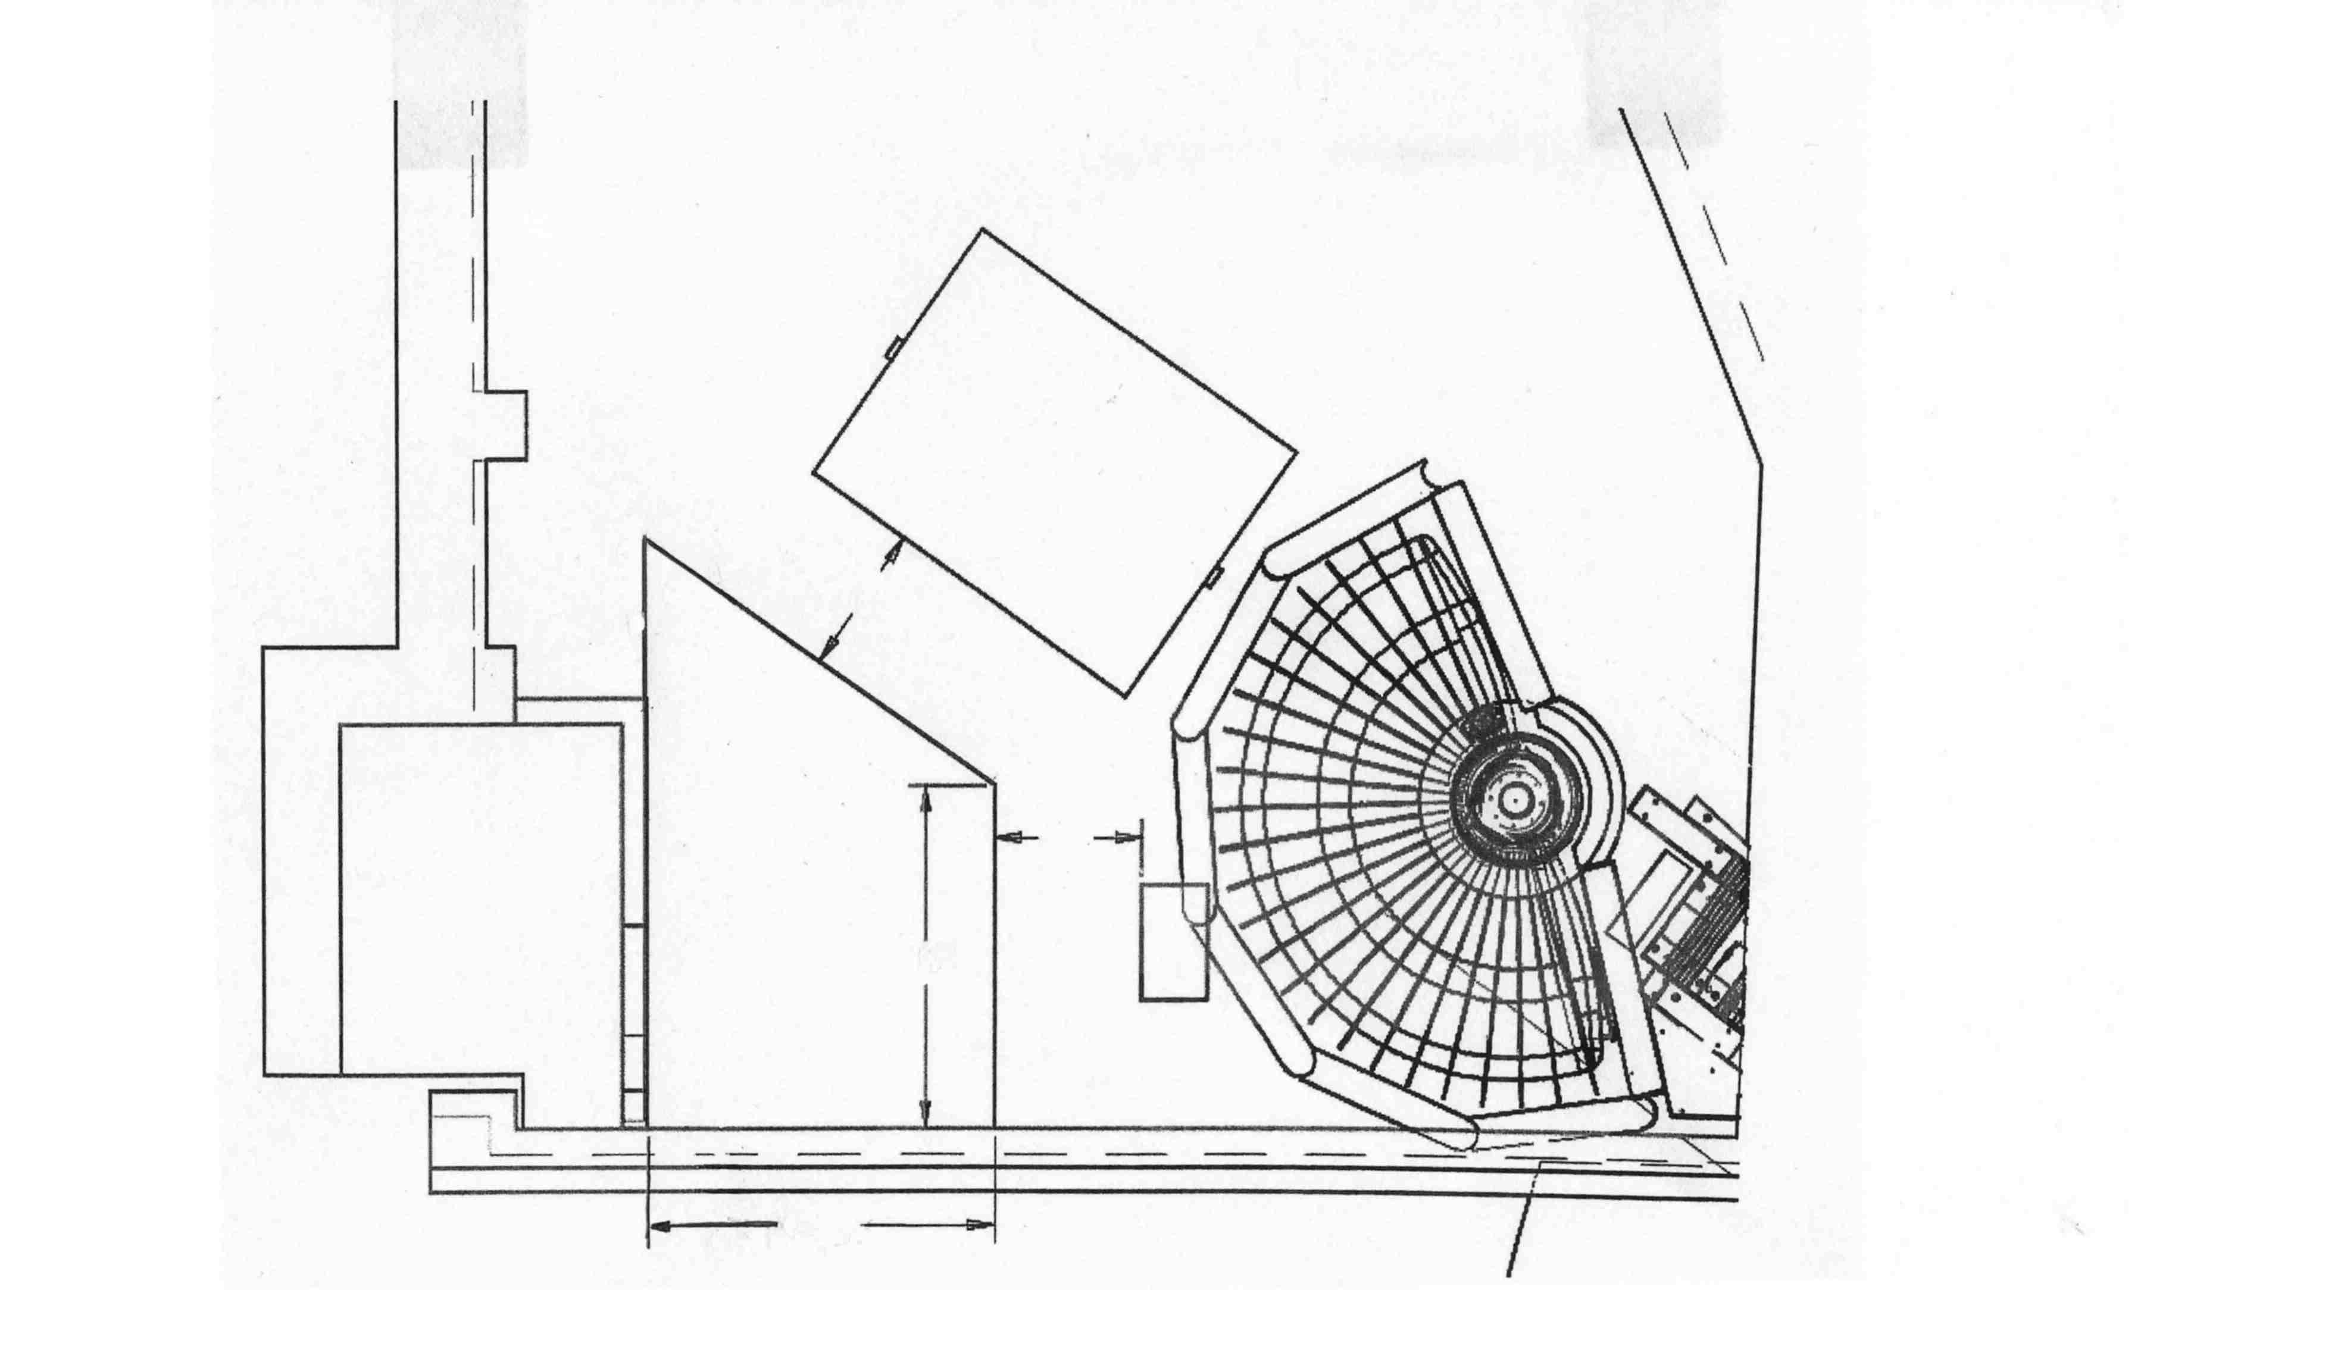
Possible detector location
1.7 m
Space
Allocated
For
Neutrinos
6.3 m
1.7 m
Target Monolith
18.3 m
170⁰
Target
4 m
Proton Beam

Slide 18
Limiting Factors
Time to build – it looks like any time is feasible. SNS at full power - 2008
Distance from the target – 18.3 ÷ 22 m
Available foot print ~ 4·6 m²
Available head room – 6-7 m
Detectors and Shielding mass – Floor loading limitations
BG from SNS – Initially looks OK. Need more study

Slide 19
Targets
One objective of this workshop is to establish a shopping list of targets
In addition we need:
to set priorities for target studies
to know how accurately we have to measure cross sections
Is following list is good enough to start with?
²d, ¹²C, ¹⁶O, ¹²⁷I, ⁵¹V, ²⁷Al, ⁹Be, ¹¹B, ⁵²Cr, ⁵⁶Fe, ⁵⁹Co, ²⁰⁹Bi, ¹⁸¹Ta

Slide 20
Two detector concept
To have maximum flexibility to measure variety of various isotopes we suggest a two detector concept
Homogeneous – for targets that can be made in liquid (transparent) form
Heterogeneous – for all other targets

Slide 21
Homogeneous detector
Hermetic vessel with capability of good photon collection
~ 15 t fiducial mass
Liquid targets
²d, ¹²C, ¹⁶O, ¹²⁷I
Scintillation / Cherenkov detector
3 m

Slide 22
Questions for the Homogeneous detector
Shape - rectangular vs. Spherical
Photon detectors – PMT vs. PD or APD
Necessary energy and space resolution
Photon detector coverage?
Directionality
Number of electronic channels
Requirements for electronics and DAQ
PID capability
Purification system
Cost

Slide 23
Heterogeneous detector
Designed to handle metals or other solid targets
⁵¹V, ²⁷Al, ⁹Be, ¹¹B, ⁵²Cr, ⁵⁶Fe, ⁵⁹Co, ²⁰⁹Bi, ¹⁸¹Ta
Requirements:
Targets should be easily replaceable
Mass of the sensitive part of the detector should be less than target mass
Modular structure

Slide 24
Heterogeneous detector II
Active detector – straw gas tubes
Energy measurement - by range
e
Expected energy resolution for tubes 10mm and 0.5 mm at 30 MeV is ~ 25%
Detector size for 20 t fiducial mass is – 3.0 ⋅ 2.3 ⋅ 2.3 m³
Number of channels ~50000

Slide 25
Questions for the Heterogeneous detector
Is it the right technology
Is energy resolution is good enough
How easy/fast is it to replace targets
Can we achieve good 3 dimensional resolution
PID
Number of electronic channels
Requirements for electronics
How complicated is a gas system ?
Cost

Slide 26
Proposed enclosure
S
Shielding
Veto
Detector 2
Detector 1

Slide 27
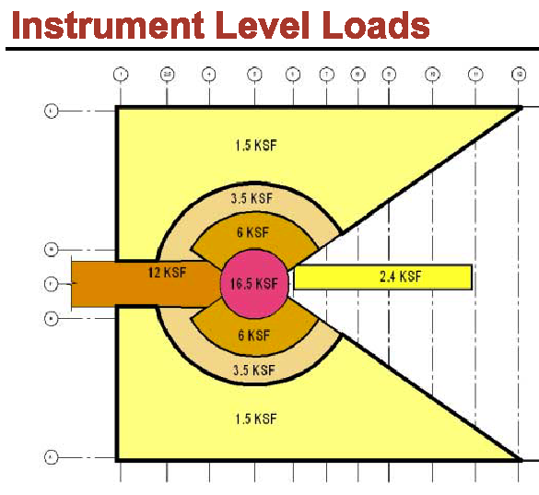
Detectors + Shielding Mass
Footprint under enclosure can support only 138 t.
= 6.7 t / m²
For the reference:
Karmen Detector - 57t
Shielding - 7000t
We can get a few credits:
there is 2 m less in concrete slab thickness because the footprint is in the pit
we can distribute the weight around
According to Initial estimations: we can have – 380 t
It is preliminarily OK with SNS engineers, however serious structural analysis is required

Slide 28
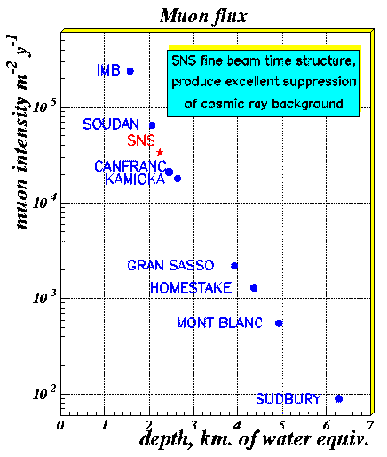
Cosmic rays BG estimation
SNS duty factor is 4⋅10⁻⁴
This effectively reduce flux to 10⁵ muons and ~600 neutrons per day entering enclosure
We need one meter of steel overburden to reduce hadronic component of atmospheric showers
and
hermetic veto with efficiency of 99%
Our estimations shows that expected number of untagged neutrons events in the detector is a few per day.
This is below expected neutrino event rates
Extra factor is expected from PID in detectors.

Slide 29
SNS induced BG
Most dangerous B.G. is from SNS neutrons
Analysis is complicated because many uncertainties still exist.
We know for sure that environment is OK for humans.
However neutrinos detectors are much more sensitive then humans!
We considered three major sources:
1.7 m
From the neutron instruments
6.3 m
Space
Allocated
For
Neutrinos
1.7 m
Target Monolith
18.3 m
4 m
Target
Proton Beam
From the tunnel

Slide 30
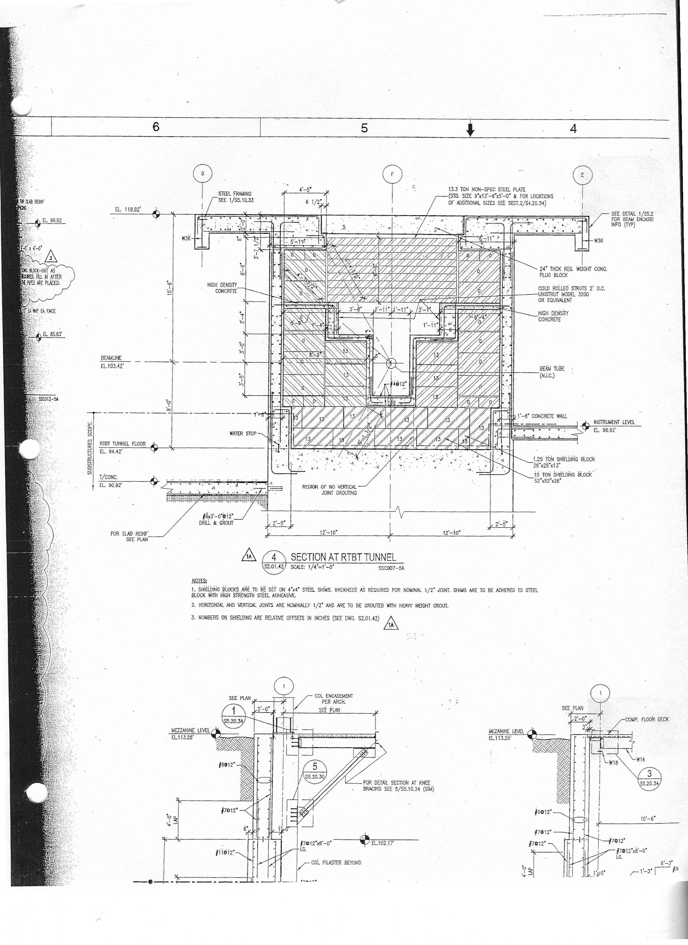
Proton beam tunnel (HETB) cross cut
Neutrino
enclosure
3.6 m of steel
Beam

Slide 31
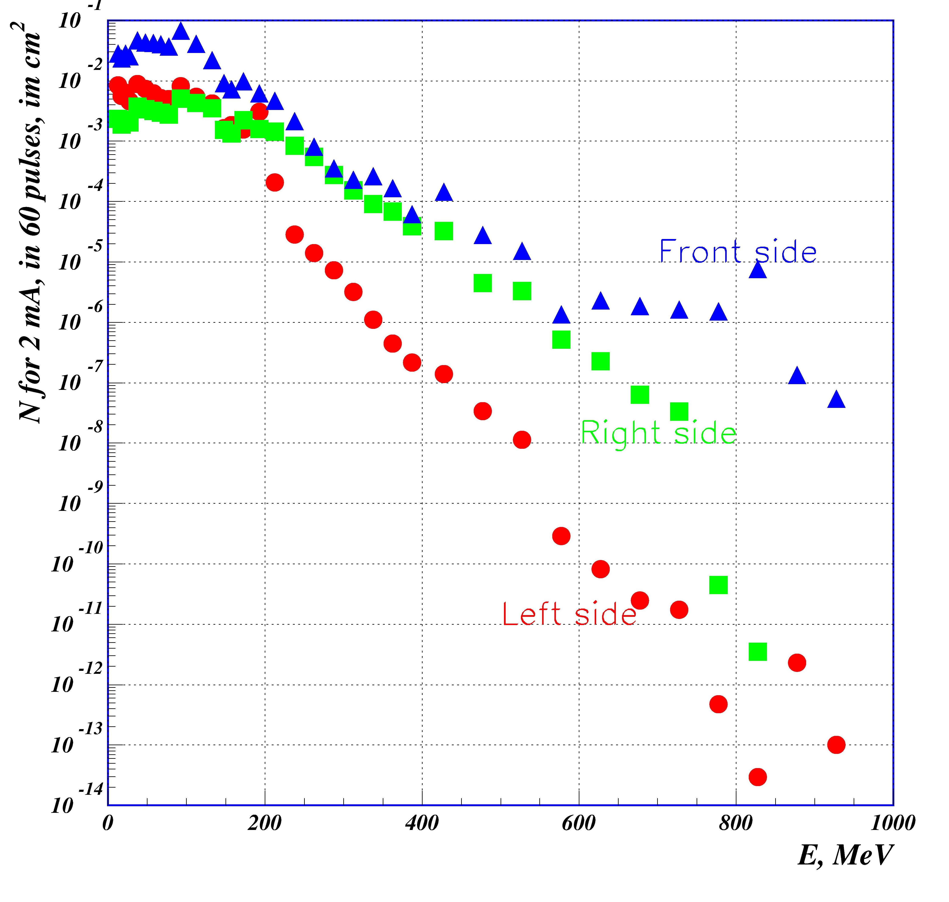
SNS induced neutron flux
High energy neutrons
can be eliminated using time cut
To reduce low energy neutrons (neutron gas), extra shielding and neutron absorbers are required
PID from detectors is welcome
This is a very conservative estimations

Slide 32
Shielding and detectors mass
Our initial assessments shows:
We need 1 m of steel shielding on the top
And at least 0.5 m from the front the and right sides + some structural from the left and from the back
This gives us ~ 340 tons for shielding and 40 tons for detectors.
Total 380 tons looks OK, however there is no margin
Need very diligent BG simulations, and careful engineering !!!

Slide 33
Possible Schedule
Formal Proposal to DOE - January 2004
Detectors R&D and design - 2004 - 2006
Detectors Construction - FY 2006 - 2007
Shielding Enclosure Erection - 2007
Detectors Installation Completed - Spring 2008
Detectors Commissioning- Summer 2008.

Slide 34
Conclusion
We have a good opportunity to start a program to use neutrinos from world most powerful intermediate energy neutrino source to collect unique data
Nuclear, Astrophysics, and Particles Physics communities need this data
Lets do it !!!

