Slide 1
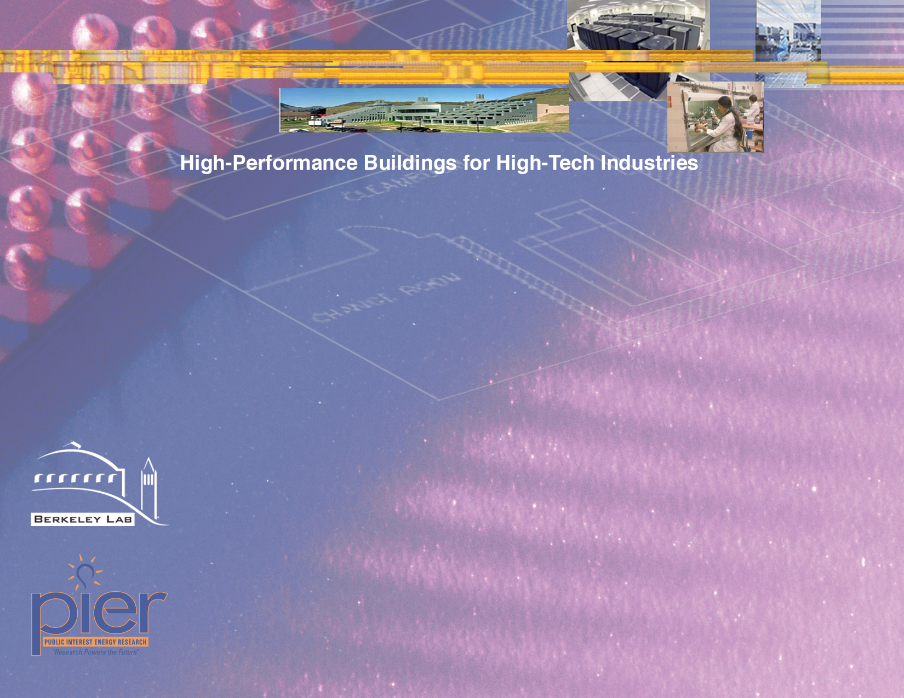
DATA CENTER RESEARCH AT THE
LAWRENCE BERKELEY NATIONAL LABORATORY
7x24 EXCHANGE 2004 FALL CONFERENCE
Steve Greenberg
segreenberg@lbl.gov
Lawrence Berkeley National Laboratory
Sponsored by: Public Interest Energy Research (PIER)
California Energy Commission and administered by
California Institute for Energy Efficiency (CIEE)
10-18-04
Page <number>

Slide 2
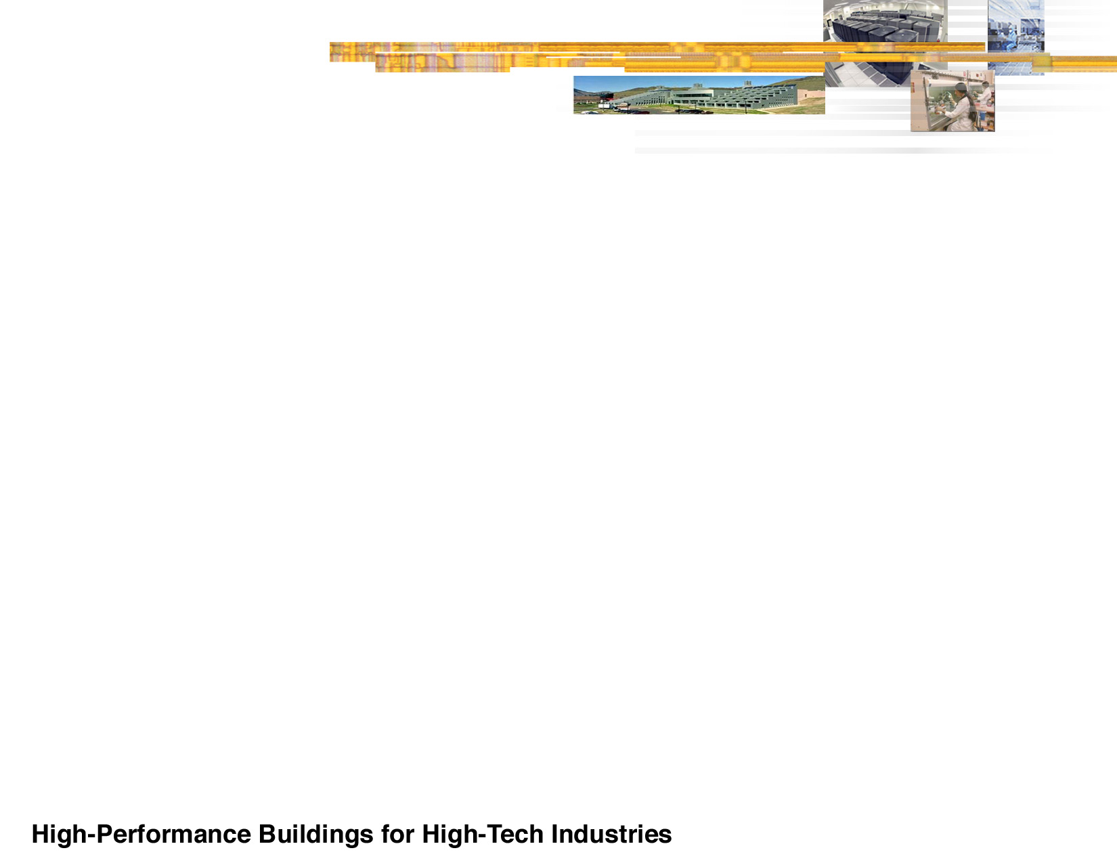
Overview
Acknowledgements
California Energy Commission
Pacific Gas and Electric Company
7 x 24 Exchange
Uptime Institute
Critical Facilities Round Table
EYP Mission Critical Facilities
Rumsey Engineers
RMI
E Source
Industry Partners (Too many to name all)

Slide 3
Overview
Energy Intensive High-tech Buildings
Cleanrooms
Laboratories
Healthcare
Data Centers

Slide 4
Overview
We also operate data centers…

Slide 5
Overview
Why Look at Data Centers?
Utilities were receiving requests for unrealistic power densities
A lot of misinformation was circulating
Large continually operating base loads
Other High-Tech buildings energy efficiency opportunities were very large
Technology improvements are transferable to other building types

Slide 6
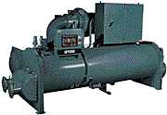
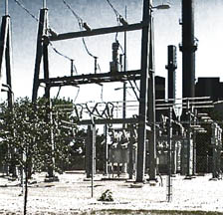
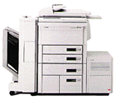
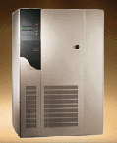
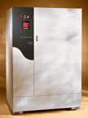
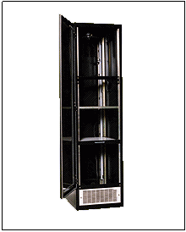

Overview
Electricity Flows in Data Centers
HVAC system
local distribution lines
lights, office space, etc.
uninterruptible
load
to the building, 480 V
computer
equipment
UPS
PDU
computer racks
backup diesel generators

Slide 7
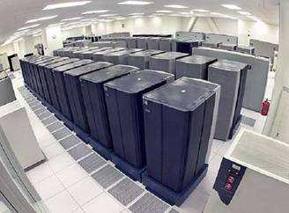
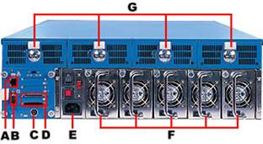
Overview
Current Data Center Research Activities
  Benchmarking and Best Practices
    Load intensity
    Performance Benchmarks
    Self-benchmarking Protocol
  Investigate UPS Efficiency Improvement
  Investigate Power Supply Improvement
  Demonstration Projects
  Technology Transfer

Slide 8
Benchmarking
Current Benchmarking Work
Benchmark (measure) energy use in 6-10 additional data centers
Solicit additional benchmarks
Identify and analyze better performing systems and document in “Best Practices” summary
Develop self-benchmarking protocol

Slide 9
Benchmarking
Data Center Benchmarking
Both LBNL and Uptime Institute found average IT equipment loading at ~25 W/ft²

Slide 10
Benchmarking
Projecting Computing Load
When Fully Loaded
(W/Sq.Ft. of electrically active floor space)

Slide 11
Benchmarking
Data Center Benchmarking

Slide 12
Benchmarking
Chiller Comparison
Average 0.75

Slide 13
Benchmarking
Total Chilled Water System Efficiency
Average 1.69

Slide 14
Benchmarking
Standby Generation Loss
  Several Sources
    Heaters
    Battery chargers
    Transfer switches
    Fuel management systems
  Heaters alone (many operation hours) use more electricity than produced by the generator (few operating hours)
  May be possible to eliminate heaters, batteries, and chargers

Slide 15
Benchmarking
Common Findings
Humidity Control and CRAC unit fighting
Lighting Control
Air side Economizing
Variable Speed Drives – pumps, chillers, fans
Control strategies - setpoints, cooling tower staging
High ceilings important with Underfloor (thermal stratification)
Air management common problem
Low UPS loading

Slide 16
Benchmarking
Follow-up Audits
We are contacting prior benchmark sites:
7 sites interviewed to date
60 total measures recommended, ranging from O&M lighting to new UPSs or chillers
20 completed, 7 planned
No estimates of savings to date

Slide 17
Benchmarking
Conclusions from follow-up:
Measures weren’t completed for various reasons, from
economic downturn to operational constraints
Savings difficult to estimate (instrumentation, masking)
Further follow-up with other centers and estimated savings will be pursued

Slide 18
Benchmarking
General Recommendations
Benchmark to know where you stand
Life-cycle cost analysis
Facilities partnership with IT professionals
Evaluate Load Spreading vs Compaction

Slide 19
Benchmarking
Available benchmark data?
Sources of other benchmark data?
Please contact LBNL:
    - Steve Greenberg: segreenberg@lbl.gov
    Bill Tschudi: wftschudi@lbl.gov
    Project site: http://hightech.lbl.gov

Slide 20
Benchmarking
Future Direction
Develop concensus on performance benchmarks, collect data, quantify energy savings potential
Incorporate other industry benchmark data

Slide 21
UPS Systems
Current Work on UPSs
Determine the range of current UPS efficiencies, highlight more efficient designs, and provide a means for comparing their total cost of ownership (TCO).
Propose a new efficiency specification for UPSs that could be considered by Energy Star and other third-party efficiency labeling organizations.
Conduct a scoping study to analyze the energy efficiency savings potential and performance of a complete DC power architecture for data centers

Slide 22
UPS Systems
UPS System Benchmarking

Slide 23
UPS Systems
Progress Update
Completed technical review of efficiency versus load (based on specification) for current generation static and inertial UPS topology.
Based on review of more than 100 static UPS models

Slide 24
UPS Systems
UPS Measured Performance
Sample of 12 field measurements.

Slide 25
UPS Systems
Measuring UPS efficiency to show impact of “high efficiency” option.
Measured Result
Manufacturer Spec
On average, existing high efficiency modes can make a 4 to 5 % difference in UPS efficiency.

Slide 26
UPS Systems
Analyzing UPS performance in “high efficiency” option.
In “high efficiency” mode, there can be one cycle
(16.6 msec for 60 Hz) of voltage deviation on the output of the UPS. Power supplies downstream of the UPS can ride through this.

Slide 27
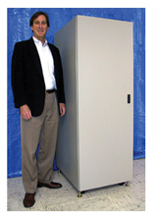
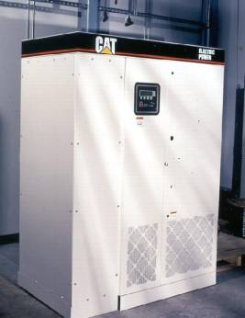
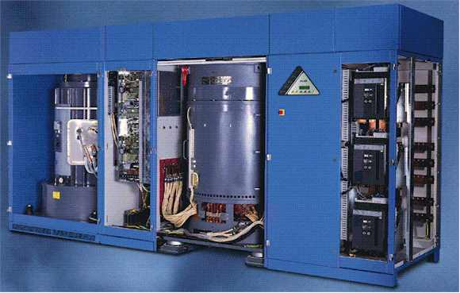
UPS Systems
Progress Update
Researching high efficiency inertial units currently available in the market.
Caterpillar
Piller
Pentadyne
Quoted efficiencies are in the 96% range and higher; we will be collecting field/lab test data to quantify the efficiency of inertial UPS systems; advantages of non-battery alternatives could also be significant based on manufacturer spec.

Slide 28
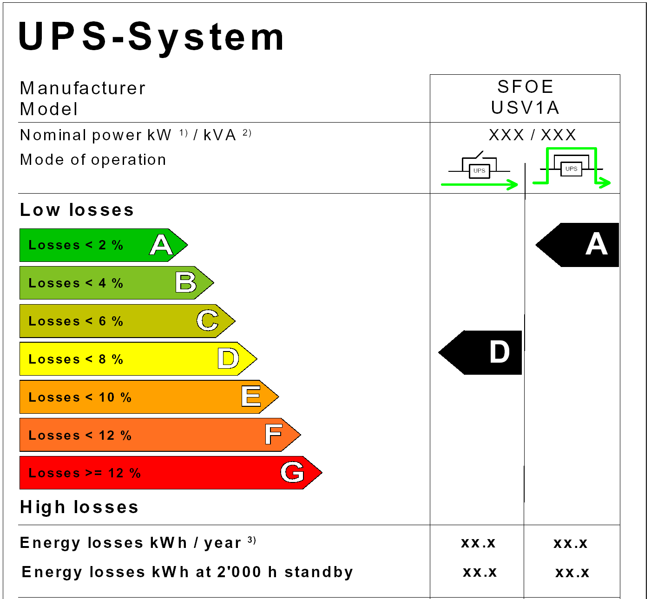
UPS Systems
Labeling
Efficiency and Reliability
  Data collection protocol.
  Technical review of efficiency versus load (based on specification) for current generation static and inertial UPS.
  Simplified calculation tools for comparing AC powering versus DC powering and evaluation of cost savings for higher efficiency UPS.
  Testing of UPS to show impact of “high efficiency” option on static UPS
  Coordinating with International labeling effort for quality & efficiency.
Possible UPS Efficiency Labeling Criteria

Slide 29
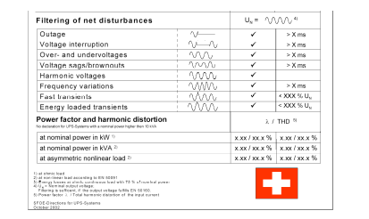
UPS Systems
Progress Update: UPS Q/E Matrix

Slide 30
UPS Systems
Future Direction
Sponsor for rack level demonstration of DC powering architecture
Sponsor for high efficiency static or rotary UPS technology demonstration
Identify “host” for UPS Q/E matrix in US
Participate in European Code of Conduct meeting and any potential IEC standard activity for harmonizing UPS efficiency standard

Slide 31
Power Supplies
Current Power Supply Work
Document efficiencies of current server power supplies
Field testing to document achievable energy savings
Recommend new efficiency levels to Server System Infrastructure Initiative (SSI) for consideration
Assess other PS saving opportunities in DC applications

Slide 32
Power Supplies
Power Supplies in IT Equipment

Slide 33
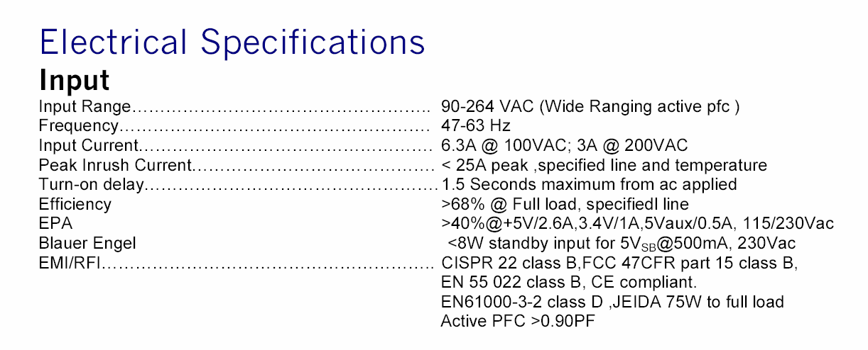
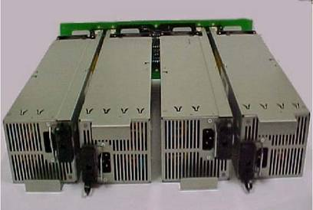
Power Supplies
Power Supplies in IT Equipment

Slide 34
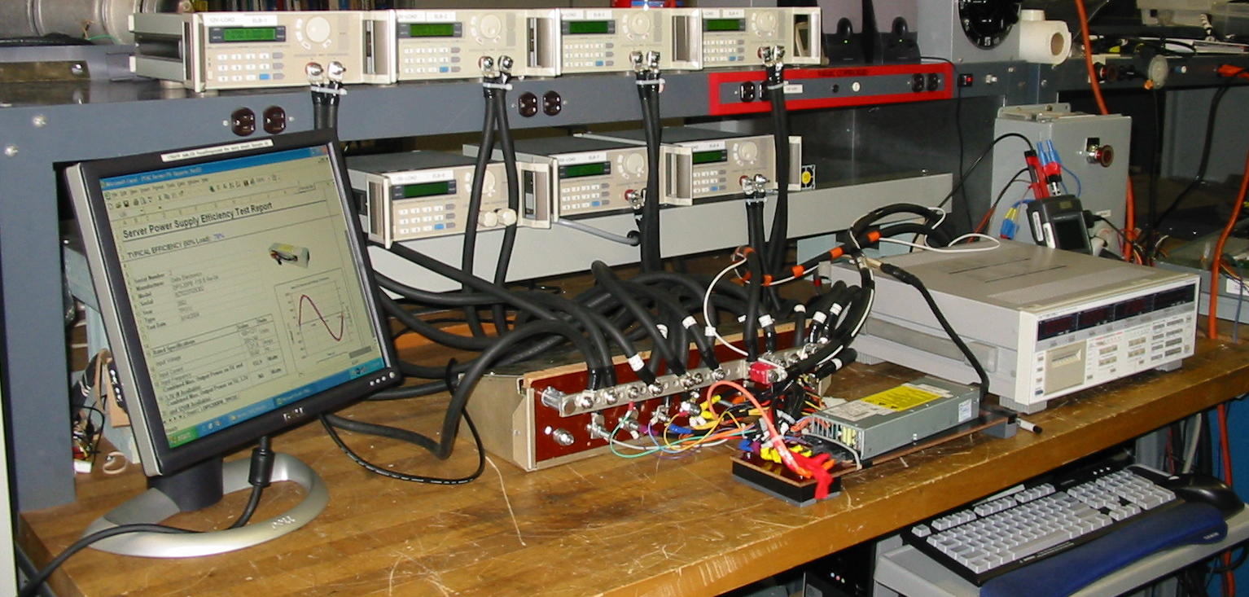
Power Supplies
Progress Update: Server Power Supply Efficiency Lab Test Setup
Electronic Load Banks
Fluke 41 Power Harmonic Analyzer
Yokogawa Digital Power Meter
Power Supply Load Test Fixtures
Computer Interface
Server Power Supply

Slide 35
Power Supplies
A consistent test protocol, loading guideline & test report format will allow more visibility on power supply efficiency
Progress Update: Sample Power Supply Test Report

Slide 36
Power Supplies
Progress Update: How Loaded are the Server Power Supplies?

Slide 37
Power Supplies
Progress Update: Power Supply Loading Versus Redundancy
Versus

Slide 38
Power Supplies
Power Supply Efficiency
  Developed loading guidelines and test protocol for testing AC/DC power
  supplies for 1U, 2U and pedestal servers.
  Calculation tool for evaluating impact of improving power conversion process efficiency at rack level.
  Coordination with Server System Infrastructure (SSI) members to adopt loading guidelines and recommend higher efficiency levels for server power supplies.
  Evaluate “real life” server PS loading level and processor usage activity for servers.

Slide 39
Power Supplies
Power Supply Efficiency
Very Low Processor Activity…
…does not relate to very low power consumption
Most of the time the GHz processor is doing activities that can be done by a MHz processor but the input power consumption is not changing much

Slide 40
Power Supplies
Future Direction
A more focused and broader assessment of:
  Server activity profile based on application/server type
  Correlation of server activity and power consumption
Develop industry interest and support for benchmarking for energy efficiency
Develop efficiency guidelines based on performance metrics

Slide 41
Demonstrations
LBNL’s Role in Demonstrations
Scoping demonstrations of technologies or strategies to improve energy efficiency in high- tech buildings
Showcase New/Emerging or Under-utilized Technologies or Approaches

Slide 42
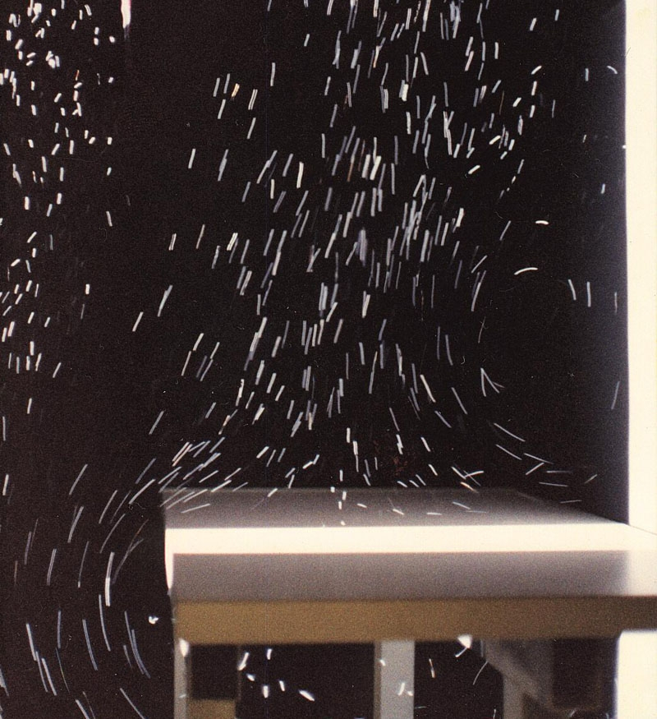
Demonstrations
Potential demonstrations for Data
Centers:
    Airflow visualization via helium bubbles
    Combined Heat and Power
    UPS efficiency improvement

Slide 43
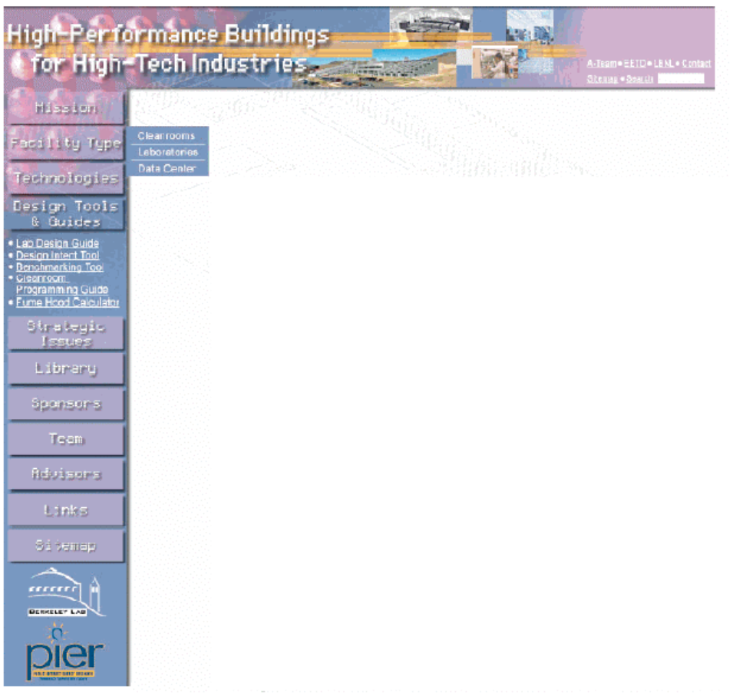
Technology Transfer
LBNL portal
Website:
  http://hightech.lbl.gov

Slide 44
Thank you
Questions?
10-18-04
Page <number>

