Slide 1

NDFD Status
What’s new and what’s coming
David Ruth
Meteorological Development Laboratory
IFPS Methodology Workshop II

Slide 2
NDFD general weather elements (per draft 10-506)
Experimental Group 1 (December – March)
  Max/min temp
  PoP12
  Weather
  Sky cover
  Wind direction
  Wind speed

Slide 3
NDFD general weather elements (per draft 10-506)
Experimental Group 2 (April – June)
  Temperature
  Dewpoint
  Precipitation amount
  Snow amount

Slide 4
NDFD general weather elements (per draft 10-506)
Developmental
  Relative humidity
  Apparent temperature
  Floating PoP12
  Wind gust

Slide 5
NDFD fire weather elements (per draft 10-506)
Max/min relative humidity (planned)
20 ft wind (developmental)
Lightning Activity Level (planned)
Mixing height (dropped from draft)
Transport wind (dropped from draft)
Haines index (dropped from draft)

Slide 6
NDFD marine elements (per draft 10-506)
Wave height (experimental group 1)
Swell height (dropped from draft)
Swell direction (dropped from draft)
Visibility (planned)
Ice coverage (dropped from draft)

Slide 7
NDFD Consistency
What’s new
  Adjacent versus coincident points
  Points excluded for elevation differences >1000 ft
  Points excluded that cross marine boundaries
  WFO scores weighted by border length
What’s coming
  WFO-specific summary pages
  Sortable reports using PHP
  WFO scores grouped according to spatial and temporal variability

Slide 8
NDFD Timeliness
What’s new
  Update page refreshed every 10 minutes
What’s coming
  WFO-specific summary pages
  Sortable reports using PHP
  Grid message receipts

Slide 9
NDFD Verification
What’s new
  Point verification using NDFD gridpoint nearest observation
    Max/min Temp, PoP12, Temp, Dewpoint, Wind Speed
  Gridded verification using RUC 20km analysis
    Temperature
  Scores updated and posted monthly
  Scores can be downloaded for local analysis
What’s coming
  Point verification for all NDFD elements
  Gridded verification using ADAS

Slide 10
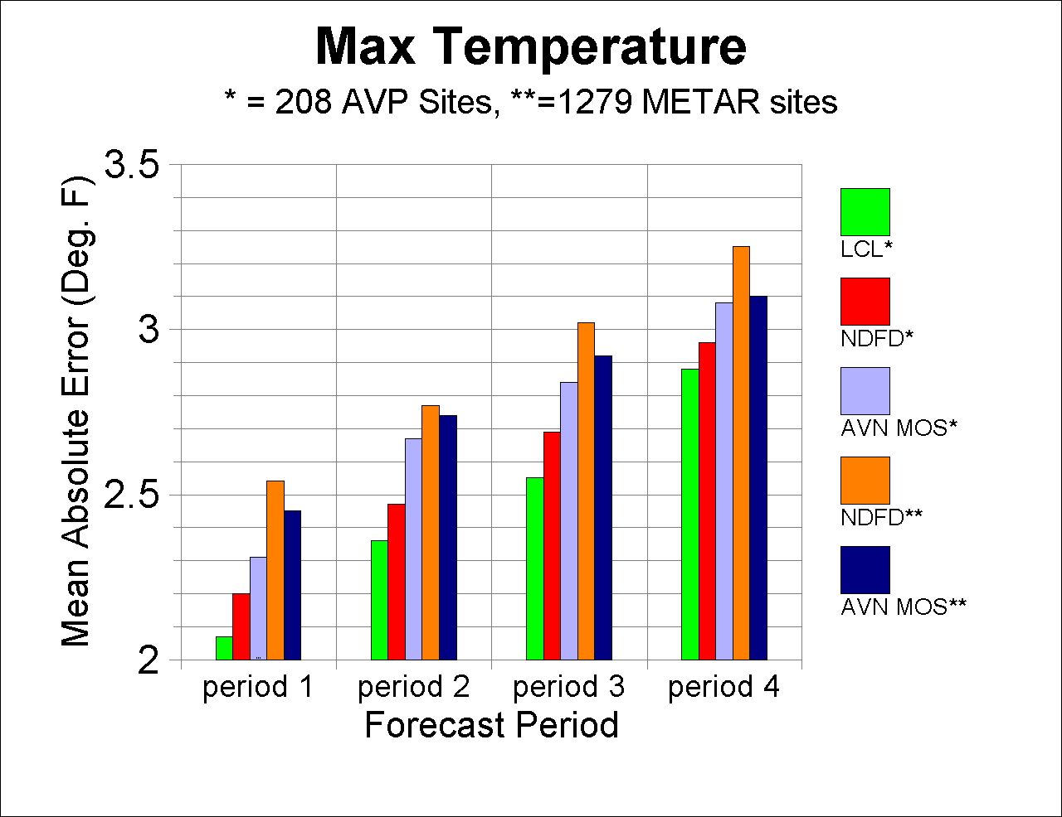
NDFD ORD verification

Slide 11
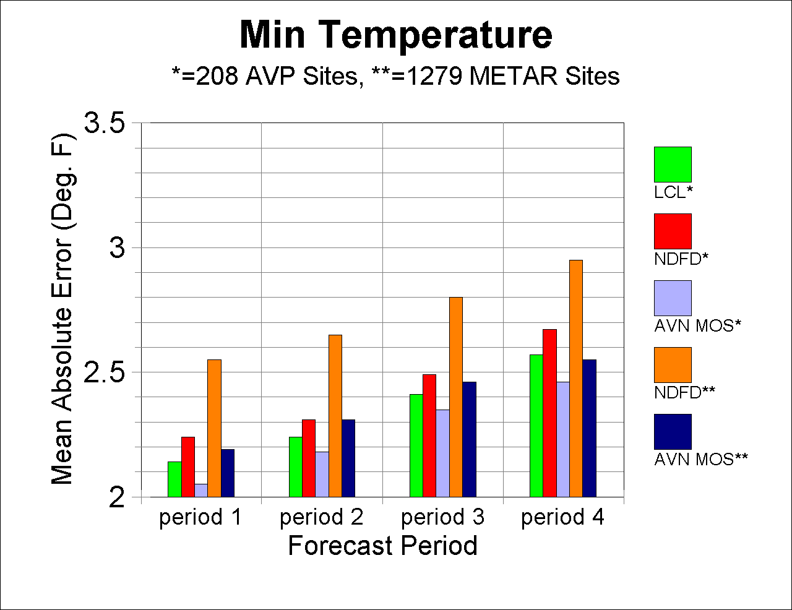
NDFD ORD verification

Slide 12
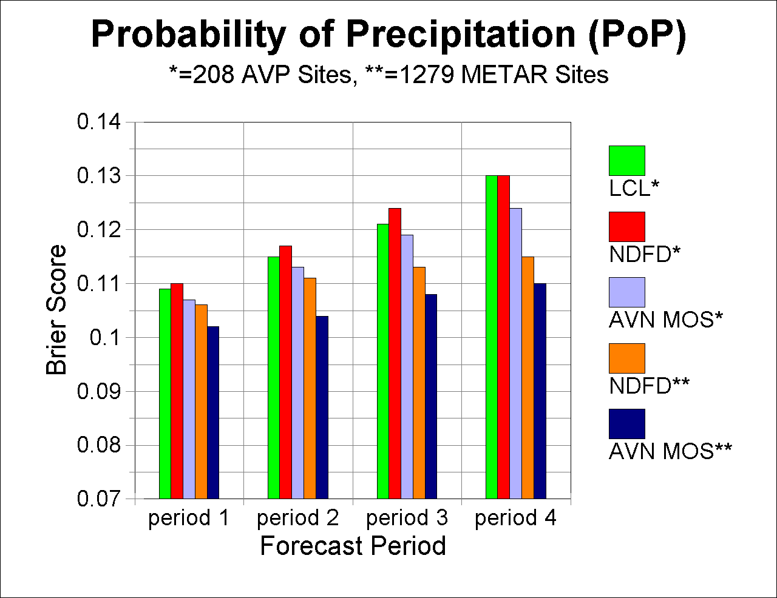
NDFD ORD verification

Slide 13
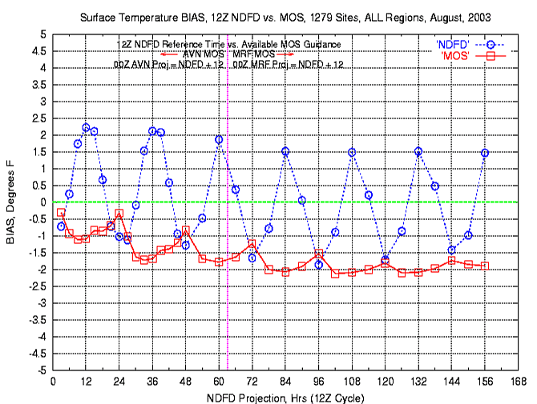
NDFD temperature bias

Slide 14
Opportunities for MDL
Produce high-resolution statistical guidance on NDFD grid
Use ensembles to produce forecast uncertainty information
Exploit emerging high resolution climate databases
Monitor NDFD and new model guidance
  develop statistical techniques that identify areas/times ripe for a “bust”
  identify most relevant datasets for forecaster to view/download
Produce probabilistic short fuse warning/nowcast guidance
Provide statistical support for production of 3D aviation grids
Develop National Digital Guidance Database comparable to NDFD
Perform comparative verifications with NDFD that support NWS decision making
Revitalize storm surge

Slide 15
Proposed Course of Action
Phase out software as an external MDL product line
Establish MDL as world leader in the Probabilistic Real-time Interpretation of Models and Forecasts
Make MDL interpretative products available in database that provides interoperability with NDFD.

Slide 16
PRIMF Digital Flow
Climatology
PRIMF
Server
Current
Observation
Numerical
Output
NDGD
NDFD
NWS Forecast Offices
and Centers
NWS Customers
and Partners

Slide 17
PRIMF Components
High-resolution MOS and updates to MOS (i.e., LAMP)
Statistical interpretation of NDFD highlighting forecast uncertainty
Real-time forecast monitoring and feedback
Probabilistic coastal hazards
Verification of NDFD and NDGD

Slide 18
Call to Action #1:
High-resolution MOS
Implement gridded MOS for elements in the NDFD
Provide MOS ensemble guidance products

Slide 19
Call to Action #2:
NDGD Development
Prototype methods to determine forecast uncertainty by comparing NDFD to:
  Model ensemble spread
  Categorical MOS probabilities
  Station/gridpoint climatology
Post MDL interpretative products experimentally

Slide 20
Call to Action #3:
Coastal Hazards
Develop and bring probabilistic surge forecasts into operations
Enhance surge/wave modeling, emphasizing coastal impact

Slide 21
Call to Action #4
NDFD Verification
Provide verification results for all NDFD elements
Conduct NDFD verification on a grid per emerging National Verification Plan.

Slide 22
Call to Action #5
SCAN
Work with SEC and PPD to implement NOAA Matrix Technology Transfer Team for local forecasts and warnings

Slide 23
Call to Action #6
Cease and desist
Phase out development of WFO product generation software
Phase out support of MDL software implemented at WFOs
Phase out generation of AFOS-Era Verification (AEV) Statistics

Slide 24
MDL Vision
Make NOAA’s NWS models and forecasts the world’s most useful.

Slide 25
New MDL Mission
Provide a full spectrum of interpretive guidance products in support of NOAA’s NWS.

