Slide 1
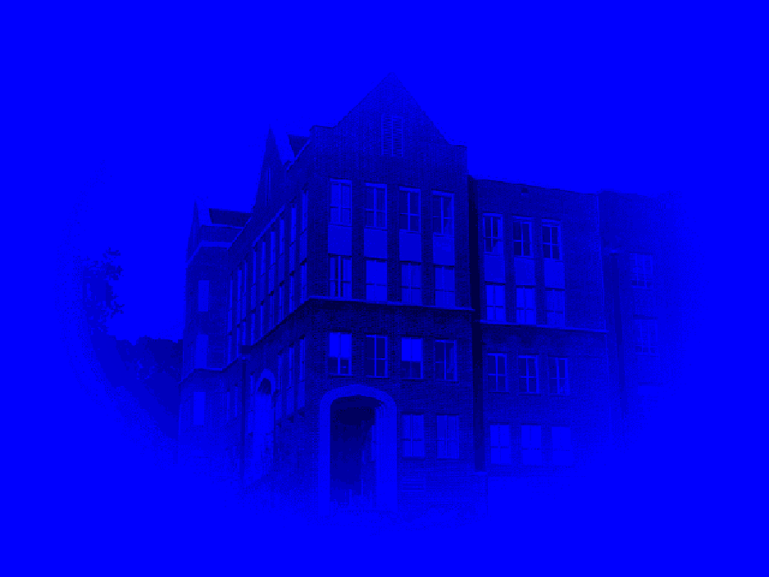


Utilizing the IFPS/GFE to Make
Coastal Waters Forecasts: Wind, Temperature,
and Dewpoint at the Tallahassee NWS WFO
T.J. Turnage, A.I. Watson, and Brandon Bolinski
NWS Tallahassee, FL

Slide 2

Marine Implementation via IFPS
Significant Wave Height
Weather
Wind Speed & Direction
Wind Gust
Near Future
Temperature
Dewpoint
Max/Min Temperature
QPF
Sky Cover
POP
Snow Amount
Visibility
Swell Height and Direction
Ice Coverage

Slide 3
Coastal Waters Temperatures
• They are important – Not an afterthought
• Could be used by:
Sportsmen
Commercial fishermen
Any offshore activities
• Could be used by SmartTools to predict sea fog and
coastal fog and stratus.

Slide 4
Coastal Waters Temperatures
• Air temperatures over water – new weather element
• Forecasters not familiar with this.
• Training must be done to introduce forecasters.
• Start with climatologies
Data readily available from NDBC
Data goes back many years at some buoys

Slide 5
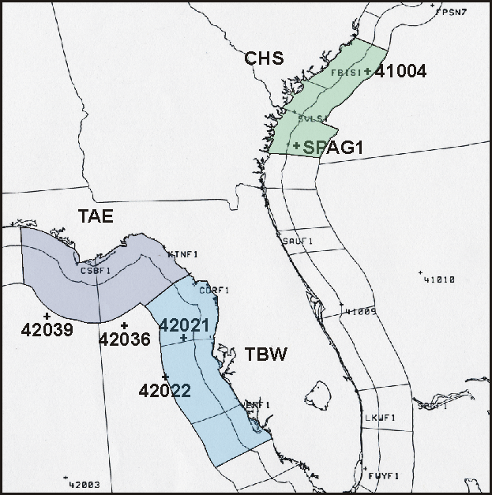
WFO Coastal Waters Forecast Areas

Slide 6
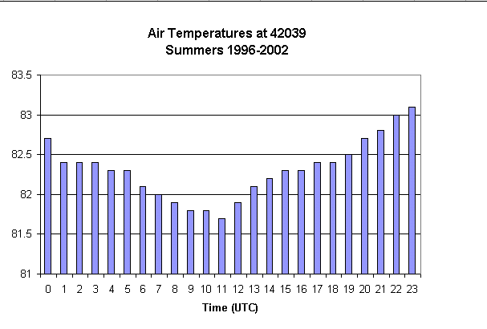
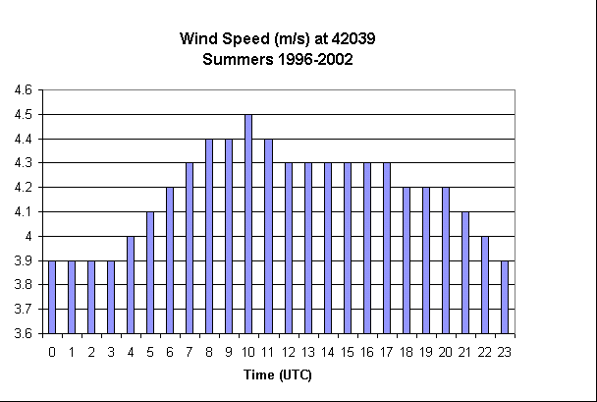
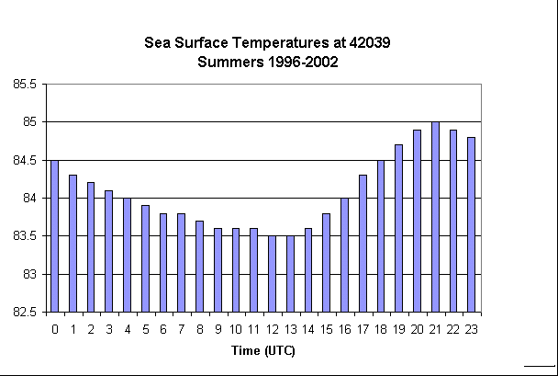
Climatologies
Summer in the Gulf
Simple Statistics!

Slide 7
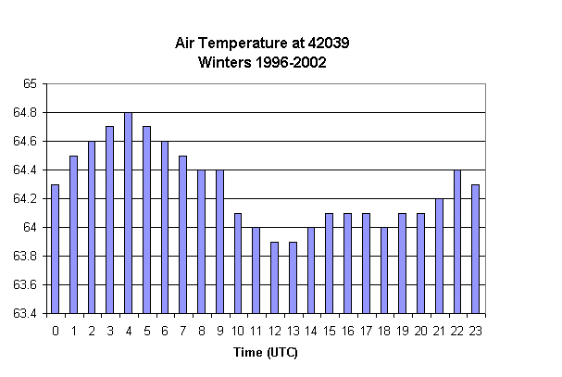
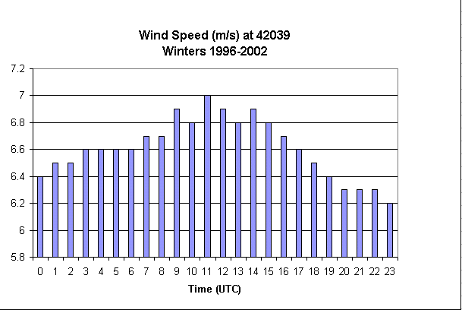
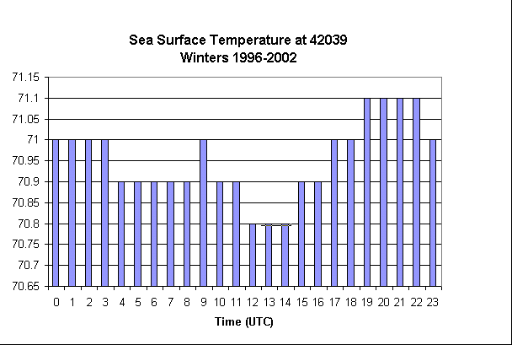
Climatologies
Winter in the Gulf

Slide 8
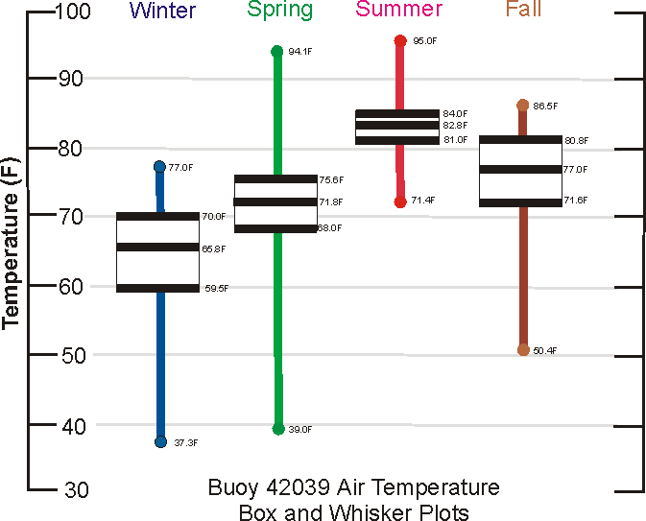

Slide 9
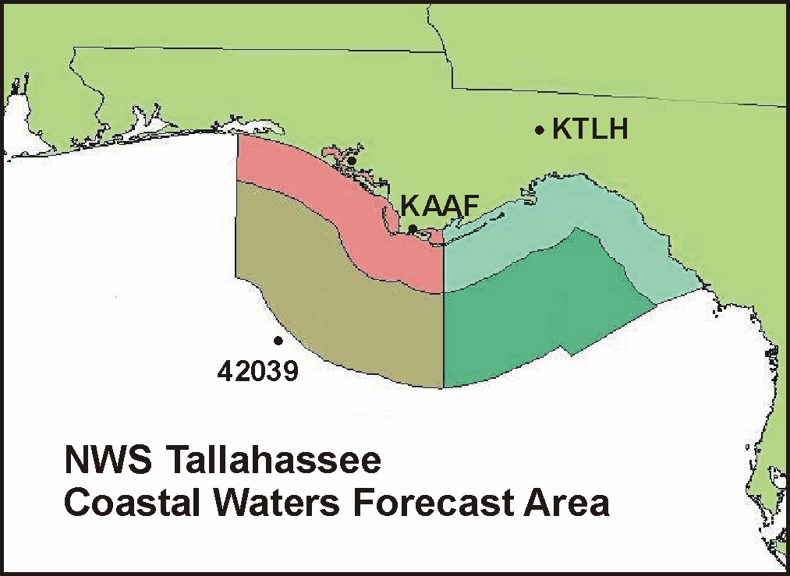
Tallahassee Surface Observation vs. Buoy 42039
KTLH
Avg Max Temp = 65.8º F
Avg Min Temp = 40.8º F
42039
Avg Max Temp = 66.6º F
Avg Min Temp = 61.0º F
Winters 2001-2002:
Avg Max ΔT = +0.8º F
Avg Min ΔT = +20.2º F
When KTLH Min Temp < 30º F
Avg Min ΔT = +27.9º F
When KAAF Min Temp < 35º F
Avg Min ΔT = +21.6º F

Slide 10

How do you predict offshore air temperatures
Know climatology
What has happened and what is happening now?
Buoys!

Slide 11
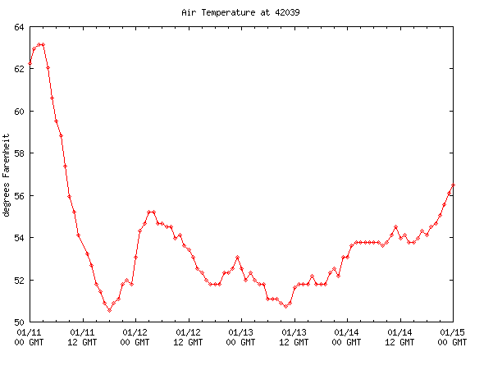
Buoy Time Series
National Data Buoy Center time series (4 days)

Slide 12
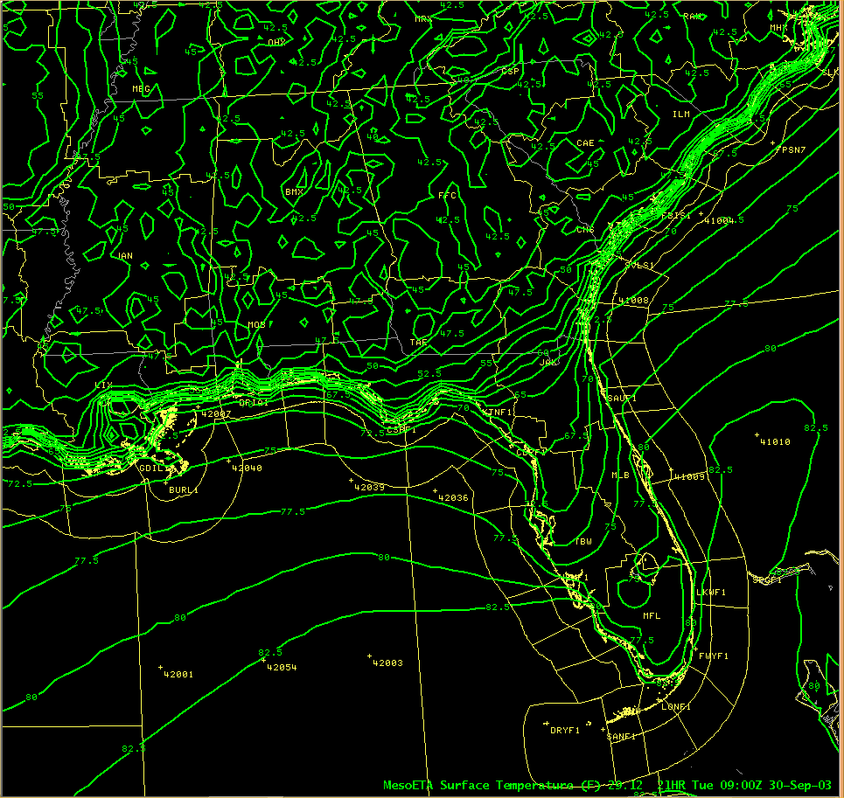
MesoEta does a good job out to 60 hrs.
MesoEta
Surface Temp

Slide 13
Comments:
Don’t use GFS!
MOS is being developed for Buoys, but no
temperature/dewpoint as yet
Sea Surface Temperatures normally 2º F warmer…
but can lag 10-20º F with strong cold fronts

Slide 14
Coastal Waters Temperatures
Verification
Procedure:
Log air temperatures at the 2 buoy sites in our coastal waters forecast area.
Do this for 1st, 2nd 3rd, and 4th period.
Verify with buoy data
Examine Ts & RMSE
Period
4-25 January 2003
22 February – 17 March 2003
In 2004 for 42039
15 January – 29 February

Slide 15
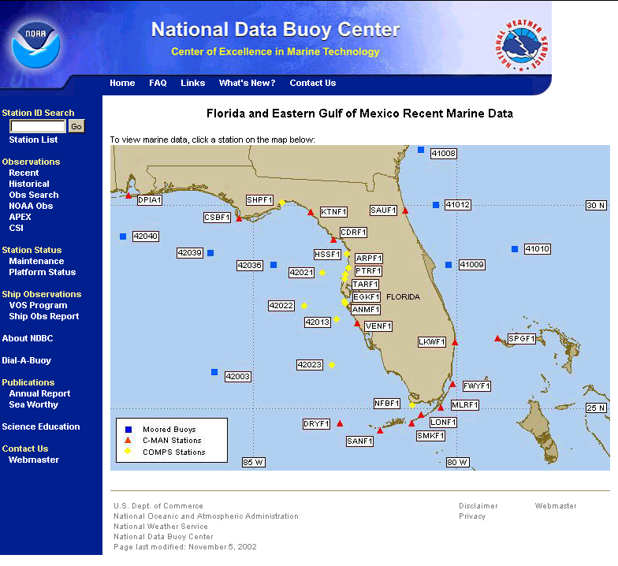

Slide 16
WFO Coastal Waters Forecast Areas

Slide 17
Expectations:
Negative Ts: Underforecasting (Obs > Forecast)
Positive Ts: Overforecasting (Obs < Forecast)
Negative Ts at night:
Forecasting land temps over water?
Positive Ts during the day:
Forecasting land temps over water?

Slide 18
Results: Maximum Temperatures
2003
TAE 42039 42036
T RMSE T RMSE
Period1 ±0.0 3.3 -0.1 3.0
Period2 -0.4 4.0 -0.5 3.7
Period3 ±0.0 4.4 -0.2 3.7
Period4 +0.1 4.5 +0.1 4.2
Positive Ts: Overforecasting (Obs < Forecast)
Or forecasting land temperatures over water.

Slide 19
Results: Maximum Temperatures
2003 2004
TAE 42039 42039
T RMSE T RMSE
Period1 ±0.0 3.3 +0.8 3.1
Period2 -0.4 4.0 +1.5 3.9
Period3 ±0.0 4.4 +0.8 3.4
Period4 +0.1 4.5 +2.1 5.3
Positive Ts: Overforecasting (Obs < Forecast)
Or forecasting land temperatures over water.

Slide 20
Results: Minimum Temperatures
2003
TAE 42039 42036
T RMSE T RMSE
Period1 -1.0 3.9 -1.4 3.8
Period2 -2.2 6.6 -2.8 7.8
Period3 -2.6 5.5 -2.6 5.6
Period4 -2.1 6.0 -1.9 5.6
Negative Ts: Underforecasting (Obs > Forecast)
The influence of land temperatures is great!

Slide 21
Results: Minimum Temperatures
2003 2004
TAE 42039 42039
T RMSE T RMSE
Period1 -1.0 3.9 +1.4 3.3
Period2 -2.2 6.6 +0.7 4.1
Period3 -2.6 5.5 +0.3 4.1
Period4 -2.1 6.0 +0.1 4.1
Negative Ts: Underforecasting (Obs > Forecast)
The influence of land temperatures is great!

Slide 22
Final Thoughts…
Significant Challenges remain with new
Weather Elements coming online soon, e.g.,
Visibility
Swell Height and Direction
Significant Challenges continue with our flagship
marine products – wave heights and winds
IFPS in general – The challenge to NWS WFOs is to
provide the public significantly improved products
over model data

Slide 24
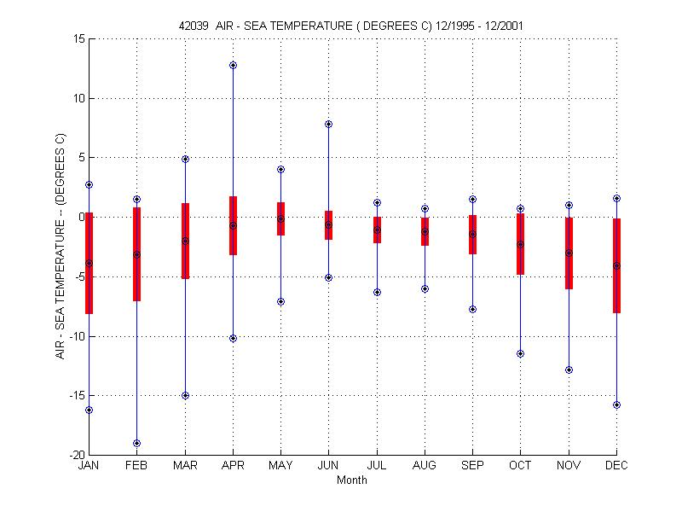

Slide 25
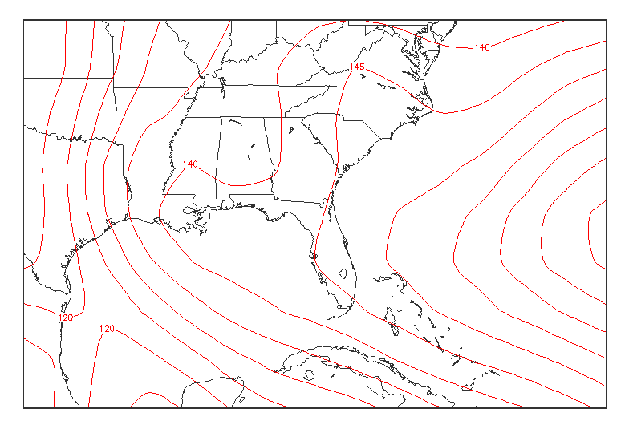
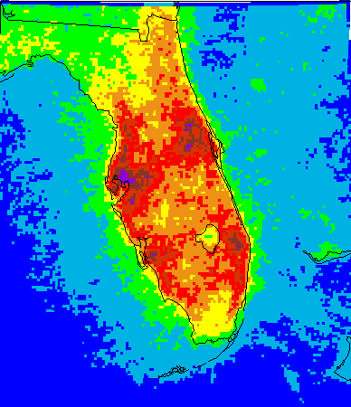
Use of Lightning Climatologies in GFE
May through September
Lightning Flash Density
850 mb Mean Height Field
Flashes per km² per regime day

Slide 26
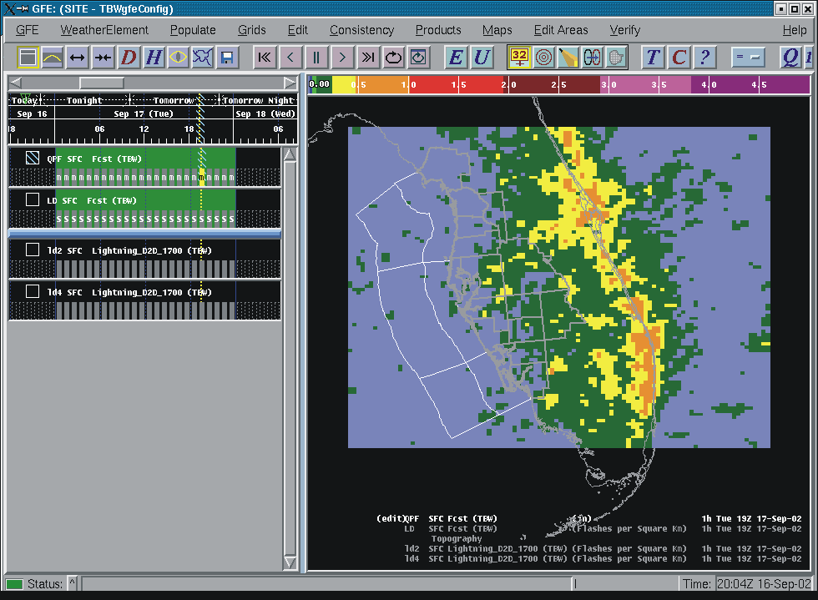
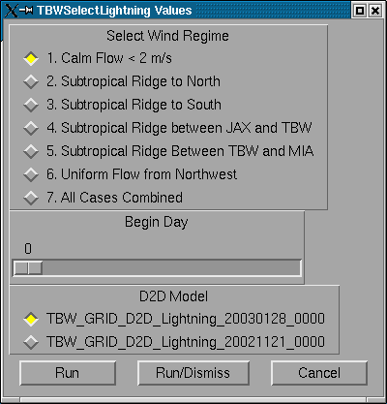
Use of Lightning Climatologies in GFE
The Problem
Conversion of 5x5km lightning
grids to netCDF files cause a
rotation error in GFE grids.
The Solution??
Convert raw lightning files
(one flash per line) into netCDF
Very large reprocessing effort:
Reorganize 15 years of data into
regimes and reprocess Gbytes of
data.
Are there other solutions?
Grid
Manager
Spatial Editor
Figure 6. By means of a procedure in the Edit Actions Dialog Box, lightning
data are converted into a QPF forecast
.

Slide 27
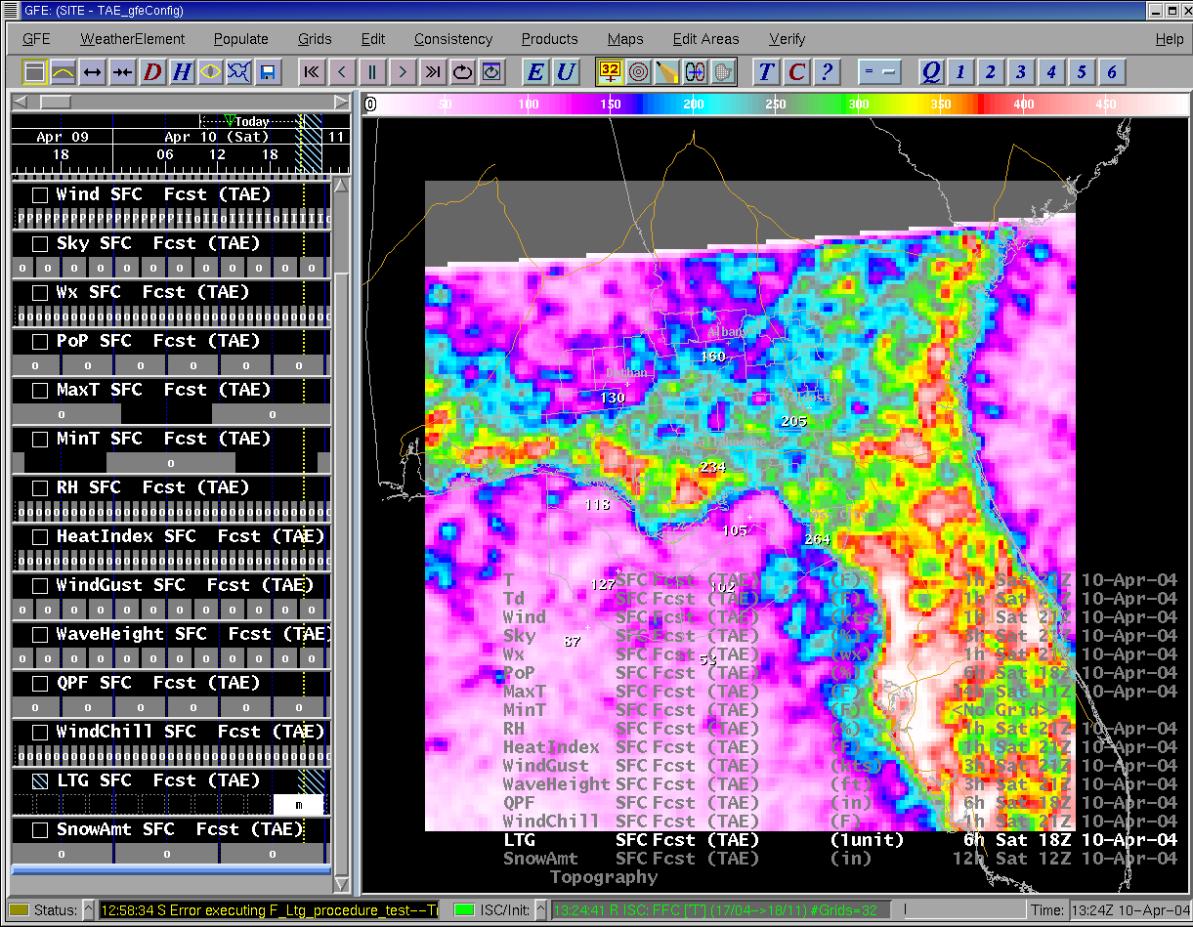
Use of Lightning Climatologies in GFE
Breaking News!!!
Solution??
On the left is a quick fix.
14 years of 6-hr flash counts
for 18-00 UTC in Calm Flow
Regime.
Use of SmartTools and
Smart Initialization

