Slide 1
Future requirements for Ocean Surface
Vector Winds (SVW)
Roger Edson
Science and Operations Officer, WFO Guam
Meeting of the Operational Satellite SVW
Requirements Workshop
TPC/NHC, Miami FL
6 June 2006

Slide 2
Setting of Criteria
-Establish a ‘minimum requirement’ and
a ‘nice-to-have’ requirement
--Perhaps break down in a near term (5 yr) and
a long term goal (10 yr+) …or percent improvement
--Each requirement should state the ‘physical need’
(how it is going to be used, why?)
- Example of future needs for a (greater) specified SVW requirement:
-- Warning timeliness and frequency
-- Increase in model resolution
-- Loss or failure of previous proxy (substituted SVW instrument) for required measurement
-- Greater need based on better understanding of physical processes

Slide 3
Importance of Scatterometer
Q&A Session between GUM and HFO
(Roger Edson, Andy Nash and Wes Browning)
Q1. Right now how important is the use of scatterometer data for the
daily surface analysis?
A1) Crucial. One of our most important graphical products is the 6-hourly
synoptic chart over our extensive AOR (part of the radio fax suite).
Chart and the scat data used for high seas, gale areas, swell and local
marine effects.
Q2. How are the scatterometer being used to support CPHC?
A2) Primarily used to support outer wind structure; also some positioning
although forecaster’s know there are some rain-related issues in
wind directions and that wind speeds are not accurately depicted
in the inner portions of the TC. Always use in conjunction with other
data. Appreciate the new rain-flag ‘circles’ on N-AWIPS. Ultimately
we would prefer aircraft and radar data when a hurricane gets close
to Hawaii.
Q3. How is your forecaster’s training and knowledge of QuikSCAT?
A3) Pretty good. Our forecasters have been using the data for several
years. WE appreciated Ralph Milliff’s visit and training last winter.
Also, value and maintain the QuikSCAT VISITVIEW (COMET) course.

Slide 4
Q4. ‘If’ the scatterometer is no longer available, what type of data would you use in it place?
A4) If?? Andy references the Congressional testimony by Prof Moore
(Mar 06)—cancelled program for a QuikSCAT follow-on.
Hope that low-level cloud drift winds are not going to be a
‘substitute’. Assume that AMSU and other types of MI (imagery)
will be placed in AWIPS….and that the GFS analysis remains
‘good’ (but not sure how much influence that scat data already
has on this product.
Q5. ‘If’ you could design a brand new instrument to measure SVW, what
requirements would you have?
A5) ….Did not really answer this one….however, 1) they know it
would probably be a microwave instrument (to see through the
clouds); ‘hoped’ that it would be more accurate than WINDSAT;
Able to measure (speed and direction) both light winds less
than 10kt and ‘strong’ winds (not sure what limit); and be
less susceptible to rain effects. Finally they wished that a new
instrument could provide data MUCH quicker than the existing
2 ½ to 3 hours.

Slide 5
Future Needs of SVW
WFO:
- Continued need for surface data over the data-sparse oceans
-- Buoys (and handars) are not being supported
-- Less accurate ship reports
- Maintain (increase) timeliness of gale and high seas warnings
-- Increase coverage
-- Increase refresh rate (4X/day) and availability (~30 minutes)
Increase accuracy of swell generation and high surf
Support development in both marine and atmospheric models (by providing higher resolution input)
Tropical Cyclones:
Increased accuracy in positions and movement
Increased knowledge of wind field in genesis area and intensification
-- Need both accurate speed and direction without strong rain
contamination
More accurate outer wind field to meet both warning criteria and
support ocean surge calculations
- Better knowledge of fetch generation area

Slide 6
Requirements for Improvements in Scatterometer Wind Retrieval Process (for TC Analysis)
1) More precise (automated) ambiguity selection process in the high gradient curvature of the TC---maybe use with the NRCS.
2) Better intensification and specification of rain-related effects, including use of the AMSR-E on ADEOS-II.
3) Improved automated ambiguity selection process or development of a forecaster-interface procedure.
4) Validation and understanding of high wind speed and heavy rain characteristics using aircraft and dropwindsonde data.
5) Establishment of uniform operational procedures in TC warning process (in cooperation with TC centers)—a Goal should be to meet ‘at least’ a standard of a well-defined center (PCN 3 or 4).

Slide 7
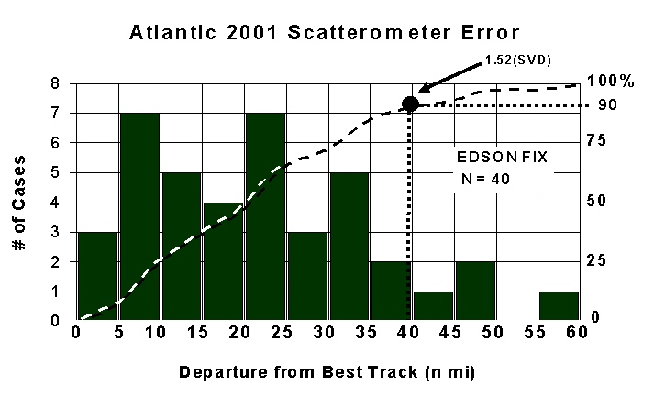
In Operations:
GOAL—To meet PCN 3-4 criteria
PCN CLASS Mean Dev SVD (nm) 1.52 SVD (nm)
(nm) (63%) (90%)
1-2 Eye 15 16.5 25
3-4 Well-defined 20 26 40
5-6 Poorly-defined 30 36 55
TC Position Code Number (PCN) Accuracy
(Adapted from 1 WWP 105-10)
(This meets PCN 3-4)

Slide 8
A) An increase (continued) in global scatterometer coverage will:
i) Provide more thorough input to the NWP assimilation process
ii) Fill in the remaining 10% gaps over the tropical oceans
iii) Support the daily METWATCH and warning criteria of most tropical cyclone warning centers
-- Early detection, motion and history
-- Position
-- Outer wind structure of destructive winds (34kt and 50kt…maybe 64t)
-- Provide a ‘minimum’ (at least) maximum wind intensity
-- Extratropical transition and dissipation
iv) Increase the data base for the research community

Slide 9
B) An increase in global scatterometer frequency will:
i) Provide input for each 6-hourly NWP analysis cycle
ii) Provide timely input to support the 6-hourly warning interval of most tropical cyclone warning centers
iii) Provide vital data during rapid changes in tropical cyclone
motion, structure and character (access w/I 30 minutes?)
-- Sudden changes in direction or speed, including rapid
acceleration cases
-- Movements over water from over land and rapid development
-- Synoptic scale interaction with other synoptic-scale features such as fronts or lows or in a multi-TC situation
-- Initial development or change in warning criteria wind radii (35kt, 50kt, or 64kt wind radii)
-- Rapid intensity change and existence or change in tropical storm(34kt) or hurricane (64kt) wind intensity criteria
-- Genesis and development of a closed circulation
-- Extratropical transition and transformation of wind structure

Slide 10
TC Research Topics with Scatterometer Data
1) Genesis: Initial position and character of TC disturbance can be more accurately ascertained in both time and space.
a) Better understanding of origin and mechanisms for formation
b) Character of incipient disturbance can be determined (i.e., wave, trough axis, pre-existing surface circulation)
c) Interaction with the environment such as surges and surge location
2) Development and the early-stage intensification process: Outer wind structure, position, and a ‘minimum’ (at least) estimate for maximum intensity.
a) Used with other data (such as microwave imagery or vertical profilers) will allow better understanding of mass and wind fields
b) Relationship of wind field with the convection
c) Change in wind structure during life cycle and early-stage
intensification process (also in relationship to other synoptic scale features)

Slide 11
3) Motion: Scatterometer wind and directions over TC (in combination with other remote sensing tools) give more accurate positions over data- sparse regions of the globe.
a) Can obtain complete best track of each TC for a TC data base and provide more thorough motion history, especially good during early stages where positioning and intensity accuracy is currently poor.
b) Short-term motion as related to surrounding environmental wind flow
c) Motion as related to asymmetric wind structure
d) Multi-TC interaction, especially as TCs begin to approach each other
d) Interaction with topography and multi-TC interaction
4) Extratropical transition: Movement of the surface feature and outer wind structure.
a) Examine change in outer wind structure as transition develops
b) Stratify with respect to different size and intensity TCs and their interaction with different extratropical features
c) Understand the dissipation process and understand the differences in situations for when the wind field weakens or strengthens

Slide 12
IWTC-V Endorsement Proposal (2002)
Future Requirements for (Increased) Global Scatterometer Coverage
Statement: Current scatterometer daily coverage over the tropical waters is approximately 90%. The addition of (maintenance of) another instrument similar to QuikSCAT with a similar swath width and offset by approximately 6 hours will provide a substantial benefit to the tropical cyclone operational and research community. Scatterometer instruments have shown to increase forecasting accuracy by providing extensive surface wind coverage in the assimilation of numerical weather prediction (NWP) models, by providing researchers with the necessary data to establish more precise physical concepts of behavior, and by providing tropical cyclone forecasters with increased knowledge in the data poor regions of the globe of position, outer wind structure, a ‘minimum’ (at least) maximum intensity, genesis and early stage development, and the evolution of the outer winds during extratropical transition.

Slide 13
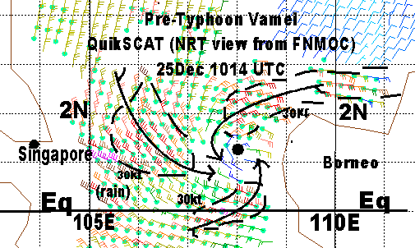
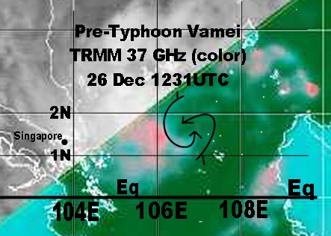
Typhoon Vamei (32W)—Record setting tropical cyclone
Use of combinations of MI Data
- History of TC can be traced from vortex off of Borneo on 24/00Z
MI and SCAT allow for identification at an earlier stage of development than with more traditional data
Synoptic data supplemented with scatterometer offers a suggested mechanism for development via wind surges in both the NH and SH
TRMM 37 GHz QuikSCAT
(see discussion on ambiguity selection)

Slide 14
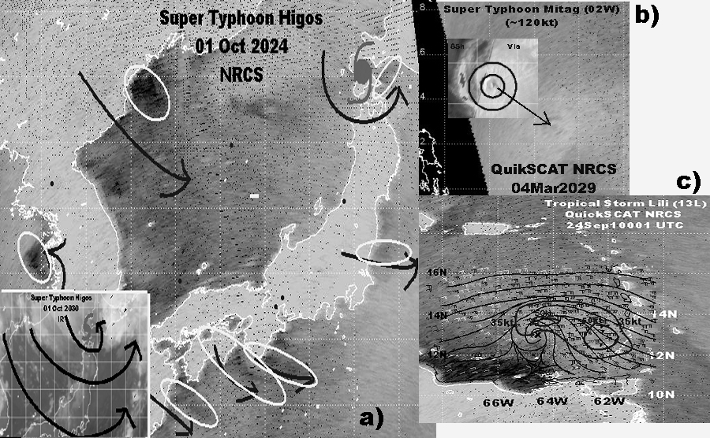
The Many Uses of the NRCS DATA
Eye Cycle
Small-scale
Land/sea interaction
Genesis/positioning

Slide 15
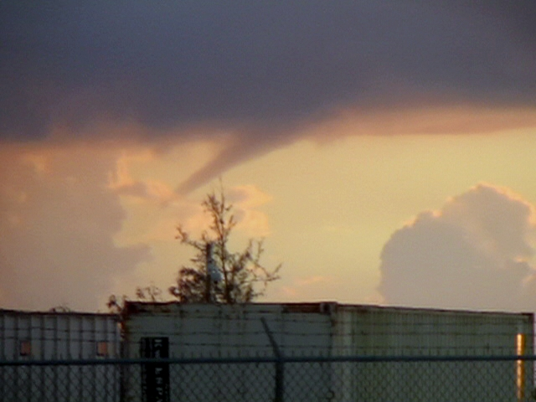
Discussion?

