Slide 1
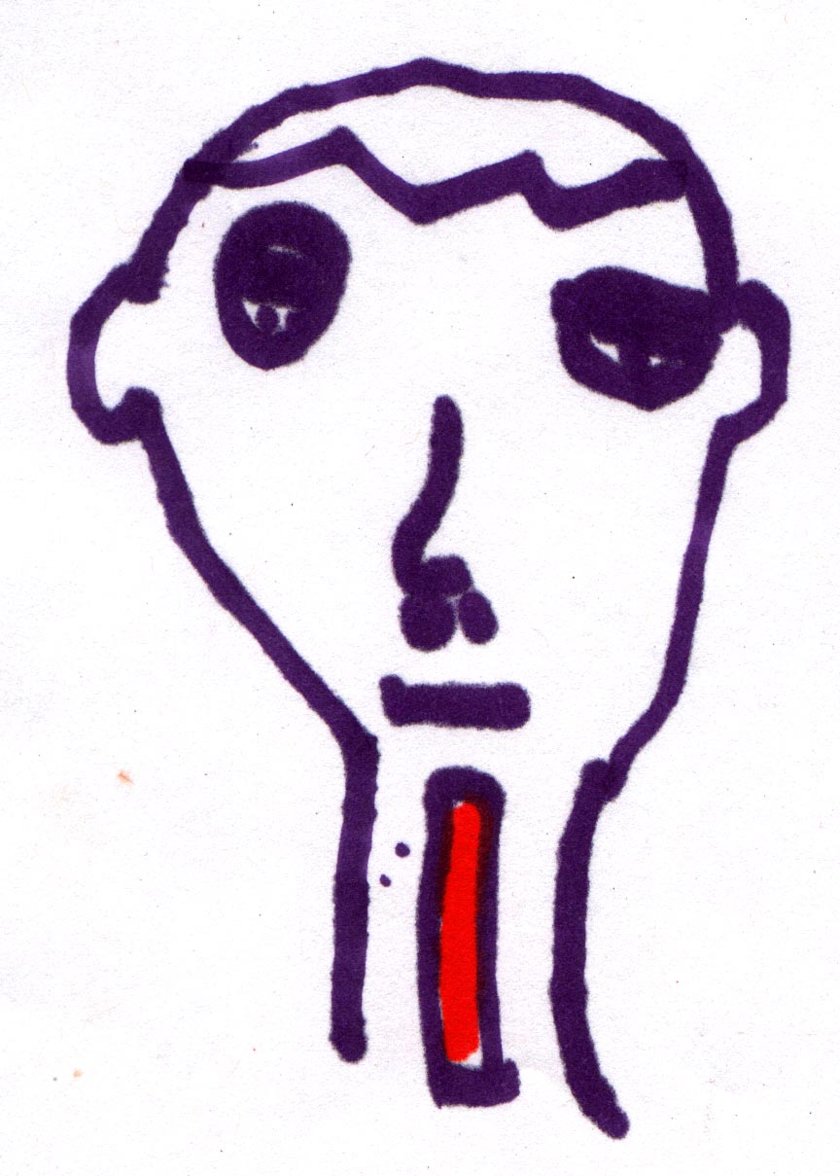
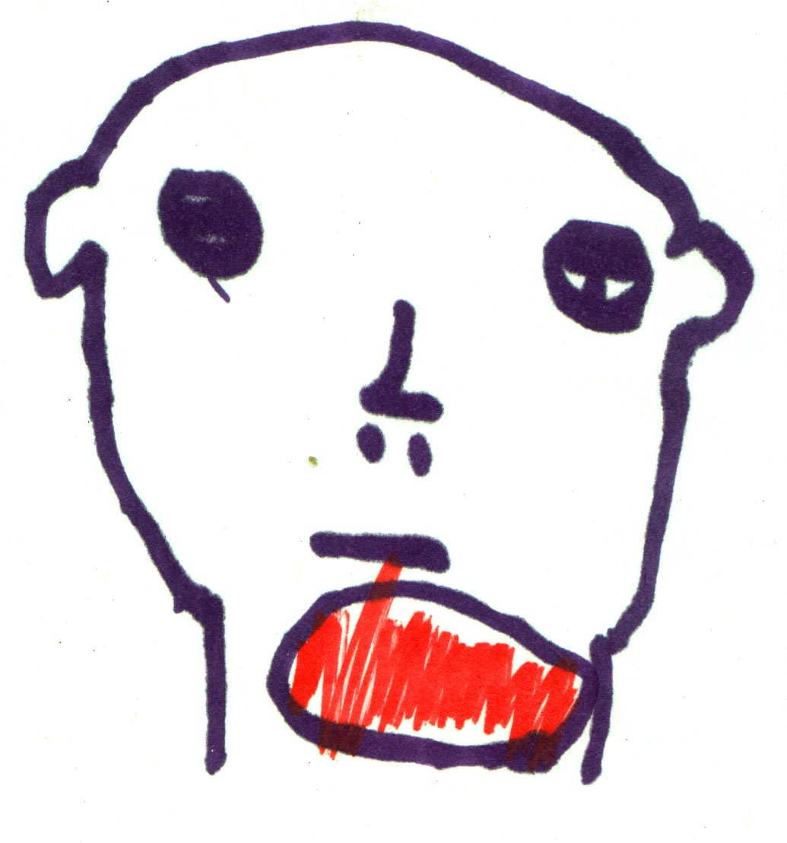
“A Bleed makes you swell”
“A Clot makes you shrink”

Slide 2
Educational Needs of General Public + Patients
and
Role of Patient Advocacy Organizations
Stephan Moll, MD
Heme-Coag
University of North Carolina
Chapel Hill, N.C.

Slide 3
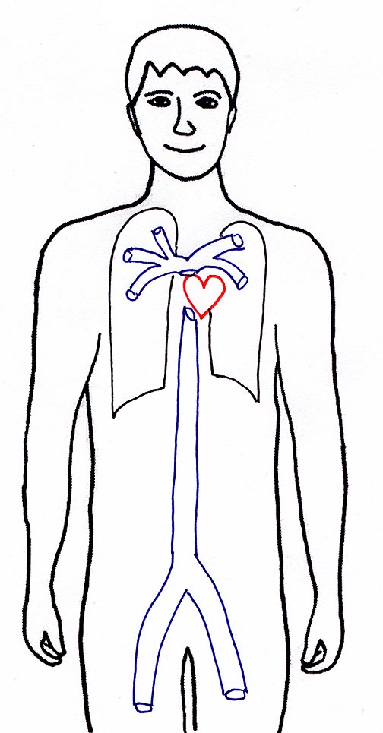
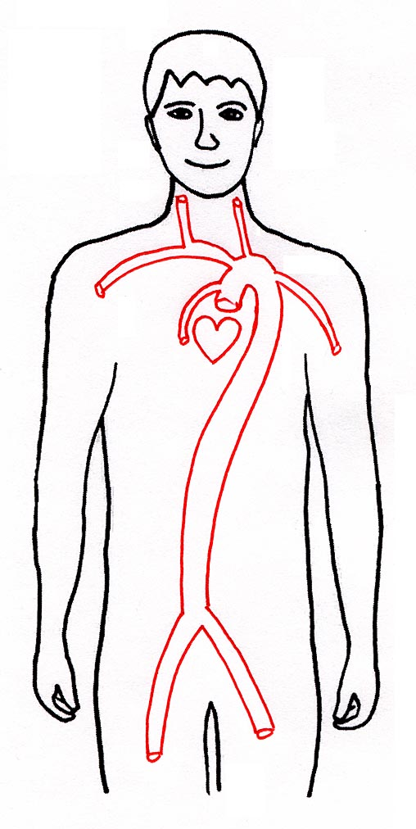
Venous Clots
Arterial Clots
Stroke
Pulmonary embolism (PE)
  short of breath
  chest pain
  cough
  bloody sputum
Heart attack
Deep vein thrombosis (DVT)
  swollen
  painful
  warm
  blue-purple
Gangrene

Slide 4
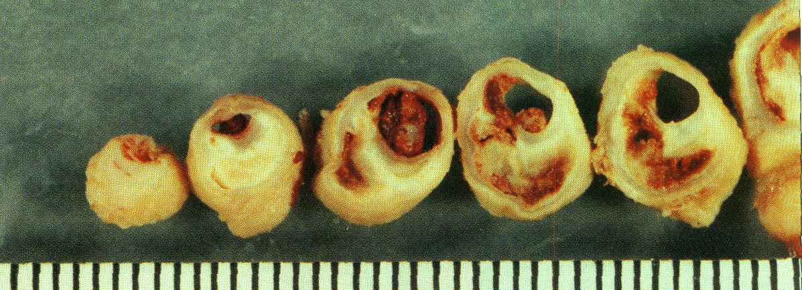
Risk Factors for Clots
Arterial
smoking
overweight
high cholesterol
high blood pressure
diabetes
Venous
immobility (overweight)
surgery, trauma
hormones
cancer
inherited or acquired clotting abnormalities

Slide 5
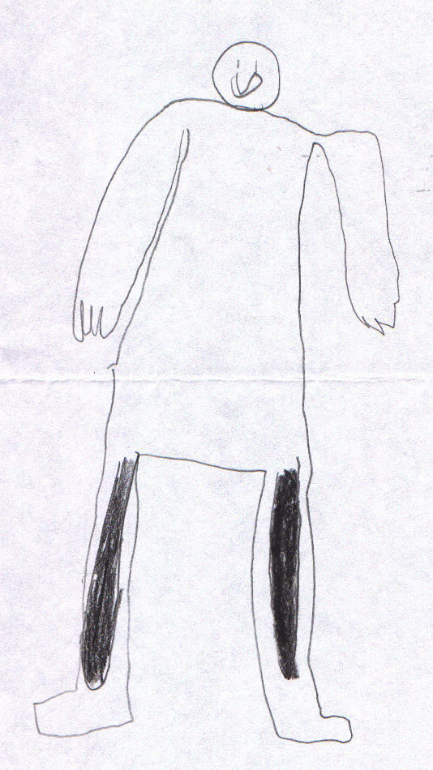
How to prevent / treat clots
Andrew, age 8

Slide 6
The Public: Lack of Awareness
APHA 2002
Telephone survey
1,003 U.S. adults
74% of the public have little or no awareness of DVT;
54% do not know any symptoms of DVT;
57% cannot name any common risk factors for DVT
[APHA Survey 2003]

Slide 7
The Patients: Education Needs
257 patients
attending 2 NATT education seminars (Denver, Detroit - 2004)
questionaire
Prevention
Treatments
Insurance issues
Signs and symptoms
Info what to discuss with my HCP about a clotting disorder
Risk in myself/family
How risk factors influence blood clotting- i.e. weight, OCP's, age
Genetics of clotting disorders
General information on clots
Support resources- local, national, regional or internet
Screening for thrombophilias
I would like to get printed educational materials
Info on research projects
4 - extremely interested
0 – not interested
Info on advocacy, lobbying etc.
2.8
3
3.2
3.4
3.6
3.8
4
Average interest level
[Varga E. J Thromb Thrombolys 2006;21:107]

Slide 8
Availability of Education Materials
Review of printed and web-based education materials
Judged by defined criteria
12-2003 to 3-2004
5 members of NATT’s Education subcommittee
(4 consumers, 1 health care provider)
Number of Patient-Appropriate Educational Materials on Thrombosis and Thrombophilia Topics
General info on thrombosis
Treatment
Factor V Leiden
Antithrombin III deficiency
Understanding genetics of thrombophilia/inheritance
Protein C/S deficiency
General info on thrombophilia
Antiphospholipid antibodies
Gap!
Thrombophilia and Pregnancy
Psychosocial implications
Prothrombin G20210A
Prevention
Contraceptives and thrombophilia
Insurance and thrombosis/thrombophilia
HRT and Thrombophilia
Genetic Testing for Thrombophilia
0
1
2
3
4
5
6
7
8
9
# of Materials
[Varga E. J Thromb Thrombolys 2006;21:107]
[Varga E. J Thromb Thrombolys 2006;21:107]

Slide 9
Availability of Education Materials
www.nattinfo.org
www.fvleiden.org
www.clotcare.org
www.dvt.net
www.preventdvt.org
501c3 non-profit
Non-profit, patient-run
ClotCare. Multiple sponsors
Sanofi-Aventis sponsored
Sanofi-Aventis sponsored

Slide 10
Thrombosis Prophylaxis
Is there a need for behavioral modifications for the prevention of DVT?
Exercise
Nutrition
Hydration
Obesity
Smoking
may be
may be
may be
may be
Formal research on whether
modification of these factors
decreases the risk of DVT is lacking
may be

Slide 11
Role of Patient Advocacy Groups
(Portions redacted)
A. Education (Public – Patients – Health Care Providers)
Helping assess the true education needs through formal research;
Creating and distributing education messages and materials for public and patients through:
- education seminars
- printed material
- websites
- getting media interested
Assisting in educating various health care provider groups.
B. Prophylaxis and treatment
Scientific studies: Encouraging the development for at-risk populations;
Therapy standards: Encouraging the development (example: patients undergoing gastric bypass surgery);
Making existing therapy standards available to all health care providers;
National DVT prophylaxis guidelines: Participation + endorsement (example: NQF-JCAHO);

Slide 12
NATT’s activities as viewed by me
Good and competent leadership – Mark Jablonski, Chicago;
Effective Education subcommittee (Chair Liz Varga, Columbus, OH);
Collaborative approach (CDC, CDC-funded Thrombophilia Pilot Site group, ASH, AC Forum, HTRS, NHF, NHLBI, DVT Coalition, Venous Forum, pharmaceutical companies, etc.);
Non-profit, 501c3, neutral
Short of money – needs full-time staff
Short of money – needs full-time staff
Key needs in next 3 years:
Successful fundraising
More volunteers to get involved to do the work

Slide 13
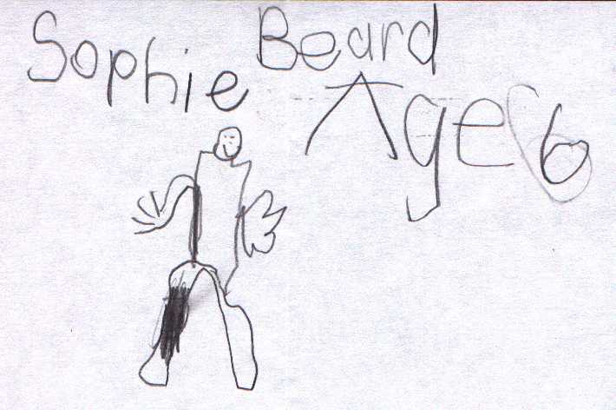

Role of Patient Advocacy Groups
Knowledge
Awareness
Prevention
Treatment
Support

