Slide 1
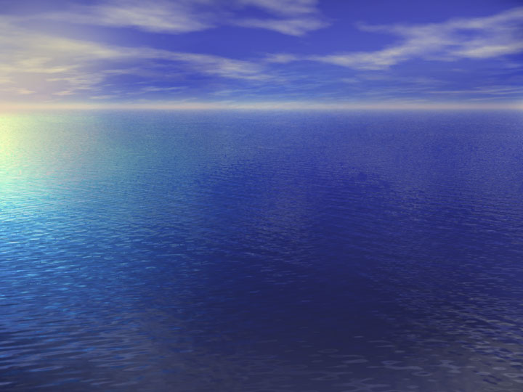
New Marine Weather Warning Product
Partners Meeting
June 20, 2007
Mark Tew
Marine Weather Program Leader
Office of Climate, Water and Weather Services

Slide 2
Watch / Warning / Advisory
How does the rest of NWS do it?
Winter Weather Program – (WSW)
  Winter Weather Watch
  Winter Weather Warning
  Winter Weather Advisory
Non-Precipitation Program –(NPW)
  Non-Precipitation Watch
  Non-Precipitation Warning
  Non-Precipitation Advisory
Hydrological Program – (FFA/FLW/FLS)
  Flood Watch
  Flood Warning
  Flood Advisory
Coastal Hazards Program – (CFW)
  Coastal Flood Watch
  Coastal Flood Warning
  Coastal Flood Advisory

Slide 3
Current Long Duration Marine Warning Program
No Marine Weather Watch
No Marine Weather Warning Bulletin
Marine Hazards Headlined in CWF, NSH and GLF
  Similar to issuing Blizzard Warnings using the ZFP
CWF and NSH contain VTEC Strings
  Forces permanent VTEC string in forecast products
  ROU – used when no hazards are in effect
GLF has NO VTEC
  VTEC hole in our marine warning program
Marine Weather Warnings and Advisories (18 total)
  Hurricane Force Wind Warning
  Storm Warning
  Gale Warning
  Small Craft Advisories
  Hurricane/Tropical Storm Warnings

Slide 4
Small Craft Advisory in CWF
SC.Y in
VTEC String
ANZ532>534-030815-
/O.CON.KLWX.SC.Y.0071.060603T1200Z-060604T0100Z/
CHESAPEAKE BAY FROM SANDY POINT TO NORTH BEACH-
CHESAPEAKE BAY FROM NORTH BEACH TO DRUM POINT-
CHESAPEAKE BAY FROM DRUM POINT TO SMITH POINT-
423 PM EDT FRI JUN 2 2006
...SMALL CRAFT ADVISORY REMAINS IN EFFECT FROM SATURDAY MORNING
THROUGH SATURDAY EVENING...
.TONIGHT...S WINDS 10 TO 15 KT. WAVES 2 FT. SHOWERS AND TSTMS.
VSBY 1 TO 3 NM.
.SAT...SW WINDS 15 TO 20 KT. WAVES 3 FT. SHOWERS LIKELY WITH A
CHANCE OF TSTMS. VSBY 1 TO 3 NM.
.SAT NIGHT...N WINDS 15 TO 20 KT EARLY IN THE EVENING...DECREASING
TO 10 TO 15 KT. WAVES 3 FT.
…etc.

Slide 5
Proposal
Develop New Marine Weather Warning Bulletin
Motivation
  Consistency with other warning programs
    Improves understanding and use of NWS Warning products
    Standardizes procedures for forecasters
  Provides needed warning tool
    CWF headline practice shows the need for Watches
      …Gale Warning Expected Tuesday…
    Vehicle to carry VTEC from CWF and NSH
    Fills VTEC Hole in the Open Waters of the Great Lakes
  Value to Users and Partners
    Allows for more detailed warning information
    Easier to obtain using automated means

Slide 6
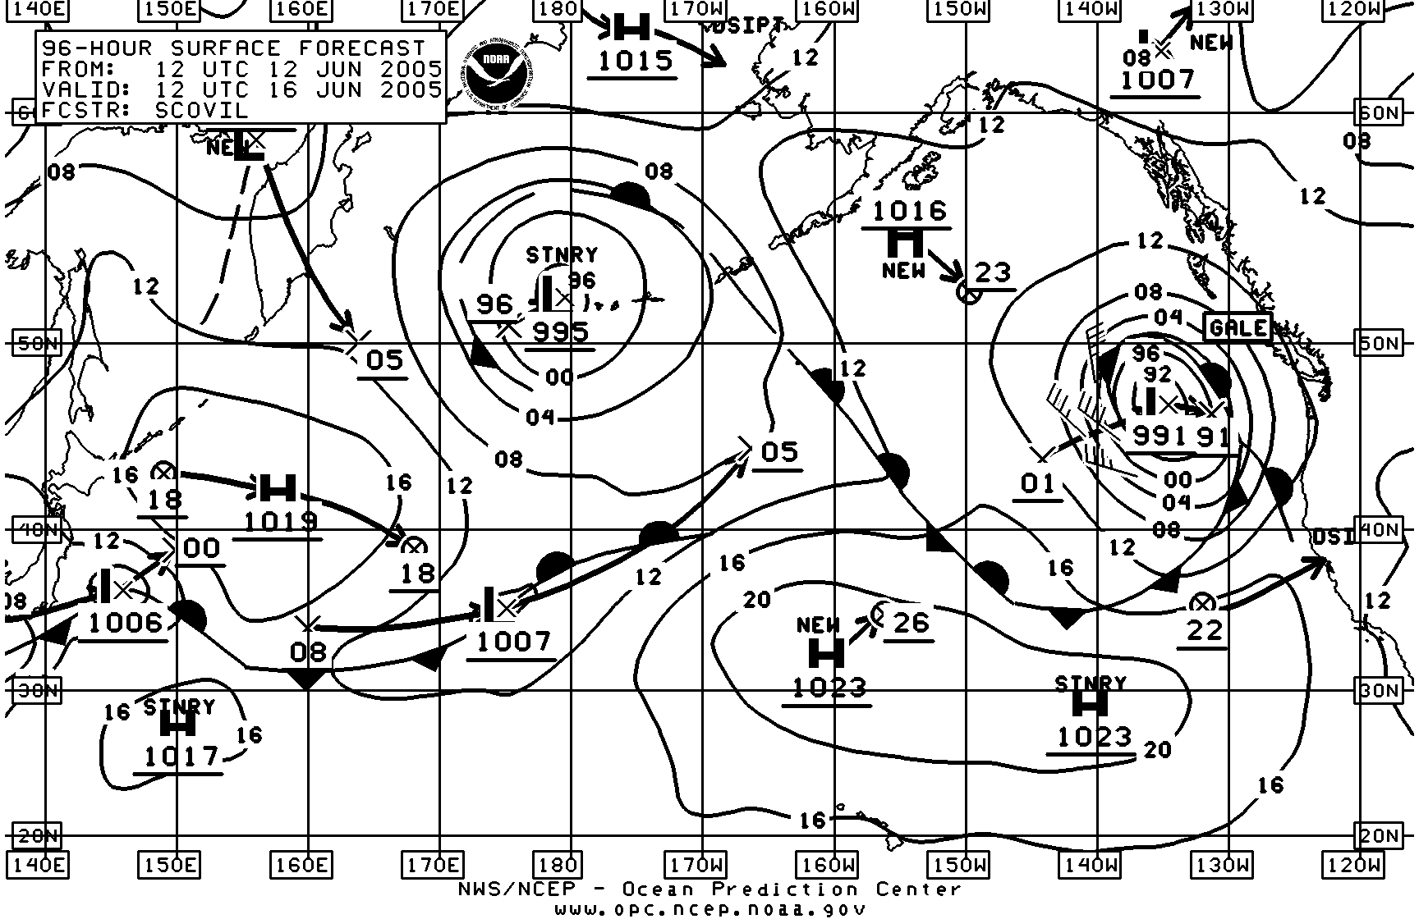
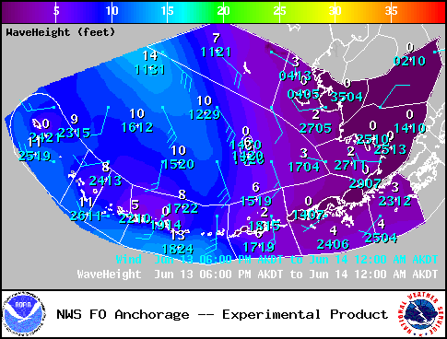
Motivation – Value to customers
The new Marine Weather Warning will allow forecasters to paint a picture of the synoptic situation and link it to the resulting hazardous wind or seas situation
Current approach does not connect the “why” with the “what”

Slide 7
Marine Wind Watch – MWW
Overview:
…GALE WINDS EXPECTED FROM PT ST GEORGE TO CAPE MENDOCINO FROM 20 NM TO 60 NM ON FRIDAY…
.STRONG LOW PRESSURE OVER THE GULF OF ALASKA WILL MOVE INTO THE NORTHERN CALIFORNIA COASTAL WATERS BY THURSDAY. WINDS WILL INCREASE WITH THE APPROACH OF THE STORM AND REACH THE HIGHEST SPEEDS ON FRIDAY. THE WINDS ARE EXPECTED TO SHIFT TO THE WEST AND DIMINISH BY FRIDAY EVENING.

Slide 8
Marine Wind Watch – MWW
Segment:
New GL.A in MWW VTEC String
PZZ470-081700-
/O.NEW.KEKA.GL.A.0001.081010T0100Z-081010T0100Z/
PT ST GEORGE TO CAPE MENDOCINO 20 TO 60 NM-
11 AM PDT WED OCT 8 2008
...GALE WATCH IN EFFECT THURSDAY NIGHT THOUGH FRIDAY…
SOUTH WINDS 30 TO 40 KT WITH ISOLATED GUSTS TO 50 MPH ARE POSSIBLE THURSDAY NIGHT AND FRIDAY MORNING AHEAD OF THE FRONT. THE WINDS WILL TO SHIFT TO THE WEST AND DIMINISH TO NEAR 20 MPH BY FRIDAY EVENING BEHIND THE FRONT.
$$

Slide 9
Hazardous Seas Warning - MWW
SE.W in MWW VTEC String
PZZ470-091700-
/O.NEW.KEKA.SE.W.0001.081009T1300Z-081009T1200Z/
PT ST GEORGE TO CAPE MENDOCINO 20 TO 60 NM-
4 PM PDT WED OCT 8 2008
...HAZARDOUS SEAS WARNING IN EFFECT THURSDAY THROUGH THURSDAY NIGHT…
LARGE NORTHWEST SWELL RESULTING FROM A LOW PRESSURE SYSTEM IN THE GULF OF ALASKA WILL APPROACH THE NORTHERN CALIFORNIA WATERS TONIGHT...WITH SEAS RISING TO 25 FEET BY THURSDAY MORNING WITH PERIODS 18 TO 20 SECONDS. AT THE SAME TIME...SOUTH WINDS WILL INCREASE TO 30 KNOTS TONIGHT...CREATING A HAZARDOUS COMBINATION OF INCREASING SOUTHERLY WIND WAVES AND LARGE NORTHWEST SWELL THROUGH THURSDAY NIGHT.
BY FRIDAY MORNING WINDS WILL DIMINISH TO NEAR 20 KNOTS...AND SWELLS WILL DIMINISH TO BELOW 10 FEET.

Slide 10
Partner Acceptance
MWW Proposal endorsed by National Partners
  Presented at Partners Meeting in June 2006
  Prefer VTEC in one hazard product like WSW & NPW
    Problems decoding VTEC in two forecast products
    Both contain “ROU” codes
MWW Supported by Great Lakes Users – Feb 07
  Lake Carriers Association & International Ship Masters
    Formally approved the MWW proposal
  USCG Ninth District
    MWW would improve the dispatching of ships for search and rescue operations
    Provide more meteorology (the why) for staff briefings

Slide 11
Requirements Development
Chartered MWW Improvement Team
  Developed Requirements and Project Plan
MWW Formatter
  Developed by SOO at WFO Detroit
  Prototype transfer of field development to AWIPS baseline
  Expedite product implementation
Establish MWW Test Sites
  Six WFOs will experimentally test the MWW on Aug 1, 2007
  Issue experimental MWW with “E” VTEC
  Continue operational VTEC in CWF and NSH
Evaluation of MWW Products
  Provide demonstration results and customer feedback
Target – AWIPS OB8.3 for Implementation in Fall 2008

Slide 12
MWW WFO Test Sites
DTX – Detroit/Pontiac, CR
BUF – Buffalo, ER
CAR – Caribou, ER
HFO – Honolulu, PR
TAE – Tampa Bay, SR
MFR – Medford, WR

Slide 13
MWW Key Milestones
Date | Action | Status
Jun 2006 | MWW proposal accepted – WFO Eureka and WRH | Complete
Jun 2006 | MWW endorsed at Partners Meeting | Complete
Nov 2006 | MWW team chartered – 1 to 2 members from each region | Complete
Feb 2006 | MWW approved by Great Lakes Marine Users (LCA, USCG, ISMA) | Complete
Apr 2007 | Develop MWW OSIP requirements – Approved through Gate 2 | Complete
Jun 2007 | Develop MWW formatter – SOO WFO DTX | Complete
Jun 2007 | Present MWW Status at NWS Partners Meeting | In Progress
Jun 2007 | Test MWW formatter at NWSH AWIPs Workstation – Field forecasters | In Progress
Jul 2007 | Draft new MWW Directive: NWSI 10-315 | In Progress
Jul 2007 | Develop MWW Product Description Document | In Progress
Jul 2007 | Issue PNS to announce experimental test of MWW | In Progress
Aug - Sep 2007 | Begin OT&E of experimental MWW at six WFOs | Low Risk
Sep 2007 | Evaluate MWW Test Results – Verify 95%(+ 5%) error free products | Low Risk
Nov 2007 | MWW formatter transferred into AWIPS OB8.3 baseline delivery | Med Risk
May 2008 | Issue National MWW SCN for all marine WFOs except AR | Low Risk
Fall 2008 | MWW operational implementation – Exception AR, later timeline | Med Risk

Slide 14
Partner Feedback
Any Questions or Comments?
NWS marine home page:
http://www.weather.gov/marine

