Slide 1
SFMR Performance During the 2005 Hurricane Season
Peter G. Black and Eric Uhlhorn
NOAA/AOML/Hurricane Research Division
Allan Goldstein, NOAA/AOC
Ivan Popstefanija, ProSensing. Inc.
and James Carswell, Remote Sensing Solutions, Inc.
60th Interdepartmental Hurricane Conference
Mobile, Alabama
March 20-24, 2006

Slide 2
2005 SFMR Performance
Flown in 9 storms, 7 landfall situations
  Arlene Cindy Dennis
  Emily Irene Katrina
  Ophelia Rita Wilma
34 total SFMR missions, 23 tasked
  16 total, 8 tasked for NOAA42
  18 total, 14 tasked for NOAA43

Slide 3
2005 SFMR Performance (cont’d)
SFMR used in 23 advisories, prompted 2 special advisories
All cases played decisive role in an important decision on current intensity or estimates of intensity change
Especially crucial for landfall intensity estimates for Dennis, Katrina, Rita and Wilma
Mentioned prominantly in Katrina, Rita and Ophelia NHC storm reports

Slide 4
SFMR Use Points to Key Deficit
Difficult for forecasters to transition from routine AFRC flight level reco data to SFMR surface data, especially in landfall situations like Katrina
Extensive use of SFMR in 2004-2005 illustrates the urgent need for SFMR installation on WC-130J aircraft as soon as possible- especially critical in current era of enhanced TC activity

Slide 5
SFMR Updates
From HRD projects:
  http://www.aoml.noaa.gov/hrd/project2005/sfmr.html
From NHC storm reports:
  http://www.nhc.noaa.gov/2005atlan.shtml

Slide 6
Key SFMR Issues
Calibration vs. Model Development
Averaging Considerations
Real-Time Quality Control
Future Interpretation Issues

Slide 7
SFMR Calibration Procedure
Single “pre-season” laboratory calibration by ProSensing
Single “pre-season” airborne ‘calibration adjustment’ of a₀ for in-flight configuration
  Flight in weak winds over known surface conditions (U10, SST) from redundant surface observation sources: buoy, GPS sonde, AXBT’s
  Adjustment to theoretically-based T_{B}
  In practice, should be performed annually

Slide 8
SFMR Model Development
Empirically-based wind/emissivity (T_{B}) model function
Statistical correlation of surface wind estimates with calibrated SFMR measurements
  Early model function related emissivity to surface adjusted flight-level winds
  Since 2003, related to GPS sonde near-surface winds
  Updated 2005 function based on larger data base of GPS near-surface winds
New model function corrects previously observed biases (e.g. moderate wind “high bias” & extreme wind “low bias” noted in 2004 data)

Slide 9
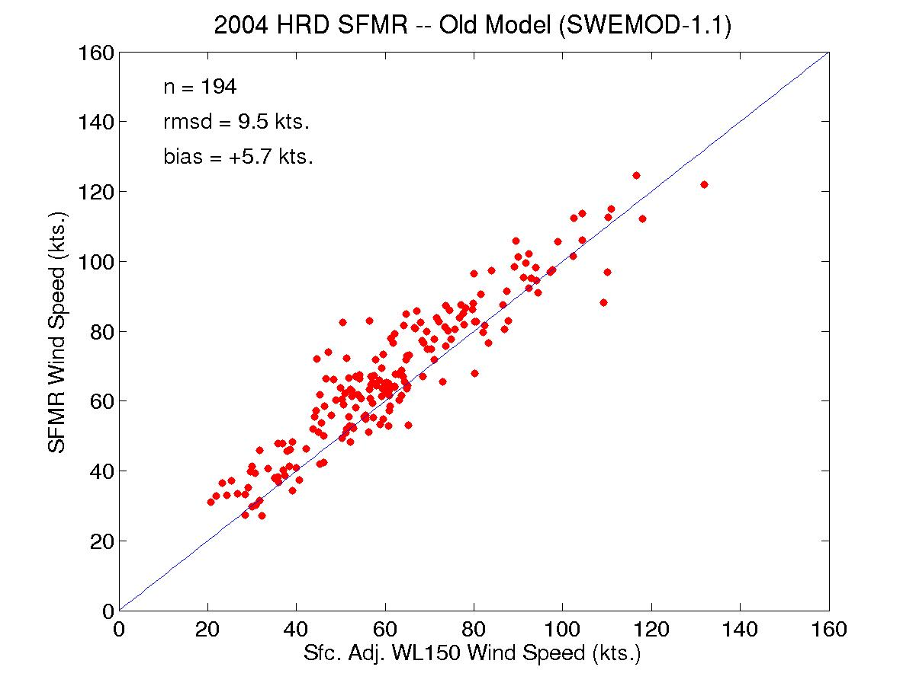
Notes:
A new wind/emissivity model was derived in 2005 from the extensive set of SFMR and dropwindsone observations in extreme CAT 4 and CAT5 conditions in Katrina and Rita. Together they formed a new relationship that is linear with wind speed above hurricane force, I.e. 33 m/s. This new relation further reduced high biases in moderate hurricane winds and low biases in extreme hurricane winds by 2-3 m/s, or about another 4%.

Slide 10
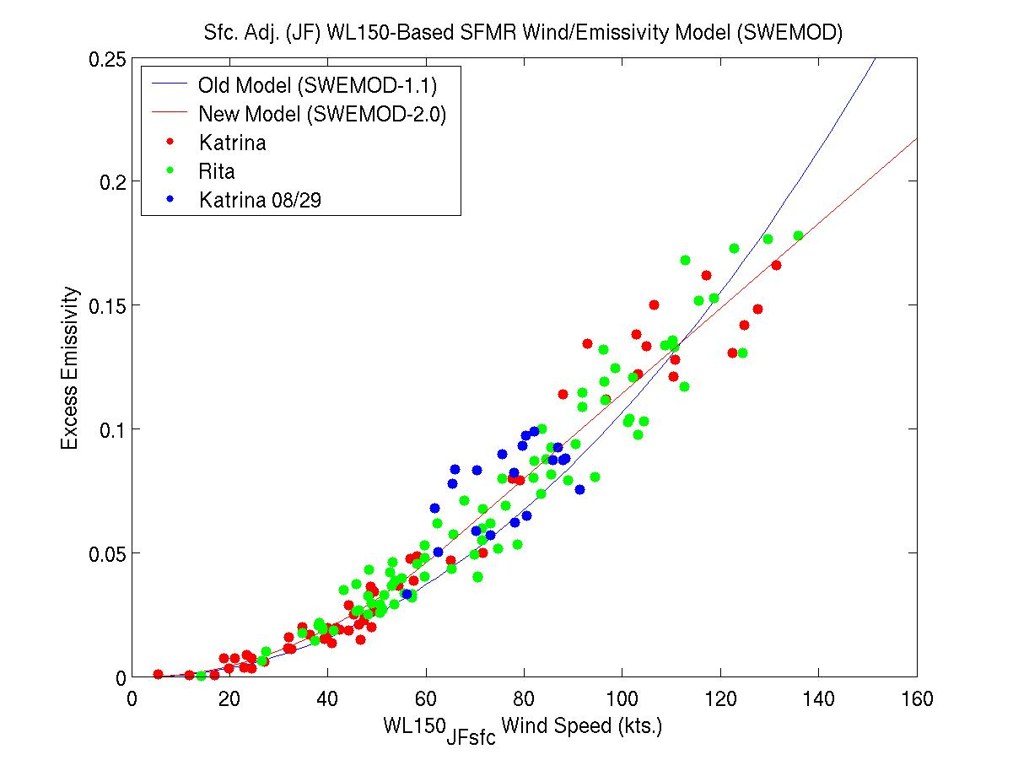
Old
Corrects moderate wind
High bias
New
Corrects extreme wind
Low bias
Notes:
A new wind/emissivity model was derived in 2005 from the extensive set of SFMR and dropwindsone observations in extreme CAT 4 and CAT5 conditions in Katrina and Rita. Together they formed a new relationship that is linear with wind speed above hurricane force, I.e. 33 m/s. This new relation further reduced high biases in moderate hurricane winds and low biases in extreme hurricane winds by 2-3 m/s, or about another 4%.

Slide 11
New SFMR Wind/Emissivity Model Function

Slide 12
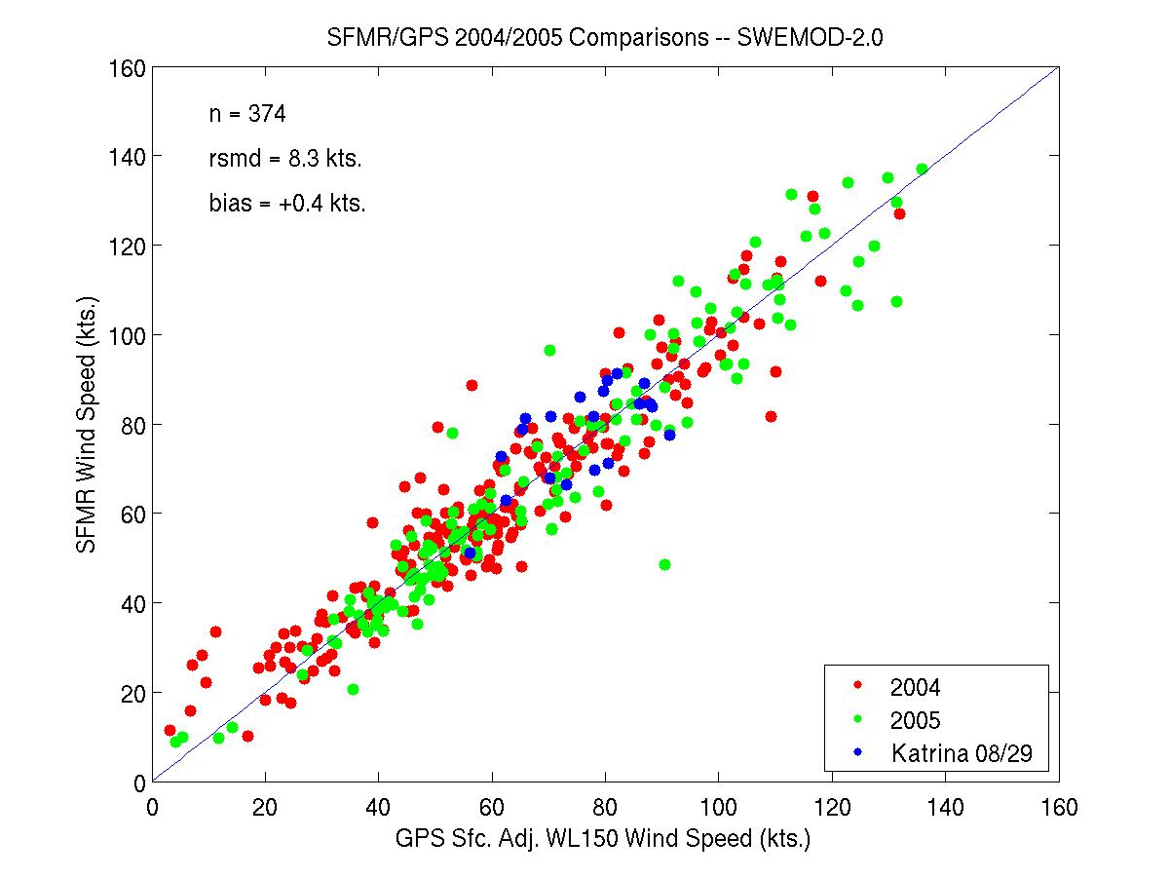
Notes:
A new wind/emissivity model was derived in 2005 from the extensive set of SFMR and dropwindsone observations in extreme CAT 4 and CAT5 conditions in Katrina and Rita. Together they formed a new relationship that is linear with wind speed above hurricane force, I.e. 33 m/s. This new relation further reduced high biases in moderate hurricane winds and low biases in extreme hurricane winds by 2-3 m/s, or about another 4%.

Slide 13
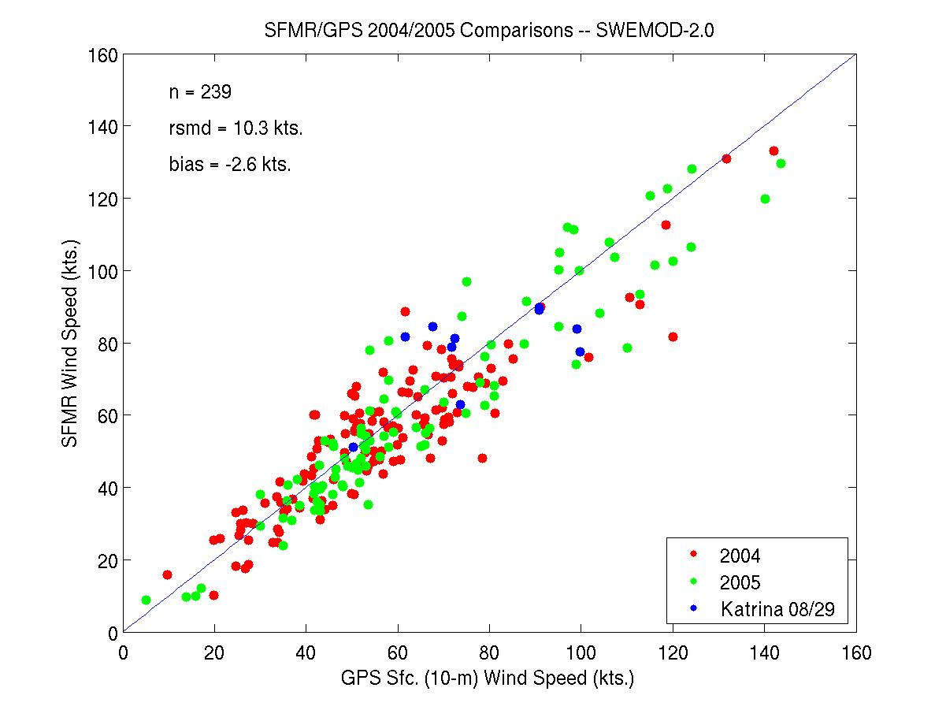
Notes:
A new wind/emissivity model was derived in 2005 from the extensive set of SFMR and dropwindsone observations in extreme CAT 4 and CAT5 conditions in Katrina and Rita. Together they formed a new relationship that is linear with wind speed above hurricane force, I.e. 33 m/s. This new relation further reduced high biases in moderate hurricane winds and low biases in extreme hurricane winds by 2-3 m/s, or about another 4%.

Slide 14
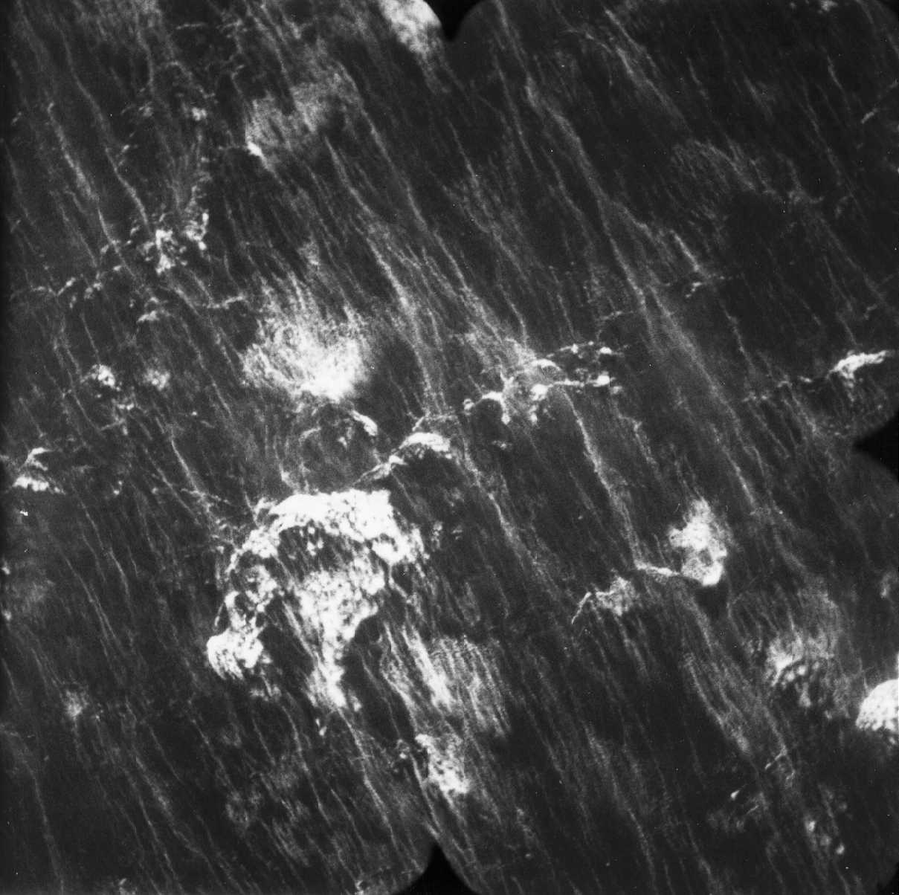
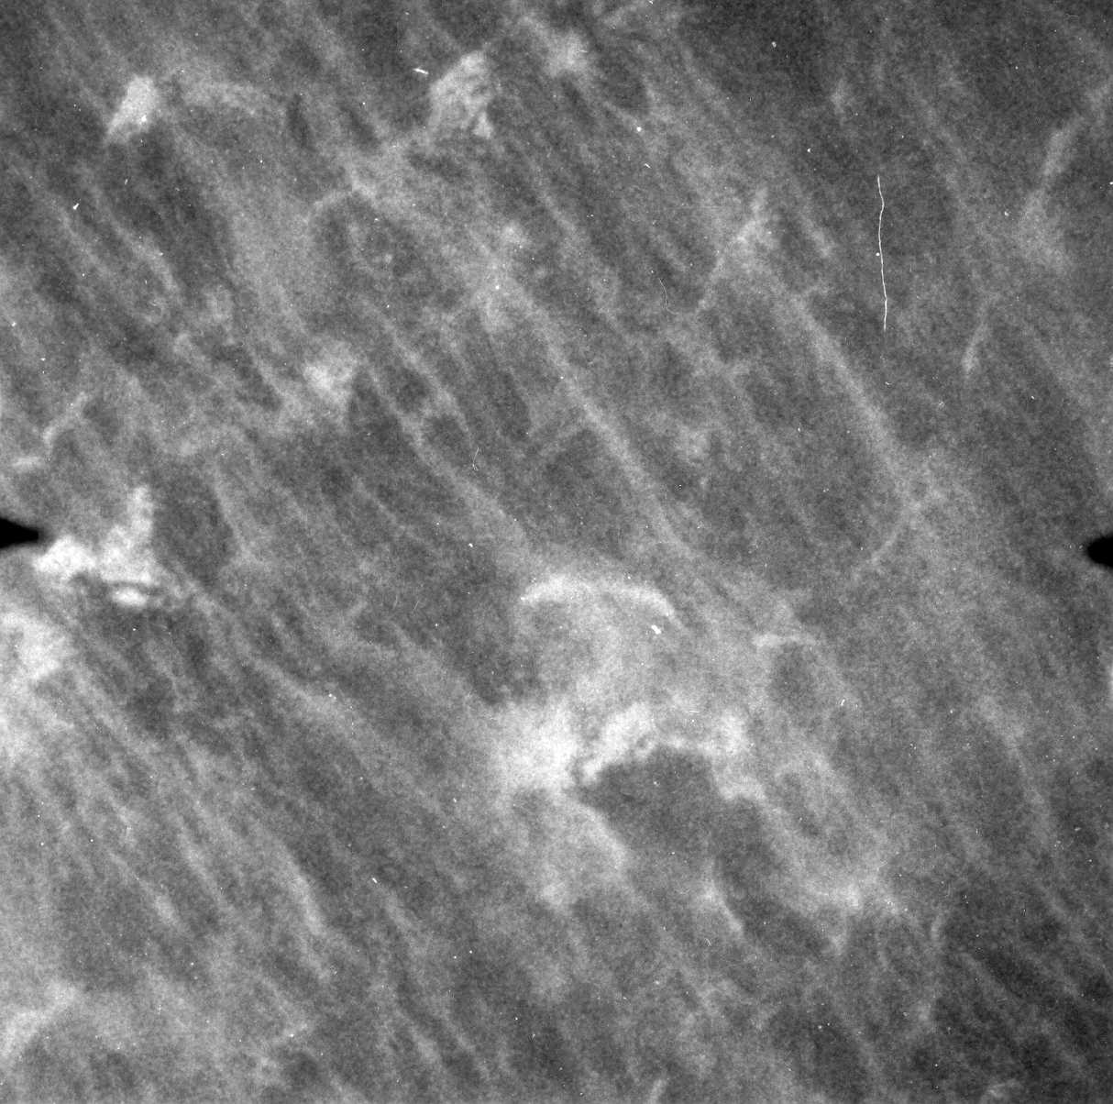
Ocean Surface Whitecaps and Foam Streaks
in a Hurricane
200 m
Wind speed ~28m/s
200 m
Wind Speed ~ 46 m/s
Notes:
The approximate field of view of the SFMR from 1500 m altitude showing the visual appearance of the foam and whitecap coverage change from 28-46 m/s.

Slide 15
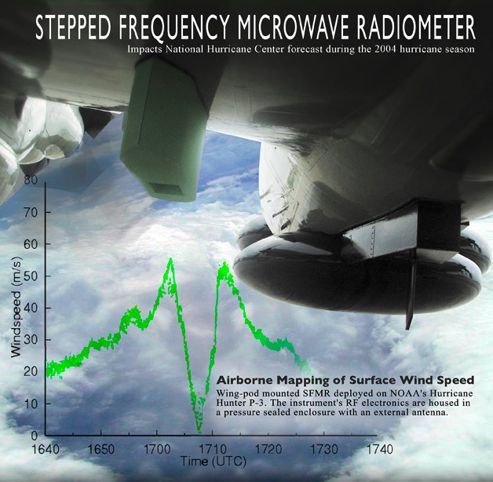
SFMR measures C-band microwave emission from foam (air bubbles in the ocean)
First guess pre-2005: Emissivity a quadratic function of wind speed for all winds.
2005 new knowledge: Emissivity a quadratic function of wind up to hurricane force only- a linear function for hurricane winds
Notes:
The SFMR is a new airborne remote sensing technology that measures sea surface emissivity at C-band. This quantity is direct measure of the concentration of bubbles in the ocean surface layer caused by wave breaking across the entire surface oceann wave spectrum. This quantity is shown to be a primarily a function of wind speed, based on more than 300 dropwindsonde obervations (Uhlhorn and Black, 2003) but is also dependent on surface roughness effects caused by wind/current interaction, anomalous wave breaking in shallow water and large sea surface temperature changes.
This instrument therefore allows observations of surface wind speed to be made with an uncertainty of ±3-4 m/s, a nearly factor of two improvement over techniques used to estimate hurricane surface wind speeds over the ocean from flight level aircraft observations.

Slide 16
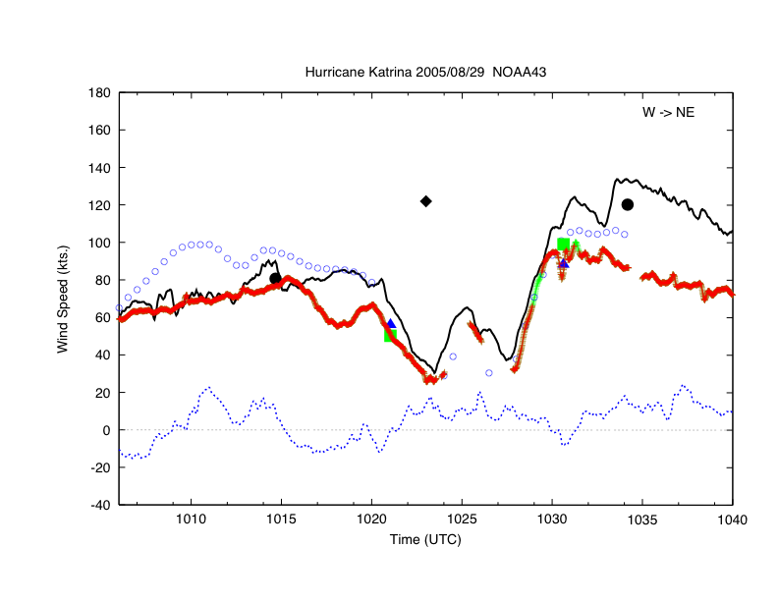
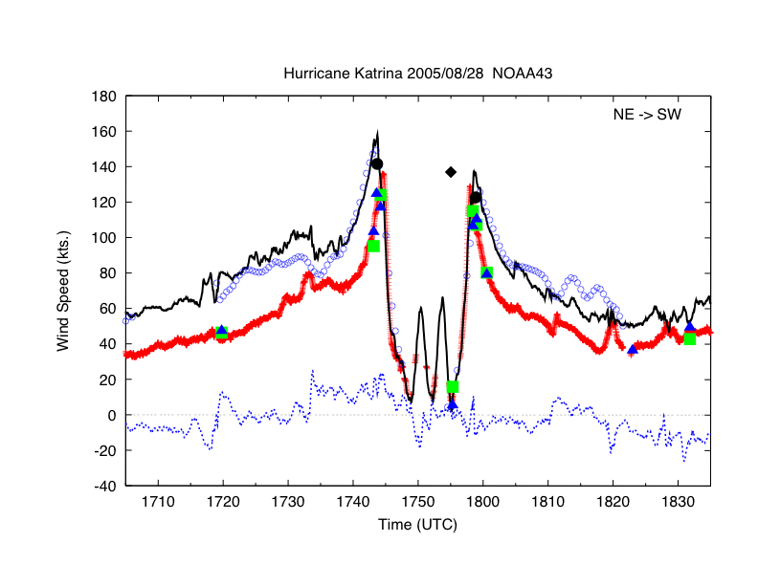
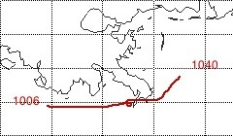
Hurricane Katrina- SFMR
29 Aug
Flat profile: Vmaxsfc=100 kt
28 Aug- Sharply peaked profile
Vmaxsfc= 142 kt
Red- SFMR sfc wind
Black- 700 mb flight level wind
Dot- Vmaxsfc NHC method
Diamond- Vmaxsfc Press/Wind
Square- GPS 10-m estimate
Triangle- GPS 10-m measurement
Open circle- 700 mb Gradient Wind
Blue dashed- Radial wind
Notes:
SFMR observations from the 28th when Katrina achieved CAT5 status indicated close agreement between SFMR surface wind estimates of 138 kt, dropsonde peak wind estimates and surface winds estimated from standard flight level reduction from 3 km altitiude (142 kt). These methods also agreed with peak gradient wind estimates from flight level pressure measurements and with peak intensity estimated from standard pressure/wind nomograms. However, 10 hrs after these measurements, when Katrina made landfall, SFMR wind estimates showed a drastically lower surface wind (100 kt) than that estimated from flight level (still 136 kt- in rough agreement with the pressure/wind nomogram estimate). However, the SFMR measurements did agree with spot dropsonde measurements showing that SFMR observations were indeed valid. The problem arose because the SFMR ovservatons came in after the CAT4 intensity at landfall determination was made, they were seemingly unusually low. Additional passes were required to establish validity.

Slide 17
Averaging Considerations
Model function
  All SFMR channels update several times (~3s) over a 10s period
  Correlate surface-adjusted WL150 wind speed (avg time = ??) with 10-s average SFMR (frequency-independent) emissivity
  Cross-track footprint (22 deg) vs along-track footprint for 10, 30, 60 s avg time @ 110 m/s (220 kt) GS:
    RA = 330m (1500’): 0.2x1.3 km, 0.2x3.9 km, 0.2x7.8 km
    RA = 1500m (5000’): 0.6x1.7 km, 0.6x5.1 km, 0.6x 10.2 km
    RA = 3000m (10000’): 1.3x2.4 km, 1.3x7.2 km, 1.3x14.4 km
  Reference: Swell wavelength ~ 200m; local sea ~ 75m
  Issue: time required for air parcel at different wind speed to travel across one beamwidth on the surface
  OR: time required for foam coverage to respond to changes in the wind
  Consideration: since all waves from cm-scale capillaries up to the peak are likely breaking in hurricane conditions, time scale likely small~ minutes??

Slide 18
Averaging Considerations (Cont’d)
Real time wind retrieval
  Transmitted retrieval averaging tied to data rate in past
  Need to be made consistent across all aircraft, i.e. IHC06 Agenda item proposal for 30-s average

Slide 19
Quality Control
Basic QC checks
  Outlier TB measurements
  Aircraft pitch, rolls (> 6 deg)
  Over-land measurements (Tb> 270K)
External QC
  Landmasking
  Bathymetry
  Improved SST
NOAA flight director’s discretion (yes/no decision on data transmission)
Many issues are to be addressed by JHT

Slide 20
Other SFMR Issues
(for SFMR JHT, YR 2)
Bathymetry
  SFMR issues in shallow water are still merely anecdotal, theory suggests that winds may be overestimated in ‘surf zone’ where swell breaking in shallow conditions
  ‘Sheltered’ shallow water (offshore flow, Bahama Banks, Lake Ponchartrain) wind retrievals ‘look good’
  To be addressed by excluding near-coastline “shallow-water” retrievals; extensive shallow-water dropsonde obs
  Similar issue with wind/current interactions (no quantitative info), i.e. Gulf Stream, Loop Current boundaries
Rain
  Has little effect on results at high (> 50 kt) winds, even in extreme rainrates (~ 50 mm/hr)
  Weaker winds have tendency to be overestimated in heavy rain (e.g. in an outer rainband) – Issue is due to emissivity-rain model bias

Slide 21
WC-130J SFMR Installation Status
Dec., 2004- $10.5M supplemental to DoD for SFMR on AFRC WC-130J’s
26 July, 2005- first Technical Interchange Meeting (TIM) at Wright-Paterson to define project scope- delivery of first SFMR set for Sept, 2006
Oct., 2005- Lockheed (LM) under contract
17 Nov., 2005- Second TIM at LM/Dobbins
Feb, 2006- Air Force purchasing office announces slippage in delivery to Jan, 2007
Mar, 2006- ProSensing under subcontract
Mar, 2006- With NOAA concurrence, G-IV SFMR to LM moves delivery to Nov, 2006
Mar, 2006- still no contract for delivery of remaining 9 SFMR units to operational WC-130J’s.

