Slide 1


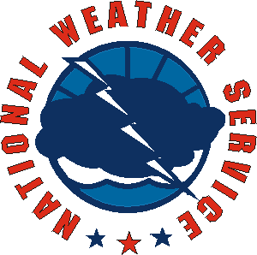
New Marine Weather Warning Product
Partners Meeting
June 6, 2006
Mark Tew
Office of Climate, Water, and Weather Services
National Weather Service
New Marine Weather Warning Product
Notes:
Self introduction and introduction of topic.

Slide 2
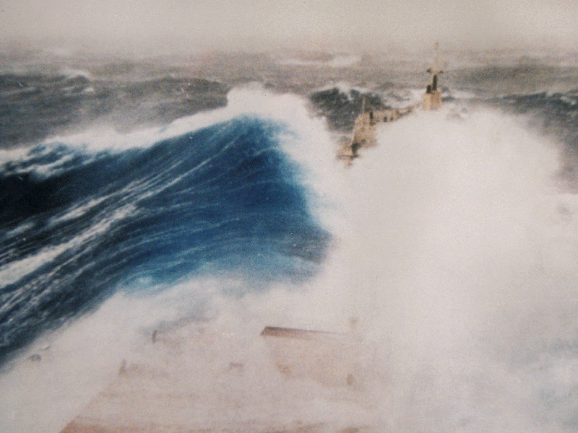
Outline
1. Current Marine Weather Warning Product
2. Proposal Overview and Motivation
3. Examples
4. Summary
New Marine Weather Warning Product

Slide 3
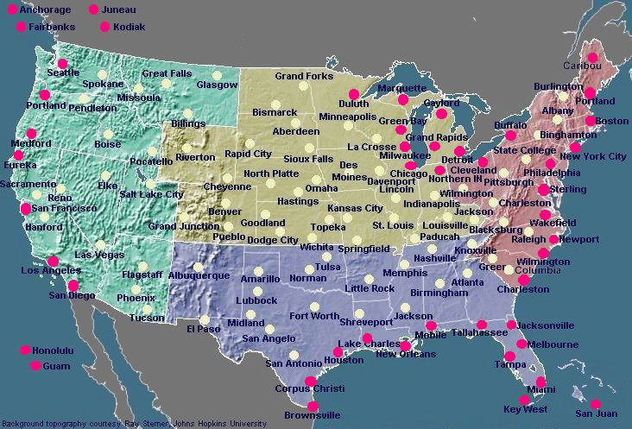
COASTAL AND GREAT LAKES OFFICES
New Marine Weather Warning Product

Slide 4
Current Long Duration
Marine Warning Program
Marine Weather Warnings and Advisories
  Hurricane Force Wind Warning
  Storm Warning
  Gale Warning
  Small Craft Advisories
No Specific Marine Weather Warning Product
  Marine Hazards Headlined in Coastal Waters Forecast (CWF)
  CWF Contains VTEC String(s)
No Current Marine Weather Watch Product
No Current Marine Outlook Product
New Marine Weather Warning Product

Slide 5
Small Craft Advisory in CWF
SC.Y in
VTEC String
ANZ532>534-030815- /O.CON.KLWX.SC.Y.0071.060603T1200Z-060604T0100Z/ CHESAPEAKE BAY FROM SANDY POINT TO NORTH BEACH- CHESAPEAKE BAY FROM NORTH BEACH TO DRUM POINT- CHESAPEAKE BAY FROM DRUM POINT TO SMITH POINT- 423 PM EDT FRI JUN 2 2006
...SMALL CRAFT ADVISORY REMAINS IN EFFECT FROM SATURDAY MORNING THROUGH SATURDAY EVENING...
.TONIGHT...S WINDS 10 TO 15 KT. WAVES 2 FT. SHOWERS AND TSTMS. VSBY 1 TO 3 NM.
.SAT...SW WINDS 15 TO 20 KT. WAVES 3 FT. SHOWERS LIKELY WITH A CHANCE OF TSTMS. VSBY 1 TO 3 NM.
.SAT NIGHT...N WINDS 15 TO 20 KT EARLY IN THE EVENING...DECREASING TO 10 TO 15 KT. WAVES 3 FT.
.SUN...NE WINDS 15 KT. WAVES 2 FT.
.SUN NIGHT...E WINDS 10 KT. WAVES 1 FT. A CHANCE OF SHOWERS AND TSTMS.
.MON...NE WINDS 10 KT. WAVES 1 FT. A CHANCE OF SHOWERS AND TSTMS.
.MON NIGHT...NE WINDS 5 TO 10 KT. WAVES 1 FT.
.TUE...NE WINDS 5 KT. WAVES 1 FT OR LESS. .WED...LIGHT WINDS...BECOMING W 5 KT. WAVES 1 FT OR LESS.
WINDS AND WAVES HIGHER IN AND NEAR TSTMS.
$$
New Marine Weather Warning Product

Slide 6
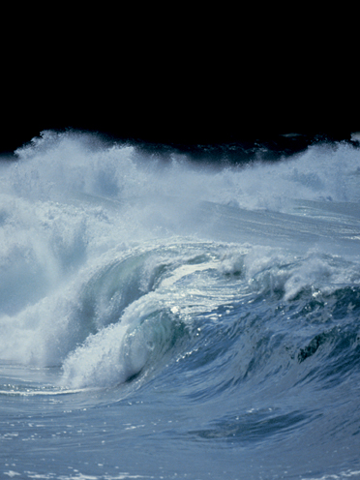
Proposal overview
1. Marine program adopts:
Outlook/Watch/Warning/ Advisory
2. Create new product :
Marine Weather Warning (MWW)
(used for watches and warnings)
New Marine Weather Warning Product

Slide 7
Outlook/Watch/Warning/Advisory
Outlook:
Early heads up, with event starting in days 3-5
Watch:
Warning conditions probable but not certain. Used when event starts 12-48 hours out.
Warning:
Warning conditions occurring, imminent, or highly probable, with event occurring in 0-36 hrs
New Marine Weather Warning Product

Slide 8
Outlook/Watch/Warning/Advisory
Advisory:
Used for conditions less than meeting Warning Criteria.
Appropriate when advisory conditions are occurring, imminent, or highly probable, with event occurring in 0-24 hrs
New Marine Weather Warning Product

Slide 9
Motivation - Consistency
Winter Weather Outlook
Winter Weather Watch
Winter Weather Warning
Winter Weather Advisory
Flood Potential Outlook
Flood Watch
Flood Warning
Flood Advisory
New Marine Weather Warning Product

Slide 10
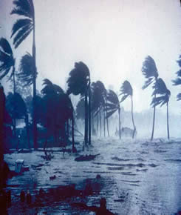
Motivation – provides needed tools
Current practice shows the need:
“Gale Warning Expected on Tuesday”
“Storm Force Winds probable for Wednesday”
New Marine Weather Warning Product

Slide 11
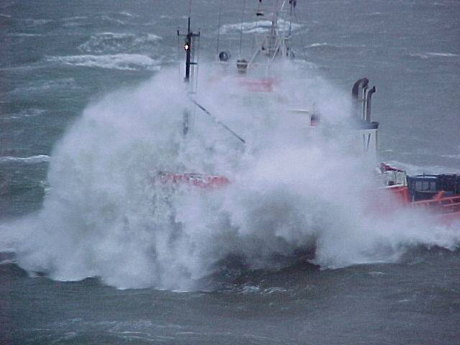
New Product:
Marine Weather Warning
Allows for more detailed information than can be included in a Coastal Waters Forecast.
Used for Watches and Warnings
Can be optionally
used for Advisories
New Marine Weather Warning Product

Slide 12
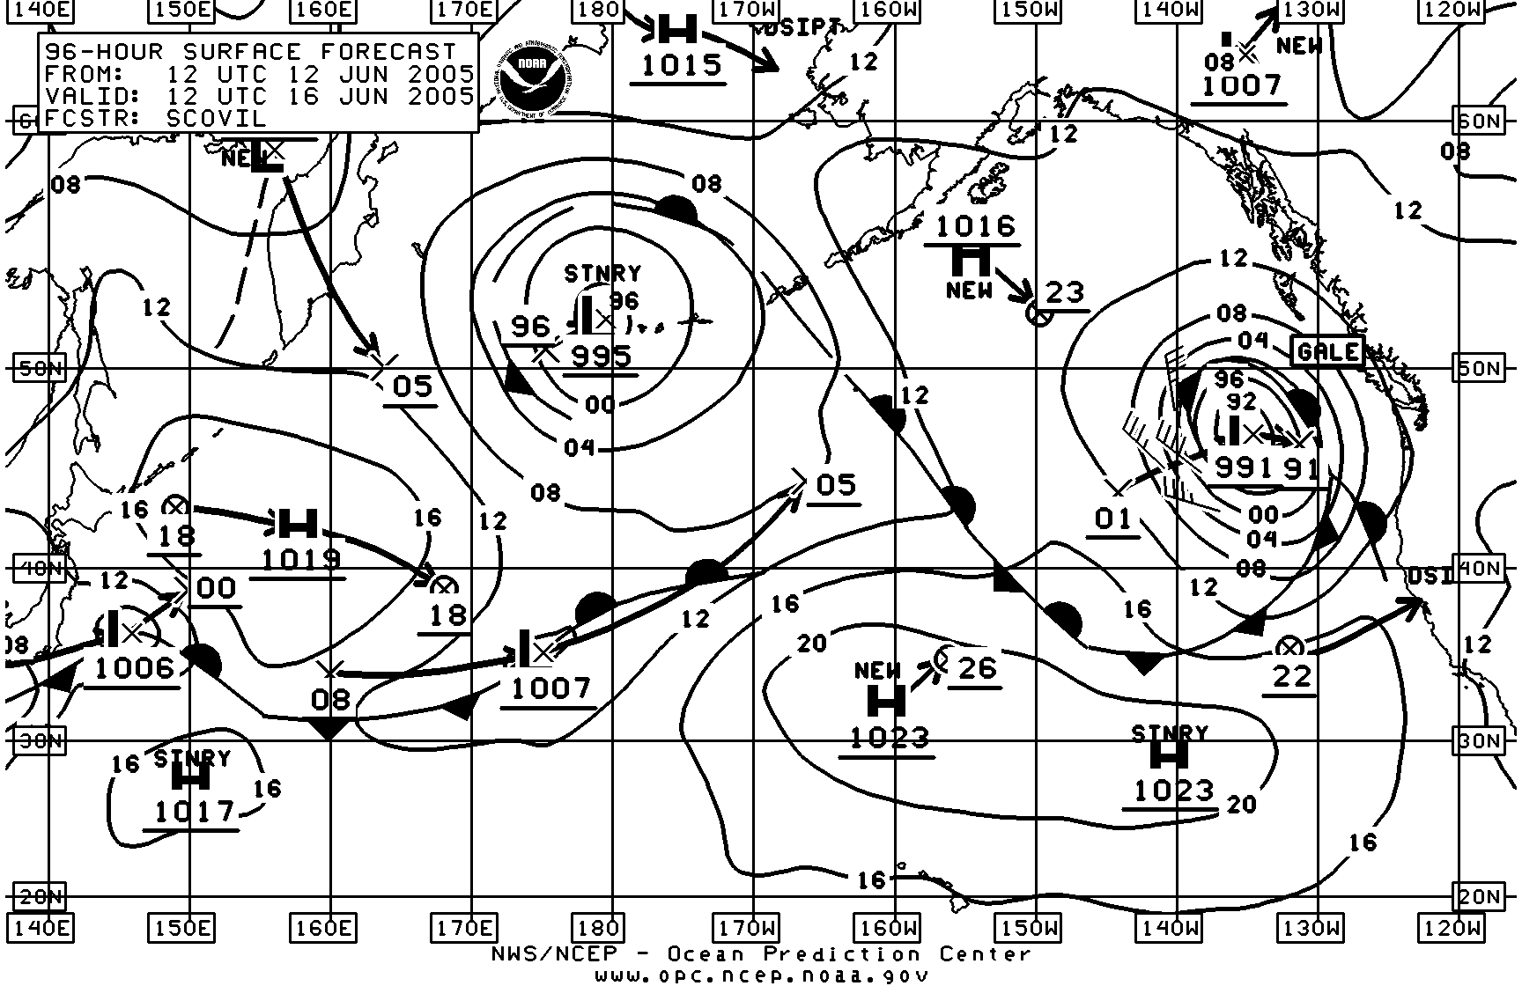
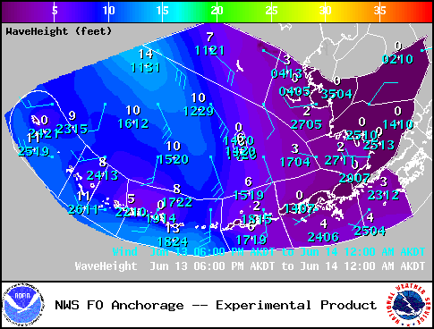
Motivation – value to customer
The new Marine Weather Warning will allow forecasters to paint a picture of the synoptic situation and link it to the resulting hazardous wind or seas situation
Current approach does not connect the “why” with the “what”
New Marine Weather Warning Product

Slide 13
Marine Wind Watch - MWW
Overview:
…GALE WINDS EXPECTED FROM PT ST GEORGE TO CAPE MENDOCINO FROM 20 NM TO 60 NM ON FRIDAY…
. STRONG LOW PRESSURE OVER THE GULF OF ALASKA WILL MOVE INTO THE NORTHERN CALIFORNIA COASTAL WATERS BY THURSDAY. WINDS WILL INCREASE WITH THE APPROACH OF THE STORM AND REACH THE HIGHEST SPEEDS ON FRIDAY. THE WINDS ARE EXPECTED TO SHIFT TO THE WEST AND DIMINISH BY FRIDAY EVENING.
New Marine Weather Warning Product

Slide 14
Marine Wind Watch - MWW
Segment:
...GALE WATCH FRIDAY…
SOUTH WINDS 30 TO 40 KT WITH ISOLATED GUSTS TO 50 MPH ARE POSSIBLE THURSDAY NIGHT AND FRIDAY MORNING AHEAD OF THE FRONT. THE WINDS WILL TO SHIFT TO THE WEST AND DIMINISH TO NEAR 20 MPH BY FRIDAY EVENING BEHIND THE FRONT.
$$
New Marine Weather Warning Product

Slide 15
Hazardous Seas Warning - MWW
...HAZARDOUS SEAS WARNING SUNDAY AND SUNDAY NIGHT…
LARGE NORTHWEST SWELL RESULTING FROM A LOW PRESSURE SYSTEM IN THE GULF OF ALASKA WILL APPROACH THE NORTHERN CALIFORNIA WATERS TONIGHT...WITH SEAS RISING TO 25 FEET BY THURSDAY MORNING WITH PERIODS 18 TO 20 SECONDS. AT THE SAME TIME...SOUTH WINDS WILL INCREASE TO 30 KNOTS TONIGHT...CREATING A HAZARDOUS COMBINATION OF INCREASING SOUTHERLY WIND WAVES AND LARGE NORTHWEST SWELL THROUGH THURSDAY NIGHT.
BY FRIDAY MORNING WINDS WILL DIMINISH TO NEAR 20 KNOTS...AND SWELLS WILL DIMINISH TO BELOW 10 FEET.
New Marine Weather Warning Product

Slide 16
Summary
NWS recognizes that even in the era of spatial data and information, the marine customer continues to require the highest caliber text forecasts and warning products.
Furthermore, because marine customers are also land customers, the format of the marine forecasts should be consistent with that of the land forecasts.
New Marine Weather Warning Product

Slide 17
Partner Feedback
Should we move forward with the
new Marine Weather Warning product?
NWS marine home page:
http://www.weather.gov/marine
New Marine Weather Warning Product
Notes:
Heat is the number one weather-related killer. On average, more than 1,000 people in the U.S. die each year from excessive heat. (Kalkstein et al., 1993). This number is greater than the 30-year annual number of deaths due to tornadoes, hurricanes, floods and lightning combined. In August 2003, a record heat wave in Europe claimed an estimated 35,000 lives.
1) Heat is the number one weather-related killer. On average, more than 1,000 people in the U.S. die each year from excessive heat. (Kalkstein et al., 1993). This number is greater than the 30-year annual number of deaths due to tornadoes, hurricanes, floods and lightning combined. In August 2003, a record heat wave in Europe claimed an estimated 35,000 lives.
2) Recent research has shown this method to be insufficient in predicting an increase in heat-related mortality. Excessive heat guidance related to actual mortality is needed to effectively warn of the threat from excessive heat.

