Slide 1
Recognized routes of exposure to latex
Contact with dipped NRL products (gloves)
Exposure to aerosilized latex (glove powder)
Exposure to consumer NRL products
Cross sensitization from foods
Inadvertent exposures

Slide 2
Inadvertent exposure to latex
Latex glove and glove powder exposure at work and brought home on clothes and hair
Latex glove use by Food Service personnel transferring allergens to food
Notes:
There are many anecdotal reports of latex reactions to glove powders brought home on clothes or in the hair.
There are also many anecdotal reports of reactivity to non-cross reacting foods prepared by persons wearing latex gloves.
While I don’t think this is a significant route of sensitization, there is exposure that occurs, and the latex allergic patients are like the canaries in the mine shaft that can detect the contamination.

Slide 3
Latex allergen transfer to foods from food handlers gloves
Schwartz HJ. Latex: A potential hidden “food “ allergen in fast food restaurants. J Allergy Clin Immunol 95:139-140, 1995 (25 yo and 31 yo with anaphylaxis to fast food prepared with latex gloves)
Franklin W, Pandolfo J. Latex as a food allergen. New Eng. J. Med. Dec 9:s1858, 1999 (46 yo periodontist with anaphylaxis to OJ stirred with latex glove)
Beezhold D, Reschke J, Allen J, Kostyal D, Sussman G. Latex protein: A hidden food allergen? Allergy Asthma Proceedings 21:301-306, 2000. (29 yo hygienist anaphylaxis to salad prepared with latex gloves)
Bernardini R, Novembre E, Lombardi E, Pucci N, Marcucci F, Vierucci A. Anaphylaxis to latex after ingestion of a cream-filled doughnut contaminated with latex. J Allergy Clin Immunol. 2002 Sep;110(3):534-5. (10 yo boy with anaphylaxis to latex contaminated doughnuts)

Slide 4
Case report
29 yo female dental hygienist
Latex allergy diagnose (1994)
No symptomatic food allergy but SPT+ to potato
30 min after eating a restaurant salad, has wheezing, angioedema (eyes swell shut), pruritis, throat tightness, lightheadedness, and blacks out.

Slide 5

Protein level of gloves
* In June/03, LTS tested a “food service” glove with Lowry of 1040 µg/gm

Slide 6
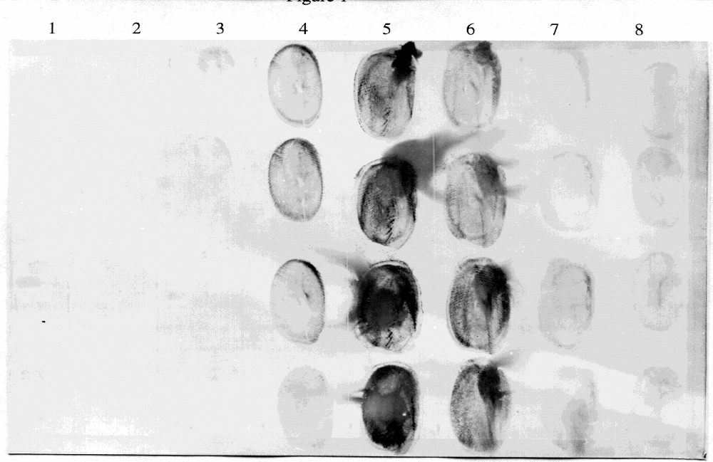
Transfer of latex protein from gloves
1 vinyl
2 vinyl
3 PF Surgical
4 powd Exam
5 powd Exam
6 powd Exam
7 powd Exam
8 powd Exam
Notes:
I briefly want to show some recent data on transfer of latex allergens to foods.
This is the transfer of proteins from single 3 second finger contacts of gloved hands to a nitrocellulose membrane.
Vinyl controls show no transfer
PF little transfer and exam significant transfer
These last 4 lanes are a single glove brand with expiration dates of 93, 97, 01, 02. We chose to work with lane 5 glove to make detection easier.

Slide 7
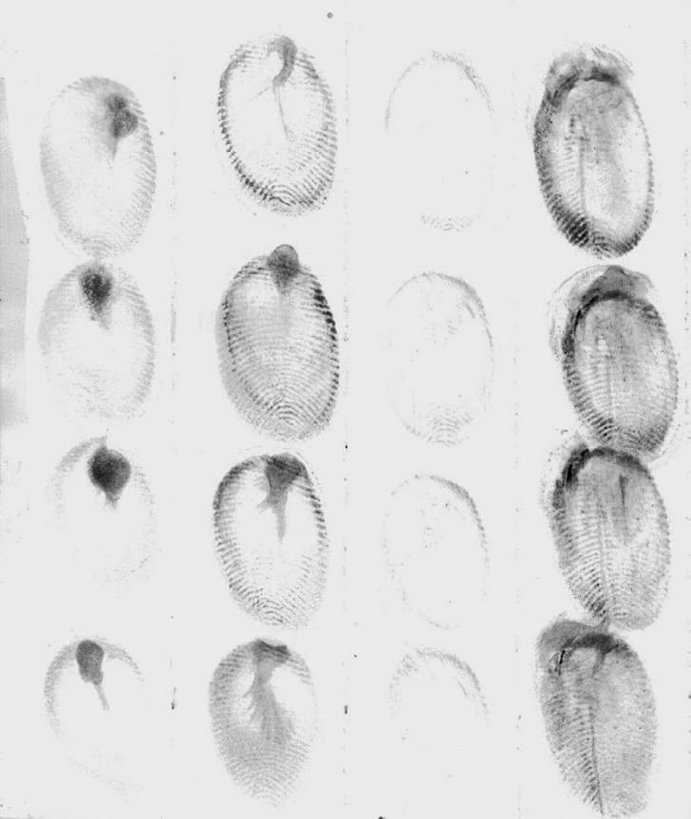
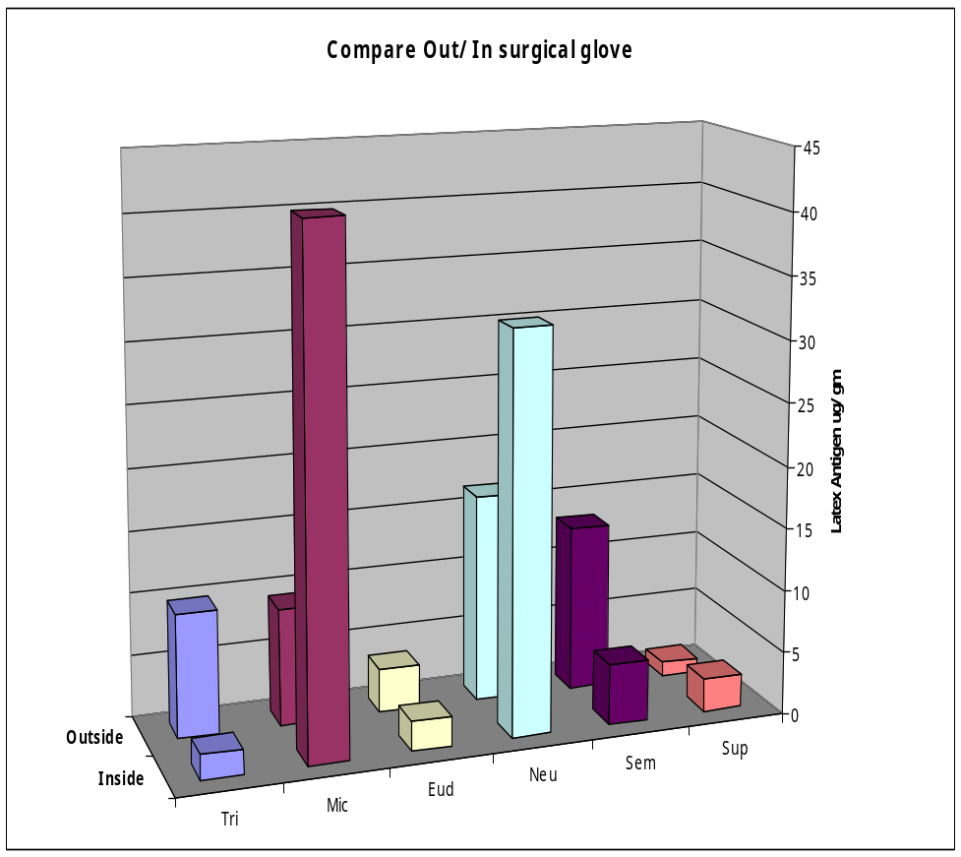
Comparison of protein levels on the inside and outside of gloves
Out In Out In
Exam gloves
Surgical gloves

Slide 8
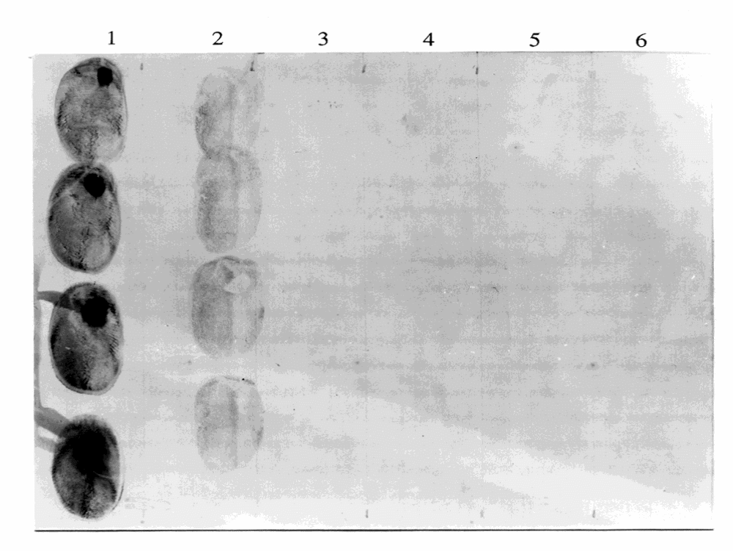
Transfer of latex allergen from gloves to food (cheese)
1 latex exam control
2 transfer to cheese
3 vinyl control #1
4 transfer to cheese
5 vinyl control #2
6 transfer to cheese
Notes:
In this experiment we performed the finger prints on a piece of cheese and then transferred the cheese to nitro and processed for latex
As you can see latex gloves transfer protein to cheese but vinyl gloves do not

Slide 9
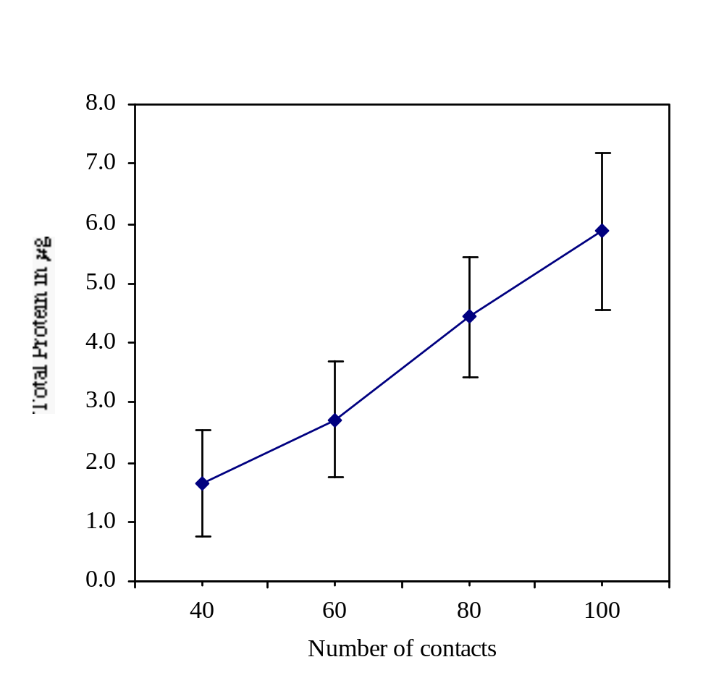
Transfer of latex protein from gloves to lettuce
Notes:
If you handle lettuce leaves with latex gloves, then extract it, an increase in latex protein is detectable on lettuce leaves dependent on the number of contacts
.
Vinyl gloves and lettuce alone were negative in the ELISA assay.
The data demonstrates that latex glove can transfer latex allergens to foods, and therefore all food service personnel should avoid the use of latex gloves.

Slide 10

Amount of antigenic latex protein transferred
* 70 pg/ml can produce a positive SPT in highly sensitized patients

Slide 11
Conclusions
Food contact with latex gloves does result in contamination of food with latex proteins
This may represent a minor route for sensitization
However, food contamination by food handlers gloves can cause significant reactions in unsuspecting latex allergic individuals
Notes:
Studies with different patient groups suggests that the primary sensitization is to latex, IgE inhibition assays reinforce this since latex is a stronger inhibitor than the foods.
And finally I showed you data to demonstrate that food contact with latex can result in contamination. Although a minor route of sensitization, latex gloves should be removed from food establishments.
Thank you for your kind attention.

Slide 12
Letters supporting removal of latex gloves from food service
3 Latex allergy support groups (Spina Bifida Association, Latex Allergy Support Group (UK), Potomac Latex Allergy Association)
3 MDs (2 with latex allergy)
7 RNs
3 others (hygienist, parents)

