Slide 1

DoD
Smallpox Vaccination Program
Science – Quality – Confidence – Care
3 June 2003
COL John D. Grabenstein, RPh, PhD
Military Vaccine (MILVAX) Agency
U.S. Army Surgeon General’s Office

Slide 2
DoD Smallpox Vaccination Policy
Announced by President Bush, 13 Dec 02.
  Vaccinating troops before an attack is best way to ensure they are protected and can continue their missions.
Stages:
  Stage 1a: Smallpox Epidemic Response Teams (SERTs).
    2,000 to 5,000 people, began mid-Dec 02
  Stage 1b: Medical Teams for Hospitals & Large Clinics.
    10,000 to 25,000 people, began early Jan 03
  Stage 2: Mission-Critical Forces, especially CENTCOM.
    About 500,000 troops, began early Jan 03

Slide 3
Precautions in Vaccination
Education up front and throughout process
Screening for contraindications (same as FDA and ACIP)
Periodic HIV screening
Pregnancy screening and testing
QA of Vaccinator: Evaluate take rates among first cohort of people (e.g., 50) vaccinated by each vaccinator
Healthcare Workers: Bandages, sleeves, hand-washing, site-evaluation stations
Military-Unique Settings: No hot-bunking with vaccine exempt
Documentation: Screening, Vaccination, Take Confirmation, Adverse Events
VIG prepositioned around globe, regionally

Slide 4
DoD Smallpox Vaccination Program as of 28 May 03 :
Response teams, hospital workers, operational forces vaccinated:
  2 Feb 03: Screened: 105,423 Vaccinated: 87,853
  28 May 03: Screened: 540,352 Vaccinated: 450,293
  Male: 87%, Female: 13%
  Primary: 70%, Revaccination: 30%
Exemption rates vary by location and setting:
  Exemption: Personal: 4.9% to 7.8%. Personal + household: 11% to 34%
Take: Primary, 3 jabs: 96%. Revaccination, 15 jabs: 96%
Notes:
* A 55-year-old male National Guard soldier called to active duty had a heart attack on March 25, 2003, at a U.S. installation. He died late on March 26, 2003. The heart attack occurred 5 days after smallpox vaccination. Autopsy findings indicate that this man had substantial narrowing of the blood vessels in his heart that existed before vaccination, as well as prior heart disease. At this stage of the investigation, this evidence of pre-existing illness, coupled with other findings and risk factors in his medical history, indicate that smallpox vaccination was unlikely to be the cause of his death. Evidence shows that he did NOT have myo/pericarditis. Additional tests will be conducted, including tests at the Armed Forces Institute of Pathology (AFIP).
A 22-year-old soldier assigned to 452d Combat Support Hospital, processing at Fort McCoy, was admitted to St. Francis Medical Center, LaCrosse, WI, for a lingering respiratory syndrome. On 1 Apr 03, she developed high fevers (40°C) and became depressed, but had no neurologic signs. On 2 Apr 03, she had grew increasingly agitated and had a seizure; there were no focal neurologic signs. She was transferred to the Mayo Clinic, where she became unresponsive. Her electroencephalogram (EEG), with diffuse brain swelling, indicates brain death. Consulting physicians consider the cause of her death "indeterminate." Preliminary autopsy finds no encephalitis, no meningitis, no vaccinia by PCR in her spinal fluid. CDC officers have enrolled this case in their "unexplained death" program. She received smallpox, measles-mumps-rubella, anthrax, hepatitis B, and typhoid vaccinations on 2 Mar 03.

Slide 5
Symptoms After Smallpox Vaccination
Day 6-8, “Take Check,” symptoms since vaccination, n = 526, Jan-Feb 2003
Local itching 60% Muscle ache 21%
Feeling lousy 20% Lymph nodes swell 14%
Headache 18% Bandage reaction 7.4%
Itchy all over 5.5% Fever (subjective) 5.3%
Local rash 5.3% Body rash 1.1%
Eye infection 0.0%
Restricted activity 1.3% Took medication 17%
Outpatient visit 0.8% Limited duty 0.0%
Missed work 0.2% Hospitalized 0.0%

Slide 6
DoD Smallpox Vaccination Program as of 28 May 03 :
Adverse Events: Expected temporary symptoms seen.
  Sick leave: Hospital staff: 3%. In theater: 0.5%. Average: 1.5 days
Noteworthy Events:
    Generalized vaccinia—36, all mild, all recovered.
    Inadvertent infection—Skin: Self—38, Contact—19, all recovered.
    Inadvertent infection—Eye: Self—10, Contact— 2, all recovered.
    Contact transfer: Family—12, intimate contact—5, friend—4, patient—0
    VIG treatments: Burn-1, eye-1
    Encephalitis—1 recovered.
    Myo-pericarditis: Suspect—1, probable—35, confirmed—1
    Eczema vaccinatum: zero Progressive vaccinia: zero Deaths: zero *
Notes:
* A 55-year-old male National Guard soldier called to active duty had a heart attack on March 25, 2003, at a U.S. installation. He died late on March 26, 2003. The heart attack occurred 5 days after smallpox vaccination. Autopsy findings indicate that this man had substantial narrowing of the blood vessels in his heart that existed before vaccination, as well as prior heart disease. At this stage of the investigation, this evidence of pre-existing illness, coupled with other findings and risk factors in his medical history, indicate that smallpox vaccination was unlikely to be the cause of his death. Evidence shows that he did NOT have myo/pericarditis. Additional tests will be conducted, including tests at the Armed Forces Institute of Pathology (AFIP).
A 22-year-old soldier assigned to 452d Combat Support Hospital, processing at Fort McCoy, was admitted to St. Francis Medical Center, LaCrosse, WI, for a lingering respiratory syndrome. On 1 Apr 03, she developed high fevers (40°C) and became depressed, but had no neurologic signs. On 2 Apr 03, she had grew increasingly agitated and had a seizure; there were no focal neurologic signs. She was transferred to the Mayo Clinic, where she became unresponsive. Her electroencephalogram (EEG), with diffuse brain swelling, indicates brain death. Consulting physicians consider the cause of her death "indeterminate." Preliminary autopsy finds no encephalitis, no meningitis, no vaccinia by PCR in her spinal fluid. CDC officers have enrolled this case in their "unexplained death" program. She received smallpox, measles-mumps-rubella, anthrax, hepatitis B, and typhoid vaccinations on 2 Mar 03.

Slide 7
DoD Smallpox Vaccination Program
Cardiac cases, as of 28 May 03:
Personnel vaccinated: 450,293 Male: 87%, Female: 13%
  Primary vaccination: 70% Revaccination: 30%
Myo-pericarditis: Suspect—1, probable—35, confirmed—1. Pending—4
Of the first 18 cases, most thoroughly reviewed, to be published soon
  Onset interval: 7 to 19 d.
  Male: 18/18 Age: 21 to 33 years
  Primary vaccination: 18/18 Present with chest pain: 18/18
  Enzymes elevated: 18/18 ECG—ST changes: 16/18
  Echo—abnormal: 10/18 Recovery: 18/18 (follow-up planned)
  Relative risk: ~6 for 2-week interval, ~3 for 4-week interval
Conclusion: Smallpox vaccination increases risk of myo-pericarditis
Notes:
A 55-year-old male National Guard soldier called to active duty had a heart attack on March 25, 2003, at a U.S. installation. He died late on March 26, 2003. The heart attack occurred 5 days after smallpox vaccination. Autopsy findings indicate that this man had substantial narrowing of the blood vessels in his heart that existed before vaccination, as well as prior heart disease. At this stage of the investigation, this evidence of pre-existing illness, coupled with other findings and risk factors in his medical history, indicate that smallpox vaccination was unlikely to be the cause of his death. Evidence shows that he did NOT have myo/pericarditis. Additional tests will be conducted, including tests at the Armed Forces Institute of Pathology (AFIP).

Slide 8
DoD Smallpox Vaccination Program
Cardiac cases, as of 28 May 03:
Ischemic events: Probable—8. Onset interval: 2 to 14 days
  MI—4 (1 fatal), angina—2, coronary spasm—1, atrial fib—1.
  Recategorizations: 2 MIs, 1 angina to myocarditis.
  Fatality: 55 y/o smoker w/ 3-vessel coronary occlusion, left ventricular hypertrophy, cardiomegaly, no myocarditis.
  Expected ischemic admissions, 14-day window—25, upper 95% CI—30
  Cardiovascular deaths, Army: average 50 per year.
Conclusion: Ischemia after vaccination does not exceed expected level.
Notes:
A 55-year-old male National Guard soldier called to active duty had a heart attack on March 25, 2003, at a U.S. installation. He died late on March 26, 2003. The heart attack occurred 5 days after smallpox vaccination. Autopsy findings indicate that this man had substantial narrowing of the blood vessels in his heart that existed before vaccination, as well as prior heart disease. At this stage of the investigation, this evidence of pre-existing illness, coupled with other findings and risk factors in his medical history, indicate that smallpox vaccination was unlikely to be the cause of his death. Evidence shows that he did NOT have myo/pericarditis. Additional tests will be conducted, including tests at the Armed Forces Institute of Pathology (AFIP).

Slide 9
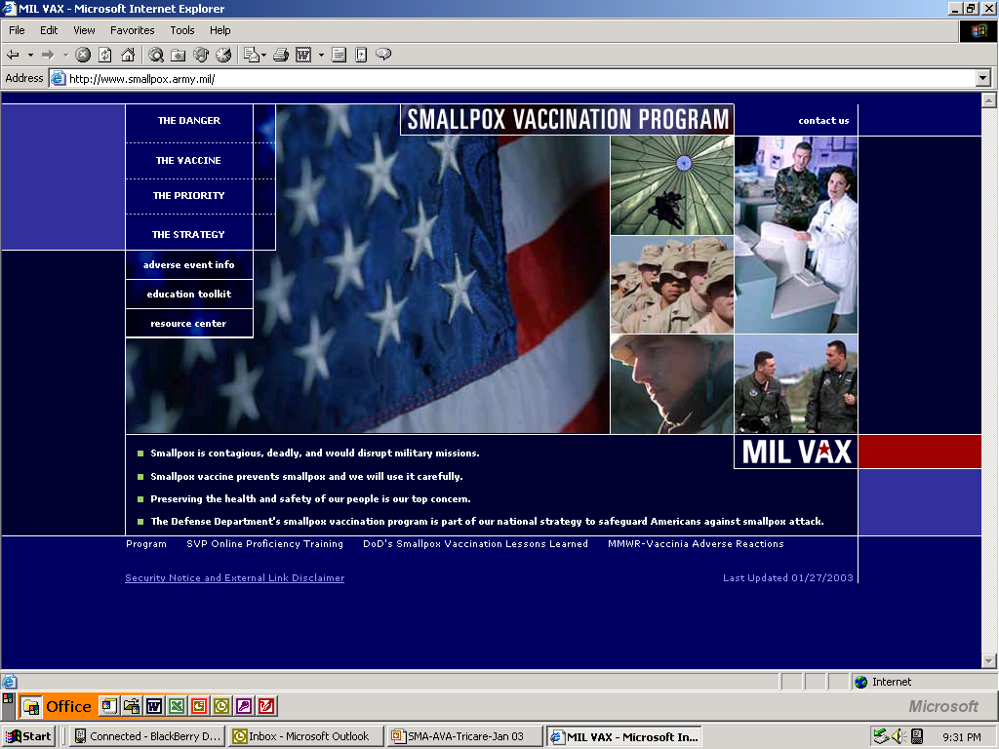
Tools & Resources
Notes:
The Vaccine Adverse Event Reporting System, referred to as VAERS, was initiated in 1990 to oversee vaccine safety issues across America. This system is managed jointly by FDA and Centers for Disease Control and Prevention (CDC). It is a ‘passive’ surveillance system. This means that it relies on health care professionals, guardians and patients to submit reports of adverse events following vaccination. Filing a VAERS report does not prove that the reaction was caused by the vaccine but only reflects an association.
Consult the Walter Reed Vaccine Health care Center (VHC) for assistance with preparing and submitting a VAERS report or vaccine adverse event consultation.

