Slide 1
Vision for
Marine and Coastal Services Digital Products
Jamie Vavra
Marine and Coastal Weather Services Branch
Office of Climate, Water and Weather Services
February 9, 2003

Slide 2
Session Outline for Marine,
Coastal, and Tropical Services
Mission
Vision for Digital Products
Forecast Areas of Responsibility
Marine Elements in NDFD
Proposed Future Marine, Coastal, and Tropical Elements in NDFD
New Product Prototyping
Research Activities in Support of Proposed New Products
Wind Grids for Hurricane Events

Slide 3
Marine and Coastal Weather Services
Mission and Responsibilities
To lead the U.S. Coastal and Marine weather forecast and warning programs for the protection of life and property, promotion of economic benefits, and the enhancement of quality of life.
Manage Products and Services for:
  Tropical Cyclone Program
    Tropical Prediction Center (TPC)
    Central Pacific Hurricane Center (CPHC)
    Weather Forecast Offices (WFOs)
  Marine Program
    Ocean Prediction Center (OPC)
    Tropical Prediction Center - Tropical Analysis Forecast Branch
    Weather Forecast Offices (WFOs)
  Coastal and Great Lakes Program
    Weather Forecast Offices (WFOs)

Slide 4
Marine and Coastal Weather Service
Vision for Digital Products
Provide weather elements we now describe in text format in gridded and graphical formats
Extend from current deterministic approach for products to increase availability of gridded and graphical probabilistic forecasts
Provide seamless product suites from WFOs and National Centers
Extend products suite to include gridded and graphical threat outlooks for Marine, Coastal and Tropical hazards

Slide 5
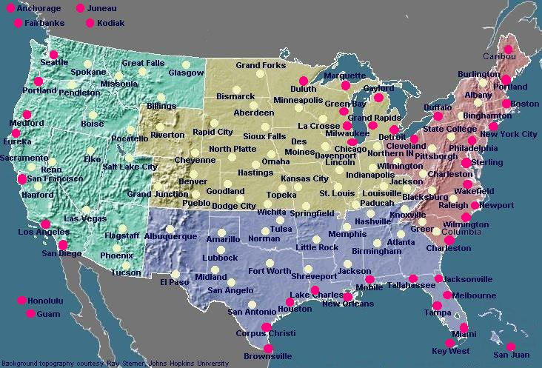
NWS Offices with Marine and Tropical Responsibility

Slide 6
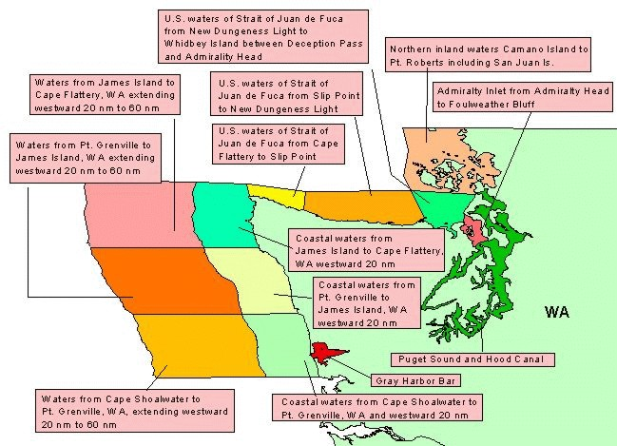
Coastal Waters Forecast Zones

Slide 7
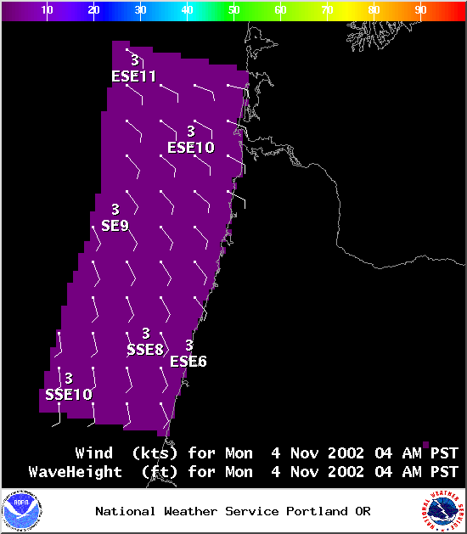
Forecast Winds and Waves for Coastal Waters Zones
WFO Portland,OR

Slide 8
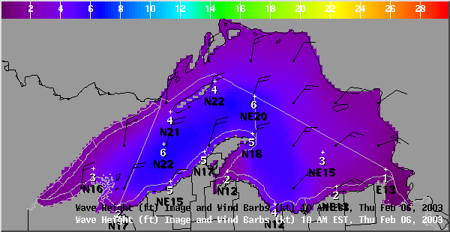
Forecast Winds and Waves for
Nearshore and Open Lakes Zones
Lake Superior Forecast by WFO Marquette,MI

Slide 9
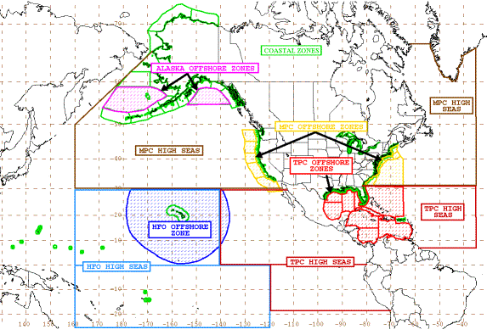
Marine and Tropical Forecast Zones

Slide 10
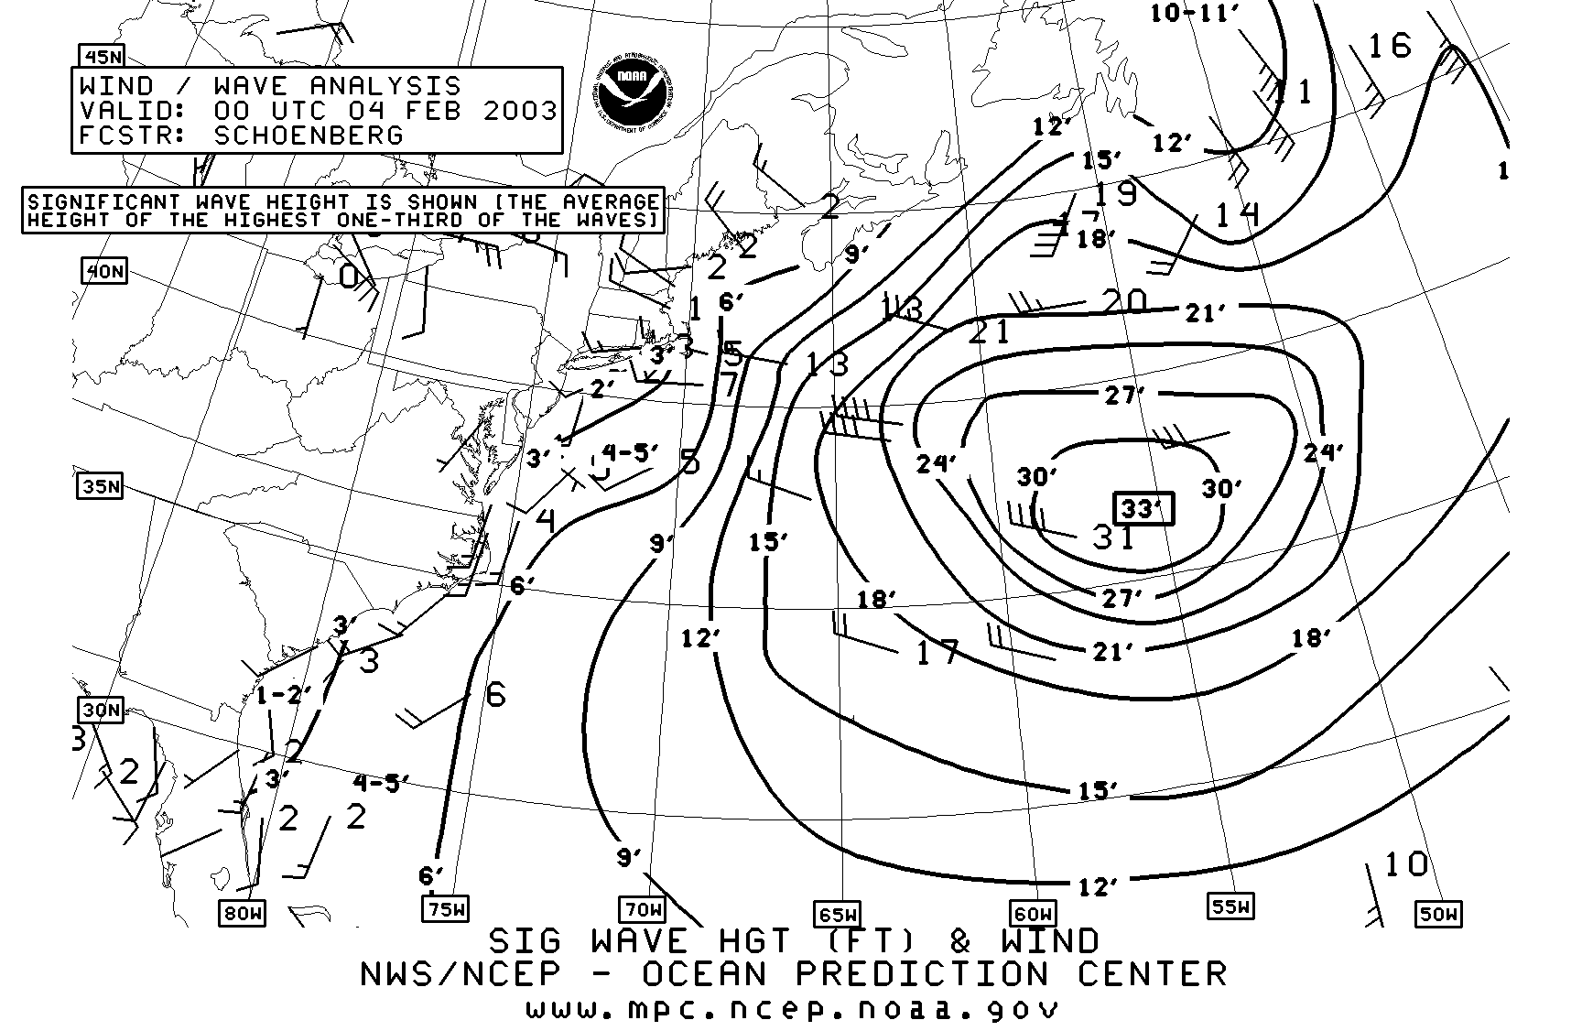
Marine Offshore Graphics

Slide 11
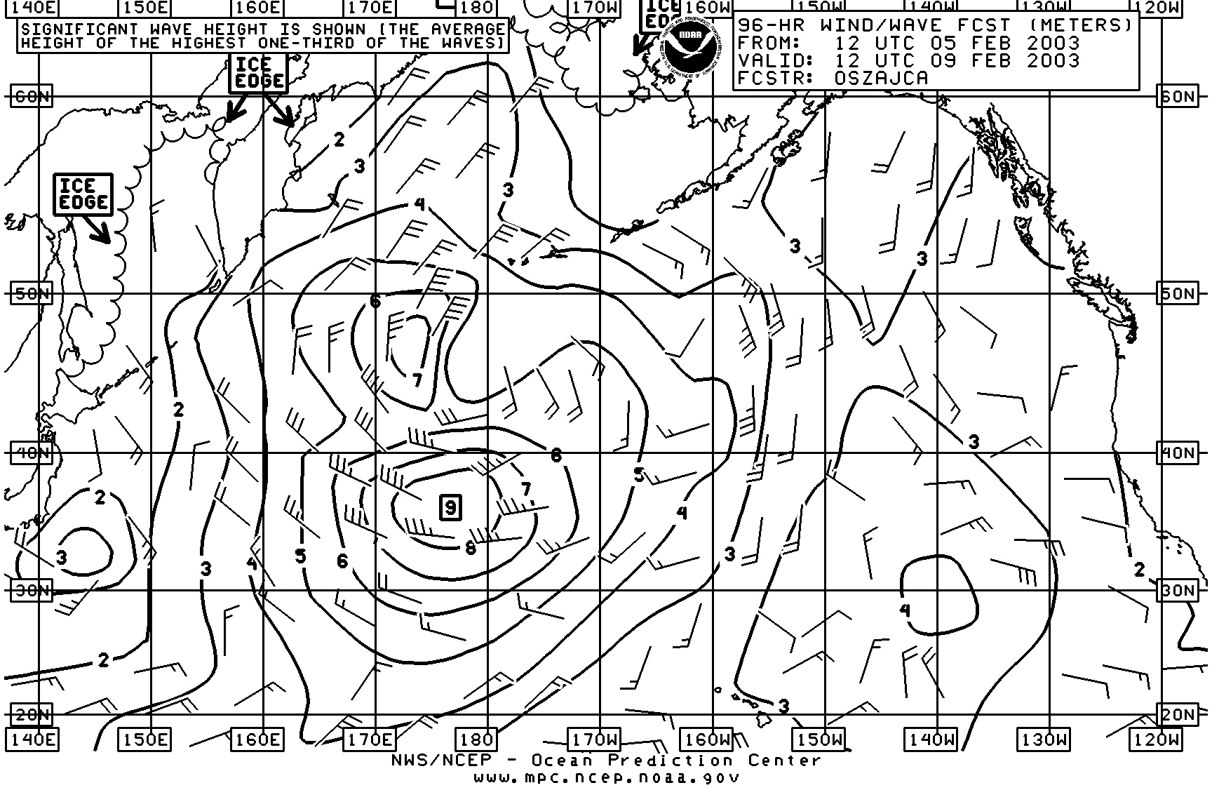
Marine High Seas Graphics

Slide 12
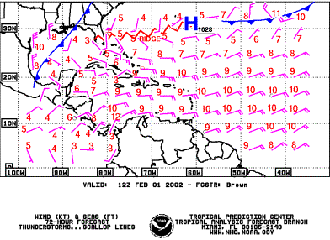
Marine High Seas Graphics

Slide 13
Initial Marine NDFD Elements
Wave Height
General Weather Elements over Coastal Waters, Nearshore and Open Lake Marine Zones:
  Air Temperature (tentatively)
  Surface Wind Direction and Speed (10 meter)
  Weather

Slide 14
Proposed Marine and Tropical
NDFD Elements
Wave Period
Wave Steepness
Swell Height and Direction
Visibility
Ice Coverage
Ice Accretion
Extend spatial domain to provide these elements over the Offshore and High Seas Zones

Slide 15
Proposed Marine and Tropical
NDFD Elements (continued)
Threat Outlooks for Tropical Cyclone Hazards such as:
  Waves, Surge, Tornados, Flash Flood, and Wind
Threat Outlooks for Marine Hazardous Weather such as:
  Waterspouts and Rip Currents
Probabilities of Wind Speed for Tropical Cyclones
  At 34 and 64 knot thresholds
Marine and Tropical Cyclone Watches and Warnings

Slide 16
Marine and Tropical New Product
National Prototyping Plans
Plans for Tropical Product
  Graphical Hurricane Local Statement
  Prototyping underway at WFO Melbourne, FL
  Planning tool for decision makers potentially impacted by tropical cyclones
  Grid over coastal land and marine zones
  Tiered threat outlook scale for hazards
  Display threat level for hazards such as:
    Storm surge
    Tornados
    Flash Flood
    Waves
    Wind

Slide 17
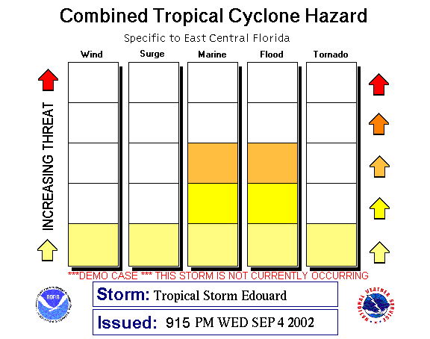
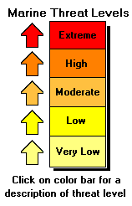
Tropical New Product
National Prototyping Plans

Slide 18
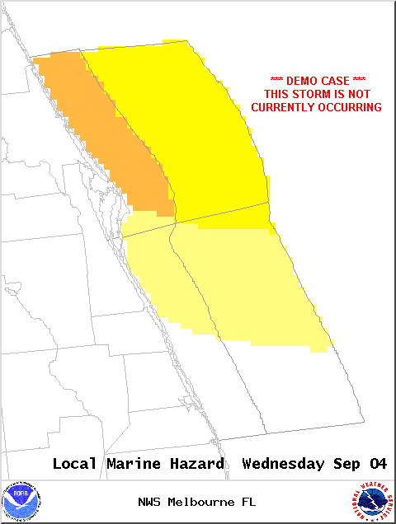
Experimental Outlook for Hazards Associated with Tropical Cyclones
Moderate Threat Level for Marine Hazard associated with Tropical Storm Edouard

Slide 19
Marine and Tropical New Product
National Prototyping Plans
Plans for Marine Product
  Graphical Hazardous Weather Outlook
  Intended to support both recreational and commercial activities
  Grid over land, surf and coastal marine zones
  Tiered threat outlook scale for hazards
  Display threat level for parameters such as:
    Rip Currents
    Waterspouts
    Coastal Flooding

Slide 20
Research Activities in Support of New Marine and Tropical Products
At the Ocean Prediction Center:
  Evaluation of Storm Track Product
At the Ocean Prediction and Tropical Prediction Centers:
  Research proposal funded to develop and distribute gridded wind fields
    Enhanced Wind Analyses based upon blend of:
      Remotely sensed wind vectors
      Numerical Model analyses
      Observational data
At the Tropical Prediction Center
  Tropical Cyclone Surface Wind Probabilities

Slide 21
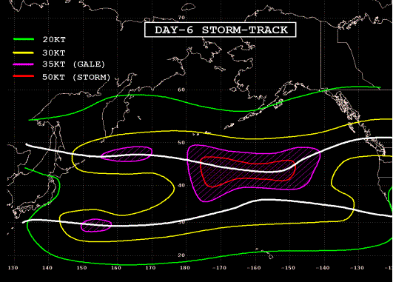
Research Activities in Support of Proposed New Marine Products
Predominant Storm Track graphically depicted in white

Slide 22
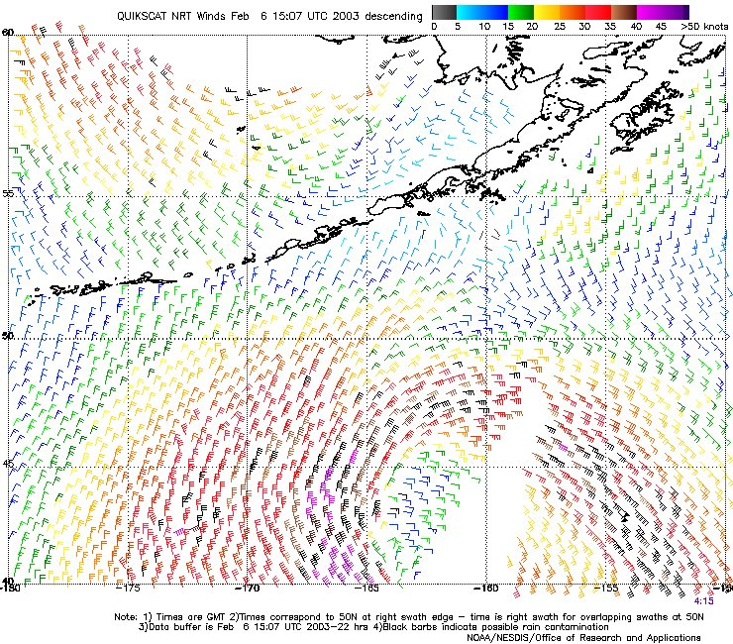
Research Activities Using
Scatterometer Wind Vector Data

Slide 23
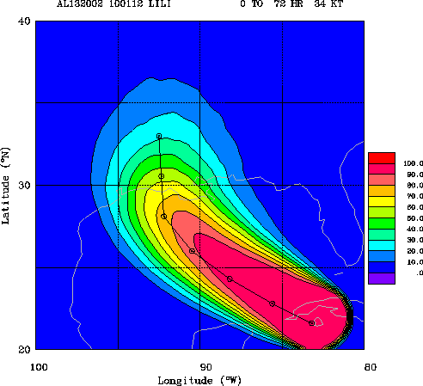
Research Activities For Tropical Cyclone Surface Wind Probabilities
72 hour probability of 34 knot winds from Hurricane Lili historical analysis

Slide 24
Hurricane Force Wind Grids Associated with Tropical Cyclones
Potential for significant track error
10 year average 72 hour forecast track error = 222 nautical miles
Lack scientific capability for predicting extreme events in extended forecast period
Team established to make policy recommendations and define procedures

Slide 25
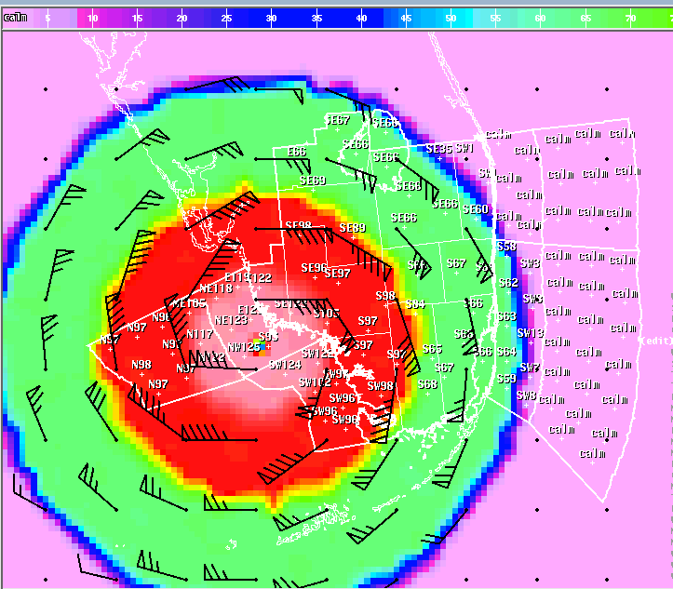
Example of Hurricane Force Winds associated with Hurricane Andrew
Issue: Beyond the 24 hour forecast period, should we depict hurricane force winds in NDFD?

Slide 26
Marine and Coastal Services Contacts
For additional information on our products and services visit our Internet pages:
  Marine and Coastal Services
    http://weather.gov/om/marine/home.htm
  Ocean Prediction Center
    http://www.opc.ncep.noaa.gov/
  Tropical Prediction Center
    http://www.nhc.noaa.gov/
We welcome your feedback on our plans for Marine, Coastal and Tropical Products
  Send comments and questions to
    Jamie.Vavra@noaa.gov
    301-713-1677 x 111

